Slide 1
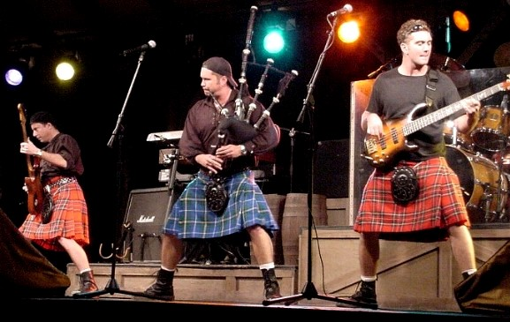
Celtic Rock Music
Exemplar Project

Slide 2
Celtic Rock
Celtic Rock music is a modern style of music which fuses traditional folk music with rock music.
Celtic rock originated in the early 1970s, when Irish bands such as the Chieftains and the Dubliners achieved mainstream success with folk music.
Bands then tried to apply the sounds of popular rock and pop music to their own cultural context.
The Irish band Thin Lizzy were influenced by Celtic music and their 1972 single Whiskey in the Jar was a rock version of a traditional Irish folk song.
In the late 1970s and early 1980s, Scottish bands such as Runrig and Capercaillie became popular.
‘S e stoidhle ciuil nuadh a th’ ann an ceol Celtic Rock.
‘S e co-mheasgaich na ceol tradaiseanta agus ceol roc a th’ ann.

Slide 3
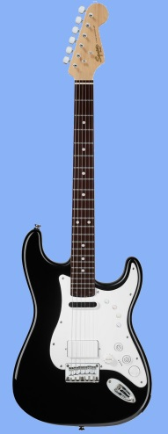
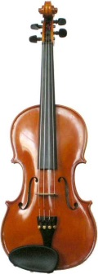
Timbre
Celtic Rock music uses traditional folk instruments and rock instruments, for example:
Fiddle
Bagpipes
Electric Guitar
Bass Guitar
Drum kit
Vocals
The typical sound of Celtic rock is like a normal rock band with added traditional instruments. This helps to create the fusion of the two styles.

Slide 4
Rhythm/Tempo
Celtic Rock music often uses the rhythms of traditional Scottish dances, such as:
Reels
Jigs
Strathspeys
Marches
Sometimes these dance rhythms are used as an instrumental solo in a song, or sometimes they form a whole piece.

Slide 5
Melody/Harmony
The melodies of Celtic Rock music often feature ornaments such as grace notes, as this is common in traditional music.
Often the accompanying instruments use chord progressions commonly found in rock music.
The lyrics of Celtic Rock songs are often about Scotland, or use a traditional Scottish song.

Slide 6
Texture/Structure/Form
Celtic Rock music often follows the structure of a typical rock song, including:
Introduction
Verse
Bridge
Chorus
Often, an instrumental section is added after a chorus, where the traditional instruments play parts of a reel or jig.

