Slide 1
structure
Miss Ward

Slide 2
What is Structure in Drama?
The way the Drama is split into sections and the way Time Place and Action are organised within the play.

Slide 3
The structure of a Drama can be…
LINEAR
NON-LINEAR

Slide 4
LINEAR
A naturalistic approach where events happen one after the other.
Time is chronological and the story follows a beginning, middle and end structure.

Slide 5
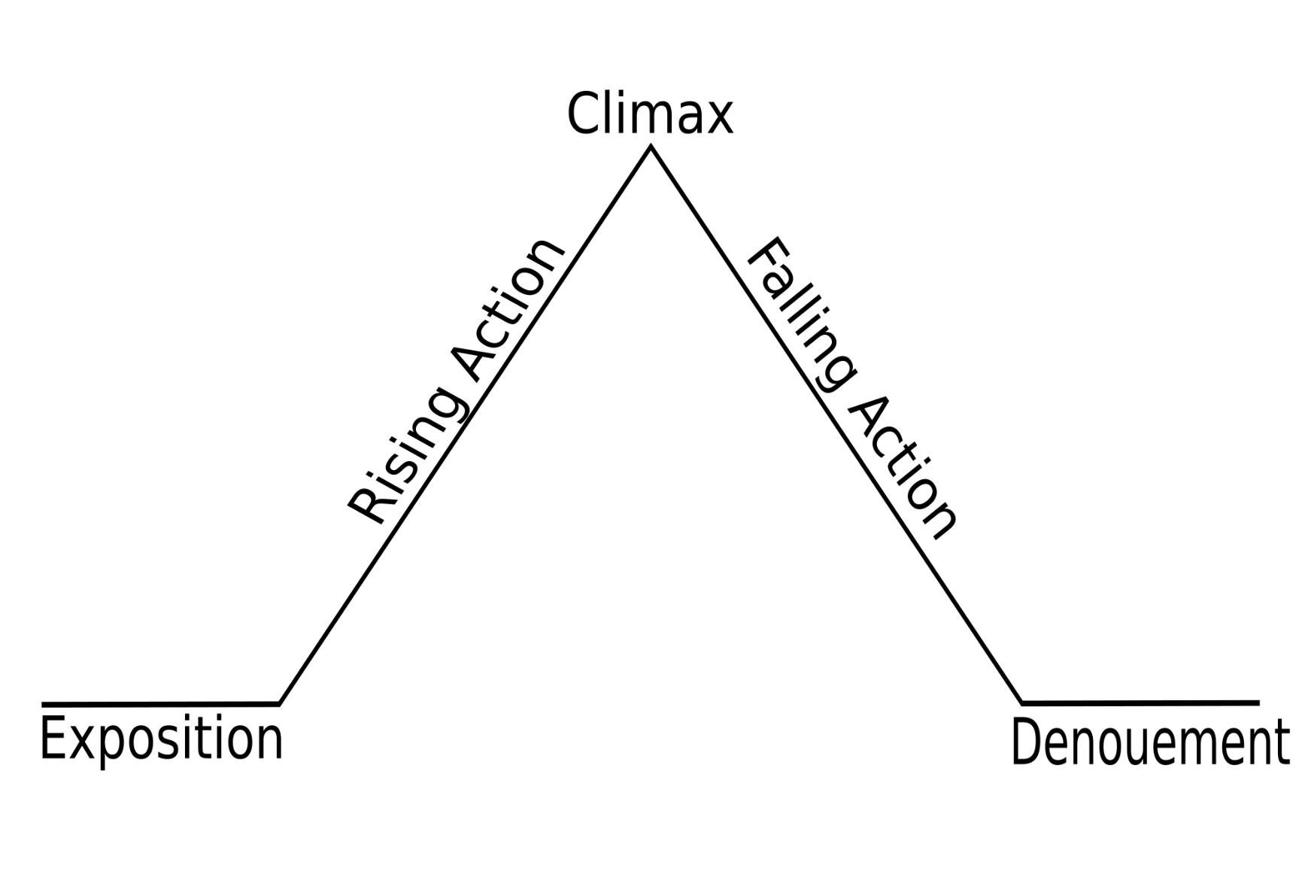
Beginning of the resolution where problems begin to resolve and questions are answered
Conflict is introduced to create dramatic tension
Turning point, something changes could be good or bad
Introduces characters, sets scene with Time, place of action identified
Resolution – Final conclusion, happy or sad ending
Linear plays often follow the traditional dramatic arc structure

Slide 6
Non-Linear
In this structure, events do not follow each other in time order. Can include flashback or flashforwards.
can use pattern or repetition. Time and place can be ambigous and dreamlike.
Narrators can be used to help explain complicated timelines.
FLASHBACK/ FORWARD

