Slide 1
Drama: Form & Genre
Miss Ward

Slide 2
Introduction
It is important to point out that Form and Genre are hard to define. They can be interchangeable and often some of the terms can fit into both categories. You can be flexible when using these terms to describe your drama

Slide 3
Form
Form is the basis of the drama.
It is how the drama is constructed

Slide 4
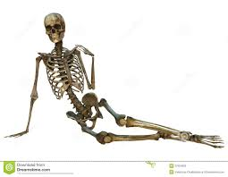
Form
Think of Form as the skeleton of the drama – as we go through the drama process we add and build upon it…

Slide 5
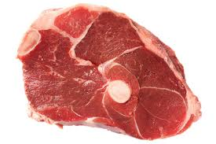
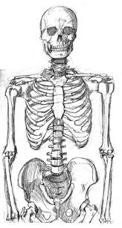
Form
Plot
Structure
F
O
RM
Genre
Character
We add meat to the bones
Conventions
Theatre Arts

Slide 6
Form
Types of Form
• A play, scripted or improvised
• Physical Theatre
• Mime
• Monologue
• Movement/ Dance Drama
• Musical
• Pantomime
• Docu-drama
• Forum theatre

Slide 7
Types of Form
A play
Scripted – This is a form of Drama where the dialogue is written down along with stage directions
Improvised –The plot is decided on and then actors make up what their characters will say. As there is no script the dialogue can sometimes change.

Slide 8
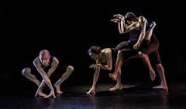
Types of Form
Physical Theatre
Physical Theatre tells the story of the drama through an emphasised use of movement.

Slide 9
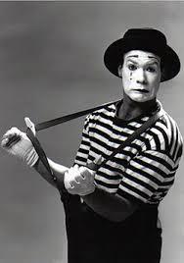
Types of Form
Mime
Mime is stylised type of movement. It uses exaggerated movement to tell a story. It is performed in silence.

Slide 10
Types of Form
Monologue
Monologue is when a character speaks their thoughts out loud. Instead of traditional dialogue it tells the audience what is going on in the character’s head.

Slide 11
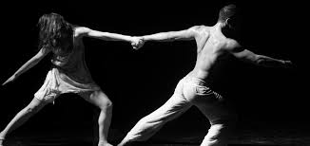
Types of Form
Movement/
Dance Drama
This Form uses Movement and dance to tell the story with often little or no dialogue.

Slide 12
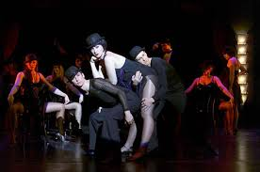
Types of Form
Musical
This Form uses a combination of Acting, Song and Dance to help tell the story.

Slide 13
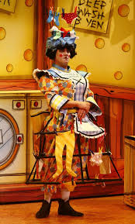
Types of Form
Pantomime
Pantomime includes songs, slapstick comedy and audience participation. Often based on well known fairy tales as well as using topical humour, they often include staple characters and have a history of cross-dressing characters such as the Dame or women playing male roles such as Prince Charming

Slide 14
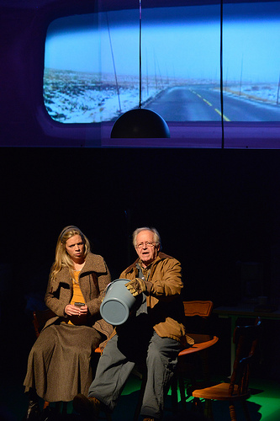
Types of Form
Docu-Drama
A dramatized re-enactment of real events. They can often be made up of verbatim, sound or film clips of the actual events

Slide 15
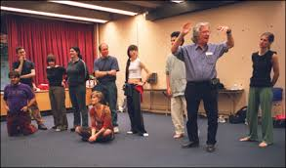
Types of Form
Forum Theatre
Created by Augusto Boal, Forum Theatre uses Audience Participation to discuss and explore situations and issues. It is known as the Theatre of the Oppressed and was created to help find solutions to social problems

Slide 16
Genre
As stated before Genre can overlap with Form and often the same terms can be used to describe both.
Genre is the type of Drama you create and specific Genre often have particular conventions attached and create a certain style of performance

Slide 17
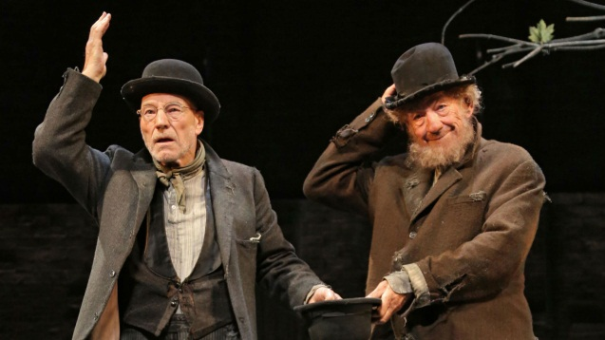
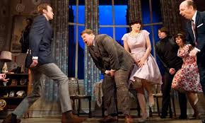
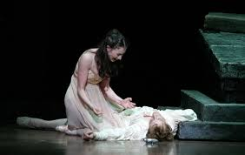
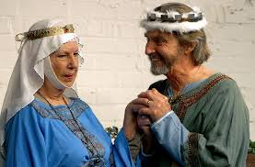
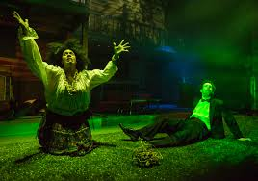
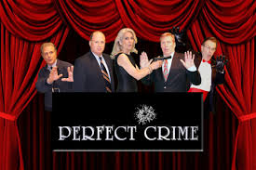
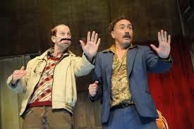
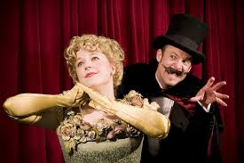
Types of Genre
Tragedy
Comedy
Tragi-Comedy
Historical
Horror
Crime
Farce
Satire
Melodrama

