Slide 1
CONVENTIONS
Miss Ward

Slide 2
What is a Convention?
Conventions are devices that can be added to a drama to enhance the storytelling or help the audience to understand the drama.
They can also be used to create a certain form/genre/style within a production.
They can also help to create mood and atmosphere.

Slide 3
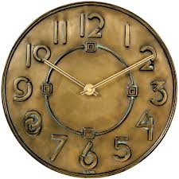
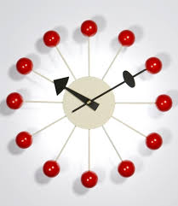
FLASHBACK
A flashback moves the action back in time and breaks the chronological sequence of events
FLASH FORWARD
As with a Flashback this moves the action through time, the action jumps forward instead of backwards

Slide 4
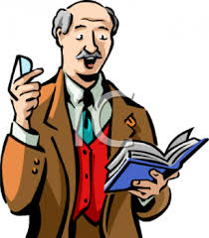
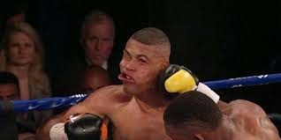
NARRATOR
A narrator tells parts of the story, this can help the audience to understand the drama better especially in a Non-Linear structure.
SLOW MOTION
Slow motion is when actions are performed at a slowed-down speed. It can help to highlight key moments or enhance dramatic parts of the drama such as fight scenes

Slide 5
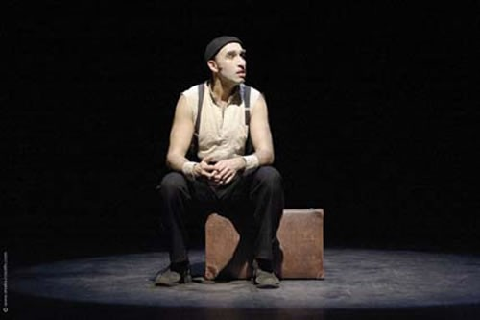
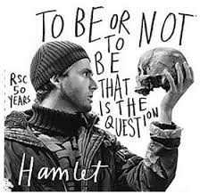
MONOLOGUE
One character speaks their thoughts out loud or uses an extended speech, directed to the audience or another character.
SOLILOQUY
One character speak their thoughts aloud, different from a Monologue as they are speaking to themselves not another character or the audience.

Slide 6
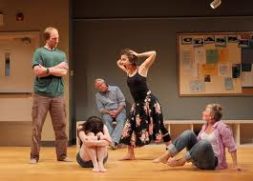
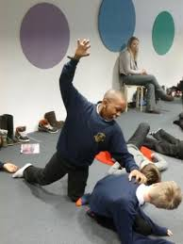
TABLEAU
Actors create a living picture that can represent an action, idea or moment in the story
FREEZE FRAME
All the actors freeze on stage. It can allow the audience to take in more information about ‘going on. It can be useful in portraying violent events such as a car accident or fight

Slide 7
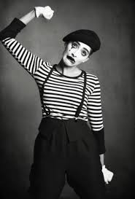
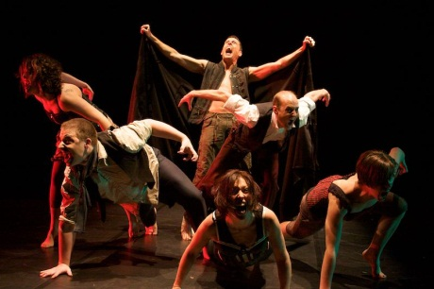
MIME/ MOVEMENT
Mime or movement can be used to highlight key moments and can add a powerful contrast when also using dialogue within a drama. It can also help to establish mood and atmosphere
VOICEOVER
A Voice-over can be off stage or recorded speech played during the production. It can help with audience understanding as well as providing interesting contrast to the action on stage

