Slide 1




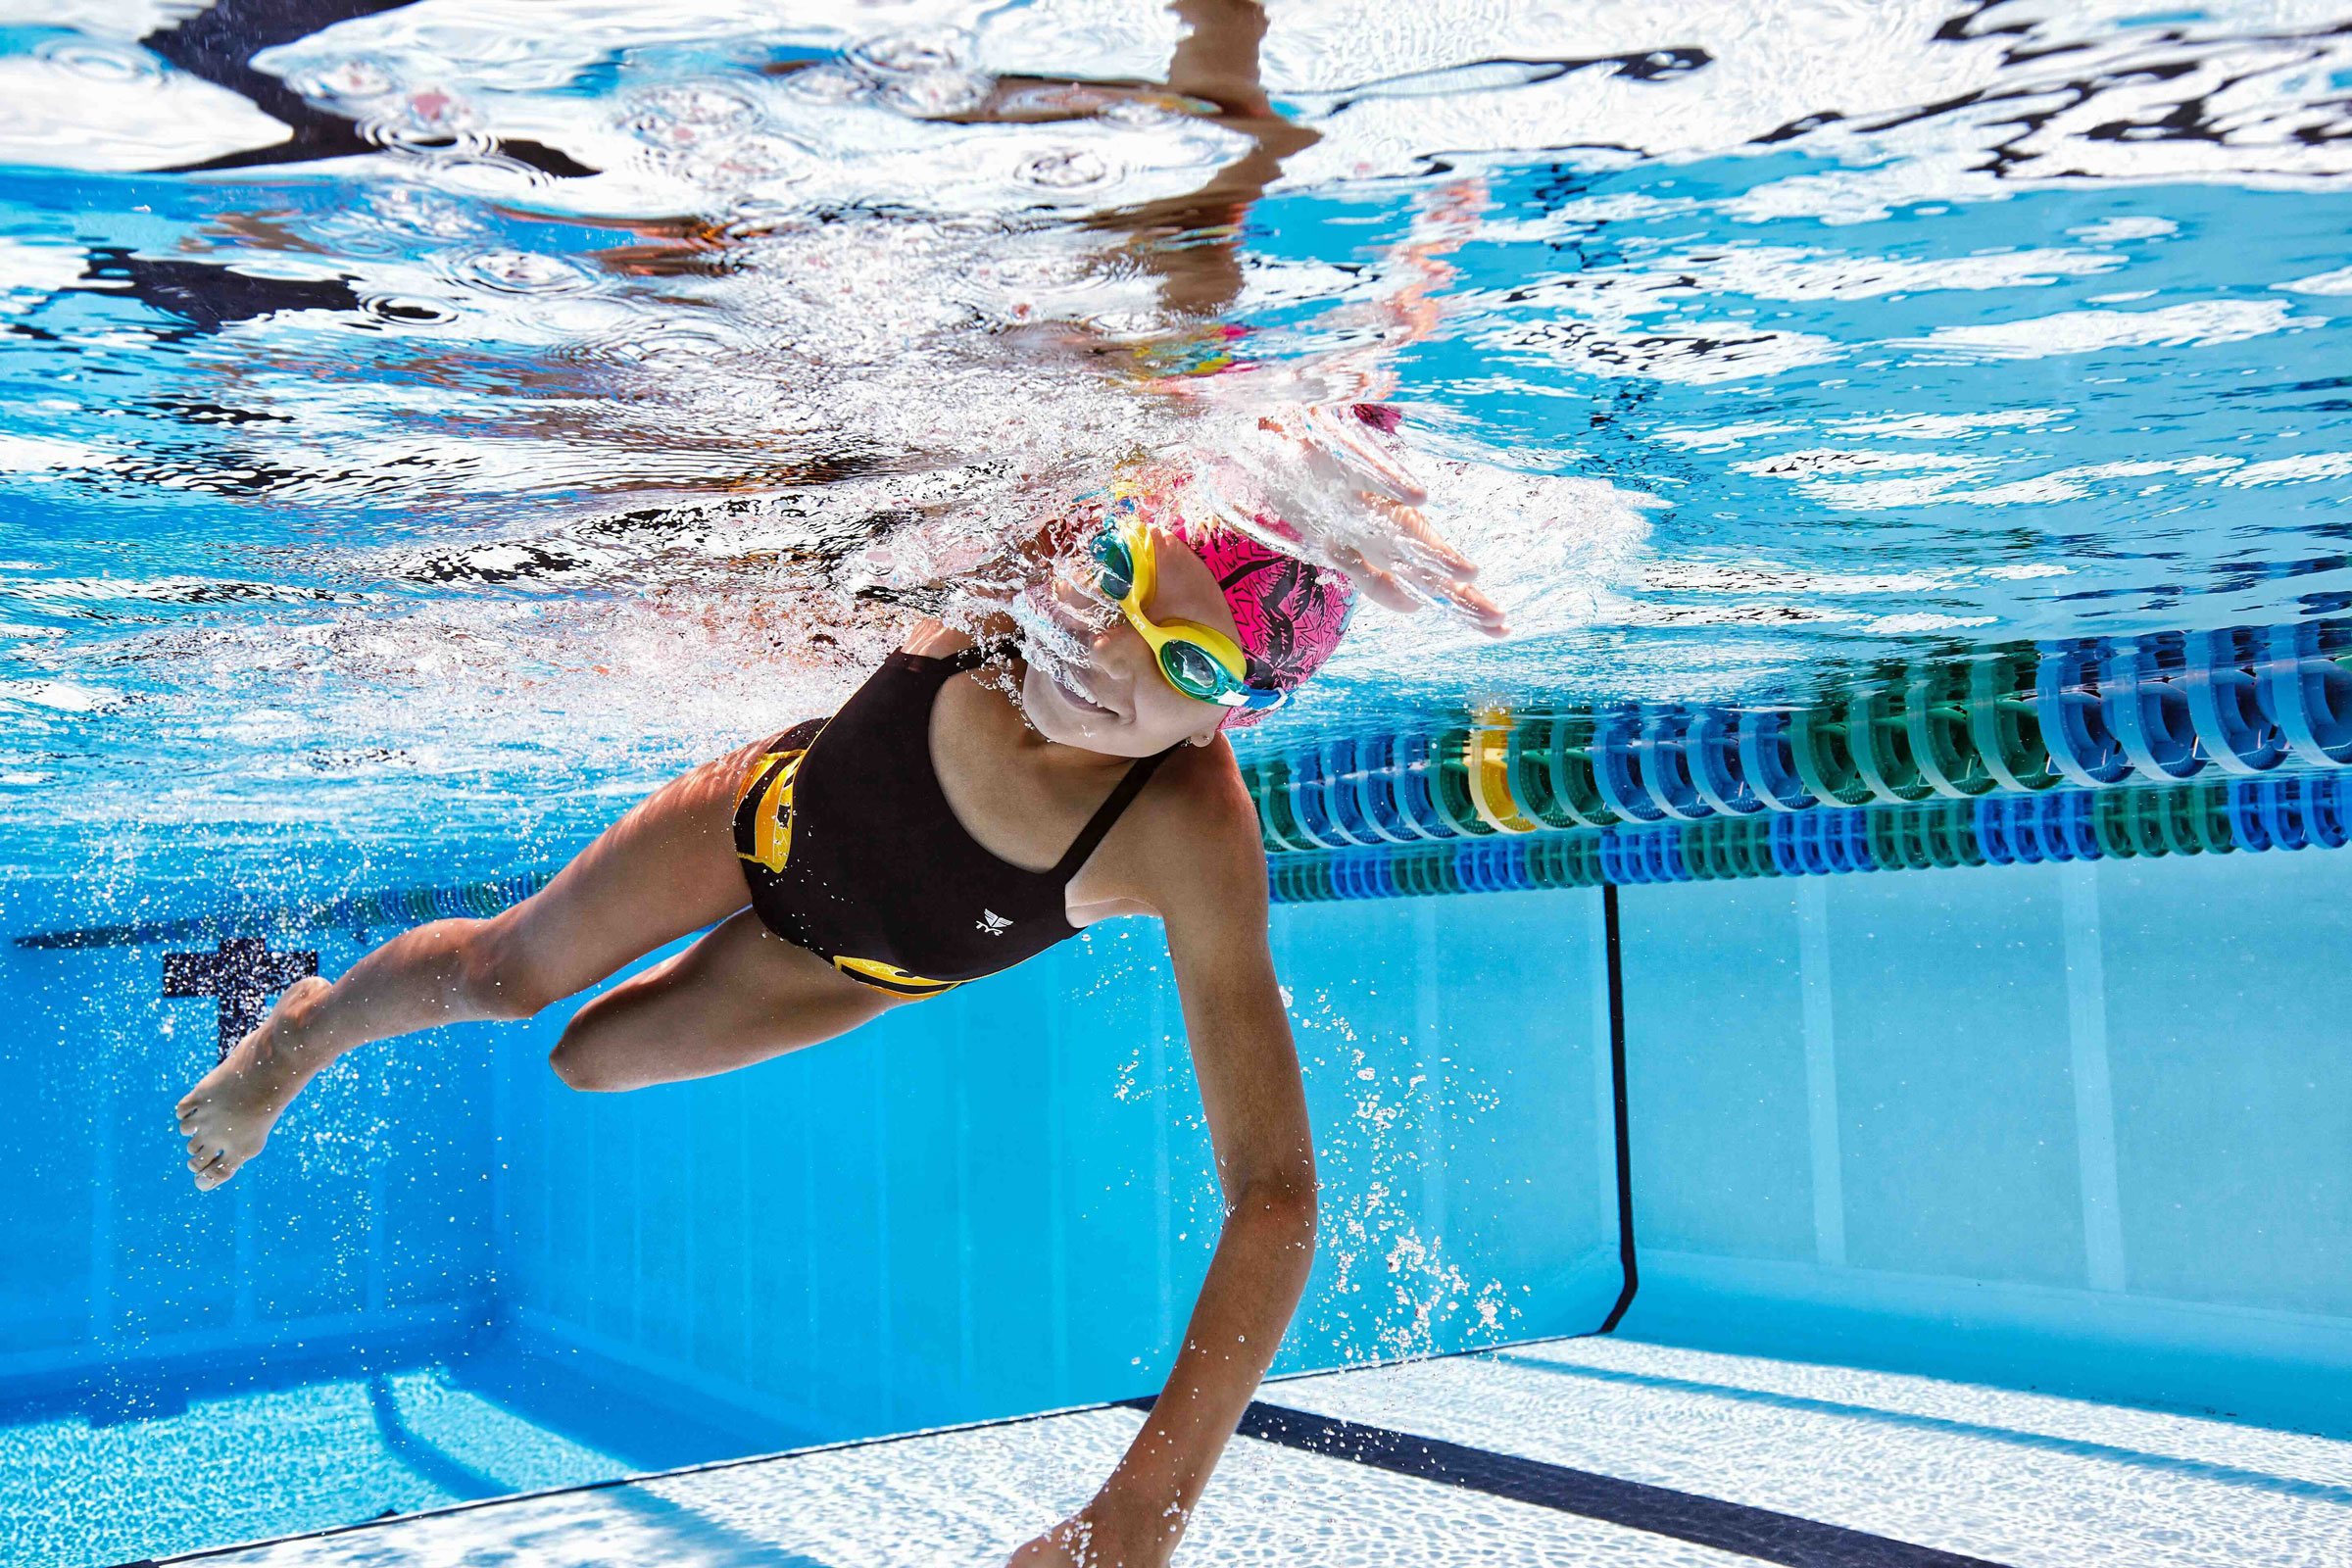
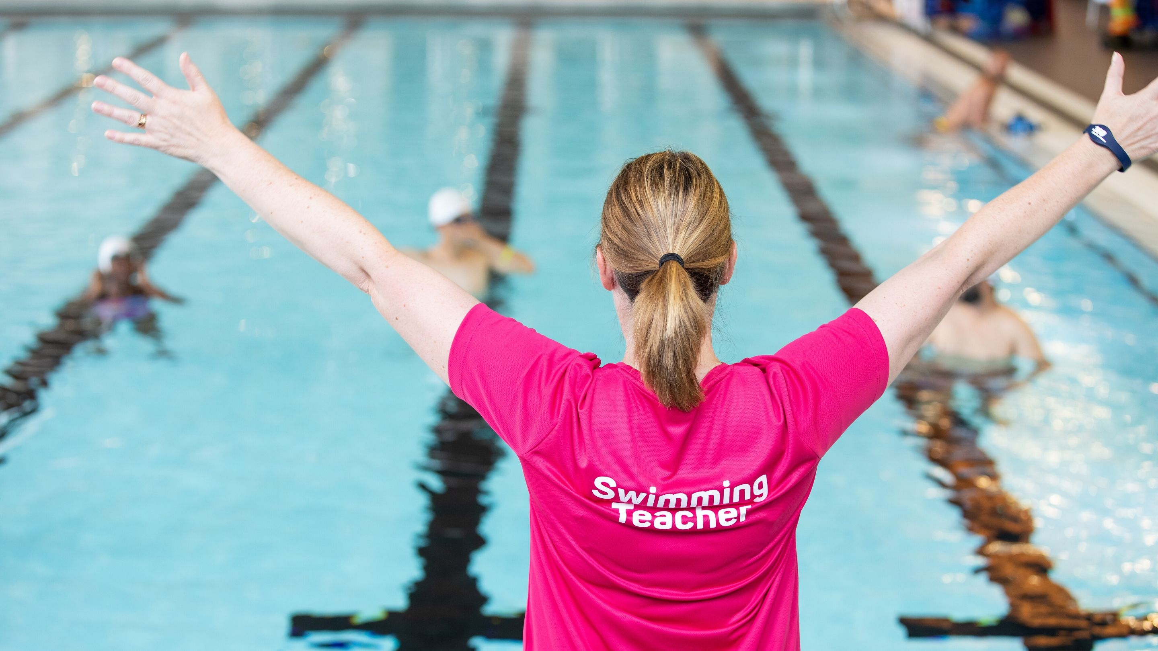
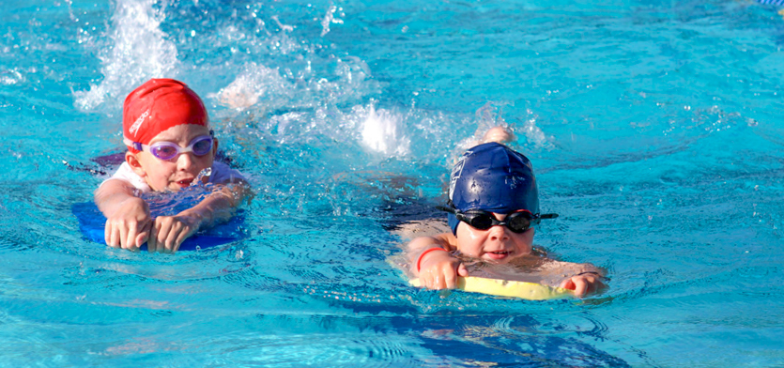



WELCOME TO
SWIM SCHOOL
GLASGOW CITY COUNCIL EDUCATION SERVICES
PRIMARY SCHOOLS SWIMMING PROGRAMME
We are delighted you will be joining us and look forward to meeting you soon!

Slide 2
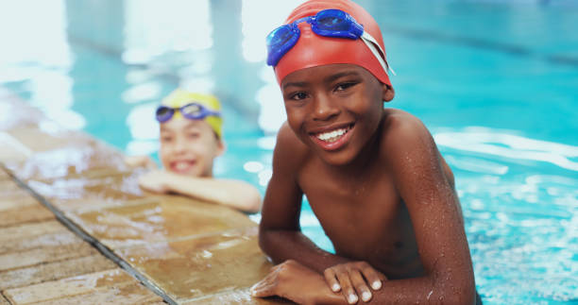
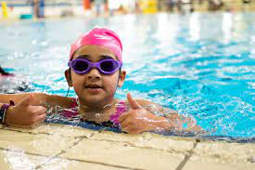

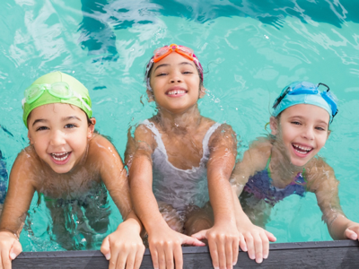


Programme
Glasgow City Council continues to provide swimming to all primary schools delivering lessons to approximately 5000 young people per year in Primaries 5, 6, or 7 to develop Health and Wellbeing through swimming. Our in-depth Physical Education swimming course provides an invaluable experience and gives young people the opportunity to develop their:
WATER CONFIDENCE - DEVELOPING CONFIDENCE AND SELF ESTEEM
PHYSICAL FITNESS - DEVELOPING STAMINA, CORE STABILITY, AND STRENGTH
STROKE TECHNIQUE - DEVELOPING MOTOR-SKILLS, CO-ORDINATION AND FLUENCY
WATER SAFETY - DEVELOPING THE UNDERSTANDING THAT SWIMMING IS A LIFE-LONG SKILL

Slide 3

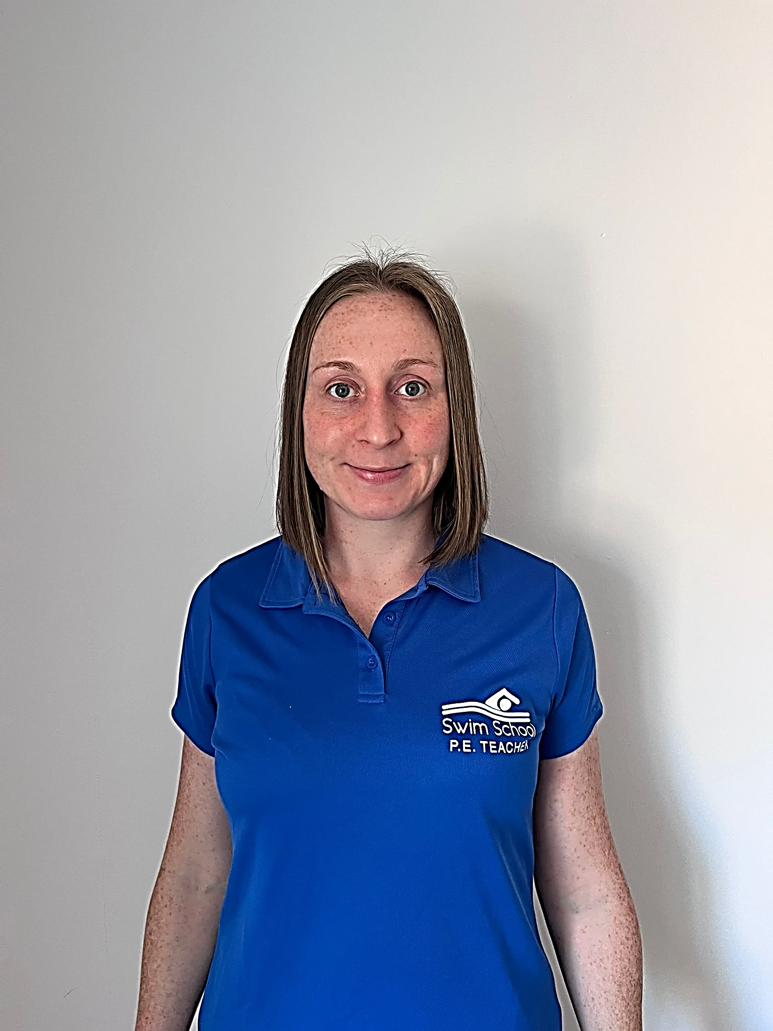
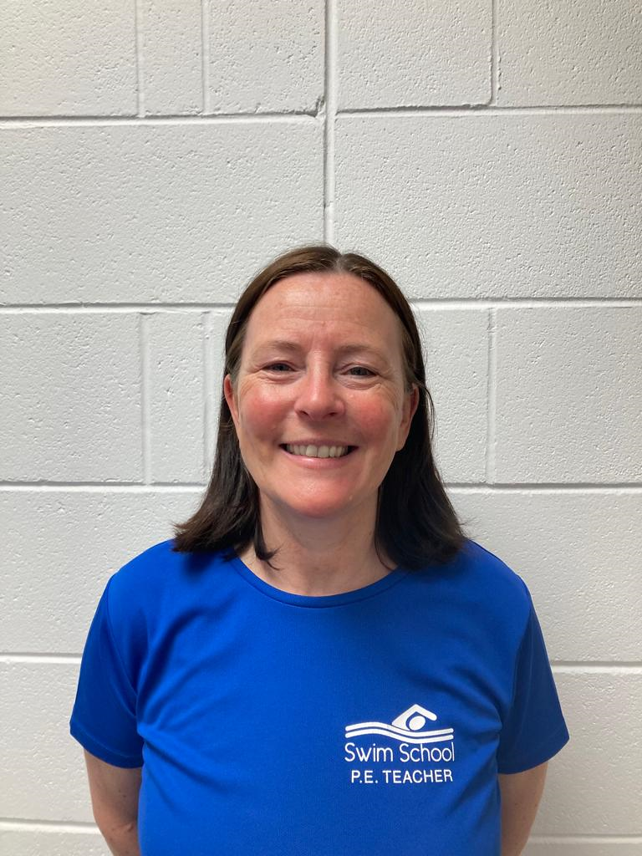
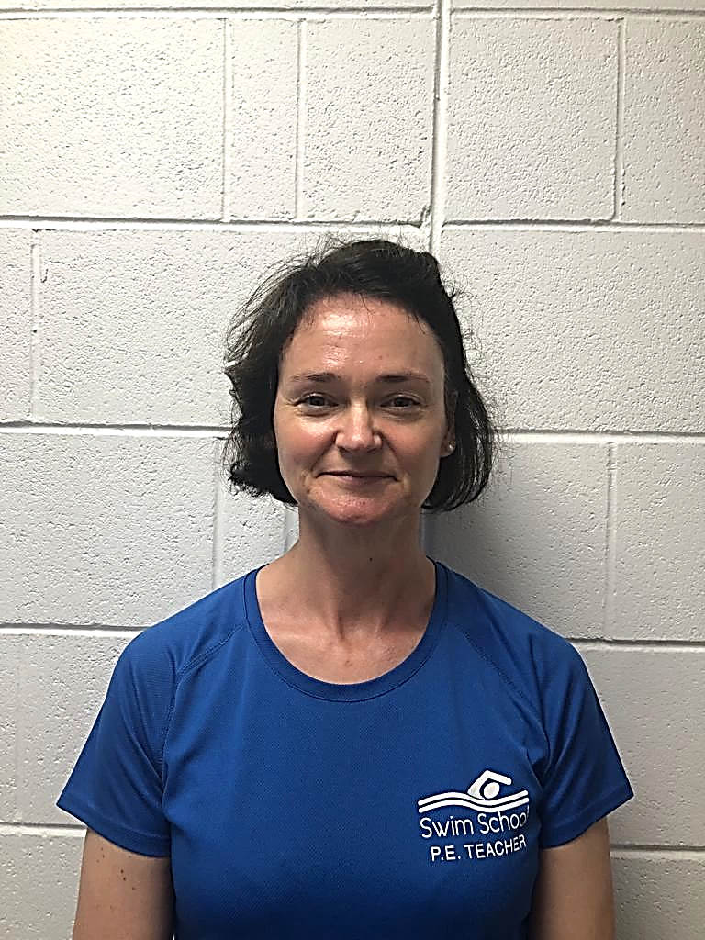

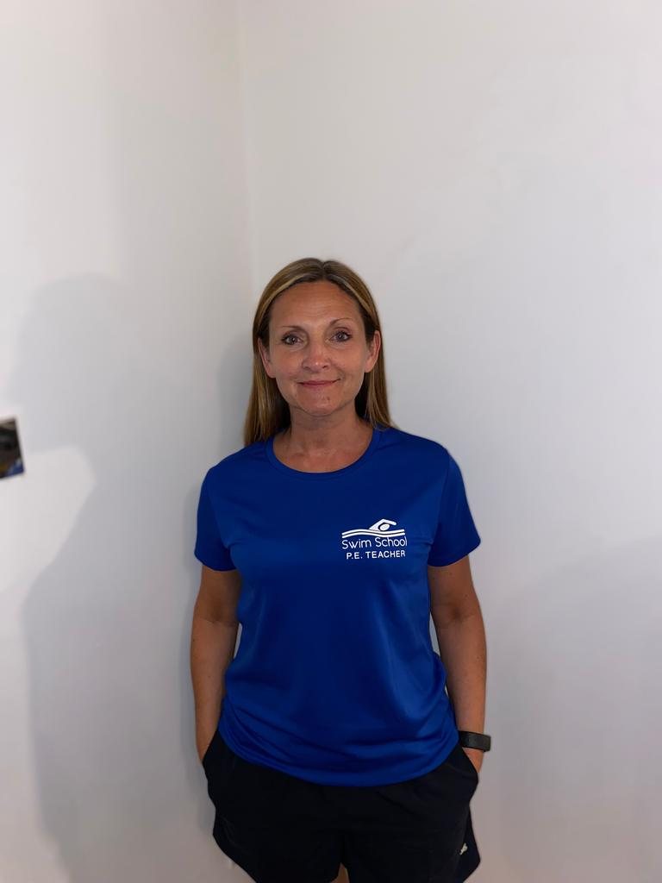
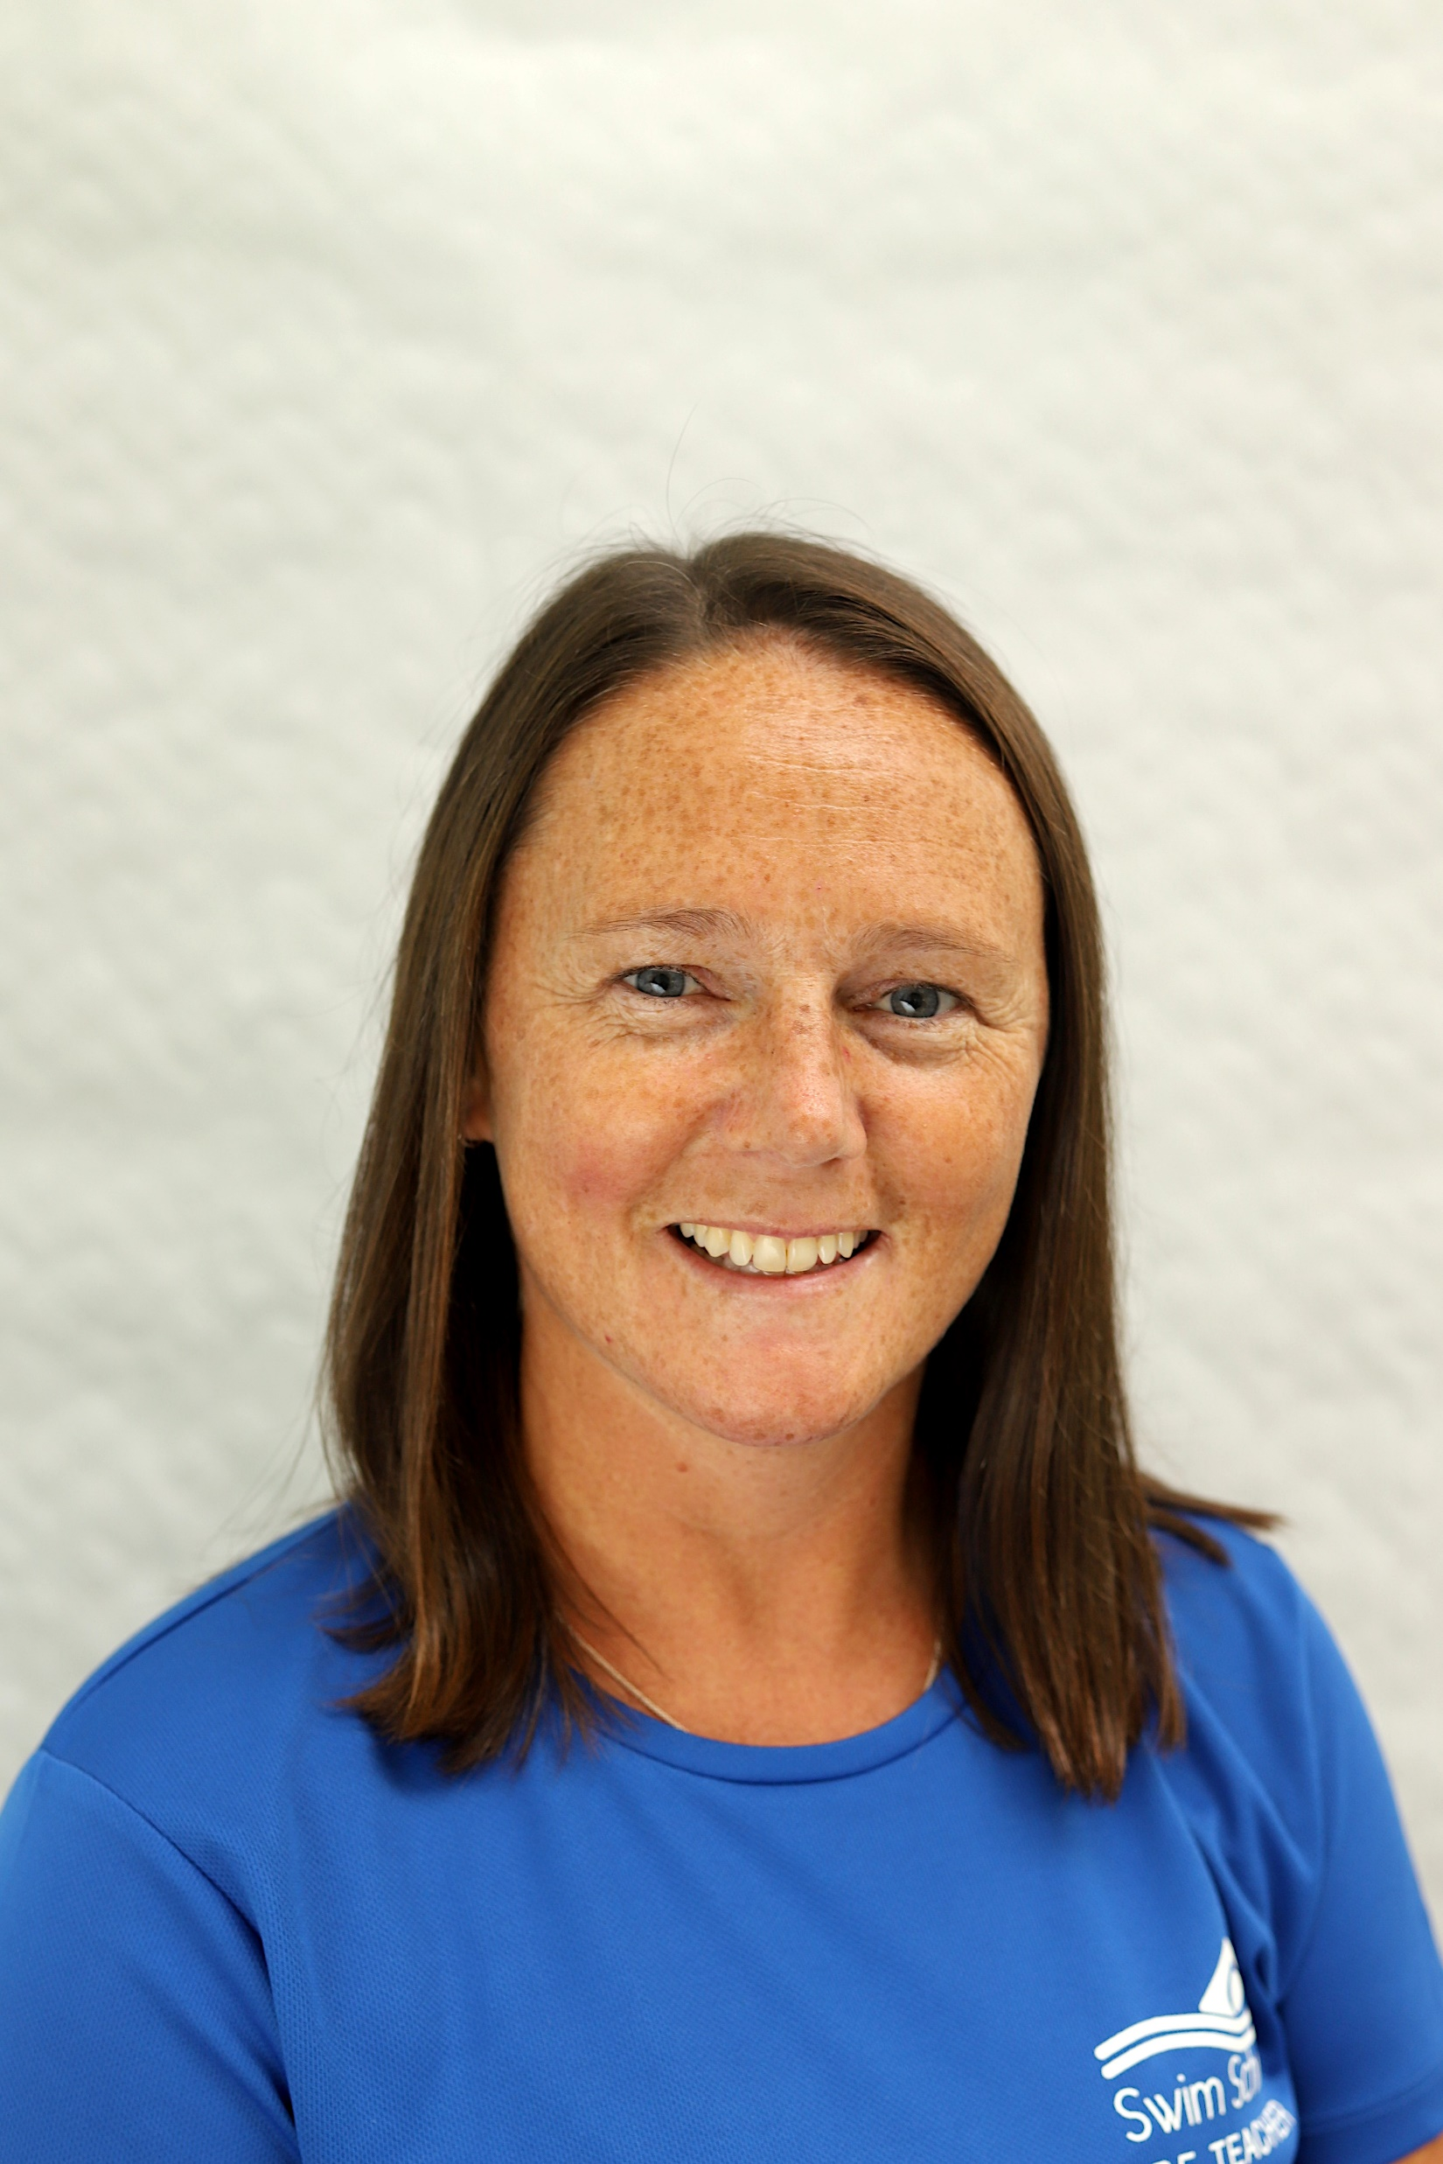

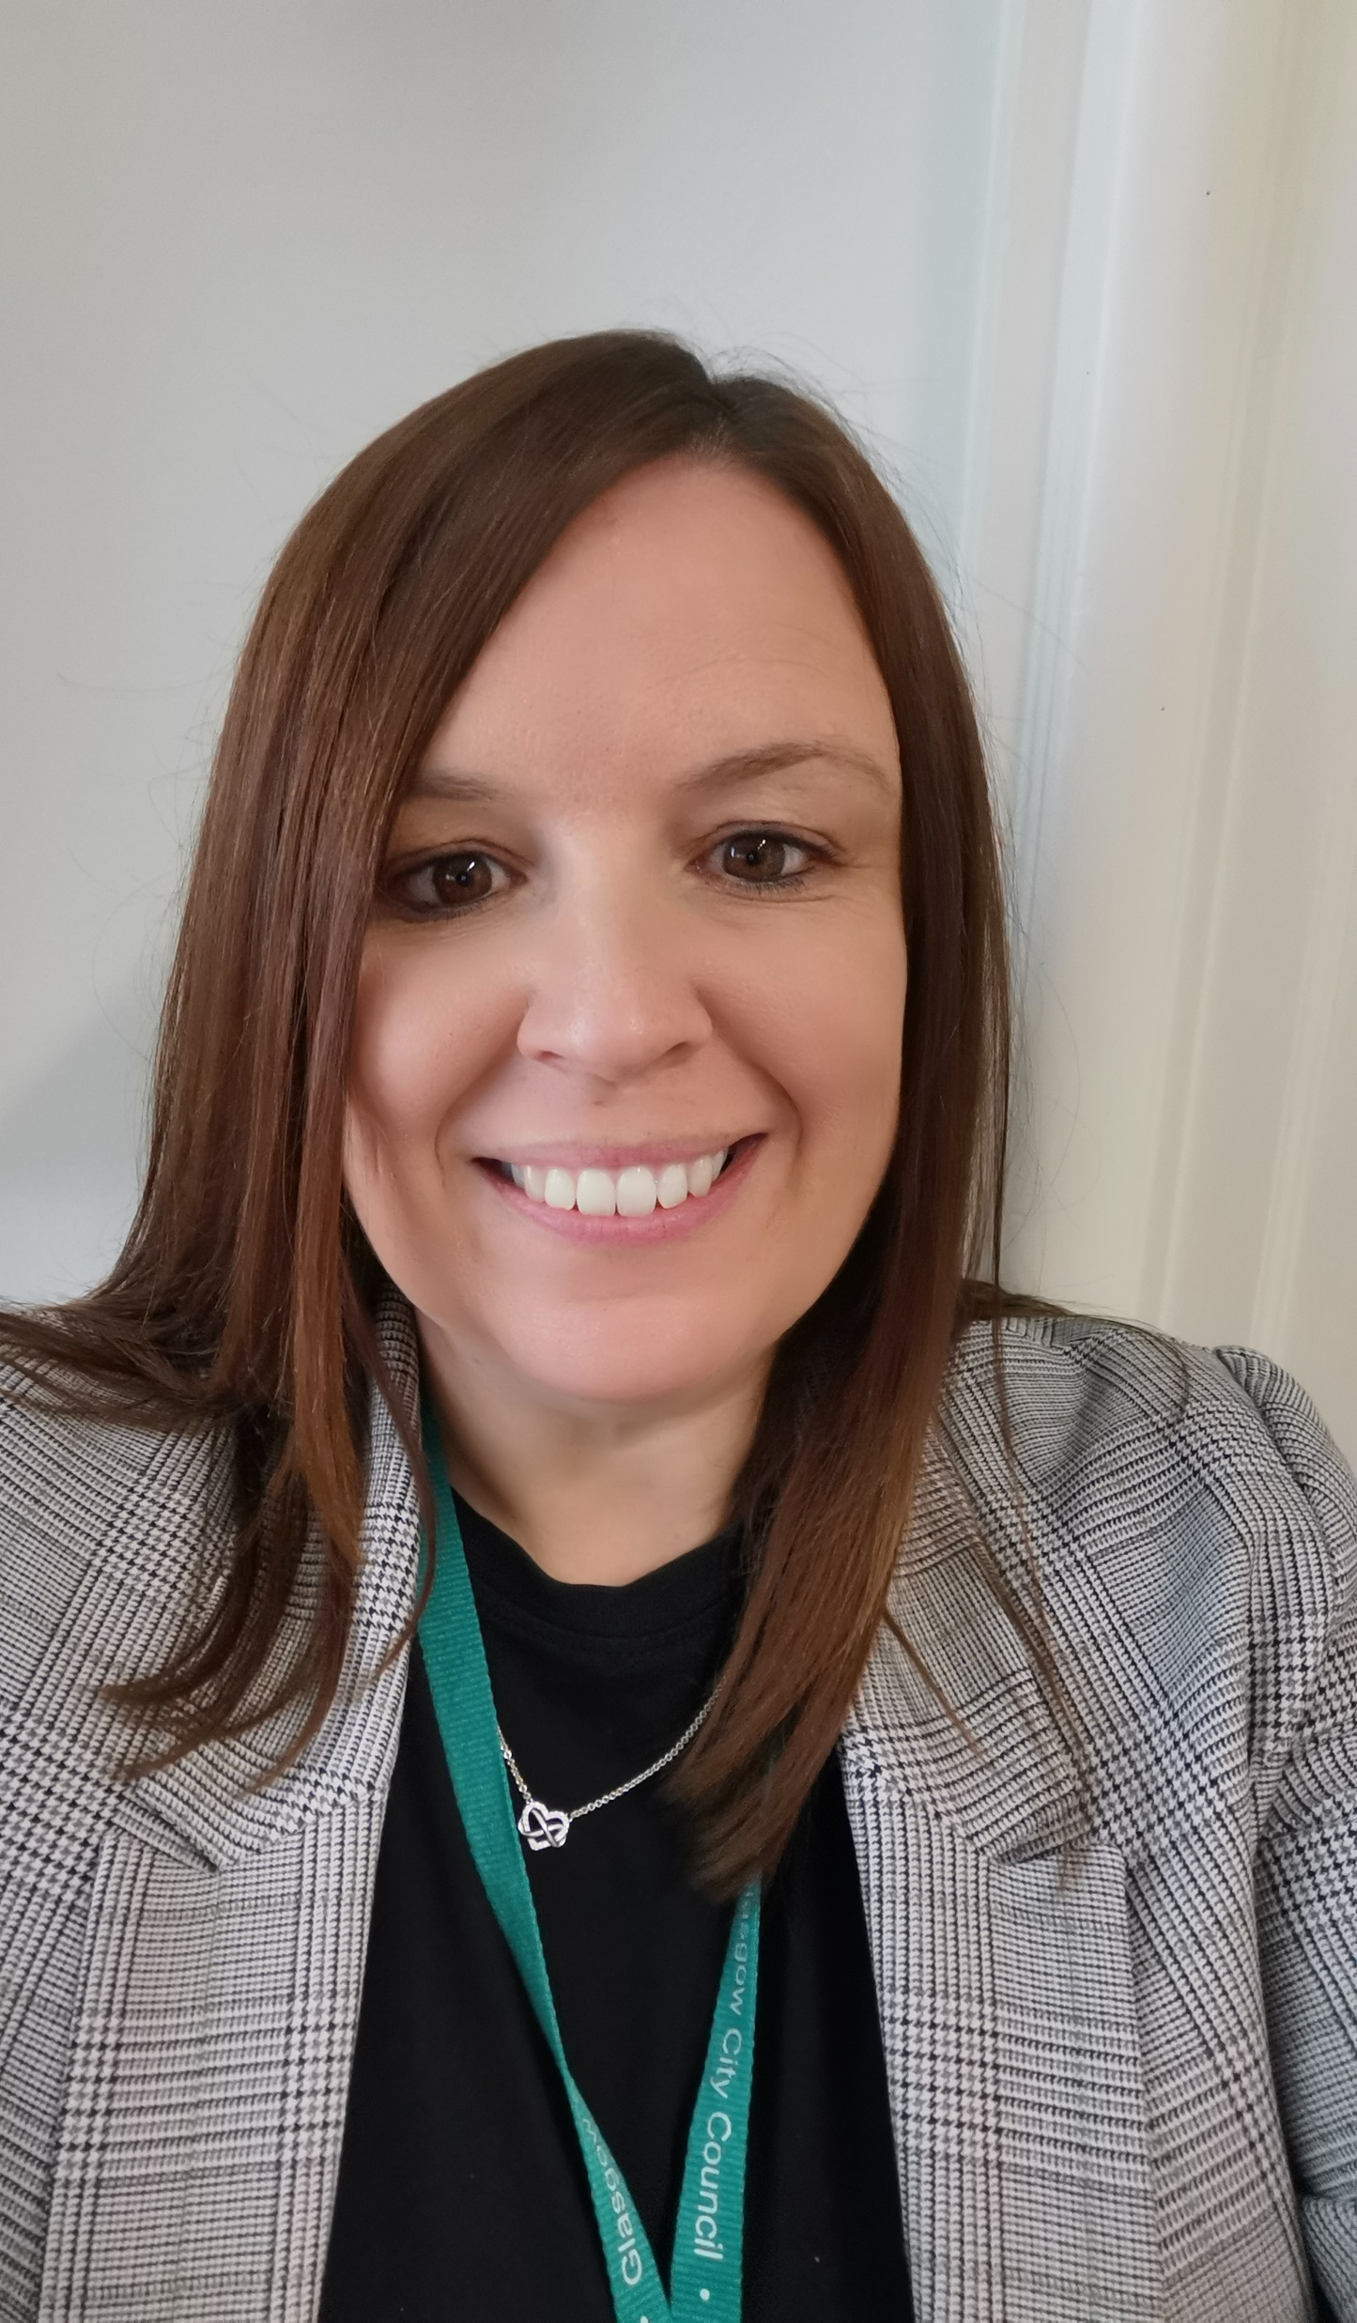
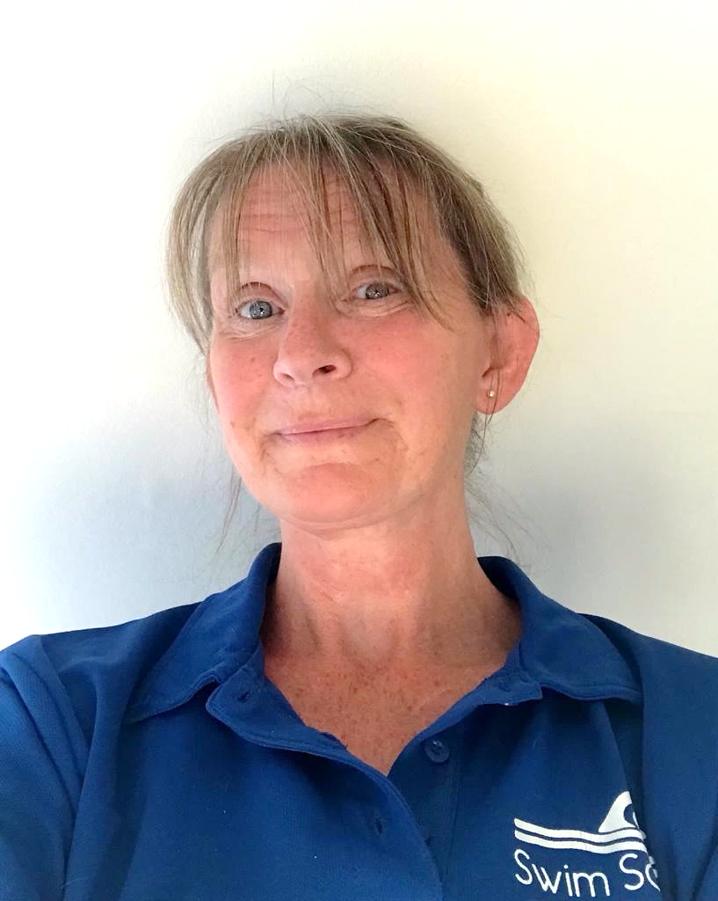
Who We Are
The Glasgow Primary Swim Team are a team of highly skilled and qualified PE teachers. We understand the importance of swimming for all as a life-long skill and have staff members providing support for pupils with additional support needs.
Mrs C Sweeney
Ms G McGreish
PE
Teachers
Mrs E Gibbons
Programme Manager
Ms L Kelman
Mrs G Dunlop
Fiona Kirk
Ms J Welsh

Slide 4






Swimming Pools
We use the many swimming pools located throughout the City to deliver our programme. In addition to using Glasgow Secondary School swimming pools, we also work with our partners in Glasgow Life using the public pools to provide a positive experience for all.
Whitehill Swimming Pool
North Woodside Swimming Pool
Scotstoun Leisure Centre
Maryhill Swimming Pool
Drumchapel Swimming Pool
Pollok Swimming Pool
Easterhouse Swimming Pool
Castlemilk Swimming Pool
Tollcross Leisure Centre
Gorbals Swimming Pool
Bellahouston Swimming Pool
Springburn Leisure Centre

Slide 5



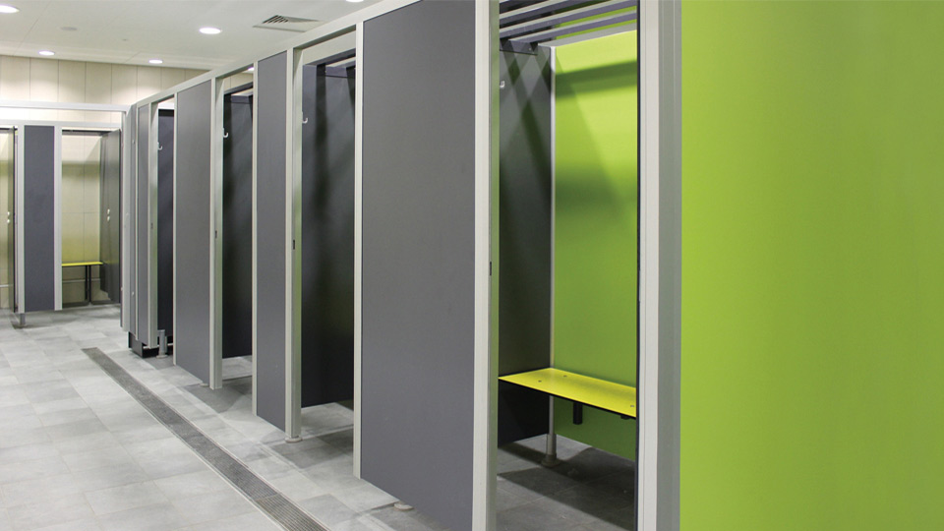
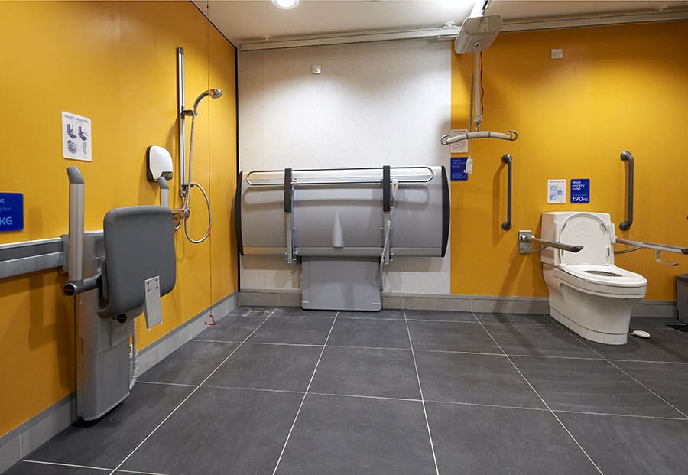
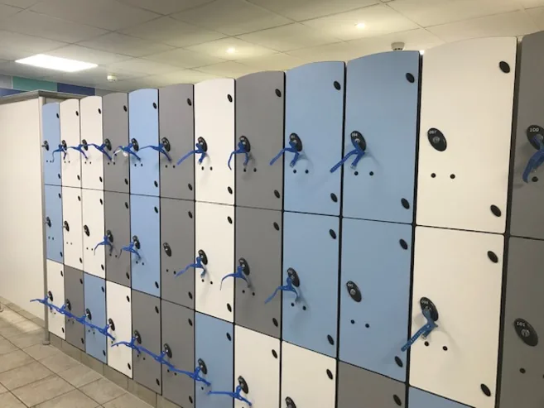
Changing Facilities
Each venue has its own changing arrangements.
Typically changing villages with individual cubicles
Fully accessible
changing facilities
Secure lockers
using 20p or £1

Slide 6


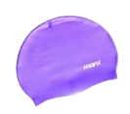

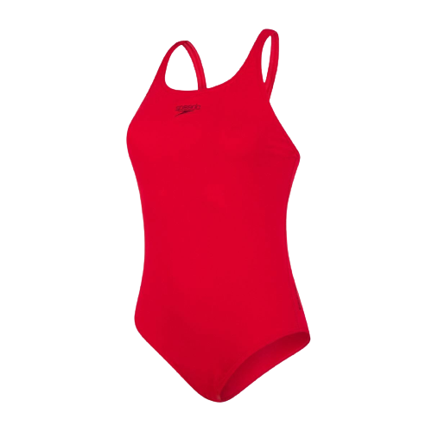
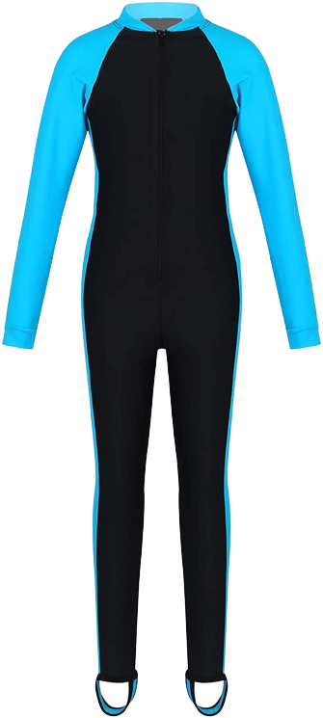

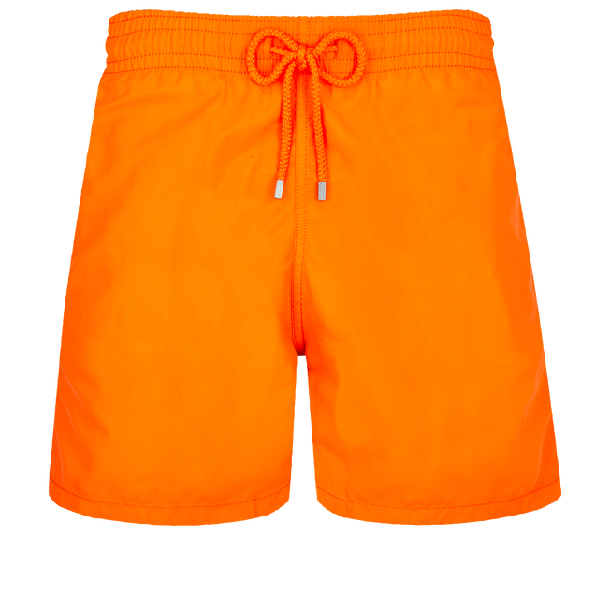

The Kit Bag
Your swimming lessons involve an hour of quality Physical Education. The lessons support the PE curriculum within Glasgow schools and reflects the SHANARRI wellbeing indicators.
Just like in schools where a PE kit is required, young people are asked to wear suitable swimming kit.
This consists of:
One piece swimming costumes/modesty suit
Swimming shorts, surf style or fitted
All young people with long hair are required to wear a swim cap.
Goggles are recommended
Remember your towel

Slide 7
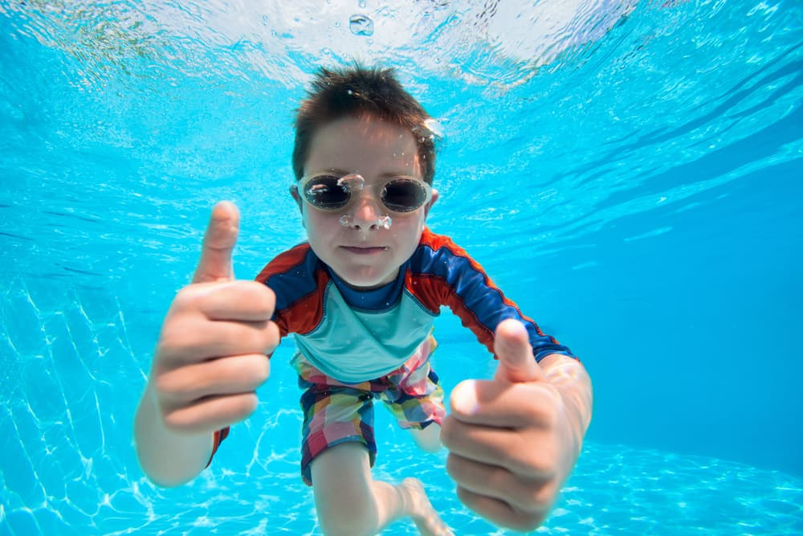
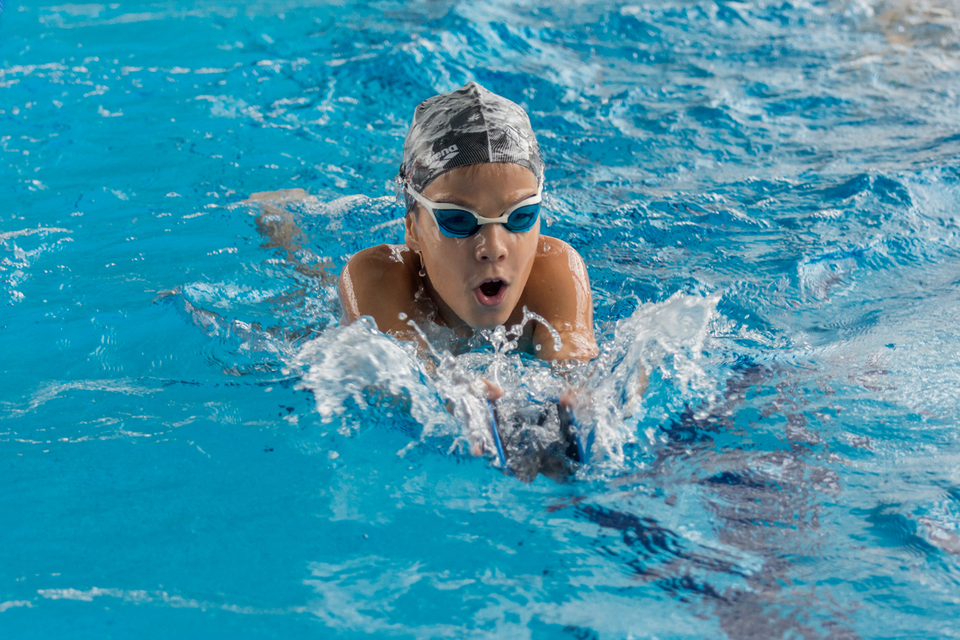
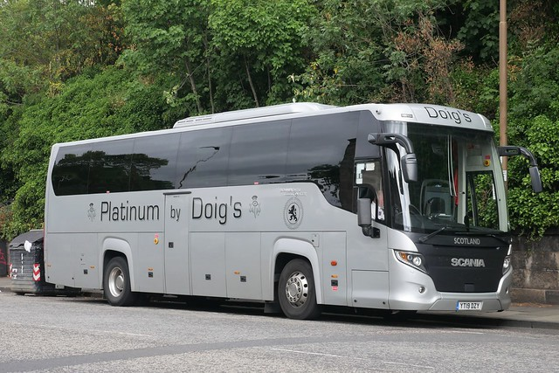
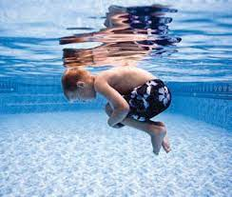
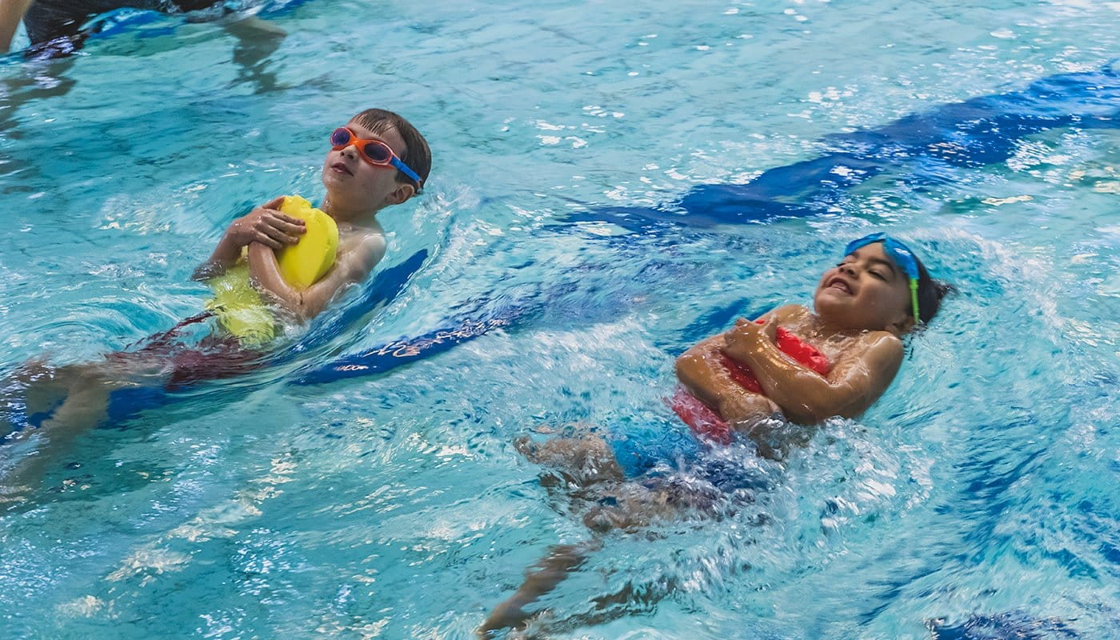
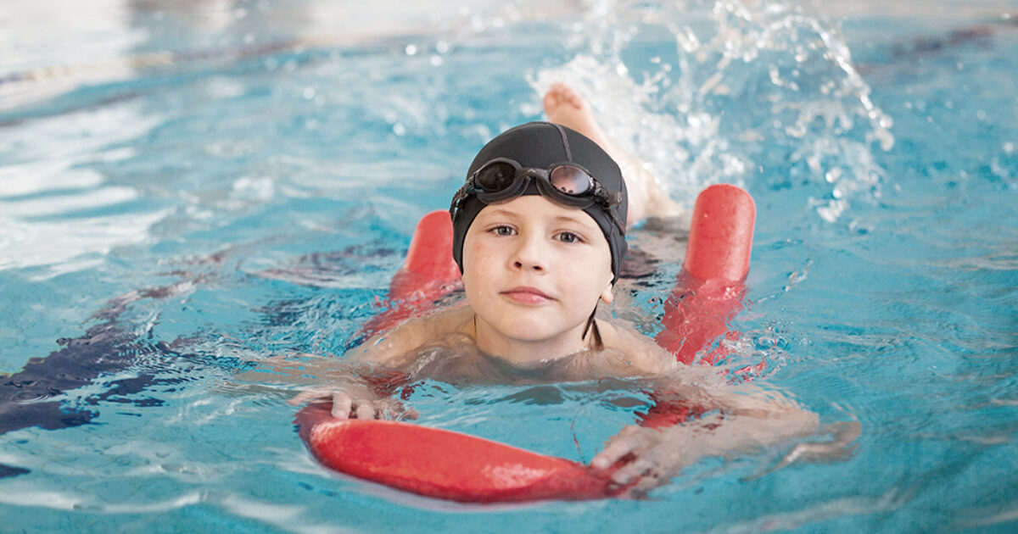
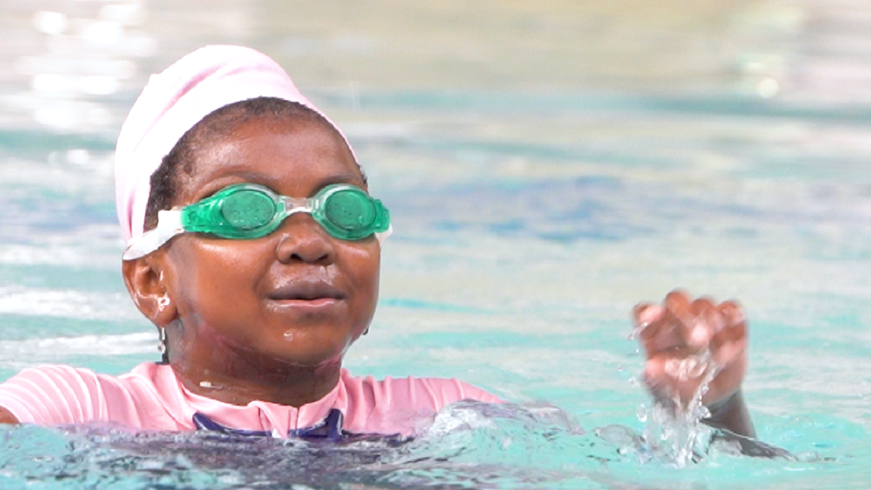
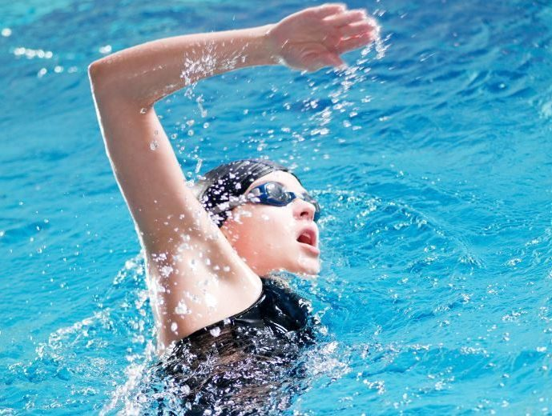
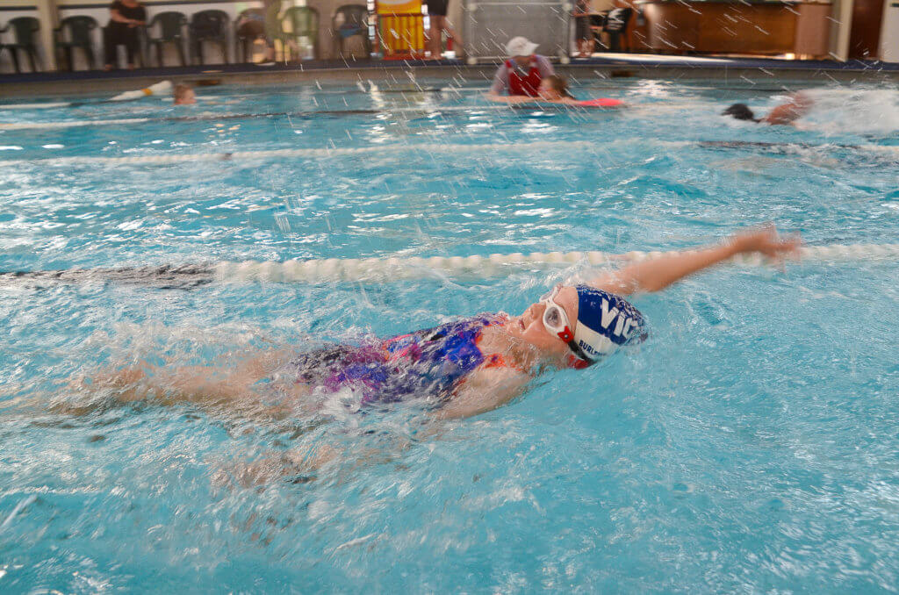
Education Services
uses local coach companies to transport classes from schools to venues.​
On arrival at the pool, you will be met by your swimming teacher who will introduce themselves and support and encourage you throughout your swimming lessons.​
School staff will also remain with the class and swimming teachers are in constant contact with Head Teachers helping best support young people throughout lessons.​​
We understand that every young person's experience in water is different and use different activities to help develop pupil confidence and achievement.

Slide 8
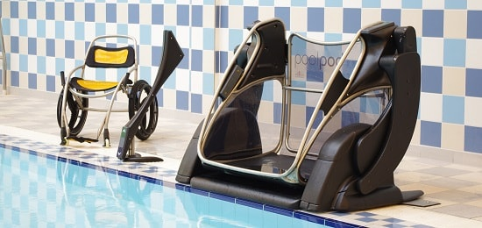
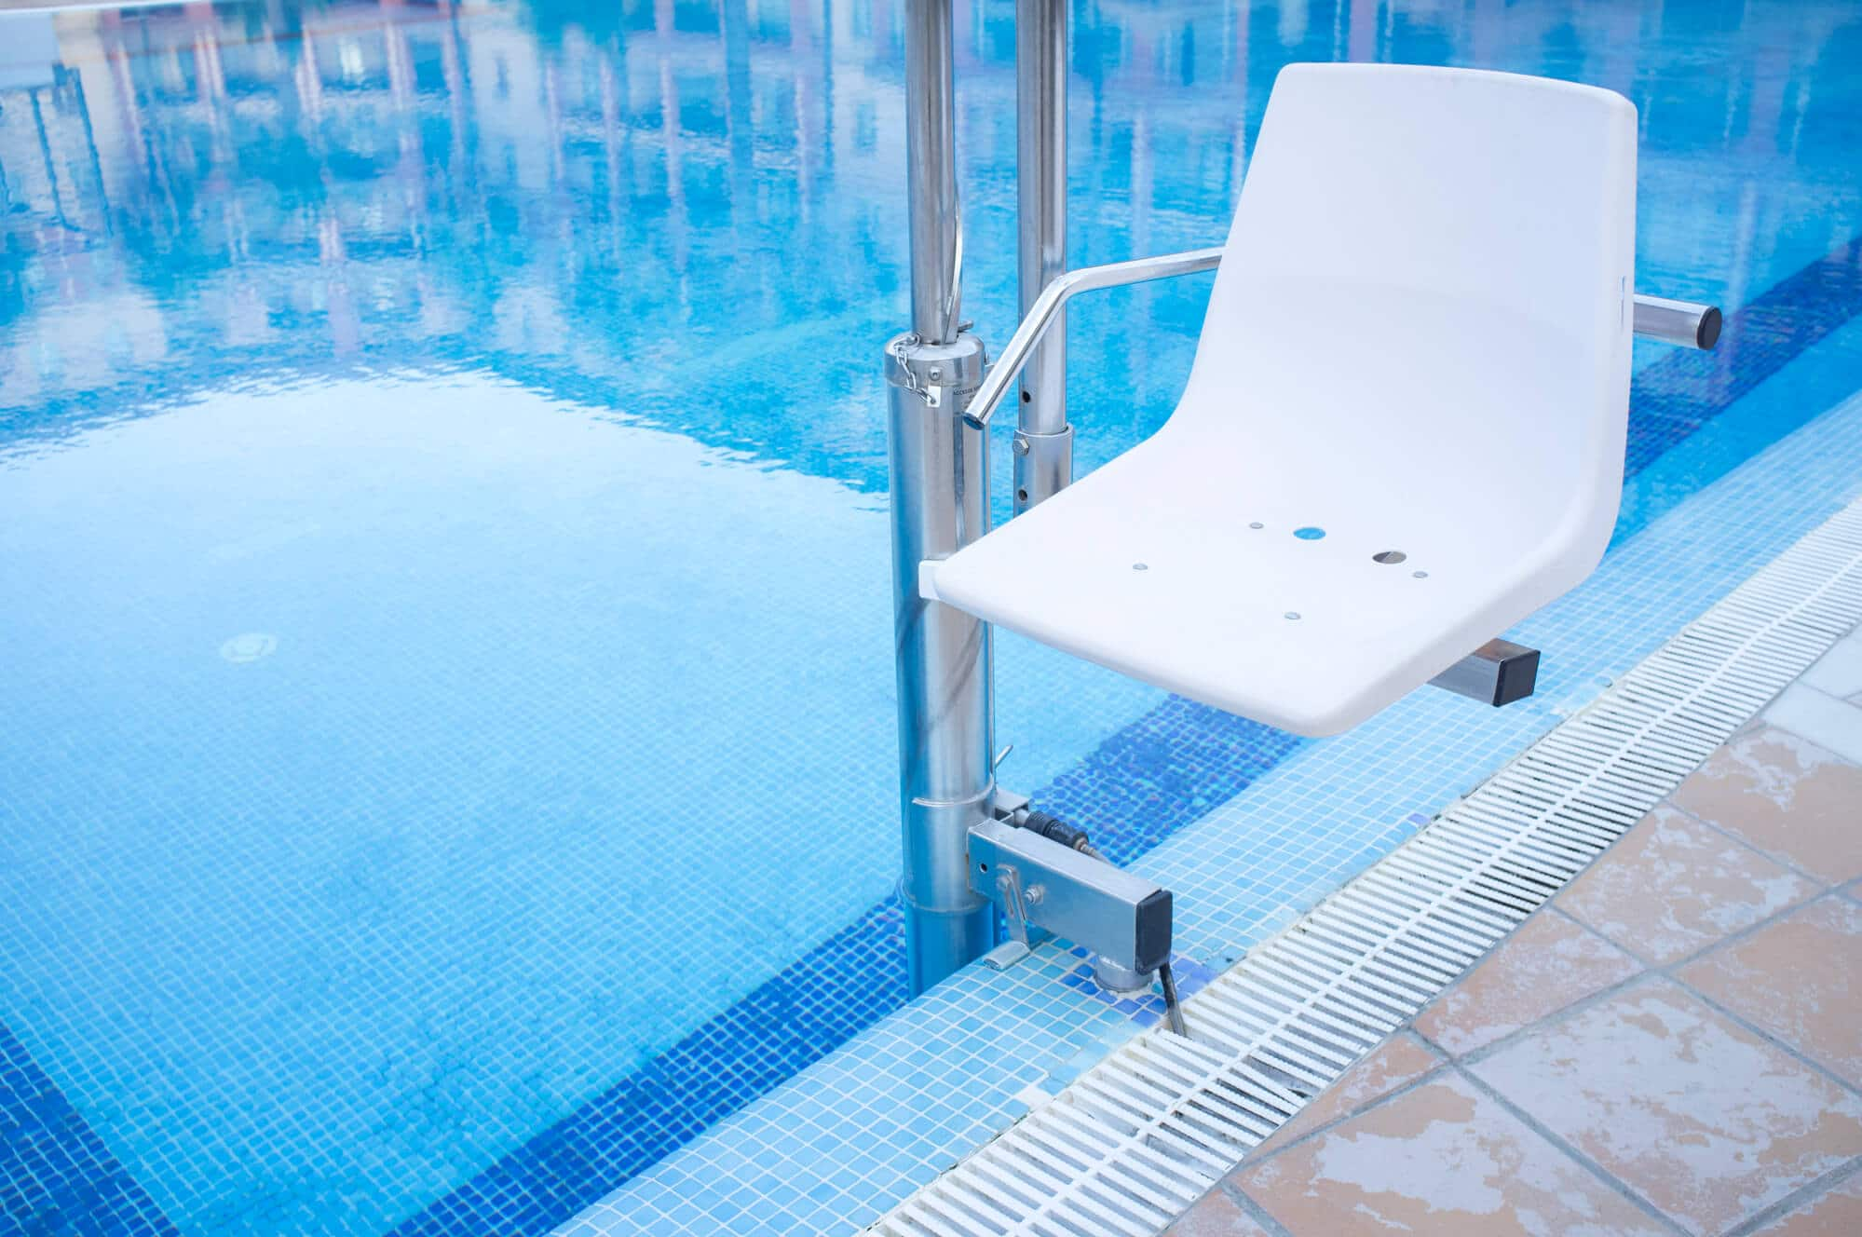

Your Swimming Experience
For Health and Safety reasons, the first lesson normally consists of an introduction where young people become more familiar with facilities and arrangements and staff are able to safely establish levels of experience and confidence.
After the initial lesson, young people will follow a course which includes activities focussed on: water confidence; stroke technique; physical fitness; and water safety.
Young people with additional needs are fully included and engaged through appropriate support.
Any medication that may be required, e.g. inhalers, must be brought to the poolside. In line with the PE Code of Practice throughout Glasgow schools, no jewellery or false nails are permitted. This adheres to Glasgow City Council policy.

Slide 9

Thanks for Watching!
We hope that you found the presentation useful. To help you get a better idea of things, we’ve made a video. Please click the link and enjoy!
If you do have any questions afterwards, please speak with your teacher or school.
“We can’t wait to meet you!”
The Glasgow Primary Swim Team

