Slide 1
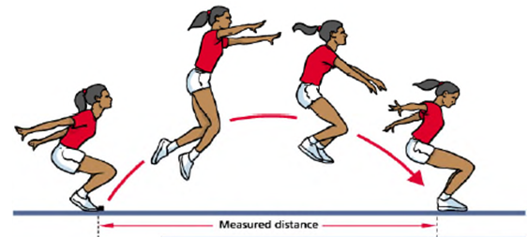
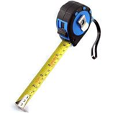
Twitter@PEPASSGlasgow
Standing Long Jump
From a standing position, pupils measure how far they can jump.
How to (for pupils):
Stand with your feet shoulder width apart just behind the starting line.
Get ready to jump (bending your knees, swinging your arms, leaning forward, taking off from the balls of your feet … see video.) Find the right action for you.
Spring into the air and land as far as you can in front of you.
You must take off from a standing position (no run up) and land on your two feet.
Your jump is measured from the part of your body that lands furthest back e.g. heel or even hand (if you were to fall backwards).
Set up support (for teachers):
Pupils could work in pairs to take turns but also to help each other to coach, encourage, measure jumps, record results etc.
Metre sticks set up alongside the jumps is much easier than using a measuring tape.

Slide 2
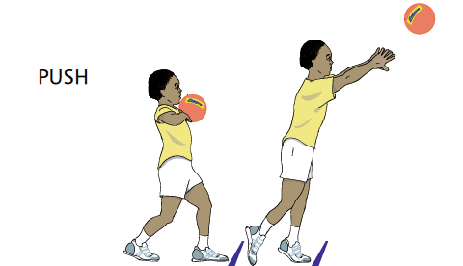
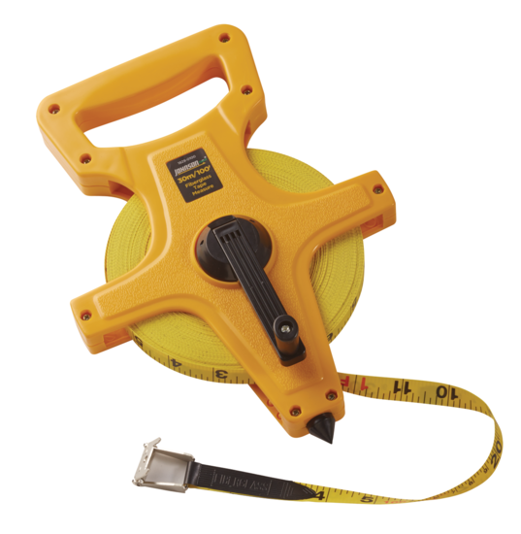
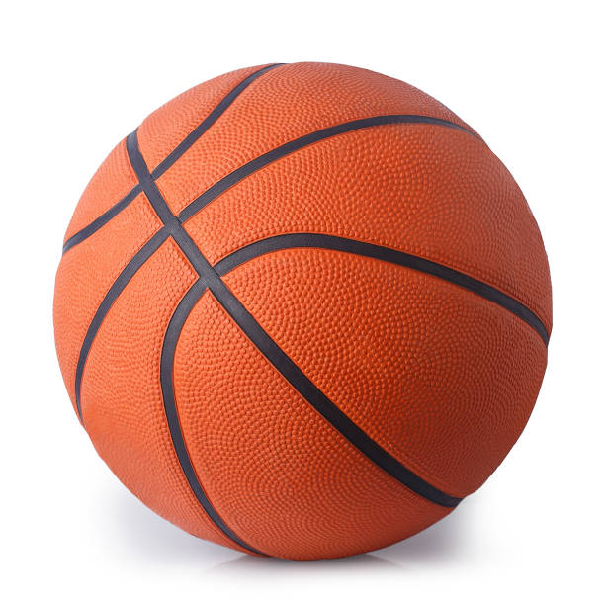
Twitter@PEPASSGlasgow
Standing two handed Chest Push
In this standing throw the participant pushes a Size 5 basketball with both hands from the chest as far as they can.
This is a good introduction to the push technique used in the shot-put event.
This technique is similar to the one used in Basketball and Netball where it is known as the chest pass.
How to (for pupils):
The ball is held against the chest with both elbows pointing out to the sides the ball must be pushed with both hands.
Both feet must remain on the floor at all times.
One foot may be in front of the other however no run up or steps are permitted.
The participant must not pass the throw line.
Measurement is to the point the centre of the ball first touches the floor rounding down to the nearest full 1cm.
The participants chest must face forward at all times during the throw, trunk rotation techniques are not allowed.
Set up support (for teachers):
Pupils could work in pairs to take turns but also to help each other to coach, encourage, measure throws, record results etc.
It is possible for multiple pupils attempting at the same time if the throwing area is clear and safe.
A measuring tape will be required to record this event.

Slide 3
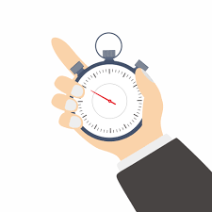
Twitter@PEPASSGlasgow
6 x 10m Sprint
Using 2 cones (or similar items) mark out a 10m distance.
Pupils must then complete 6 shuttle runs as quickly as possible.
How to (for pupils):
On instruction to start, pupils complete the 6 runs as fast as they can.
Children must touch the cone at each end with their hand, before turning and sprinting quickly to the other. You must also touch the final cone upon completion to end the challenge.
(sanitise cones after use)
Ask your teacher for a practice before your recorded time
challenge.
Set up support (for teachers):
Pupils could work in pairs to take turns but also to help each other to coach, encourage, count runs, record time and results etc.
A few 6 x10m stations can be set up next to each other to have more pupils going at once.
A measuring tape, stopwatch and maybe even an iPad to record footage, will be required to record this event.

Slide 4
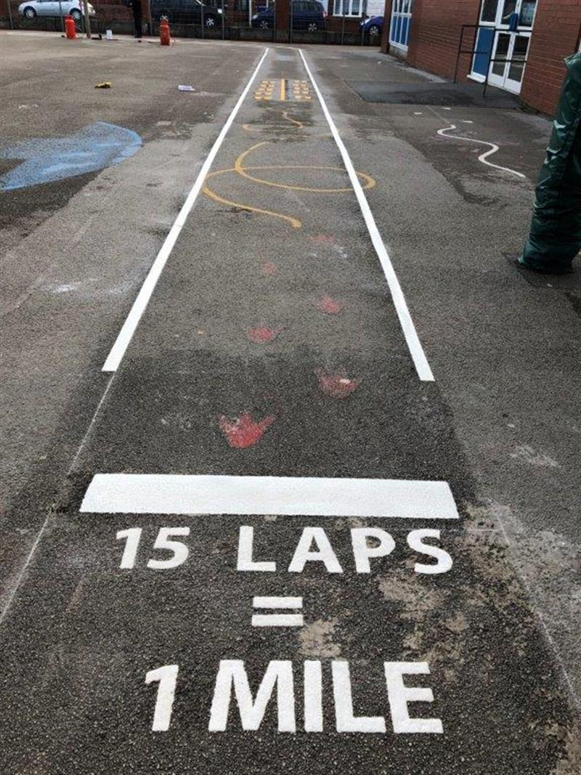
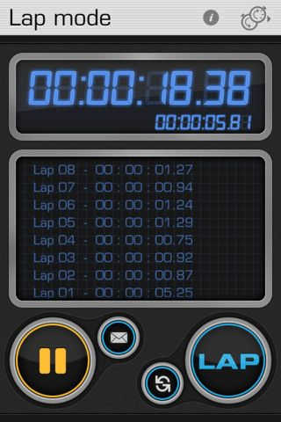
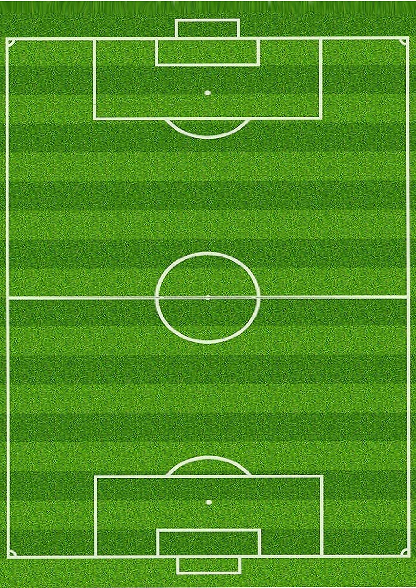
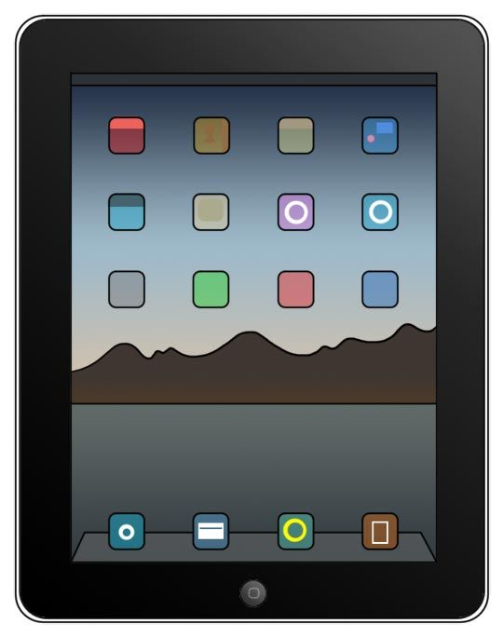
Twitter@PEPASSGlasgow
1 Mile Run
In this run pupils have to complete a 1 mile course in their fastest time
Teachers will need to work out an appropriate safe running area (flat if possible) and work out how many laps are required to complete the mile
Two main key things are making sure the correct number of laps are completed by each pupil and also an accurate time is recorded for all
How to (for pupils):
Pupils should do a warm-up before attempting their mile e.g. 5 mins walking/jogging on spot
Pupils should know how many laps for 1 mile
Pupils should have an idea of how to pace themselves and not go off too quickly at the beginning – teacher should remind them of this
Set up support (for teachers):
Area measured and marked out and set up in advance
The warm up could be a walk around the course to make sure pupils are familiar.
3 roles: runner, lap-counter and timer – these could be split between 2 or 3 pupils working together
Pupils could collect a sticker or cube after each lap to help with count.

Slide 5
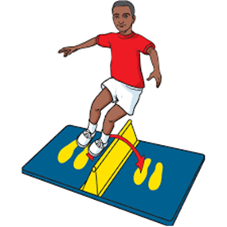
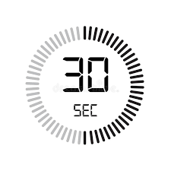
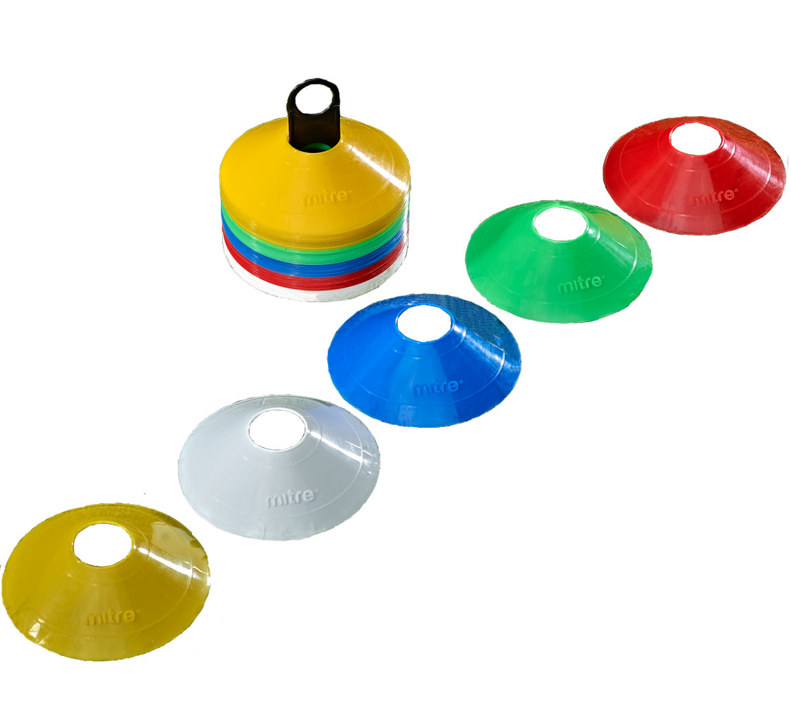
Twitter@PEPASSGlasgow
Speed Bounce
How many times in 30 seconds can you jump side to side over the cones
How to (for pupils):
1. Row of marker cones used as object to jump over.
2. Standing with feet together and jump side to side over the markers
jump over as many times as you can in 30 seconds.
3. Partner counts how many times they have done this and records
score.
Set up support (for teachers):
Pupils into pairs and numbered 1 and 2
Each pair given are given cones to jump over and a designated space to set up the event.
The teacher is the only person with stopwatch and shouts ‘start’ and ‘stop’.
Number 1’s to jump first and 2’s to count score. 2’s record on a sheet or record with the teacher on the master sheet.
Repeat for number 2’s to jump and 1’s to record

