Slide 1
Notre Dame High School Uniform
Frances Scanlan, Logoxpres

Slide 2
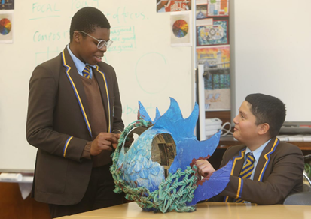
Uniform Consultation
The aim of consulting with our parents/carers and pupils is primarily to ensure that, in line with Cost of the School Day, our uniform continues to be affordable and accessible.

Slide 3
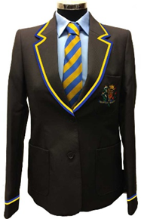
Options for Consideration
SCHOOL BLAZER
Historically school blazer was 100% wool. In 2017, parents moved to polyester and reduced the cost by more than 50%.
Further savings of 25% can be achieved by removing yellow/royal trim.
Options:
No trim
Retain trim for S4 – S6
Retain trim for all pupils

Slide 4
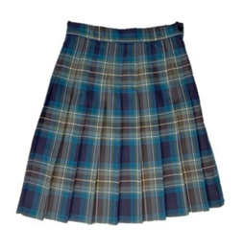
Options for Consideration
TARTAN SKIRT
Currently worn by 6th Year Pupils only.
Options:
Keep for S6 only
Extend to S5 and S6
Extend to S4 – S6
Remove tartan skirt

Slide 5
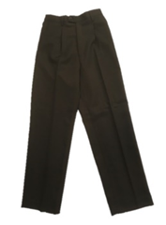
Options for Consideration
BROWN TROUSERS
Difficult to purchase 12 months of year.
Changing to a generic Black/Grey/Navy would allow better availability all year round and access to the high street.

Slide 6
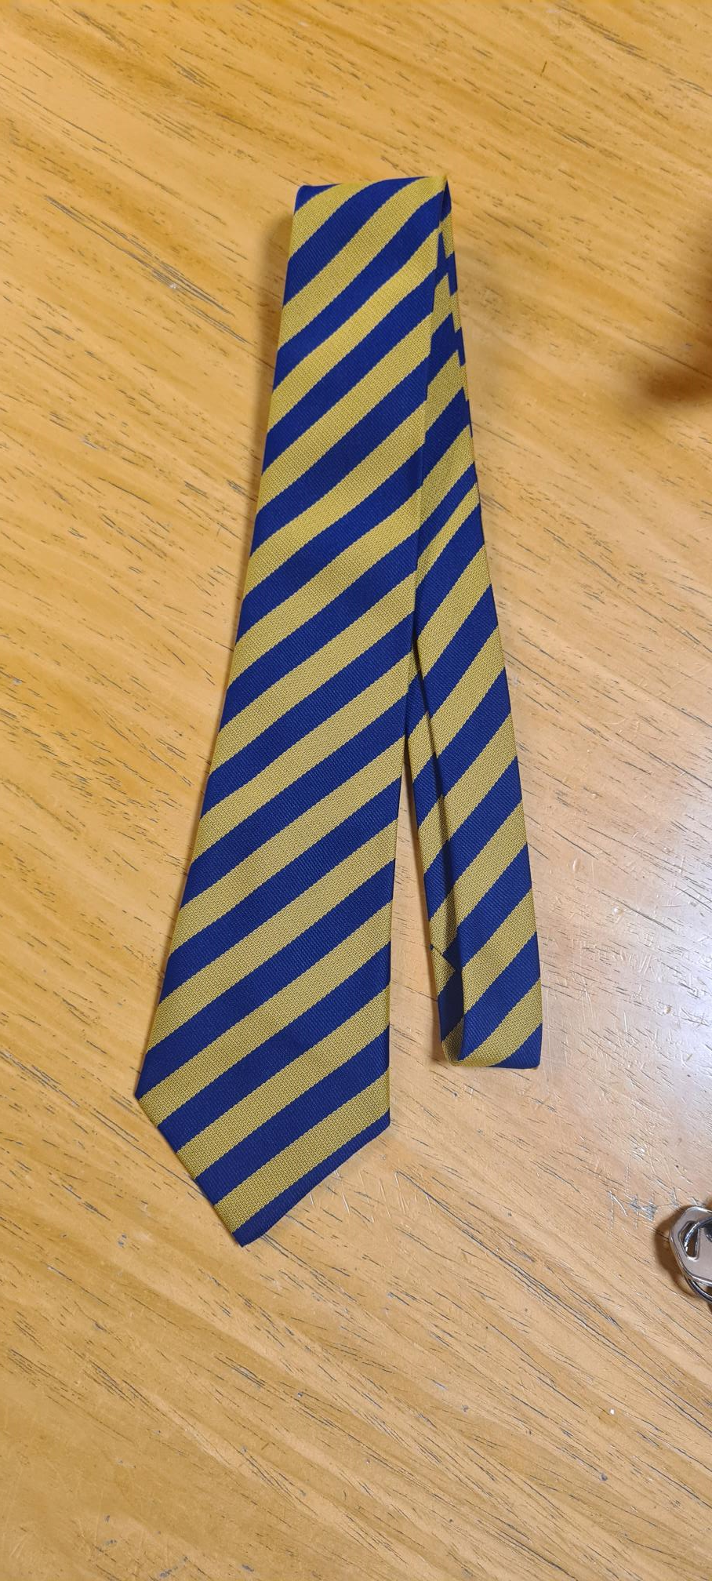
Options for Consideration
SCHOOL TIE
S1 – S5 – Stripe
S6 – Plain blue
Options:
Keep blue tie for S6 only
Extend blue tie to S5 and S6
Extend blue tie to S4 – S6
Introduce tartan tie (S6 boys)

Slide 7
Other best practice initiatives
Buy quality and durable garments that wash and wear well and can be passed on.
1
Actively promote and encourage the availability of Second-Hand Uniform in school.
2
Use the uniform sizing sessions in school to ensure you are buying the best fit for growth.
3
Use the Free Deliver to school option for delivery and Exchanges.
4

Slide 9
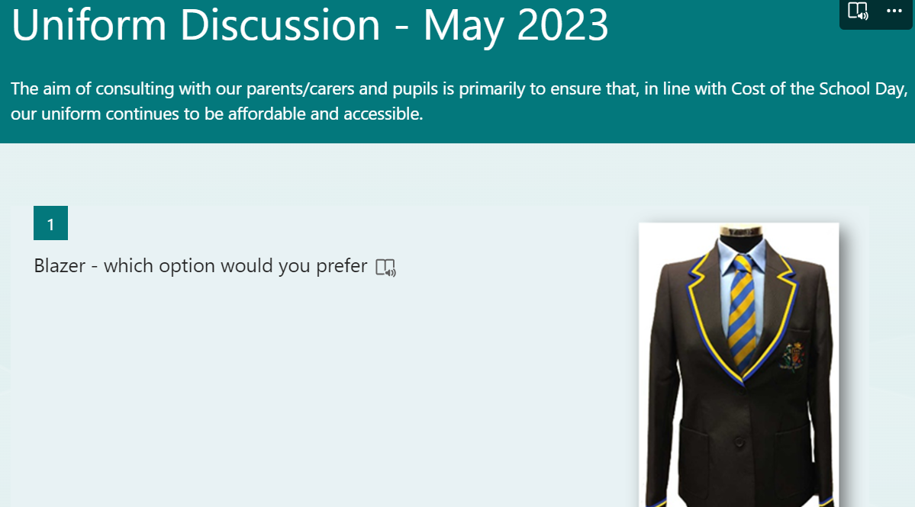
https://forms.office.com/e/8Yan69AMQi

