Slide 1
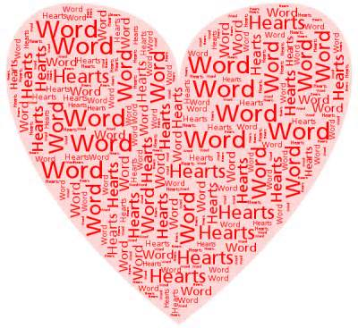
Imagery
Revision

Slide 2
How to answer
1. Quote the image and state what type of image it is.
2. Say what is being compared to what
Explain what links the two things being compared.
    Just as … so too…
Explain the effect the image has on the reader and link to the question.

Slide 3
Simile
A comparison between two things using ‘like’ or ‘as’.
The effect can be any number of things. However, it adds a visual emphasis or impact to a written description.
He’s like a dog with a bone.

Slide 4
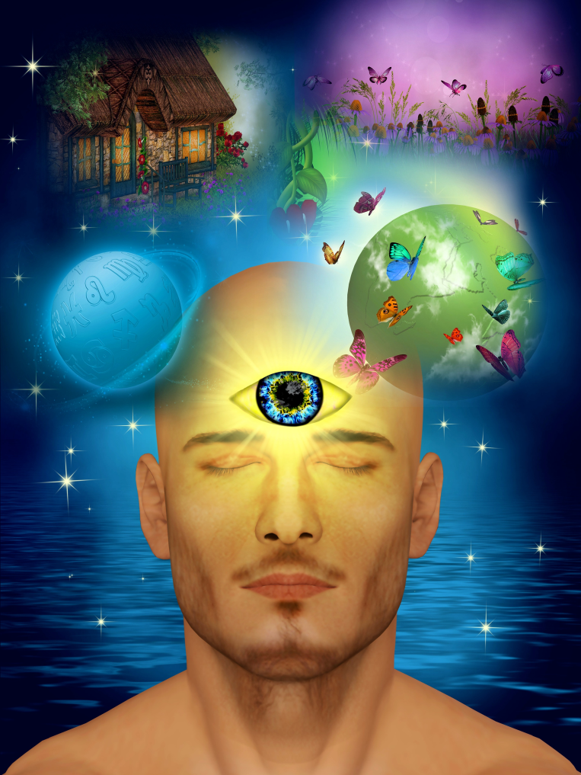
Metaphor
A comparison between two things where one thing becomes or is the other.
Similar effects as similes.
You’re an angel.

Slide 5
Personification
An image where you give human characteristics to an animal or inanimate object.
It is a special type of image: similes and metaphors can become personification.
The wind howled down the corridor.

Slide 6
Which Imagery is which?
In the corridors of power, the doors keep secrets that could change history.
The camera shutters exploded like machine gun fire as the royal couple left their hotel.
The actress erupted at the offensive questioning, lashing out at the nearest reporter
Metaphor
Simile
Personification

Slide 7
Which Imagery is which?
In the corridors of power, the doors keep secrets that could change history.
The camera shutters exploded like machine gun fire as the royal couple left their hotel.
The actress erupted at the offensive questioning, lashing out at the nearest reporter
Metaphor
Simile
Personification

Slide 8
How to Answer
1. Quote the image and state what type of image it is.
2. Say what is being compared to what
Explain what links the two things being compared.
    Just as … so too…
Explain the effect the image has on the reader and link to the question.
“_________” – This is a ______________
_________ is being compared to __________
Just as _____________, so too ____________
This makes it clear that _____________________ ________________________________________

Slide 9
“My brother is an absolute pig!”
1. Quote the image and state what type of image it is.
2. Say what is being compared to what
Explain what links the two things being compared.
    Just as … so too…
Explain the effect the image has on the reader and link to the question.
“My brother is an absolute pig!” – This is a Metaphor
The brother is being compared to a pig
Just as a pig rolls around in the mud, so too is the brother messy
This makes it clear that the speaker thinks their brother is bad at keeping things clean

Slide 10

Practice Question
At 13, 1 would spend a long time beside the home telephone every evening, calling the friends who I had seen all day at school to resume our conversation. Everyone did. It’s normal for teenagers to require constant interaction with their peer group, while other figures, like parents, vanish to the margins, and I saw nothing strange about spending hours crouched in our hall, discussing embarrassing teachers and hilarious friends in exhausting detail
Look at the following image: ‘vanish to the margins’
Explain what this imagery tells us about the role of parents in modern society.

Slide 11
“parents vanish to the margins”
1. Quote the image and state what type of image it is.
2. Say what is being compared to what
Explain what links the two things being compared.
    Just as … so too…
Explain the effect the image has on the reader and link to the question.
“_________” – This is a ______________
_________ is being compared to __________
Just as _____________, so too ____________
This makes it clear that _____________________ ________________________________________

Slide 12
“parents vanish into the margins”
1. Quote the image and state what type of image it is.
2. Say what is being compared to what
Explain what links the two things being compared.
    Just as … so too…
Explain the effect the image has on the reader and link to the question.
“Vanish into the margins” this is a metaphor
A parent is being compared to information that gets moved to the margin of a piece of writing.
Just as is unimportant information is moved from the centre of a page, into the margin, so too parents are being made less central to the lives of children.
This makes it clear that the writer thinks that in modern society, parents play less of a role in the lives of their children

Slide 13

Question 1
Texting begins early morning and lets up last thing at night. Friends wake them up, friends say goodnight and Facebook fills all the gaps in between. The sweet, individualised ring tones that signify when a particular friend is texting beep from 6.30am to 11pm, chirruping their insistent way through supper, homework, bath time and sleep. Technology embraces our children.
Look at the following image: ‘Technology embraces our children’
Explain how what this image tells us about the relationship between young people and technology

Slide 14
“Technology embraces our children”
1. Quote the image and state what type of image it is.
2. Say what is being compared to what
Explain what links the two things being compared.
    Just as … so too…
Explain the effect the image has on the reader and link to the question.
“_________” – This is a ______________
_________ is being compared to __________
Just as _____________, so too ____________
This makes it clear that _____________________ ________________________________________

Slide 15
“Technology embraces our children”
1. Quote the image and state what type of image it is.
2. Say what is being compared to what
Explain what links the two things being compared.
    Just as … so too…
Explain the effect the image has on the reader and link to the question.
“Technology embraces our children” this is personification
Children’s constant use of technology is being compared to an embrace
Just as an embrace wraps itself around you to make you feel warm and comforted so too children are always wrapped up in technology and it makes them feel comfortable.
This makes it clear that children these days have a very close relationship with technology

Slide 16
Question 2
I have been thinking about this because I recently moved flat, as I stacked my books high, and watched my friends get buried in landslides of novels, it struck me that this scene might be incomprehensible a generation from now. The book – the physical paper book – is being circled by a shoal of sharks, with sales down 9 percent this year alone. It’s being chewed by the e-book. It’s being gored by the death of the bookshop and library.
Show how the writer’s use of imagery makes clear the number of books he possesses. (2)

Slide 17
Question 2
1. Quote the image and state what type of image it is.
2. Say what is being compared to what
Explain what links the two things being compared.
    Just as … so too…
Explain the effect the image has on the reader and link to the question.
“_________” – This is a ______________
_________ is being compared to __________
Just as _____________, so too ____________
This makes it clear that _____________________ ________________________________________

Slide 18
Question 2
1. Quote the image and state what type of image it is.
2. Say what is being compared to what
Explain what links the two things being compared.
    Just as … so too…
Explain the effect the image has on the reader and link to the question.
‘buried in landslides of novels.’ – This is a metaphor
Stacks of books are being compared to a landslide
Just as people disappear in huge amounts of earth or snow in a landslide, so too did the writer’s friends vanish under the enormous number of his books they were carrying for him.
This makes it clear that the writer has a massive amount of books

Slide 19
Question 3
I have been thinking about this because I recently moved flat, as I stacked my books high, and watched my friends get buried in landslides of novels, it struck me that this scene might be incomprehensible a generation from now. The book – the physical paper book – is being circled by a shoal of sharks, with sales down 9 percent this year alone. It’s being chewed by the e-book. It’s being gored by the death of the bookshop and library.
How does the writer use imagery to make clear the threat to the paper book? (2)

Slide 20
Question 3
1. Quote the image and state what type of image it is.
2. Say what is being compared to what
Explain what links the two things being compared.
    Just as … so too…
Explain the effect the image has on the reader and link to the question.
“_________” – This is a ______________
_________ is being compared to __________
Just as _____________, so too ____________
This makes it clear that _____________________ ________________________________________

Slide 21
Question 3
1. Quote the image and state what type of image it is.
2. Say what is being compared to what
Explain what links the two things being compared.
    Just as … so too…
Explain the effect the image has on the reader and link to the question.
“circled by a shoal of sharks.” – This is a metaphor
The poor sales of books is being compared to a shoal of sharks
Just as sharks slowly surround their prey before they attack to kill, so too are the decreasing sales of books a slow sign of their eventual death
This makes it clear that the physical book is under threat of disappearing due to poor sales

Slide 22
Question 3
1. Quote the image and state what type of image it is.
2. Say what is being compared to what
Explain what links the two things being compared.
    Just as … so too…
Explain the effect the image has on the reader and link to the question.
“It’s being chewed by the e-book.” – This is personification
The e-book’s success is being compared to an animal chewing something
Just as animals chew something before they eventually eat it, so too is the e-book gradually breaking down the physical book, before it gets rid of it for good
This makes it clear that the physical book is under threat of disappearing due the popularity of e-books

