Slide 1

Use of Language

Slide 2
Technique Revision
Match each technique to its partner definition.
A question that is asked in order to make a point, rather than to get an answer.
Simile
Repetition
Giving an object or thing human characteristics.
Words chosen by an author to make a particular point or get across a particular idea.
Personification
Rhetorical Question
The use of words that begin with the same sound near one another.
Word Choice
Saying something again for emphasis.
Onomatopoeia
Saying an object is something else (normally something that is very different).
Alliteration
Used to compare two different things, usually using words such as ‘like’ or ‘as’ to draw the comparison.
Metaphor
A word which imitates the sound it is describing.

Slide 3
Use of Language includes all aspects of the Close Reading and RUAE (Reading, Understanding, Analysis, and Evaluation).
It includes things like Word Choice, Imagery, Sentence Structure and Tone

Slide 4
Word Choice
Imagery
Tone
Sentence Structure
These two we have covered in depth for their individual questions, so we will quickly revise these

Slide 5
Word Choice

Slide 6
Denotation and Connotation
Most words have two levels of meaning, a denotation and a more complex connotation
A) The denotation is the basic, simple, dictionary meaning.
B) The connotations of a word are the ideas that a word suggests to us.

Slide 7

For Example…
Butterfly
The denotation of this word is a flying insect that transforms from a caterpillar
But for the connotation we have to think of the ideas we associate with the word butterfly.
We think of delicate things, beauty, transformation
If the word is then used to describe a person then these qualities are associated with that person.

Slide 8
How To Answer:
Quote an appropriate word which answers the questions
Explain what the connotation of the word (what it makes you think)
Say what the word suggests about the passage (explain how it answers the question)
The word “_____” has connotations of _________ which suggests ______________.

Slide 9
For example…
The ballerina's dancing reminded me of a butterfly in flight.
How does the writer’s use of language make it clear that he enjoys the ballerina’s dancing? (2)

Slide 10
For example…
The ballerina's dancing reminded me of a butterfly in flight.
How does the writer’s use of language make it clear that he enjoys the ballerina’s dancing? (2)
The word “_____________” has connotations of ____________ which suggests _____________
(And remember to make sure you are ANSWERING THE QUESTION)

Slide 11
For example…
The ballerina's dancing reminded me of a butterfly in flight.
How does the writer’s word choice make it clear that he enjoys the ballerina’s dancing? (2)
The word “butterfly” has connotations of being light and pretty which suggests the ballerina’s movement was delicate which is a positive description her dancing.

Slide 12
Imagery

Slide 13
Simile
A comparison between two things using ‘like’ or ‘as’.
The effect can be any number of things. However, it adds a visual emphasis or impact to a written description.
He’s like a dog with a bone.

Slide 14

Metaphor
A comparison between two things where one thing becomes or is the other.
Similar effects as similes.
You’re an angel.

Slide 15
Personification
An image where you give human characteristics to an animal or inanimate object.
It is a special type of image: similes and metaphors can become personification.
The wind howled down the corridor.

Slide 16
How to answer
1. Quote the image and state what type of image it is.
2. Say what is being compared to what
Explain what links the two things being compared.
    Just as … so too…
Explain the effect the image has on the reader and link to the question.

Slide 17
For example…
The ballerina was like a butterfly in flight.
How does the writer’s use of language make it clear that he enjoys the ballerina’s dancing? (2)

Slide 18
For example…
The ballerina was like a butterfly in flight.
How does the writer’s use of language make it clear that he enjoys the ballerina’s dancing? (2)
Quote the image and state what type of image it is.
Say what is being compared to what
Explain what links the two things being compared.
    Just as … so too…
Explain the effect the image has on the reader and link to the question.
“The ballerina was like a butterfly in flight” This is a simile.
The ballerina is being compared to a butterfly
Just as a butterfly moves delicately, so too is the ballerina beautiful and captivating
This is a very positive image, making clear that the writer enjoys the dancing

Slide 19
For example…
The butterfly danced in the wind
How does the writer’s use of language make it clear that he thinks the butterfly is captivating? (2)

Slide 20
For example…
The butterfly danced in the wind
How does the writer’s use of language make it clear that he thinks the butterfly is captivating? (2)
Quote the image and state what type of image it is.
Say what is being compared to what
Explain what links the two things being compared.
    Just as … so too…
Explain the effect the image has on the reader and link to the question.
“The butterfly danced in the wind” This is personification.
The butterfly’s movement is being compared to a dance
Just as a dance is rhythmic and entertaining, so too is the butterfly’s movement flowing and nice to watch
This image shows that the writer is enjoying watching the butterfly move, suggesting he is captivated by the butterfly

Slide 21
Tone

Slide 22
Tone can be defined as the mood or attitude of the writer towards the subject matter. A question on tone involves you writing a sentence in which you clearly identify the tone.
Then, depending on the marks available, you should explain what tone is clear from the sentence and why.

Slide 23
Tone questions are often seen as the most difficult to answer.
A first step to being able to answer them is knowing some of the common examples of tone in close reading papers.

Slide 24
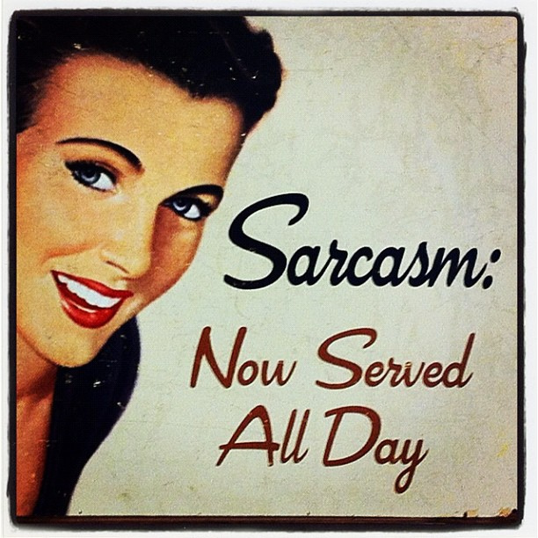
Copy Down
Most common types of tone:
Sarcastic
Humorous
Ironic
Disapproving
Angry
Flippant
(not showing a serious attitude towards something usually considered worthy of respect.)

Slide 25
How to answer
S: State what tone is being used
Q: Quote an example that makes the tone clear
A: Analyse how the quote shows the tone and how the use of this tone answers the question

Slide 26
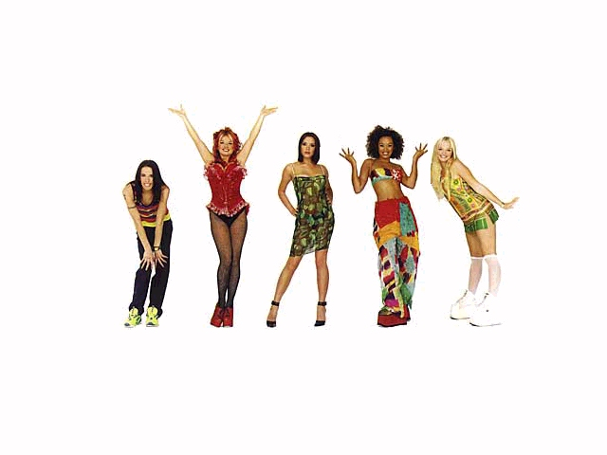
As a class
Everyone knows the Spice Girls. They are, apparently, the greatest pop phenomenon of the 1990s. Over the years they released 3 studio albums, 1 greatest hits compilation and 13 singles.
How does the writer’s use of language make clear his opinion of the Spice Girls (2)

Slide 27
As a class
1. Everyone knows the Spice Girls. They are, apparently, the greatest pop phenomenon of the 1990s. Over the years they released 3 studio albums, 1 greatest hits compilation and 13 singles.
How does the writer’s use of language make clear his opinion of the Spice Girls (2)
S: State what tone is being used
Q: Quote an example that makes the tone clear
A: Analyse how the quote shows the tone and how the use of this tone answers the question
The writer uses disapproving tone
“They are, apparently, the greatest pop phenomenon of the 1990s.”
This quote shows a disapproving tone, as the word “apparently” suggests that he does not agree that they were the greatest, showing his negative opinion of the Spice Girls.

Slide 28
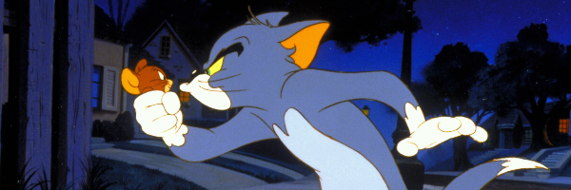
In a pair
Today, when we think of a cat chasing a mouse it’s usually in some cartoonesque, Tom and Jerry sort of way. The dumb cat is always foiled by its tiny heroic adversary, like we’re supposed to support the mouse as it gnaws at our possessions and spreads disease.
Explain how the writer’s use of language make it clear that he is defending cats here. (2)

Slide 29
In a pair
Today, when we think of a cat chasing a mouse it’s usually in some cartoonesque, Tom and Jerry sort of way. The dumb cat is always foiled by its tiny heroic adversary, like we’re supposed to support the mouse as it gnaws at our possessions and spreads disease.
Explain how the writer’s use of language make it clear that he is defending cats here. (2)
S: State what tone is being used
Q: Quote an example that makes the tone clear
A: Analyse how the quote shows the tone and how the use of this tone
The writer uses sarcastic tone
“The dumb cat is always foiled by its tiny heroic adversary, like we’re supposed to support the mouse as it gnaws at our possessions and spreads disease.”
This quote shows a sarcastic tone, as he points out bad things mice do, showing he does not really think they are heroic, which suggests he is defending cats, as he doesn’t actually think they are dumb.

Slide 30
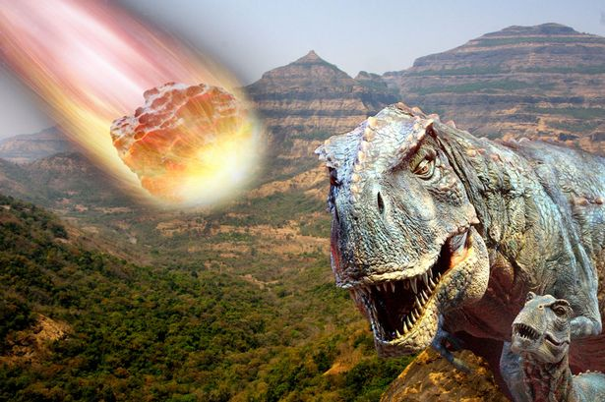
On Your Own
Survivors of impact catastrophes were those creatures who just happened to be ‘lucky’ enough to find themselves alive after the dust settled. It doesn’t matter how well a creature may have been able to survive in a particular environment before an event – millions of years of evolution are useless when a tiny piece of rock comes from space to say hello to your head.
How does the writer’s use of language help to show the random and unexpected nature of meteor catastrophes? (2)

Slide 31
On Your Own
Survivors of impact catastrophes were those creatures who just happened to be ‘lucky’ enough to find themselves alive after the dust settled. It doesn’t matter how well a creature may have been able to survive in a particular environment before an event – millions of years of evolution are useless when a tiny piece of rock comes from space to say hello to your head.
How does the writer’s use of language help to show the random and unexpected nature of meteor catastrophes? (2)
S: State what tone is being used
Q: Quote an example that makes the tone clear
A: Analyse how the quote shows the tone and how the use of this tone
The writer uses humorous/flippant tone
“millions of years of evolution are useless when a tiny piece of rock comes from space to say hello to your head.”
This quote shows a humorous/flippant tone, as the writer makes a joke about how these creatures died, which suggests he finds it random and unexpected because he can’t take seriously something that is so unlikely and hard to predict.

Slide 32
Sentence Structure

Slide 33
Sentence Structure
Sentence Structure – refers to when a writer tries to emphasise certain words or ideas through the way that sentences are set out.

Slide 34
Repetition
When single words, or groups of words, are repeated.
Emphasises the repeated idea
We have to study. Study in the day. Study in the night. Study all the time.

Slide 35
Short Sentence
Grab the reader’s attention and emphasise the information within them. Important words are mad to stand out.
If you want to pass your exams, I have one word for you. Study.

Slide 36
Lists
Lists emphasise that there is a lot of something, either to show how important it is, or to make it seem crowded/tedious
A colon (:) will often introduce a list
The students who get the best grades are all similar because they revise a lot, pay attention in class, get to sleep early, take detailed notes and attend supported study.

Slide 37
Colon (:)
A colon introduces important information that the writer wants to emphasise or a list
All the students who got the best grades had one thing in common: they studied hard.

Slide 38
Questions (?)
Usually they are trying to make the reader feel involved, by making them consider their answer, emphasising the opinion.
They might also emphasise confusion.
If you fail your exams, you need to ask yourself one thing. Did you study enough?

Slide 39
Exclamations (!)
They emphasise the excitement or passion behind the words.
After studying long and hard, Bob finally got his results. He opened the letter and saw his grades. He passed every exam!

Slide 40
Parenthesis
Additional information, explanations or opinions are added to the text using –dashes – or (brackets) The extra information is emphasised.
John – who didn’t study at all – failed all his exams. But Bob (who studied very hard) passed them all.

Slide 41
The students who get the best grades are all similar because they revise a lot, pay attention in class, get to sleep early, take detailed notes and attend supported study.
After studying long and hard, Frank finally got his results. He opened the letter and saw his grades. He passed every exam!
John – who didn’t study at all – failed all his exams. But Frank (who studied very hard) passed them all.
All the students who got the best grades had one thing in common: they studied hard.
We have to study. Study in the day. Study in the night. Study all the time.
If you want to pass your exams, I have one word for you. Study.
If you fail your exams, you need to ask yourself one thing. Did you study enough?
Repetition
Short sentence
List
Colon
Question
Exclamation
Parenthesis

Slide 42
How To Answer: SQA
S: State what sentence structure is being used
Q: Quote an example of it being used
A: Analyse how it is used and how that answers the question

Slide 43
As a class
Before we go on holiday, I have to pack the cases, take the dog to the kennels, make up a packed lunch for travelling, check we have our tickets and phone for a taxi to the airport.
How does the author’s use of language show how busy she is? (2)

Slide 44
As a class
Before we go on holiday, I have to pack the cases, take the dog to the kennels, make up a packed lunch for travelling, check we have our tickets and phone for a taxi to the airport.
How does the author’s use of language show how busy she is? (2)
S: State what sentence structure is being used
Q: Quote an example of it being used
A: Analyse how it is used and how that answers the question
The writer uses a list
“I have to pack the cases, take the dog to the kennels, make up a packed lunch for travelling, check we have our tickets and phone for a taxi to the airport.”
This list emphasises how many things there are still to do, which makes her seem busy because there are a lot of things in the list

Slide 45
As a pair
There is one thing that we know for certain: the water is rising. We – and our descendants – will have to learn to live with it.
How does the author use language to try to get the reader to take the issue of global warming seriously? (4)

Slide 46
As a pair
There is one thing that we know for certain: the water is rising. We – and our descendants – will have to learn to live with it.
How does the author use language to try to get the reader to take the issue of global warming seriously? (4)
Identify a sentence structure feature, and either quote it or explain where it is used
Explain what feature emphasises in the passage and how it answers the question

Slide 47
As a pair
There is one thing that we know for certain: the water is rising. We – and our descendants – will have to learn to live with it.
How does the author use language to try to get the reader to take the issue of global warming seriously? (4)
S: State what sentence structure is being used
Q: Quote an example of it being used
A: Analyse how it is used and how that answers the question
The writer uses a colon
“: the water is rising.”
The colon emphasises this important phrase, which shows a negative result of global warming, which might scare people into taking the issue seriously.

Slide 48
As a pair
There is one thing that we know for certain: the water is rising.
We – and our descendants – will have to learn to live with it.
How does the author use language to try to get the reader to take the issue of global warming seriously? (4)
S: State what sentence structure is being used
Q: Quote an example of it being used
A: Analyse how it is used and how that answers the question
The writer uses parenthesis
“We - and our descendants -”
This emphasises this important phrase, which shows a lasting effect of global warming, which might help people to take the issue seriously because they are thinking about their future generations.

Slide 49
On Your Own
I often find myself awake at night thinking about that night. Why did this have to happen? I will never understand what you did. Never.
How does the author’s use of language highlight his confusion over the event. (4)

Slide 50
On Your Own
I often find myself awake at night thinking about that night. Why did this have to happen? I will never understand what you did. Never.
How does the author’s use of language highlight his confusion over the event. (4)
S: State what sentence structure is being used
Q: Quote an example of it being used
A: Analyse how it is used and how that answers the question
The writer uses a question
“Why did this have to happen?”
This question emphasises the fact that the speaker still wants to know more about the event, which suggests he is confused about it

Slide 51
On Your Own
I often find myself awake at night thinking about that night. Why did this have to happen? I will never understand what you did. Never.
How does the author’s use of language highlight his confusion over the event. (4)
S: State what sentence structure is being used
Q: Quote an example of it being used
A: Analyse how it is used and how that answers the question
The writer uses a short sentence
“Never.”
This short sentences emphasises the word “Never” which makes clear just how unlikely it is that he will ever understand the event, which suggests he is confused and will remain that way forever.

Slide 52
On Your Own
I often find myself awake at night thinking about that night. Why did this have to happen? I will never understand what you did. Never.
How does the author’s use of language highlight his confusion over the event. (4)
S: State what sentence structure is being used
Q: Quote an example of it being used
A: Analyse how it is used and how that answers the question
The writer uses repetition
“I will never understand what you did. Never.”
This repetition emphasises the word “Never” which makes clear just how unlikely it is that he will ever understand the event, which suggests he is confused and will remain that way forever.

Slide 53
On Your Own
The scientists say that even if the world’s governments and industries meet international goals on reducing greenhouse gases – which they probably will not – it still won’t be enough to prevent severe changes to the world’s weather. The government isn’t going to help, so get used to it!
How does the author’s use of language in the paragraph emphasise her concern about the future? (4)

Slide 54
On Your Own
The scientists say that even if the world’s governments and industries meet international goals on reducing greenhouse gases (which they probably will not) it still won’t be enough to prevent severe changes to the world’s weather. The government isn’t going to help, so get used to it!
How does the author’s use of language in the paragraph emphasise her concern about the future? (4)
S: State what sentence structure is being used
Q: Quote an example of it being used
A: Analyse how it is used
The writer uses parenthesis
“(which they probably will not)”
This parenthesis emphasises an important phrase, which shows the writer’s lack of belief in the world’s governments, this suggests she is concerned because she doesn’t think the problems will get fixed.

Slide 55
On Your Own
The scientists say that even if the world’s governments and industries meet international goals on reducing greenhouse gases (which they probably will not) it still won’t be enough to prevent severe changes to the world’s weather. The government isn’t going to help, so get used to it!
How does the author’s use of language in the paragraph emphasise her concern about the future? (4)
S: State what sentence structure is being used
Q: Quote an example of it being used
A: Analyse how it is used
The writer uses an exclamation
“so get used to it!”
This exclamation emphasises that the writer is angry about the fact that the problems aren’t going to change, which shows her concern as she is upset at those not working to fix the future

