Slide 1
Assisi
Poetry of norman maccaig

Slide 2
Before Reading - Context
“Assisi” is a town in the centre of Italy.
There are many historical towns and the landscape is beautiful here so it is popular with tourists.

Slide 3
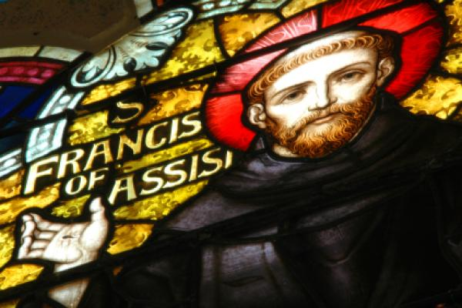
Before Reading - Context
“Assisi” is most famous for being the home of St. Francis of Assisi.
He was born here in 1181.

Slide 4
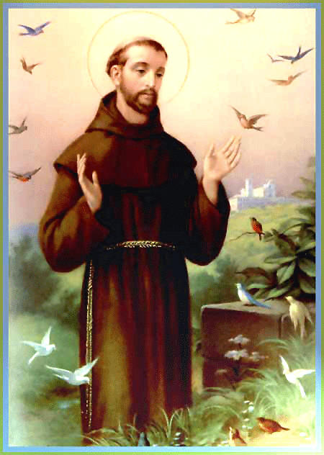
Before Reading - Context
Saint Francis was born to a rich family but chose to live a life in poverty.
He chose to help the poor and needy.
He is the patron saint of animals, so he is usually pictured surrounded by animals.

Slide 5
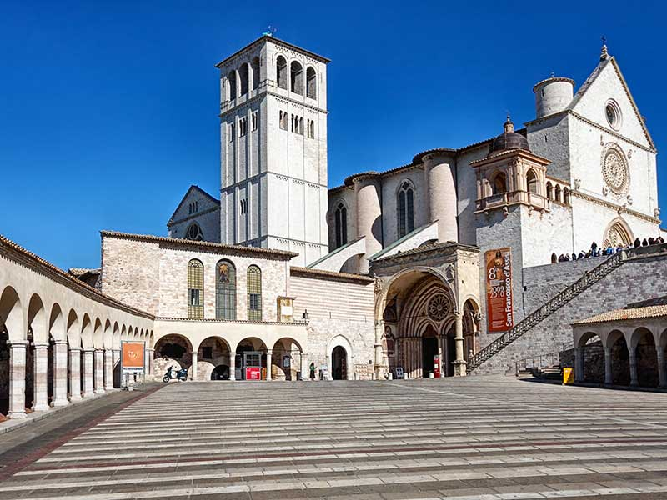
Basilica of St. Francis of Assisi

Slide 6

Poet’s Main Idea
This poem is an encounter MacCaig has with a beggar outside the Basilica of St. Francis of Assisi
This is a famous landmark build to commemorate the life of St. Francis of Assisi a saint famous for his compassion and kindness to the poor.
MacCaig is angry and frustrated at the hypocrisy of the church; they ignore a beggar while celebrating the life of St Francis, a man who would have cared for him.

Slide 7
Reflective Nature of the Poem
In the interview ‘A Metaphorical Way of Seeing Things’, MacCaig maintained that poetry ‘clears your eyes and you see things’.
MacCaig reflects throughout the poem on the hypocrisy of the church and his angry and bitter tone is apparent throughout the poem.

Slide 8

Theme
Attack on the hypocrisy of the church and, in turn, human nature. We judge people by how they look and do not care for those outside of society in the way that we should.
He also focusses on the suffering of the beggar and the fact that the tourists (and society in general) ignore this suffering in order to live their lives.

Slide 9

Structure
Stanza One – Description of the dwarf
Stanza Two – Focus on the priest and the church
Stanza Three – Focus on the tourists and ends with another description of the beggar

Slide 10
Stanza One
The dwarf with his hands on backwards
sat, slumped like a half-filled sack
on tiny twisted legs from which
sawdust might run,
outside the three tiers of churches built
in honour of St Francis, brother
of the poor, talker with birds, over whom
he had the advantage
of not being dead yet.
Think about:
What happens in this stanza? Is there a point where the stanza changes focus?
What is your impression of the beggar?
What mood or emotion is the poet feeling?

Slide 11
Focus of stanza one
Derogatory comment at start of poem
Beggar is twisted and deformed. Outwardly ugly – this is why people judge him
Stanza One
The dwarf with his hands on backwards
sat, slumped like a half-filled sack
on tiny twisted legs from which
sawdust might run,
outside the three tiers of churches built
in honour of St Francis, brother
of the poor, talker with birds,
over whom
he had the advantage
of not being dead yet.
Simile
Shapeless and unattractive
Shell of a human being
Unable to stand on his legs. Cannot support himself – just as he receives no support from the church
Makes the church sound grand and impressive – contrasting against the dwarf, making it clear they could help
Word Choice
Beggar is outside church but also society, rejected
Description of what St Francis’ kindness, creates contrast to way beggar is being treated now
The only advantage that the beggar has is that he is alive, making it clear that he has no positive aspects in his miserable life
Suggestion that the beggar may soon be dead. Creates more sympathy

Slide 12
Stanza Two
A priest explained
how clever it was of Giotto
to make his frescoes tell stories
that would reveal to the illiterate the goodness
of God and the suffering
of His Son. I understood
the explanation and
the cleverness.
Think about:
What is your impression of the priest?
What is the priest doing? What would you expect a priest to be doing?
What is the priest’s opinion of the people he is talking to?
What mood or emotion is the poet feeling?

Slide 13
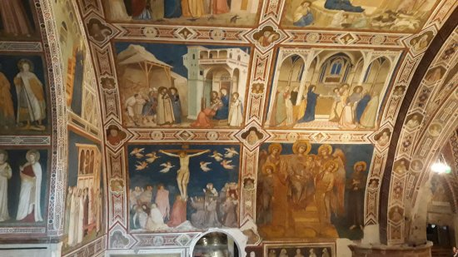
Showing off his cleverness, rather the word of God – giving a tour, rather than acting like a priest should
Admiring the artwork and intelligence of an artist, rather than the word of God
Stanza Two
Once again shows someone who was concerned with helping the less fortunate – contrasting with the priest and the church who are not helping the drwarf
A priest explained
how clever it was of Giotto
to make his frescoes tell stories
that would reveal to the illiterate
the goodness
of God and the suffering
of His Son. I understood
the explanation and
the cleverness
Disparaging Tone – looking down on people he should be helping
Reminds the reader of what the priest should be focussing on.
Critical of making the church commercial and the patronising nature of the priest
Ambiguous, could be referring to:
The cleverness of Giotto
Or the cleverness of the priest at commercialising church

Slide 14
Stanza Three
A rush of tourists, clucking contentedly,
fluttered after him as he scattered
the grain of the Word. It was they who had passed
the ruined temple outside, whose eyes
wept pus, whose back was higher
than his head, whose lopsided mouth
said Grazie in a voice as sweet
as a child's when she speaks to her mother
or a bird's when it spoke
to St Francis.
Think about:
What is your impression of the tourists?
What is the tourists’ impression of the beggar?
What is the poet’s opinion of the beggar?

Slide 15
Shows numbers and speed of tourists – only there to see the sights, no one is there to help
Extended metaphor – comparing the tourists to chickens, makes them seem mindless and easily manipulated by the priest’s attempts to take advantage of them
Stanza Three
The priest is paying attention to the tourists and not the beggar. St Francis would have wanted would have wanted him to pay attention to the beggar – more hypocricy.
Shows MacCaig sees himself as separate and different from the other tourists
A rush of tourists, clucking contentedly,
fluttered after him as he scattered
the grain of the Word.
It was they who had passed
the ruined temple outside, whose eyes
wept pus, whose back was higher
than his head, whose lopsided mouth
said Grazie in a voice as sweet
as a child's when she speaks to her mother
or a bird's when it spoke
to St Francis.
Word choice shows they have ignored the beggar and the message of St Francis of Assisi
Repetition of outside – again shows beggar is outside of society and ignored by the church
Contrast filled metaphor to describe the beggar – ruined refers to his ugly exterior, but temple implies he is just as beautiful and important as the church
Simile shows beggar’s inner beauty – he is as innocent and as beautiful as a child
The spirit of St Francis lies within the beggar. Concludes by re-empahasising important of message of St Francis

Slide 16
An Overview of the Stanzas
Poem of contrasts
Stanza One – Starts with description of beggar and moves on to reveal the message of St Francis. Reveals the suffering of the beggar
Stanza Two – Starts with description of the priests and moves on to show his anger at the hypocrisy of the church
Stanza Three – Starts with description of the tourists and their unthinking approach to the church and beggar. Shows the inner beauty of the beggar and the importance of the true message of St Francis.

Slide 17

Revision Tasks
To help you remember the key points of the poem you should:
Write a summary of the poem showing how the poet moves from experience to reflection.
Identify a key quote for each of the following points:
  The poet highlights the suffering of the beggar
  The poet reveals his anger and frustration at the priest
  The tourists mindlessly follow the priest
  The inner beauty of the beggar
Write down and analyse any images used

Slide 18
Practice Question 1
Look at stanza 1.
With reference to two examples of the poet’s language, explain how MacCaig makes the beggar’s appearance clear to us (4)

Slide 19
Practice Question 1 Answer

Slide 20
Practice Question 2
Look at stanza 2.
With reference to one example of the poet’s language, show the negative impression we are given of the priest. (2)

Slide 21
Practice Question 2 Answers

Slide 22
Practice Question 3
Look at stanza 3.
With reference to two examples of the poet’s language, explain how MacCaig makes it clear that the beggar is internally beautiful. (4)

Slide 23
Practice Question 3 Answers

