Slide 1
Basking Shark
Poetry of norman maccaig

Slide 2

Poet’s Main Idea
This poem is about a strange and unsettling encounter that MacCaig has with a Basking Shark
A Basking Shark is a very large shark - reaching sizes in excess of ten metres and weighing several tonnes.
They are harmless - having no true teeth - and therefore this shark wouldn’t have been a real threat to MacCaig.
As you can imagine encountering a shark like that in a small boat would be unnerving and scary.
The subject of the poem is never mentioned in the body of the poem itself, instead we infer from the title what the poet's small boat collided with that day.

Slide 3
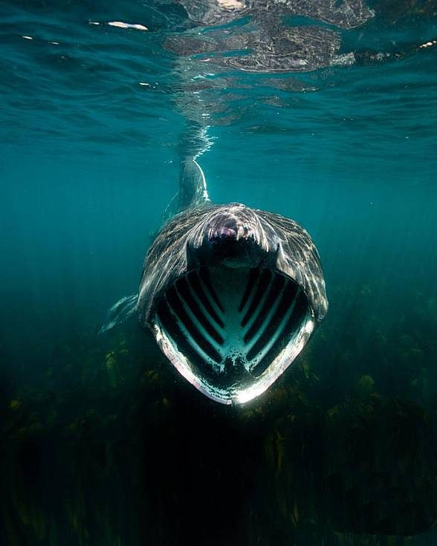
A Basking Shark

Slide 4
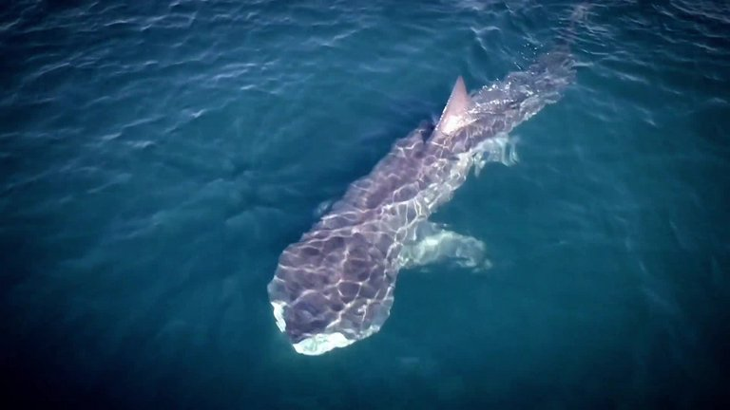
Reflective Nature of the Poem
In the interview ‘A Metaphorical Way of Seeing Things’, MacCaig maintained that poetry ‘clears your eyes and you see things’.
Like many of MacCaig’s poems, ‘Basking Shark’ moves from description to reflection. This experience leads the poet to reflect on his own and humanity’s relationship with the natural world and to ponder ‘Who’s the monster?’.

Slide 5

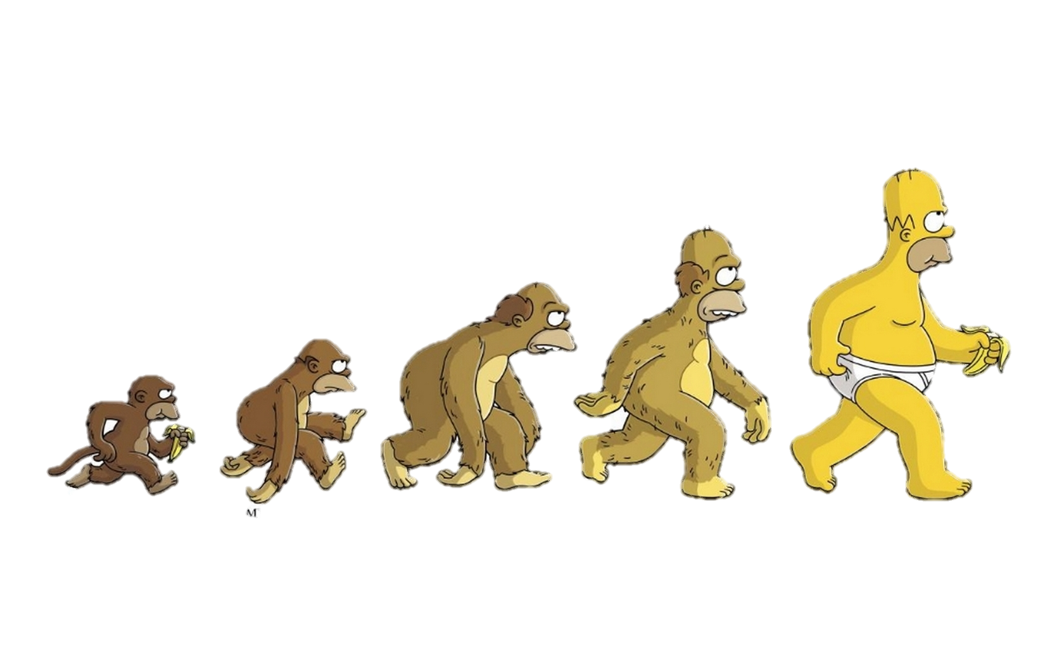
Theme
This encounter with a Basking Shark started him reflecting on evolution.
He thinks about how each species took a different evolutionary path:
  A shark unchanged for millions of years
  Humans who have evolved and changed vastly over a period of time
He then thinks about who is the monster in this encounter. Is it the shark who looks as large as a monster? Or is it himself, as a representative of the human race and all the evil that humanity is capable of?
The thought remains with the poet, unresolved, as the shark swims off.

Slide 6

Structure
This poem is set out in five stanzas.
Each stanza has three lines, and each line being end-rhymed with the others in the stanza.
The meter of the poem is also fairly regular: the first two lines of each stanza have five stressed syllables, while the final one has four. The effect of the final shorter stressed line is to create a sense of fitting closure to the stanza.
In this poem the tightness of structure serves to encapsulate the uniqueness of the experience, and the regularity of rhythm and rhyme matches the rhythmic quality of the rise and the fall of the sea itself, and likewise the steady pulling of the oars.

Slide 7
Stanza One
To stub an oar on a rock where none should be,
To have it rise with a slounge out of the sea
Is a thing that happened once (too often) to me.
Think about:
What happens in this stanza?
What is your first impression of the shark?
What is the effect of the parenthesis? (too often)

Slide 8
Repetition of ‘To’ actions – throw us right into the action of this memory
Metaphor comparing the shark to a rock – bulky/solid without feeling or intelligence. But also shows his initial feeling of confusion – He didn’t know what this was and thought it was a rock.
Stanza One
To stub an oar on a rock where none should be,
To have it rise with a slounge out of the sea
Is a thing that happened once (too often) to me.
Slounge – onomatopoeia – reflects the noise of waves and makes the shark’s movements sound clumsy
Although the poet is frightened he uses parenthesis to inject humour to make light of the situation – one time was already too many, continuing the initial portrayal of the encounter as negative

Slide 9
Stanza Two
But not too often - though enough. I count as gain
That once I met, on a sea tin-tacked with rain,
That roomsized monster with a matchbox brain.
Think about:
What point the poet is making about the encounter in the first line?
What is the impact of the description of the shark?

Slide 10
Repetition of ‘too often’ but this time with ‘not’ before. Shows that he has since changed his opinion from when he first said these words
Stanza Two
Emphasises that the experience is worthwhile, as opposed to frightening – explains reasons why in rest of poem
But not too often - though enough. I count as gain
That once I met, on a sea tin-tacked with rain,
That roomsized monster with a matchbox brain.
Met – experience is now not a shock, he views is as a pleasant meeting, almost humanises the shark
Metaphor – making it clear that, despite its large size, the creature has a small brain.
Contrast of these two quotes shows difference between physical and mental capacities
Speaker views himself as very different – smaller but smarter.
Metaphor:
Roomsized – emphasises terrifying size
Monster – reminds us of his initial fear of this animal, and how he views it as a lesser being

Slide 11
Stanza Three
He displaced more than water. He shoggled me
Centuries back - this decadent tow0nee
Shook on a wrong branch of his family tree.
Think about:
What does the poet start thinking about?
What is the effect of the word “shoggled”?
What is “family tree” a reference to?

Slide 12
Stanza Three
Metaphor – The shark didn’t just move the water, it also moved the man emotionally and made him rethink the place of humans in the world.
Use of colloquial words to describe the shark moving him, both physically and emotionally
He displaced more than water. He shoggled me
Centuries back - this decadent townee
Shook on a wrong branch of his family tree.
Shows he is thinking back to prehistoric times, to reconsider his place in the world
He is reminded that this shark too is part of our own family tree. Humans often think of themselves as above other creatures – but we are linked.
A negative view of himself: Describes himself as “decadent” he is spoilt and spends his time just enjoying himself. And “townee” makes it clear he no longer feels he has a place within nature.
He has evolved past the point where the shark still exists.

Slide 13
Stanza Four
Swish up the dirt and, when it settles, a spring
Is all the clearer. I saw me, in one fling,
Emerging from the slime of everything.
Think about:
What point is he making in first two lines?
What is “slime” a reference to?

Slide 14
Metaphor: When you displace dirty water, often you can see through it better once the dirt settles.
The dirt in this case is the murky thought of how humans evolved into what they now are. This encounter has moved him and helped him to see through the dirt, and understand better
Stanza Four
The onomatopoeic swish of the water repeats the idea of movement from the previous stanza.
Swish up the dirt and, when it settles, a spring
Is all the clearer. I saw me, in one fling,
Emerging from the slime of everything.
Emphasises the sudden nature of his thoughts and how one encounter can change your point of view
The primeval slime from which we and all other living organisms were created how the poet (and humans in general) are connected to every animal through evolution

Slide 15
Stanza Four
So who's the monster? The thought made me grow pale For twenty seconds while, sail after sail,
The tall fin slid away and then the tail.
Think about:
Why does the poet ask this question? What is his reaction to the question?
Has his opinion of the shark changed from stanza one?

Slide 16
Question - Referring back to calling it a monster in stanza 2. This creature is a considered a monster because of its size and appearance, but in a metaphorical sense, perhaps humans are the true monsters.
Stanza Five
The realisation that he is the true monster fills him with fear and anxiety
So who's the monster? The thought made me grow pale for twenty seconds while, sail after sail,
The tall fin slid away and then the tail.
But he doesn’t think about it for long – emphasises how man is the monster, as he is able to move on from a realisation like this
Shark’s movements are now described in an elegant way – a contrast to at the clumsy movements from the start of the poem, showing how the speaker’s outlook has changed

Slide 17
An Overview of the Stanzas
Stanza One – MacCaig describes the chance meeting with the shark and makes it clear it has happened before.
Stanza Two – the meetings have had an effect on him and he thinks back to one particular meeting.
Stanza Three – he begins to question his position in the evolutionary process.
Stanza Four – explains how indistinct humans were from other species at the beginning of the evolutionary process.
Stanza Five – his opinion of the shark changes and the poet reveals that he is not so sure of his own superiority over the rest of nature.

Slide 18

Revision Tasks
To help you remember the key points of the poem you should:
Write a summary of the poem showing how the poet moves from experience to reflection.
Identify a key quote for each of the following points:
  The poet views the shark as an unthinking animal
  The poet begins to question his beliefs because of this incident
  The poet realises that it is not the shark who is dangerous
  By the end of the poem the poet sees the beauty in the animal
Write down and analyse any images used

Slide 19
Practice Question 1
How does the writer’s use of language make the shark seem clumsy in lines 1-3? (2)

Slide 20
Practice Question 1 Answers

Slide 21
Practice Question 2
How does the writer’s use of language in lines 4-6 emphasise the differences between the shark and the speaker? (2)

Slide 22
Practice Question 2 Answers

Slide 23
Practice Question 3
Look at lines 7-12. How does the speaker make it clear that he and the shark are not as different as he first thought? (2)

Slide 24
Practice Question 3 Answers

Slide 25
Practice Question 4
Look at lines 13-15. How does the writer make it seem like the new perspective he gained during this encounter might be fleeting? (2)

Slide 26
Practice Question 4 Answers

