Slide 1
Aunt Julia
Poetry of norman maccaig

Slide 2

Poet’s Main Idea
MacCaig ‘s Aunt Julia lived in a remote Scottish island called Scalpay
She lived a traditional crofting life and only spoke Gaelic, which MacCaig didn’t.
Despite the fact that he didn’t speak Gaelic he had strong feelings of love and admiration of his aunt
MacCaig explores the anger and frustration at the barrier between him and his aunt, first through language and then when she dies
At the end of the poem he explores the finality of death and how he can no longer communicate with his aunt.

Slide 3
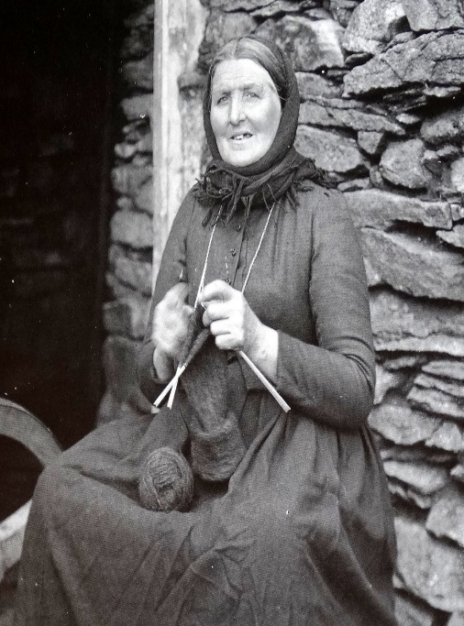
Traditional Crofting Woman

Slide 4
Reflective Nature of the Poem
In the interview ‘A Metaphorical Way of Seeing Things’, MacCaig maintained that poetry ‘clears your eyes and you see things’.
MacCaig reflects throughout the poem on the ways that we are connected to people through love and the different kinds of barriers that stop us communicating

Slide 5

Themes
Isolation due to communication barrier – he is unable to truly communicate with his aunt and learn from her.
Also shows that love can transcend any barrier shown through his obvious affection to his Aunt

Slide 6

Structure
First person
Free verse echoing the personality of Aunt Julia
Each stanza begins with a reference to Aunt Julia showing her importance

Slide 7
Stanza One
Aunt Julia spoke Gaelic
very loud and very fast.
I could not answer her —
I could not understand her.
Think about:
What do we learn about Aunt Julia in this stanza?
What do we learn about the poet in this stanza?
What is the relationship between the poet and his aunt?

Slide 8
Stanza One
The poem immediately begins with her name – showing her importance
Immediately introduces the language barrier, showing the issue and isolation
Repetition of “very” emphasises her personality: She is confident and an extrovert
Repetition of “very” emphasises her personality: She is confident and an extrovert
Aunt Julia spoke Gaelic
very loud and very fast.
I could not answer her —
I could not understand her.
Repetition to reinforce the barrier between them – the lack of ability to communicate is the issue to overcome and the cause of isolation. Repeating it makes him sound frustrated about this.

Slide 9
Stanza Two
She wore men's boots
when she wore any.
— I can see her strong foot,
stained with peat,
paddling with the treadle of the spinning wheel
while her right hand drew yarn
marvellously out of the air.
Think about:
What do we learn about Aunt Julia in this stanza?
What emotion does the poet have towards his aunt?
What does this tell you about Aunt Julia’s life?

Slide 10
Stanza Two
She is not conventionally feminine – she works so she prefers practicality over beauty
Powerful – shows the speakers admiration
She wore men's boots
when she wore any.
— I can see her strong foot,
stained with peat,
paddling with the treadle of the spinning wheel
while her right hand drew yarn
marvellously out of the air.
Shows her connection to her land.
Creates a vivid impression of how she looks and stained makes it clear she is out working often
Shows her connection to Scottish island life – she works with her hands and she is skilled at her work
Her skill is almost magic – shows his admiration again

Slide 11
Stanza Three
Hers was the only house
where I've lain at night
in the absolute darkness
of a box bed, listening to
crickets being friendly.
Think about:
What do we learn about Aunt Julia in this stanza?
What do we learn about where Aunt Julia lives?
How does MacCaig feel staying at her house?

Slide 12
Show the special bond between aunt and MacCaig – he has memories with her that he has no where else
Stanza Three
Hers was the only house
where I've lain at night
in the absolute darkness
of a box bed, listening to
crickets being friendly.
Word choice of absolute makes it clear how incredibly dark it is – but bond with aunt means he is not scared/worried
Reinforces that he is comfortable and happy staying with his aunt.
Creates a happy atmosphere
No full stops in this stanza,
creating a sense of pace and excitement, further emphasising the happy atmosphere

Slide 13
Stanza Four
She was buckets
and water flouncing into them.
She was winds pouring wetly
round house-ends.
She was brown eggs, black skirts
and a keeper of threepennybits
in a teapot
Think about:
What do we learn about Aunt Julia in this stanza?
What do we learn about where Aunt Julia lives?

Slide 14
Stanza Four
Metaphors – Shows the power and strength of her character: as sturdy as a bucket and as powerful as wind.
These are all natural metaphors: she is symbol of the land, nature and the elements
She was buckets
and water flouncing into them.
She was winds pouring wetly
round house-ends.
She was brown eggs, black skirts
and a keeper of threepennybits
in a teapot.
Makes it clear she works hard to avoid poverty and represents a hard-working life

Slide 15
Stanza Five
Aunt Julia spoke Gaelic
very loud and very fast.
By the time I had learned
a little, she lay
silenced in the absolute black
of a sandy grave
at Luskentyre. But I hear her still, welcoming me
with a seagull's voice
across a hundred yards
of peatscrapes and lazybeds
and getting angry, getting angry
with so many questions
unanswered.
Think about:
What do we learn about Aunt Julia in this stanza?
What is the final tone of the poem?

Slide 16
Repetition from first stanza makes us think it will be similar, however this stanza is darker than stanza one, so the repetition strengthens the dark and sad tone
Stanza Five
Tried to communicate but it was too late – relates to themes of isolation (he never got to communicate) and love (he tried because he loved her)
Contrast to the talkative and active life she had, it is sad to see her silent
Aunt Julia spoke Gaelic
very loud and very fast.
By the time I had learned
a little, she lay
silenced in the absolute black
of a sandy grave
at Luskentyre.
But I hear her still, welcoming me
with a seagull's voice
across a hundred yards
of peatscrapes and lazybeds
and getting angry, getting angry
with so many questions
unanswered.
Refers back to “absolute darkness” but this time she cannot provide comfort, so now the black makes us think of death and the grave
“But” shifts us away from the sad tone – the memories can bring us back to the happiness
Reinforces bond and love that they have – we have moved to a nostalgic and happy tone
Metaphor: she is loud and incomprehensible. Strengthens connection to nature
Repetition emphasises the anger and frustration that they will be forever isolated
Unanswered is emphasised through being on a line of its own. Sense of frustration about lack of communication and the things he will never know

Slide 17
An Overview of the Stanzas
Stanza One - introduces us to the subject of the poem- Aunt Julia.
Stanza Two - describes her physical appearance and the objects MacCaig most strongly associates with her.
Stanza Three - the perspective moves away from Julia to the way the poet felt when he visited her.
Stanza Four - MacCaig uses personification to create a sense of her character.
Stanza Five - The concluding stanza reflects on his own frustration that he was unable to communicate effectively with her while she was alive, whilst at the same time expressing his enduring affection and admiration for her.

Slide 18

Revision Tasks
To help you remember the key points of the poem you should:
Write a summary of the poem showing how the poet explores the feelings MacCaig has for his Aunt
Identify a key quote for each of the following points:
  MacCaig’s inability to communicate with his Aunt
  His Aunt’s enthusiasm and energy
  His Aunt’s connection to nature
  His despair and anger about her death
Write down and analyse any images used

Slide 19
Revision Question 1
Show how the writer’s use of language immediately introduces us to the main themes of the poem in line 1-4? (2)

Slide 20
Revision Question 1 Answers

Slide 21
Revision Question 2
Explain how the language used lines 5-16 make it clear that the speaker has a very positive opinion of Aunt Julia (4)

Slide 22
Revision Question 2 Answers

Slide 23
Revision Question 3
Show how the writer’s use of imagery in line 17-23 shows us some of the things the speaker admires about Aunt Julia (2)

Slide 24
Revision Question 3 Answers

Slide 25
Revision Question 4
Explain how the writer’s use of contrast in lines 23-37 show proves that he has had a mixed reaction to the death of Aunt Julia (4)

Slide 26
Revision Question 4 Answers

