Slide 1
BROOKLYN COP
Poetry of norman maccaig

Slide 2

Poet’s Main Idea
This poem is based on an experience MacCaig had in New York in 1968
He describes the physical appearance of the policeman and shows his violent and brutal side
In the poem he looks at the hidden vulnerable side of the cop.
He also looks at the urban city that the policeman works and explores the violence that is a fact of life to the policeman
He uses this to reflect on the wider issues of good and evil in society

Slide 3
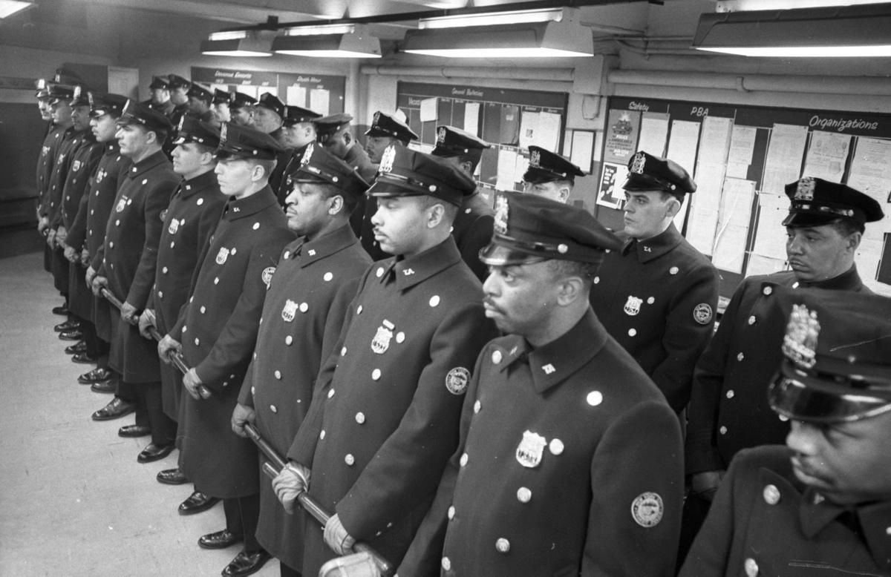
New York Policemen

Slide 4
Reflective Nature of the Poem
In the interview ‘A Metaphorical Way of Seeing Things’, MacCaig maintained that poetry ‘clears your eyes and you see things’.
Like many of MacCaig’s poems, ‘Brooklyn Cop’ moves from description to reflection. This experience leads the poet to reflect on the nature of policemen and who the reader should really feel sympathy for – the victims or the policeman.

Slide 5

Theme
Reflection on the nature of violence and the impact it has on people.
The policeman has been changed by the nature of his job and his fear that he may not return home to his wife
However he may sacrifice innocent lives to do his job and reveals the true impact of living in a violent city.
Shows the vulnerability of humanity.

Slide 6

Structure
Almost stereotypical cop at the beginning – strong/brutal/violent – but hints at a more tender side.
Show how quickly cop could be thrust from safety into chaos – violence is always present
Moves to a more reflective tone – showing impact of violence

Slide 7

Theme
MaCaig draws parallels between the cop and the violent criminals. He explores how contact with violence can change you and how complicated human nature is

Slide 8
Stanza One
Built like a gorilla but less timid,
thick‑fleshed, steak‑coloured, with two
hieroglyphs in his face that mean
trouble, he walks the sidewalk and the
thin tissue over violence. This morning,
when he said, "See you, babe" to his wife,
he hoped it, he truly hoped it.
He is a gorilla
to whom "Hiya, honey" is no cliché.
Think about:
How is the policeman described?
What two sides of the cop are shown?
What is your impression of the city?

Slide 9
Simile
Big and strong. Hints at violence and menace
Stanza One
WC:Emphasises that he is brutal – a gorilla is already not timid, so he must be very brutal to be even less timid
Imagery: Ancient stone carving, face is impassive and hard to read like hieroglyphics
Contrast to what a cop should be – open and honest to the public.
WC/description: Emphasises his tough masculine nature through mention of thick steak
Built like a gorilla but less timid,
thick‑fleshed, steak‑coloured, with two
hieroglyphs in his face that mean
trouble, he walks the sidewalk and the
thin tissue over violence. This morning
when he said, "See you, babe" to his wife,
he hoped it, he truly hoped it.
He is a gorilla
to whom "Hiya, honey" is no cliché.
Contrasting descriptions – the tough and hard literal sidewalk vs. the fragile metaphor describing society – easy and ready to break into violence
Repetition of hoped reveals the hidden fear he feels in his job – he fears he may not see her again
Reveals another side to the cop – a family man, it humanizes him
Simile from start repeated but now it is a metaphor – re-emphasises his savage and animalistic nature

Slide 10
Stanza Two
Should the tissue tear, should he plunge through
into violence, what clubbings, what
gunshots between Phoebe's Whamburger
and Louie's Place
Think about:
What is revealed about the cop’s personality?
What you learn about the violence in the city?
What is your impression of the city?

Slide 11
Repetition of should
Highlights the uncertainty of living in the city
Stanza Two
Imagery/WC: Emphasises the threat of violence that is always present and could break out as easily as a tissue ripping
Should the tissue tear, should he plunge through
into violence, what clubbings, what
gunshots between Phoebe's Whamburger
and Louie's Place
WC: Falling quickly and uncontrollably.
Cop is also on verge of violence, and it is like he cannot even control his violent urges
List – shows escalating violence, emphasising how dangerous the city is.
Suggests Mafia hangouts
Showing the disreputable places in the city

Slide 12
Stanza Three
Who would be him, gorilla with a nightstick,
whose home is a place
he might, this time, never get back to?
Think about:
What is the effect of the rhetorical question?
What you learn about the cop?
What do you learn about the job of being a policeman?

Slide 13
Stanza Three
Questioning: who would chose to do this job? To become this inhuman and violent person?
Metaphor is brought back to re-emphasise brutality
WC:Uses a baton as a weapon:
Doesn’t use a gun – enjoys physical violence/being up close
Who would be him, gorilla with a nightstick,
whose home is a place
he might, this time, never get back to?
Rhetorical q: The fear at the heart of the cop – that he may be killed and not come back to, another potential explanation for brutality – fear.
Home can also represent his sense of self – suggesting that one day he will be changed so much by his job that he will never be able to get his sense of self back.
Parenthesis: This fear comes back every night on the job – even though the worst never happens, each night could be the one where it does

Slide 14
Stanza Four
And who would be who have to be
his victims?
Think about:
What is the effect of the rhetorical question?
How these final lines conclude the poem?

Slide 15
Stanza Four
Rhetorial Q: Similar question as previous stanza – repeating the questioning idea, but this time asking about the people he targets
Command?:“have to” makes it sounds like they have no choice – repeating the idea that violence is inevitable in the city
And who would be who have to be
his victims?
There has been a sense that the cop is the one in danger throughout the poem, suggesting we should feel sympathy for him, but the final word choice of “victims” reverses this – instead emphasising that the cop is the violent aggressor, and we should feel sympathy for those he meets

Slide 16
An Overview of the Stanzas
Stanza One – Physical description of policeman. Shows contrast between his cop persona and his real life
Stanza Two – Focus on the violence underlying the society the man polices
Stanza Three – Reveals the vulnerability of the policeman and asks who would do such a job
Stanza Four – Rhetorical, ambiguous question. Forces the reader to think about who is the victim and who we should feel sympathy for.
As the poem progresses the stanzas get shorter and more condensed – reveals poets fragmented thinking

Slide 17

Starter – 10 Mins - Revision Tasks
To help you remember the key points of the poem you should:
Write a summary of the poem showing how the poet moves from experience to reflection. (No more than five sentences)
Identify a key quote for each of the following points (COPY AND COMPLETE):
  The policeman is a violent and brutal man
  The violence of the city is ever present
  The cop is vulnerable
  Being a policeman is a difficult and complicated job

Slide 18
Starter – Brooklyn Cop
Look at line 1-5
How does the poet create the sense that the cop is unapproachable in these lines? (4)

Slide 19
Practice Question 1 Answers

Slide 20
Practice Question 2
Look at line 6-16
How does the poet make it clear that the police has many concerns surrounding his job? (4)

Slide 21
Practice Question 2 Answers

Slide 22
Practice Question 3
Look at line 17-18
How does the poet provide a surprising ending to the poem? (2)

Slide 23
Practice Question 3 Answers

Slide 24
starter
Write down the three steps for answering the 8 mark question.

Slide 25
Brooklyn cop – 8 marker – 20 minutes
MacCaig very often uses particularly strange or unusual imagery in his poetry. Referring to this and at least one other poem, discuss some of his strange or unusual imagery.

Slide 26
commonality
In Brooklyn Cop MacCaig uses unusual imagery to dehumanize the police officer and make him seem animalistic. (1)
In Assisi, MacCaig uses unusual imagery to describe the beggar and the tourists that he sees. (1)

Slide 27
Primary text
“Built like a gorilla but less timid” (1)
– This simile opens the poem and immediately dehumanises the cop by comparing him to a gorilla. This is unusual because MacCaig states he is less timid than a gorilla – indicating that he is even more violent and aggressive than a wild animal (1)

Slide 28
Secondary text
MacCaig very often uses particularly strange or unusual imagery in his poetry. Referring to this and at least one other poem, discuss some of his strange or unusual imagery.
“slumped like a half filled sack” (1)
– This simile compares the beggar to a half filled sack. This is unusual because it indicates that he is shapeless, and similar to more of an empty shell of a human being. (1)
“tourists clucking contentedly, fluttered after him” (1)
– This metaphor is comparing the tourists to chickens. This is unusual because it implies the tourists have very small brains and cannot think for themselves, suggesting they can be easily manipulated. (1)

Slide 29
commonality
In Brooklyn Cop MacCaig uses unusual imagery to dehumanize the police officer and make him seem animalistic. (1)
In Basking Shark, MacCaig uses unusual imagery to describe the shark and the . (1)

Slide 31
Brooklyn cop – 8 marker – 20 minutes
MacCaig very often uses particularly strange or unusual imagery in his poetry. Referring to this and at least one other poem, discuss some of his strange or unusual imagery.

Slide 32
commonality
In Brooklyn Cop, MacCaig uses unusual imagery to dehumanize the police officer and make him seem animalistic. (1)
In Basking Shark, MacCaig uses unusual imagery to describe the shark and human evolution. (1)

Slide 33
Primary text
“Built like a gorilla but less timid” (1)
– This simile opens the poem and immediately dehumanises the cop by comparing him to a gorilla. This is unusual because MacCaig states he is less timid than a gorilla – indicating that he is even more violent and aggressive than a wild animal (1)

Slide 34
Secondary text
“roomsized monster with a matchbox brain” (1)
This metaphor makes it clear that, despite its large size, the creature has a small brain.
Contrast of this with the animal’s size shows difference between physical and mental capacities. Speaker views himself as very different – smaller but smarter. (1)
“Swish up the dirt and, when it settles, a spring is all the clearer” (1)
MacCaig uses a metaphor here to discuss human evolution. The dirt in this case is the murky thought of how humans evolved into what they now are. This encounter has moved him and helped him to see through the dirt, and understand better. (1)

