Slide 1
Hotel room
12th floor
Poetry of norman maccaig

Slide 2

Poet’s Main Idea
This poem is about a strange and unsettling experience that MacCaig has in New York
He describes what he sees and hears from his hotel room
He is a visitor to the city and reflects on the fear and violence lurking beneath the civilisation of the city
He shows the poverty and violence that is underneath the glamour and exuberance of New York
He uses this to reflect on the wider issues of good and evil in society

Slide 3
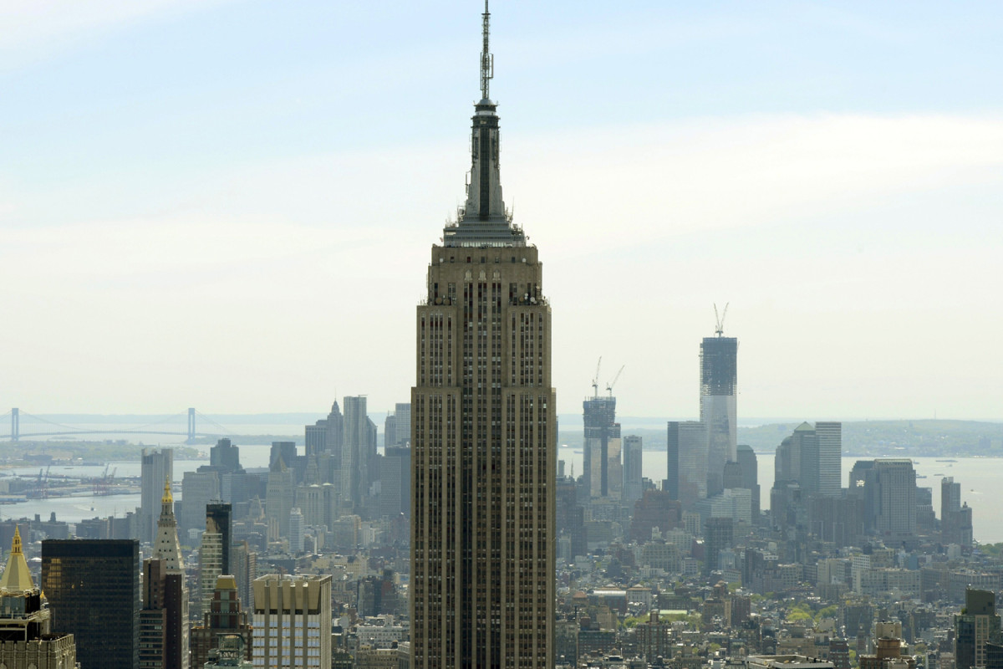
New York in the 1960s

Slide 4
Reflective Nature of the Poem
In the interview ‘A Metaphorical Way of Seeing Things’, MacCaig maintained that poetry ‘clears your eyes and you see things’.
Like many of MacCaig’s poems, ‘Hotel Room, 12th Floor’ moves from description to reflection. This experience leads the poet to reflect on society and the battle between good and evil which lies beneath our civilisation

Slide 5

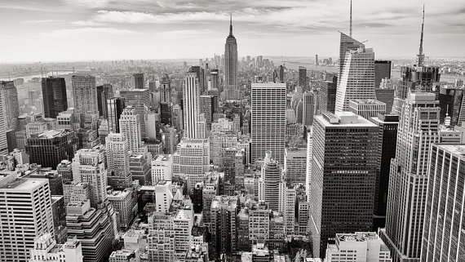
Theme
Attack on materialistic attitude of society - suggests violence is a product of materialism.
Wider comment being made on society – violence can break out easily and is never far away – on tv and films, but also on nearby streets.
Poor (in ‘coldwater flats’) are isolated and suffering in the midst of wealth and show.

Slide 6

Structure
Speaker is anxious and attacks the materialistic attitude of society.
Sense of fear – seems to be hiding in his room
Strong conclusion

Slide 7
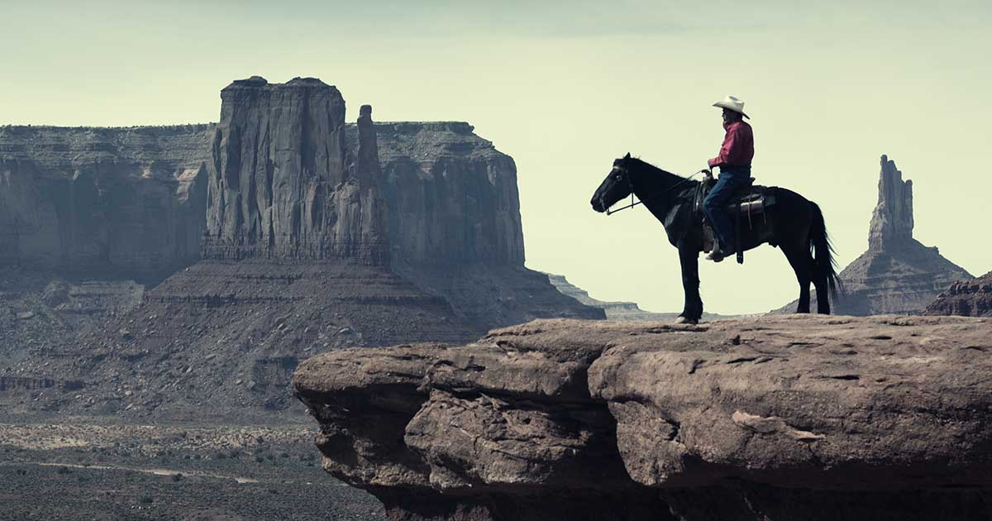
Extended Metaphor
Compares modern society to the American frontier or Wild West. (and Western films) shows uncivilised nature of violence on the streets.

Slide 8
Stanza One
This morning I watched from here
a helicopter skirting like a damaged insect
the Empire State building, that
jumbo size dentist’s drill, and landing
on the roof of the PanAm skyscraper.
But now midnight has come in
from foreign places. Its uncivilised darkness
is shot at by a million lit windows, all
ups and acrosses.
Think about:
What happens in this stanza? Is there a point where the stanza changes?
What is your impression of the city?
What mood or emotion is the poet feeling?

Slide 9
Symbol of technology that society is based on. It being there suggests something is wrong.
Sense of time.
Light and hopefulness
Passive – he is not taking part in what he sees
Visual
Stanza One
Annoying and broken
Unpleasant connotations
This morning I watched from here
a helicopter skirting like a damaged insect
the Empire State building, that
jumbo size dentist’s drill, and landing
on the roof of the PanAm skyscraper.
But now midnight has come in
from foreign places. Its uncivilised
darkness is shot at by a million lit windows,
all ups and acrosses.
Connotations of fear and pain
Was New York’s tallest building: symbol of wealth and power
Emphasis on height – ignores harsh reality “on the ground”
Uninvited. Just turned up (as violence does)
Turning point, day to night. Connection to darkness (and evil)
Darkness represents evil and unfamiliar danger
Unfamiliar/strange/ scary. Shows poets anxiety of unknown
Connotations of violence and crime
Window frames in the form of the cross – religious image, continues good vs evil
Contrast to the darkness – shows good vs evil theme. Light provides safety/clarity in darkness

Slide 10
Stanza Two
But midnight is not
so easily defeated. I lie in bed, between
a radio and a television set, and hear
the wildest of warwhoops continually ululating through
the glittering canyons and gulches -
police cars and ambulances racing
to the broken bones, the harsh screaming
from coldwater flats,
the blood glazed on sidewalks.
Think about:
What happens in this stanza?
What is your impression of the city? Has it changed from stanza one?
What mood or emotion is the poet feeling?

Slide 11
Signals that light (good) is losing the battle. Darkness (evil) is winning. Struggle is futile. Darkness will happen
Stanza Two
Passive/struggling to sleep. What is happening outside is affecting him inside
Wild West –comparing skyscrapers to the landscape of the West. Glittering makes it sound pretty
But midnight is not
so easily defeated. I lie in bed, between
a radio and a television set, and hear
the wildest of warwhoops continually ululating through
the glittering canyons and gulches -
police cars and ambulances racing
to the broken bones, the harsh screaming
from coldwater flats,
the blood glazed on sidewalks.
Change in focus from sight in stanza 1 to what he hears: Invading his space
Link to wild west (Native American warriors)
Shows chaos of outside, suggestion of violence and aggression
Bones represent the people – not seen as whole people but just the violence against them
Hints at emergency
Crime and people being hurt (violence). Racing emphasises the speed and chaos
Screaming suggests fear or panic. Harsh shows intensity.
Extreme amount of blood – covering sidewalk. The results of violence
Poverty – below the glittering skyscrapers, people live violent, desperate lives

Slide 12
Stanza Three
The frontier is never somewhere else.
And no stockades
can keep the midnight out.
Think about:
What happens in this stanza?
How does this stanza sum up the mood or feeling of the poet?
How does this stanza relate to the theme of the poem?

Slide 13
Concludes by linking back to Wild West comparison. A frontier is also the front line of a conflict.
Somewhere lawless and violent
Stanza Three
A barrier to keep out attackers from Wild West times. Comparable to modern technology and protections – none of it can help truly stop evil
The frontier is never
somewhere else. And no stockades
can keep the midnight out.
It can’t be avoided
Evil is around us and within us – we can never escape it
We may think we’ve advanced, but we are still in the chaotic Wild West
Ends on a pessimistic note
Resistance is futile. Just as the night always inevitably comes – Darkness and evil will always be around.

Slide 14
An Overview of the Stanzas
Stanza One – MacCaig describes the sights outside his hotel room. He is anxious about the violence that is always nearby but also attacks the materialistic viewpoint of New York
Stanza Two – MacCaig focusses on what he hears and reveals the violence and brutality of the night. Reflects that people are reduced to their injuries and lose their humanity
Stanza Three – Ends on a pessimistic tone. Reflects on what he as seen and heard but offers no hope or change to the violence and harsh reality of life.

Slide 15

Starter Tasks – Hotel Room 12th Floor
To help you remember the key points of the poem you should:
Write a summary of the poem showing how the poet moves from experience to reflection.
Identify a key quote for each of the following points (copy and complete):
  The poet views New York as a brutal and violent place
  MacCaig is anxious about the uncivilised nature of people after dark.
  The violence is harsh and unrelenting
  There is no escape from the evil of humanity

Slide 16
Practice Question 1
Look at line 1-10
With close reference to the poet’s use of language, explain how the writer uses contrast to show different aspects of the city in these lines. (4)

Slide 17
Practice Question 1 Answers

Slide 18
Practice Question 2
Look at line 11-19
With close reference to the poet’s use of language, show how MacCaig creates a sense of chaos within the city. (4)

Slide 19
Practice Question 2 Answers

Slide 20
Practice Question 3
Look at line 20-22
Explain how these final lines make it clear that negative things, like violence and suffering, are inevitable in the city. (2)

Slide 21
Practice Question 3 Answers

Slide 22
Practise 8 - marker
MacCaig often explores encounters with places, things or people who are far different from him. Referring to this poem and at least one other, show how he uses language in order to explore these differences (8)

Slide 23
Commonality
In Hotel Room 12th Floor, MacCaig explores how different the brutal surroundings of New York City and the violent tendencies of those who live there are.
In Basking Shark, MacCaig explores how different the speaker is and his views about himself in comparison to how he views the shark.

Slide 24
Folio / Practise 8 Markers
MacCaig often explores encounters with places, things or people who are far different from him. Referring to this poem and at least one other, show how he uses language in order to explore these differences (8)
Finish original from yesterday then use Hotel Room as Secondary
MacCaig’s poetry often includes very vivid impressions of people. Referring to this poem and at least one other, show how he creates these vivid impressions of people. (8)
Primary – Aunt Julia
Often, MacCaig elicits the reader’s sympathy for the people in his poems. Referring to one or two poems, show how he elicits the reader’s sympathy. (8)
Primary – Brooklyn Cop

