Slide 1
Essay Writing 101-’The Handmaid’s Tale’

Slide 2
Reading The Question

Slide 3
Reading The Question
The Process
Always read the question carefully, considering both parts.
Underline key words from it that you will use from the beginning of your essay right through to the end.
The starting point of your essay should focus on the question, not the text you have studied.
Pay attention to ‘the magic box’…
Answers to questions on Prose should refer to the text and to such relevant features as:
characterisation, setting, language, key incident(s), climax, turning point, plot, structure, narrative technique, theme, ideas, description…

Slide 4
Example
Check you’re looking at the right section!
Q type
Choose a novel or short story that deals with a theme of moral or social significance.
With reference to appropriate techniques, explain how the writer develops this theme and discuss why its development adds to your appreciation of the text as a whole.
Specific wording of Q-elevated from N5
Techniques from ‘magic box’
Personal response
Over course of novel
Refer to whole novel

Slide 5
Task
Go through the prose Qs on pgs 2-3 of your booklet, highlighting the key words and writing beside each Q what type of Q it is
COMMON TYPES OF Q
Character
Theme
Key incident
Conflict
Setting

Slide 6
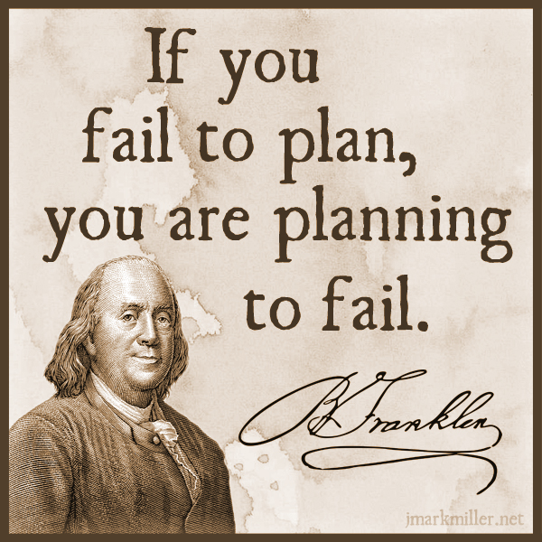
Planning Your Essay

Slide 7
Planning Your Essay
In an exam, it doesn’t hurt to make a small plan of action for your essay, to give yourself focus and ensure you stay on task
This could be a series of bullet points, a mind map or a few scribbles in a margin
It will help you structure your essay well and adhere to what the question is asking

Slide 8
Planning Tips
focus specifically on what is being asked-what type of Q, and what key aspects of the novel you are looking at-e.g. theme, character, key incident, conflict, etc.
think about the key moments in the novel that relate to your Q-key incidents, climax, etc
plan your essay chronologically-follow the order of the novel in order to show how a theme is developed, a character changes, conflict grows, etc.

Slide 9
Example
Check you’re looking at the right section!
Q type
Choose a novel or short story that deals with a theme of moral or social significance.
With reference to appropriate techniques, explain how the writer develops this theme and discuss why its development adds to your appreciation of the text as a whole.
Specific wording of Q-elevated from N5
Techniques from ‘magic box’
Personal response
Over course of novel
Refer to whole novel

Slide 10
Planning Essay-Theme
Key Moments
What Is The Theme?
HT Theme Essay
Writer’s message

Slide 11
Planning Your Essay-Next Steps
For each of the key moments identified, use your quotation booklet to find an appropriate quote
Each group will pick a specific quote for each key moment, and we will use these in the main body of our essay

Slide 12
HT Theme Essay Key Quotes

Slide 13
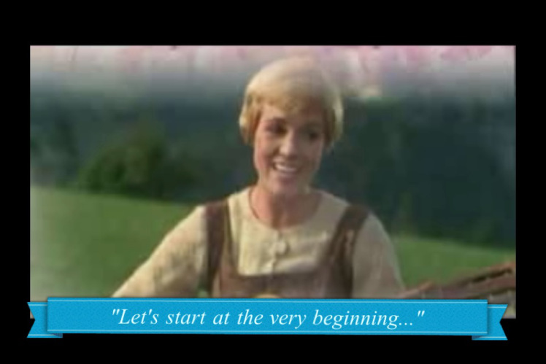
Writing Your Introduction

Slide 14
To write a good intro, you have to have TASTE
Your introduction to an essay should be fairly identical in any task, until you get to referring to the question and techniques
Use the TASTE acronym to help you remember what to include

Slide 15
TASTE
Title (name of text)
Author (who wrote text)
Summary (what happens, where, when)
Task (link to Q)
Explain techniques (how does writer do this?)

Slide 16
Example
Title (name of text)
Author (who wrote text)
Summary (what happens, where, when)
Task (link to Q)
Explain techniques (how does writer do this?)
Question
Choose a novel or short story or work of non-fiction which theme of moral or social significance.
With reference to appropriate techniques, explain how the writer develops this theme and discuss why its development adds to your appreciation of the text as a whole.
Introduction
‘Of Mice and Men’ by John Steinbeck is a novella set in 1930s California, which focuses on the life of working farm hands struggling to get by during a time of great poverty. This novella deals with the important social issues of the time in America, as a result of The Great Depression, focusing primarily on disillusionment with The American Dream, and the inability for many struggling Americans to achieve this goal. Steinbeck develops this theme through careful use of characterisation, key incident and symbolism.

Slide 17
What we can prep-TAS
We can very easily prepare for part of the introduction in advance, and use the same
Title
Author
Summary
section for every essay we write, making it easy for you to write a quick intro and move on to the main focus on your essay.
We can also make this a very high quality opening, getting the marker on side early!

Slide 18
Writing your TAS
Using your previous essays and the examples given in class, write a successful and impressive part-intro that includes:
Title-’The Handmaid’s Tale’
Author-Margaret Atwood
Summary (key words):
SUMMARY WORD BANK:

Slide 19
Model TAS
Title (name of text)
Author (who wrote text)
Summary (what happens, where, when)

Slide 20
Making it specific
So you have an amazing start to your intro. Now you need to show the marker that you are answering a specific question, and what in particular you intend to focus on
This is vital because if a marker can see your good intentions, and you don’t quite manage to complete everything you plan to write about, they will assume what you would have written would have been good!
Also, it helps to structure your essay and remind you of what to include

Slide 21
Adding the TE-EXAMPLE
Question
Choose a novel or short story or work of non-fiction which theme of moral or social significance.
With reference to appropriate techniques, explain how the writer develops this theme and discuss why its development adds to your appreciation of the text as a whole.
Example T.E
This novella deals with the important social issues of the time in America, as a result of The Great Depression, focusing primarily on disillusionment with The American Dream, and the inability for many struggling Americans to achieve this goal. Steinbeck develops this theme through careful use of characterisation, key incident and symbolism.
Task (link to Q)
Explain techniques (how does writer do this?)

Slide 22
Your Turn!
Question
Choose a novel or short story or work of non-fiction which theme of moral or social significance.
With reference to appropriate techniques, explain how the writer develops this theme and discuss why its development adds to your appreciation of the text as a whole.
T.E
What theme? Moral/social/both? Why?
Explain techniques-look back at chosen quotes
Task (link to Q)
Explain techniques (how does writer do this?)

Slide 23
Essay Writing 101- Writing FULLY in Main Paragraphs

Slide 24
Using the Structure
REMEMBER!
Point-(topic sentence-what are you writing about in this paragraph?)
Context- (when in the play does this take place? What’s going on at that point?)
Quotation-(appropriate evidence)
Explanation-(what does this quotation tell us? Explain key techniques used, why they are important)
Link to Q-(why is this important to your overall point? How does it relate to the wider ideas/themes?)

Slide 25
Making Your Point
Topic sentences are really important as they signpost your essay and help you to structure your writing
They remind you of what you are trying to say in the paragraph, and let the marker know what you intend to discuss
A topic sentence should include:
A linking word/phrase
A reference to the technique you will be analysing
A reference to the Q

Slide 26
Linking Words
Introducing an idea
-firstly -to begin
-primarily -initially
Contrasting an idea/argument
-in contrast -on the other hand
-in comparison -instead
Adding to an idea/argument
-additionally -furthermore
-in addition -also -moreover -in the same way
-as previously stated -similarly
Giving examples
-for example -for instance
-such as -by way of illustration
Concluding and summarising
-in conclusion -to conclude -lastly
-all in all -in summary -to sum up

Slide 27
Example
Question
Choose a novel or short story or work of non-fiction which theme of moral or social significance.
With reference to appropriate techniques, explain how the writer develops this theme and discuss why its development adds to your appreciation of the text as a whole.
Example topic sentence-MP1
Initially, Atwood introduces the theme of women’s subjugation through her use of characterisation when describing the Handmaid’s clothing.
A topic sentence should include:
A linking word/phrase
A reference to the technique you will be analysing
A reference to the Q

Slide 28
Your Turn
Question
Choose a novel or short story or work of non-fiction which theme of moral or social significance.
With reference to appropriate techniques, explain how the writer develops this theme and discuss why its development adds to your appreciation of the text as a whole.
QUOTE FOR MP1
EXAMPLE
Initially, Atwood introduces the theme of women’s subjugation through her use of characterisation when describing the Handmaid’s clothing.
A topic sentence should include:
A linking word/phrase
A reference to the technique you will be analysing
A reference to the Q

Slide 29
Example topic sentence
A topic sentence should include:
A linking word/phrase
A reference to the technique you will be analysing
A reference to the Q

Slide 30
Context
Your context is where you orientate your reader and let them know what’s happening in the novel. Include brief details about:
roughly where in the novel it takes place
briefly what is happening at this point in the novel
Example
At the beginning of the novel, Offred vividly describes the uniform prescribed for Handmaids:

Slide 31
Context Practice
OUR QUOTE
CONTEXT:
CONTEXT
Where in the play does this occur?
Briefly, what is happening at this point?

Slide 32
Choose Quotation
Your quotation is your evidence to back up the point you are trying to make about the text. It must clearly show something important about the novel, and must be relevant to the question asked.
Have you used quotations properly?
Use a colon : to introduce them
If longer than a few words, take a new line
No longer than one or two lines
They should illustrate a point not simply repeat it
Example:
It is clear she had no money: ‘Katie was heavy skint.’
MAKE SURE YOUR QUOTATIONS ARE WORTHWHILE!

Slide 33
Quotation for Your Paragraph
“_______________________”

Slide 34
Explanation
Your explanation should be the longest section of your paragraph. Here you will explain in detail how your quotation backs up your point, by:
analysing literary techniques used by the writer
making a personal comment
relating back to the question
Example sentence starters
Here, Atwood emphasises _____through her use of ____. The ____ used illustrates…

Slide 35
Words for linking analysis to quotes
The following words and phrases describe what the writer does, or what part of the text does.
They will help you to show that you are analysing the author’s work.
This…
reinforces emphasises highlights
foreshadows exemplifies explains
demonstrates echoes has connotations of
suggests show creates
mirrors establishes underlines
reveals hints illustrates

Slide 36
Example Explanation
Question
Choose a novel or short story or work of non-fiction which theme of moral or social significance.
With reference to appropriate techniques, explain how the writer develops this theme and discuss why its development adds to your appreciation of the text as a whole.
Example Explanation
“Everything except the wings around my face is red: the colour of blood, which defines us….The white wings too are prescribed issue, they are to keep us from seeing, but also from being seen.” pg 18(C2)
Here, Atwood emphasises the theme of women’s subjugation through her use of characterisation. The vivid description used illustrates the strict dress code of the Handmaids, containing very symbolic elements. The colour red is significant as it symbolises their fertility, but also acts as a warning that they are untouchable. The contrasting white symbolises their ‘purity’, particularly teamed with the idea of ‘wings’, hinting at an angelic quality. However despite wings often symbolising freedom, these ‘wings’ block the Handmaids’ vision, meaning they are trapped and kept ignorant from their position. The heavy covering of the Handmaid’s bodies is symbolic of the control Gilead has over women, and suggests that women’s bodies are seen as dangerous and tempting.

Slide 37
Writing Our Explanation
Example sentence starters
Here, Atwood emphasises _____through her use of ____. The ____ used illustrates…

Slide 38
Linking to the Q
In your final section of your main paragraph, you should:
Evaluate why your chosen quotation is important
Use wording from the question to make it clear your essay has a specific focus
Words that indicate a personal response
The following words and phrases describe how the reader feels, or how the text affects us as we read.
They will help you to show that you are evaluating the author’s work.
This is…
thought-provoking inspiring hard-hitting stimulating
fast-paced gripping profound important
skilfully done moving horrifying (a) pivotal moment
effective perceptive striking thoughtful

Slide 39
Example Link to Q
Example
Atwood’s intriguing use of characterisation here demonstrates the complete control Gilead have over women in society in the novel, as symbolised in the enforced uniform of the Handmaids.
Sentence Starter
Atwood’s (personal response word) use of (technique) here emphasises/demonstrates/conveys….
*Link to Q-conflict/rejection of another character; consequences on play as a whole*

Slide 40
Full Main Paragraph Example
Initially, Atwood introduces the theme of women’s subjugation through her use of characterisation when describing the Handmaid’s clothing. At the beginning of the novel, Offred vividly describes the uniform prescribed for Handmaids:
“Everything except the wings around my face is red: the colour of blood, which defines us….The white wings too are prescribed issue, they are to keep us from seeing, but also from being seen.” pg 18(C2)
Here, Atwood emphasises the theme of women’s subjugation through her use of characterisation. The vivid description used illustrates the strict dress code of the Handmaids, containing very symbolic elements. The colour red is significant as it symbolises their fertility, but also acts as a warning that they are untouchable. The contrasting white symbolises their ‘purity’, particularly teamed with the idea of ‘wings’, hinting at an angelic quality. However despite wings often symbolising freedom, these ‘wings’ block the Handmaids’ vision, meaning they are trapped and kept ignorant from their position. The heavy covering of the Handmaid’s bodies is symbolic of the control Gilead has over women, and suggests that women’s bodies are seen as dangerous and tempting. Atwood’s intriguing use of characterisation here demonstrates the complete control Gilead have over women in society in the novel, as symbolised in the enforced uniform of the Handmaids.

Slide 41
HOMEWORK
For Weds 15th January
Finish 4 MPs of ‘Handmaid’s Tale’ theme essay
We will complete the conclusion in class together

Slide 42
Essay Writing 101- Writing a Successful Conclusion

Slide 43
Concluding-SERVE
In your conclusion you should:
Summarise the points you have made
Evaluate writer’s message (link to themes)
Refer back to the question
Vary your expression (don’t repeat yourself)
Express an opinion (appreciation of text)

Slide 44
Example
Summarise the points you have made
Evaluate writer’s message (link to themes)
Refer back to the question
Vary your expression (don’t repeat yourself)
Express an opinion (appreciation of text)
Question
Choose a novel or short story or work of non-fiction which theme of moral or social significance.
With reference to appropriate techniques, explain how the writer develops this theme and discuss why its development adds to your appreciation of the text as a whole.
Example Conclusion
Ultimately, The American Dream is seen as an unobtainable goal within Steinbeck’s novel reflecting the difficulties of this time period and great despair felt by the working man. Through Steinbeck’s skilful use of characterisation, symbolism and key incident, this theme makes a powerful impact on the reader, allowing them to share the disillusionment felt by Lennie and George.

Slide 45
Your Turn!
Using the example and SERVE structure, write a conclusion for your homework essay on the Q below:
Choose a novel or short story or work of non-fiction which theme of moral or social significance.
With reference to appropriate techniques, explain how the writer develops this theme and discuss why its development adds to your appreciation of the text as a whole.
Techniques analysed-
Writer’s message-women’s subjugation
Opinion-what did you learn/gain?-DO NOT USE I-”the reader”, “the audience”
Summarise the points you have made
Evaluate writer’s message (link to themes)
Refer back to the question
Vary your expression (don’t repeat yourself)
Express an opinion (appreciation of text)

Slide 46
Reviewing Your Work

Slide 47
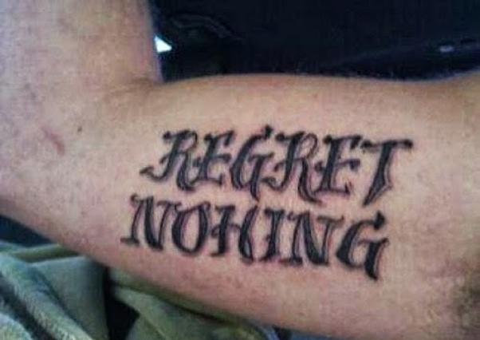
Spelling
Ensure all words are spelt correctly, to the best of your ability
Check carefully for spellings of author names, key terminology and key words in the novel
If you can’t spell it, don’t use it!

Slide 48
Punctuation and Grammar
Ensure you are structuring your sentences properly using full stops and commas-don’t let them ramble on!
Look back at advice for structuring quotations-ensure this is done properly
Again, if you don’t know how to use it, don’t use it! E.g. don’t use a semi-colon if you don’t know why it’s used.
PARAGRAPHING-follow the structure and you’ll do fine!

Slide 49
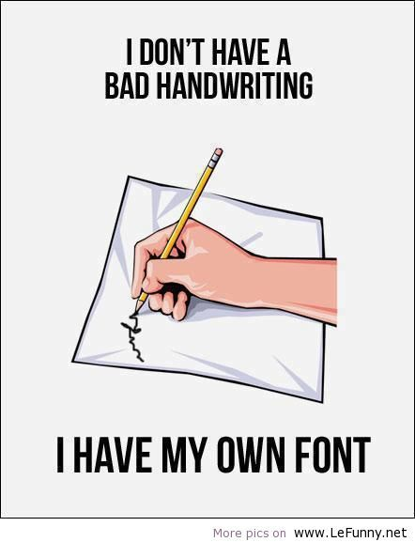
Presentation
Take time to ensure your handwriting is legible-not just to you, but to others!
Make sure spacing and size of lettering is appropriate
To emphasise changes in paragraphs, miss a line before beginning a new one

Slide 50
Clarity of Expression

