Slide 1
The Way My Mother Speaks
Scottish Set Text

Slide 2
Imagine…
You have been offered your dream university course/job
However…it is in London
What would you miss most?

Slide 3
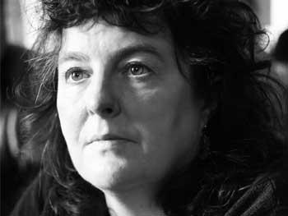
Duffy’s Experience
Duffy was born in Scotland to a Scottish father and Irish mother
As a child she moved to Stafford (‘Originally’)
She moved to Liverpool (1 hr 30 mins from Stafford) for university
She then moved to London to progress her writing career (‘The Way My Mother Speaks’)

Slide 4
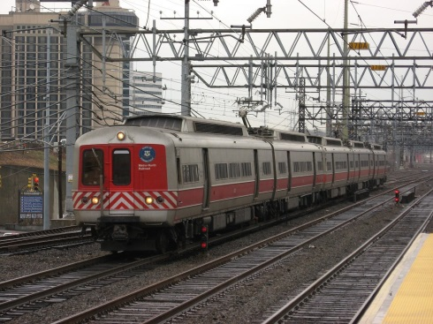
Journey
Like in ‘Originally’, this poem refers to a journey-the speaker travelling away from home to somewhere new
This experience causes conflicted emotions-why might this be?
Positives Negatives

Slide 5
The Way My Mother Speaks
In this poem, Duffy explores the ideas of:
moving somewhere new
Losing something important
Mixed emotions
nostalgia

Slide 6
DEADLINES
WEDS 30th OCT
Theme paragraphs (Notes on GLOW); read ‘Handmaid’s Tale’ Chapters 40-45
FRI 1ST NOV
Mini deadline-plan for creative if you want it checked

Slide 7
Complete understanding Qs on ‘The Way My Mother Speaks’

Slide 8
Understanding The Poem
Scottish Set Text

Slide 9
Understanding The Poem
How does the writer’s use of language create a sense of isolation and loneliness in lines 1-4?
Look at the writer’s description of the journey in lines 6-8. What impression do you get of the journey?
How does the writer use colour to emphasise mood in line 9?
Look at lines 10-12, and line 14. Why do you think there is repetition here?
Look at lines 13 and 16. What technique is being used here, and why has Duffy used this?
Analyse Duffy’s use of imagery in lines 16-20.
In lines 5 and 21, Duffy repeats the same phrase “The day and after”. Why do you think she repeats this oddly worded expression?
Look at lines 22-23. What is interesting about Duffy’s choice of adjectives here? How does this create an effective ending to the poem?

Slide 10
Annotating the Poem
The Way My Mother Speaks

Slide 11
DEADLINES
WEDS 6th NOV
Read ‘The Handmaid’s Tale’ chapter 46 and HN
FRI 8th NOV
Creative folio first draft due

Slide 12
Using Ipads to annotate
I will Airdrop a copy of the poem via Classroom (join using code on the board)
Each group will be given specific lines to annotate and send back to me
When annotating, remember to:
Highlight key/interesting words
Underline poetic techniques
Include detailed notes explaining effect of techniques

Slide 13
Sections
SEAN, ANTON, VINCENT-lines 1-5
KELVIN, JEAN, MATTHEW-lines 6-9
AMEILIA, DYLAN, CONNOR, ADAM-lines 10-14
SKYE, LIZZY, MARYAM-lines 15-20
ABBIE, SOPHIE, ERIN, LEIGHRAH-lines 20-23
MATTHEW, ELLIE, RHIANNON-lines 10-14
AMY, NESSE, PEACE, NIAMH-lines 15-20
LOUIE, LUKE-lines 20-23

Slide 14
Paired Annotation
This is a tricky poem-often shorter poems are harder to understand, as the poet relies more on techniques to get their meaning across, rather than detailed explanation
With a partner, try to:
Underline poetic techniques used
Highlight interesting words used
Identify techniques and analyse

Slide 15
Key Techniques
Scottish Set Text

Slide 16
Key Poetic Techniques
In this poem, Duffy uses a range of poetic techniques to convey her experience and emotions about leaving home
The main techniques she uses are…?
We will analyse some key examples fully, to ensure you give detailed answers in your TA responses at Higher (remember-2 marks for analysis, none for quoting!)

Slide 17
Key Poetic Techniques
Repetition
Contrast
Imagery
Symbolism

Slide 18
Example | Technique | Analysis
“The day and ever. The day and ever.” | repetition | Odd sentence construction-mother’s phrasing-repeats in order to soothe self; mimics rhythmic nature of train moving
…the right sky/too blue swapped for cool grey”
“nothing is silent. Nothing is not silent.”
“what like is it….what like is it”
“I am happy and sad/like a child/who stood at the end of summer/and dipped a net/in a green, erotic pond.”
“I am homesick, free, in love /with the way my mother speaks”
Repetition
Contrast
Imagery
symbolism

Slide 19
Key Techniques in ‘The Way My Mother Speaks’
Example | Technique | Analysis
“The day and ever. The day and ever.” | repetition | Odd sentence construction-mother’s phrasing-repeats in order to soothe self; mimics rhythmic nature of train moving
…the right sky/too blue swapped for cool grey”
“nothing is silent. Nothing is not silent.”
“what like is it….what like is it”
“I am happy and sad/like a child/who stood at the end of summer/and dipped a net/in a green, erotic pond.”
“I am homesick, free, in love /with the way my mother speaks”

Slide 20
DEADLINES
WEDS 6th NOV
Read ‘The Handmaid’s Tale’ chapter 46 and HN
FRI 8th NOV
Creative folio first draft due

Slide 21
Key Themes
Scottish Set Text

Slide 22
DEADLINES
TODAY
Overdue Folios:
Nesse
Niamh
Louie
Ellie
Sophie
Anton
Peace
Lizzy
Rhiannon
WEDS 13TH NOV
Finish Link Qs for R4UAE

Slide 23
Duffy’s Major Themes
Look back at the list of themes in Duffy’s work, discussed at the beginning of the course.
Which themes are present in ‘The Way My Mother Speaks’?
Memory-childhood, lost love, preserving memories
Time-past-pleasant and haunting; inability to return to past; decay; losing time
Love and relationships-passion and desire; heartbreak
Isolation-socially, emotionally
Truth-honesty, bluntness
Any other themes not previously mentioned?

Slide 24
Themes in ‘The Way My Mother Speaks’
Memory
Isolation
Time
Nostalgia

Slide 25
Exploring the Key Themes-Carousel
The class will be split into groups
Each group will look at a particular theme for a set time
Each group within a time limit will explore a different aspect of that theme:
Theme definition-what does “memory” etc mean in terms of this poem?
Quotation 1-choose a quotation that demonstrates this theme, and analyse in detail
Quotation 2-choose a quotation that demonstrates this theme, and analyse in detail
Poet’s overall message-what is Duffy trying to say about this theme?
We will combine these elements to create detailed theme notes for revision

Slide 26
Groups
SIDE 1
Memory-V, S, A
Isolation-J, K, M
Time-A,C,D,A
Nostalgia-M, L, S
SIDE 2
Memory-E, L, A, S
Isolation-M, R, E
Time-P, N, N, A
Nostalgia-L, L

Slide 27
Round 1
TITLE-
“________” in ‘The Way My Mother Speaks’
Theme definition-what does “_______” mean in relation to ‘TWMMS’?

Slide 28
Round 2
QUOTATION-Find a quotation that shows that theme

Slide 29
Round 3
ANALYSIS-analyse the quotation the previous group have given:
What poetic techniques are used, and analyse these
How does it link to the theme?

Slide 30
Round 4
QUOTATION
Find another quotation that shows that theme
Underline/highlight important words/techniques for next group to analyse

Slide 31
Round 5
ANALYSIS-analyse the quotation the previous group have given:
What poetic techniques are used, and analyse these
How does it link to the theme?

Slide 32
Round 6
OVERALL MESSAGE-What point is Duffy making about your theme?

Slide 33
Round 7
FINISHING TOUCHES-add detail to any unfinished/weak sections; double check information

Slide 34
Links to other poems
What does ‘Originally’ have in common with other poems we have studied?
Your pair will be given one of the poems to compare with ‘Originally’.
Indicate all the links between the two poems, using evidence to back it up
Consider:
Common themes
Similar use of techniques
Speaker voice

Slide 35
DEADLINES
TODAY
Overdue Folios:
Niamh
Louie
Ellie
Rhiannon
WEDS 13TH NOV
Finish Link Qs for R4UAE
Supported study on today 2.40-3.30pm

Slide 36
Links to Other Poems
Scottish Set Text

Slide 37
Linking Poems
TWMMS
Originally
IMTC

Slide 38
Linking Poems
TWMMS
Originally
IMTC

Slide 39
Linking Poems
TWMMS
Originally
IMTC
COMMONALITIES
Identity
Nostalgia
Memory
Time
Imagery
First person narration/personal experience

Slide 40
Preparing for TA
Next Monday you will complete a textual analysis on ‘The Way My Mother Speaks’, including a 10 mark Q
Each group will prepare notes for a different 10 mark Q

Slide 41
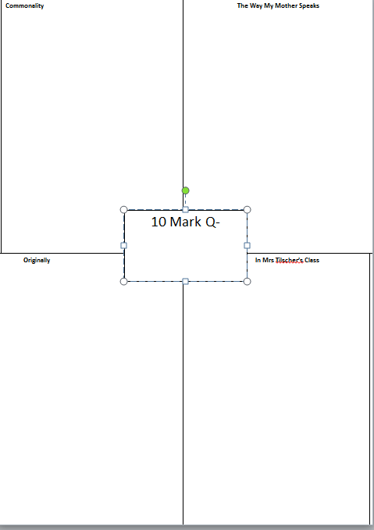
Explain how each poem links to theme/uses technique
2 quotes from poem-QTAL
2 quotes from poem-QTAL
2 quotes from poem-QTAL

Slide 42
Next Monday 18th Nov
Textual analysis practice assessment on ‘TWMMS’-without notes!
It will include a 10 mark Q-be prepared!
Review:
Notes on TWMMS
Links between poems notes-given tomorrow
10 mark Q structure sheet

Slide 43
‘TWMMS’ Textual Analysis Practice
Scottish Set Text

Slide 44
Textual Analysis-Tips!
Treat it like a close reading!
Bullet point answers
Number of marks=number of points
Understanding Qs
Use own words where possible
Identify themes where asked
Summarise key events briefly
Analysis Qs
Quote/Identify key techniques (W.C., S.S., Imagery, Tone, poetic techniques)
Explain analysis
link to question

Slide 45
Textual Analysis Review
We will review and discuss our responses to the textual analysis, to help you identify:
Areas where you are having success
Areas where you need more support

Slide 46
Prelim/Assessment Prep
Scottish Set Text

