Slide 1
For Tomorrow
Persuasive Topic Proposal (given out on Thurs, set as work on Fri)
If you did not receive one, let me know!
Must be a different topic from your N5 piece

Slide 2
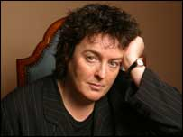
Carol Ann Duffy
Scottish Set Text-Textual Analysis

Slide 3
What is the Scottish Text Study?
In class
Part of your critical reading study
You will study a series of poems by a Scottish poet (six poems in total), analysing key language features and ensuring you have a good understanding of the common themes in their work
In exam
Part of critical reading paper, alongside critical essay (1hr 30mins)
You are given one of the poems you have studied in class
You will answer questions based on that poem (textual analysis), looking at the language, themes, characters etc.
You will then compare the extract to another poem you have studied, in an 10 mark extended question
NO MARKS FOR QUOTING AT HIGHER!

Slide 4
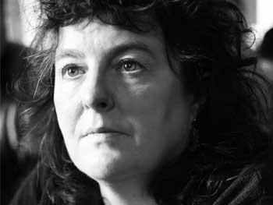
Who Is Carol Ann Duffy?
Born in Glasgow 1955, moved to Stafford aged 6.
Critically acclaimed as well as popular with readers.
One of the best known and most celebrated of living poets, Duffy was appointed Poet Laureate in 2009, the first female, and first LGBT poet, to hold the position.
As well as being Poet Laureate, Duffy is currently the Director of the Writing School at Manchester Metropolitan University.

Slide 5
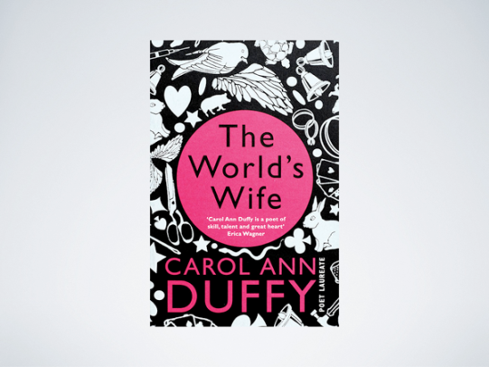
Her Work
She says she uses “simple words in a complicated way.”
Duffy’s poems often explore political, philosophical and social issues, especially issues centring on gender, identity and inequality.
Duffy is particularly known for her exploration of feminine archetypes, the subversion of gender stereotypes and her dramatic monologues.
These monologues are often written in the voices of characters marginalised or demonised by mainstream society.
A lapsed Catholic for whom poetry is very close to prayer, for Duffy, in each of her poems she is “trying to reveal a truth”.

Slide 6
https://www.youtube.com/watch?v=wnt5p1DGD9U

Slide 7
Major Themes in Duffy’s Writing
Duffy’s poetry focuses on specific themes
What do we mean when we talk about theme?

Slide 8
Major Themes in Duffy’s Writing
A theme is…the big idea/message within a piece of writing.
Writer may be making a grand statement/expressing their opinion on:
An aspect of human nature
A group of people
An aspect of society
A key topic

Slide 9
Major Themes in Duffy’s Writing
Memory-childhood, lost love, preserving memories
Nostalgia-a longing for the past; inability to return to past; losing time
Love and relationships-passion and desire; heartbreak; familial love
Isolation-socially, emotionally
Female voice-characters and female myths
Truth-honesty, bluntness

Slide 10
Poems
In Mrs Tilscher’s Class
Originally
The Way My Mother Speaks
Valentine
Mrs Midas
War Photographer

Slide 11
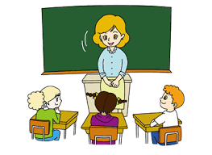
In Mrs Tilscher’s Class
Scottish Set Text

Slide 12
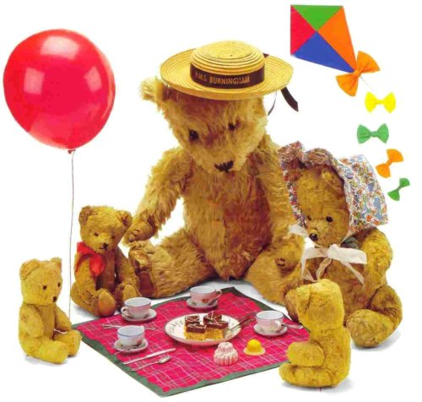
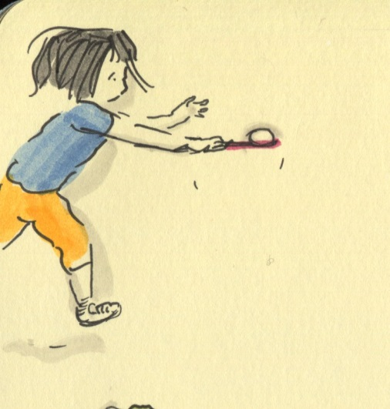
Primary School Memories
What feelings do you associate with being in primary school, particularly the younger years (P1-3)?
What memories do you have of this time?

Slide 13
Your Favourite Teacher
Think back again to primary school. Can you remember your favourite teacher?
What age/stage were you when you had this teacher?
Why were they your favourite?

Slide 14
Primary Vs. Secondary
Do the relationships you have with your teachers change from primary to secondary?
How? Explain 3 ways in which they are different
Primary | Secondary

Slide 15
‘In Mrs Tilscher’s Class’
In this poem, Duffy looks back at her last year at primary school, reflecting on:
her memories of school and her favourite teacher
feelings at that time
Sense of growing older and maturing

Slide 16
Stanza Summary
This poem has 4 stanzas, each of which focus on a different idea of being at school.
Summarise in your groups what each stanza is about

Slide 17
Our Stanza Summary
Stanza 1- what it feels like to be in a lesson taught by Mrs Tilscher
Stanza 2-the classroom environment, the safety and love felt by the children
Stanza 3-the children begin to grow and mature
Stanza 4-leaving school, moving on, growing up

Slide 18
Our Stanza Summary
Stanza 1-Describing setting of classroom/typical lesson
Stanza 2-pleasant sensory description of classroom-safety, comfort
Stanza 3-chaos of primary playground, growing up and maturing
Stanza 4-leaving primary school, ready for change-growing up

Slide 19
Due Today
Persuasive Topic Proposal (given out on Thurs, set as work on Fri)

Slide 20
Getting Organised For Higher-Tips
Use different folders or workbooks for different parts of the course-R4UAE, TA, Critical Essay, Folio. Label them clearly
Keep a copy of weekly schedule for English on phone to save having to bring everything everyday-take photo of next slide!
Set reminders in phone of deadlines e.g. “1 week until persuasive first draft due” to ensure you are on track
Get own copy of class novel (‘The Handmaid’s Tale-Margaret Atwood’) so you can label and highlight it to save rummaging for quotes every time
Regularly check GLOW site (https://blogs.glowscotland.org.uk/gc/missinnes/) for missed notes if absent or to help with work at home

Slide 21
Structure of Week
Monday P2-Scottish Set Text (Carol Ann Duffy Poetry)
Tuesday P1-Scottish Set Text (Carol Ann Duffy Poetry)
Wednesday P3&4-Critical Essay- ‘The Handmaid’s Tale’
Thursday P5-R4UAE
Friday P6-R4UAE/Folio

Slide 22
Understanding The Poem
Scottish Set Text

Slide 23
Our Stanza Summary
Stanza 1- what it feels like to be in a lesson taught by Mrs Tilscher
Stanza 2-the classroom environment, the safety and love felt by the children
Stanza 3-the children begin to grow and mature
Stanza 4-leaving school, moving on, growing up

Slide 24
Understanding The Poem
For each poem, you will initially answer some understanding question to ensure you grasp the basic PLOT and IDEAS of the poem
These questions will also provide some analysis work on the poem
You will answer in full sentences as far as possible

Slide 25
Example Question
Look at lines 1-5. What kind of atmosphere is created in Mrs Tilscher’s classroom, in the opening of the poem?
In the opening lines of ‘IMTC’, the poet uses imagery to create an atmosphere of wonder and authenticity: “You could travel up the Blue Nile/with your finger.” This suggests the teacher brings the lessons to life for pupils, and creates vivid images in their minds of far-off places.

Slide 26
Example Question
Look at lines 1-5. What kind of atmosphere is created in Mrs Tilscher’s classroom, in the opening of the poem?
The atmosphere in Mrs Tilscher’s classroom is one of endless possibilities, as she brings the lessons to life : “You could travel up the Blue Nile/with your finger.”

Slide 27
Understanding The Poem
2. How does Duffy create a playful and joyous setting in lines 6-10? Quote an example and explain.
Duffy uses the expression “the laugh of a bell swung by a running child” to create a playful and joyous setting, as this suggests the children are filled with happiness and excitement in the classroom.
3. How does Duffy create an overwhelmingly positive view of the classroom in her description in lines 11-14? Quote an example and explain.
Duffy creates an overwhelmingly positive view of the classroom in her use of “the classroom glowed like a sweetshop”. This suggests that the classroom is a place that the kids want to be, a place of joy, excitement, appealing.

Slide 28
Understanding The Poem
4. How does Duffy create a strong image of Mrs Tilscher in lines 16-17? Quote an example and explain.
5. How does Duffy create a sense of change in lines 20-24? Quote an example and explain.
6. Look at stanza 4 (lines 28-34). How does Duffy use the weather to predict/reflect the changing behaviour of the pupils? Quote an example and explain. Do you know what this technique is called?
7. How does the writer create a sense of finality and moving on in lines 31-32? Quote an example and explain.
8. What is Duffy’s overall message about school in this poem?

Slide 29
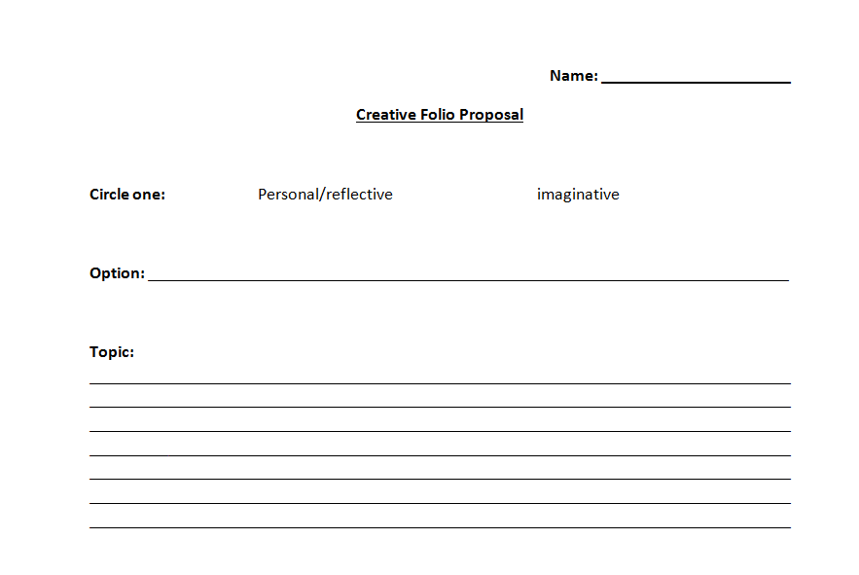
HOMEWORK REMINDER
Creative folio proposal-due Weds 29th Aug

Slide 30
Annotating The Poem
Scottish Set Text

Slide 31
What is annotating?
Annotating means…to add notes to a text or diagram, giving explanation or comment

Slide 32
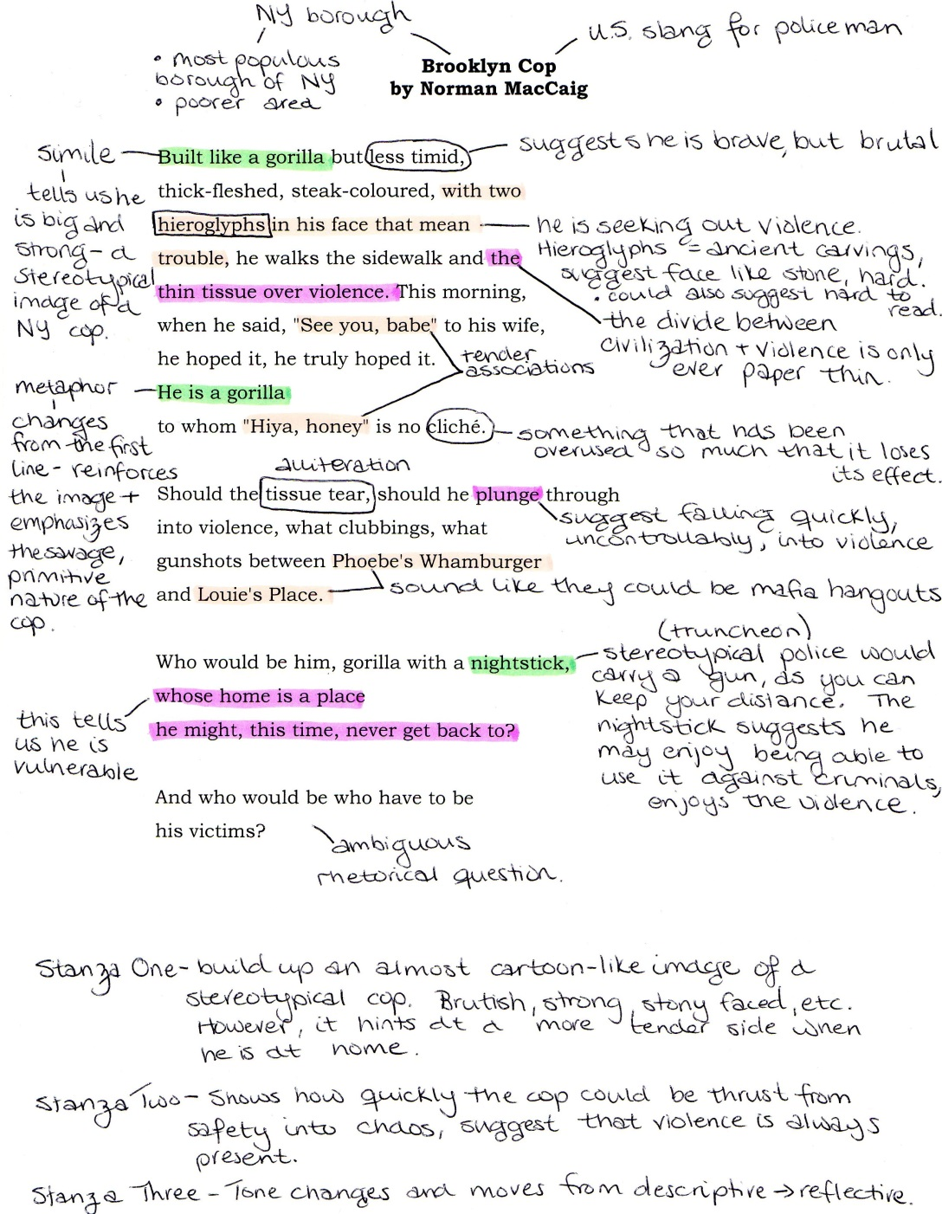
An Annotated Poem

Slide 33
Poetic Techniques Cheat Sheet
Using your bingo card, match the name of the technique up to the definition and example
This will be your bible for textual analysis!

Slide 34
Poetic Techniques
theme
Alliteration
Pathetic fallacy
Onomatopoeia
Contrast
Repetition
hyperbole
Metaphor
Tone
Enjambment
Symbolism
Rhyme
Synecdoche
Assonance
Litotes
Rhetorical Question
personification
Simile

Slide 35
Technique | Definition | Example
 | The implied attitude of a writer toward the subject | Sarcastic, excited, negative, positive, amused, humorous
 | Understatement | (when referring to a deep wound) “Oh, it’s just a scratch”
 | The big idea in a poem | The power of love; the importance of family; the danger of greed
 | The repetition of consonant sounds, especially at the beginning of words | Incredible Innes
 | An object or action in a literary work that means more than itself, that stands for something beyond itself. | A rose representing love
 | A sentence that continues onto the next line in a poem | That's my last Duchess painted on the wall, Looking as if she were alive. I call That piece a wonder, now....
 | The matching of final vowel or consonant sounds in two or more words | Whenever Richard Cory went down town, We people on the pavement looked at him; He was a gentleman from sole to crown Clean favored and imperially slim.

Slide 36
Technique | Definition | Example
Tone | The implied attitude of a writer toward the subject | Sarcastic, excited, negative, positive, amused, humorous
Litotes | Understatement | (when referring to a deep wound) “Oh, it’s just a scratch”
Theme | The big idea in a poem | The power of love; the importance of family; the danger of greed
Alliteration | The repetition of consonant sounds, especially at the beginning of words | Incredible Innes
Symbolism | An object or action in a literary work that means more than itself, that stands for something beyond itself. | A rose representing love
Enjambment | A sentence that continues onto the next line in a poem | That's my last Duchess painted on the wall, Looking as if she were alive. I call That piece a wonder, now....
Rhyme | The matching of final vowel or consonant sounds in two or more words | Whenever Richard Cory went down town, We people on the pavement looked at him; He was a gentleman from sole to crown Clean favored and imperially slim.

Slide 37
Technique | Definition | Example
 | The repetition of similar vowel sounds in a sentence or a line of poetry | I rose and told him of my woe
 | a comparison between unlike things using like, as, or as though | “My love is like a red, red rose”
 | The use of words to imitate the sounds they describe | Bang, pow, boom
 | Exaggeration | If I’ve told you once, I’ve told you a million times!
 | A direct comparison between unlike things | I felt a wave of disgust towards him
 | Giving an object human qualities | The table trembled under the weight of the plates
 | Stating the same information over and over | And slowly we go down. And slowly we go down.
 | Two opposing ideas placed together | A beautiful disaster
 | A question asked to make the reader think; asked for effect | Do you think I’m stupid?

Slide 38
Technique | Definition | Example
Assonance | The repetition of similar vowel sounds in a sentence or a line of poetry | I rose and told him of my woe
Simile | a comparison between unlike things using like, as, or as though | “My love is like a red, red rose”
Onomatopoeia | The use of words to imitate the sounds they describe | Bang, pow, boom
Hyperbole | Exaggeration | If I’ve told you once, I’ve told you a million times!
metaphor | A direct comparison between unlike things | I felt a wave of disgust towards him
personification | Giving an object human qualities | The table trembled under the weight of the plates
repetition | Stating the same information over and over | And slowly we go down. And slowly we go down.
contrast | Two opposing ideas placed together | A beautiful disaster
rhetorical question | A question asked to make the reader think; asked for effect | Do you think I’m stupid?

Slide 39
Annotating Task
In your group, you will annotate a section of the poem in DETAIL
Underline poetic techniques
Highlight interesting words used
Note down on the poem your thoughts and explanations

Slide 40
Annotation Example
Look closely at the annotation example
Look at the level of detail in the annotated notes-replicate this for your section!
You will present your example to the class, so make sure it is detailed and you understand it well

Slide 41
Example Annotation

Slide 42
Sections
ANNOTATING
Underline poetic techniques
Highlight interesting words used
Note down on the poem your thoughts and explanations
Vincent, Sean, Anton-5-9
Kelvin, Ameilia, Matthew-9-12
Dylan, Connor, Jean, Adam-13-16
Rhiannon, Matthew, Ellie-17-20
Erin, Louie, Luke-21-24
Skye, Lizzy, Dani, Maryam-25-28
Peace, Nesse, Amy, Niamh-29-33

Slide 43
Presenting Your Annotations
You are going to present your section of the poem and your annotated notes to the class
You need to explain clearly:
Where to highlight/underline
What words mean/suggest
What techniques are being used
Explanations of key techniques

Slide 44
Homework Reminder
For Weds 4th Sept-
Read chapters 7-12 of ‘The Handmaid’s Tale’
Setting paragraph for chapters 1-6 (notes on GLOW)
For Fri 13th Sept-
First draft of persuasive essay-
notes on GLOW

Slide 45
Analysing Imagery
Scottish Set Text

Slide 46
Analysing Imagery
Throughout the poem, Duffy uses imagery to express certain emotions, particularly:
Nostalgia
Joy
excitement
Look at the imagery used in the poem, and explain fully how these emotions are conveyed through comparison
While you do this in groups…Attainment discussions!

Slide 47
Image | Comparison | Analysis | Emotion conveyed
“The laugh of a bell swung by a running child” (stanza 1) | Sound of bell to laughing | Just as laughing is a pleasant, joyful sound, so too the bell was a sound that was appealing to the children | Joy –symbol of happiness and comfort in school environment
“The classroom glowed like a sweetshop.” (stanza 2)
“Brady and Hindley faded, like the faint, uneasy smudge of a mistake” (stanza 2)
“inky tadpoles changed from commas into exclamation marks. “ (stanza 3)
“the air tasted of electricity.” (stanza 4)

Slide 48
Image | Comparison | Analysis | Emotion conveyed
“The laugh of a bell swung by a running child” (stanza 1) | Sound of bell to laughing | Just as laughing is a pleasant, joyful sound, so too the bell was a sound that was appealing to the children | Joy –symbol of happiness and comfort in school environment
“The classroom glowed like a sweetshop.” (stanza 2) | Classroom to a sweetshop | Just as a sweetshop is exciting, colourful and warm, so to the classroom is an inviting, welcoming and desirable place | Joy-sweeties as something desirable to children
“Brady and Hindley faded, like the faint, uneasy smudge of a mistake” (stanza 2) | Thoughts of the murderers compared to something erased | Just as something erased is removed, almost entirely gone, so too the thoughts of the Moors murderers disappear when the children are in school, due to safe environment | Safety-children feel comforted and protected at school
“inky tadpoles changed from commas into exclamation marks. “ (stanza 3) | Children compared to tadpoles; compared further to punctuation | Just as tadpoles are the in-between development stage in a frog’s lifecycle, So too the children are maturing, changing, beginning puberty. Just as commas continue a sentence and exclamation marks convey strong emotion So too the children are moving into a new phase of development-hormones raging. | Emotional change-puberty affecting children’s feelings and behaviour
“the air tasted of electricity.” (stanza 4) | Air compared to something electric | Just as electricity is a form of energy, So too the atmosphere is tense, full of excitement and potential | Excitement-leaving school, growing up, change

Slide 49
Homework Reminder
For Today
Finish WC Edinburgh R4UAE task
For Weds 11th Sept-
Complete character paragraph (begun in class last week, notes on GLOW
5 bullet point summary of what we know so far (->chapter 12):
Plot
Setting
Offred
For Fri 13th Sept-
First draft of persuasive essay-
notes on GLOW

Slide 50
Image | Comparison | Analysis | Emotion conveyed
“The laugh of a bell swung by a running child” (stanza 1) | Sound of bell to laughing | Just as laughing is a pleasant, joyful sound, so too the bell was a sound that was appealing to the children | Joy –symbol of happiness and comfort in school environment
“The classroom glowed like a sweetshop.” (stanza 2)
“Brady and Hindley faded, like the faint, uneasy smudge of a mistake” (stanza 2)
“inky tadpoles changed from commas into exclamation marks. “ (stanza 3)
“the air tasted of electricity.” (stanza 4)
EMOTIONS
Nostalgia
Joy
Excitement

Slide 51
Image | Comparison | Analysis | Emotion conveyed
“The laugh of a bell swung by a running child” (stanza 1) | Sound of bell to laughing | Just as laughing is a pleasant, joyful sound, so too the bell was a sound that was appealing to the children | Joy –symbol of happiness and comfort in school environment
“The classroom glowed like a sweetshop.” (stanza 2) | Classroom to sweet shop | Just as a sweetshop is a place designed to appeal to children-colourful, lots of trinkets to look at/discover, pleasant aroma; so too the classroom is well-organised, bright, designed with the children in mind | Excitement/joy/nostalgia-children are excited by classroom appearance, it brings them joy. Duffy nostalgic for memories of her past.
“Brady and Hindley faded, like the faint, uneasy smudge of a mistake” (stanza 2) | Murderers to a smudge/something that has been erased | Just as a smudge/something erased is blurred/no longer fully there, removed, less obvious; so too the Moors Murderers are no longer a major concern/source of fear for the children when in the classroom | Relief/calm/peacefulness/comfort- Children feel a sense of safety in classroom
“inky tadpoles changed from commas into exclamation marks. “ (stanza 3) | Children to tadpoles->frogs Tadpoles=commas Frogs=exclamation marks | Just as tadpoles are the earlier stage in a frog’s development, under-developed, changing, growing; so too the children are maturing and changing. Just as commas are used to continue a sentence, list, extend, are smaller; so too the tadpole stage is extended form of change; just as exclamation marks indicate strong emotion, so too the children are experiencing emotional change | Excitement for change
“the air tasted of electricity.” (stanza 4) | Air to electricity | Just as electricity is energy giving, creates power; so too the air is charged with a sense of change-tangible | Tension, excitement-for future, for changes to come

Slide 52
Themes
Scottish Set Text

Slide 53
Duffy’s Major Themes
Look back at the list of themes in Duffy’s work, discussed at the beginning of the course.
Which themes are present in ‘In Mrs Tilscher’s Class’?
Memory-childhood, lost love, preserving memories
Time-past-pleasant and haunting; inability to return to past; decay; losing time
Love and relationships-passion and desire; heartbreak
Isolation-socially, emotionally
Truth-honesty, bluntness
Any other themes not previously mentioned?

Slide 54
Homework Reminder
For Weds 11th Sept-
Complete character paragraph (begun in class last week, notes on GLOW
5 bullet point summary of what we know so far (->chapter 12):
Plot
Setting
Offred
For Fri 13th Sept-
First draft of persuasive essay-
notes on GLOW

Slide 55
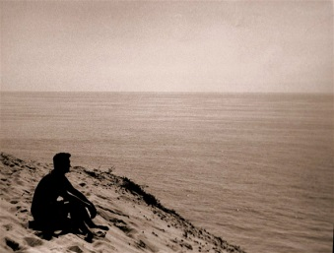
Themes in ‘IMTC’
Memory
Truth
Time
Nostalgia

Slide 56
Group Mind Map
Each group will create a mind map based on a particular theme.
In your mind map, you will explain:
What your theme means in relation to the poem
In detail, analyse how 2 quotations demonstrate that theme, explaining key techniques used
What the poet’s overall message about that theme

Slide 57
Quotation 1
“Brady and Hindley/faded like the faint smudge of a mistake.”
Explanation
Allusion to Moors Murderers-truth of childhood trauma/horror figures are hidden in cozy classroom environment; hiding truth seen as protective
Theme definition
In Duffy’s poetry, she always strives to be truthful when conveying her personal experiences-sharing her emotions honestly.
Truth is also important in this poem, as the children grow older and discover the truths about life.
Theme-Truth
Quotation 2
“You asked her/how you were born and Mrs Tilscher smiled/then turned away.”
Explanation
Inability to explain true ‘facts of lives’ demonstrates Mrs Tilscher’s diminishing role in their lives as they grow. Her change from knowledgeable and loving figure to memory
Poet’s overall message
Young people search for truth in life as they grow older; affection can sometimes cloud the truth

Slide 58
Peer Checking
Rotate your mind maps
Check the other group’s mind map. Ensure they have:
2 relevant quotes for the specified theme
DETAILED analysis of these quotes (techniques!) and how they link to the theme
A clear description of what the theme means and how it relates to ‘IMTC’
A clear idea of Duffy’s message/stance on this theme

Slide 59
Group Presentations
As the group presents, you should be making notes of each of the themes

Slide 60
Links to Other Poems
Scottish Set Text

Slide 61
Links to other poems
What does ‘Originally’ have in common with other poems we have studied?
Your pair will be given one of the poems to compare with ‘Originally’.
Indicate all the links between the two poems, using evidence to back it up
Consider:
Common themes
Similar use of techniques
Speaker voice

Slide 62
Linking Poems-Venn Diagrams
IMTC
Mrs Midas

Slide 63
Linking Poems-Venn Diagrams
IMTC
Valentine

Slide 64
Linking Poems-Venn Diagrams
IMTC
Originally

Slide 65
Linking Poems-Venn Diagrams
IMTC
War Photographer

Slide 66
Textual Analysis Practice
Scottish Set Text

Slide 67
Textual Analysis-Tips!
Treat it like a close reading!
Bullet point answers
Number of marks=number of points
Understanding Qs
Use own words where possible
Identify themes where asked
Summarise key events briefly
Analysis Qs
Quote/Identify key techniques (W.C., S.S., Imagery, Tone, poetic techniques)
Explain analysis
link to question

Slide 68
N5->Higher
Like R4UAE, you do not get marks for quoting at Higher
You have to write more detailed analysis of the techniques you identify, and link your analysis more to the Q asked

Slide 69
Question 1-Decoding the Q
Make sure you are checking which lines you are being asked about
Analysis-look for techniques, analyse in detail
Look at lines 1-5. Explain how the poet makes use of extended metaphor here to explore the idea of change. (4 marks)
Specific technique I am looking for
2 examples must be given
Link to Q-2nd point of analysis-must mention ‘change’ in analysis

Slide 70
Question 1-Example Answers
Look at lines 1-5. Explain how the poet makes use of extended metaphor here to explore the idea of change. (4 marks)
ANSWER
Q-“inky tadpoles”
T-metaphor
A-children are compared to tadpoles. Just as tadpoles are an in-between stage in the frog’s lifespan, so to the children are going through puberty and a period of new development. (1)
L-this demonstrates the idea of change as puberty is a time of great hormonal changes and differences. (1)
Q-“commas into exclamation marks”
T-metaphor
A-children are compared to punctuation. Just as commas suggest a continuation of a sentence, the children’s lives are progressing. Just as exclamation marks suggest strong emotion, so too the children are experiencing new emotions due to hormones. (1)
L-this demonstrates the idea of change as during puberty, hormonal change is a huge feature that effects how children react emotionally. (1)
“jumping and croaking”

Slide 71
Homework Reminder
For Weds 18th Sept
Complete theme paragraph
Read chapters 13-17

Slide 72
Question 1-Example Answers
Look at lines 1-5. Explain how the poet makes use of extended metaphor here to explore the idea of change. (4 marks)
Highlight/underline potential quotes we will use-lines 1-5.
“…inky tadpoles”
“changed/from commas into exclamation marks”
“three frogs/hopped in the playground”
“jumping and croaking”

Slide 73
Question 1-Example Answers
Look at lines 1-5. Explain how the poet makes use of extended metaphor here to explore the idea of change. (4 marks)
N5
“inky tadpoles”/”jumping and croaking” (1)
Duffy uses a metaphor comparing children to tadpoles becoming frogs. Just as tadpoles grow from smaller, less developed creatures into larger, more independent and complex animals, so too children grow older and their attitudes and behaviour change and mature. (1)
“changed/from commas into exclamation marks” (1)
__________________________________________ (1)
HIGHER
“inky tadpoles”/”jumping and croaking”
Duffy uses a metaphor comparing children to tadpoles becoming frogs. Just as tadpoles grow from smaller, less developed creatures into larger, more independent and complex animals, so too children grow older and their attitudes and behaviour change and mature. (1)
This is an effective way of exploring the idea of change, as it gives the reader an idea of immense transition, of childhood as a time of extreme changes and growth. (1)
“changed/from commas into exclamation marks”
__________________________________________ (1)
__________________________________________ (1)

Slide 74
Notes on Q2&3
Q2&3-“use of language”=any poetic technique, S.S., imagery, tone, W.C
Q3-“effective conclusion”-how does it summarise the main ideas in the poem well? How does it leave the reader feeling? Link to major themes, similar techniques used earlier
4 marks=2 examples
2 marks=1 example
N5-marks for quoting
Higher=two points of analysis

Slide 75
Textual Analysis Review
We will review and discuss our responses to the textual analysis, to help you identify:
Areas where you are having success
Areas where you need more support

Slide 76
10 Mark Q Practice
Scottish Set Text

