Slide 1
DEADLINES
OVERDUE
Creative topic proposals
Niamh
Skye
Louie
Ellie
Anton
Lizzy
Rhiannon
Jean
DUE TODAY
Key Incident paragraphs

Slide 2
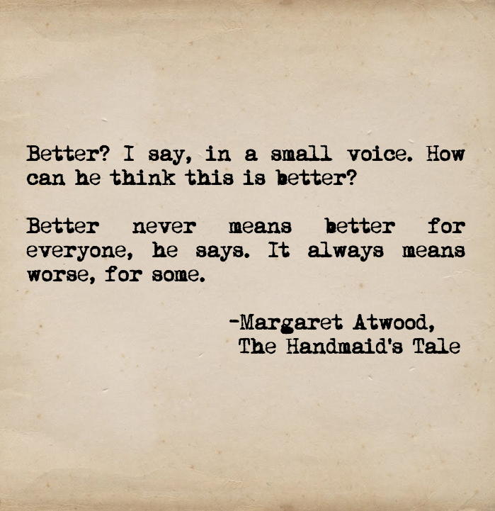
‘The Handmaid’s Tale’ Margaret Atwood
Chapters 30-39

Slide 3
Key Quotes
Share the three key quotations that you identified when reading chapters 30-39
Note down the most interesting/commonly quoted example on your post-it
Place it on the board

Slide 4
Key Quotes
“That is what you have to do before you kill, I thought. You have to create an it, where none was before. You do that first, in your head, and then you make it real. So that’s how they do it, I thought.” (202, C30)
“That’s one of the things they do. They force you to kill, within yourself.” (203, C30)
“The Eyes of God run all over the earth.” (203, C30)
“The moment of betrayal is the worst, the moment when you know beyond any doubt that you’ve been betrayed: that some other human being has wished you that much evil. It was like being in an elevator cut loose at the top. Falling, falling, and not knowing when you will hit.” (203, C30)
“I make a point of keeping track. I should scratch marks on the wall, one for each day of the week, and run a line through them when I have seven. But what would be the use, this isn’t a jail sentence; there’s no time here that can be done and finished with.” (209 C31)
“I sit in my chair, the wreath on the ceiling floating above my head, like a frozen halo, a zero.” (210, C31)
“Ofglen says some other people got out that way, by pretending to be Jewish…You get hanged for being a noisy Jew who won’t make the choice. Or for pretending to convert….And all the owners of them, sullen-faced, unrepentant, pushed by the Eyes against the walls of their bedrooms…So, the J isn’t for Jew…Whatever it meant, he’s just as dead.” (211, C31)
“…these clipped whispers, projected through the funnels of our white wings. It’s more like a telegram, a verbal semaphore. Amputated speech.” (211 C31)

Slide 5
Key Quotes
“I find it hard to believe in these whisperings, these revelations, though I always do at the time. Afterwards though they seem improbably, childish even, like something you’d do for fun…Passwords, things that cannot be told, people with secret identities, dark linkages: this does not seem as if it ought to be the true shape of the world.” (212 C31)
“This idea hangs between us, almost visible, almost palpable: heavy, formless, dark; collusion of a sort, betrayal of a sort. She does want that baby.” (216 C31)
“The problem wasn’t only with the women…The main problem was with the men. There was nothing for them any more…They could make money, I say, a little nastily….It’s not enough, he says. It’s too abstract. I mean there was nothing for them to do with women…I’m not talking about sex…sex was too easy. Anyone could just buy it. There was nothing to work for, nothing to fight for…You know what they were complaining about the most? Inability to feel. Men were turning off on sex, even.” (221 C32)
“We thought we could do better. Better? How can he think this is better? Better never means better for everyone, he says. It always means worse, for some.” (222 C32)
“This rope segregates us, marks us off, keeps the others from contamination by us, makes for us a corral or pen” (226 C33)
“…Janine’s baby, the baby that passed through Janine on its way to somewhere else…’My God,’ I say. To go through all that, for nothing. Worse than nothing.” (226 C33)

Slide 6
Key Quotes
“Are they old enough to remember anything of the time before, playing baseball, in jeans and sneakers, riding their bicycles?...And the ones after them will, for three or four or five years; but after that they won’t. They’ll always have been in white, in groups of girls; they’ll always have been silent.” (231 C34)
“Women’s Prayvaganzas are for group weddings like this, usually. The men’s are for military victories. These are the things we are supposed to rejoice in the most, respectively.” (232 C34)
“I don’t have to tell it. I don’t have to tell anything, to myself or to anyone else. I could just sit here, peacefully…Nolite te bastardes carborundorum. Fat lot of good it did her. Why fight?” (237, C35)
“It is strange to remember how we used to think, as if everything were available to us, as if there were no contingencies, no boundaries; as if we were free to shape and reshape forever the ever-expanding perimeters of our lives.” (239, C35)
“So they still make them, cameras like that…there will be family albums, too, with all the children in them; no Handmaids though. From the point of view of future history, this kind, we’ll be invisible.” (240, C35)
“I am only a shadow now, far back behind the glib shiny surface of this photograph. A shadow of a shadow, as dead mothers become. You can see it in her eyes: I am not there. But she exists, in her white dress. She grows and lives. Isn’t that a good thing? A blessing?” (240, C35)
“Yet there’s an enticement in this thing, it carries with it the childish allure of dressing up. And it would be so flaunting, such a sneer at the Aunts, so sinful, so free. Freedom, like everything else, is relative.” (242, C36)

Slide 7
Key Quotes
“’It means you can’t cheat Nature,’ he says. ‘Nature demands variety, for men. It stands to reason, it’s part of the procreational strategy. It’s Nature’s plan’….So now that we don’t have different clothes…you merely have different women.” (249, C37)
“It was about life in the Colonies. In the Colonies, they spend their time cleaning up…Sometimes it’s just bodies, after a battle…So the women in the Colonies there do the burning. The other Colonies are worse, though, the toxic dumps and the radiation spills. They figure you’ve got three years maximum, at those before your nose falls off and your skin pulls away like rubber gloves…It’s old women…and Handmaids who’ve screwed up their three chances, and incorrigibles like me. Discards, all of us. They’re sterile, of course. If they aren’t that way to begin with, they are after they’ve been there for a while.” (260-261, C38)
“I’d say it’s about a quarter men in the Colonies…Gender Traitors…All of them wear long dresses…women and the men too…I guess it’s supposed to demoralise the men, having to wear a dress.” (261, C38)
“I don’t want her to be like me. Give in, go along, save her skin. That is what it comes down to. I want gallantry from her, swashbuckling, heroism, single-handed combat. Something I lack.” (261, C38)
“I think of my mother, sweeping up deadly toxins; the way they used to use up old women, in Russia, sweeping dirt. Only this dirt will kill her. I can’t quite believe it. Surely her cockiness, her optimism and energy, her pizzazz, will get her out of this. She will think of something. But I know this isn’t true. It is just passing the buck, as children do, to mothers. I’ve mourned for her already. But I will do it again, and again.” (265, C39)
“Alone at last, I think. The fact is that I don’t want to be alone with him, not on a bed. I’d rather have Serena there too. I’d rather play Scrabble.” (266, C39)

Slide 8
Key Points
In this section, we:
Are told about Offred’s failed attempt to escape with her family
Find out Serena’s proposition to Offred
Witness a Prayvaganza and a group wedding in Gilead
Find out what happened to Janine’s baby
Witness Offred receiving an update on her daughter
See Offred visit Jezebel’s with the Commander
Find out about Moira’s failed escape
Find out about the fate of Offred’s mother

Slide 9
Key terms
Sex
Gender
Sexuality
Do these terms mean different things to you?

Slide 10
Key terms
Sex- your biological category based on the sex organs you present and genetic/hormonal differences
Gender-a social/cultural construct of your identity, often based on your sex,
Sexuality-your sexual attraction

Slide 11
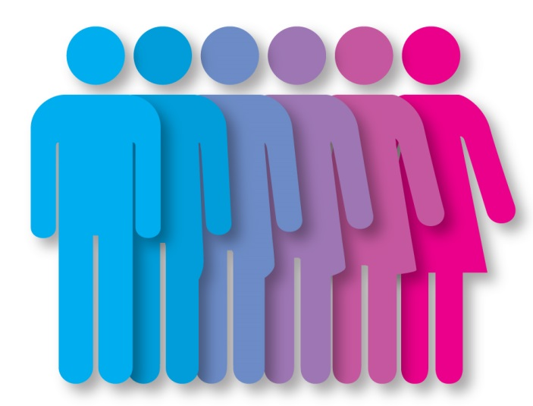
Gender Norms
If, like we have discussed, gender is a social and cultural construct, what does it mean to be male or female?
What messages are we given about the different genders?
Where do these messages come from?

Slide 12
Gender Norms
Group 1-create a mind map of gender norms for females
Group 2-create a mind map of gender norms for males
These mind maps can include:
Appearance
Jobs
Hobbies/interests
Insults/compliments
Messages
Dreams and aspirations
Expectations of behaviour
Actions

Slide 13
Gender Norms
Review your mind maps
How many of the gender ‘norms’ apply to your own behaviour and conduct?
Do any of these gender ‘norms’ offend you?
Do you think any of these gender ‘norms’ are harmful or dangerous?

Slide 14
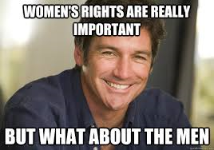
Feminism and Toxic Masculinity
We have spoken in detail about the need for feminism to give women equality and opportunity
However, men need feminism too!
Men need feminism to tackle toxic masculinity

Slide 15
Feminism and Toxic Masculinity
In a society ruled by gender norms, there were very set ideas about gender roles-what men and women should do and how they should behave
Men are often expected to be the ‘bread-winners’- they work to provide money for the family
They are also often seen as the head of the household-making key decisions, disciplining and controlling finances
Men are supposed to be dominant, manly and strong
This is very limiting, and can lead some men to feel like they don’t live up to this expectation
This kind of strict masculinity is sometimes called ‘toxic’, as many believe it causes men to feel like they cannot express their emotions, which can often result in increased aggression and has been linked to high suicide rates in young males

Slide 16
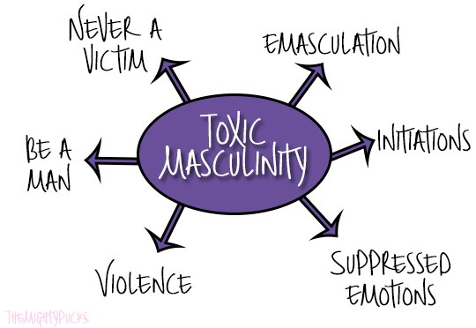
Toxic Masculinity
Not reporting a crime
Not go to doctors
Being seen as feminine, unmanly
homophobia
Having to prove yourself through risk taking
Strong, dominant, no emotions
“big boys don’t cry”
Having to support others
Never backing down from confrontation
testosterone

Slide 17
Toxic Masculinity
https://www.youtube.com/watch?v=UwI2U27UlGU

Slide 18
Gender Roles in ‘The Handmaid’s Tale’
“The problem wasn’t only with the women…The main problem was with the men. There was nothing for them any more…They could make money, I say, a little nastily….It’s not enough, he says. It’s too abstract. I mean there was nothing for them to do with women…I’m not talking about sex…There was nothing to work for, nothing to fight for…You know what they were complaining about the most? Inability to feel. Men were turning off on sex, even.” (221 C32)
“’It means you can’t cheat Nature,’ he says. ‘Nature demands variety, for men. It stands to reason, it’s part of the procreational strategy. It’s Nature’s plan’….So now that we don’t have different clothes…you merely have different women.” (249, C37)
Add annotations to these key quotes about gender norms
“I’d say it’s about a quarter men in the Colonies…Gender Traitors…All of them wear long dresses…women and the men too…I guess it’s supposed to demoralise the men, having to wear a dress.” (261, C38)
“Women’s Prayvaganzas are for group weddings like this, usually. The men’s are for military victories. These are the things we are supposed to rejoice in the most, respectively.” (232 C34)

Slide 19
Homework
For Weds 30th Oct
Read Chapters 40-45 (27 pages)
Finish theme paragraph
As you read, highlight and/or note down THREE interesting quotations
These could be about:
Characters
Key themes
Descriptions of setting
Dialogue
Be prepared to share these next week

Slide 20
Writing About Theme
Gender norms; women’s subjugation
Essay Question
Choose a novel or short story that deals with a theme of moral or social significance.
With reference to appropriate techniques, explain how the writer develops this theme and
discuss why its development adds to your appreciation of the text as a whole.
Pick ONE of the quotations discussed today.
Write a critical paragraph in response to the essay Q above, using PCQEL structure.

Slide 21
PCQEL
Essay Q
Choose a novel or short story that deals with a theme of moral or social significance.
With reference to appropriate techniques, explain how the writer develops this theme and
discuss why its development adds to your appreciation of the text as a whole.
Point- (topic sentence-ref to Q, technique and point being made)
In ‘The Handmaid’s Tale’, Atwood explores the theme of women’s subjugation through discussion of…
Context-(where in novel? What is happening at this point?)
This theme is developed further when Offred explains…
Quotation
““Women’s Prayvaganzas are for group weddings like this, usually. The men’s are for military victories. These are the things we are supposed to rejoice in the most, respectively.” ”
Explanation (thorough analysis of quotation, technique used)
Here, Atwood uses ________ to…
Link (how does quotation link back to Q? What does it tell us about essay topic?)
This demonstrates Atwood’s theme of…as…

