Slide 1
‘The Handmaid’s Tale’ Margaret Atwood
Chapters 40-45

Slide 2
DEADLINES
DUE TODAY
Theme paragraph
FRI 1ST NOV
Mini deadline for creative plan
MON 4TH NOV
10 mark Q-complete if absent Mon/Tues
FRI 8TH NOV
Creative folio 1st draft

Slide 3
Plot Summary
In your groups, summarise what happened in this part of the novel-the key events
Narrow it down to three-five key things that occur
Write them on your post-it

Slide 4
Key Quotes
“I made that up. It didn’t happen that way. Here is what happened.” (273 C40)
“It didn’t happen that way either. I’m not sure how it happened, not exactly. All I can hope for is a reconstruction: the way love feels is always only an approximate.” (275, C40)
“I would like to be without shame. I would like to be shameless. I would like to be ignorant. Then I would not know how ignorant I was.” (275, C40)
“I wish this story were different. I wish it were more civilised. I wish it showed me in a better light, if not happier, then at least more active, less hesitant, less distracted by trivia…I’m sorry there is so much pain in this story. I’m sorry it’s in fragments, like a body caught in crossfire or pulled apart by force. But there is nothing I can do to change it.” (279, C41)
“But I keep on going with this sad and hungry and sordid, this limping and mutilated story, because after all I want you to hear it, as I will hear yours too if I ever get the chance, if I meet you or if you escape, in the future or in Heaven or in prison or underground, some other place…By telling you anything at all I’m at least believing in you, I believe you’re there, I believe you into being. Because I’m telling you this story I will your existence. I tell, therefore you are.” (279, C41)
“Fear is a powerful stimulant.” (280, C41)
“Being here with him is safety; it’s a cave, where we huddle together while the storm goes on outside. This is a delusion, of course. This room is one of the most dangerous places I could be.” (281, C41)
“I tell him my real name, and feel that therefore I am known. I act like a dunce. I should know better. I make him an idol, a cardboard cutout.” (282, C41)
“We could get you out, she says. We can get people out if we really have to, if they’re in danger. Immediate danger. The fact is that I no longer want to leave, escape, cross the border to freedom. I want to be here, with Nick, where I can get at him.” (283, C41)
“Truly amazing, what people can get used to, as long as there are a few compensations.” (283, C41)
“Ofglen is giving up on me. She whispers less, talks more about the weather. I do not feel regret about this. I feel relief.” (283, C41)

Slide 5
Key Quotes
“It’s Aunt Lydia. How many years since I’ve seen her?...I’ve begun to shiver. Hatred fills my mouth like spit.” (286, C42)
“…placed my hand on my heart to show my unity with the Salvagers and my consent, and my complicity in the death of this woman…I don’t want to see it any more. I look at the grass instead. I describe the rope.” (288, C42)
“The three bodies hang there…like chickens strung up by the necks in a meatshop window, like birds with their wings clipped, like flightless birds, wrecked angels. It’s hard to take your eyes off them.” (289, C43)
“It’s a mistake to hang back too obviously in any group like this. lt stamps you as lukewarm, lacking in zeal.” (289, C43)
“I want to tear, gouge, rend…our nostrils flare, sniffing death, we look at one another, seeing the hatred. Shooting was too good.” (291, C43)
“The women are looking at him with horror, as if he’s a half-dead rat dragging itself across a kitchen floor.” (291, C43)
“…the red bodies tumble forward and I can no longer see, he’s obscured by arms, fists, feet. A high scream comes from somewhere, like a horse in terror…he has become an it.” (292, C43)
“’I saw what you did,’ I say to her. Now I beginning to feel again: shock, outrage, nausea….’Don’t be stupid. He wasn’t a rapist at all, he was an political. He was one of ours. I knocked him out. Put him out of his misery. Don’t you know what they’re doing to him?’” (292, C43)
“…Janine. There’s a smear of blood across her cheek, and more of it on the white of her headdress. She’s smiling, a bright diminutive smile. Her eyes have come loose. ‘Hi there,’ she says. ‘How are you doing?” She’s holding something, tightly, in her right hand. It’s a clump of blond hair. She gives a small giggle.” (292, C43)
“Death makes me hungry. Maybe it’s because I’ve been emptied, or maybe it’s the body’s way of seeing to it that I remain alive, continue to repeat its bedrock prayer. I am, I am. I am, still.” (293, C43)

Slide 6
Key Quotes
“’Has Ofglen been transferred, so soon?’ I ask, but I know she hasn’t. I saw her only this morning…’I am Ofglen,’ the woman says. Word perfect. And of course she is, the new one, and Ofglen, wherever she is, is no longer Ofglen. I never did know her real name. That is how you can get lost, in a sea of names.” (295, C44)
“’I’ve only known her since May,’…I can feel my skin growing hot, my heart speeding up. This is tricky. For one thing, it’s a lie. And how do I get from there to the next vital word? ‘Around the first of May I think it was. What they used to call May Day.’ ‘Did they?’ she says, light, indifferent, menacing. ‘That isn’t a term I remember. I’m surprised you do. You ought to make an effort…’ She pauses. ‘To clear your mind of such…’ she pauses again. ‘Echoes.’ Now I feel cold, seeping over my skin like water. What she is doing is warning me. She isn’t one of us. But she knows.” (296, C44)
“Dear God, I think, I will do anything you like. Now that you’ve let me off, I’ll obliterate myself, if that’s what you really want; I’ll empty myself, truly, become a chalice. I’ll give up Nick, I’ll forget about the others, I’ll stop complaining. I’ll accept my lot. I’ll sacrifice. I’ll repent. I’ll abdicate. I’ll renounce…I want to keep on living, in any form. I resign my body freely to the uses of others. They can do what they like with me. I am abject. I feel, for the first time, their true power.” (298, C45)
“’How could you be so vulgar? I told him…Behind my back,’ she says. ‘You could have left me something…Just like the other one. A slut. You’ll end up the same.’” (299, C45)

Slide 7
Key Points
In this section, we:
Witness a Salvaging (hanging) of 2 Handmaids and a Commander’s Wife
Witness a Particicution
Find out Ofglen has been replaced
Discover that Offred’s relationship with the Commander has been discovered by Serena Joy

Slide 8
Unnerving?
This section of the novel is the darkest part, and we are exposed to some of the most violent and twisted aspects of Gilead
“Death makes me hungry. Maybe it’s because I’ve been emptied, or maybe it’s the body’s way of seeing to it that I remain alive, continue to repeat its bedrock prayer. I am, I am. I am, still.” (293, C43)
“…Janine. There’s a smear of blood across her cheek, and more of it on the white of her headdress. She’s smiling, a bright diminutive smile. Her eyes have come loose. ‘Hi there,’ she says. ‘How are you doing?” She’s holding something, tightly, in her right hand. It’s a clump of blond hair. She gives a small giggle.” (292, C43)
“’Has Ofglen been transferred, so soon?’ I ask, but I know she hasn’t. I saw her only this morning…’I am Ofglen,’ the woman says. Word perfect. And of course she is, the new one, and Ofglen, wherever she is, is no longer Ofglen. I never did know her real name. That is how you can get lost, in a sea of names…’I’ve only known her since May,’…I can feel my skin growing hot, my heart speeding up. This is tricky. For one thing, it’s a lie. And how do I get from there to the next vital word? ‘Around the first of May I think it was. What they used to call May Day.’ ‘Did they?’ she says, light, indifferent, menacing. ‘That isn’t a term I remember. I’m surprised you do. You ought to make an effort…’ She pauses. ‘To clear your mind of such…’ she pauses again. ‘Echoes.’ Now I feel cold, seeping over my skin like water. What she is doing is warning me. She isn’t one of us. But she knows.” (296, C44)

Slide 9
Unnerving?
This section of the novel is the darkest part, and we are exposed to some of the most violent and twisted aspects of Gilead
“…Janine. There’s a smear of blood across her cheek, and more of it on the white of her headdress. She’s smiling, a bright diminutive smile. Her eyes have come loose. ‘Hi there,’ she says. ‘How are you doing?” She’s holding something, tightly, in her right hand. It’s a clump of blond hair. She gives a small giggle.” (292, C43)
“Death makes me hungry. Maybe it’s because I’ve been emptied, or maybe it’s the body’s way of seeing to it that I remain alive, continue to repeat its bedrock prayer. I am, I am. I am, still.” (293, C43)
“’Has Ofglen been transferred, so soon?’ I ask, but I know she hasn’t. I saw her only this morning…’I am Ofglen,’ the woman says. Word perfect. And of course she is, the new one, and Ofglen, wherever she is, is no longer Ofglen. I never did know her real name. That is how you can get lost, in a sea of names.” (295, C44)
“’I’ve only known her since May,’…I can feel my skin growing hot, my heart speeding up. This is tricky. For one thing, it’s a lie. And how do I get from there to the next vital word? ‘Around the first of May I think it was. What they used to call May Day.’ ‘Did they?’ she says, light, indifferent, menacing. ‘That isn’t a term I remember. I’m surprised you do. You ought to make an effort…’ She pauses. ‘To clear your mind of such…’ she pauses again. ‘Echoes.’ Now I feel cold, seeping over my skin like water. What she is doing is warning me. She isn’t one of us. But she knows.” (296, C44)

Slide 10
An Unlikeable Narrator
Throughout the novel, we empathise with Offred’s position as victim of the Gilead regime, and her desperate desire to escape and reunite with her family
In this section, however, Offred’s desires change, and we see her in a different light
In what ways is Offred unlikeable in this section of the novel?

Slide 11
An Unlikeable Narrator
Offred is ‘unlikeable’ in this section as she:
Selfish in her actions-protective of her own role and future, rather than the resistance cause
hypocritical-unfaithful to her own beliefs, her husband
takes part in Particicution and Salvaging

Slide 12
An Unlikeable Narrator
Offred is ‘unlikeable’ in this section as she:
Is “unfaithful” to her husband-desires Nick
Takes part in Salvaging and Particicution
Wishes to turn back on resistance movement in order to stay with Nick
Starts to prize her own life over the resistance cause (298, C45)

Slide 13
The Unlikeable Narrator
Usually a narrator in a novel is someone who we sympathise with, as we see the novel through their experiences and viewpoint
We are usually on their side, as we receive their opinions of characters, and their justification for their actions
However, narrators can be unreliable, and mislead the reader
Why might a writer choose to create an unreliable narrator?

Slide 14
The Unlikeable Narrator
Why would a reader or author bother with an unlikable or hard-to-like narrator at all?
Because they aren’t like us.
Because they live lives that are unlike ours.
Because they get to say things we wish we could say.
Because they get to break the rules.
Because they might reveal aspects of the human psyche you want to explore.
Because they could embody key themes

Slide 15
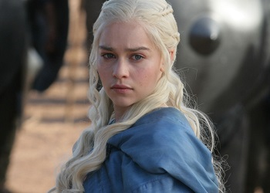
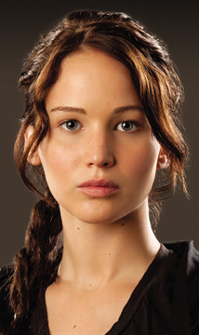
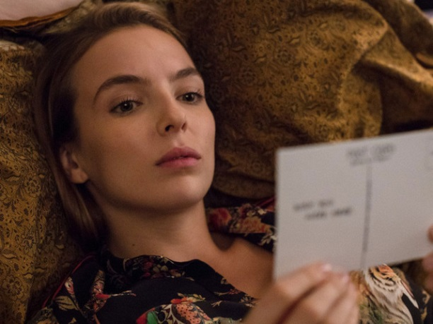
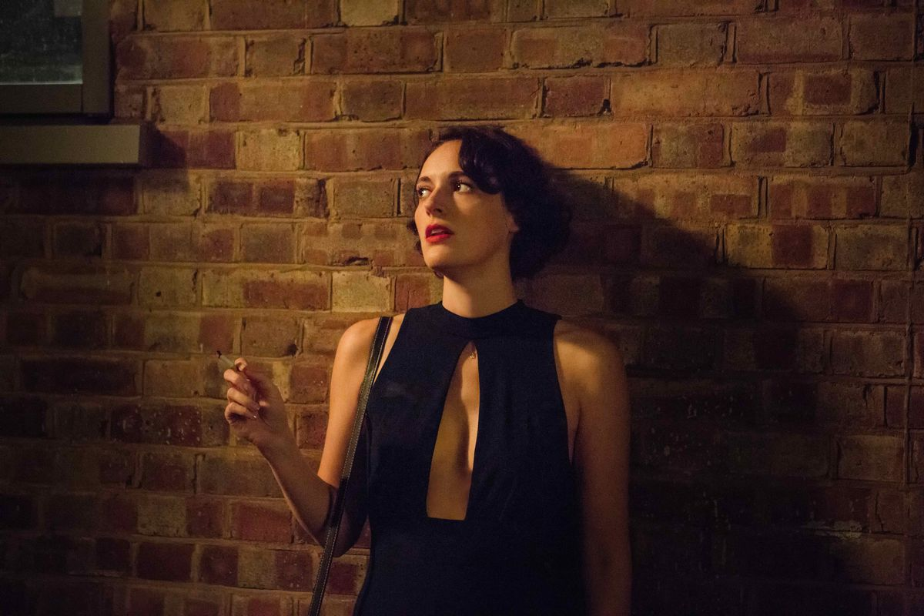
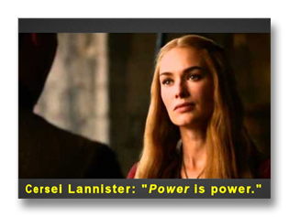
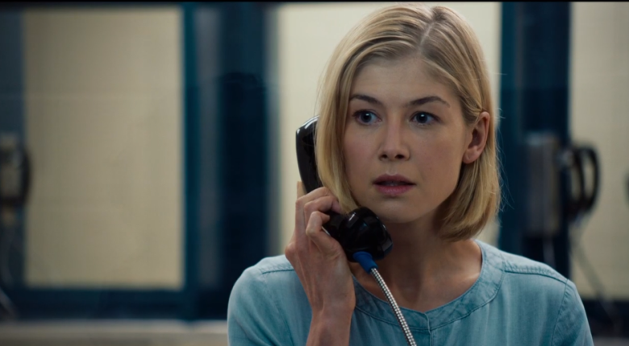
The Unlikeable Female

Slide 16
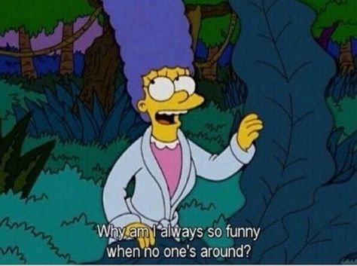
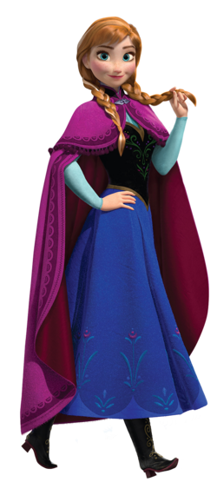
The Unlikeable Female
In literature and media, there is a history of expectations on female characters to be likeable, acting almost as props for the male characters, who are given permission to act how they wish
Think about Marge and Homer Simpson!
Women are often given cute quirks rather than character flaws-they may be clumsy, messy, ditzy, but not truly flawed
They are supposed to be sympathetic-someone you can see as your daughter, your mother, your girlfriend

Slide 17
The ‘Cool Girl’
“Men always say that as the defining compliment, don’t they? She’s a cool girl. Being the Cool Girl means I am a hot, brilliant, funny woman who adores football, poker, dirty jokes, and burping, who plays video games, drinks cheap beer…jams hot dogs and hamburgers into her mouth…while somehow maintaining a size 2, because Cool Girls are above all hot. Hot and understanding. Cool Girls never get angry; they only smile in a chagrined, loving manner and let their men do whatever they want. Go ahead..., I don’t mind, I’m the Cool Girl.
Men actually think this girl exists. Maybe they’re fooled because so many women are willing to pretend to be this girl. For a long time Cool Girl offended me. I used to see men – friends, coworkers, strangers – giddy over these awful pretender women, and I’d want to sit these men down and calmly say: You are not dating a woman, you are dating a woman who has watched too many movies written by socially awkward men who’d like to believe that this kind of woman exists and might kiss them. I’d want to grab the poor guy…and say: The bitch doesn’t really love chili dogs that much – no one loves chili dogs that much! And the Cool Girls are even more pathetic: They’re not even pretending to be the woman they want to be, they’re pretending to be the woman a man wants them to be.”
- ‘Gone Girl’-Gillian Flynn

Slide 18
Offred: The Unlikeable Female
How does Offred disappoint us as a female in this section of the novel?
What expectations do we have of Offred and her behaviour?
How does she fail to live up to the expectations we have for her?

Slide 19
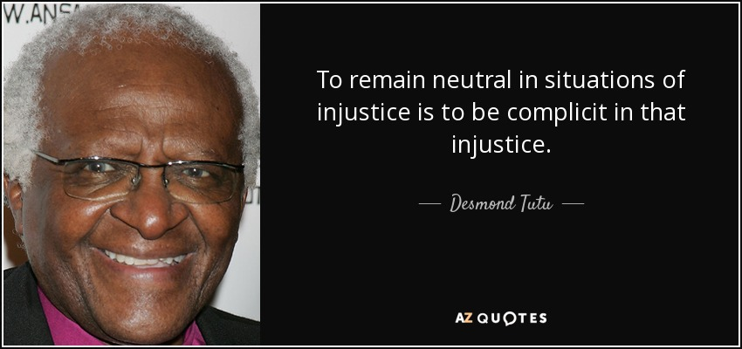
Theme of Complicity
Complicit- to be involved with others in an activity that is unlawful or morally wrong.
In what ways can Offred be said to be complicit in the Gilead regime and her own subjugation?

Slide 20
Theme of Complicity
“…placed my hand on my heart to show my unity with the Salvagers and my consent, and my complicity in the death of this woman…I don’t want to see it any more. I look at the grass instead. I describe the rope.” (288, C42)
“Ofglen is giving up on me. She whispers less, talks more about the weather. I do not feel regret about this. I feel relief.” (283, C41)
Add annotations to your mind map, relating to the theme of complicity
“Dear God, I think, I will do anything you like. Now that you’ve let me off, I’ll obliterate myself, if that’s what you really want; I’ll empty myself, truly, become a chalice…I want to keep on living, in any form. I resign my body freely to the uses of others. They can do what they like with me. I am abject. I feel, for the first time, their true power.” (298, C45)
“…the red bodies tumble forward and I can no longer see, he’s obscured by arms, fists, feet. A high scream comes from somewhere, like a horse in terror…he has become an it.” (292, C43)

Slide 21
Writing About Theme
Complicity
Essay Question
Choose a novel or short story that deals with a theme of moral or social significance.
With reference to appropriate techniques, explain how the writer develops this theme and
discuss why its development adds to your appreciation of the text as a whole.
Pick ONE of the quotations discussed today.
Write a critical paragraph in response to the essay Q above, using PCQEL structure.

Slide 22
PCQEL
Point- (topic sentence-ref to Q, technique and point being made)
In ‘The Handmaid’s Tale’, Atwood explores the theme of complicity through Offred’s changing view on her position in Gilead.
Context-(where in novel? What is happening at this point?)
This theme is conveyed when…
Quotation
“____________________”
Explanation (thorough analysis of quotation, technique used)
Here, Atwood uses ________ to…
Link (how does quotation link back to Q? What does it tell us about essay topic?)
This demonstrates Atwood’s theme of complicity, as…
Essay Q
Choose a novel or short story that deals with a theme of moral or social significance.
With reference to appropriate techniques, explain how the writer develops this theme and
discuss why its development adds to your appreciation of the text as a whole.

Slide 23
Email paragraph to me
gw15innesmairi@glow.sch.uk
missminnes@gmail.com

Slide 24
Homework
For Weds 6th Nov
Read Chapters 46 and the Historical Notes (this is still part of the novel!) (21 pages)
As you read, highlight and/or note down THREE interesting quotations
These could be about:
Characters
Key themes
Descriptions of setting
Dialogue
Be prepared to share these next week

