Slide 1
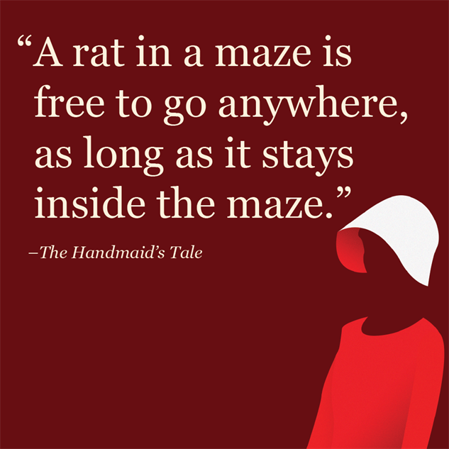
‘The Handmaid’s Tale’ Margaret Atwood
Chapters 24-29

Slide 2
Key Plot Points
Note down the key plot points from this section of the novel (major things that happened) on your post-it
Aim for 3-5 points
Place it on the board

Slide 3
Key Points
In this section, we:
See Offred being offered reading material (magazines)-something she has craved
Discover the Ofglen has some link to the resistance movement
Find out the circumstances of Gilead’s creation
Discover the meaning of “Nolite te bastardes carborundorum”

Slide 4
Collating Paragraphs
When you are given your critical paragraphs back, keep them together-maybe even type them up at home!
When revising/preparing for critical essay assessments, you can use these to build on your knowledge, or as the basis of your first main paragraph of an essay
Don’t throw them away/lose them in the depths of your bag/folder

Slide 5
Key Quotes
“Perspective is necessary. Otherwise there are only two dimensions. Otherwise you live with your face squashed against a wall…Otherwise you live in the moment, which is not where I want to be.” (153, C24)
“Time’s a trap, I’m caught in it. I must forget about my secret name and all ways back. My name is Offred now, and here is where I live.” (153, C24)
“Men are sex machines…They only want one thing. You must learn to manipulate them, for your own good…Aunt Lydia did not actually say this, but it was implicit” (153, C24)
“This is one of the most bizzare things that’s happened to me, ever. Context is all.” (154, C24)
“She did not believe he was a monster. H was not a monster, to her. Probably he had some endearing trait….How easy it is to invent a humanity, for anyone at all.” (155, C24)
“Here I am in the closet. Nolite te bastardes carborundorum. I can’t see it in the dark but I trace the tiny scratched writing with the ends of my fingers, as if it’s a code in Braille. It sounds in my head now less like a prayer, more like a command; but to do what?...Why did she write it, why did she bother? There’s no way out of here.” (156, C24)
“There is something subversive about this garden of Serena’s, a sense of buried things bursting upwards, wordlessly, into the light, as if to point, to say: Whatever is silenced will clamour to be heard, though silently.” (161, C25)
“Staring at the magazine, as he dangled it before me like fishbait, I wanted it. I wanted it with a force that made the ends of my fingers ache. At the same time I saw this longing of mine as trivial and absurd, because I’d taken such magazines lightly enough once…they were infinitely discardable…Though I remembered now. What was in them was promise. They dealt in transformations, they suggested an endless series of possibilities…they suggested one adventure after another, one wardrobe after another, one improvement after another, one man after another. They suggested rejuvenation, pain overcome and transcended, endless love. The real promise in them was immortaility.” (164-5 C25)

Slide 6
Key Quotes
“What’s dangerous in the hands of the multitudes…is safe enough for those whose motives are….Beyond reproach, I said.” (166, C25)
“So there it was, out in the open: his wife didn’t understand him. That’s what I was there for, then. The same old thing. It was too banal to be true.” (166, C25)
“He watched me smoothing it over my hands and then my face with that same air of looking in through the bars…For him, I must remember, I am only a whim.” (168 C25)
“It was like being on an operating table, in the full glare; like being on a stage.” (169 C26) “This act of copulation, fertilisation, perhaps, which should have been no more to me than a bee is to a flower, had become for me indecorous, an embarrassing breach of propriety, which it hadn’t been before. He was no longer a thing to me. That was the problem.” (170, C26)
“…the hatred was no longer pure and simple. Partly I was jealous of her; but how could I be jealous of a woman so obviously dried-up and unhappy?” (170, C26)
“Also: I now had power over her, of a kind, although she didn’t know it. And I enjoyed that. Why pretend? I enjoyed it a lot.” (171, C26)
“Your daughters will have greater freedom. We are working towards the goal of a little garden for each one, each one of you…but we can’t be greedy pigs and demand too much before it’s ready, now can we?” (172, C26)
“The mistress used to be kept in a minor house or apartment of her own, and now they’ve amalgamated things. But underneath it’s the same. More or less. Outside woman, they used to be called, in some countries. I am the outside woman.” (172, C26)
“I don’t love the Commander or anything like it, but he’s of interest to me, he occupies space, he is more than a shadow...To him I’m no longer merely a useable body…To him I am not merely empty.” (172, C26)
“Now and again we vary the route; there’s nothing against it, as long as we stay within the barriers. A rat in a maze is free to go anywhere, as long as it stays inside the maze.” (174, C27)

Slide 7
Key Quotes
“It occurs to be that she may be a spy, a plant, set to trap me; such is the soil in which we grow. But I can’t believe it; hope is rising in me, like sap in a tree. Blood in a wound. We have made an opening.” (178 C27)
“What I feel is relief. It wasn’t me.” (179 C27)
“From the outside I must look like a cocoon, a spook, a face enshrouded like this, only the outlines visible, of nose, bandaged mouth, blind eyes.” (180, C28)
“She said I was poaching, on another woman’s ground. I said Luke wasn’t a fish or a piece of dirt either, he was a human being and could make his own decisions. She said I was rationalising. I said I was in love. She said that was no excuse.” (180, C28)
“She said it was different, because the balance of power was equal between women so sex was an even-stevens transaction.” (180, C28)
“I said there was more than one way of living with your head in the sand and that if Moira thought that she could create Utopia by shutting herself up in a women-only enclave she was sadly mistake. Men were not just going to go away, I said. You couldn’t just ignore them.” (181, C28)
“Are you calling Luke a social disease?” (181, C28)
“It was after the catastrophe, when they shot the President and machine-gunned the Congress and the army declared a state of emergency. They blamed it on the Islamic fanatics, at the time. Keep calm, they said on television. Everything is under control…That was when they suspended the Constitution. They said it would be temporary. There wasn’t even any rioting in the streets. People stayed home at night, watching television, looking for some direction. There wasn’t even an enemy you could put your finger on.” (183, C28)

Slide 8
Key Quotes
“it was the tension, you could feel it, like a subterranean hum, although things seemed so quiet.” (184, C28)
“I have to let you go, he said. It’s the law, I have to…He said this almost gently, as if we were wild animals, frogs he’d caught, in a jar, as if he were being humane.” (185, C28)
“But I could see out into the corridor, and ther were two men standing there, in uniforms, with machine guns. This was too theatrical to be true, yet here they were: sudden apparitions, like Martians. There was a dreamlike quality to them; they were too vivid, too at odds with their surroundings.” (186, C28)
“We looked at one another’s faces and saw dismay and a certain shame, as if we’d been caught doing something we shouldn’t. It’s outrageous, one woman said, but without belief. What was it about this that made us feel we deserved it?” (186, C28)
“She was not stunned, the way I was. In some strange way she was gleeful, as if this was what she’d been expecting for some time and now she’d been proven right. She even looked more energetic, more determined.” (188, C28)
“I feel as if somebody cut off my feet.” (188, C28)
“I didn’t go on any of the marches. Luke said it would be futile and I had to think about them, my family, him and her…I started doing more housework, more baking.” (189, C28)
“Maybe he even likes it. We are not each other’s, anymore. Instead, I am his.” (192, C28)
“…like an attentive pet, prick-eared and eager to perform.” (193, C29)
“On these occasions I read quickly, voraciously, almost skimming, trying to get as much into my head as possible before the next long starvation. If it were eating it would the gluttony of the famished.” (194, C29)
“Nolite te bastardes carborundorum. Here, in this context, it’s neither prayer nor command, but a sad graffitti, scrawled once, abandoned.” (196, C29)
“The pen between my fingers is sensuous, alive almost, I can feel its power, the power of the words it contains. Pen Is Envy.” (196, C29)
“She hanged herself’…If your dog dies, get another.” (197, C29)

Slide 9
How It Happened
In Chapter 28, Offred finally reveals the circumstances under which the Gilead regime came into effect
She explains how the government were overthrown, and how women’s rights were taken away from them

Slide 10
How It Happened
In Chapter 28, Offred finally reveals the circumstances under which the Gilead regime came into effect
She explains how the government were overthrown, and how women’s rights were taken away from them

Slide 11
How It Happened
Look back at chapter 28.
Note down 3 quotes referencing how the Gilead regime was implemented
Note down 3 quotes referencing different character reactions to the take over (Offred, Luke, Moira)
Leave space to analyse these quotations

Slide 12
Gilead-How It Happened
How it happened | Reactions
Pg 172-3 | Offred Pg 178/9
Pg 175/176 | Luke Pg 179/pg181-2
Pg 174-5 | Moira Pg 178

Slide 13
Gilead-How It Happened
How it happened | Reactions
Pg 172-3 “It was after the catastrophe, when they shot the president and machine-gunned the Congress and the army declared a state of emergency. They blamed it on the Islamic fanatics, at the time. Keep calm, they said on the television. Everything is under control.” | Offred Pg 178/9 “I feel as if somebody cut off my feet.”
Pg 175/176 “I have to let you go, he said. It’s the law I have to…He said this almost gently, as if we were wild animals, frogs he’d caught, in a jar, as if he were being humane.” (pg 175) | Luke Pg 179/pg181-2 “He doesn’t mind this, I thought. He doesn’t mind it at all. Maybe he even likes it. We are not each other’s, any more. Instead, I am his.” (pg 181-2)
Pg 174-5 “It’s not valid…see that red light? Means it’s not valid…See? He said again, still with that smile, as if he knew some private joke he wasn’t going to tell me.” (pg 185) | Moira Pg 178 “She was not stunned, the way I was. In some strange way she was gleeful, as if this was what she’d been expecting for some time and now she’d been proven right.”

Slide 14
How It Happened
“It was after the catastrophe, when they shot the President and machine-gunned the Congress and the army declared a state of emergency. They blamed it on the Islamic fanatics, at the time. Keep calm, they said on television. Everything is under control…That was when they suspended the Constitution. They said it would be temporary. There wasn’t even any rioting in the streets. People stayed home at night, watching television, looking for some direction. There wasn’t even an enemy you could put your finger on.” (183, C28)
“it was the tension, you could feel it, like a subterranean hum, although things seemed so quiet.” (184, C28)
“I have to let you go, he said. It’s the law, I have to…He said this almost gently, as if we were wild animals, frogs he’d caught, in a jar, as if he were being humane.” (185, C28)
“But I could see out into the corridor, and ther were two men standing there, in uniforms, with machine guns. This was too theatrical to be true, yet here they were: sudden apparitions, like Martians. There was a dreamlike quality to them; they were too vivid, too at odds with their surroundings.” (186, C28)
“We looked at one another’s faces and saw dismay and a certain shame, as if we’d been caught doing something we shouldn’t. It’s outrageous, one woman said, but without belief. What was it about this that made us feel we deserved it?” (186, C28)
“She was not stunned, the way I was. In some strange way she was gleeful, as if this was what she’d been expecting for some time and now she’d been proven right. She even looked more energetic, more determined.” (188, C28)
“I feel as if somebody cut off my feet.” (188, C28)
“I didn’t go on any of the marches. Luke said it would be futile and I had to think about them, my family, him and her…I started doing more housework, more baking.” (189, C28)
“Maybe he even likes it. We are not each other’s, anymore. Instead, I am his.” (192, C28)

Slide 15
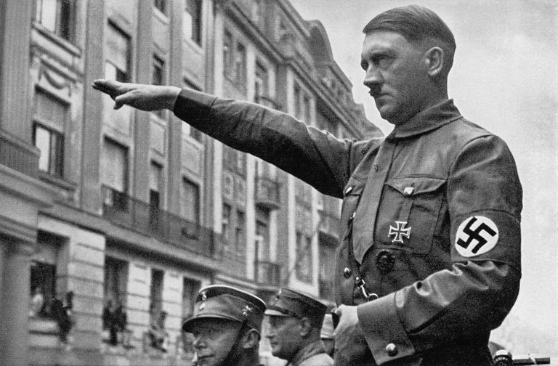
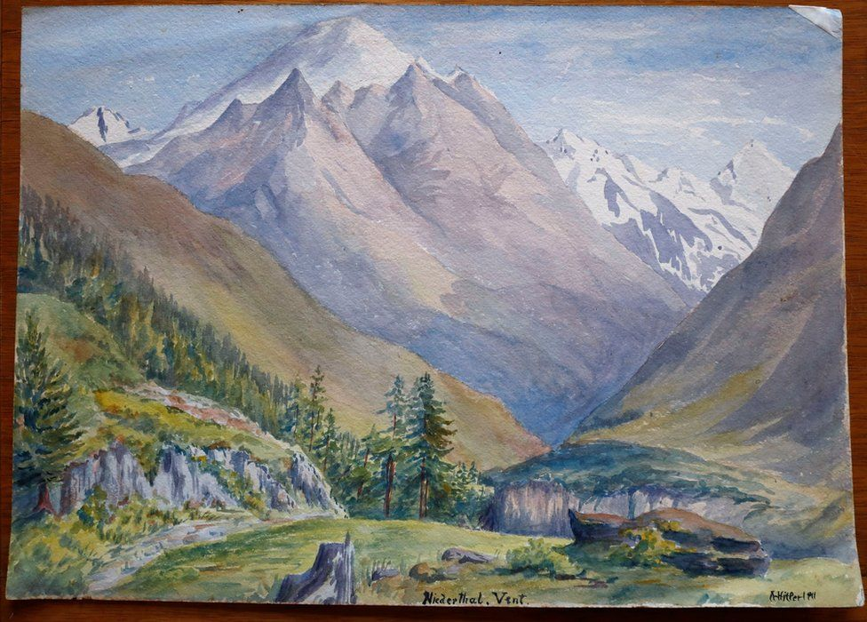
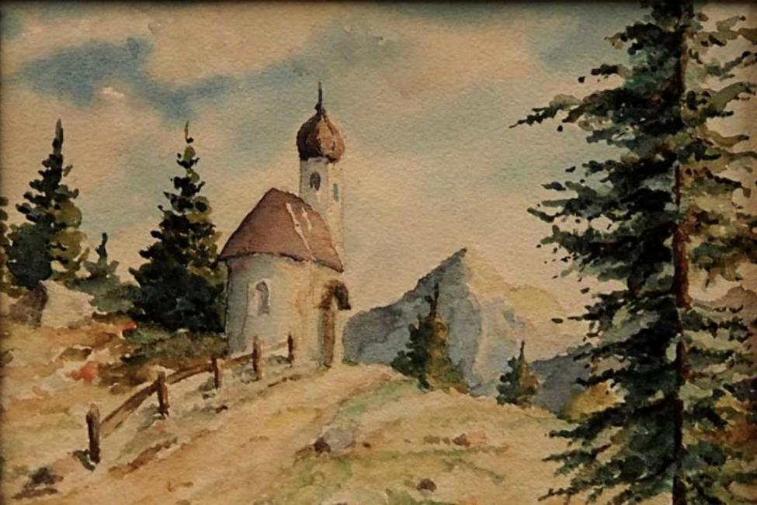
“She did not believe he was a monster. He was not a monster, to her. Probably he had some endearing trait… How easy it is to invent a humanity, for anyone at all.” (155, C24)

Slide 16
Holocaust Comparison
“She did not believe he was a monster. He was not a monster, to her. Probably he had some endearing trait…How easy it is to invent a humanity, for anyone at all.” (155, C24)
In Chapter 24, Offred recalls watching a documentary about the Holocaust, and those complicit in the atrocities.
Why do you think Margaret Atwood includes this section?

Slide 17
Writing About Key Incident
Lack of agency, power; women’s subjugation
Essay Question
Choose a novel or short story in which an incident is significant in relation to the central concerns of the text.
By referring to appropriate techniques, explain why the incident is significant and discuss how it adds to your appreciation of the text as a whole.
Pick TWO of the quotations discussed today-one about what happened when Gilead rose to power, one of the reactions.
Write TWO critical paragraphs, in response to the essay Q above.

Slide 18
PCQEL
Essay Q
Choose a novel or short story in which an incident is significant in relation to the central concerns of the text.
By referring to appropriate techniques, explain why the incident is significant and discuss how it adds to your appreciation of the text as a whole.
Point- (topic sentence-ref to Q, technique and point being made)
Atwood uses _________ in the form of… to…
Context-(where in novel? What is happening at this point?)
A key moment in the novel is…
Quotation
“____________________”
Explanation (thorough analysis of quotation, technique used)
Here, Atwood uses ________ to…
Link (how does quotation link back to Q? What does it tell us about essay topic?)
______________ is an important incident in this novel as it clearly conveys…
Try to write your second paragraph without sentence starters!

Slide 19
Paragraph 2
Atwood demonstrates the effects of Gilead’s takeover when…
CONTINUE-TRY TO FOLLOW PCQEL!

Slide 20
Homework
For Weds 23rd Oct
Read Chapters 30-39 (66 pages)
Finish key incident paragraphs (if incomplete)
As you read, highlight and/or note down THREE interesting quotations
These could be about:
Characters
Key themes
Descriptions of setting
Dialogue
Be prepared to share these next week

