Slide 1
Higher R4UAE- Word Choice

Slide 2
Analysis Questions
You will be asked to comment on the features of
the writer’s language
e.g. How does the writer’s language...
Analyse how the writer’s use of imagery...
Word choice – Imagery – Tone – Sentence structure

Slide 3
The Analysis Question
-Word Choice-
Ask yourself – why a writer has chosen one particular word to describe someone or something, rather than any of the other words which have a similar meaning.
Denotation
The place where someone lives
Connotations
Safety, comfort, warmth, family, calm, peacefulness
Home
Connotation = the associations connected to a certain word/phrase
Denotation = the definition of the word

Slide 4
Word Choice Formula
HIGHER
Quote appropriate word/phrase (2-3 words)
Explain what word suggests (connotations) (1)
Link specifically to idea in Q (1)

Slide 5
NEVER!
Analyse a word using the word

Slide 6
“Pushing past the gas-blanket, I blundered down the stairs to the company headquarters’ dug-out.”
What does the word ‘blundered’ reveal about the way the speaker descended the stairs? (2 marks)
FORMULA
Quote appropriate word/phrase (2-3 words)
Explain what word suggests (connotations) (1)
Link specifically to idea in Q (1)

Slide 7
“My guest was lying sprawled on his back. There was a long knife through his heart which skewered him to the floor.”
Explain how the word ‘skewered’ adds to the horror of the scene.(2 marks)
The word “skewered” suggests…
This makes the scene horrifying, as…

Slide 8
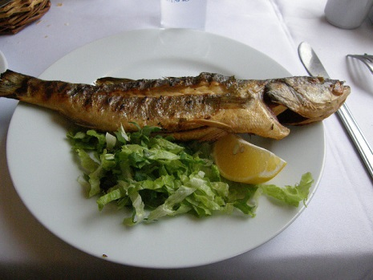
Full Example
This is from an article about the benefits of eating fish.
There’s also the matter of not being bothered enough to think of anything else to eat in the face of a sumptuously juicy salmon steak fizzing away under the grill, to be served with a drizzle of virgin olive oil and a splash of the zingiest lemon – yum! For me, a world without fish is a world where there's nowt for tea. I write as someone who eats fish three times a week, who hasn’t eaten meat since 1983 and has been resolutely adolescent in subject ever since.
Referring to at least 2 examples, analyse how the writer, by her word choice, makes her eating of fish sound attractive. (4 marks)
(connotations) The word/phrase “_______” suggests… (1)
(link to Q) This makes eating fish seem attractive, as…(1)
(connotations) The word/phrase “_______” suggests…(1)
(link to Q) This makes eating fish seem attractive, as…(1)

