Slide 1
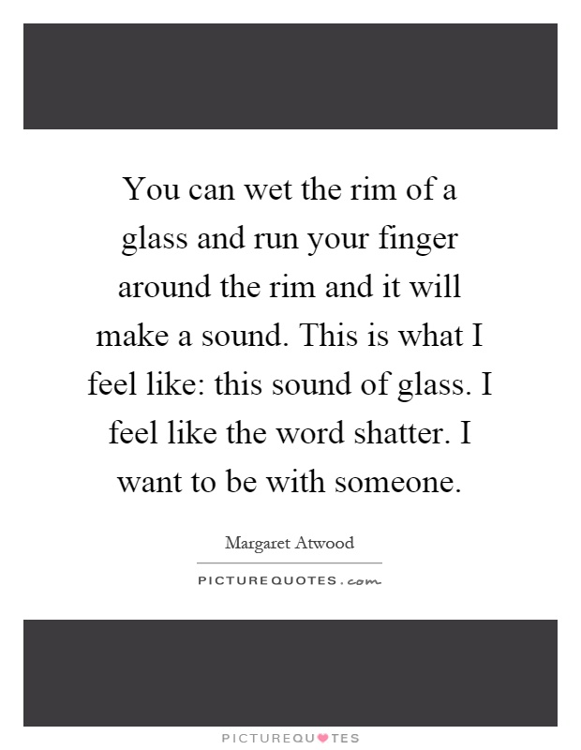
‘The Handmaid’s Tale’ Margaret Atwood
Chapters 18-23

Slide 2
Key Points
On your post-it, make a list of THREE things that happen in this section
Place it on the board

Slide 3
Key Quotes
“This is what I feel like: this sound of glass. I feel like the word shatter.” (113 C18)
“…nobody dies from lack of sex. It’s lack of love we die from. There’s nobody here I can love, all the people I could love are dead or elsewhere…They might as well we nowhere, as I am for them. I too am a missing person.” (113 C18)
“Can I be blamed for wanting a real body to put my arms around? Without it I too am disembodied.” (113 C18)
“I am like a room where things once happened and now nothing does” (114 C18)
“Someone must be out there, taking care of things. I believe in the resistance as I believe there can be no light without shadow; or rather, no shadow unless there is also light.” (115 C18)
“I’m dreaming that I am awake…I feel drugged…Maybe the life I think I’m living is a paranoid delusion…Sanity is a valuable possession; I hoard it the way people once hoarded money.” (119 C19)
“I can’t think of myself, my body, sometimes, without seeing the skeleton…A cradle of life, made of bones.” (122 C19)
“It’s a risk you’re taking, said Aunt Lydia, but you are the shock troops, you will march out in advance, into dangerous territory. The greater the risk the greater the glory.” (122-3 C19)
“A thing is valued, she says, only if it is rare and hard to get…Think of yourselves as pearls…I think about pearls. Pearls are congealed oyster spit…All of us here will lick you into shape, says Aunt Lydia.” (124, C19)

Slide 4
Key Quotes
“More like a daughter to you, as you might say. One of the family…Little whores, all of them, but still, you can’t be choosy.” (125, C19)
“You are a transitional generation, said Aunt Lydia. It is the hardest for you. We know the sacrifices you are being expected to make. It is hard when men revile you. For the ones who come after you, it will be easier. They will accept their duties with willing hearts. She did not say: Because they will have no memories, of any other way. She said: Because they won’t want things they can’t have.” (127, C20)
“A man is just a woman’s strategy for making other women.” (130, C20)
“I admired my mother in some ways, although things between us were never easy. She expected too much from me, I felt. She expected me to vindicate her life for her, and the choices she’d made. I didn’t want to live my life on her terms…I am not your justification for existence, I said to her once.” (132, C20)
“She scrambles onto the Birthing Stool, sits on the seat behind and above Janine, so that Janine is framed by her: her skinny legs come down on either side, like the arms of an eccentric chair.” (135, C21)
“Envy radiates from them, I can smell it, faint wisps of acid, mingled with their perfume. The Commander’s Wife looks down at the baby as if it’s a bouquet of flowers: something she’s won, a tribute.” (136, C21)
“We ache. Each of us holds in her lap a phantom, a ghost baby.” (137, C21)
“Mother…You wanted a women’s culture. Well, now there is one. It isn’t what you meant, but it exists. Be thankful for small mercies.” (137, C21)

Slide 5
Key Quotes
“Help me, that look said, we are all in this together. You are a reliable girl, she went on, not like some of the others.” (139, C22)
“Moira was like an elevator with open sides. She made us dizzy. Already we were losing the taste for freedom, already we were finding these walls secure.” (143, C22)
“This is a reconstruction. All of it is a reconstruction. It’s a reconstruction now, in my head, as I lie flat on my single bed, rehearsing what I should or shouldn’t have said, what I should or shouldn’t have done, how I should have played it. If I ever get out of here-” (144, C23)
“When I get out of here….it will be a reconstruction then too, at yet another remove. It’s impossible to say a thing exactly the way it was….you always have to leave something out.” (144, C23)
“But if you happen to be a man, sometime in the future, and you’ve made it this far, please remember: you will never be subjected to the temptation of feeling you must forgive, a man, as a woman.” (144, C23)
“Maybe none of this is about control. Maybe it isn’t really about who can own whom, who can do what to whom and get away with it, even as far as death…Maybe it’s about who can do what to whom and be forgiven for it.” (144-5, C23)
“We are for breeding purposes: we aren’t concubines, geisha girls, courtesans. On the contrary: everything possible has been done to remove us from that category. There is supposed to be nothing entertaining about us…We are two legged wombs, that’s all: sacred vessels, ambulatory chalices.” (146, C23)
“What a luxury. The counters are like candies, made of peppermint, cool like that…I would like to put them into my mouth…The letter C. Crisp…delicious.” (149, C23)
“I think about how I could approach the Commander…some approach to true love…and drive the sharp end into him suddenly, between his ribs. I think about the bloody coming out of him, hot as soup, sexual, over my hands.” (150, C23)

Slide 6
Key Points
In this section, we:
Find out more of what happened at the Red Centre and the teachings of the Aunts
Witness a birth in Gilead
Find out more about Offred’s mother and her relationship with her
Hear about Moira’s escape from the Red Centre
Witness Offred having a secret meeting with the Commander

Slide 7
Women on Women
Who said that?
“A thing is valued, she says, only if it is rare and hard to get…Think of yourselves as pearls…I think about pearls…All of us here will lick you into shape.”
1.
“More like a daughter to you, as you might say. One of the family…Little whores, all of them, but still, you can’t be choosy.” “
2.
4.
“Help me, that look said, we are all in this together. You are a reliable girl, she went on, not like some of the others.”
3.
“A man is just a woman’s strategy for making other women.”

Slide 8
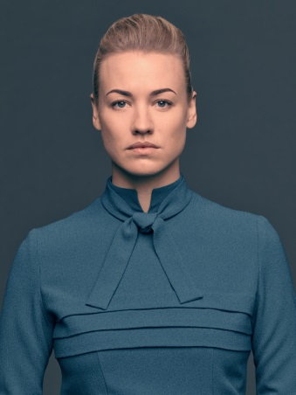
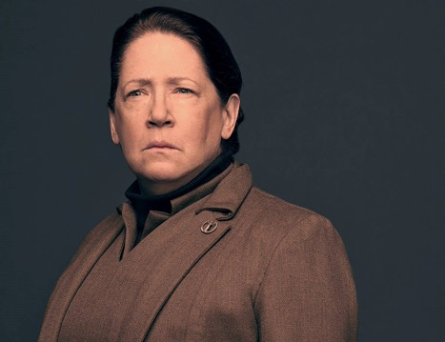
Women on Women
“A thing is valued, she says, only if it is rare and hard to get…Think of yourselves as pearls…I think about pearls…All of us here will lick you into shape.”
“More like a daughter to you, as you might say. One of the family…Little whores, all of them, but still, you can’t be choosy.” “
“Help me, that look said, we are all in this together. You are a reliable girl, she went on, not like some of the others.”
“A man is just a woman’s strategy for making other women.”

Slide 9
Women on Women
What is interesting about the way women speak about women in this society?
Is this what you expect them to do?
Why do you think the Aunts exist, and why have they taken on this role?
What do you think of the Commander’s wives?
What do you think of Offred’s mother’s personal brand of feminism? Could this in any way link to the current system in Gilead?

Slide 10
Aunts
An Aunt must be:
The Aunts exist to:
The Aunts have taken this role to:

Slide 11
Aunts
An Aunt must be:
Someone who is calm natured
Older, potentially post-menopause-wiser, more respected, not sexualised
Someone who was formerly in a respected position-high up in career/high standing in society/viewed as intelligent
The Aunts exist to:
Pacify the Handmaids-keep them under control
Teach the Handmaids the ways of Gilead and responsibilities in their new role
Assist with births
The Aunts have taken this role to:
So they are seen as still having value
Protected from the Colonies and radiation exposure
To support the Gileadean cause

Slide 12
Commander’s Wives
Commander’s wives are:
Jealous of the fertility and actions of the Handmaids-usurping their wifely duties
Pointless/useless because they cannot perform their “biological destiny”
Superior-think highly of themselves, enjoy their privilege
Rude and bitter about lack of control/duty

Slide 13
Pre-Gilead Feminism
Pre-Gilead feminism was:
Bold and brash, fighting to get their point across
Men viewed as a vessel-reversal of Gilead’s position
“man-hating”, “burn-the bra” stereotype of feminism
Gilead a reaction-return to conservative beliefs?

Slide 14
Moira’s Escape
“The story was passed among us that night, in the semi-darkness, under our breath, from bed to bed.
Moira was out there somewhere. She was at large, or dead. What would she do? The thought of what she might do expanded until it filled the room…Moira had power now, she’d been set loose, she’d set herself loose. She was now a loose woman.
I think we found that frightening.
Moira was like an elevator with open sides. She made us dizzy. Already we were losing the taste for freedom, already we were finding these walls secure.
Nevertheless Moira was our fantasy. We hugged her to us…she was lava in the crust of our daily life. In the light of Moira, the Aunts were less fearsome and more absurd.”
How does Moira’s escape affect the other women?
Can Moira’s escape be seen as a selfish act?
What do you think Moira’s plans are?

Slide 15
Narrative Style
We see Gilead and its regime through a limited gaze-Offred is a Handmaid, she is oppressed by the system and not privy to all its inner workings, or the reason for its creation
However as a victim of the system, she can speak honestly about its effects and how the transition from independent woman to powerless vessel has impacted her
Offred imagines writing her tale, and makes reference to her storytelling throughout

Slide 16
Narrative Style
Add annotations beside these quotes. What is Atwood trying to say about Offred’s role in storytelling?
“Myself is a thing I must now compose, as one composes a speech. What I must present is a made thing, not something born.” (pg 76 C12)
“I would like to believe this is a story I’m telling. I need to believe it. I must believe it. Those who can believe that such stories are only stories have a better chance. If it’s a story I’m telling, then I have control over the ending. Then there will be an ending, to the story, and real life will come after it. I can pick up where I left off.” pg 49 (c7)
“This is a reconstruction. All of it is a reconstruction. It’s a reconstruction now, in my head, as I lie flat on my single bed, rehearsing what I should or shouldn’t have said, what I should or shouldn’t have done, how I should have played it. If I ever get out of here-… When I get out of here….it will be a reconstruction then too, at yet another remove. It’s impossible to say a thing exactly the way it was….you always have to leave something out.” (144, C23)
“I want to be held and told my name. I want to be valued, in ways that I am not; I want to be more than valuable. I repeat my former name, remind myself of what I once could do, how others saw me.” (108, C17)

Slide 17
Writing About Narrative Style
First person, Offred recounting experience
Essay Question
Choose a novel or short story in which the method of narration is important. Outline briefly the writer’s method of narration and explain why you feel this method makes such a major contribution to your understanding of the text as a whole.
Pick ONE of the quotations (shorten if necessary!) about narrative style and write a critical paragraph, in response to the essay Q above.

Slide 18
PCQEL
Essay Q
Choose a novel or short story in which the method of narration is important. Outline briefly the writer’s method of narration and explain why you feel this method makes such a major contribution to your understanding of the text as a whole.
Point- (topic sentence-ref to Q, technique and point being made)
In ‘The Handmaid’s Tale’, Atwood uses _________ as the main form of narration.
Context-(where in novel? What is happening at this point?)
Throughout the novel…
Quotation
“____________________”
Explanation (thorough analysis of quotation, technique used)
At this moment, Atwood uses ________ to…
Link (how does quotation link back to Q? What does it tell us about essay topic?)
Atwood’s use of ________ is important, as…

Slide 19
Narrative Style
Add annotations beside these quotes. What is Atwood trying to say about Offred’s role in storytelling?
“Myself is a thing I must now compose, as one composes a speech. What I must present is a made thing, not something born.” (pg 76 C12)
“I would like to believe this is a story I’m telling. I need to believe it. I must believe it. Those who can believe that such stories are only stories have a better chance. If it’s a story I’m telling, then I have control over the ending. Then there will be an ending, to the story, and real life will come after it. I can pick up where I left off.” pg 49 (c7)
“This is a reconstruction. All of it is a reconstruction. It’s a reconstruction now, in my head, as I lie flat on my single bed, rehearsing what I should or shouldn’t have said, what I should or shouldn’t have done, how I should have played it. If I ever get out of here-… When I get out of here….it will be a reconstruction then too, at yet another remove. It’s impossible to say a thing exactly the way it was….you always have to leave something out.” (144, C23)
“I want to be held and told my name. I want to be valued, in ways that I am not; I want to be more than valuable. I repeat my former name, remind myself of what I once could do, how others saw me.” (108, C17)

Slide 20
Homework
For Weds 2nd Oct
Read Chapters 24-29 (45 pages) and finish narrative style paragraph
As you read, highlight and/or note down THREE interesting quotations
These could be about:
Characters
Key themes
Descriptions of setting
Dialogue
Be prepared to share these next week

Slide 21
DEADLINES
Supported study session for persuasive redrafts on tonight 3.30-4.30pm!
THURS 26TH SEPT
Complete imagery Qs (pg 10-13)
TUES 1ST OCT
Persuasive 2nd draft
WEDS 2ND OCT
Read chapters 24-28; finish narrative style paragraph

