Slide 1
‘The Handmaid’s Tale’ Margaret Atwood
Chapters 7-12

Slide 2
Key Quotes
Share the three key quotations that you identified when reading chapters 7-12
Note down the most interesting/commonly quoted example on your post-it-write down the chapter/page number
Place it on the board
I will collate these into a word doc and put it on GLOW for future use in essay writing

Slide 3
Key Quotes
“I would like to believe this is a story I’m telling. I need to believe it. I must believe it. Those who can believe that such stories are only stories have a better chance. If it’s a story I’m telling, the I have control over the ending. Then there will be an ending, to the story, and real life will come after it. I can pick up where I left off.” pg 49 (c7)
“She’s like my own reflection, in a mirror from which I am moving away.” (pg 54 C8)
“Serena Joy didn’t do this herself, she made speeches instead, but she presented this failure of hers as a sacrifice she was making for the good of all.” (pg 55, C8)
“The future is in your hands, she resumed. She held both her own hands out to us…But there was nothing in them. They were empty. It was our hands that were supposed to be full, of the future; which could be held but not seen.” (pg57 C8)
“…there it was, in tiny writing, quite fresh it seemed, scratched with a pin or maybe just a fingernail, in the corner where the darkest shadow fell: Nolite te bastardes carborundorum...Still, it was a message, and it was in writing, forbidden by that very fact, and it hadn’t yet been discovered…It pleases me to know that her taboo message made it through, to at least one other person, washed itself up on the wall of my cupboard, was opened and ready by me. Sometimes I repeat the words to myself. They give me a small joy…I wonder who she was or is, and what’s become of her.” (pg 62 C9)
“Nothing changes instantaneously: in a gradually heating bathtub you’d be boiled to death before you knew it. There were stories in the newspapers…but they were about other women…We were the people who were not in the papers. We lived in the blank white spaces at the edges of print. It gave us more freedom. We lived in the gaps between stories.” (pg66-67 C10)
“I ought to feel hatred for this man. I know I ought to feel it, but it isn’t what I do feel. What I feel is more complicated than that. I don’t know what to call it. It isn’t love.” (pg 68 C10)
“It intersects me so that the doctor will never see my face. He deals with a torso only.” pg 70 C11
“Why am I frightened? I’ve crossed no boundaries, I’ve given no trust, taken no risk, all is safe. It’s the choice that terrifies me. A way out, a salvation.” (pg 71 C11)
“My nakedness is strange to me already. My body seems outdated. Did I really wear bathing suits, at the beach?...Shameful, immodest. I avoid looking down at my body, not so much because it is shameful or immodest but because I don’t want to see it. I don’t want to look at something that determines me so completely.” (pg72-73 C12)
“I cannot avoid seeing, now, the small tattoo on my ankle. Four digits and an eye, a passport in reverse. It’s supposed to guarantee that I will never be able to fade, finally, into another landscape. I am too important, too scarce, for that. I am a national resource.” (pg 75 C12)
“Myself is a thing I must now compose, as one composes a speech. What I must present is a made thing, not something born.” (pg 76 C12)

Slide 4
Key Points
In this section we are:
Shown some of what life was like for Offred at the Red Centre
Given hints at Serena Joy’s past
Shown Offred receiving a message from a former handmaid
Given insight into the medical treatment in Gilead

Slide 5
The Body
In the novel, Offred reflects on her constant depersonalisation-losing her sense of identity and ownership over her self and body
Offred goes from being a university educated, working independent woman, to a vessel at the complete control of those above: as exemplified in her name, Of Fred.
In her musings, she often considers her body, and its new purpose.

Slide 6
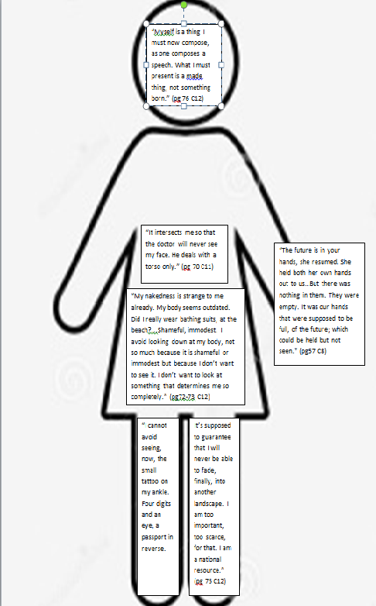
Add annotations around the body/quotations, explaining what these quotations tell us about Offred’s feelings towards herself.

Slide 7
Writing About The Body
Essay Question
Choose a novel or short story in which there is a character who experiences rejection or isolation. With reference to appropriate techniques, explain the rejection or isolation, and discuss how this aspect adds to your appreciation of the text as a whole.
Pick ONE of the quotations from our ‘body’ worksheet and write a critical paragraph, in response to the essay Q above, using PCQEL structure.

Slide 8
PCQEL
Essay Q
Choose a novel or short story in which there is a character who experiences rejection or isolation. With reference to appropriate techniques, explain the rejection or isolation, and discuss how this aspect adds to your appreciation of the text as a whole.
Point- (topic sentence-ref to Q, technique and point being made)
In her creation of Offred, Atwood uses _________ to…
Context-(where in novel? What is happening at this point?)
In the novel, Offred…
Quotation
“____________________”
Explanation (thorough analysis of quotation, technique used)
Here, Atwood uses ________ to…
Link (how does quotation link back to Q? What does it tell us about essay topic?)
Atwood’s description/characterisation of Offred here demonstrates…

Slide 9
PCQEL Example Paragraph
Essay Q
Choose a novel or short story in which there is a character who experiences rejection or isolation. With reference to appropriate techniques, explain the rejection or isolation, and discuss how this aspect adds to your appreciation of the text as a whole.
In her creation of Offred, Atwood uses characterisation to convey the isolation Offred experiences as a result of her depersonalisation under Gilead. In the novel, Offred describes seeing her partner handmaid walk away after shopping: “She’s like my own reflection, in a mirror from which I am moving away.”
Here, Atwood uses characterisation to illustrate Offred’s estrangement from her personal identity: she sees her handmaid partner as a replica of herself, as she has lost any individuality. Her reference to “moving away” suggests the isolation she feels: despite her similarities and shared struggles with her partner, she is unable to make any form of personal connection due to the oppressive regime of which she is a victim.
Atwood’s characterisation of Offred here demonstrates the manipulative mechanisms of the Gileadean regime: a divide and conquer regime that uses depersonalisation and isolation to make its citizens subservient, creating an unnerving dystopian experience for the reader.
Point- (topic sentence-ref to Q, technique and point being made)
Context-(where in novel? What is happening at this point?)
Quotation
Explanation (thorough analysis of quotation, technique used)
Link (how does quotation link back to Q? What does it tell us about essay topic?)

Slide 10
A Sign of Hope?

Slide 11
A Sign of Hope?
“…there it was, in tiny writing, quite fresh it seemed, scratched with a pin or maybe just a fingernail, in the corner where the darkest shadow fell: Nolite te bastardes carborundorum...
Still, it was a message, and it was in writing, forbidden by that very fact, and it hadn’t yet been discovered…
It pleases me to know that her taboo message made it through, to at least one other person, washed itself up on the wall of my cupboard, was opened and ready by me. Sometimes I repeat the words to myself. They give me a small joy…I wonder who she was or is, and what’s become of her.” (pg 62 C9)

Slide 12
Thoughts?
“Nothing changes instantaneously: in a gradually heating bathtub you’d be boiled to death before you knew it. There were stories in the newspapers…but they were about other women…We were the people who were not in the papers. We lived in the blank white spaces at the edges of print. It gave us more freedom. We lived in the gaps between stories.” (pg66-67 C10)

Slide 13
Homework
For Weds 11th Sept
Read Chapters 13-17 (31 pages) and complete characterisation paragraph
As you read, highlight and/or note down THREE interesting quotations
These could be about:
Characters
Key themes
Descriptions of setting
Dialogue
Be prepared to share these next week
ANY MISSED NOTES-GLOW!
https://blogs.glowscotland.org.uk/gc/missinnes/

