Slide 1
‘The Handmaid’s Tale’ Margaret Atwood
Chapters 13-17

Slide 2
Key Quotes
Share the three key quotations that you identified when reading chapters 13-17
Note down the most interesting/commonly quoted example on your post-it
Place it on the board

Slide 3
Key Quotes
“I wait, washed, brushed, fed, like a prize pig.” (pg 79, C13)
“Her fault, her fault, her fault, we chant in unison. Who led them on? Aunt Helen beams, pleased with us. She did. She did. She did. Why did God allow such a terrible thing to happen? Teach her a lesson. Teach her a lesson. Teach her a lesson.” (82, C13)
“She looked disgusting: weak, squirmy, blotchy, pink, like a newborn mouse. None of us wanted to look like that, ever. For a moment, even though we knew what was being done to her, we despised her.” (PG82, C13)
“I sink down into my body as into a swamp, fenland, where only I know the footing. Treacherous ground, my own territory.” (pg 83, C13)
“Each month I watch for blood, fearfully, for when it comes it means failure. I have failed once again to fulfil the expectation of others, which have become my own.” (pg 83, C13)
“I used to think of my body as an instrument, of pleasure or a means of transportation, or an implement for the accomplishment of my will. I could use it to…make things happen…Now the flesh arranges itself differently. I’m a cloud, congealed around a central object, the shape of a pear, which is hard and more real than I am and glows red within its translucent wrapping.” (pg 83-84 C13)
“Serena Joy will shortly enthrone herself, leaning on her cane while she lowers herself down. Possibly she’ll put a hand on my shoulder, to steady herself, as if I’m a piece of furniture. She’s done it before.” (pg89 C14)
“It’s my fault, this waste of her time. Not mine, but my body’s, if there is a difference. Even the Commander is subject to its whims.” (pg 91 C14)

Slide 4
Key Quotes
“I tell myself it doesn’t matter, your name is like your telephone number, useful only to others; but what I tell myself is wrong, it does matter. I keep the knowledge of this name like something hidden, some treasure I’ll come back to dig up, one day. I think of this name as buried. This name has an aura around it, like an amulet, some charm that’s survived from an unimaginably distant past. I lie in my single bed at night, with my eyes closed, and the name floats there behind my eyes, not quite within reach, shining in the dark.” (94, C14)
“The Bible is kept locked up…It is an incendiary device: who knows what we’d make of it, if we ever got our hands on it?” (pg 98 C15)
“To be a man, watched by women. It must be entirely strange. To have them watching him all the time. To have them wondering, What’s he doing to do next? To have them flinch when he moves…To have them sizing him up. To have them thinking, he can’t do it, he won’t do, he’ll have to do…Still, it must be hell, to be a man like that. It must be just fine. It must be hell. It must be very silent.” (99 C15)
“I pray silently: Nolite te bastardes carborundorum. I don’t know what it means, but it sounds right, and it will have to do, because I don’t know what else I can say to God.” (101, C15)
“My arms are raised; she holds my hands, each of mines in each of hers. This is supposed to signify that we are one flesh, one being. What it really means is that she is in control, of the process and thus of the product.” (104, C16)
“Below it the Commander is fucking. What he is fucking is the lower part of my body. I do not say making love, because this is not what he’s doing. Copulating too would be inaccurate, because it would imply two people and only one is involved. Nor does rape cover it: nothing is going on here that I haven’t signed up for. There wasn’t a lot of choice but there was some, and this is what I chose.” (105 C16)
“I want to be held and told my name. I want to be valued, in ways that I am not; I want to be more than valuable. I repeat my former name, remind myself of what I once could do, how others saw me.” (108, C17)

Slide 5
Key Points
In this section, we:
See how the Red Centre attempted to control and brainwash the Handmaids
Gain insight into the process of The Ceremony
Gain insight into Offred’s views on the Commander

Slide 6
Scenario
What is your immediate reaction to the girl in this story?
A 19 year old girl goes on a girl’s holiday with two friends to Salou in Spain. On their first night, the girls have some drinks in their apartment as they are getting ready. They then head out to a bar, where they buy a round of drinks and dance. They are the only girls in a fairly quiet bar.
After the first round, one of the girls goes up to the bar again. She buys another round of drinks, but is distracted by a man as she is trying to pay. She brings the drinks back over to the table and begins to drink. Her friends are still finishing their first round.
The girl then goes to the toilet. She returns and collapses, knocking all the drinks off the table.
The bar staff refuse to phone an ambulance. The other two girls manage to get a taxi outside, but as they travel back to the hotel, the girl begins to vomit. The taxi driver stops, drags the girl out of the car and leaves her on the side of the road.
A ambulance is phoned and the girl is taken to hospital. Only one of her friends is permitted in the ambulance with her, the other is left to get a taxi alone.
At the hospital she is put on a drip and given oxygen. The nurse is too busy watching YouTube videos to provide a receptacle to hold the vomit she is producing. The girl is sick into her friend’s hands.
After some fluids and oxygen, the girl is deemed well enough to leave the hospital. The girls return to the hotel room.
The girl wakes up the next day, with no recollection of what happened. She has a puncture mark in her arm, and no memory.

Slide 7
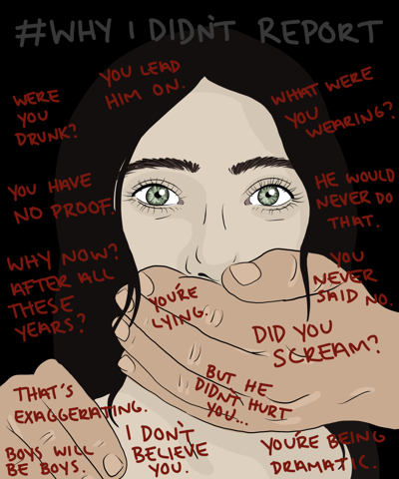
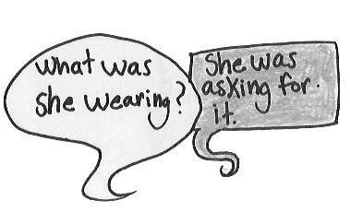
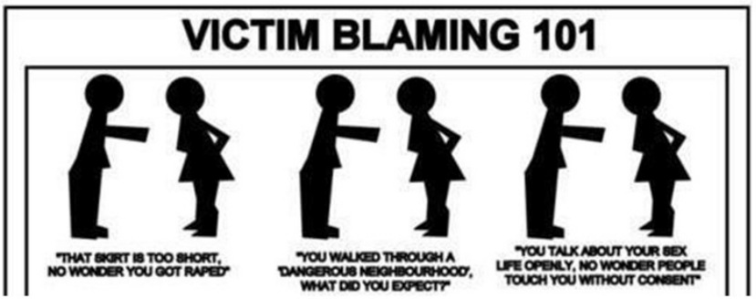
Victim Blaming

Slide 8
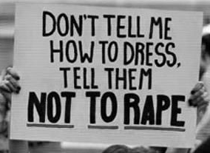
Victim Blaming

Slide 9
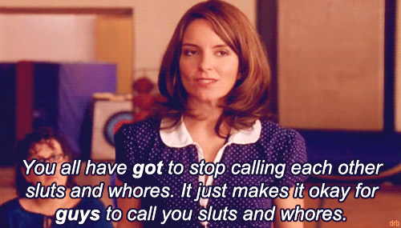
Victim Blaming and Complicity

Slide 10
Victim Blaming
In this section, there is a particularly harrowing scene in chapter 13 (pgs 81-83)
Janine, one of the Handmaids-in-training, is forced to share her experience of being violently gang raped at 14 and having an abortion.
These sessions are known as Testifying, almost like confessing to sins, and Janine is held responsible for the horrific things done to her
Is this scenario completely unfamiliar to you?
“Her fault, her fault, her fault, we chant in unison. Who led them on? Aunt Helen beams, pleased with us. She did. She did. She did. Why did God allow such a terrible thing to happen? Teach her a lesson. Teach her a lesson. Teach her a lesson.” (82, C13)

Slide 11
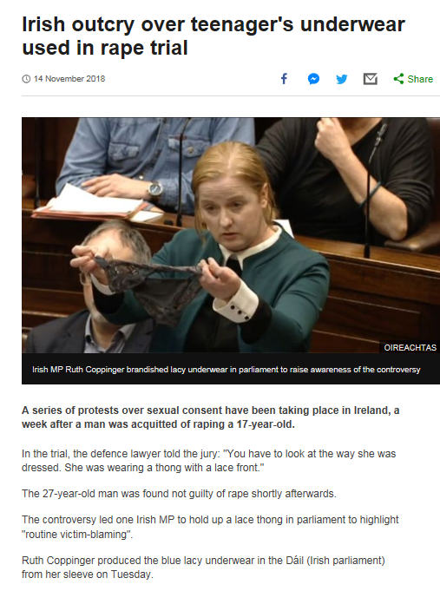

Slide 12
Victim Blaming
“Her fault, her fault, her fault, we chant in unison. Who led them on? Aunt Helen beams, pleased with us. She did. She did. She did. Why did God allow such a terrible thing to happen? Teach her a lesson. Teach her a lesson. Teach her a lesson.” (82, C13)
“She looked disgusting: weak, squirmy, blotchy, pink, like a newborn mouse. None of us wanted to look like that, ever. For a moment, even though we knew what was being done to her, we despised her.” (82, C13)
Add annotations beside these quotes. What is Atwood trying to say about how women are seen in Gilead?
“Each month I watch for blood, fearfully, for when it comes it means failure. I have failed once again to fulfil the expectation of others, which have become my own.” (pg 83, C13)
“It’s my fault, this waste of her time. Not mine, but my body’s, if there is a difference. Even the Commander is subject to its whims.” (91, C14)

Slide 13
The Ceremony
In this section (Chapters 14-16), we discover more about an important aspect of Gilead culture, and Offred’s role in this: The Ceremony
This makes for uncomfortable reading. In this scenario, Offred is a sexual surrogate, and this is carried out in order to conceive a child.
The Ceremony is a ritual, in which all members know their place and role. Does this take away from the horror of the scenario?

Slide 14
The Ceremony
“Serena Joy will shortly enthrone herself, leaning on her cane while she lowers herself down. Possibly she’ll put a hand on my shoulder, to steady herself, as if I’m a piece of furniture. She’s done it before.” (pg89 C14)
“To be a man, watched by women. It must be entirely strange. To have them watching him all the time. To have them wondering, What’s he doing to do next? To have them flinch when he moves…To have them sizing him up. To have them thinking, he can’t do it, he won’t do, he’ll have to do…Still, it must be hell, to be a man like that. It must be just fine. It must be hell. It must be very silent.” (99 C15)
“My arms are raised; she holds my hands, each of mines in each of hers. This is supposed to signify that we are one flesh, one being. What it really means is that she is in control, of the process and thus of the product.” (104, C16)
“Below it the Commander is fucking. What he is fucking is the lower part of my body. I do not say making love, because this is not what he’s doing. Copulating too would be inaccurate, because it would imply two people and only one is involved. Nor does rape cover it: nothing is going on here that I haven’t signed up for. There wasn’t a lot of choice but there was some, and this is what I chose.” (105 C16)

Slide 15
Writing About Key Incident
Lack of agency, power; women’s subjugation
Essay Question
Choose a novel or short story in which an incident is significant in relation to the central concerns of the text.
By referring to appropriate techniques, explain why the incident is significant and discuss how it adds to your appreciation of the text as a whole.
Pick ONE of the quotations about The Ceremony and write a critical paragraph, in response to the essay Q above.

Slide 16
The Ceremony
“Serena Joy will shortly enthrone herself, leaning on her cane while she lowers herself down. Possibly she’ll put a hand on my shoulder, to steady herself, as if I’m a piece of furniture. She’s done it before.” (pg89 C14)
“To be a man, watched by women. It must be entirely strange. To have them watching him all the time. To have them wondering, What’s he doing to do next? To have them flinch when he moves…To have them sizing him up. To have them thinking, he can’t do it, he won’t do, he’ll have to do…Still, it must be hell, to be a man like that. It must be just fine. It must be hell. It must be very silent.” (99 C15)
“My arms are raised; she holds my hands, each of mines in each of hers. This is supposed to signify that we are one flesh, one being. What it really means is that she is in control, of the process and thus of the product.” (104, C16)
“Below it the Commander is fucking. What he is fucking is the lower part of my body. I do not say making love, because this is not what he’s doing. Copulating too would be inaccurate, because it would imply two people and only one is involved. Nor does rape cover it: nothing is going on here that I haven’t signed up for. There wasn’t a lot of choice but there was some, and this is what I chose.” (105 C16)

Slide 17
PCQEL
Essay Q
Choose a novel or short story in which an incident is significant in relation to the central concerns of the text.
By referring to appropriate techniques, explain why the incident is significant and discuss how it adds to your appreciation of the text as a whole.
Point- (topic sentence-ref to Q, technique and point being made)
Furthermore, Atwood uses _________ in the form of… to convey the theme of women’s subjugation.
Context-(where in novel? What is happening at this point?)
A key moment in the novel is…
Quotation
“____________________”
Explanation (thorough analysis of quotation, technique used)
Here, Atwood uses ________ to…
Link (how does quotation link back to Q? What does it tell us about essay topic?)
The Ceremony is an important incident in this novel as it clearly conveys…

Slide 18
Homework
For Weds 25th Sept
Read Chapters 18-23 (37 pages)
As you read, highlight and/or note down THREE interesting quotations
These could be about:
Characters
Key themes
Descriptions of setting
Dialogue
Be prepared to share these next week

