Slide 1
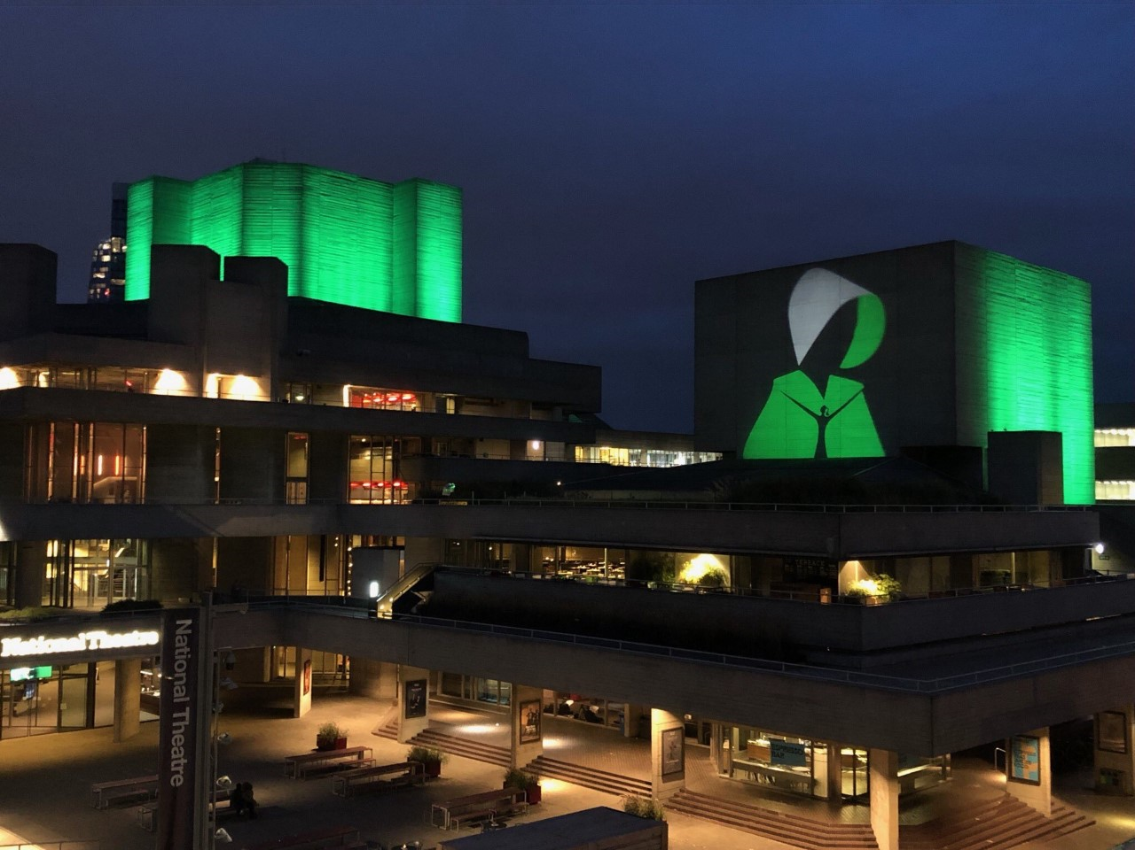
London, Mon 9th September 2019

Slide 2
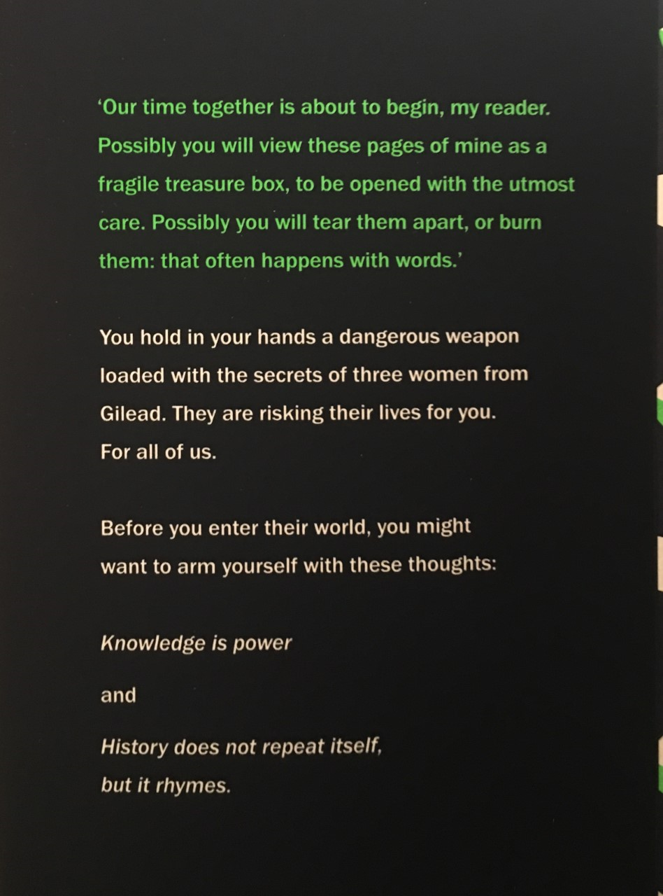
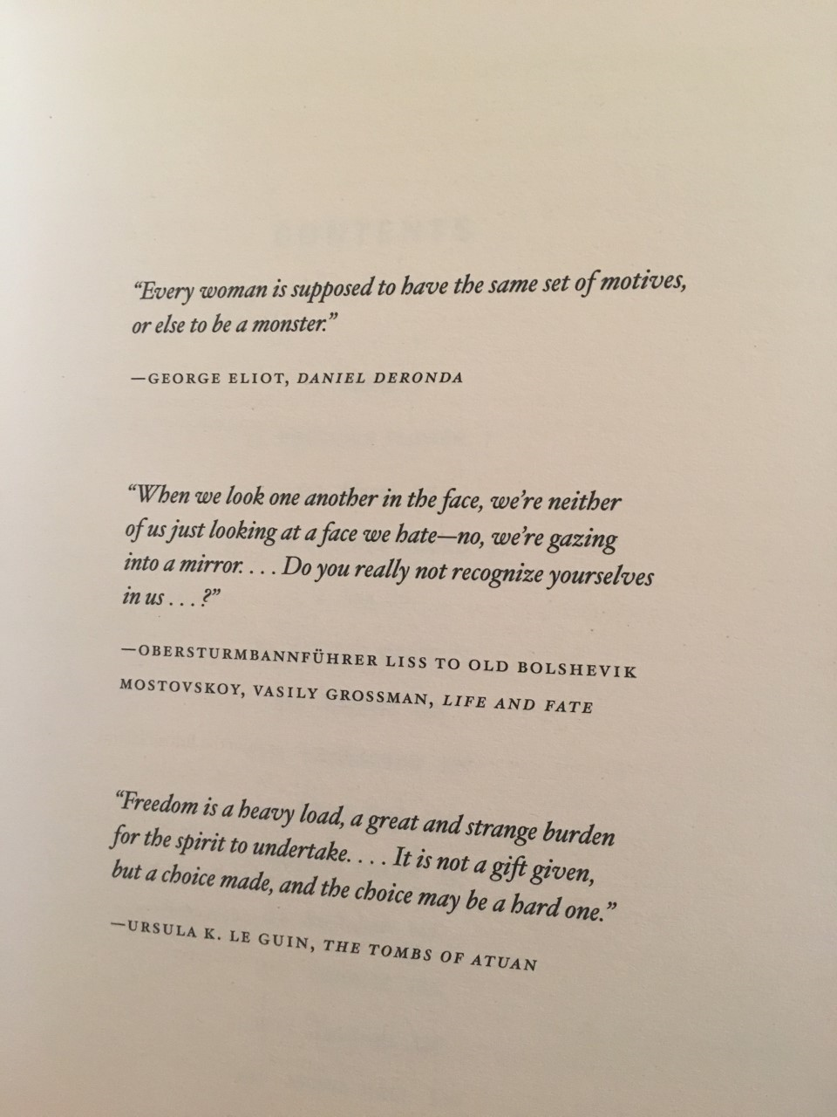

Slide 3
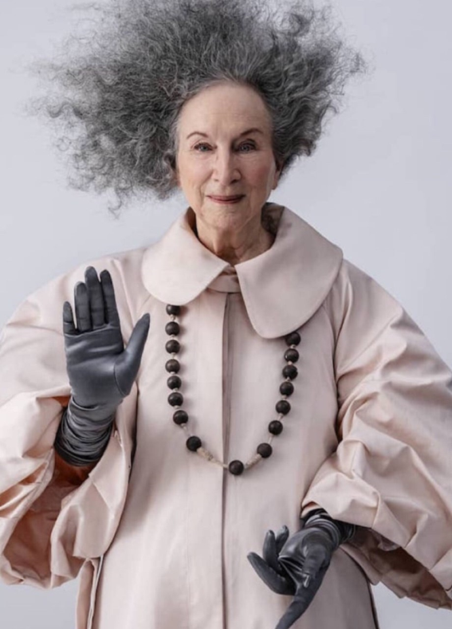
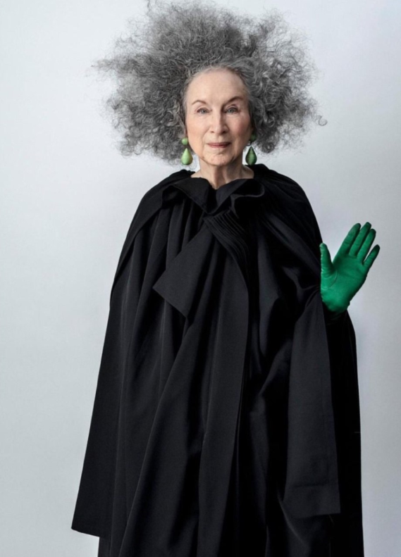
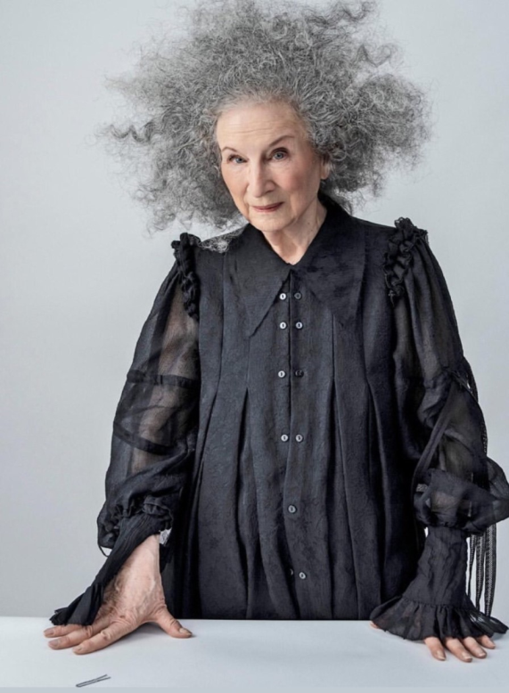
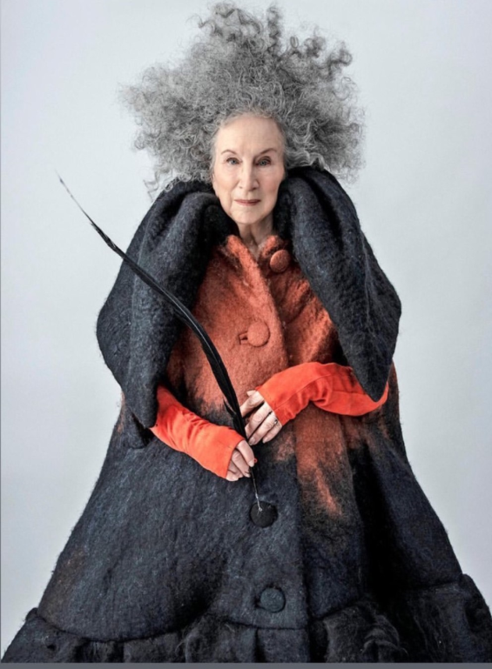

Slide 4
Atwood Interview
https://www.youtube.com/watch?v=_rDoROcHbpI

Slide 5
‘The Handmaid’s Tale’ Margaret Atwood
Chapters 7-12

Slide 6
Your Questions
On your post-it, write down any questions you have about the novel so far:
things you don’t understand about plot/character/setting
Terms we have discussed that you need clarification on
Work that we have covered that has been challenging for you
This will help me know what to cover in this lesson!

Slide 7
Summary Task
You will be split into three groups:
Group 1: Anton, Sean, Jean, Dylan
Group 2: Rhiannon, Ellie, Matthew, Abbie, Sophie
Group 3: Luke, Niamh, Skye, Erin
Each group will be given an A3 sheet, to begin summarising their knowledge of the novel so far
We will rotate these to see how much information we can add to our notes

Slide 8
Summary Task
You will be split into two larger groups:
Group 1:
Adam, Dylan, Ameilia, Connor
Kelvin, Matthew McK, Jean, Sean
Ellie, Rhiannon, Matthew Mullen, Anton
Group 2:
Maryam, Lizzie, Skye, Dani
Abbie, Sophie, Erin, Leighrah
Louie, Luke, Vincent
Peace, Nesse, Niamh, Amy
Each group will be given an A3 sheet, to begin summarising their knowledge of the novel so far
We will rotate these to see how much information we can add to our notes

Slide 9
Summarising Gilead
Summaries created by you!
Run by a religious group
Dystopian setting
Strict society
In the household of a Commander
Totalitarian
Fundamentalist Christian beliefs
Beginning sees a gymnasium filled with handmaids
Opening of book, Offred describes room as a prison
Theocracy-a system ruled by religious belief
Patriarchy-society where men rule

Slide 10
Summarising Offred
Summaries created by you!
Offred is a Handmaid
Number on her ankle, shows she is property
Not treated like a person
Ashamed of her body, doesn’t feel like it is hers
Used as an object
Had a husband and daughter
Often thinks about her past
Controlled by Commander
Set on survival
Alive because of one thing-her fertility
Of Fred-belongs to her commander
Offred envies those with freedom and the higher up wives

Slide 11
Summarising Plot
Summaries created by you!
At the beginning of the novel, Offred narrates the story where she meets the wife of the Commander Fred Waterford-Serena Joy, who was a famous televangelist that believed in traditional home values
Handmaid’s are forced into giving birth for upper class
United States overrun by religious group named Gilead
If not pregnant, there will be consequences for the handmaids
They have a certain job
Totalitarian regime as Gilead is controlling everyone
Disjointed narrative-flashbacks to past events

Slide 12
Understanding and Analysing Key Quotes
Your group will be given a key quotation from chapters 1-12 to look at in detail
You will create detailed notes on:
Context of the quotation (what is happening at this point in the text)
Analysis of techniques (what is particular quote telling us about character/theme/setting/conflict, etc)
Aspect of the novel (characterisation, setting, language, key incident, climax, turning point, plot, structure, narrative technique, theme, ideas, description, etc…)
Potential Qs this quote will be useful for (e.g. character, setting, key incident, theme, conflict, etc)

Slide 13
EXAMPLE
CONTEXT:
Offred greets her fellow Handmaid
QUOTATION:
“Blessed be the fruit,”…”May the Lord open,” I answer, the accepted response.”pg 29 (C4)
ASPECT OF NOVEL:
Characterisation, language
ANALYSIS:
Archaic language/formal phrasing indicates strict regime of Gilead-biblical reference frames this setting as a theocracy, where religious faith is priority
“accepted response”-even speech is policed under totalitarian state-idea of always being watched
Greeting as reference to fertility (“fruit”)-highlights Handmaid’s sole purpose in this society
LINKS TO Q:
setting (Gilead), characterisation (Offred/role of handmaid); Theme (women’s subjugation)

Slide 14
Pairs
Anton and Sean
Dylan and Jean
Rhiannon, Ellie, Matthew
Abbie and Sophie
Erin and Luke
Skye and Niamh

Slide 15
Key Themes
What are the key themes we have encountered so far in ‘The Handmaid’s Tale’?
Consider-what is the message that Margaret Atwood is trying to deliver through this novel?
Write down your group’s thoughts on your post-it
E.G.

Slide 16
Key Themes
Women’s subjugation-the active attempt by an individual or society to keep women inferior to men.
Resistance and rebellion

Slide 17
Your Quote and Theme
Consider the quote you were given to analyse
Which theme does this quotation link to:
Women’s subjugation?
Resistance and rebellion?

Slide 18
Writing About Theme
Women’s subjugation/resistance and rebellion
Essay Question
Choose a novel or short story that deals with a theme of moral or social significance.
With reference to appropriate techniques, explain how the writer develops this theme and discuss why its development adds to your appreciation of the text as a whole.
Using your given quotation, write a critical paragraph in response to the essay Q above, using PCQEL structure.

Slide 19
PCQEL
Essay Q
Choose a novel or short story that deals with a theme of moral or social significance.
With reference to appropriate techniques, explain how the writer develops this theme and
discuss why its development adds to your appreciation of the text as a whole.
Point- (topic sentence-ref to Q, technique and point being made)
In ‘The Handmaid’s Tale’, Atwood explores the theme of_____[theme]____through _____[aspect of novel]__
Context-(where in novel? What is happening at this point?)
This theme is developed when…
Quotation
“____________________”
Explanation (thorough analysis of quotation, technique used)
Here, Atwood uses __[aspect of novel]______ to…
Link (how does quotation link back to Q? What does it tell us about essay topic?)
This demonstrates Atwood’s theme of…as…

Slide 20
An Example Theme Paragraph C1-12
In ‘The Handmaid’s Tale’, Atwood explores the theme of women’s subjugation through the language used in Gilead. This theme is developed when Offred greets her fellow Handmaid:
“Blessed be the fruit,”…”May the Lord open,” I answer, the accepted response.”pg 29 (C4)
Here, Atwood uses archaic language and formal phrasing to indicate the strict regime of Gilead, one where even turn of phrase is carefully monitored. The biblical references in their speech frames this setting as a theocracy, where demonstrating religious faith is the main priority of all citizens. Offred describes her reply as an “accepted response”, indicating that even speech is policed under the totalitarian state, emphasising that the Handmaids are being constantly watched. The reference to fertility that forms the greeting highlights the Handmaid’s sole purpose in this society, as the bearers of the “fruit” of their wombs. This demonstrates Atwood’s theme of women’s subjugation, as even the language used emphasises the controlling nature of Gilead towards females, and places the Handmaids firmly in their place as mere vessels for the future of the upper class.

Slide 21
Homework
For Weds 18th Sept
Finish theme paragraph (if not completed in class)
Read Chapters 13-17 (31 pages)
As you read, highlight and/or note down THREE interesting quotations
These could be about:
Characters
Key themes
Descriptions of setting
Dialogue
Be prepared to share these next week
WARNING: References to abuse and rape in this section.

