Slide 1
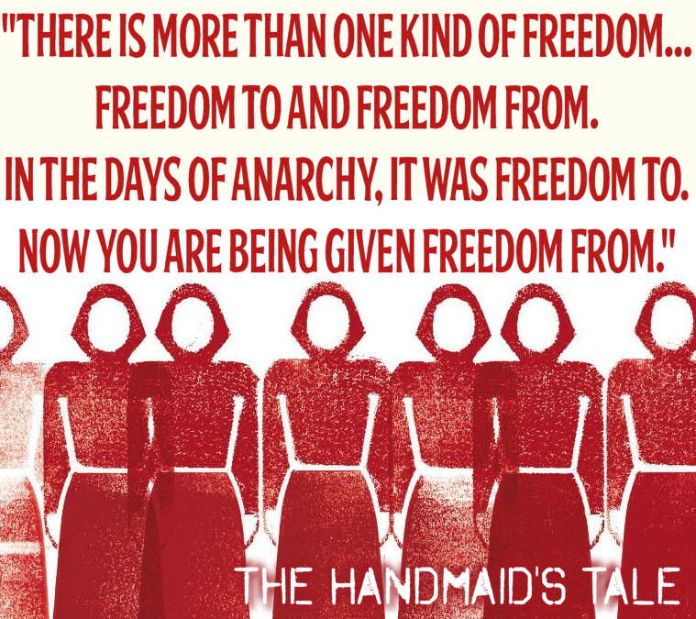
‘The Handmaid’s Tale’ Margaret Atwood
Chapters 1-6

Slide 2
Key Quotes
Share the three key quotations that you identified when reading chapters 1-6
Note down the most interesting/commonly quoted example on your post-it
Place it on the board

Slide 3
Key Quotes
“I am alive, I live, I breathe, I put my hand out, unfolded into the sunlight. Where I am is not a prison but a privilege, as Aunt Lydia said, who was in love with either/or.” pg 18(C2)
“Everything except the wings around my face is red: the colour of blood, which defines us….The white wings too are prescribed issue, they are to keep us from seeing, but also from being seen.” pg 18(C2)
“A parody of something, some fairytale figure in a red cloak…A Sister, dipped in blood.” pg 19(C2)
“Yes Ma’am, I said again, forgetting. They used to have dolls, for little girls, that would talk if you pulled a string at the back; I thought I was sounding like that, voice of a monotone, voice of a doll.” pg 26 (C3)
“Blessed be the fruit,”…”May the Lord open,” I answer, the accepted response.”pg 29 (C4)
“They touch with their eyes instead and I move my hips a little…It’s like…teasing a dog with a bone held out of reach, and I’m ashamed of myself for doing it, because none of this is the fault of these men, they’re too young.” pg 32 (C4)
“This is the heart of Gilead, where the war cannot intrude except on television…The Republic of Gilead, said Aunt Lydia, knows no bounds. Gilead is within you.” pg 33 (C5)
“There is more than one kind of freedom, said Aunt Lydia. Freedom to and freedom from. In the days of anarchy, it was freedom to. Now you are being given freedom from. Don’t underrate it.” pg 34 (C5)
“We are fascinated but also repelled. They seem undressed. It has taken so little time to change our minds, about things like this. Then I think: I used to dress like that. That was freedom. Westernised, they used to call it.” pg 38 (C5)
“What we are supposed to feel towards these bodies is hatred and scorn…What I feel towards them is blankness. What I feel is that I must not feel.” pg 43 (C6)

Slide 4
Key Points
In this section, we are:
Introduced to our narrator, Offred
Given a clear description of the image of a Handmaid
Given a glimpse at the day to day life of a Handmaid
Given an insight into what Gilead is like-the rules and it’s culture

Slide 5
Epigraph
An epigraph is a short quotation or saying at the beginning of a book or chapter, intended to suggest its theme
This novel has THREE quotes as epigraphs
Each group will be given one. From your reading so far, note down:
What you think this quotation means-you can look online for more info
How it relates to the text

Slide 6
From Genesis 30:1-3
“And when Rachel saw that she bare Jacob no children, Rachel envied her sister; and said unto Jacob, Give me children, or else I die.
And Jacob’s anger was kindled against Rachel; and he said, Am I in God’s stead, who hath withheld from thee the fruit of the womb?
And she said, Behold my maid Bilhah, go in unto her; and she shall bear upon my knees, that I may also have children by her.”

Slide 7
From Genesis 30:1-3
“And when Rachel saw that she bare Jacob no children, Rachel envied her sister; and said unto Jacob, Give me children, or else I die.
And Jacob’s anger was kindled against Rachel; and he said, Am I in God’s stead, who hath withheld from thee the fruit of the womb?
And she said, Behold my maid Bilhah, go in unto her; and she shall bear upon my knees, that I may also have children by her.”
MEANING
Describes Rachel’s infertility and feelings of despair over this-she proposes her husband “uses” her handmaid in order to bear a child.
LINK TO HANDMAID’S TALE
Gilead is a Christian society founded on very fundamentalist Christian beliefs-using biblical tale and creating specific roles in society.

Slide 8
Notes on Genesis Quote
Rachel was married to Jacob, the father of the Israelites.
She was unable to conceive children, and offered up her maidservant Bilhah to be a surrogate for her
Bilhah gave birth to two sons, and Rachel later gave birth to a son, Joseph, Jacob’s favourite child.
She died during the childbirth of her second son, Benjamin

Slide 9
From ‘A Modest Proposal’-Jonathan Swift
“But as to myself, having been wearied out for many years with offering vain, idle, visionary thoughts, and at length utterly despairing of success, I fortunately feel upon this proposal…”

Slide 10
From ‘A Modest Proposal’-Jonathan Swift
“But as to myself, having been wearied out for many years with offering vain, idle, visionary thoughts, and at length utterly despairing of success, I fortunately feel upon this proposal…”
MEANING
An essay based on the Irish famine and overpopulation. Solution-sell and eat the kids! Satire-poking fun at cruel government
LINK TO HANDMAID’S TALE
Women’s rights being removed and disrespected-so extreme it is almost satire

Slide 11
Notes on Swift Quote
The satirical essay suggests that the impoverished Irish might ease their economic troubles by selling their children as food for rich gentlemen and ladies.
This satirical hyperbole mocked heartless attitudes towards the poor, as well as British policy toward the Irish in general.

Slide 12
From a Sufi proverb
“In the desert there is no sign that says, Thou shalt not eat stones.”

Slide 13
From a Sufi proverb
“In the desert there is no sign that says, Thou shalt not eat stones.”
MEANING
Although rules may be implemented strictly, leaving few options, people still have free choice.
LINK TO HANDMAID’S TALE
There is the option of small rebellions, even if they seem detrimental to your situation.

Slide 14
Notes on Sufi Quote
Sufism is a particular philosophy of Islam
A possible meaning is that in the desert there is nothing to eat except stones, but no-one wants to eat them, for they cannot sustain life. In other words, there is no point in prohibiting something that no-one wants to do anyway
It could also mean - live with what you have, however terrible or life destroying it is.
Some rules don't have to be written down; they should be obvious.

Slide 15
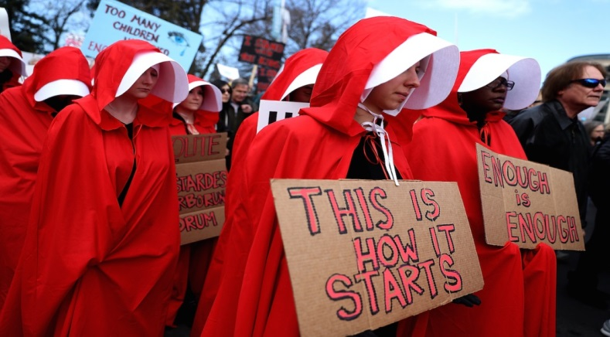
Image of a Handmaid
The Handmaid image is so iconic, and has recently been adopted by women around the world protesting against laws that infringe on their rights
What makes this uniform so iconic? What does it represent?

Slide 16
Image of a Handmaid
“I get up out of the chair, advance my feet into the sunlight, in their red shoes, flat-heeled to save the spine and not for dancing. The red gloves are lying on the bed. I pick them up, pull them onto my hands, finger by finger. Everything except the wings around my face is red: the colour of blood, which defines us. The skirt is ankle-length, full, gathered to a flat yoke that extends over the breasts, the sleeves are full. The white wings too are prescribed issue, they are to keep us from seeing, but also from being seen. I never looked good in red.” pg 18(C2)

Slide 17
Image of a Handmaid
Red as a warning of their important role
“I get up out of the chair, advance my feet into the sunlight, in their red shoes, flat-heeled to save the spine and not for dancing. The red gloves are lying on the bed. I pick them up, pull them onto my hands, finger by finger. Everything except the wings around my face is red: the colour of blood, which defines us. The skirt is ankle-length, full, gathered to a flat yoke that extends over the breasts, the sleeves are full. The white wings too are prescribed issue, they are to keep us from seeing, but also from being seen. I never looked good in red.” pg 18(C2)
High heels used to signify attractiveness, sexuality; height as power
Every part is covered, no skin showing
Symbol of fertility (period)
No individualilty-defined by job/body
Victorian ideas of modesty
Covered up
Angelic nature
Kept ignorant, no voice
Not sexualised/attractive/ tempting

Slide 18
Image of a Handmaid
Red symbolism-passion, desire, anger, violence, blood
“I get up out of the chair, advance my feet into the sunlight, in their red shoes, flat-heeled to save the spine and not for dancing. The red gloves are lying on the bed. I pick them up, pull them onto my hands, finger by finger. Everything except the wings around my face is red: the colour of blood, which defines us. The skirt is ankle-length, full, gathered to a flat yoke that extends over the breasts, the sleeves are full. The white wings too are prescribed issue, they are to keep us from seeing, but also from being seen. I never looked good in red.” pg 18(C2)
High heels as symbol of promiscuity, risk, sexiness
Hands covered-protection, purity
Violence, danger
Period, fertility-only use in society
Modest, Victorian ideals of dress
Wings symbolise freedom; white like dove, peace-opposite here
No skin shown
Protected, shameful
Trapped, no control

Slide 19
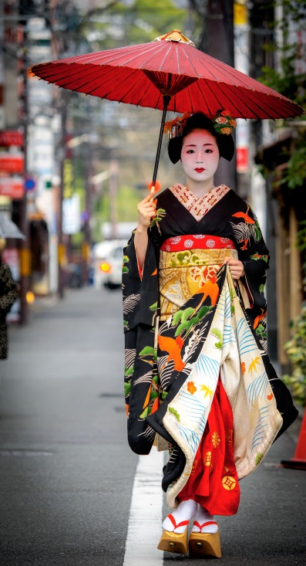
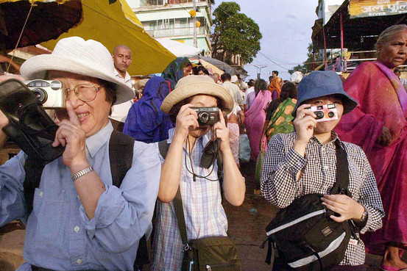
“We are fascinated but also repelled. They seem undressed. It has taken so little time to change our minds, about things like this. Then I think: I used to dress like that. That was freedom. Westernised, they used to call it.” pg 38 (C5)

Slide 20
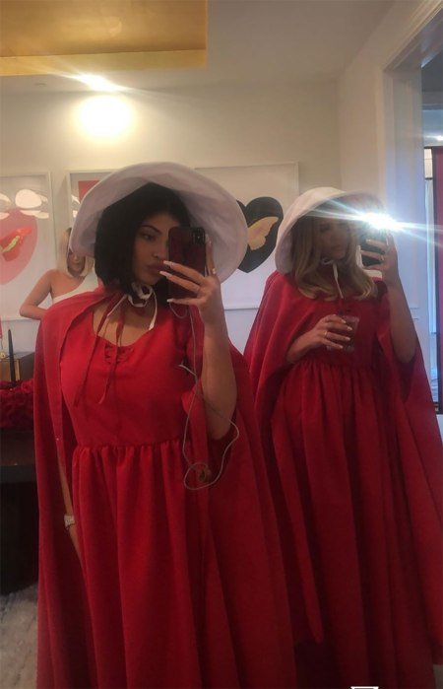
Thoughts?

Slide 21
Creating Gilead
Theocracy
Dystopia
Republic of Gilead
Totalitarian regime
Patriarchy
Discuss and look up the meanings of these terms. Write a SIMPLIFIED definition for each, and how they relate to the ideas in ‘The Handmaid’s Tale’ thus far.

Slide 22
Creating Gilead
Add the quotes about Gilead to the relevant sections of your Gilead mind map-what aspect of Gilead do they show?
“I am alive, I live, I breathe, I put my hand out, unfolded into the sunlight. Where I am is not a prison but a privilege, as Aunt Lydia said, who was in love with either/or.” pg 18(C2)
This is the heart of Gilead, where the war cannot intrude except on television…The Republic of Gilead, said Aunt Lydia, knows no bounds. Gilead is within you.” pg 33 (C5)
“There is more than one kind of freedom, said Aunt Lydia. Freedom to and freedom from. In the days of anarchy, it was freedom to. Now you are being given freedom from. Don’t underrate it.” pg 34 (C5)

Slide 23
Writing About Setting
Essay Question
Choose a novel or short story in which the choice of setting is central to your appreciation of the text.
Briefly explain how the writer effectively creates setting and, with reference to appropriate techniques, discuss how the writer’s presentation of the setting is central to your appreciation of the text as a whole.
In your groups, pick one of the quotations discussed today about Gilead, and write a critical paragraph in reference to this question.
Use PCQEL format

Slide 24
PCQEL
Essay Q
Choose a novel or short story in which the choice of setting is central to your appreciation of the text.
Briefly explain how the writer effectively creates setting and, with reference to appropriate techniques, discuss how the writer’s presentation of the setting is central to your appreciation of the text as a whole.
Point- (topic sentence-ref to Q, technique and point being made)
Initially, Atwood uses _________ to…
Context-(where in novel? What is happening at this point?)
At the beginning of the novel, Atwood…
Quotation
“____________________”
Explanation (thorough analysis of quotation, technique used)
Here, Atwood uses ________ to…
Link (how does quotation link back to Q? What does it tell us about essay topic?)
Atwood’s description of setting here helps exemplify…

Slide 25
Homework
For Weds 4th Sept
Finish your setting paragraph (handwritten or emailed) and read Chapters 7-12 (29 pages)
As you read, highlight and/or note down THREE interesting quotations
These could be about:
Characters
Key themes
Descriptions of setting
Dialogue
Be prepared to share these next week

