Slide 1
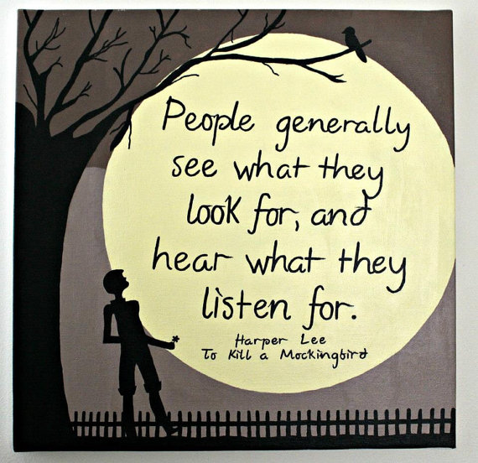
Critical Essay Conclusion Revision Lesson

Slide 2
Concluding-SERVE
In your conclusion you should:
Summarise the points you have made
Evaluate writer’s message (link to themes)
Refer back to the question
Vary your expression (don’t repeat yourself)
Express an opinion (appreciation of text)

Slide 3
Example Conclusion
ESSAY QUESTION
Choose a novel or short story in which the writer creates a realistic or convincing character.
By referring to appropriate techniques, show how the writer creates this character, and say why you find him or her to be realistic or convincing.
EXAMPLE CONCLUSION
In conclusion, Atticus is an interesting character due to his strong moral compass and insistence on fighting for what he believes to be morally right, despite the opposition he faces from his small-minded community. Lee uses Atticus’ defeat to demonstrate her theme of racial prejudice, and the overwhelming battle faced by the black community in the Deep South in the 1930s. Lee’s compelling use of characterisation, key incident and symbolism effectively create a strong and sympathetic character, who the reader admires greatly.
Summarise the points you have made
Evaluate writer’s message (link to themes)
Refer back to the question
Vary your expression (don’t repeat yourself)
Express an opinion (appreciation of text)

Slide 4
Practising Writing Conclusions
THEME ESSAY
Summarise Lee’s message/points made about 1930s Deep South and prejudice
KEY INCIDENT ESSAY
Summarise what key incident of court case tells us about prejudice
CONFLICT ESSAY
Summarise what Atticus’ conflict with community tells us about prejudice and morality
Summarise the points you have made
Evaluate writer’s message (link to themes)
Refer back to the question
Vary your expression (don’t repeat yourself)
Express an opinion (appreciation of text)

Slide 5
Peer Assessing
Review your partner’s conclusion
Highlight where they have fulfilled the SERVE requirements
Summarise the points you have made
Evaluate writer’s message (link to themes)
Refer back to the question
Vary your expression (don’t repeat yourself)
Express an opinion (appreciation of text)

