Slide 1
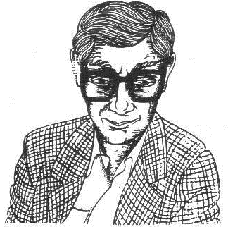
Scottish Set Text Revision Tips

Slide 2
Pop Quiz!

Slide 3
How to revise for Textual Analysis
Key quotations from each poem-flashcards
Mind maps of key info for each poem/theme
key quotes
themes
Techniques
Links with other poems
Links between poems-Venn diagrams
Practice papers

Slide 4
Flashcards
Identify 3/4 key quotes from each poem-that demonstrate particular themes, use particularly interesting techniques, etc.
To help you memorise these quotes and how to analyse them, create flashcards

Slide 5
Example Flashcard
ITSB
QUOTE
“like a monstrous animal caught in a tent/in some story”
TECHNIQUE
Simile
ANALYSIS
compared to a frightening creature, trapped and struggling to escape-dehumanised
Seems bizarre, alien to those around him
THEME/LINKS
Interesting character
Isolation
Helplessness
Misconceptions

Slide 6
Venn Diagram Links
If you are a ‘visual learner’, a good way to remember links between poems might be to create Venn diagrams showing the features the poems have in common
E.G.
visions

Slide 7
‘Winter’
‘Glasgow Sonnets I’
‘Glasgow 5th March 1971’
decay
Visions of Glasgow
Despair
Interesting setting

Slide 8
Mind Mapping Poems
Each group will be given a poem to look at in detail
They will create a mind map of key information from that poem, that will be useful for revision, including:
Key quotes
Key themes
Links with other poems
Key techniques used

Slide 9
Groups
‘ITSB’-Amy, Rhiannon, Sean, Katelan
‘Winter’-Anna, Sarah, Peace, Joe
‘Glasgow 5th March 1971’-Rebecca, Charli, Ben, Matthew M; Drew, Ilyas, Brodie, Amelia
‘Glasgow Sonnets I’-Daniel, Erin, Nesse, Niamh C; Jack W, Miljana, Sophie, Abbie
‘Good Friday’-Rose, Adam, Jack C, Niamh M
‘Trio’-Maryam, Matthew G, Tolu, Grace

Slide 10
Mind Map Example
Key Quotes (3/4-with brief explanation of techniques)
Key Themes
Poem
Links to other poems

Slide 11
REVISION RESOURCES
https://blogs.glowscotland.org.uk/gc/missinnes/

