Slide 1
Higher English Masterclass
R4UAE-Comparison Q

Slide 2
Structure of Paper
2 articles, similar topics
Most questions will be on passage 1
IYOW
Word Choice
Imagery
Sentence Structure
Tone
Link
One question-the comparison question-will ask you to COMPARE the two articles on issues they AGREE or DISAGREE with

Slide 3
Comparison Q Structure
Look at both passages.
The writers agree/disagree about_________. Identify three key areas on which they agree/disagree.
You should support the points by referring to important ideas in both passages.
You may answer this Q in continuous prose or in a series of developed bullet points.

Slide 4
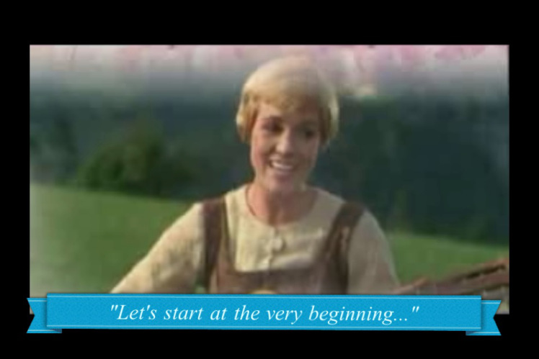
Comparison Process
You should begin work on the comparison Q before you even start looking at any of the Qs!
After reading each passage, you should be writing a SUMMARY of KEY POINTS made about the topic beneath each article
This will make the comparison Q much easier, as you won’t need to spend time rereading the passages at the end of the paper

Slide 5
Step by Step Process
Step 1-work out if the Q is asking your for points of agreement (P.O.A) or points of disagreement (P.O.D)
Step 2-briefly sum up the main points of each passage-in note form underneath each passage (highlight points while reading!)
Step 3-compare summary points based on Q-what do they agree/disagree on?
Step 4-write up answer using answer structure

Slide 6
Comparison Answer Structure
P.O.A/D (Point of Agreement/Disagreement) 1
Passage 1 states…
“_________” (P.1)
Passage 2 states…
“________” (P.2)
P.O.A/D 2
Passage 1 states…
“_________” (P.1)
Passage 2 states…
“________” (P.2)
P.O.A/D 3
Passage 1 states…
“_________” (P.1)
Passage 2 states…
“________” (P.2)
What does each passage say, and what is the evidence of this?
What ideas do the articles agree or disagree about?

Slide 7
Practice Q

Slide 8
Example Q
Look at both passages.
The writers agree about success of the film ‘A Star Is Born’. Identify three key areas on which they agree.
You should support the points by referring to important ideas in both passages.
You may answer this Q in continuous prose or in a series of developed bullet points.

Slide 9
Step by Step Process
Step 1-work out if the Q is asking your for points of agreement (P.O.A) or points of disagreement (P.O.D)
Step 2-briefly sum up the main points of each passage-in note form underneath each passage (highlight points while reading!)
Step 3-compare summary points based on Q-what do they agree/disagree on?
Step 4-write up answer using answer structure

Slide 10
Article Summaries
Passage 1
Passage 2
Lady Gaga’s performance was great (P1, 6)
easy to watch and enjoyable (p.1)
Lady Gaga shines, obviously a star (P1, 6)
story is full of excitement and drama (P1)
Bradley Cooper is great in his role (P.6)
Lady Gaga is phenomenal (P2,11)
Cooper’s directing abilities (P9, 11)
Music praised highly (P2, 10)
Enjoyable for most audiences (P10)
brave choice of remake, but successful (P1)
Read Passage 1 and highlight key points as we read.
After, look back at highlighted sections and summarise main points about ‘A Star Is Born’.

Slide 11
Article Summaries
Passage 1
Passage 2
Read Passage 2 and highlight key points as we read.
After, look back at highlighted sections and summarise main points about zoos.

Slide 12
Comparison Answer Structure
What are our MAIN points that they AGREE on? What do BOTH articles mention about ‘A Star Is Born’, and agree on?

Slide 13
Comparison Answer Structure
Point of Agreement/Disagreement(POA/D) 1-Both passages agree/disagree…
Passage 1 states…
“_________”
Passage 2 states…
“________”
POA/D 2-Both passages agree/disagree…
Passage 1 states…
“_________”
Passage 2 states…
“________”
POA/D 3-Both passages agree/disagree…
Passage 1 states…
“_________”
Passage 2 states…
“________”

Slide 14
R4UAE Comparison Q
POA 1-Both passages agree Lady Gaga gives an incredible performance
Passage 1 states that Lady Gaga is obviously a star
“…a sensationally good Lady Gaga…functions at the highest level at all times.”
Passage 2 states that Lady Gaga is phenomenal in the film
“an acting star is born in Lady Gaga”

Slide 15
POA 2-Both passages agree…
Passage 1 states…
“_________”
Passage 2 states…
“________”
POA 3-Both passages agree…
Passage 1 states…
“_________”
Passage 2 states…
“________”

