Slide 1
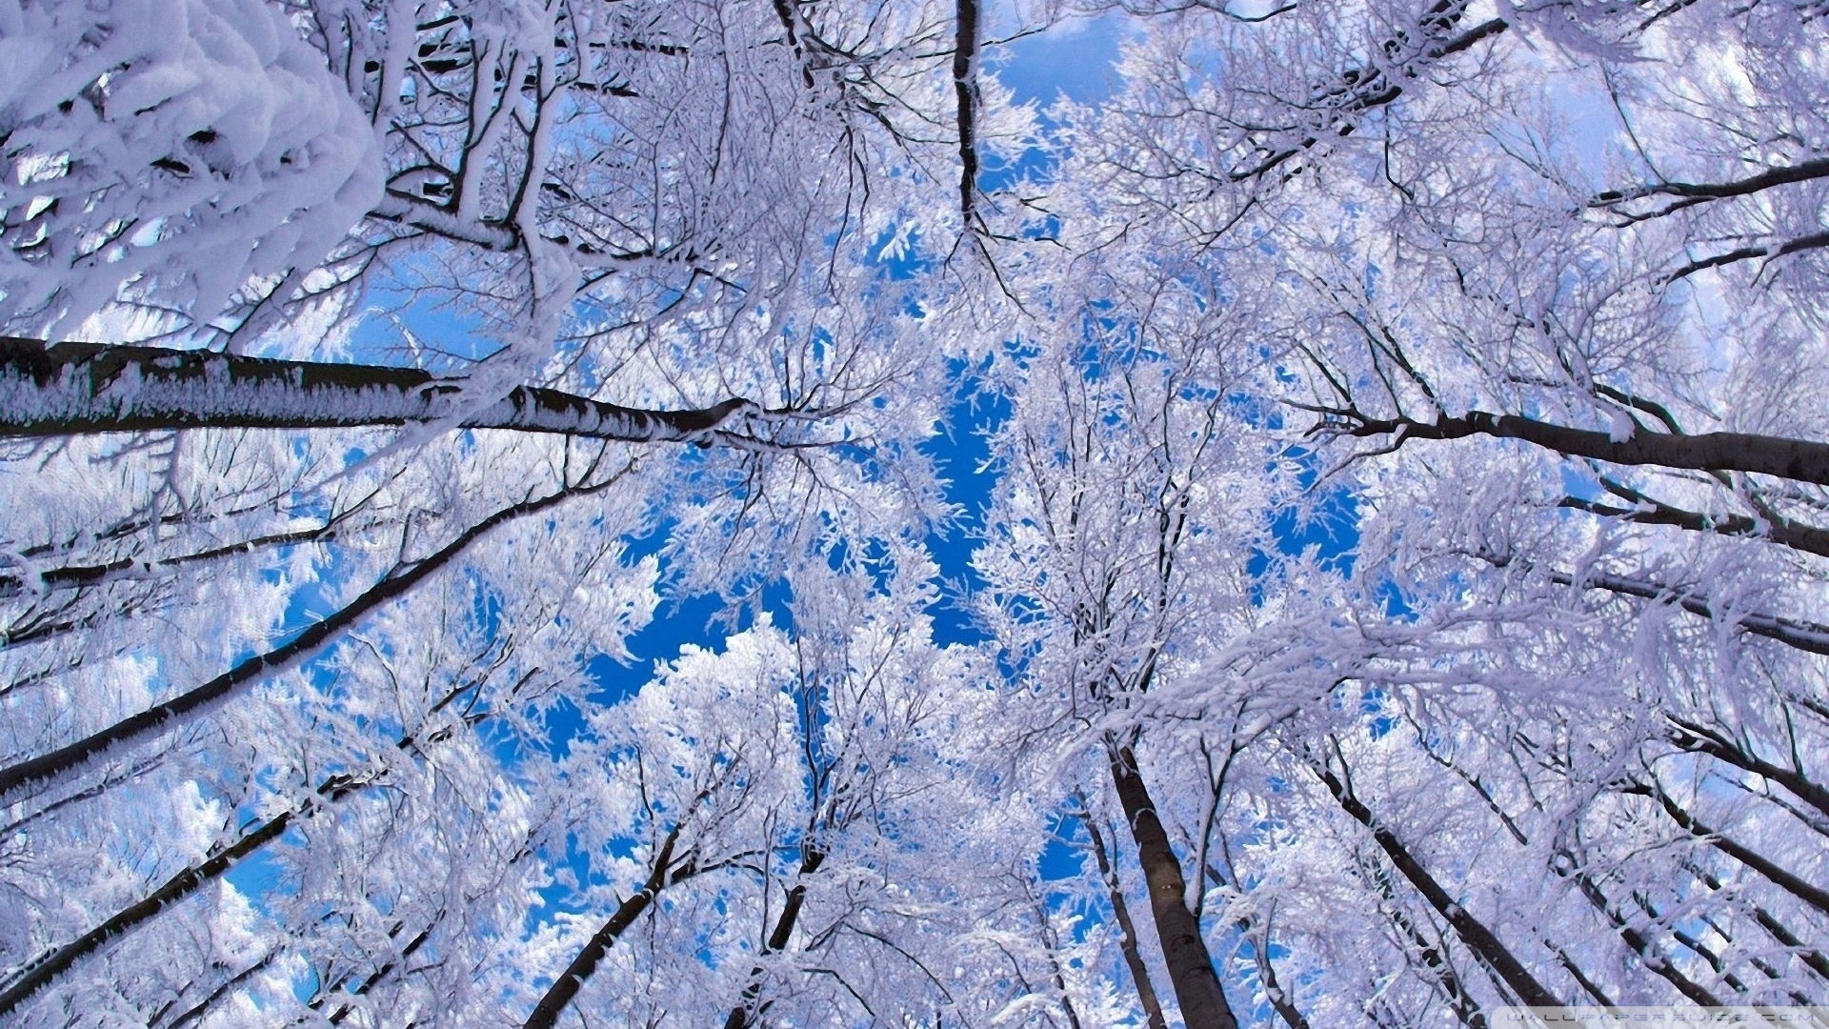
Exploring themes in Edwin Morgan's ‘Winter’

Slide 2
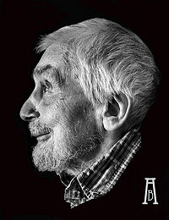
Winter - Edwin Morgan
Background:
The poem ‘Winter’ is inspired by the poem ‘Tithonus’ by Lord Tennyson which surrounds the melancholy of the frozen season. Deterioration, death and the passage of time are prominent themes in both poems.

Slide 3
Winter - Edwin Morgan
Passage of Time
Definition:
The time which a piece of literature can effect it’s over all message and how the reader interprets it.
(Past, Present, Etc)
The time which the poem is oriented in is present tense and it flows organically amidst the linear changing of the seasons.

Slide 4
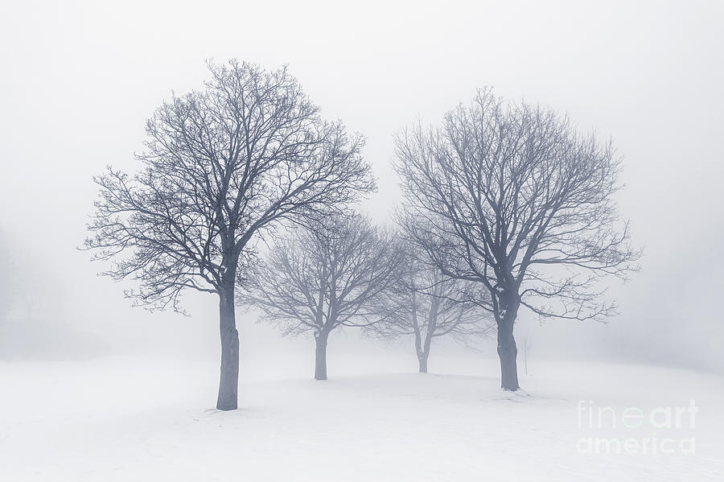
Quotation 1
‘The year goes, the woods decay, and after, many summers die’
‘Goes’ and ‘Gone’ are sprinkled in abundance throughout the poem this reinforces the passing of time and is also demonstrated through the change in season.
Also demonstrates that when winter arrives, colour and saturation is drained from the world.

Slide 5
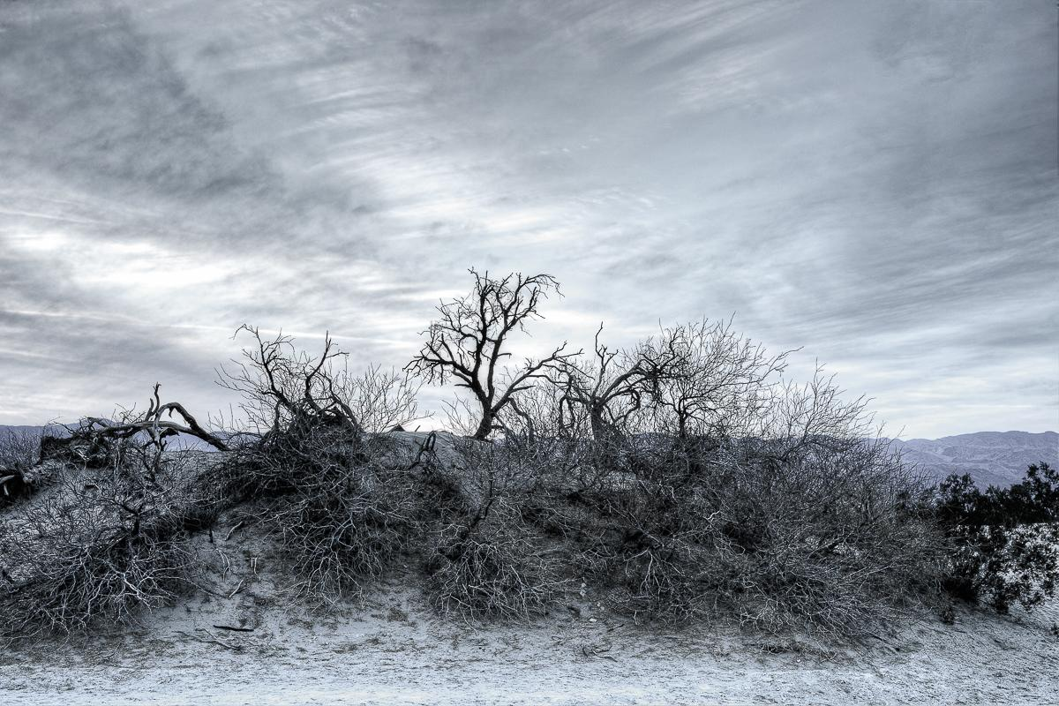
Quotation 2
‘Fades off, goes, the seen, the voices fade’
This is the first instance where humanity is shown leaving the poem as winter comes, contrasting against the first part of the poem where they flocked to the pond to skate. And demonstrates the ethereal and sublime qualities of winter.
This is another instance were tense comes into play similar to some of Morgan’s other poems. ‘Fades’ (present tense) demonstrates that the action is unfolding in front of the reader/ writer’s eyes and that the effect of the season hasn’t yet ceased. ye

Slide 6
Conclusion
In conclusion the passage of time used in tangent with the themes of death, decay and the season of winter. Winter is represented as an omnipotent enigma that the reader isn’t fully able to comprehend nor control and is used as an extended metaphor for death and mortality. The passage of time is slow and peaceful in the beginning represented by short lines with innocent imagery and towards the end of the poem Winter grows more intense then expected and darker and drearyer.

Slide 7
Citations
Images:
http://www.bwallpapers.com/wallpaper/winter-hd-wallpaper-4652/
https://pixels.com/featured/winter-trees-in-fog-elena-elisseeva.html
https://en.wikipedia.org/wiki/Edwin_Morgan_(poet)

