Slide 1
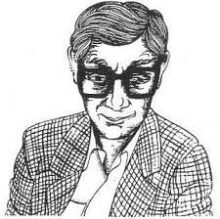
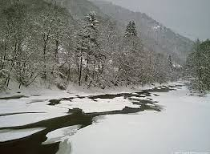
Key Theme – Death (Winter)
By Jack, Matthew, Daniel, Ilyas

Slide 2
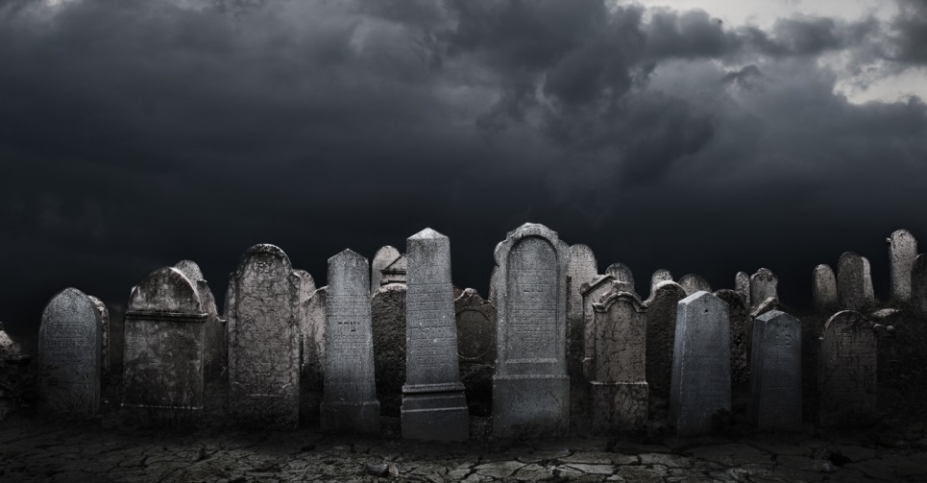
Definition
Death - the action or fact of dying or being killed; the end of the life of a person or organism
In this poem death is used to symbolise the harshness of winter and creates a dark atmosphere.

Slide 3
Quotation 1
“many a summer dies”
The poet here has used personification to show that the season has ended. The poet has explicitly used the word “dies” to show how sad he is at the passing of summer.
This links to the theme of death as the writer emphasises on the idea of summer dying.

Slide 4
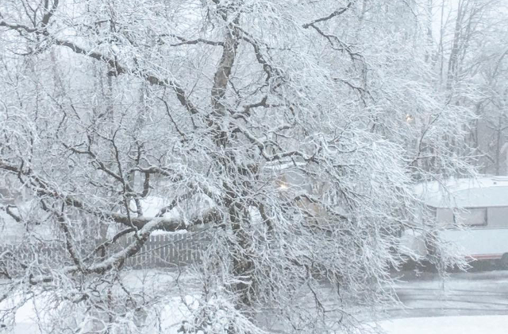
Quotation 2
“fades off. Fades off, goes, the scene, the voices fade,”
The writer repeats the phrase “fades off” to emphasises winter as a time of death, decay and nothingness. “The voices fade” gives the idea of absence of people which creates a lonely atmosphere.
This links to the key theme of death as the word “fade” shows that dead people deteriorate and fade out of others lives.

Slide 5
Quotation 3
“sees nothing and that nothing sees.”
The writer has used repetition and personification again to show that the once lively pond has been covered by a sheet of ice. The poet has given the pond human qualities by saying that it can no longer see.
This links to the key theme of death as someone near their death may go blind or be looked at differently.

Slide 6
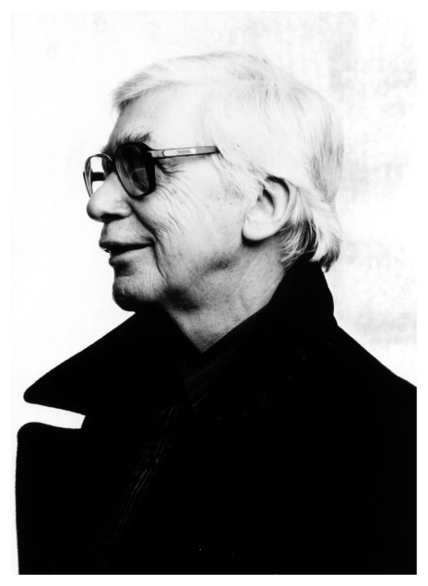
Conclusion
Morgan has used repetition and personification to develop the key theme of death.
In this poem Morgan uses death to show the passing of summer and gives the poem a bleak atmosphere.
Morgan has effectively used different techniques to leave the reader feeling uncomfortable.

