Slide 1
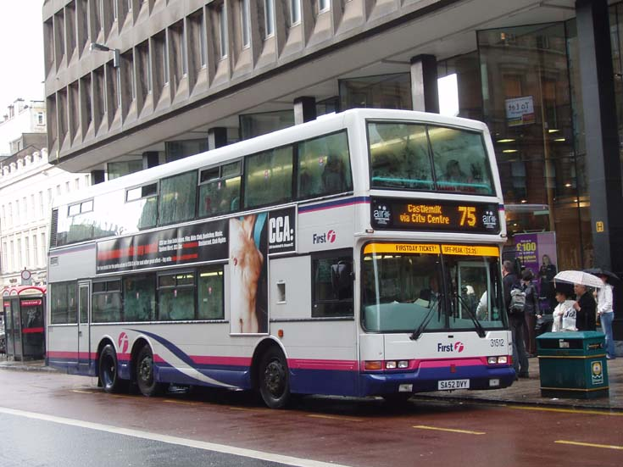
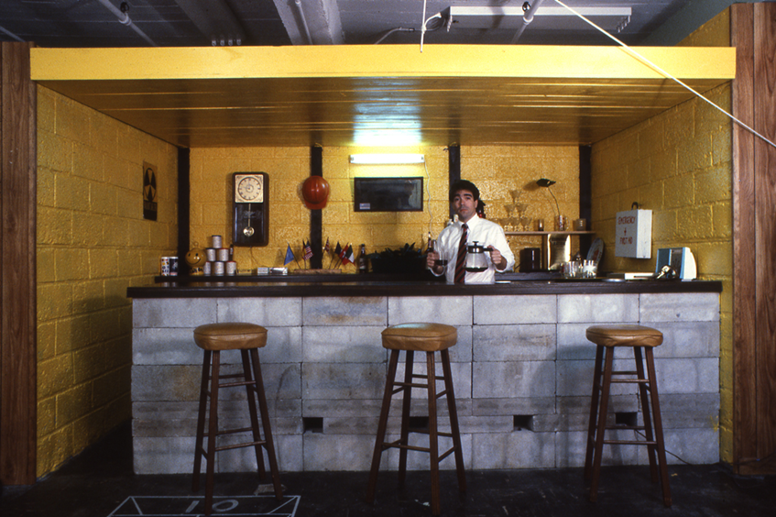
Comparing Texts-‘Good Friday’ and ‘In The Snack Bar’

Slide 2
What is the 8 mark question?
The final question in your textual analysis paper will be worth 8 marks.
It will ask you to compare at least two of the poems you have studied, based on aspects they have in common.
These aspects could be:
Common themes
Similar characters
Poetic techniques commonly used
Similar settings-time/place
Similarities in structure
Persona/speaker’s voice

Slide 3
What’s the connection?
We have spoken a little about similarities between these two texts.
What do these poems have in common? Identify at least two things they have in common.
both characters that are sometimes judged, seen as outsiders, viewed differently, looked down upon by society
both involve two characters
Both involve chance encounters
Both set in Glasgow
Shared theme of prejudice/isolation
Shared theme of relationships
both use imagery

Slide 4
Example Question
By referring closely to this text (‘Good Friday’) and at least one other poem by Morgan, show how Morgan uses language effectively to create interesting characters. 8 marks

Slide 5
Structure of 8 Mark Question
Your answer to this question can follow a mini-essay structure, but you can also do it under headings, as bullet points
Remember-in the exam, you will have to note down your own headings!

Slide 6
8 mark Q
Commonality
2 marks
Given poem (‘ITSB’)
2 marks
Chosen poem (‘Good Friday’)
4 marks

Slide 7
8 mark Q
By referring closely to this text (‘Good Friday’) and at least one other poem by Morgan, show how Morgan uses language effectively to create interesting characters.
Commonality
How do the two poems link together? How do they relate to the Q? Be specific
In Morgan’s poem ‘_____________’ the poet…
In Morgan’s poem ‘_____________’ the poet…
2 marks
EXAMPLE
In Morgan’s poem ‘Good Friday’, the poet uses language to create an interesting character in the form of the drunken man on the bus.
In Morgan’s poem ‘In The Snack Bar’ the poet…

Slide 8
8 Mark Q
Given Poem (Poem in Extract)
Quote demonstrating link to Q
“___________”
Analyse poetic techniques used in quote
Here, Morgan uses ________ to…
Link to Q
This demonstrates/create/shows/conveys…
2 marks

Slide 9
EXAMPLE
“the working man/has nae education, he jist canny – jist/hasny got it…/he’s jist bliddy ignorant”
Here Morgan uses repetition of “jist” to convey how frustrated and limited the man feels by his position in life. His consistent use of negatives when describing himself shows a self-deprecating nature and a sense of interiority he feels compared with others.
This shows he is an interesting character as Morgan has created a character that conveys the frustrations of living within social class boundaries and how limiting these categories are.
YOUR TURN-USE DIFFERENT QUOTATION
Given Poem (Poem in Extract)
Quote demonstrating link to Q-“__________”
Analyse poetic techniques used in quote-”Here, Morgan uses ________ to…”
Link to Q-”This demonstrates/create/shows/conveys…”
2 marks

Slide 10
8 Mark Q
Chosen Poem
Quote demonstrating link to Q
“___________”
Analyse poetic techniques used in quote
Here, Morgan uses ________ to…
Link to Q
This demonstrates/create/shows/conveys…
X 2!
4 marks
EXAMPLE QUOTATIONS
“The dismal hump/looming over him forces his head down.”
“He stands in his stained beltless garberdine/like a monstrous animal caught in a tent/in some story”
“‘I want –to go to the-toilet.’”

