Slide 1
To Kill A Mockingbird
Chapters 2 & 3 Key Quotes

Slide 2
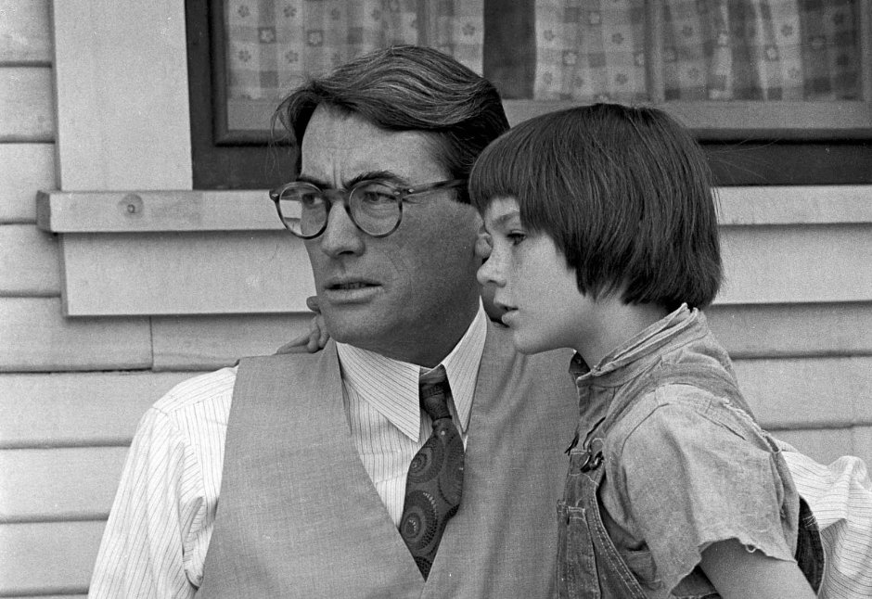
Important Quotations Explained
CONTEXT-
Atticus is talking to Scout about her argument with her teacher
QUOTATION-
“You never really understand a person until you consider things from his point of view…until you climb into his skin and walk around in it.’” (pg 33)
EXPLANATION-this moral advice sets the course of the novel and exemplifies Lee’s theme of justice and judgement. The simple wisdom of his words demonstrates the purity of Atticus’ spirit and judgement, and he demonstrates his ability to follow his own advice in his simple explanation. It also hints at the roots of the problems Maycomb faces

Slide 4
Key Quotation Analysis
CONTEXT-
Scout defending Walter Cunningham and explain to Miss Caroline about how things work in Maycomb
QUOTATION-
“‘You’re shamin’ him, Miss Caroline. Walter hasn’t got a quarter at home to bring you, and you can’t use any stovewood.’”(pg 24)
EXPLANATION-
Scout makes clear Miss Caroline’s ignorance as an outsider to ‘Maycomb ways’; Scout shows her indignation over the situation and confronts her teacher, showing her stubborn and defensive nature. Shows supportive nature towards Walter, and that she is her father’s daughter-aware and outraged by the injustices and inequalities in Maycomb

Slide 5
Key Quotation Analysis
CONTEXT-
Calpurnia is scolding Scout for judging her guest, Walter
QUOTATION-
“There’s some folks who don’t eat like us…but you ain’t called on to contradict ‘em at the table when they don’t. That boy’s yo’ comp’ny an if he wants to eat up the table cloth you let him, you hear?” (pg 27)
EXPLANATION-
By teaching Scout some social etiquette through Calpurnia, Lee highlights the novel’s theme of prejudice and its effects on the children. These words are particularly important coming from Calpurnia, and Lee makes a connection through her scolding between social class inequalities and racial inequalities, as she speaks from experience of being judged.

Slide 6
Key Quotation Analysis
CONTEXT-
Scout describes her first sighting of Burris Ewell
QUOTATION-
“The boy stood up. He was the filthiest human I had ever seen. His neck was dark grey, the backs of his hands were rusty, and his fingernails were black deep into the quick.” (pg 29)
EXPLANATION-
Burris’ appearance is used by Lee to introduce the Ewells and indicate their background and social standing in Maycomb. His unhygienic description tells us how poorly the Ewell children are cared for, and hints that they are rural folk and that the children are left to their own devices

Slide 7
Key Quotation Analysis
CONTEXT-
Burris Ewell argues with Miss Caroline (teacher)
QUOTATION-
“Report and be damned to ye! Ain’t no snot-nosed slut of a school teacher ever born c’n make me do nothin’! You ain’t makin’ me go nowhere, missus.” (pg 31)
EXPLANATION-
Indicates Ewells’ distrust of authority figures and brazen flouting of rules and laws-hints at Ewell family values and foreshadows older Ewells’ callous and cold behaviour later in novel

Slide 8
Key Quotation Analysis
CONTEXT-
Atticus explains to Scout why she must attend school
QUOTATION-
“sometimes it’s better to bend the law a little in special cases. In your case, the law remains rigid. So to school you must go.” (pg 33)
EXPLANATION-
Atticus refers to Ewells here, suggesting that in some cases it is easier to accommodate rather than scold, hinting that the Ewells are challenging figures. Lee emphasises Atticus’ position as authority figure and loyalty to the law

Slide 9
Key Quotation Analysis
CONTEXT-
Atticus explains the Ewell family to Scout
QUOTATION-
“…the Ewells had been the disgrace of Maycomb for three generations…they were people, but they lived like animals.” pg33-34)
EXPLANATION-
Ewells are presented as infamous figures in the community, but long-standing citizens who Maycomb’s traditional values protect out of respect for family name. Ewells are considered outside of the law, due to their behaviour, and looked down on by rest of Maycomb-considered “animals” rather than part of the community

