Slide 1
Higher R4UAE

Slide 2
N5-> Higher
2 texts, similar topics-comparison required
More language analysis Qs
Less IYOW/understanding Qs
More complex language to decode
No marks for quoting/giving examples!
Longer, more in depth analysis required

Slide 3
Question Types
Understanding - What is the writer saying?
Paraphrase, define, link
Analysis - How has the writer said it?
Word choice, Imagery, Tone, Sentence Structure
Climax, Repetition, Inversion, Parenthesis, Punctuation, Lists, Ellipsis, Sentence type
Evaluation - How well did the writer say it?
Quote and explanation

Slide 4
Higher R4UAE- In Your Own Words

Slide 5
In Your Own Words
Even though they are less common at Higher level, an R4UAE paper will still test your understanding of the vocabulary and ideas in the passage
You will be asked to translate more complex ideas than previously

Slide 6
In Your Own Words Formula
Locate-find the relevant information in the passage
Translate-put key info into simpler terms

Slide 7
WARNING
Avoid word-for-word translations → reshape the sentence if you need to
Not all words can be changed...be sensible! (focus on verbs, adjectives, and figures of speech; not nouns and proper nouns)

Slide 8
How to spot an IYOW Q
“explain”
“explain in your own words”
“identify”
“use your own words”
“How does the writer go on to explain”
”How does the writer demonstrate”

Slide 9
Example Question
This article is about a man who only has one hand, and how he feels he is treated differently.
As a conversation with a girl moved from our mutual love of Kanye West to trainers, I mentioned the fact that I couldn’t tie my own laces. She suddenly said: “You’re so brave, if I had one hand I’d probably never leave the house.”
“Sorry, what was that?”
“Oh it’s just, you know, I don’t know how I’d live with one hand.”
I’ve had one hand since I was born and in 22 years, no one had ever said anything like that to me. I’m more than used to people being curious about it, asking questions from the basic and innocent “did you lose it in an accident?” to the more intrusive and awkward “how do you date?”, with people even making jokes about it if they’re comfortable enough. But there has never been a statement that’s left me feeling how that one did. I didn’t know what to say. I was offended that my very presence in that place was being questioned, but also that I was seen as some sort of hero for “overcoming” my disability to be an ordinary member of society, enjoying myself on a night out.
Identify two reasons why the writer was offended by the girl’s statement. Use your own words in your answer. (2 marks)

Slide 10
Example Question
Locate!
As a conversation with a girl in the club moved from our mutual love of Kanye West to trainers, I mentioned the fact that I couldn’t tie my own laces. She suddenly said: “You’re so brave, if I had one hand I’d probably never leave the house.”
“Sorry, what was that?”
“Oh it’s just, you know, I don’t know how I’d live with one hand.”
I’ve had one hand since I was born and in 22 years, no one had ever said anything like that to me. I’m more than used to people being curious about it, asking questions from the basic and innocent “did you lose it in an accident?” to the more intrusive and awkward “how do you date?”, with people even making jokes about it if they’re comfortable enough. But there has never been a statement that’s left me feeling how that one did. I didn’t know what to say. I was offended that my very presence in that place was being questioned, but also that I was seen as some sort of hero for “overcoming” my disability to be an ordinary member of society, enjoying myself on a night out.
Identify two reasons why the writer was offended by the girl’s statement. Use your own words in your answer. (2 marks)

Slide 11
Example Question
“my very presence in that place was being questioned”
“I was seen as some sort of hero for “overcoming” my disability”
Translate!

Slide 12
Example Question
“my very presence in that place was being questioned”
She was wondering why he was even at the club
“I was seen as some sort of hero for “overcoming” my disability”
He was being viewed as something superhuman for working around his impairment
Translate!

Slide 13
Paired Example
The article is about the rise of online hate.
Overall there is no question that something has to be done. The police are concerned about the spike in hate crime that followed the Brexit vote. The toxic and depressing bile online is part of this. The anonymity of the digital world has been liberating in radical ways, but it has liberated some of the worst impulses. Everything can be said. Everything is permitted. And we have got to this situation because the social media platforms take such little responsibility for their content. Facebook and Twitter may be taking the problem more seriously lately, but they have had a laissez-faire attitude to abuse. We have now got to the point where if all hate crime was prosecuted, it’s hard to know what time the police would have for anything else. But does this mean we do nothing?
Explain why the writer believes online hate has risen in recent years. Use your own words. (3 marks)

Slide 14
Paired Example
Locate!
The article is about the rise of online hate.
Overall there is no question that something has to be done. The police are concerned about the spike in hate crime that followed the Brexit vote. The toxic and depressing bile online is part of this. The anonymity of the digital world has been liberating in radical ways, but it has liberated some of the worst impulses. Everything can be said. Everything is permitted. And we have got to this situation because the social media platforms take such little responsibility for their content. Facebook and Twitter may be taking the problem more seriously lately, but they have had a laissez-faire attitude to abuse. We have now got to the point where if all hate crime was prosecuted, it’s hard to know what time the police would have for anything else. But does this mean we do nothing?
Explain why the writer believes online hate has risen in recent years. Use your own words. (3 marks)

Slide 15
Paired Example
Translate!
“spike in hate crime that followed the Brexit vote.”
“anonymity of the digital world”
“social media platforms take such little responsibility for their content”
“if all hate crime was prosecuted, it’s hard to know what time the police would have for anything else.”

Slide 16
Paired Example
“spike in hate crime that followed the Brexit vote.”
Increase in abuse after UK voted to leave the EU.
“anonymity of the digital world”
Able to disguise your identity online
“social media platforms take such little responsibility for their content”
Sites do not monitor or prosecute comments made on their sites
“if all hate crime was prosecuted, it’s hard to know what time the police would have for anything else.”
It would be overwhelming to try to legally deal with every instance of online abuse

Slide 17
Solo Example
The article is about overfishing
Since the 1900s, this disaster has seen the voracious global fishing system savage 90 per cent of the ocean’s largest species – tuna, swordfish and sharks – bringing about an imminent end to the eco system, the planet and the ne billion people who rely on fish for protein. And if we don’t know much about fish in peril because we just don’t particularly care – then why not? Is it because we ‘must; eat fish for our ‘essential’ omega 3, otherwise we will be dead within weeks from nineteenth century scurvy? Or because fish are Earth’s own aliens, no-limbed spooky beings with amoebas for brains? Or because we’ve more important things to worry about, like unemployment.
Identify 3 reasons why we don’t care that we eat too much fish.
(3 marks)

Slide 18
Solo Example
The article is about overfishing
Since the 1900s, this disaster has seen the voracious global fishing system savage 90 per cent of the ocean’s largest species – tuna, swordfish and sharks – bringing about an imminent end to the eco system, the planet and the ne billion people who rely on fish for protein. And if we don’t know much about fish in peril because we just don’t particularly care – then why not? Is it because we ‘must; eat fish for our ‘essential’ omega 3, otherwise we will be dead within weeks from nineteenth century scurvy? Or because fish are Earth’s own aliens, no-limbed spooky beings with amoebas for brains? Or because we’ve more important things to worry about, like unemployment.
Identify 3 reasons why we don’t care that we eat too much fish.
(3 marks)

Slide 19
Solo Example
“‘must’; eat fish for our ‘essential’ omega 3, otherwise we will be dead within weeks from nineteenth century scurvy?”
“Or because fish are Earth’s own aliens, no-limbed spooky beings with amoebas for brains?”
“Or because we’ve more important things to worry about, like unemployment.”

Slide 20
Solo Example
“‘must’; eat fish for our ‘essential’ omega 3, otherwise we will be dead within weeks from nineteenth century scurvy?”
Fish provide necessary items to supplement our diet so that we avoid illness
“Or because fish are Earth’s own aliens, no-limbed spooky beings with amoebas for brains?”
Fish are not attractive animals so we don’t care about them
“Or because we’ve more important things to worry about, like unemployment.”
Other, more important aspects of our real lives don’t leave us any room to care about fish.

Slide 21
Article Practice
Vicky Allan: Please, Sirs, can we have some more male primary teachers?

Slide 22
Question 1
In paragraph 3, the writer gives the example of her children’s primary school experience to illustrate the role men are given in the school. Explain in your own words how men are given an elevated position. (3 marks)

Slide 23
Question 1
In paragraph 3, the writer gives the example of her children’s primary school experience to illustrate the role men are given in the school. Explain in your own words how men are given an elevated position. (3 marks)
“one of whom was the head teacher”
E.g. given most senior position
“rapidly disappeared to do something important”
E.g. often promoted
“female deputy head acted up for a while…new head teacher came along, also male”
E.g. women in high positions often replaced with men

Slide 24
Question 2
Why did the writer “applaud” in paragraph 4 when she heard to proposal to encourage more men into primary teaching? Explain in your own words. (2 marks)

Slide 25
Question 2
Why did the writer “applaud” in paragraph 4 when she heard to proposal to encourage more men into primary teaching? Explain in your own words. (2 marks)
“only one in 10 primary school teachers in male”
E.g. Very few men in Scotland are primary teachers (10%)
“a monoculture in which few men are to be found”
E.g. in primary schools it often seems like there is only one gender represented
“a firm message is being delivered to children-that looking after the young is the job of the women, not men”
E.g. kids are being taught that males do not work in caring roles

Slide 26
Question 3
In Paragraph 7, the writer outlines some of the “gender stereotypes” society holds about men and women. In your own words, briefly explain the stereotypes held for each gender. (2 marks)

Slide 27
Question 3
In Paragraph 7, the writer outlines some of the “gender stereotypes” society holds about men and women. In your own words, briefly explain the stereotypes held for each gender. (2 marks)
“women are more caring and nurturing”
E.g. women are kind, able to look after others
“men are more likely to be paedophiles”
E.g. Child abusers are usually male

Slide 28
Question 4
The writer describes what’s happening with gender in teaching as “a microcosmic lesson in how wider society works”. Explain in your own words, the reasons she gives for this theory. (Paragraph 10) (3 marks)

Slide 29
Question 4
The writer describes what’s happening with gender in teaching as “a microcosmic lesson in how wider society works”. Explain in your own words, the reasons she gives for this theory. (Paragraph 10) (3 marks)
“so gender-stratified”
e.g. there is a clear role for men and women
“devalued and disrespected since women entered the workforce”-e.g. teaching is seen as a lesser career path, given less prestige/value now women are in the majority of roles
“when men do appear, it’s often at the top of the tree, as heads”
e.g usually men are found in management roles

Slide 30
Question 5
In paragraph 11, the writer gives reasons why she thinks “pay and attitudes don’t reflect” the hard work of childcare. In your own words, outline her reasons for this. (2 marks)

Slide 31
Question 5
In paragraph 11, the writer gives reasons why she thinks “pay and attitudes don’t reflect” the hard work of childcare. In your own words, outline her reasons for this. (2 marks)
“because this work has been done, unpaid, by women for centuries”
E.g. Childcare has stereotypically been carried out by women as their natural role
“anything women used to do for nothing is undervalued”
E.g. Women’s skills are not praised, especially if they are not receiving pay for it

Slide 32
Question 6
Explain in your own words the writer’s suggested changes, designed to entice men to the career. (paragraph 12) (3 marks)

Slide 33
Question 6
Explain in your own words the writer’s suggested changes, designed to entice men to the career. (paragraph 12) (3 marks)
“greater status and respect for the profession”
E.g. The job needs to be give more value
“more financial reward”
E.g. better pay
“Better working conditions”
E.g. an improved job environment

Slide 34
Higher R4UAE- Word Choice

Slide 35
Analysis Questions
You will be asked to comment on the features of
the writer’s language
e.g. How does the writer’s language...
Analyse how the writer’s use of imagery...
Word choice – Imagery – Tone – Sentence structure

Slide 36
The Analysis Question
-Word Choice-
Ask yourself – why a writer has chosen one particular word to describe someone or something, rather than any of the other words which have a similar meaning.
Denotation
The place where someone lives
Connotations
Safety, comfort, warmth, family, calm, peacefulness
Home
Connotation = the associations connected to a certain word/phrase
Denotation = the definition of the word

Slide 37
Word Choice Formula
Quote appropriate word/phrase (2-3 words)
Explain what word suggests (connotations) (1)
Link specifically to idea in Q (1)

Slide 38
NEVER!
Analyse a word using the word

Slide 39
“Pushing past the gas-blanket, I blundered down the stairs to the company headquarters’ dug-out.”
What does the word ‘blundered’ reveal about the way the speaker descended the stairs? (2 marks)
“blundered” suggests a stumbling or falling movement, clumsy
This tells us that the speaker was moving quickly to get out, not caring about the manner in which they moved

Slide 40
“Pushing past the gas-blanket, I blundered down the stairs to the company headquarters’ dug-out.”
What does the word ‘blundered’ reveal about the way the speaker descended the stairs? (2 marks)
ANSWER
“blundered” suggests quick, clumsy movement. (1)
This tells the reader that the speaker was eager to leave where he was, and took little care while doing so.(1)

Slide 41
“My guest was lying sprawled on his back. There was a long knife through his heart which skewered him to the floor.”
Explain how the word ‘skewered’ adds to the horror of the scene.(2 marks)
“skewered” suggests a lot of force behind action, a body being pierced/impaled, someone pinned down, unable to move, helpless
This creates a horrifying image, as it suggests there may be a large, bloody wound, makes us think the person is being treated like a piece of meat-inhumane, trapped

Slide 42
“My guest was lying sprawled on his back. There was a long knife through his heart which skewered him to the floor.”
Explain how the word ‘skewered’ adds to the horror of the scene.(2 marks)
ANSWER
“skewered” suggests something that has been impaled, is stuck in place by a rod, unable to move, and often refers to food(1).
This tells the reader that the person was completely helpless, and the speaker was treating him in a very inhumane way. (1)

Slide 43
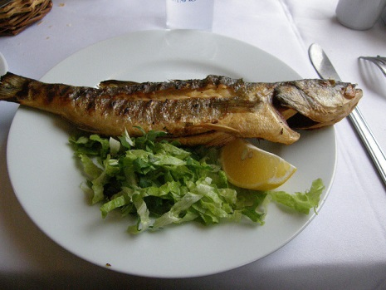
Full Example
This is from an article about the benefits of eating fish.
There’s also the matter of not being bothered enough to think of anything else to eat in the face of a sumptuously juicy salmon steak fizzing away under the grill, to be served with a drizzle of virgin olive oil and a splash of the zingiest lemon – yum! For me, a world without fish is a world where there's nowt for tea. I write as someone who eats fish three times a week, who hasn’t eaten meat since 1983 and has been resolutely adolescent in subject ever since.
Referring to at least 2 examples, analyse how the writer, by her word choice, makes her eating of fish sound attractive. (4 marks)

Slide 44
Full Example
This is from an article about the benefits of eating fish.
There’s also the matter of not being bothered enough to think of anything else to eat in the face of a sumptuously juicy salmon steak fizzing away under the grill, to be served with a drizzle of virgin olive oil and a splash of the zingiest lemon – yum! For me, a world without fish is a world where there's nowt for tea. I write as someone who eats fish three times a week, who hasn’t eaten meat since 1983 and has been resolutely adolescent in subject ever since.
Referring to at least 2 examples, analyse how the writer, by her word choice, makes her eating of fish sound attractive. (4 marks)

Slide 45
The word ‘sumptuously’ has connotations of luxury and excess. The writer is using this to suggest that eating fish is very attractive as it is seen as a treat.
The word ‘juicy’ has connotations of moistness and flavour. The writer is using this to suggest that eating fish is very attractive as it has a strong taste and texture.
The word ‘fizzing’ has connotations of something energetic and full of potential. The writer is using this to suggest that eating fish is very attractive to all of our senses, not just taste.
The word ‘drizzle’ has connotations of a thin stem of something precious. The writer is using this to suggest that eating fish is very attractive as care is taken in preparation.
The word ‘splash’ has connotations of chef-like flourishes to the flavour, delicate treatment/flavouring. The writer is using this to suggest that eating fish is very attractive and well-presented.

Slide 46
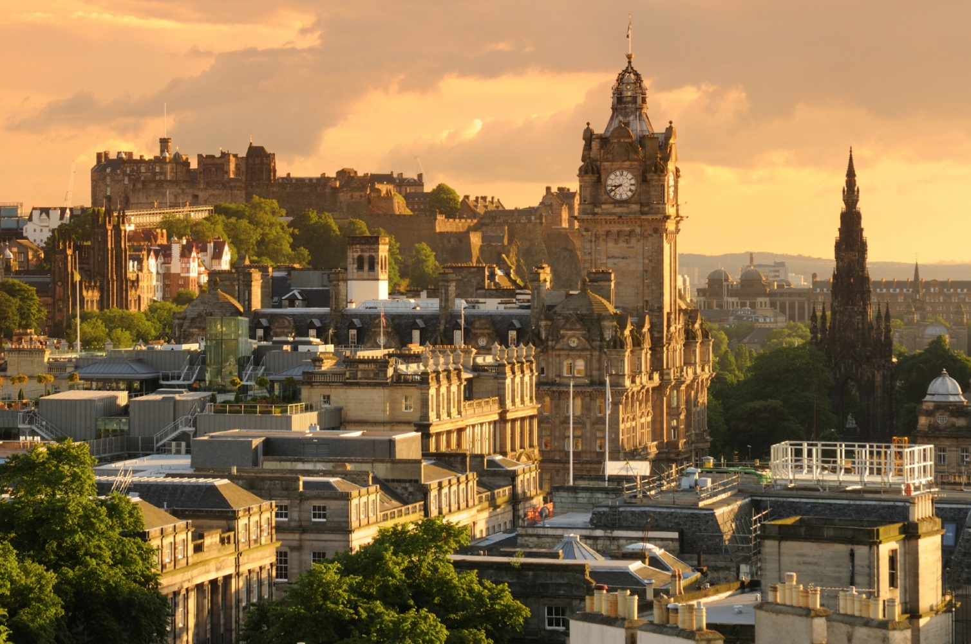
Rosemary Goring: Can anyone halt the relentless destruction of Edinburgh?

Slide 47
Question 1
How does the writer use word choice to create a negative image of students in paragraph one? Use at least two examples in your answer. (4 marks)

Slide 48
Question 1
How does the writer use word choice to create a negative image of students in paragraph one? Use at least two examples in your answer. (4 marks)
“scrape of suitcases and stilettos”
Suggests careless behaviour, loud and irritating sounds (1)
Tells the reader the writer believes students are noisy and lack consideration for others (1)
“braying”
Suggests loud, animalistic noises (1)
Tells the reader the writer believes students make too much noise and disturb the peace (1)

Slide 49
Question 2
How does the writer’s use of language in paragraph 3 indicate that during the Festival the city becomes less appealing? Use two examples in your answer. (4 marks)

Slide 50
Question 2
How does the writer’s use of language in paragraph 3 indicate that during the Festival the city becomes less appealing? Use two examples in your answer. (4 marks)
“decibels increase”
Suggests the city gets noisier (1)
This tells the reader that the writer does not enjoy how loud the Festival is (1)
“marauding gulls”
Suggests sea gulls become more vicious (1)
This tells the reader that the writer thinks the gulls are threatening and unpleasant (1)
“a stranger in your own city”
Suggests the writer feels like an outsider (1)
Tells the reader that the writer feels like she does not recognise her hometown, as it changes so dramatically (1)

Slide 51
Question 3
How does the word choice used in paragraph 6 highlight the difference of the writer’s opinions on the two proposed ideas for the Old Royal High School? (4 marks)

Slide 52
Question 3
How does the word choice used in paragraph 6 highlight the difference of the writer’s opinions on the two proposed ideas for the Old Royal High School? (4 marks)
“cash cow”
Suggests the hotel would solely be intended to make money (1)
Tells the reader the writer thinks this proposal is selfish and greedy (1)
“undermining its heritage”
Suggests the hotel would take away from the cultural history of Edinburgh, removing something special (1)
Tells the reader the writer thinks this proposal will negatively affect Edinburgh (1)
“builds on”
Suggests growth, development, improvement (1)
Tells the reader that the writer thinks this proposal would benefit Edinburgh (1)
“enlightenment”
Suggests an awakening of ideas, massive positive change (1)
Tells the reader that the writer believes this would be a huge improvement for Edinburgh (1)

Slide 53
Question 4
How does the writer use language to express her distaste at the new building developments in Edinburgh in paragraph 7? (6 marks)

Slide 54
Question 4
How does the writer use language to express her distaste at the new building developments in Edinburgh in paragraph 7? (6 marks)
“unsympathetic new builds”
Suggests buildings do not complement surroundings, are not thoughtfully merged with current builds (1)
Tells the reader that the writer dislikes the style of these new buildings (1)
“soulless development”
suggests the building lacks character, uniqueness (1)
tells the reader that the writer does not appreciate the generic nature of this building (1)
“blow to the heart”
Suggests an aggressive act to destroy what Edinburgh is all about (1)
Tells the reader that the writer does not think these buildings fit in with Edinburgh’s style (1)
“assault”
Suggests an aggressive act to destroy Edinburgh’s specific appeal (1)
Tells the reader that the writer does not think the architects have deliberately sabotaged Edinburgh’s appeal (1)
“tipping point”
Suggests a huge change (1)
Tells the reader that the writer thinks these buildings could warp the face of Edinburgh (1)
“irrevocably”
Suggests there is no going back, there would be no way of repairing the situation (1)
Tells the reader that the writer thinks this would negatively impact Edinburgh’s landscape forever(1)
“benefits no one”
Suggests these changes would be unhelpful for the city (1)
Tells the reader the writer believes new builds will ruin the Edinburgh we know and love (1)

Slide 55
Higher R4UAE- Sentence Structure

Slide 56
The Analysis Question
-Sentence Structure-
Climax, Repetition, Inversion, Parenthesis, Punctuation, Lists, Ellipsis, Sentence type
You must:
Identify technique and quote
Explain impact (specific to context)

Slide 57
Device | Definition | Example
Climax
Repetition
Inversion
Parenthesis
Punctuation
Lists
Ellipsis

Slide 58
Device | Definition | Example
Climax | Build up of words/phrases to most important part | We need more food, clothing, freedom.
Repetition | Saying the same thing again and again | Obama’s ‘yes we can’ speech; I came, I saw, I conquered
Inversion | Yoda speak-changing the order of a sentence | A huge cake is what Tony had to eat.
Parenthesis | Dashes/brackets used to provide extra info | Ed’s aunt (who he hated) came to dinner.
Punctuation | Symbols used to indicate a change to the sentence | : ; , “”, -, !, ?
Lists | Make multiple points clear, emphasise details, exaggerate | Dave bought a horse, a llama, a pig and a zebra.
Ellipsis | …-create tension/suspense/mystery; indicates a pause | Anyone would think you were…up…to something…

Slide 59
Device | Definition | Example
Climax | Words and phrases are arranged in an order to increase their importance within the sentence | This note was a promise that all men, yes, black men as well as white men, would be guaranteed the unalienable Rights of Life, Liberty, and the pursuit of Happiness.
Repetition | The recurrence of a word or phrase | I came, I saw, I conquered.
Inversion | Normal expected order of events is turned around | The man was bitten by the dog.
Parenthesis | The use of commas, brackets, or dashes to give additional information | The man, who had done nothing to create suspicion, waited outside the bank.
Punctuation | The use of marks to add meaning to text | This house has everything I need: two bedrooms, a backyard and a garage.
Lists | A number of items separated by punctuation marks (often commas and semi-colons). | You may be required to bring many things: sleeping bags, pans, utensils, and warm clothing.
Ellipsis | The omission from speech or writing of a word(s) that is superfluous. Indicated with ‘…’ | If only she had . . . Oh, it doesn’t matter now.

Slide 60
Sentence Structure
Climax (and anti-climax)
CLIMAX
is a series of statements -usually three - in which each section is an intensification of the section before.
Tell the truth ,the whole truth, and nothing but the truth.
ANTICLIMAX
can either make fun of something by offering a farcical conclusion, or it can indicate the seriousness of earlier items by the use of contrast:
If the shrapnel doesn't get you, then the mustard gas will, and they say the mosquitoes are bad here in the summer.
You must identify the feature and comment on it’s effect

Slide 61
Sentence Structure
Repetition
1. repetition in sentence structure
2. repetition of expressions or words
3. repetition of sounds (alliteration or assonance)
Take one of the more famous statements attributed to Julius Caesar: I came. I saw. I conquered.
Repetition of sentence structure has the effect of suggesting the inevitable move up to the climax of ‘conquered’.
Repetition of ‘I’ stresses the importance of the man who did all this, the speed at which he did it, and possibly his egomania.
You must identify the feature and comment on it’s effect

Slide 62
Sentence Structure
Inversion
Inversion is where the normal expected order of events is turned round for effect. It places emphasis on the word that is out of order.
The standard word order in an English sentence is:
SUBJECT | VERB | MORE INFORMATION
MISS INNES | IS PRAISING | HER STUDENT’S COMMITMENT TO CLOSE READING
You must identify the feature and comment on it’s effect

Slide 63
Sentence Structure
Inversion
Inversion is where the normal expected order of events is turned round for effect. It places emphasis on the word that is out of order.
The standard word order in an English sentence is:
MORE INFORMATION | SUBJECT | VERB
HER STUDENT COMMITMENT TO CLOSE READING IS WHAT | MISS INNES | IS PRAISING
You must identify the feature and comment on it’s effect

Slide 64
Inversion Effect -important words at the beginning-
Jack ate a sickening amount of cake that morning.
A sickening amount of cake Jack ate that morning.
The government is adopting the measure with great enthusiasm.
With great enthusiasm the Government is adopting this measure.
In each case the sentence is made more vivid and important by putting the interesting feature first:
‘sickening’, ‘with great enthusiasm’

Slide 65
Inversion Effect -important words at the end-
This technique is similar to climax/anticlimax
The chief coach was a strong disciplinarian with his players but fierce in the protection of his team.
The chief coach was a strong disciplinarian with his players but, in the protection of his team, fierce.
There are other effects of word order but these are the easiest to spot.
The beginnings and ends of sentences, paragraphs, lines of poetry, all have the potential to bring something special to the reader’s notice.

Slide 66
Sentence Structure
Punctuation
You must identify the feature and comment on it’s effect

Slide 67
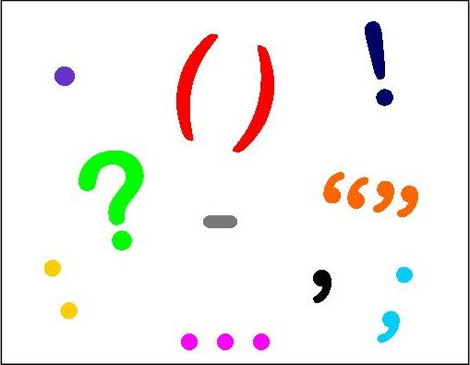
Punctuation Task
On the first side of your worksheet, match the names of the punctuation to the symbols and their definitions.

Slide 68
Name | Symbol | Use
Full stop | . | -indicates completion of a sentence -determines long/short sentence
comma | , | -separates brief items in a list: apples, pears, bananas and a grapefruit. -used like parenthesis when before and after a phrase: Enter Arthur, a distant cousin, in love with Anne. (additional info)
Semi-colon | ; | -separates larger items in a list: A beach house in Bermuda; a chalet in the Alps; a castle in Scotland with 40 rooms. -indicates a turning point in a balanced sentence: Sober, he was unpredictable; drunk, he was dangerous.
colon | : | -signals explanation or elaboration: It was now night: stars twinkled overhead and the moon was rising. -signals upcoming quotation -introduces a list: Her garden was a picture: tulips, roses, marigolds and daisies.

Slide 69
Name | Symbol | Use
Full stop | . | -indicates completion of a sentence -determines long/short sentence
Comma | , | -separates brief items in a list: apples, pears, bananas and a grapefruit. -used like parenthesis when before and after a phrase: Enter Arthur, a distant cousin, in love with Anne. (additional info)
Semi-colon | ; | -separates larger items in a list: A beach house in Bermuda; a chalet in the Alps; a castle in Scotland with 40 rooms. -indicates a turning point in a balanced sentence: Sober, he was unpredictable; drunk, he was dangerous.
Colon | : | -signals explanation or elaboration: It was now night: stars twinkled overhead and the moon was rising. -signals upcoming quotation -introduces a list: Her garden was a picture: tulips, roses, marigolds and daisies.

Slide 70
Punctuation Task
On the second side of your worksheet, match the names AND symbols of the punctuation to their definitions.

Slide 71
Name | Symbol | Use
parenthesis | - ( ) | -adds additional information -single dash adds emphasis or importance to a word or phrase
ellipsis | … | -in middle of a sentence, suggests interruption, hesitation or indecision -end of sentence, suggests anticipation or suspense
Exclamation mark | ! | -indicates strong emotion, often surprise, excitement or anger
Question mark | ? | -may ask a question to answer in following paragraph -series of questions=confusion or bewilderment -rhetorical question-invites reader to share the writer’s views.
Inverted commas | “ “ | -around a word or phrase-casts doubt on meaning of word -indicates title of poem, song, article or chapter.

Slide 72
Name | Symbol | Use
parenthesis | ( ) - , , | -adds additional information -single dash adds emphasis or importance to a word or phrase
Ellipsis | … | -in middle of a sentence, suggests interruption, hesitation or indecision -end of sentence, suggests anticipation or suspense
Exclamation mark | ! | -indicates strong emotion, often surprise, excitement or anger
Question mark | ? | -may ask a question to answer in following paragraph -series of questions=confusion or bewilderment -rhetorical question-invites reader to share the writer’s views.
Inverted commas Speech marks Quotation marks | “ “ ‘ ‘ | -around a word or phrase-casts doubt on meaning of word -indicates title of poem, song, article or chapter.

Slide 73
Name | Symbol | Use
Dashes and brackets (Parenthesis) | - ( ) | -adds additional information -single dash adds emphasis or importance to a word or phrase
Ellipsis | … | -in middle of a sentence, suggests interruption, hesitation or indecision -end of sentence, suggests anticipation or suspense
Exclamation mark | ! | -indicates strong emotion, often surprise, excitement or anger
Question mark | ? | -may ask a question to answer in following paragraph -series of questions=confusion or bewilderment -rhetorical question-invites reader to share the writer’s views.
Inverted commas (quotation marks) | ‘ ’ | -around a word or phrase-casts doubt on meaning of word -indicates title of poem, song, article or chapter.

Slide 74
Sentence Structure
Parenthesis
Extra information (single word or phrase) inserted into a sentence and enclosed by a pair of commas, brackets or dashes.
Although the sentence will still make sense if the parenthesis wasn’t there, it adds something significant and makes meaning clearer.
“A girl, not of her set, called Judith, giggled.
It may also affect the tone by adding a humorous or ironic comment.
“The responsibility of the officer is to look after, to supervise, to lead (whatever that means).”

Slide 75
Sentence Structure
Lists
Numbers of items separated by punctuation marks (often commas and semi-colons) form lists.
You must identify the feature and comment on it’s effect

Slide 76
Sentence Structure
Ellipsis
Ellipsis:
Shows that text is missing
Suggests a ‘pause’ in writing
You must identify the feature and comment on it’s effect

Slide 77
Sentence Structure
Sentence Types
COMMANDS
QUESTIONS
EXCLAMATIONS
MINOR SENTENCES
STATEMENTS
Match the sentence type to the definition in your booklet
tell you something and end with full stop.
ask something and end with question mark.
tell you to do something.
express excitement or surprise.
don’t contain a verb, create tension/drama

Slide 78
Sentence Structure
Sentence Types
STATEMENTS tell you something and end with full stop.
QUESTIONS ask something and end with question mark.
COMMANDS tell you to do something.
EXCLAMATIONS express excitement or surprise.
MINOR SENTENCES don’t contain a verb, create tension/drama

Slide 79
Statement, command, question, exclamation or minor sentence?
Where is my coat
Go get your book.
The more, the merrier.
I won
Please sit down.
Joey is absent today.
How many apples are on the tree

Slide 80
What type is each sentence?
Where is my coat?
Go get your book.
The more, the merrier.
I won!
Please sit down.
Joey is absent today.
How many apples are on the tree?
question
command
minor
exclamation
command
statement
question

Slide 81
Sentence Structure Formula
Quote/identify technique
Explain why technique is typically used
Explain in detail why it has been used in this context-link to Q

Slide 82
Taylor Swift is so sick of everyone talking about her that she made a video so everyone will do just that

Slide 83
Example Q
S.S. Formula
Quote/identify technique
Explain why technique is typically used
Explain in detail why it has been used in this context-link to Q
How does the writer use sentence structure to express her attitude towards Taylor Swift in paragraph 4? (2 marks)
Swift lampoons her celebrity girl squad, her fake “Oh I’ve won an award” face, her label as a “snake”. But just to make it clear, all new Taylor Swift is totally rising above all this tittle-tattle about Katy Perry, Kim Kardashian, Kanye West or Calvin Harris.

Slide 84
Example Q
S.S. Formula
Quote/identify technique
Explain why technique is typically used
Explain in detail why it has been used in this context-link to Q
How does the writer use sentence structure to express her attitude towards Taylor Swift in paragraph 4? (2 marks)
Swift lampoons her celebrity girl squad, her fake “Oh I’ve won an award” face, her label as a “snake”. But just to make it clear, all new Taylor Swift is totally rising above all this tittle-tattle about Katy Perry, Kim Kardashian, Kanye West or Calvin Harris.

Slide 85
Example Q
S.S. Formula
Quote/identify technique
Explain why technique is typically used
Explain in detail why it has been used in this context-link to Q
How does the writer use sentence structure to express her attitude towards Taylor Swift in paragraph 4? (2 marks)
Inverted commas/list
Used to…?

Slide 86
Example Q
S.S. Formula
Quote/identify technique
Explain why technique is typically used
Explain in detail why it has been used in this context-link to Q
How does the writer use sentence structure to express her attitude towards Taylor Swift in paragraph 4? (2 marks)
Inverted commas/list
Used to suggest doubt/sarcasm; used to group TS’s enemies together/exaggerate, give detailed information about something
Suggests that the writer thinks…

Slide 87
Full Answer
Use of inverted commas
Suggests doubt/sarcasm (1)
Suggests she doesn’t believe Taylor Swift’s reactions are real (1)
OR
Use of list
used to group TS’s enemies together/exaggerate, give detailed information about something
Suggests she thinks TS is unlikeable, has many enemies, causes drama

Slide 88
Higher R4UAE- Imagery

Slide 89
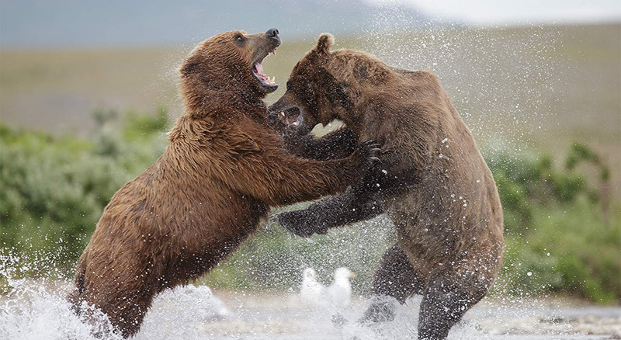
Imagery
The Simile
Simile – comparison using ‘like or ‘as’
‘Swinging his hands like a bear’
FIGURATIVE
LITERAL

Slide 90
Imagery
The Metaphor
Suggests comparison without stating it explicitly.
‘Her home is a prison.’
FIGURATIVE
LITERAL

Slide 91
Imagery
Personification
Attaching human traits and characteristics with inanimate objects, phenomena and animals
‘The raging winds.’
FIGURATIVE
LITERAL

Slide 92
Imagery Formula
Quote image
Identify technique (simile, metaphor, personification)
Explain similarities (just as…so too…)

Slide 93
She had a face like a baboon’s bum
State the Technique (simile, metaphor, personification)
simile
Say what is being compared to what
Girl’s face is compared to a baboon’s bum
Say what they have in common (“just as…, so too…”)
Just as a baboon’s bum is ugly and red, so too, the girl’s face was unpleasant to look at.

Slide 94
The Analysis Question
-Imagery-
He was a lion in battle.
How does this image show the man’s bravery?
technique
Just as…so too…

Slide 95
The Analysis Question
-Imagery-
He was a lion in battle.
How does this image show the man’s bravery?
technique-metaphor
Just as…so too…
Just as a lion are fierce and fearless hunters, so too the writer suggests the man is not afraid to go into battle.

Slide 96
The Analysis Question
-Imagery-
The Analysis Question
-Imagery-
Your love is like my scripture.
Explain how the writer’s use of imagery helps to convey their feelings.
Your love is my scripture.
Explain how the writer’s use of imagery helps to convey their feelings.
Technique?
Just as…so too…

Slide 97
The Analysis Question
-Imagery-
The Analysis Question
-Imagery-
Your love is like my scripture.
Explain how the writer’s use of imagery helps to convey their feelings.
Your love is my scripture.
Explain how the writer’s use of imagery helps to convey their feelings.
Technique? -Simile
Just as…so too…
Just as scripture can be very important to someone, used in worship so too love for someone else can be a number one priority, someone can be devoted to another.

Slide 98
The Analysis Question
-Imagery-
Your love is like my scripture.
Explain how the writer’s use of imagery helps to convey their feelings.
simile
Just as a scripture is a holy piece of writing that people use to guide them in their life, the writer is suggesting that their partner’s love is sacred, and they will be guided and shaped by it.

Slide 99
The Analysis Question
-Imagery-
The stars danced playfully in the moonlit sky
Explain how the writer’s use of imagery help to express the beauty of the evening.
Technique? personification
Just as…so too…
Just as a person dances when they feel happy, are celebrating,/dancing is entertaining so too the stars flickered in the sky, creating a pleasant sight.

Slide 100
The Analysis Question
-Imagery-
The stars danced playfully in the moonlit sky
Explain how the writer’s use of imagery help to express the beauty of the evening.
Technique?
Just as…so too…

Slide 101
The Analysis Question
-Imagery-
The stars danced playfully in the moonlit sky
Explain how the writer’s use of imagery help to express the beauty of the evening.
personification
Just as a person dancing can be captivating, entertaining and suggests joy, so too the stars are shining brightly, as if they are moving beautifully across the sky.

Slide 102
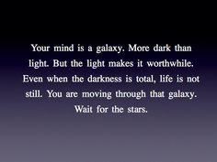
I used to think social media was a force for good. Now the evidence says I was wrong

Slide 103
Question 1
How does the writer’s use of imagery help to demonstrate how certain mental illnesses are linked? (paragraph 2) 3 marks
Quote
“the evil twins of anxiety and depression”
Identify technique
Personification/metaphor
Just as…so too…
Just as evil twins are always together, causing trouble, so too anxiety and depression are often mental illnesses that are linked and experience together by an individual.

Slide 104
Higher R4UAE- Tone

Slide 105
The Analysis Question
-Tone-
Tone refers to the writer’s attitude
Imagine how the words would sound if read aloud

Slide 106
Tone Formula
Identify tone (angry, sarcastic, ironic, etc.) (1)
Give evidence (quote)
Comment on effect-how techniques indicate tone (1)

Slide 107
Irony or Sarcasm?
Irony: “A mockingly humorous use of words in which the intended meaning is the opposite of what is actually said.”
Sarcasm: “Using harsh, bitter words intended to hurt or insult, especially in an exaggerated or ironical way.”

Slide 108
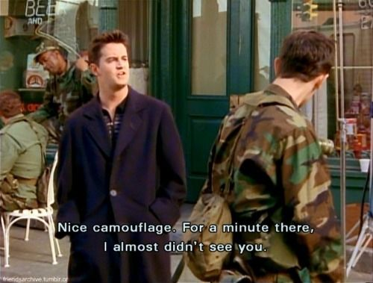
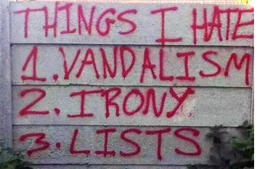
Irony or Sarcasm?

Slide 109
Identifying Tone
You should look for particular words or phrases that help to identify the tone.
“I’m sorry,” she spat.
“I’m sorry,” she sneered.
“I’m sorry,” she sighed.
“I’m sorry,” she sobbed.
4 different words = 4 different tones.

Slide 110
Identifying tone
Spat-disgusted, frustrated, hateful, disingenuous, forced
Sneered-insulting, superior, sly, sneaky
Sighed-bored, tired, fed up, annoyed, disappointment, frustrated
Sobbed-distraught, inconsolable, guilty, grovelling, desperate

Slide 111
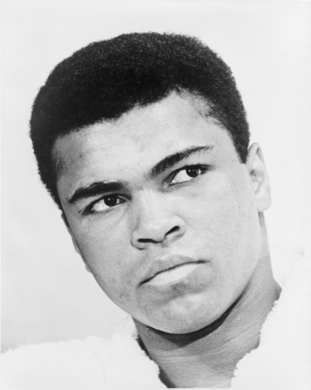
‘This was marginally inconvenient…boxing gold.’ What tone is adopted by the writer in this sentence? Go on to explain the effect of the tone in this context. (2)
The truth was that he (Ali) was dead scared of flying. Two months earlier, on his way to the U.S. boxing trials, he had been violently buffeted during a turbulent flight across to California. It was the first time he had ever travelled by air, and he swore he would never fly again. This was marginally inconvenient when he was one of the hottest hopes America had for Olympic boxing gold.
Tone formula
Identify tone (angry, sarcastic, ironic, etc.) (1)
Give evidence (quote)
Comment on effect-how techniques indicate tone (1)

Slide 112
Tone Answer 1
Tone: amused/humorous/ironic.
“Marginally” inconvenient? Actually massively inconvenient!-use of litotes/understatement
Effect: emphasises writer’s amusement at situation: hero is afraid of flying and Olympic committee would be in a state of panic.

Slide 113
Show how the writer uses tone to demonstrate her strength of feeling in these lines. (2)
Yet Ireland has managed to attract its young entrepreneurs back to help drive a burgeoning economy. We must try to do likewise. We need immigrants. We cannot grow the necessary skills fast enough to fill the gap sites. We need people with energy and commitment and motivation, three characteristics commonly found among those whose circumstances prompt them to make huge sacrifices to find a new life.
Tone formula
Identify tone (angry, sarcastic, ironic, etc.) (1)
Give evidence (quote)
Comment on effect-how techniques indicate tone (1)

Slide 114
Tone Answer 2
Tone could be: demanding; persuasive; pleading
Stress on ‘must’, ‘need’ ‘cannot’ and ‘need’.
These words demand action.
Repetition of ‘we’:
Underlines the fact that they must help themselves/each other .
Repetition of ‘and’:
Emphasises importance of qualities that are needed.

Slide 115
Show how the language of these lines contributes toward a complex portrait of the Scots. You should consider tone. (2)
And we are certainly not mean: we may sometimes be cautious, for we have long memories of poverty; but we are just as often generous to a fault. We are not hypocritical, at least not very.
Tone formula
Identify tone (angry, sarcastic, ironic, etc.) (1)
Give evidence (quote)
Comment on effect-how techniques indicate tone (1)

Slide 116
Tone Answer 3
Tone could be: defensive, tongue-in-cheek, self-deprecating
Word choice of “certainly not mean”
Suggests writer is offended at the very idea.
Uses euphemism of “cautious” instead, though both words have the same basic meaning.

Slide 117
Well done, Ryanair - yes, Ryanair! – for shaming the speedy boarders

Slide 118
Higher R4UAE- Link Q

Slide 119
The Understanding Question
-Link-
These questions are designed to assess your understanding of how writers link similar or opposing points together in a way that helps the flow of their argument.
The question usually asks you to show how a sentence provides an effective link between two paragraphs or ideas.

Slide 120
Link Formula
(Identify link word or phrase)
Quote the part referring back to previous paragraph
Explain, in your own words, what the earlier topic is.
Quote the part linking forward/introducing something new
Explain, in your own words, what that new topic is.

Slide 121
Dummy Answer
The expression “______” acts as a link in the writer’s argument.
“_____” links back to the idea in the previous paragraph about ________.
“______” links forward to the idea in the next paragraph about _________.

Slide 122
Example 1
The playground was full of acts of premeditated violence. The building was dilapidated. The morale amongst the teachers was poor, with many objecting to acts of intimidation directed at them by the pupils they tried to teach. The cleaners had given up trying to deal with the debris, which lay scattered in every corridor and stairwell at the end of morning interval or the all too brief lunchtimes. Local drug dealers had taken to hanging about the school gates, finding too many willing customers exiting there.
Yet, these terrible problems did not deter the new Rector, as he put a variety of strategies into operation. Firstly, he and the Board Of Studies began regular patrols in the playground during times when the pupils were using it, and motivated pupils were sworn in as prefects to help enforce the law. A new Staff Social Committee was set up and the staffroom was redecorated. New litter patrols were initiated using the pupils who wanted to have pride in their school. Money was spent installing a new security system and a more effective and hard-hitting anti-drugs education pack was used during Social Education lessons.
Explain how the sentence “ Yet, these terrible…..into operation” performs a linking function in the passage. (2)

Slide 123
Example Answer
The expression “Yet, these terrible…..into operation” acts as a link in the writer’s argument.
Dummy Answer
The expression “______” acts as a link in the writer’s argument.
“_____” links back to the idea in the previous paragraph about ________.
“______” links forward to the idea in the next paragraph about _________.

Slide 124
Example Answer
Dummy Answer
The expression “______” acts as a link in the writer’s argument.
“_____” links back to the idea in the previous paragraph about ________.
“______” links forward to the idea in the next paragraph about _________.
The playground was full of acts of premeditated violence. The building was dilapidated. The morale amongst the teachers was poor, with many objecting to acts of intimidation directed at them by the pupils they tried to teach. The cleaners had given up trying to deal with the debris, which lay scattered in every corridor and stairwell at the end of morning interval or the all too brief lunchtimes. Local drug dealers had taken to hanging about the school gates, finding too many willing customers exiting there.
Yet, these terrible problems did not deter the new Rector, as he put a variety of strategies into operation.
What is the paragraph before about?
What part of the linking phrase refers back to the ideas of the paragraph before?
“_____” links back to the idea in the previous paragraph about ________.

Slide 125
Example Answer
Dummy Answer
The expression “______” acts as a link in the writer’s argument.
“_____” links back to the idea in the previous paragraph about ________.
“______” links forward to the idea in the next paragraph about _________.
The playground was full of acts of premeditated violence. The building was dilapidated. The morale amongst the teachers was poor, with many objecting to acts of intimidation directed at them by the pupils they tried to teach. The cleaners had given up trying to deal with the debris, which lay scattered in every corridor and stairwell at the end of morning interval or the all too brief lunchtimes. Local drug dealers had taken to hanging about the school gates, finding too many willing customers exiting there.
Yet, these terrible problems did not deter the new Rector, as he put a variety of strategies into operation.
What is the paragraph before about?
What part of the linking phrase refers back to the ideas of the paragraph before?
“terrible problems” links back to the idea in the previous paragraph about the many issues faced by the school.

Slide 126
Example Answer
Dummy Answer
The expression “______” acts as a link in the writer’s argument.
“_____” links back to the idea in the previous paragraph about ________.
“______” links forward to the idea in the next paragraph about _________.
Yet, these terrible problems did not deter the new Rector, as he put a variety of strategies into operation. Firstly, he and the Board Of Studies began regular patrols in the playground during times when the pupils were using it, and motivated pupils were sworn in as prefects to help enforce the law. A new Staff Social Committee was set up and the staffroom was redecorated. New litter patrols were initiated using the pupils who wanted to have pride in their school. Money was spent installing a new security system and a more effective and hard-hitting anti-drugs education pack was used during Social Education lessons.
What is the new paragraph about?
What part of the linking phrase brings in a new idea?
“variety of strategies” links forward to the idea in the next paragraph about the improvements planned for the school.

Slide 127
Example Answer
Dummy Answer
The expression “______” acts as a link in the writer’s argument.
“_____” links back to the idea in the previous paragraph about ________.
“______” links forward to the idea in the next paragraph about _________.
Yet, these terrible problems did not deter the new Rector, as he put a variety of strategies into operation. Firstly, he and the Board Of Studies began regular patrols in the playground during times when the pupils were using it, and motivated pupils were sworn in as prefects to help enforce the law. A new Staff Social Committee was set up and the staffroom was redecorated. New litter patrols were initiated using the pupils who wanted to have pride in their school. Money was spent installing a new security system and a more effective and hard-hitting anti-drugs education pack was used during Social Education lessons.
What is the new paragraph about?
What part of the linking phrase brings in a new idea?
“put a variety of strategies into operation” links forward to the idea in the next paragraph about how the Rector tried to improve the school.

Slide 128
Full Answer
Dummy Answer
The expression “______” acts as a link in the writer’s argument.
“_____” links back to the idea in the previous paragraph about ________.
“______” links forward to the idea in the next paragraph about _________.
The expression “Yet, these terrible…..into operation” acts as a link in the writer’s argument.
“terrible problems” links back to the idea in the previous paragraph about the many issues faced by the school.
“put a variety of strategies into operation” links forward to the idea in the next paragraph about how the Rector tried to improve the school.

Slide 129
Example 2
Dummy Answer
The expression “______” acts as a link in the writer’s argument.
“_____” links back to the idea in the previous paragraph about ________.
“______” links forward to the idea in the next paragraph about _________.
During his time at High School, Harding became a cause for concern. His behaviour with female students was intimidating and there were many complaints about his inappropriate comments to them, often of a violent or sexual nature. He also found it impossible to relate to his peers and he was an isolated figure in the playground or corridors as he actively sought to separate himself from the other children. Most problematic was his art work and he produced images of the bizarre fantasies spewing forth from his dark imagination. One depiction of a wart-time massacre was so horrific that his Art teacher refused to teach him any more.
Despite the psychological problems that were becoming increasingly obvious in his words and actions, Harding had undoubted academic potential. He won a Creative Writing competition during his first year at the school. Moreover, his performance in Science and Mathematics tests at the end of second year was so much more advanced than his classmates that he won Awards in both subjects.
Explain the function of the sentence “Despite the psychological problems…academic potential” in the passage. (2)

Slide 130
The expression “Despite the psychological problems…academic potential” acts as a link in the writer’s argument.
“psychological problems” links back to the idea in the previous paragraph about Harding’s terrible behaviour.
“undoubted academic potential” links forward to the idea in the next paragraph about his success in his studies.

Slide 131
Example 2
Dummy Answer
The expression “______” acts as a link in the writer’s argument.
“_____” links back to the idea in the previous paragraph about ________.
“______” links forward to the idea in the next paragraph about _________.
The expression “Despite the psychological problems…academic potential” acts as a link in the writer’s argument.
“psychological problems” links back to the idea in the previous paragraph about the issues Harding faced at school.
“had undoubted academic potential” links forward to the idea in the next paragraph about his success in education.

Slide 132
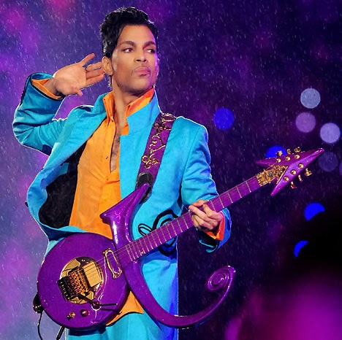
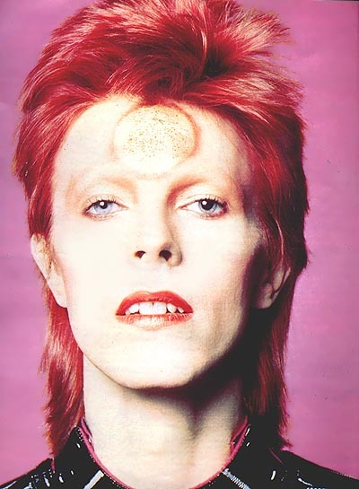
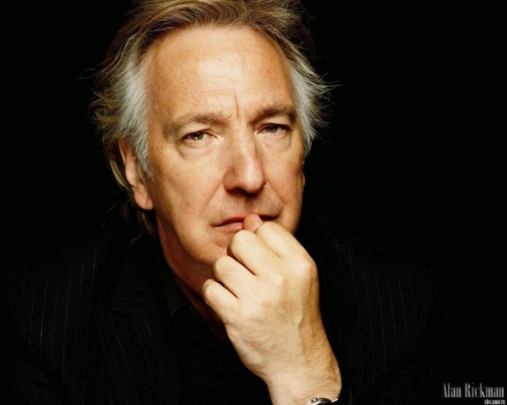
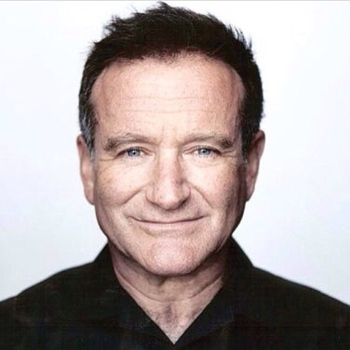
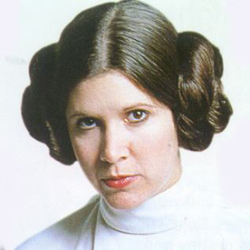
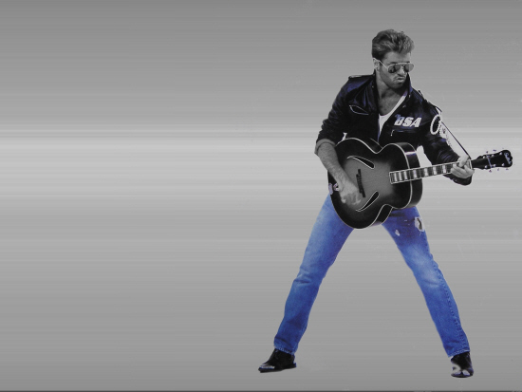
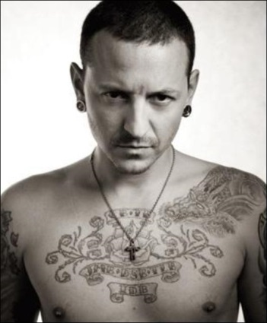
Co-parented by popular culture: why celebrity deaths affect us so deeply

Slide 133
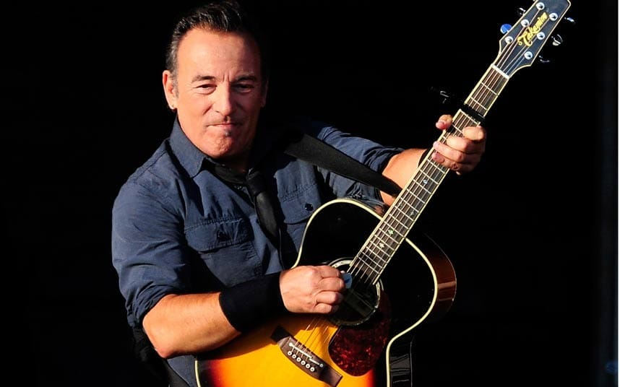
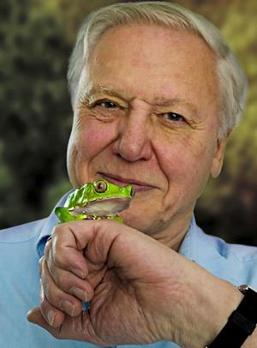
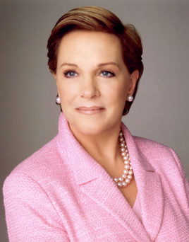
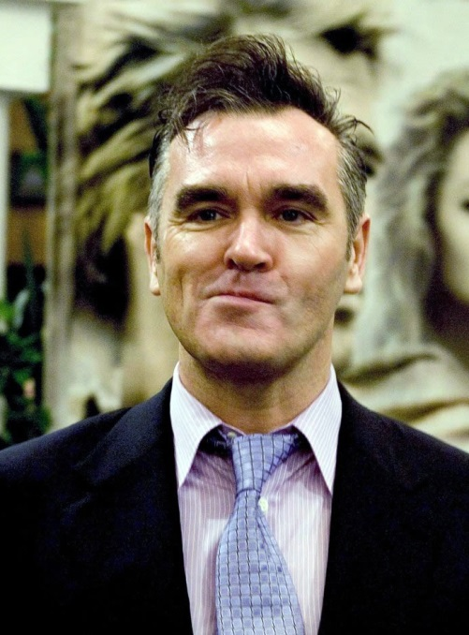
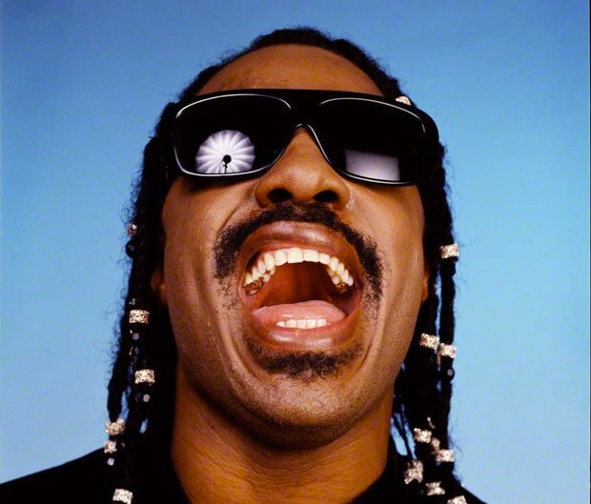
People I Would Mourn

Slide 134
Link Q example
Explain the function of these lines in the development of the writer’s argument. You should make close reference to the passage in your answer. 2 marks
Explain the function of these lines in the development of the writer’s argument. You should make close reference to the passage in your answer. (2 marks)

Slide 135
Higher R4UAE- Comparison Q

Slide 136
Structure of Paper
2 articles, similar topics
Most questions will be on passage 1
One question-the comparison question-will ask you to COMPARE the two articles on issues they AGREE or DISAGREE with

Slide 137
Comparison Q Structure
Look at both passages.
The writers agree/disagree about_________. Identify three key areas on which they agree/disagree.
You should support the points by referring to important ideas in both passages.
You may answer this Q in continuous prose or in a series of developed bullet points.

Slide 138
Comparison Answer Structure
P.O.A/D (Point of Agreement/Disagreement) 1
Passage 1 states…
“_________” (P.1)
Passage 2 states…
“________” (P.2)
P.O.A/D 2
Passage 1 states…
“_________” (P.1)
Passage 2 states…
“________” (P.2)
P.O.A/D 3
Passage 1 states…
“_________” (P.1)
Passage 2 states…
“________” (P.2)

Slide 139
Example Q
Look at both passages.
The writers agree about the purpose of school uniform. Identify three key areas on which they agree.
You should support the points by referring to important ideas in both passages.
You may answer this Q in continuous prose or in a series of developed bullet points.

Slide 140
Comparison Answer Structure
P.O.A(Point of Agreement) 1-school uniform makes pupils look smart
Passage 1 states that pupils who wear a full uniform are more respected by their communities
“The neighbourhoods know who these intellectual students are” (P.1)
Passage 2 states that pupils who wear full uniform are often seen as more successful by their peers
“Consider the smart kid in your science class. Wasn’t he wearing a blazer and tie all year?” (P.2)
P.O.A 2-school uniform creates equality
Passage 1 states that uniform means pupils are not under fashion or societal pressure
“teens already worry about enough-daily fashion choices add unnecessary stress” (P.1)
Passage 2 states that uniform means that those who are from impoverished backgrounds do not face discrimination
“what better way to remove class barriers than by using a uniform-identical outfits regardless of background.” (P.2)
P.O.A 3-school uniform prepares pupils for later life
Passage 1 states that uniforms allow pupils to become comfortable with dressing smartly
“although they might not wear uniforms in future, they will be expected to live up to a professional dress code of some sort” (P.1)
Passage 2 states…
“________” (P.2)

Slide 141
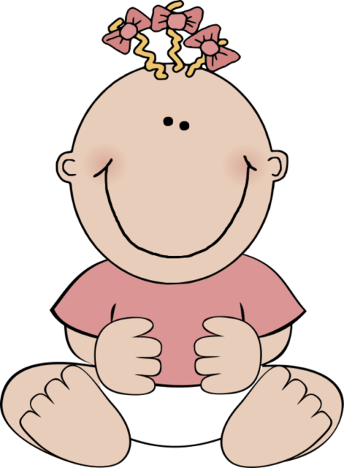
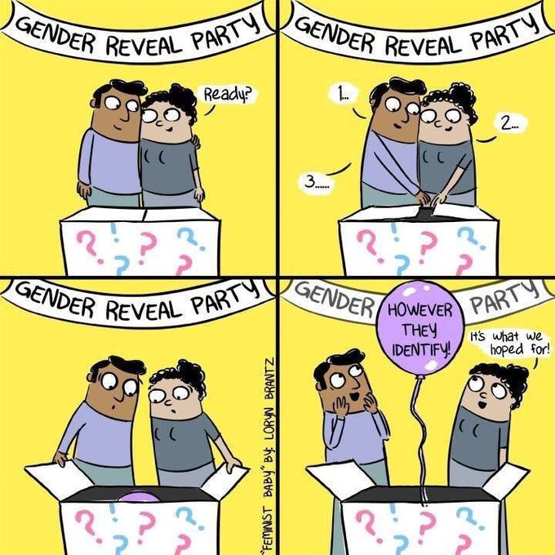
Example-Gender Articles

Slide 142
Article Summaries
Passage 1
Passage 2
toys presented to kids are too gender specific (P1, 2)
a lot of discussion about gender in the press lately (P3)
John Lewis created gender neutral clothing-people disagreed with it-writer thinks it is a good thing (P4)
school got it wrong with trousers-only policy-all should be allowed to wear all uniform(P6)
There are not only two genders-people can have masculine and feminine qualities(P7)
JL gender neutral-controversial (P2)
Sussex school made people feel uncomfortable by banning skirts (P.2)
gender is not just 2 categories (P3)

Slide 143
Article Summaries
Passage 1
Passage 2
Babies don’t care about gendered clothing (P.2)
The backlash against degendered clothes is ridiculous(P.4/5)
Priory School meant well in their choice about uniforms (P. 6)
Changing attitudes about gender stereotypes is difficult (P.7)
Gender and biological sex are two different things (P.8)
Gender and biological sex are two different things (P.3)
There has been an increase in people ‘coming out’ as non-binary (P.4)
Changing attitudes about gender stereotypes is difficult (P.12-13)
Gender stereotypes are generally unhelpful and unneccessary (P. 13/14/15)
The backlash against degendered clothes is ridiculous (P.15)

Slide 144
Comparison Question
Look at both passages.
The writers agree that gender stereotypes can be negative. Identify three key areas on which they agree.
You should support the points by referring to important ideas in both passages.
You may answer this Q in continuous prose or in a series of developed bullet points.

Slide 145
Comparison Answer Structure
What are our points that they agree on? What do BOTH articles say about gender stereotypes?
John Lewis genderless clothing was a good thing
Sussex school gender neutral uniform was controversial
there are not only two genders-non-binary exists

Slide 146
Comparison Answer Structure
POA 1-John Lewis are trying to tackle gender stereotypes
Passage 1 states that the writer thinks John Lewis made a good decision by removing their gendered kid’s clothing
“this, the expansion of choice, is what gender neutrality should be about”(P5)
Passage 2 states that John Lewis’ decision was controversial, but a step forward
“praised by many as progressive”(P2)
POA 2-East Sussex school banning skirts was not a positive gender neutral act
Passage 1 states…
“_________” (P6)
Passage 2 states…
“________” (P2)
POA 3-both writers believe that there are not solely two genders
Passage 1 states…
“_________” (p7)
Passage 2 states…
“________” (P3)

Slide 147
Comparison Answer Structure
POA 1-The backlash against degendered clothes is ridiculous
Passage 1 states that…
“__________” (P.4-5)
Passage 2 states that…
“_________” (P. 15)

Slide 148
Comparison Answer Structure
POA 1-The backlash against degendered clothes is ridiculous
Passage 1 states that those against John Lewis’ decision overreacted and were acting ridiculously
“the backlash was as idiotic as it was inevitable”
Passage 2 states that criticism against degendered clothing prevents growth and acceptance of non-binary gender
“The backlash against efforts to de-gender children’s clothes, quite clearly that we are a long way off understanding gender as more diverse”

Slide 149
Comparison Answer Structure
POA 2-Gender and biological sex are two different things
Passage 1 states…
“_________” (P. 8)
Passage 2 states…
“________” (P.3)

Slide 150
Comparison Answer Structure
POA 2-Gender and biological sex are two different things
Passage 1 states that they disapprove of gender and sex being grouped together
“Gender stereotypes are too often confused with biology”
Passage 2 states that gender is much more of an open concept, and should not be assigned at birth
“gender isn’t as rigid as we thought it might be. It’s more fluid than the longheld binaries of “girl” and “boy”, and “man” and “woman”. ” / “the gender the midwife assigns us at birth after taking a look at our genitals doesn’t always match up with how we feel inside.”

Slide 151
Comparison Answer Structure
POA 3- Changing attitudes about gender stereotypes is difficult
Passage 1 states…
“_________” (P.7)
Passage 2 states…
“________” (P.12-13)

Slide 152
Comparison Answer Structure
POA 3- Changing attitudes about gender stereotypes is difficult
Passage 1 states that even those who are adopting the term ‘non-binary’ still often adhere to gender stereotypes
“discussions of gender today, rather than expanding boundaries, only contract them. When people say they’re “non-binary”, it sounds to me more like they swallowed the lie of the pink and blue onesies. ”
Passage 2 states that gender ideas are so much part of our society that it is hard to think of things differently
“it is so entrenched in every aspect of our society. It's hard to think about a society that works a little differently to the one we have now. ”

Slide 153
Example-Mental Health in Schools

Slide 154
Comparison Question
Look at both passages.
The writers disagree about the way schools approach mental health issues in young people. Identify three key areas on which they disagree.
You should support the points by referring to important ideas in both passages.
You may answer this Q in continuous prose or in a series of developed bullet points.

Slide 155
Article Summaries
Passage 1
Passage 2

Slide 156
Article Summaries
Passage 1
Passage 2
The mental health issues among young people are increasing (P.1)
School demands can be a source of stress (P.2)
Social media can make problems worse (P.3)
There needs to be a higher government investment in mental health care for young people (P.4)
Schools need more encouragement and training to fulfil health and wellbeing goals (P.5)
The government needs a way of measuring success in mental health provision in schools (P.6)
Mental health services need more funding (P.6)
Mental health training has so far been unsuccessful (P.1)
Can often allow children to dwell on problems (P.4)
Mental health classes often incorrectly teach about emotions (P. 5)
Mental health issues among young people are increasing (P. 7)
Programmes funded by the government have been wrongly chosen (P. 8/9)
Over-reacting and overemphasis on mental health issues can cause panic (P.11)

Slide 157
Comparison Question
Look at both passages.
The writers disagree about the way schools approach mental health issues in young people. Identify three key areas on which they disagree.
You should support the points by referring to important ideas in both passages.
You may answer this Q in continuous prose or in a series of developed bullet points.

Slide 158
Comparison Answer Structure
What are our points that they disagree on?

Slide 159
Comparison Answer Structure
What are our points that they disagree on?
The benefits/harm mental health lessons can have
Government choices over mental health support programmes
The importance of these schemes in schools

Slide 160
Comparison Answer Structure
POD 1-The benefits/harm mental health lessons can have
Passage 1 states…
“_________”
Passage 2 states…
“________”
POD 2-Government choices over mental health support programmes
Passage 1 states…
“_________”
Passage 2 states…
“________”
POD 3- The importance of these schemes in schools
Passage 1 states…
“_________”
Passage 2 states…
“________”

Slide 161
Higher R4UAE- Ali Practice Paper

Slide 162
Passages
In the first passage, Hugh McIlvanny discusses the joys and drawbacks of fame and notoriety for boxing legend, Muhammad Ali.
In the second passage, the author considers the role of boxing in today’s sporting world.

Slide 163
Identifying Question Types
Beside each question, write what kind of Q it is
E.g.
IYOW
WC
SS
Link
Imagery
Comp

Slide 164
Identifying Q Types
IYOW
1, 3, 4
WC
2, 6, 7, 8
SS
2, 6, 7, 8
Link
5
Imagery
2, 6, 8
Comp
9

