Slide 1
Deadlines
Final folio pieces must be submitted electronically to me via email or USB before Thursday (15th March)
If not handed in by this date, you will not be sitting N5
No further marking will be done to either piece

Slide 2
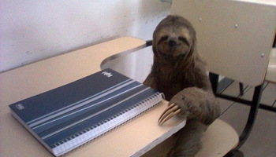
Essay Writing 101- Decoding Questions and Writing Introductions

Slide 3
Decoding Questions
One of the main issues many students struggle with is understanding exactly what the question is asking you to do.
You need to see through all the ‘essay talk’ and be able to pick out the key information.

Slide 4
The Process
Always read the question carefully, considering both parts.
Underline key words from it that you will use from the beginning of your essay right through to the end.
The starting point of your essay should focus on the question, not the text you have studied.
Pay attention to ‘the magic box’…
Answers to questions on Prose should refer to the text and to such relevant features as characterisation, setting, language, key incident(s), climax, turning point, plot, structure, narrative technique, theme, ideas, description…

Slide 5
Example
Make sure you’re in the right question section!
Choose a novel or short story or a work of non-fiction which explores a theme which you find interesting.
By referring to appropriate techniques, show how the writer explores this theme.
Think about the key themes in OM&M
Consider one’s discussed in class-symbolism, characterisation, key incident, etc
Track the theme-when introduced, how is it developed, when is message clarified

Slide 6
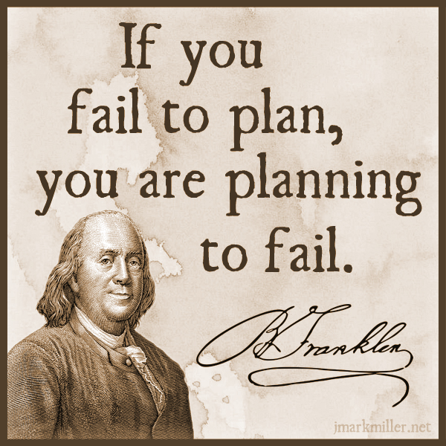
Planning Your Essay
In an exam, it doesn’t hurt to make a small plan of action for your essay, to give yourself focus and ensure you stay on task
This could be a series of bullet points, a mind map or a few scribbles in a margin
It will help you structure your essay well and adhere to what the question is asking

Slide 7
Planning Tips
focus specifically on what is being asked-what type of Q, and what key aspects of the play you are looking at-e.g. theme, character, key scene, conflict, etc.
think about the key moments in the play that relate to your Q-key scenes, climax, etc
plan your essay chronologically-follow the order of the play in order to show how a theme is developed, a character changes, conflict grows, etc.

Slide 8
Planning Your Essay
Question
Choose a novel or short story in which there is a character involved in some form of conflict.
By referring to appropriate techniques, show how the character comes to be involved in this conflict and how the conflict develops throughout the text.

Slide 9
Planning Essay-Conflict
Interpret Q-Conflict-who? When occurs?
Consequences?
Lennie vs Curley
Begins when L arrives on ranch
C broken hand; L dies; C’s wife dies
Key Moments
Key incident-hand crushing
Murder of C’s wife
L’s death
Initial meeting of L and C
Conflict OM&M Essay
Message/related themes
American Dream causes suffering, inequality
C represents privileged middle class
L represents poor struggling working class
Question
Choose a novel or short story in which there is a character involved in some form of conflict.
By referring to appropriate techniques, show how the character comes to be involved in this conflict and how the conflict develops throughout the text.

Slide 10
Planning Essay-Conflict
Key Moments
Interpret Q-Conflict-who? When occurs?
Consequences?
Conflict OM&M Essay
Message/related themes
Question
Choose a novel or short story in which there is a character involved in some form of conflict.
By referring to appropriate techniques, show how the character comes to be involved in this conflict and how the conflict develops throughout the text.

Slide 11
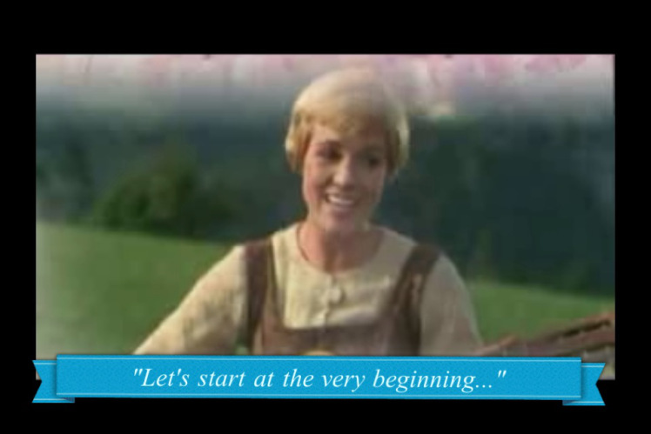
To write a good intro, you have to have TASTE
Your introduction to an essay should be fairly identical in any task, until you get to referring to the question and techniques
Use the TASTE acronym to help you remember what to include

Slide 12
TASTE
Title (name of text)
Author (who wrote text)
Summary (what happens, where, when)
Task (link to Q)
Explain techniques (how does writer do this?)

Slide 13
Example
Title (name of text)
Author (who wrote text)
Summary (what happens, where, when)
Task (link to Q)
Explain techniques (how does writer do this?)
Question
Choose a play in which a central character is in conflict with or rejects another character.
Briefly explain the circumstances of the conflict or rejection and go on to discuss the consequences of this conflict or rejection for the play as a whole.
Introduction
‘A View From The Bridge’ is a play written by Arthur Miller that follows the format of a Greek tragedy. The play is set in 1950s New York, in a small Italian immigrant community called Red Hook, based in Brooklyn. The protagonist Eddie Carbone is a family man who works as a longshoreman. Eddie’s fatal flaw is slowly revealed to the audience after the arrival of his wife’s cousins from Italy. One of the cousins, Rodolpho, begins a relationship with Catherine, Eddie’s niece, which ignites a conflict between Eddie and Rodolpho that motivates the action of the play, and ultimately leads to his downfall. Miller develops this conflict through careful use of characterisation, key scene and symbolism.

Slide 14
‘Of Mice and Men’ by John Steinbeck is a novella set in 1930s California, which focuses on the life of working farm hands struggling to get by during a time of great poverty. This novella deals with the important social issues of the time in America, as a result of The Great Depression, focusing primarily on disillusionment with The American Dream, and the inability for many struggling Americans to achieve this goal. Steinbeck develops this theme through careful use of characterisation, key incident and symbolism.

Slide 15
What we can prep-TAS
We can very easily prepare for part of the introduction in advance, and use the same
Title
Author
Summary
section for every essay we write, making it easy for you to write a quick intro and move on to the main focus on your essay.
We can also make this a very high quality opening, getting the marker on side early!

Slide 16
Writing your TAS
Using your previous essays and the examples given in class, write a successful and impressive part-intro that includes:
Title-
Author-
Summary:

Slide 17
Name | Creative | Persuasive | Both
Niamh | ✓ | ✓ | ✓
Dylan
Kai
Jessica Makengo | ✓
Jessica Mbungu
Ben
Erin |  | ✓
Fahad
Corina
Dammy
Zak R
Marc | ✓ | ✓ | ✓
Neketa |  | ✓
Sophie
Gavin | ✓
Harrison
Jack
Danielle

Slide 18
Model TAS
Title (name of text)
Author (who wrote text)
Summary (what happens, where, when)
‘Of Mice and Men’ is a novella by John Steinbeck. The novella is set during the 1930s, the time of the Great Depression, in California. The two main protagonists Lennie and George are drifters who travel to find work on a ranch, in order to earn enough money to fulfil their dream of owning their own land.

Slide 19
Making it specific
So you have an amazing start to your intro. Now you need to show the marker that you are answering a specific question, and what in particular you intend to focus on
This is vital because if a marker can see your good intentions, and you don’t quite manage to complete everything you plan to write about, they will assume what you would have written would have been good!
Also, it helps to structure your essay and remind you of what to include

Slide 20
Adding the TE-EXAMPLE
Question
Choose a play in which a central character is in conflict with or rejects another character.
Briefly explain the circumstances of the conflict or rejection and go on to discuss the consequences of this conflict or rejection for the play as a whole.
Example T.E
In this play, the central character Eddie rejects Rodolpho, as he is suspicious and jealous of the budding relationship between Rodolpho and Catherine. Eddie’s fatal flaw of his hidden desire for Catherine causes him to openly berate Rodolpho, creating conflict and tension with Rodolpho’s brother Marco. Through this rejection and conflict, Miller explores the theme of toxic masculinity, expressed through use of characterisation, symbolism and climax.
Task (link to Q)
Explain techniques (how does writer do this?)

Slide 21
Your Turn!
Question
Choose a novel or short story in which there is a character involved in some form of conflict.
By referring to appropriate techniques, show how the character comes to be involved in this conflict and how the conflict develops throughout the text.
T.E
Conflict-what is it? Who is it between? why
What theme is explored/clarified in this conflict?
“In this novella, there is conflict between…”
“Steinbeck uses this conflict to explore the theme of…”
Explain techniques-for this kind of essay-characterisation, key incident, symbolism
“This conflict is demonstrated through Steinbeck’s use of…”
Task (link to Q)
Explain techniques (how does writer do this?)
Example T.E
In this play, the central character Eddie rejects Rodolpho, as he is suspicious and jealous of the budding relationship between Rodolpho and Catherine. Eddie’s fatal flaw of his hidden desire for Catherine causes him to openly berate Rodolpho, creating conflict and tension with Rodolpho’s brother Marco. Through this rejection and conflict, Miller explores the theme of toxic masculinity, expressed through use of characterisation, symbolism and climax.

Slide 22
EXAMPLE TE
In this novella, there is conflict between Lennie, a working class man with learning difficulties, and Curley, a ranch owner’s son who is in a position of power and privilege. Steinbeck uses this conflict to explore the theme of The American Dream. This conflict is demonstrated through Steinbeck’s use of characterisation, key incident and symbolism.

Slide 23
Example Intro
‘Of Mice and Men’ is a novella by John Steinbeck. The novella is set during the 1930s, the time of the Great Depression, in California. The two main protagonists Lennie and George are drifters who travel to find work on a ranch, in order to earn enough money to fulfil their dream of owning their own land. In this novella, there is conflict between Lennie, a working class man with learning difficulties, and Curley, a ranch owner’s son who is in a position of power and privilege. Steinbeck uses this conflict to explore the theme of The American Dream. This conflict is demonstrated through Steinbeck’s use of characterisation, key incident and symbolism.

Slide 24
Essay Writing 101- Writing FULLY in Main Paragraphs

Slide 25
Using the Structure
REMEMBER!
Point-(topic sentence-what are you writing about in this paragraph?)
Context- (when in the play does this take place? What’s going on at that point?)
Quotation-(appropriate evidence)
Explanation-(what does this quotation tell us? Explain key techniques used, why they are important)
Link to Q-(why is this important to your overall point? How does it relate to the wider ideas/themes?)

Slide 26
Making Your Point
Topic sentences are really important as they signpost your essay and help you to structure your writing
They remind you of what you are trying to say in the paragraph, and let the marker know what you intend to discuss
A topic sentence should include:
A linking word/phrase
A reference to the technique you will be analysing
A reference to the Q

Slide 27
Linking Words
Introducing an idea
-firstly -to begin
-primarily -initially
Contrasting an idea/argument
-in contrast -on the other hand
-in comparison -instead
Adding to an idea/argument
-additionally -furthermore
-in addition -also -moreover -in the same way
-as previously stated -similarly
Giving examples
-for example -for instance
-such as -by way of illustration
Concluding and summarising
-in conclusion -to conclude -lastly
-all in all -in summary -to sum up

Slide 28
Example
Question
Choose a novel or short story in which there is a character involved in some form of conflict.
By referring to appropriate techniques, show how the character comes to be involved in this conflict and how the conflict develops throughout the text.
Example topic sentence-MP1
Firstly, Steinbeck creates a sense of conflict between the characters of Lennie and Curley in their initial meeting, through characterisation.
A topic sentence should include:
A linking word/phrase
A reference to the technique you will be analysing
A reference to the Q

Slide 29
Topic Sentence Practice
Question
Choose a play in which a central character is in conflict with or rejects another character.
Briefly explain the circumstances of the conflict or rejection and go on to discuss the consequences of this conflict or rejection for the play as a whole.
Create topic sentence
MP2-the hand crushing scene
Linking word->ref. to Q
(developing conflict)->
technique being analysed
A topic sentence should include:
A linking word/phrase
A reference to the technique you will be analysing
A reference to the Q
Technique-key incident
Example topic sentence-MP1
Initially, Miller introduces the idea of conflict between Eddie and Rodolpho through his use of stage directions in their first meeting.

Slide 30
Example topic sentence MP2
Furthermore, Steinbeck shows that the conflict between the two men is growing stronger through the use of key incident.
A topic sentence should include:
A linking word/phrase
A reference to the technique you will be analysing
A reference to the Q

Slide 31
Name | Creative | Persuasive | Both
Niamh | ✓ | ✓ | ✓
Dylan
Kai
Jessica Makengo | ✓
Jessica Mbungu
Ben |  | ✓
Erin |  | ✓
Fahad | ✓
Corina
Dammy
Zak R |  | ✓
Marc | ✓ | ✓ | ✓
Neketa | ✓ | ✓
Sophie
Gavin | ✓
Harrison
Jack | ✓ | ✓ | ✓
Danielle

Slide 32
Context
Your context is where you orientate your reader and let them know what’s happening in the novel. Include brief details about:
roughly where in the novel it takes place
briefly what is happening at this point in the novel
Example
At the beginning of the novel, Lennie and George arrive at the ranch and are introduced to the ranch-owner’s son, Curley, who takes an instant dislike to Lennie:
CONTEXT
Where in the play does this occur?
Briefly, what is happening at this point?

Slide 33
Context Practice
Question
Choose a novel or short story in which there is a character involved in some form of conflict.
By referring to appropriate techniques, show how the character comes to be involved in this conflict and how the conflict develops throughout the text.
Example context
MP2-the hand crushing scene- “The next minute Curley was flopping like a fish on a line, and his closed fist was lost in Lennie’s big hand.”
Where in the novel does this occur?-midway through
Briefly, what is happening at this point?

Slide 34
Example Context MP2
Midway through the novel, Curley tries to provoke Lennie. At first Lennie does not respond, however the encouragement from George leads him to retaliate:
CONTEXT
Where in the play does this occur?
Briefly, what is happening at this point?

Slide 35
Choose Quotation
Your quotation is your evidence to back up the point you are trying to make about the text. It must clearly show something important about the novel, and must be relevant to the question asked.
Have you used quotations properly?
Use a colon : to introduce them
If longer than a few words, take a new line
No longer than one or two lines
They should illustrate a point not simply repeat it
Example:
It is clear she had no money: ‘Katie was heavy skint.’
MAKE SURE YOUR QUOTATIONS ARE WORTHWHILE!

Slide 36
Quotation for Your Paragraph
“The next minute Curley was flopping like a fish on a line, and his closed fist was lost in Lennie’s big hand.”

Slide 37
Summary-Paragraph So Far
Furthermore, Steinbeck shows that the conflict between the two men is growing stronger through the use of key incident. Midway through the novel, Curley tries to provoke Lennie. At first Lennie does not respond, however the encouragement from George leads him to retaliate:
“The next minute Curley was flopping like a fish on a line, and his closed fist was lost in Lennie’s big hand.”

Slide 38
Explanation
Your explanation should be the longest section of your paragraph. Here you will explain in detail how your quotation backs up your point, by:
analysing literary techniques used by the writer
Example sentence starters
Here, Steinbeck emphasises _____through his use of ____. The ____ used illustrates…
Here, Steinbeck emphasises the growing conflict between Curley and Lennie through his use of key incident. The imagery used illustrates…
Analyse image of Curley as flopping fish-weak, vulnerable, completely in L’s control-compared to before-ranch owner’s son, boxer
How are the roles reversed for L and C here?
What is revealed about L here, compared to how he has been portrayed so far?

Slide 39
Words for linking analysis to quotes
The following words and phrases describe what the writer does, or what part of the text does.
They will help you to show that you are analysing the author’s work.
This…
reinforces emphasises highlights foreshadows
exemplifies explains demonstrates echoes
has connotations of suggests show creates mirrors establishes underlines reveals hints illustrates

Slide 40
Example Explanation
Question
Choose a novel or short story in which there is a character involved in some form of conflict.
By referring to appropriate techniques, show how the character comes to be involved in this conflict and how the conflict develops throughout the text.
Example Explanation
“He glanced coldly at George and then at Lennie. His arms gradually bent at the elbows and his hands closed into fists.” Here, Steinbeck emphasises Curley’s immediate dislike and resentment towards Lennie through his characterisation. The description of Curley’s reaction demonstrates an instant dislike and feeling of threat, as Steinbeck indicates that he makes himself appear larger by bending his elbows, and uses his fists to create a threatening stance. In previous descriptions of each character, Steinbeck has created contrast in terms of their appearances: Lennie is very tall and large, Curley is small and stocky, potentially causing Curley to feel inferior to Lennie, despite the fact he is in a position of power on the ranch.

Slide 41
Example MP2
Example sentence starters
Here, Steinbeck emphasises _____through his use of ____. The ____ used illustrates…
“The next minute Curley was flopping like a fish on a line, and his closed fist was lost in Lennie’s big hand.”
Here, Steinbeck emphasises _____________through his use of key incident. The incident used illustrates…
Despite the fact Curley has been antagonising Lennie and trying to make himself seem powerful, here he is instantly overpowered by Lennie, reduced to a ‘fish on a line’-trapped, caught
Conflict here is symbolic-Lennie, as underprivileged working man, is fighting back against Curley-a symbol of the success of the American Dream
Conflict is developed here, as Lennie’s true nature is revealed, and Curley’s pride will not withstand such a crushing blow to his perceived authority

Slide 42
Example Explanation-MP2
“The next minute Curley was flopping like a fish on a line, and his closed fist was lost in Lennie’s big hand.”
Here, Steinbeck emphasises the growing conflict between Curley and Lennie through his use of key incident. The imagery used illustrates that Curley is not as powerful as he is made out to be, as the ranch-owner’s son and a former boxer. The comparison to a flopping fish makes Curley appear weak, vulnerable and completely under Lennie’s control. Despite his learning difficulties and lower status on the ranch, Lennie is able to overpower Curley completely in this physical conflict. In this key incident, Lennie’s true strength and fearsome nature is revealed to the reader, which contrasts with his child-like, sensitive personality.

Slide 43
Linking to the Q
In your final section of your main paragraph, you should:
Evaluate why your chosen quotation is important
Use wording from the question to make it clear your essay has a specific focus
Words that indicate a personal response
The following words and phrases describe how the reader feels, or how the text affects us as we read.
They will help you to show that you are evaluating the author’s work.
This is…
thought-provoking inspiring hard-hitting stimulating
fast-paced gripping profound important
skilfully done moving horrifying (a) pivotal moment
effective perceptive striking thoughtful

Slide 44
Example Link to Q
MP1
These opposing descriptions, combined with Curley’s aggressive reaction towards Lennie indicate from the beginning of the text that these are very different characters, and are used by Steinbeck to demonstrate the inequality between the struggling working man and the privileged few in trying to achieve the American Dream.
MP2
Miller’s (personal response word) use of (technique) here emphasises/demonstrates/conveys….
Miller’s thought-provoking use of key incident here emphasises
Conflict growing between the pair
Foreshadows the tragic events later within the novel
Warns the reader of Lennie’s uncontrollable strength, and how this may cause him difficulties on the ranch.
*Link to Q-conflict with another character-how is it developed here?*

Slide 45
Full Main Paragraph Example
“He glanced coldly at George and then at Lennie. His arms gradually bent at the elbows and his hands closed into fists.” Here, Steinbeck emphasises the Curley’s immediate dislike and resentment towards Lennie through his characterisation. The description of Curley’s reaction demonstrates an instant dislike and feeling of threat, as Steinbeck indicates that he makes himself appear larger by bending his elbows, and uses his fists to create a threatening stance. In previous descriptions of each character, Steinbeck has created contrast in terms of their appearances: Lennie is very tall and large, Curley is small and stocky. potentially causing Curley to feel inferior to Lennie, despite the fact he is in a position of power on the ranch. These opposing descriptions, combined with Curley’s aggressive reaction towards Lennie indicate from the beginning of the text that these are very different characters, and are used by Steinbeck to demonstrate the inequality between the struggling working man and the privileged few in trying to achieve the American Dream.

Slide 46
Homework-for Mon 19th March
Introduction and 4 main paragraphs for following essay Q:
Choose a novel or short story in which there is a character involved in some form of conflict.
By referring to appropriate techniques, show how the character comes to be involved in this conflict and how the conflict develops throughout the text.

Slide 47
Essay Writing 101- Writing a Successful Conclusion

Slide 48
Concluding-SERVE
In your conclusion you should:
Summarise the points you have made
Evaluate writer’s message (link to themes)
Refer back to the question
Vary your expression (don’t repeat yourself)
Express an opinion (appreciation of text)

Slide 49
Example
Title (name of text)
Author (who wrote text)
Summary (what happens, where, when)
Task (link to Q)
Explain techniques (how does writer do this?)
Question
Choose a play in which a central character is in conflict with or rejects another character.
Briefly explain the circumstances of the conflict or rejection and go on to discuss the consequences of this conflict or rejection for the play as a whole.
Introduction
‘A View From The Bridge’ is a play written by Arthur Miller that follows the format of a Greek tragedy. The play is set in 1950s New York, in a small Italian immigrant community called Red Hook, based in Brooklyn. The protagonist Eddie Carbone is a family man who works as a longshoreman. Eddie’s fatal flaw is slowly revealed to the audience after the arrival of his wife’s cousins from Italy. One of the cousins, Rodolpho, begins a relationship with Catherine, Eddie’s niece, which ignites a conflict between Eddie and Rodolpho that motivates the action of the play, and ultimately leads to his downfall. Miller develops this conflict through careful use of characterisation, key scene and symbolism.

Slide 50
Example
Summarise the points you have made
Evaluate writer’s message (link to themes)
Refer back to the question
Vary your expression (don’t repeat yourself)
Express an opinion (appreciation of text)
Question
Choose a play in which a central character is in conflict with or rejects another character.
Briefly explain the circumstances of the conflict or rejection and go on to discuss the consequences of this conflict or rejection for the play as a whole.
Example Conclusion
In conclusion, the conflict between Eddie and Rodolpho, and later conflict between Eddie and Marco, are used by Miller to demonstrate his key message concerning toxic masculinity-that the rigid ideas of male dominance are ultimately destructive. This message is made particularly clear to the reader through Miller’s intriguing use of the Greek tragedy format, as Eddie’s tragic demonstrates how his own actions and refusal to change his views inevitably cause his downfall.

Slide 51
Your Turn!
Using the example and SERVE structure, write a conclusion for your homework essay on the Q below:
Choose a novel or short story in which there is a character involved in some form of conflict.
By referring to appropriate techniques, show how the character comes to be involved in this conflict and how the conflict develops throughout the text.
Techniques analysed-characterisation, key incident, symbolism, climax
Writer’s message-the American Dream
Refer back to conflict-between who, why
Opinion-what did you learn/gain?-DO NOT USE I-the reader, the audience
Summarise the points you have made
Evaluate writer’s message (link to themes)
Refer back to the question
Vary your expression (don’t repeat yourself)
Express an opinion (appreciation of text)

Slide 52
Reviewing Your Work

Slide 53
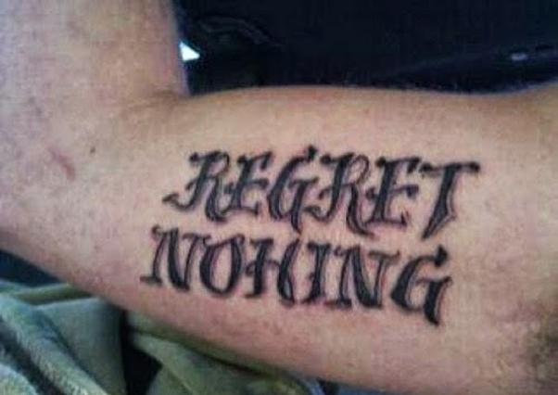
Spelling
Ensure all words are spelt correctly, to the best of your ability
Check carefully for spellings of author names, key terminology and key words in the novel
If you can’t spell it, don’t use it!

Slide 54
Punctuation and Grammar
Ensure you are structuring your sentences properly using full stops and commas-don’t let them ramble on!
Look back at advice for structuring quotations-ensure this is done properly
Again, if you don’t know how to use it, don’t use it! E.g. don’t use a semi-colon if you don’t know why it’s used.
PARAGRAPHING-follow the structure and you’ll do fine!

Slide 55
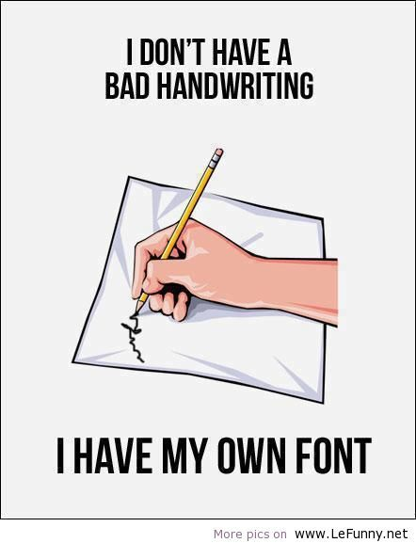
Presentation
Take time to ensure your handwriting is legible-not just to you, but to others!
Make sure spacing and size of lettering is appropriate
To emphasise changes in paragraphs, miss a line before beginning a new one

Slide 56
Clarity of Expression

