Slide 1
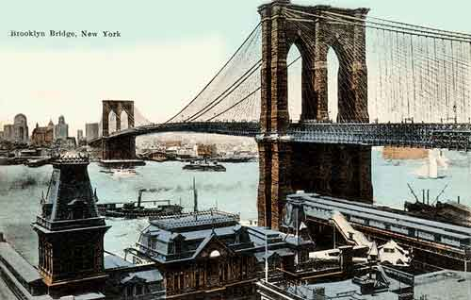
A View From The Bridge
By Arthur Miller

Slide 2
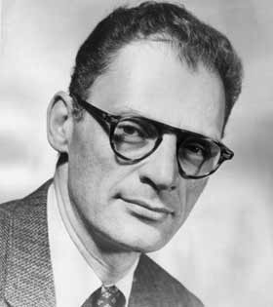
Arthur Miller

Slide 3
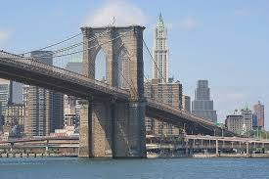
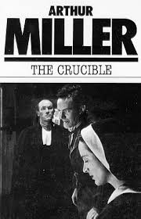
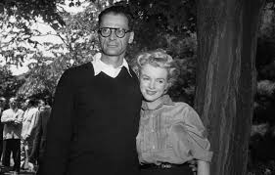
Arthur Miller-A Brief History
Born in New York to Polish immigrant parents in 1915-lived in Brooklyn
Famous works:
-The Crucible
-All My Sons
-Death of a Salesman
Married three times, once to Marilyn Monroe

Slide 4
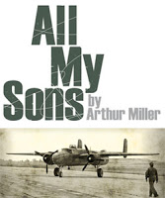
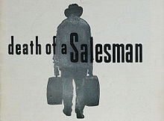
Miller’s work
Most of his work is set in the America of the day (1950s) and portrays realistic characters and events.
He deals with political and moral issues and weaves in ideas from Greek tragedy.
He is interested in how personal relationships dictate the way one leads one's life and about people's struggles to do what is right.

Slide 5
Drama-key terminology
To prepare ourselves for discussing drama, we must revise key terminology used in drama texts.
In your groups…
Complete your key terminology worksheet to the best of your abilities.
Fill in the ‘Definitions’ column-we will discuss the play column together
There may be some new terms you are unfamiliar with-it’s okay! We’ll discuss after!

Slide 6
Playwright
Definition?
The person who wrote the play; the dramatist
A View From The Bridge?
Arthur Miller

Slide 7
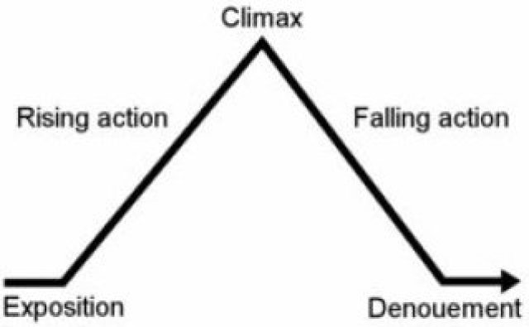
Plot
Definition?
The story; the basis of the piece of drama
A View From the Bridge?
Italian immigration
Family relationships
Jealousy
fate

Slide 8

Characters
Definition?
The people involved in the plot of the play.
Involves:
-delivery of dialogue
-emotion and expression
-movement
A View From The Bridge-Main Characters
Eddie, Alfieri, Beatrice, Catherine, Marco, Rodolpho

Slide 9

Protagonist
Definition?
The main characters who the audience feel sympathy for
A View From The Bridge
?

Slide 10

Antagonist
Definition?
The main characters who cause disruption in the play
A View From The Bridge
?

Slide 11
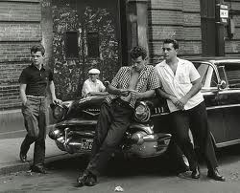
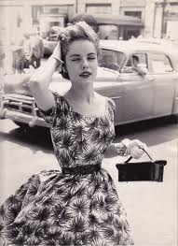
Setting
Definition?
The place and time at which a play is represented as happening
A View From The Bridge
Brooklyn, NY
1950s

Slide 12

Stage Directions
Definition?
Unspoken action of the play.
Involves:
-facial expressions
-gestures
-position on the stage
-use of voice
-use of props
-mise-en-scene

Slide 13

Dialogue
Definition?
Conversation or exchange between characters.

Slide 14
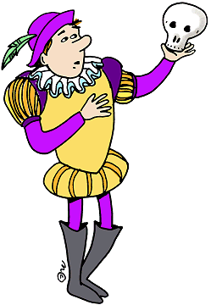
Monologue/Soliloquy
Definition?
A single character expressing their mental thoughts aloud, sometimes also to directly address another character (monologue) or the audience (soliloquy).
A View From The Bridge
Alfieri’s speech

Slide 15
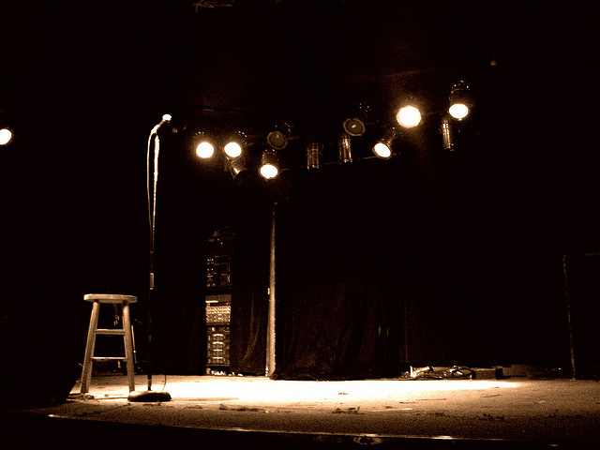
Scenic Arrangements/Mise-en-Scene
Definition?
Everything you see on the stage.
Involves:
-props
-set design
-costume
-actors’ positioning

Slide 16

Conflict
Definition?
The different drives/motivations of the characters or forces involved. Conflict may be internal or external—it may occur within a character's mind or between a character and exterior forces.

Slide 17
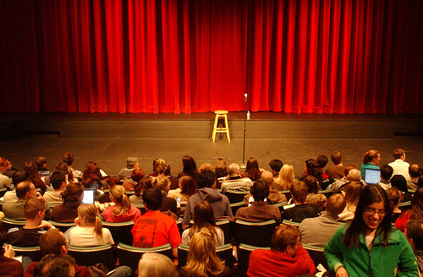
Dramatic Irony
Definition?
A process whereby the audience are more aware of what is happening in the plot than some or at least one of the main characters.

Slide 18
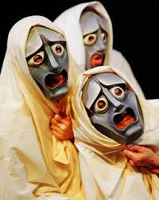
What is Greek Tragedy?
Depicts the downfall of a hero or heroine
The tragic hero's powerful wish to achieve some goal fails
Hero has a fatal flaw that causes downfall
The hero need not die at the end, but he / she must undergo a change
The tragic hero may achieve some revelation or recognition about human fate, destiny, and the will of the gods.
Chorus that offered a variety of background and summary information to help the audience follow the performance and commented on themes.

Slide 19
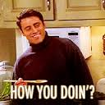
Background to Setting
Miller worked in the Brooklyn shipyards for two years, where he befriended the Italians he worked alongside. He heard a story of some men coming over to work illegally and being betrayed. The story inspired A View from the Bridge, which was written in 1955.
Based in the Italian American community of Red Hook, Brooklyn…let’s get practising those accents!

Slide 20
Italian American Accent
https://www.youtube.com/watch?v=G-0z0zKNWc0

Slide 21


1950s and Italian Immigration
Italy in 1955 was a very poor country-effects post-WW2-Italy’s fascist dictator Mussolini fought alongside Nazi Germany During World War 2,
After the war, the economy was slow to grow. With no jobs and no prospects, it was not surprising that many people decided to try their luck in 'rich' America.
There was a thriving trade in illegal immigration, encouraged by the dockyard owners, who knew that they could get cheap labour from immigrants if they had paid for their passage over.

Slide 22
Casting Act 1
We will change roles between acts so more people will get a chance to read.
Alfieri-our all-knowing Greek choric figure. A lawyer.
Eddie-a middle-aged longshoreman (docker); husband of Beatrice; uncle of Catherine
Beatrice-wife of Eddie
Catherine-young and beautiful, in her early twenties. Eddie and Beatrice’s niece
Marco-The cousin of Beatrice; illegal immigrant
Rodolpho-The cousin of Beatrice; illegal immigrant
Tony-a friend of the Carbones
Louis-friend of Eddie
Mike-friend of Eddie

Slide 23
A View From The Bridge: Section 1 pg 3-18

Slide 24
Today
We will read through pages 3-18 together
No scenes, so we will stop at key points in the act

Slide 25
Casting Act 1
We will change roles between acts so more people will get a chance to read.
Alfieri-our all-knowing Greek choric figure. A lawyer.
Eddie-a middle-aged longshoreman (docker); husband of Beatrice; uncle of Catherine
Beatrice-wife of Eddie
Catherine-young and beautiful, in her early twenties. Eddie and Beatrice’s niece
Louis-friend of Eddie

Slide 26
Summary of Section 1
Write a bullet point summary of the events of this first section
Include:
Who is involved
What characters do
What we find out about them

Slide 27
Characters: First Impressions
In your groups, you are going to create mind maps of a particular character
  Eddie
  Beatrice
  Catherine
  Alfieri
Use quotations from the play to support what you say
Remember to look at:
  Description of appearance (stage directions)
  Their personality (stage directions may describe character, way they say things)
  What they think about other characters (dialogue)
  How other characters see them (dialogue)

Slide 28
Larger, middle-aged man
Stage directions “He is forty-a husky, slightly overweight longshoreman” (pg4)
Appearance
Personality
Eddie
How they see others
How others see them

Slide 29
Present your findings to the class!
On the whiteboard, draw up and explain your mind map to the class.
While another group is explaining, make your own mind map for this character based on their presentation.

Slide 30
Analysing Key Quotations
After each section studied, we will analyse key quotations that demonstrate:
  Characterisation
  Key themes
  Setting
  symbolism

Slide 31
Analysing Key Quotations
Context-what is happening at this point in the play
Quotation-important part of the play
Analysis-what this quotation means, what it tells us about characters/themes/setting

Slide 32
Example
Context
Alfieri’s opening monologue, describing the area of Red Hook
Quotation
“This is the gullet of New York, swallowing the tonnage of the world.” (pg 4)
Analysis
gullet-=throat-Red Hook is at side of river Hudson (mouth of river)-ability to ‘swallow up’ migrating people and absorb into community-negative image, aggressive

Slide 33
Key Quotations-Section 1
“Now we settle for half, and I like it better.” (pg 4)
“Now don’t aggravate me, Katie, you are walkin’ wavy!....You ain’t ‘all the girls’.”pg 6
“You see what he is?....You’re an angel! God’ll bless you.” pg 9
“…a guy do a thing like that? How’s he gonna show his face?” pg 16
“…a powerful emotion is on him, a childish one and a knowing fear, and the tears show in his eyes-and they are shy before the avowal.”(17)

Slide 34
Example
Context
Alfieri’s initial monologue, describes the civilised neighbourhood of Red Hook
Quotation
“Now we settle for half, and I like it better.” (pg 4)
Analysis
Crime is dealt with differently in NY than Italy-ideas of justice vs. law-moral justice=doing what you think is fair/right; law=what the police/society see is right-THEME justice vs law

Slide 35
Example
Context
Eddie speaking to Catherine about behaviour
Quotation
“Now don’t aggravate me, Katie, you are walkin’ wavy!....You ain’t ‘all the girls’.”pg 6
Analysis
Eddie is controlling/possessive over C-father figure. Wants C to remain childlike-sees her as special, doesn’t want her to be objectified/sexualised

Slide 36
Example
Context
B talking to C about E
Quotation
“You see what he is?....You’re an angel! God’ll bless you.” pg 9
Analysis
B thinks of E as innocent and idolises him, subservient to him-cooks/cleans/does what he tells her-blinded by love for him

Slide 37
Example
Context
E talking about snitch story-Vinny
Quotation
“…a guy do a thing like that? How’s he gonna show his face?” pg 16
Analysis
E uses stern tone-rhetorical Q-disappointment, disbelief-V seen as disgrace, outcast. Uses story as a warning about community spirit and values-THEME-justice and law

Slide 38
Example
Context
E reacting to C’s new job
Quotation
“…a powerful emotion is on him, a childish one and a knowing fear, and the tears show in his eyes-and they are shy before the avowal.”(pg17)
Analysis
“powerful” E succumbs to his emotions easily, finds it hard to hide feelings. Doesn’t want C to grow up, be independent –controlling/possessive

Slide 39
A View From The Bridge: Section 2 pg 18-27

Slide 40
Pg 18-27
Alfieri
Eddie
Marco
Rodolpho
Tony
Beatrice
Catherine

Slide 41
Starter Task
Think back to the section we read yesterday...
Is there anything you can add to your character mind maps for Alfieri, Eddie, Beatrice or Catherine, in terms of their appearance or personality?
Add in how they see Rodolpho and Marco to your “how they see others” section, and how they are viewed by Rodolpho and Marco, if relevant

Slide 42
Summary Questions pg 18-27
How do Rodolpho and Marco enter the Carbone home? How would you describe their greeting to Beatrice and Eddie? Use a quotation to support your answer (pg 19)
When Rodolpho and Marco arrive, they greet Beatrice and Eddie with gratitude-Marco “kisses her hand”pg 19. Eddie wants to welcome them, as shown when he “takes Marco’s bag” (pg 19)

Slide 43
Summary Questions pg 18-27
1. How do Rodolpho and Marco enter the Carbone home? How would you describe their greeting to Beatrice and Eddie? Use a quotation to support your answer (pg 19)
2. How is life in Italy different compared to life in America? Look at Rodolpho’s descriptions in pgs 20-21.
3. How does Marco show gratitude towards Eddie in pg 23? Use a quotation to support your answer.

Slide 44
Summary Questions pg 18-27
4. What is different about Marco and Rodolpho’s goals? (Pg 22-23)
5. How does Catherine react to Rodolpho’s singing? What word tells you this? (Pg 26)
6. How does Eddie demonstrate control over Catherine in pg 26?
7. Why is Eddie’s face described as “puffed with trouble” at the end of this section? (Pg 27)

Slide 45
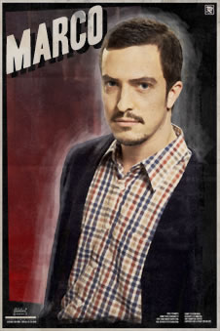

Introducing Marco and Rodolpho
Create mind maps for each of these characters, following the same format. This is how we will add to our ideas over the course of our reading.

Slide 46
Analysing Key Quotations
After each section studied, we will analyse key quotations that demonstrate:
  Characterisation
  Key themes
  Setting
  symbolism

Slide 47
Analysing Key Quotations
Context-what is happening at this point in the play
Quotation-important part of the play
Analysis-what this quotation means, what it tells us about characters/themes/setting

Slide 48
Example
Context
Introductory description of Marco
Quotation
“he is a square-built peasant of thirty-two, suspicious, tender, and quiet-voiced” pg 18
Analysis
Tells us Marco is a complex character: strong, but poor; untrusting but kind; powerful but softly spoken-unpredictable

Slide 49
Key Quotations-Section 2
Find quotations from:
Pg 21-22-Marco, about his family
Pg 23-Marco, speaking to Eddie
Pg 23-Rodolpho, speaking about America
Pg 26-Eddie’s reaction to Rodolpho

Slide 50
Example
Context
Marco, speaking about his family in Italy
Quotation
“…if I stay there, they will never grow up. They eat the sunshine.” (pg 22)
Analysis
Marco is under pressure to provide for his family-similar role to Eddie-strong family man. He is desperate to earn money, but is selfless in how he will use it-opposite of R.

Slide 51
Example
Context
Marco interacting with Eddie
Quotation
“(he is near tears)Eduardo…(He goes to Eddie, offering his hand)”
Analysis
Marco is very grateful to Eddie. SDs shows gratitude, given hope. “Eduardo”, “offering hand”-showing respect for Eddie, seeing him as an equal-Italianised name

Slide 52
Example
Context
Rodolpho, about his plans in America
Quotation
“Me, I want to be an American. And then I want to go back to Italy when I am rich, and I will buy a motorcycle.” (pg 23)
Analysis
Sees America as ‘land of opportunity’, believes in American Dream. He is ambitious, but a dreamer-his goals are quite childish and materialistic-opposite to Marco’s

Slide 53
Example
Context
Eddie judging Rodolpho
Quotation
“he is sizing up Rodolpho, and there is a concealed suspicion” pg 26
Analysis
E is looking R up and down, determining if he is a threat or not-doesn’t accept him like Marco; trying to hide his wariness towards him, presenting a strong front

Slide 54
Key Quotations-Section 2
“My wife-she feeds them from her own mouth. I tell you the truth, if I stay there they will never grow up. They eat the sunshine.” pg21-22
“(he is near tears) Eduardo…(He goes to Eddie, offering his hand” pg 23
“I want to be an American. And then I want to go back to Italy when I am rich, and I will buy a motorcycle.” pg 23
“he is sizing up Rodolpho, and there is a concealed suspicion” pg 26

Slide 55
A View From The Bridge: Section 3 pg 27-31

Slide 56
Pg 27-31
Eddie
Rodolpho
Beatrice
Catherine
Mike
Louis
Alfieri

Slide 57
Pg 27-31 Summary Qs
1. Why is Eddie agitated? (pg 27)
2. Write down a list of the reasons why Rodolpho gives Eddie the “heeby-jeebies” (p27-8)
3. What does Beatrice say in Rodolpho’s defence? (p27-28)
4. What, according to Eddie, is the difference between Marco and Rodolpho? (p28) Write down a quotation to support what you say.

Slide 58
Pg 27-31 Summary Qs
5. What do we learn about Eddie and Beatrice’s relationship on p29?
6. Why does Louis refer to Marco and Rodolpho as “submarines”? (pg 30)
7. What are Louis and Mike’s opinions of Marco and Rodolpho? (p30-31)

Slide 59
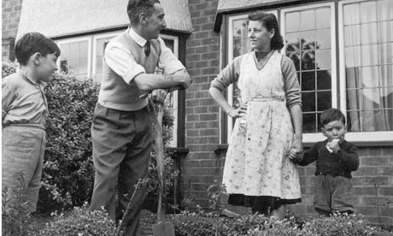
Masculinity in the 1950s
In the post-war world of the 1950s, there were very set ideas about gender roles-what men and women should do and how they should behave
Men were expected to be the ‘bread-winners’- they worked to provide money for the family
They were also the head of the household-making key decisions, disciplining and controlling finances
Men were supposed to be dominant, manly and strong

Slide 60
https://www.youtube.com/watch?v=2O1K-JcP1w4

Slide 61
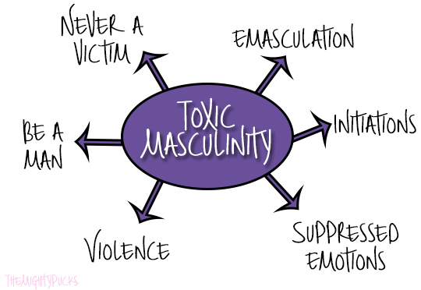
Toxic Masculinity
This set way of viewing masculinity in the 1950s continues to be a stereotypical way men are viewed in today’s society
This is very limiting, and can lead some men to feel like they don’t live up to this expectation
This kind of strict masculinity is sometimes called ‘toxic’, as many believe it causes men to feel like they cannot express their emotions, which can often result in increased aggression and has been linked to high suicide rates in young males

Slide 62
https://www.youtube.com/watch?v=UwI2U27UlGU

Slide 63
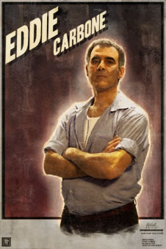
Theme-Ideas of Masculinity
Miller plays with this idea of masculinity and attitudes towards it in ‘A View from the Bridge’, with his three main male characters:
  Eddie
  Marco
  Rodolpho

Slide 64
 | Eddie | Marco | Rodolpho
Job | Pg 14 Longshoreman-loading boats at the docks-manual labour | Pg 20 | Pg 24
Interests | Pg30-31 | n/a | Pg 25
Priorities | Pg 27 | Pg 21-22 | Pg 23 Wants to live the 'American Dream'; interested in material things e.g. motorcycle
Appearance | Pg 4 | Pg 18 Strong despite his poverty “square-built” | Pg 23

Slide 65
 | Eddie | Marco | Rodolpho
Job | Pg 14 Longshoreman-loading boats at the docks-manual labour | Pg 20 Mason (bricklayer)-typically masculine profession-manual labour | Pg 24 A singer-performer/messenger
Interests | Pg30-31 Bowling-’sport’-does it with male friends | n/a | Pg 25 Singing/music-bonds with Catherine over this
Priorities | Pg 27 Family-B and C, providing for them | Pg 21-22 Similar to E-sending money home to Italy | Pg 23 Wants to live the 'American Dream'; interested in material things e.g. motorcycle
Appearance | Pg 4 “husky, slightly overweight”-not concerned about appearance | Pg 18 Strong despite his poverty “square-built” | Pg 23 Blonde, unusual in their community-fair

Slide 66
Analysing Key Quotations
Context-what is happening at this point in the play
Quotation-important part of the play
Analysis-what this quotation means, what it tells us about characters/themes/setting

Slide 67
Example
Context
Alfieri’s description of Eddie
Quotation
“Who can ever know what will be discovered? Eddie Carbone had never expected to have a destiny...Now…there was a future, there was a trouble that would not go away.” pg 27
Analysis
Alfieri playing choric role-emphasising importance of Eddie’s actions and impact this will have on the play. Idea of fate-typical of Greek tragedy-sense of forboding

Slide 68
Key Quotations-Section 3
Find quotations from:
Pg 28-Eddie, about Rodolpho (Nixon, Joseph, Shannon)
Pg 28-Eddie, about Marco (Arran, James)
Pg 30-Mike, about Marco (Shea, Amy, Mandy)
Pg31-32-Mike and Louis, about Rodolpho (Marta, Patrycja, Katie, Sophie)

Slide 69
Section 3-Important Quotations
“Paper Doll they’re callin’ him. Canary. He’s like a weird...with that wacky hair, he’s like a chorus girl or sump’m.”pg 28
“Marco goes around like a man; nobody kids Marco.” pg 28
“that older one, boy, he’s a regular bull...they leave him alone he woulda load the whole ship by himself.” pg 30
“their laughter rises as they see Rodolpho, who does not understand but joins in” 31-32

Slide 70
Example
Context
Eddie talking to B about R
Quotation
“And with that wacky hair; he’s like a chorus girl or sump’m” (pg 28)
Analysis
E sees R as less of a man than M, respects him less, uses v. silly justifications for why-won’t admit that he doesn’t like R because of his relationship with C, so is trying to undermine him

Slide 71
Example
Context
E talking to B about M
Quotation
“Marco goes around like a man; nobody kids Marco.” (pg 28)
Analysis
E respects M as a man-sees similarities between them; fulfils stereotypical idea of masculinity-strong provider who takes responsibilities seriously

Slide 72
Example
Context
Mike, talking to E about Marco
Quotation
“That older one, boy, he’s a regular bull” (pg 30)
Analysis
Comparison to bull-strong, powerful, dedicated, manly. Contrasts to ‘canary’ description of R (sweet, fragile, small); impressed by M, respect him

Slide 73
Example
Context
Mike and Louis, about R
Quotation
“Their laughter rises as they see Rodolpho, who does not understand but joins in.” (pg 31-32)
Analysis
M&L laugh at R, not with him-think he is a joke, do not respect him-make fun of him to E, who takes it as an insult-R oblivious to their mocking

Slide 74
A View From The Bridge: Section 4 pg 32-38

Slide 75
Pg 32-38
Eddie
Beatrice
Catherine
Rodolpho

Slide 76
Homework
Creative folio first draft-due Fri 29th Sept -this Fri!)
Handwritten, printed, emailed, pen drive-get it in!
gw15innesmairi@glow.sch.uk

Slide 77
Pg 32-38 Summary Qs
How does Miller use stage directions on pg 32 to show Eddie’s affection for Catherine?
What does Eddie accuse Rodolpho of? What is his evidence? (pg 34)
What is Catherine’s reaction to Eddie’s accusation? (pg 35)

Slide 78
Pg 32-38 Summary Qs
4. After Catherine leaves, the stage directions state that Eddie “makes an awkward gesture of eroded command” (pg 35) after Catherine. What does this mean?
5. What is Beatrice’s advice to Catherine? (pg 36-37)
6. What does Beatrice suggest about the relationship between Catherine and Eddie? (pg 37-38)

Slide 79
Catherine and Eddie Relationship Timeline
Start of play-
Cinema trip-
Arrival of Marco and Rodolpho-

Slide 80
Catherine and Eddie Relationship Timeline
Start of play-
Controlling (E)
Close
Childish (C)
Cinema trip-
E is losing control over C
Argumentative
C becoming more independent
Arrival of Marco and Rodolpho-
C more aware of E’s control
C less interested in E
E becomes jealous

Slide 81
Analysing Key Quotations
Context-what is happening at this point in the play
Quotation-important part of the play
Analysis-what this quotation means, what it tells us about characters/themes/setting

Slide 82
Example
Context
Eddie, about his relationship with Catherine
Quotation
“Now, I turn around, you’re a big girl. I don’t know how to talk to you...you’re runnin’, you’re runnin’, Katie. I don’t think you listening any more to me.” pg 33
Analysis
Eddie expresses his sadness at the distance growing between them-he desires to keep control over her, makes her feel guilty about becoming independent

Slide 83
Key Quotations-Section 4
Find quotations from:
Pg 33-Catherine’s fear about telling Eddie how she feels about Rodolpho, Eddie’s reaction
Pg 34-Eddie’s accusation about Rodolpho
Pg 35-Eddie’s struggle to control his emotions

Slide 84
Section 4-Important Quotations
“she looks at him for consequences, smiling but tense. He looks at her like a lost boy.” pg 33
“Katie, he’s only bowin’ to his passport.”pg 34
“inwardly angered at his flowing emotion, which in itself alarms her” pg 35

Slide 85
Example
Context
C tells E she likes R
Quotation
“(Now she looks at him for the consequences, smiling but tense. He looks at her like a lost boy)”(pg 33)
Analysis
C’s reaction indicates she expects E to react badly to her admission, worried/fearful of what he will say/do, but trying to stand up for herself. E no longer in position of control, becomes child figure here, pathetic image

Slide 86
Example
Context
E speaking about R’s ‘true’ intentions
Quotation
“Katie, he’s only bowin’ to his passport.”pg 34
Analysis
E is portraying R as a user-that he is deceitful and charming C to remain in the country, looking for a green card marriage-indicates E’s low opinion of R and desperation to make C disillusioned with idea of R

Slide 87
Example
Context
Description of B’s reaction to E’s emotional outpour
Quotation
“inwardly angered at his flowing emotion, which in itself alarms her” pg 35
Analysis
Suggests she is not used to E expressing his emotions (‘alarms’)-stoic figure; becomes angered by E’s obsession over C and how he is allowing this to make him emotional-jealous over effect C has on him?

Slide 88
A View From The Bridge: Section 5 pg 38-44

Slide 89
Pg 38-44 Characters
Alfieri
Eddie

Slide 90

Key Scene
What is a key scene? What does a scene need to do in order to gain this title?

Slide 91
Key Scene
A key scene is one in which:
- there is a turning point
- a character develops or is exposed in some way
- tension/conflict between characters is built
something important happens to move the plot along
Which of these statements applies to the scene we have read today? Why? Discuss in your groups why Eddie’s meeting with Alfieri can be seen as a key scene.

Slide 92
Turning Point
Turning Point
Eddie admits he has lost control of the situation and he has been repressing his emotions-both about Catherine and about C’s relationship with R
Evidence
“(it begins to break through) And now I gotta sit in my house and look at a son-of-a-bitch punk like that…puts his dirty filthy hands on her like a goddam thief!” (pg 43)

Slide 93
Character develops/exposed
Character develops/exposed
Eddie’s manner changes when accused of trying to ‘snitch’ on R; obsession over C exposed in anger about her relationship with R
Evidence
“he’s stealing from me!”
“She wants to get married, Eddie. She can’t marry you, can she?”

Slide 94
Tension/conflict built
Tension/conflict built
Eddie makes opinion of R clear, reveals his hatred/distrust to Alfieri
Evidence
“….that ain’t why they’re laughin’. Which they’re not goin’ to come out with me because they know he’s my relative….when I think of that guy laying’ his hands on her I could-” pg 41

Slide 95
Plot development
Plot development
Alfieri hints towards Eddie snitching on R and M-going against moral code of community
Evidence
“There’s only one legal question here…the manner in which they entered the country. But I don’t think you want to do anything about that, do you?”

Slide 96
Analysing Key Quotations
Context-what is happening at this point in the play
Quotation-important part of the play
Analysis-what this quotation means, what it tells us about characters/themes/setting

Slide 97
Example
Context
Alfieri, describing Eddie
Quotation
“his eyes were like tunnels; my first thought was that he had committed a crime-...but soon I saw it was only a passion that had moved into his body, like a stranger.” pg 38-39
Analysis
‘tunnel vision’-set on one goal/purpose, ignoring everything else; link between passion/crime-unsettling force taking over Eddie, unusual-idea of toxic masculinity

Slide 98
Example
Context
Alfieri, describing Eddie’s destiny
Quotation
“I could see every step coming, step after step, like a dark figure walking down a hall toward a certain door. I knew where he was heading for, I knew where he was going to end.” pg 43
Analysis
Alfieri’s role as choric figure-foreshadowing future events-idea of fate, Eddie’s tragic outcome is predestined-hinting at tragic end-‘dark figure’

Slide 99
Key Quotations-Section 5
Find quotations from:
pg 38-39-Alfieri, describing Eddie-K and S
Pg 43-Alfieri describing Eddie’s destiny-M and P
Pg 40-Eddie’s description of Rodolpho-A and M
Pg 41-Eddie’s description of Rodolpho and dresses-S, J, A
Pg 42-Alfieri’s advice to Eddie about his feelings for Catherine-N and J
Pg 43-Eddie’s reaction to Rodolpho and Catherine-

Slide 100
Analysing Key Quotations
Context-
Alfieri, describing a change in E
Quotation-
“his eyes were like tunnels; my first thought was that he had committed a crime-...but soon I saw it was only a passion that had moved into his body, like a stranger.” pg 38-39
Analysis-
Tunnel vision-to be focused on one goal-E’s obsession with R and C’s relationship has taken control of him, like a possession-becomes unrecognisable, a dark, threatening figure

Slide 101
Analysing Key Quotations
Context-
A describing E’s destiny
Quotation-
“I could see every step coming, step after step, like a dark figure walking down a hall toward a certain door. I knew where he was heading for, I knew where he was going to end.”(pg43)
Analysis-
A as Greek choric figure predicts future events-ominous words suggest a tragic fate for E-theme of fate-E and A both unable to stop this tragedy occurring. Powerless to stop E’s actions

Slide 102
Analysing Key Quotations
Context-
E describing R
Quotation-
“if you came into the house and you didn’t know who was singin’, you wouldn’t be lookin’ for him you be lookin’ for her.” pg 40
Analysis-
Portrays R as feminine, suggesting/hinting to A that R may be gay-picks out superficial qualities such as singing and hair to illustrate this-theme of masculinity. Distrust emphasises E’s obsession with C and hatred of their relationship

Slide 103
Analysing Key Quotations
Context-
E’s description of R and dresses
Quotation-
“I mean he looked so sweet there, like an angel-you could kiss him he was so sweet.” (pg 41)
Analysis-
E’s description compares R to an angel-feminine, delicate, beautiful-trying to emasculate him. “could kiss him”-weird for E, homophobe, to say-desperate to show R is unworthy, doesn’t mind ruining his own rep

Slide 104
Analysing Key Quotations
Context-
Alfieri’s advice to E about C
Quotation-
“sometimes…there’s too much…there’s too much love for the daughter, there is too much love for the niece.”(pg 42)
Analysis-
A insinuates E’s love for C is not a fatherly love but a romantic love-exposes this aspect that E has tried to hide-controversial, shocking –E’s fatal flaw that will cause his downfall

Slide 105
Analysing Key Quotations
Context-
Quotation-
Analysis-

Slide 106
Section 5-Key Quotations
“I mean if you came in the house and you didn’t know who was singin’, you wouldn’t be lookin’ for him, you be lookin’ for her.” pg 40
“I mean he looked so sweet there, like an angel-you could kiss him he was so sweet.”pg 41
“everyone’s got somebody that he loves...but sometimes...there’s too much...there is too much love for the daughter, there is too much love for the niece.”pg42
“I take blankets off my bed for him, and he takes and puts his dirty filthy hands on her like a goddam thief!”pg 43

Slide 107
A View From The Bridge: Section 6 pg 44-52

Slide 108
Pg 44-52
Eddie
Catherine
Beatrice
Marco
Rodolpho

Slide 109
Analysing Key Quotations
Context-what is happening at this point in the play
Quotation-important part of the play
Analysis-what this quotation means, what it tells us about characters/themes/setting

Slide 110
Example
Context
Eddie, while talking about Rodolpho
Quotation
“he has been unconsciously twisting the newspaper into a tight roll. They are all regarding him now; he senses he is exposing the issue and he is driven on” pg49
Analysis
Twisting newspaper=sign of frustration, channelling aggression at R&C dancing into paper, cannot mask his feelings anymore; obvious to other characters and he is no longer worried about appearing jealous

Slide 111
Key Quotations-Section 6
Find quotations from:
Pg 51-Eddie fighting Rodolpho-Marta, Patrycja, Sophie, Katie
Pg 52-Marco sizing up Eddie-Shea, Amy, Mandy, Arran
Pg 52-Eddie realising Marco’s strength-Joseph, Nixon, Shannon, James

Slide 112
Section 6-Key Quotations
“watch out, here I come, Danish! (he feints with his left hand and lands with his right. It mildly staggers Rodolpho. Marco rises.” pg 51
“Marco is face to face with Eddie, a strained tension gripping his eyes and jaw, his neck stiff, the chair raised like a weapon over Eddie’s head” pg 52
“he transforms what might appear like a glare of warning into a smile of triumph, and Eddie’s grin vanishes as he absorbs his look.” pg 52

Slide 113
Example
Context
Eddie fighting Rodolpho
Quotation
“He feints with his left hand and lands with his right. It mildly staggers Rodolpho. Marco rises.” pg 51
Analysis
E tries to trick R and seem like the alpha male-strongest, more dominant. R is overcome, physically undermined as well as verbally. M shows protective nature towards R

Slide 114
Example
Context
Marco sizing up Eddie
Quotation
“Marco is face to face with Eddie, a strained tension gripping his eyes and jaw, his neck stiff, the chair raised like a weapon” pg 52
Analysis
M retaliating against E’s comments about R-making himself seem intimidating and threatening towards E-makes E aware that he is not the most powerful person, that R is protected-”strained tension”=M has been restrained before out of politeness, now demonstrating power

Slide 115
Example
Context
Eddie realising Marco’s strength
Quotation
“he transforms what might appear like a glare of warning into a smile of triumph, and Eddie’s grin vanishes as he absorbs his look.” pg 52
Analysis
M is giving E a clear warning about his behaviour, but tries to mask this as showmanship-E realises this though, and is taken aback by M’s strength and threat

Slide 116
Creating and Building Tension
Dramatic tension-a problem or problems that arise in the narrative that sets the pace and tone of the plot, keeping the reader interested and engaged.
Tension introduced->tension builds->climax->resolution/outcome

Slide 117
Tension Introduced
Where in the play so far has there been conflict between characters?
Why does this conflict exist?
Where is this initial conflict shown in this scene?

Slide 118
Tension Introduced
Conflict between Eddie and Rodolpho
competing for Catherine’s affections;
two conflicting ideas of masculinity
Fruit discussion-(pg 45)

Slide 119
Tension builds
How does Catherine reignite the tension in this scene? (pg 48)
How is this conflict increased later in the scene? How does Eddie antagonise Rodolpho? (pg 49)

Slide 120
The Climax
A climax is the highest point of tension within a scene.
Why does Eddie want to teach Rodolpho to box? What is he trying to demonstrate to Rodolpho? Pg 50
What is the key moment of climax in this scene? (pg 51)
How do the stage directions show Eddie’s enjoyment of Rodolpho’s injury? Pg 51

Slide 121
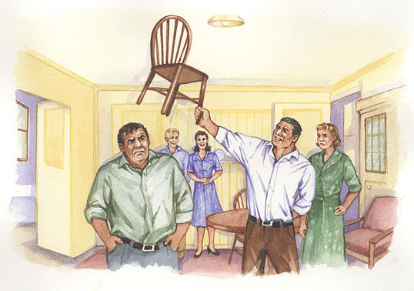
Resolution/Outcome
How do the characters react to the fight?
What does Marco’s reaction tell us about his character? Explain what he does, and why. (pg 52)
What does Eddie’s reaction to this tell us?

Slide 122
Learning Review
Why does this scene take place at the end of Act 1? What does it leave the audience wondering?

Slide 123
A View From The Bridge: Review of Act 1

Slide 124
Essay Writing-N5 Vs Higher
N5 | Higher
-familiarity with the text as a whole - good understanding of the central concerns of the text -a line of thought that is relevant to the task | -secure knowledge and understanding of the text -detailed textual evidence to support line of thought which is coherently structured and expressed -secure focus on the demands of the question
sound awareness of the writer’s techniques through analysis, making good use of critical terminology - detailed explanation of stylistic devices supported by appropriate references and/or quotation | detailed analysis of the effect of features of language/filmic techniques
a reasonably developed commentary of what has been enjoyed/ gained from the text(s), supported by appropriate references to its relevant features | engaged evaluative stance with respect to the text and the task
uses language to communicate a line of thought clearly -uses spelling, grammar, sentence construction and punctuation which are mainly accurate -structures the essay very well -uses paragraphing which is accurate | few errors in spelling, grammar, sentence construction, punctuation and paragraphing the ability to be understood at first reading

Slide 125
Writing About AVFTB
Example Essay Q
Choose a play in which a central character is in conflict with or rejects another character.
Briefly explain the circumstances of the conflict or rejection and go on to discuss the consequences of this conflict or rejection for the play as a whole.
Answers to questions on Drama should refer to the text and to such relevant features as characterisation, key scene(s), structure, climax, theme, plot, conflict, setting...

Slide 126
Breaking Down the Question
Always double-check you’re looking at the correct section!
Who is our central character?
Choose a play in which a central character is in conflict with or rejects another character.
Who are they in conflict with/who do they reject?

Slide 127
Breaking Down The Question
Introduction of conflict, how conflict builds, climax
Briefly explain the circumstances of the conflict or rejection and go on to discuss the consequences of this conflict or rejection for the play as a whole.
Link to wider themes of play
Resolution/outcome

Slide 128
The ‘Magic Box’
Answers to questions on Drama should refer to the text and to such relevant features as characterisation, key scene(s), structure, climax, theme, plot, conflict, setting...
Helpful hints at what to analyse in more detail
Use dramatic terminology section of booklet as well!

Slide 129
Introduction
Your introduction should include:
Name of text
Name of playwright
Brief summary of plot
Rephrase Q-what is essay looking at? What themes are involved?

Slide 130
Example Introduction Plan
Your introduction should include:
Name of text
‘Of Mice and Men’
Name of playwright/author
John Steinbeck
Brief summary of plot
Novella, 1930s, California; two travelling workers trying to make enough money to afford a farmhouse of their own
Rephrase Q-what is essay looking at? What themes are involved?
Conflict between Curley and Lennie epitomises struggle of working class man fighting against capitalism to achieve the American Dream
Example Essay Q
Choose a play in which a central character is in conflict with or rejects another character.
Briefly explain the circumstances of the conflict or rejection and go on to discuss the consequences of this conflict or rejection for the play as a whole.

Slide 131
Example Intro
‘Of Mice and Men’ by John Steinbeck is a novella set in 1930s California, during the Great Depression. The novella follows two travelling workers trying to make enough money to afford a farmhouse of their own, but struggling to achieve this dream. There is a key conflict within this novel between Lennie, a poor ranch hand with learning disabilities, and Curley, the wealthy but aggressive ranch owner’s son. Steinbeck uses this conflict to highlight the struggle of working class man fighting against capitalism to achieve the American Dream.

Slide 132
Main Paragraph Plans
4 main paragraphs, charting conflict:
MP1-How conflict begins (section 2)
“he is sizing up Rodolpho, and there is a concealed suspicion” pg 26
MP2-How it builds (section 3/ 4)
“ “
MP3-Climax (section 6)
“ “
MP4-Resolution/outcome (section 6)
“ “
Try to find key quotations from your booklet to act as textual evidence in your essay-remember, you can use more than one quotation per paragraph

Slide 133
Main Paragraph Structure-PCQE
POINT-what point are you making, in relation to Q (e.g. about character, conflict, theme)
CONTEXT-where in the play does this take place? What is happening at this point?
QUOTATION-textual evidence to demonstrate your point
EXPLANATION-explain what quotation shows; link back to theme and Q

Slide 134
Main Paragraph 1 (Example)
POINT
Conflict begins in initial meeting-R demonstrates v different view of masculinity from E’s expectations
CONTEXT
When R arrives he sings, C is instantly impressed, whereas E is less amused:
QUOTATION
“he is sizing up Rodolpho, and there is a concealed suspicion” pg 26
EXPLANATION
SDs show E is watching R closely, indicating he sees him as a rival- “sizing up”
attempt to hide true feelings about him from others
Introduces theme of toxic masculinity-E feels threatened by R’s ability to charm C, despite not acting traditionally ‘manly’

Slide 136
Main Paragraph 2-Building Tension
POINT
Conflict progresses as C gets closer to R
CONTEXT
QUOTATION
EXPLANATION

Slide 137
Main Paragraph 3-Climax
POINT
Conflict becomes obvious to audience and other characters in key scene at end of act 1
CONTEXT
QUOTATION
EXPLANATION

Slide 138
Main Paragraph 4-Consequence
POINT
Impact of key scene shown in reaction to fight between R and E
CONTEXT
QUOTATION
EXPLANATION

Slide 139
Conclusion
Summarise points made
Explain what conflict represents-theme
Explain impact of conflict on play thus far-what will it now lead to?

Slide 140
Example Conclusion
Ultimately, the conflict in Steinbeck’s ‘Of Mice and Men’ perfectly reflects the conflict between the working class and the middle class during the Great Depression. Curley’s contempt of Lennie indicates the disgust at travelling workers at this time, and his continual belittling of Lennie reflects the treatment of workers, and their struggle against the capitalist regime that has left them downtrodden. Lennie’s tragic death at the end of this novel demonstrates Steinbeck’s bleak message about the American Dream-that it is merely a distant fantasy for many.

Slide 141
A View From The Bridge: Section 7 pg 53-59

Slide 142
Pg 53-59
Alfieri
Eddie
Catherine
Rodolpho

Slide 143

The Kissing Scene
The kissing scene is one of the most shocking/dramatic scenes in the play
Both kisses are controversial in their own way
Briefly explain why each kiss is so controversial

Slide 144
Eddie and Catherine’s kiss

Slide 145

Eddie and Catherine’s Kiss
Eddie and Catherine’s kiss indicates to us that Eddie can no longer hide his sexual feelings towards his niece, and that his desire for control over her does not come from a purely fatherly place.
The kiss is an act of dominance and passion, claiming Catherine as his own.
This kiss is controversial as it changes the relationship between these characters, and Catherine is now aware of Eddie’s desire for her.

Slide 146
Eddie and Rodolpho’s Kiss
Eddie and Rodolpho’s kiss is a display of dominance from Eddie-he is trying to embarrass Rodolpho and prove the subtle accusations he has made about Rodolpho’s sexuality as true.
Eddie kisses Rodolpho in an attempt to both intimidate him and ‘out’ him to Catherine-by kissing Rodolpho, he wants to prove R is not masculine enough for C.
This would have been especially controversial in the 1950s, when being homosexual was illegal and severely punished.

Slide 147
Key Scene
A key scene is one in which:
- there is a turning point
- a character develops or is exposed in some way
- tension/conflict between characters is built
something important happens to move the plot along
Which of these statements applies to the scene we have read today? Why? Discuss in your groups why the kissing scene can be seen as a pivotal moment in the play

Slide 148
Key Scene-pg 53-59
Key Scene Criteria | Moment | Quotation
there is a turning point
a character develops or is exposed in some way
tension/conflict between characters is built
something important happens to move the plot along | Catherine decides to leave with Rodolpho | “I’m going with him, Eddie. (she starts toward Rodolpho)” (pg 59)

Slide 149
Key Scene-pg 53-59
Key Scene Criteria | Moment | Quotation
there is a turning point | When Eddie kisses Catherine | “she strives to free herself, he kisses her on the mouth”pg 58
a character develops or is exposed in some way | “ ” | “ “
tension/conflict between characters is built | When Eddie kisses Rodolpho | “Rodolpho flies at him in attack. Eddie pins his arms, laughing, and suddenly kisses him”pg 58
something important happens to move the plot along | Catherine decides to leave with Rodolpho | “I’m going with him, Eddie. (she starts toward Rodolpho)” (pg 59)

Slide 150
Analysing Key Quotations
Context-what is happening at this point in the play
Quotation-important part of the play
Analysis-what this quotation means, what it tells us about characters/themes/setting

Slide 151
Example
Context
Rodolpho, after accused of looking for a green card
Quotation
“It’s so wonderful? You think we have no tall buildings in Italy?...I want to be an American so I can work, that is the only wonder here-work!” (pg 55)
Analysis
R is disillusioned with life in America-no longer carefree, happy character at beginning-American Dream failing; exposes R’s true noble nature-wants Catherine for love, not ulterior motive

Slide 152
Key Quotations-Section 7
Find quotations from:
Pg 55-R asking C about E (K, S, M, P)
Pg 56-C’s conflicting feelings about E (A, M)
Pg 56-7-R speaking about E and C (A, J)
Pg 58-E’s unusual actions towards R (S, N, J)

Slide 153
Example
Context
Rodolpho asking Catherine about Eddie
Quotation
“My heart dies to look at you. Why are you so afraid of him?” pg 55
Analysis
R worried for C-sees control E has over her, manipulation. R struggles to understand relationship between C and E.

Slide 154
Example
Context
Catherine’s conflicting feelings about Eddie
Quotation
“I want him to be happy. I mean, I like him Rodolpho-and I can’t stand it!” Pg 56
Analysis
C is afraid to anger E, as she knows his temper and how he responds, but also has deep respect for him as he has been a fatherly figure-difficult bond to break-tension between C and R, as conversation is fuelled by E’s doubts-causes doubts in C’s mind

Slide 155
Example
Context
Rodolpho speaking about Eddie and Catherine
Quotation
“If I take in my hands a little bird. And she grows and wishes to fly. But I will not let her out of my hands because I love her so much, is that right for me to do?” Pg 56-7
Analysis
Little bird=C-vulnerable, but wishes to be independent; E as controlling, stifling C and preventing her from achieving what she wants-R acknowledging that E is caring and has good intentions for C, but it is too much

Slide 156
Example
Context
Eddie’s unusual actions towards Rodolpho
Quotation
“Rodolpho flies at him in attack. Eddie pins his arms, laughing, and suddenly kisses him.”Pg 58
Analysis
E doing this to expose R, insinuating he is gay; trying to show his dominance over R, ability to humiliate R’s attempt at defending C-E is willing to put himself into shocking situation in order to prove point-driven by fatal flaw

Slide 157
Section 7-Key Quotations
“my heart dies to look at you-why are you so afraid of him?” (pg 55)
“I want him to be happy-I mean-I like him, Rodolpho-and I can’t stand it!” (pg 56)
“If I take in my hands a little bird…but I will not let her out of my hands because I love her so much, is that right for me to do?” (pg 56-7)
“Rodolpho flies at him in attack. Eddie pins his arms, laughing, and suddenly kisses him.” (pg 58)

Slide 158
A View From The Bridge: Section 8 pg 59-71

Slide 159
Pg 59-61
Alfieri
Eddie

Slide 160
https://www.youtube.com/watch?v=HTIHbqo_wRw

Slide 161
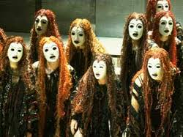
Alfieri-Greek Choric Figure
Alfieri as choric figure:
Provides background and context (pg 4)
Comments on themes (pg 27)
Moral compass (60)
Predicts future events-almost omniscient role (p43)
Find evidence of Alfieri fulfilling this Greek choric role for each bullet point here.

Slide 162
Alfieri-Greek Choric Figure
Role | Evidence | Explanation
Provides background and context | “This is the gullet of New York, swallowing the tonnage of the world. And now we are quite civilised, quite American. Now we settle for half, and I like it better. I no longer keep a pistol in my filing cabinet.” (pg4) | Red Hook as popular immigrant community-hides individuals well. Migration of Italian immigrants had to change passionate ways to adapt to American culture, creating safer but less vibrant lifestyle
Comments on themes | pg 27
Moral compass | pg 60
Predicts future events-almost omniscient role | pg 43

Slide 163
Alfieri-Greek Choric Figure
Role | Evidence | Explanation
Provides background and context | “This is the gullet of New York, swallowing the tonnage of the world. And now we are quite civilised, quite American. Now we settle for half, and I like it better. I no longer keep a pistol in my filing cabinet.” (pg4) | Red Hook as popular immigrant community-hides individuals well. Migration of Italian immigrants had to change passionate ways to adapt to American culture, creating safer but less vibrant lifestyle
Comments on themes | ”Who can ever know what will be discovered? Eddie Carbone had never expected to have a destiny.”pg 27 | theme of fate-E destined to fulfil prophecy as a result of his fatal flaw-pride/passion for C
Moral compass | ”I’m warning you-the law is nature. The law is only a word for what has a right to happen. When the law is wrong it is unnatural, but in this case it is natural and a river will drown you if you buck it now.”pg 60 | justice and law-A sees it as moral and controlled by the community-going against community values for sake of the law is dangerous
Predicts future events-almost omniscient role | “I could see every step coming, step after step like a dark figure walking down a hall towards a certain door. I knew where he was heading for, I knew where he was going to end.” pg 43 | A hinting that E will meet an unfortunate end if he continues to be led by his fatal flaw-ominous language typical of Greek tragedy

Slide 164
Pg 61-71
Eddie
Beatrice
Catherine
Rodolpho
Marco
First Officer
Second Officer

Slide 165
Rising Conflict-Eddie Vs Marco
In this section of the play, the major conflict of the drama shifts from Eddie vs. Rodolpho, to Eddie vs. Marco
Why is this shift such a dramatic turning point in the play?

Slide 166
Rising Conflict-Eddie Vs Marco
In this section of the play, the major conflict of the drama shifts from Eddie vs. Rodolpho, to Eddie vs. Marco
Why is this shift such a dramatic turning point in the play?
Moves from two different ideas of masculinity, to two very similar characters going head to head. Both Marco and Eddie are dominant male figures with a great deal of pride, so will be unwilling to back down in a confrontation.

Slide 167
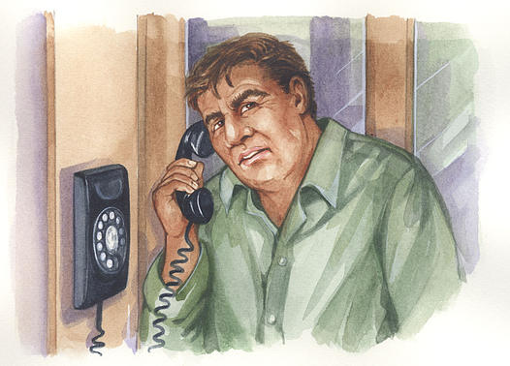
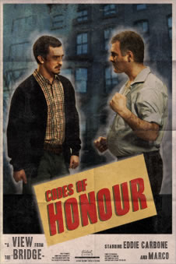
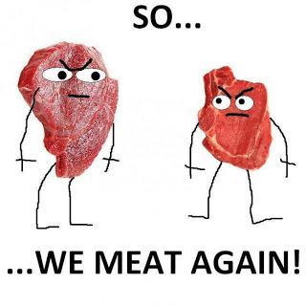
Symbolism
Glowing phone box(pg 61)
Marco spitting in Eddie’s face (pg 70)
Lipari the butcher (pg 71)

Slide 168
Symbolism
Glowing phone box(pg 61)
Glowing emphasises importance in Eddie’s mind-an idea emerging about how to get rid of Rodolpho-movement of light from Alfieri to phonebox shows shift in Eddie’s priorities-from moral justice to selfish desire.
Marco spitting in Eddie’s face (pg 70)
Lipari the butcher (pg 71)

Slide 169
Analysing Key Quotations
Context-what is happening at this point in the play
Quotation-important part of the play
Analysis-what this quotation means, what it tells us about characters/themes/setting

Slide 170
Example
Context
Alfieri, speaking about E visiting office
Quotation
“I will never forget how dark the room became when he looked at me” (59)
Analysis
Choric role-speaks in past tense-memory still haunts him; makes moment seem important. E as dark figure, threatening

Slide 171
Key Quotations-Section 8
Find quotations from:
Pg 60-A speaking about the law-Sophie, Katie
Pg 61-A warning E-Marta, Patrycja
Pg 63-E feeling victimised-Mandy, Amy, Shea
Pg 70-Marco’s actions to E-Arran, James
Pg 71-community reaction to E-Nixon, Joseph, Shannon

Slide 172
Analysing Key Quotations
Context-
Alfieri speaking about the law
Quotation-
Pg 60
Analysis-

Slide 173
Analysing Key Quotations
Context-
Alfieri warning Eddie
Quotation-
Pg 61
Analysis-

Slide 174
Analysing Key Quotations
Context-
Eddie feeling victimised
Quotation-
Pg 63
Analysis-

Slide 175
Analysing Key Quotations
Context-
Marco’s actions to Eddie
Quotation-
“Marco spits into Eddie’s face.”Pg 70
Analysis-
spitting-=sign of disrespect, disgust-M now repulsed by E’s treachery-previously v similar characters-family men-now divided in their values

Slide 176
Analysing Key Quotations
Context-
community reaction to Eddie
Quotation-
“Lipari and wife exit…Louis barely turns, then walks off.”Pg 71
Analysis-
E’s actions have led to him being shunned by the community-even best friends ignore him-seen as a disgrace for going against community values

Slide 177
Section 8-Key Quotations
“When the law is wrong it’s because it’s unnatural, but in this case it is natural and a river will drown you if you buck it now.” (60)
“You won’t have a friend in the world, Eddie! Even those who understand will turn against you, even the ones who feel the same will despise you.” (pg 60)
“It’s a shootin’ gallery in here and I’m the pigeon” (pg 63)
“Marco…dashes into the room and faces Eddie…spits into Eddie’s face.” (pg 70)
“Louis barely turns, then walks off.” (pg 71)

Slide 178
A View From The Bridge: Section 9 pg 71-79

Slide 179
Pg 71-79
Alfieri
Eddie
Beatrice
Catherine
Rodolpho
Marco

Slide 180
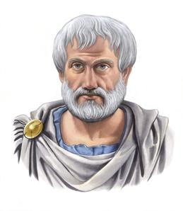
Greek Tragic Hero
“A man doesn’t become a hero until he can see the root of his own downfall”-Aristotle (Greek Philosopher)

Slide 181
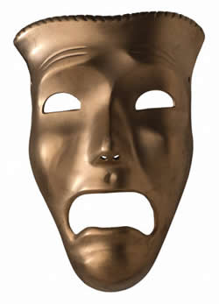
Eddie-A Tragic Hero?
A tragic hero must possess the following qualities:
Flaw or error of judgment
Reversal of fortune brought about because of the hero’s error of judgement
Discovery or recognition that the reversal was brought about by the hero’s own actions
Excessive pride
Fate must be greater than deserved

Slide 182
Eddie-A Tragic Hero?
Tragic hero trait | Eddie
Flaw or error of judgment
Reversal of fortune brought about because of the hero’s error of judgement
Discovery or recognition that the reversal was brought about by the hero’s own actions
Excessive pride
Fate must be greater than deserved

Slide 183
Eddie-A Tragic Hero?
Tragic hero trait | Eddie
Flaw or error of judgment | Desire for Catherine
Reversal of fortune brought about because of the hero’s error of judgement | Loses status in house when picking on R; community shuns him when he snitches to Immigration Bureau
Discovery or recognition that the reversal was brought about by the hero’s own actions | No-Eddie continues to blame M and R for his problems, even as he is dying; HOWEVER calls for B rather than C in dying moments
Excessive pride | Dominant masculine figure, feels undermined by C falling in love with R
Fate must be greater than deserved | Justice vs law-in eyes of community, shunned, ‘community justice’ at hands of M; in eyes of law, has done the ‘right’ thing

Slide 184
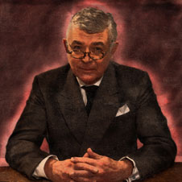
‘Heroic’?
“Most of the time we settle for half and I like it better. Even as I know how wrong he was, and his death useless, I tremble, for I confess that something perversely pure calls to me from his memory—not purely good, but himself purely And yet, it is better to settle for half, it must be! And so I mourn him—I admit it—with a certain alarm.”
Why does Alfieri suggest a sense of admiration towards Eddie? What makes him admirable? Why is this perhaps unusual for us, as the modern reader, to see him in this way?

Slide 185
AVFTB-A Tragedy?
Depicts the downfall of a hero or heroine
The tragic hero's powerful wish to achieve some goal fails
Hero has a fatal flaw that causes downfall
The hero need not die at the end, but he / she must undergo a change
The tragic hero may achieve some revelation or recognition about human fate, destiny, and the will of the gods.
Chorus that offered a variety of background and summary information to help the audience follow the performance and commented on themes.

Slide 186
Aspect of Tragedy | AVFTB
Depicts the downfall of a hero or heroine
The tragic hero's powerful wish to achieve some goal fails
Hero has a fatal flaw that causes downfall
The hero need not die at the end, but he / she must undergo a change
The tragic hero may achieve some revelation or recognition about human fate, destiny, and the will of the gods.
Chorus that offered a variety of background and summary information to help the audience follow the performance and commented on themes.

Slide 187
Aspect of Tragedy | AVFTB
Depicts the downfall of a hero or heroine | Eddie-goes from respected family man to despised person shunned by community and ultimately murdered
The tragic hero's powerful wish to achieve some goal fails | To control Catherine, get rid of Rodolpho
Hero has a fatal flaw that causes downfall | Desire for Catherine
The hero need not die at the end, but he / she must undergo a change | Eddie dies, does not acknowledge wrongdoing, but calls for B rather than C in dying moment
The tragic hero may achieve some revelation or recognition about human fate, destiny, and the will of the gods. | Learns that community justice sometimes is more meaningful than the law
Chorus that offered a variety of background and summary information to help the audience follow the performance and commented on themes. | Alfieri

Slide 188
Climax
The climax is the most exciting part of the play-the moment of most action, what the tension has been building towards.
Describe in detail WHAT the climax of this play is, and WHY it is the most exciting part.
The climax of the play is…
This is the most exciting part of the play, because…

Slide 189

Themes-Final Comments
Explain, with evidence, the final point Miller makes concerning his main themes within the text
Justice Vs. The Law
Miller believes…
Fate
Miller thinks…
Masculinity
Miller presents masculinity as…

Slide 190
Theme-Justice Vs. Law

Slide 191
Theme-Fate

Slide 192
Theme-Masculinity

Slide 193
Analysing Key Quotations
Context-what is happening at this point in the play
Quotation-important part of the play
Analysis-what this quotation means, what it tells us about characters/themes/setting

Slide 194
Example
Context
Marco speaking to Alfieri
Quotation
“All law is not in a book”
Analysis
Theme justice vs law-idea that the law can be unsatisfying in settling grievances-M believes E deserves to suffer more for what he has done

Slide 195
Key Quotations-Section 9
Find quotations from:
Pg 75-C’s description of E-K&S
Pg 77-B’s outburst-M&P
Pg 78-E goading M-M, A, S
Pg 79-E’s death-J, A
Pg 79-A’s speech-return to beginning-N, J
Pg 79-A’s speech-E’s character

Slide 196
Example
Context
C’s description of E
Quotation
“He’s a rat! He belongs in the sewer!...he bites people when they sleep!”
Analysis
C’s eyes finally open to poisonous, controlling person E is; ‘rat’ suggests he is disgusting to her; “biting people” suggests he is a traitor, cannot be trusted

Slide 197
Example
Context
B’s outburst
Quotation
“You want somethin’ else, Eddie, and you can never have her!”
Analysis
Fed up with E hiding secret feelings-exposes E’s fatal flaw to everyone, indicating E’s motivations for his actions were not as hidden as he wished; tragic for B as well-knows husband does not want her

Slide 198
Example
Context
E goading M
Quotation
“Wipin’ the neighbourhood with my name like a dirty rag! I want my name, Marco.”
Analysis
“name”=reputation, feels M has destroyed how he is seen in community-wants to settle score, challenges M for dominance-toxic masculinity and pride causes downfall

Slide 199
Example
Context
E’s death
Quotation
“Eddie lunges with the knife. Marco grabs his arm, turning the blade inward and pressing it home…Eddie, the knife still in his hand, falls to his knees before Marco.”
Analysis
Symbolises E has caused own downfall, resulting in death-making him a tragic hero. Turning of blade symbolic of community turning against him due to his actions

Slide 200
Example
Context
A’s speech-return to beginning
Quotation
“most of the time now we settle for half and I like it better”
Analysis
Commenting on E-stubborn, refused to compromise and let others choose their own path-own passions deemed more important, and this led to downfall

Slide 201
Example
Context
A’s speech-E’s character
Quotation
“not purely good, but himself purely, for he allowed himself to be wholly known”
Analysis
A acknowledges E’s wrongdoing, but admires him for being true to himself and exposing his true desires, even if they were shameful-made him a vulnerable character

Slide 202
Section 9-Key Quotations
“He’s a rat! He belongs in a sewer…he bites people in their sleep” (75)
“You want somethin’ else Eddie, and you can never have her!” (77)
“I want my name, Marco” (78)
“Eddie lunges with the knife, Marco grabs his arm, turning the blade inward, and pressing it home.” (79)
“Most of the time now, we settle for half and I like it better” (79)
“…perversely pure…not purely good but himself purely, for he allowed himself to be wholly known.” (79)

Slide 203
A View From The Bridge-Essay Questions

Slide 204

Most Common Question Types
Key scene
Character
Theme
Conflict

Slide 205
Key Scene Practice Essay
Choose a play which has an effective opening or concluding scene.
By briefly referring to details of the scene, explain how the dramatist made it effective and discuss how it contributes to your appreciation of the text as a whole.

Slide 206
Format of a Key Scene Essay
Introduction
Summary of Key Scene
Main Paragraph 1-establishing theme
Main Paragraph 4-key scene (ending)
Main Paragraph 3-bretrayal-E’s character change
Main Paragraph 2-climax act 1
Conclusion

Slide 207
Key Scene Quotations
MP1
“Now we settle for half, and I like it better.”
“A guy do a thing like that? How’s he gonna show his face?”
MP2
MP3
“Marco…dashes into the room and faces Eddie…spits into Eddie’s face.” (pg 70)
“Louis barely turns, then walks off.” (pg 71)
MP4
“Eddie lunges with the knife. Marco grabs his arm, turning the blade inward and pressing it home…Eddie, the knife still in his hand, falls to his knees before Marco.”
“not purely good, but himself purely, for he allowed himself to be wholly known”

Slide 208
Key Scene Essay Plan-Introduction
Your introduction should include:
Name of play and playwright
Reference to type of play, background
Brief summary of plot
Rephrase question-what is essay focusing on? What themes are involved? What aspects (magic box) are you going to look at to illustrate this?
Effective closing scene-typical tragic ending based on protagonist’s fatal flaw
Emphasises theme of fate and value of moral justice vs. law
Techniques-key scene, characterisation, symbolism

Slide 209
Key Scene Essay Plan-Summary
Explain briefly what leads to key scene and what happens during key scene.
Briefly touch on what key scene reveals about character (tragic hero, fatal flaw) and theme (justice vs. law)

Slide 210
Structure of MP
Point
What are you trying to say in this paragraph? What aspect of the play are you discussing in relation to the key scene?
Opening of play establishes key theme of justice vs law that is highlighted in concluding scene.
Context
What is going on at the point from which your quotation is taken?
A is choric figure, narrates play, comments on themes-introduces community values
Quotation
Evidence that backs up what you are trying to say
“Now we settle for half, and I like it better.”
Explanation
A clear discussion of how your quotation indicates the point you are making about the key scene
Explains contrast between Italy and Italian community in NY-less passionate desire for justice, more respect for law-introduces concept that will be explored through E’s behaviour
Link
Refer back and clearly point out how what you’ve said relates to the question
Key theme established-highlights consequences of E’s betrayal and why this has such an impact

Slide 211
Key Scene Plan-MP1-Establishing theme
POINT
Beginning of play themes are established in Alfieri’s dialogue-choric role, which predict events of final scene
CONTEXT
Alfieri introducing audience to the community and values
QUOTATION
“Now we settle for half, and I like it better.” (pg 4)
EXPLANATION
Contrasts behaviour of Italians with 2nd generation-Crime is dealt with differently in NY than Italy
ideas of justice vs. law-moral justice=doing what you think is fair/right; law=what the police/society see is right
LINK
key theme explored and commented on in final scene, where justice is valued above the law

Slide 212
Key Scene Plan-MP1-Establishing theme
CONTEXT
Beginning of play-E elaborates on this idea of moral justice in the community
QUOTATION
Give evidence
EXPLANATION
Explain how theme is illustrated, and why this makes the key scene so surprising/unpredictable
LINK
Explain how this adds to your appreciation of the play

Slide 213
Key Scene Essay Plan-MP2-Establishing Character
POINT
Who is the most important character, in relation to the ending of the play? Why is their development over the course of the play important?
CONTEXT
When is there a change in Eddie’s behaviour?
QUOTATION
Give evidence
EXPLANATION
Explain how this indicates a change in behaviour, and how this leads to his downfall
LINK
Explain how this adds to your appreciation of the key scene

Slide 214
Key Scene Essay Plan-MP3-Climax of Act 1
POINT
Why is the climax of Act 1 important in building towards the key scene?
CONTEXT
When does the event occur and why?
QUOTATION
Give evidence
EXPLANATION
Explain how this indicates a change in the play
LINK
Explain how this adds to your appreciation of the key scene

Slide 215
Key Scene Essay Plan-MP3-Climax of Act 1
CONTEXT
Explain another point in this climax that is relevant to the key scene
QUOTATION
Give evidence
EXPLANATION
Explain how this indicates a change in the play
LINK
Explain how this adds to your appreciation of the key scene

Slide 216
Key Scene Essay Plan-MP4-Key Scene
POINT
Explain that the key scene (ending) creates a satisfying yet tragic end to the play
CONTEXT
Explain what happens as part of the key scene
QUOTATION
Give evidence
EXPLANATION
Explain how this creates a satisfying conclusion to the play
LINK
Explain how this satisfaction is linked to other elements of the play discussed previously

Slide 217
Key Scene Essay Plan-MP4-Key Scene
CONTEXT
Explain how the final moments of the play acts as a powerful resolution
QUOTATION
Give evidence
EXPLANATION
Explain how this summarises key themes and Miller’s message
LINK
Explain how this message links to the character and theme development in the play

Slide 218
Conclusion
Summarise how playwright has used key scene effectively
Explain why aspect is important in play-link to main themes

Slide 219
REMINDER
2nd draft of persuasive essay due Thurs 8th Feb (this thurs!)
Typed, preferably on USB/sent over email

Slide 220
A View From The Bridge-Character Essay

Slide 221
Previous Character Essay Qs
Choose a play in which a major character's actions influence the emotions of others.
Briefly explain how the dramatist presents these emotions and actions and discuss how this contributes to your understanding of the play as a whole.
Choose a play in which a central character struggles to cope with social convention or financial difficulties or family duties.
Briefly explain the reasons for the character's struggle and discuss how the dramatist's presentation of this struggle enhances your understanding of character and/or theme in the play as a whole.

Slide 222
Example Character Q
Always Eddie
Choose a play in which a central character struggles to cope with social convention or financial difficulties or family duties.
Briefly explain the reasons for the character's struggle and discuss how the dramatist's presentation of this struggle enhances your understanding of character and/or theme in the play as a whole.
What idea in society does E go against?
How does he not fulfil role in family?
Build up in play
Consequences of betrayal
What theme does this relate to?

Slide 223
Initial Thoughts-What to Include
E snitching on Marco and R
E talking to A
E talking about name
E talking about Vinny
Character essay-against social convention
The ending

Slide 224
Format of a Character Essay
Introduction
Main Paragraph 1-establishing theme/character
Main Paragraph 2-development of character
Main Paragraph 4-key scene (ending)
Conclusion
Main Paragraph 3-turning point (Alfieri’s office)

Slide 225
Character Essay Plan-Introduction
Your introduction should include:
Name of play and playwright
Reference to type of play, background
Brief summary of plot
Rephrase question-what is essay focusing on? Who is the character involved? What is the social convention he struggles to cope with? What aspects (magic box) are you going to look at to illustrate this?
In this play, Eddie struggles with….Miller uses this to convey his theme of…., through characterisation, key scene and symbolism.

Slide 226
Character Plan-MP1-Establishing theme/character
POINT
Beginning of play theme/character are established in E’s dialogue-idea of community and justice
CONTEXT
E speaking about Vinny-local boy who snitched on family
QUOTATION
“a guy do a thing like that? How’s he gonna show his face?”
EXPLANATION
Explain role of justice in community; E’s role within the family –foreshadows E’s later betrayal
LINK
key theme explored through Eddie’s character-social convention within community=justice vs. law
Completed character essay-due Thurs 15th Feb
EMAIL PERSUASIVE REDRAFT ASAP
gw15innesmairi@glow.sch.uk
missminnes@gmail.com

Slide 227
For Thurs 15th Feb
Complete main paragraphs of character essay
We will discuss the conclusion and complete this in class

Slide 228
Character Plan-MP2-Developing character
POINT
Explain how E changes after arrival of R and M, and why this occurs
CONTEXT
“Katie, he’s only bowin’ to his passport.”
QUOTATION
Give evidence
EXPLANATION
Explain E’s reaction, what motivates this and how this shows betrayal of community values
LINK
Explain how this links to social convention of period-community justice vs. law

Slide 229
Character Plan-MP3-Turning Point-Alfieri’s Office
POINT
Explain how this scene acts as a turning point in the play, changing E’s attitudes towards social conventions
CONTEXT
E asking A’s advice
QUOTATION
“When the law is wrong it’s because it’s unnatural, but in this case it is natural and a river will drown you if you buck it now.”
EXPLANATION
Explain how A warns E about his decision (choric figure!), and how that will go against E and force him to betray community values
LINK
Explain how this links to social convention of period-moral justice
CONTEXT
What happens to E as result of betrayal
QUOTATION
“Marco…dashes into the room and faces Eddie…spits into Eddie’s face…“Lipari and wife exit…Louis barely turns, then walks off.”
EXPLANATION
Explain how community’s reaction indicates E has gone against social convention
LINK
Explain how this links to idea of moral justice; respect in community

Slide 230
Character Plan-MP4-Climax-ending
POINT
Explain how ending is the climax of the play, why this conflict comes about
CONTEXT
“He’s a rat! He belongs in the sewer!”
QUOTATION
Give evidence
EXPLANATION
Explain how her language indicates change in attitude towards E as result of his betrayal
LINK
Explain how this links to social convention of period-reputation, community values
CONTEXT
E fighting with M
QUOTATION
“Eddie lunges with the knife. Marco grabs his arm, turning the blade inward and pressing it home…Eddie, the knife still in his hand, falls to his knees before Marco.”
EXPLANATION
Explain how E’s death is symbolic of his betrayal of social convention-why this is important and his death was inevitable
LINK
Explain how this links to social convention of period-moral justice vs. law

Slide 231
Conclusion
Summarise how playwright has portrayed this character effectively
Explain why this character is important in play-link to main themes

Slide 232
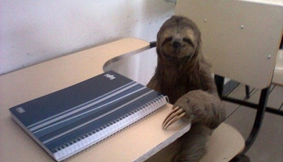
Essay Writing 101-
Decoding Questions and Writing Introductions

Slide 233

Decoding Questions
One of the main issues many students struggle with is understanding exactly what the question is asking you to do.
You need to see through all the ‘essay talk’ and be able to pick out the key information.

Slide 234
The Process
Always read the question carefully, considering both parts.
Underline key words from it that you will use from the beginning of your essay right through to the end.
The starting point of your essay should focus on the question, not the text you have studied.
Pay attention to ‘the magic box’…
Answers to questions on Drama should refer to the text and to such relevant features as characterisation, key scene(s), structure, climax, theme, plot, conflict, setting...

Slide 235
Example
Make sure you’re in the right question section!
Does this idea suit your text/text’s main character?
Choose a play in which a central character is in conflict with or rejects another character.
Briefly explain the circumstances of the conflict or rejection and go on to discuss the consequences of this conflict or rejection for the play as a whole.
Is there a clear negative relationship?
How does it begin/arise?
What does it lead to?
How does it relate to the wider ideas/themes?

Slide 236
Your turn!
Each pair will decode a question for the class and explain
Q2-Patrycja and Marta
Q3-Amy and Mandy
Q4-Shea and James
Q5-Katie and Sophie
Q6-Arran and Shannon
Q8-Joseph and Nixon

Slide 237
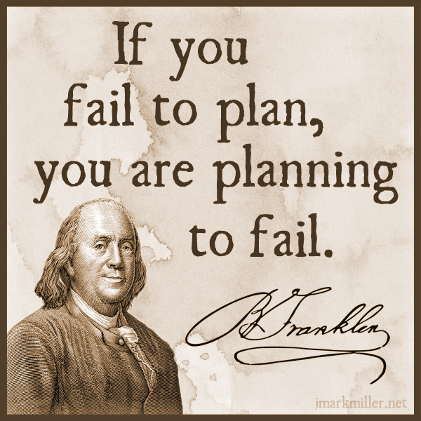
Planning Your Essay
In an exam, it doesn’t hurt to make a small plan of action for your essay, to give yourself focus and ensure you stay on task
This could be a series of bullet points, a mind map or a few scribbles in a margin
It will help you structure your essay well and adhere to what the question is asking

Slide 238
Planning Tips
focus specifically on what is being asked-what type of Q, and what key aspects of the play you are looking at-e.g. theme, character, key scene, conflict, etc.
think about the key moments in the play that relate to your Q-key scenes, climax, etc
plan your essay chronologically-follow the order of the play in order to show how a theme is developed, a character changes, conflict grows, etc.

Slide 239
Planning Your Essay
Question
Choose a play in which a central character is in conflict with or rejects another character.
Briefly explain the circumstances of the conflict or rejection and go on to discuss the consequences of this conflict or rejection for the play as a whole.

Slide 240
Planning Essay-Conflict
Key Moments
Conflict/Rejection-who?
Conflict AVFTB Essay
Message/related themes

Slide 241
Planning Essay-Conflict
Key Moments
The kissing scene
The ending-Eddie’s death
The chair scene/boxing scene
Eddie-phonebox scene-consequences-community
Conflict/Rejection-who?
Eddie and Rodolpho-conflict and rejection
Eddie and Marco-conflict
Conflict AVFTB Essay
Message/related themes
Toxic masculinity

Slide 242
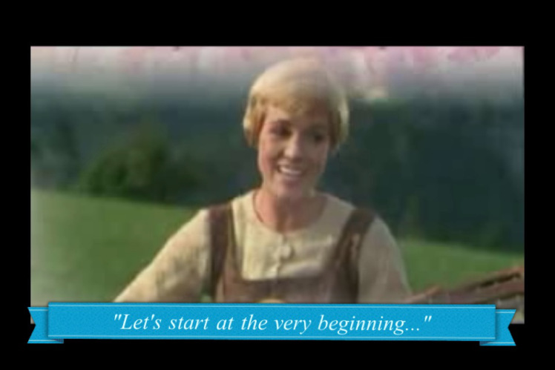
To write a good intro, you have to have TASTE
Your introduction to an essay should be fairly identical in any task, until you get to referring to the question and techniques
Use the TASTE acronym to help you remember what to include

Slide 243
TASTE
Title (name of text)
Author (who wrote text)
Summary (what happens, where, when)
Task (link to Q)
Explain techniques (how does writer do this?)

Slide 244
Example
Title (name of text)
Author (who wrote text)
Summary (what happens, where, when)
Task (link to Q)
Explain techniques (how does writer do this?)
Question
Choose a novel or short story or work of non-fiction which theme of moral or social significance.
With reference to appropriate techniques, explain how the writer develops this theme and discuss why its development adds to your appreciation of the text as a whole.
Introduction
‘Of Mice and Men’ by John Steinbeck is a novella set in 1930s California, which focuses on the life of working farm hands struggling to get by during a time of great poverty. This novella deals with the important social issues of the time in America, as a result of The Great Depression, focusing primarily on disillusionment with The American Dream, and the inability for many struggling Americans to achieve this goal. Steinbeck develops this theme through careful use of characterisation, key incident and symbolism.

Slide 245
What we can prep-TAS
We can very easily prepare for part of the introduction in advance, and use the same
Title
Author
Summary
section for every essay we write, making it easy for you to write a quick intro and move on to the main focus on your essay.
We can also make this a very high quality opening, getting the marker on side early!

Slide 246
Writing your TAS
Using your previous essays and the examples given in class, write a successful and impressive part-intro that includes:
Title-’A View From The Bridge’
Author-(playwright) Arthur Miller
Summary:
  Follows format of Greek tragedy
  1950s, Red Hook (Italian immigrant community) Brooklyn
  Plot summary-who Eddie is, arrival of 2 cousins, how do things change-ref to fatal flaw, downfall

Slide 247
Model TAS
Title (name of text)
Author (who wrote text)
Summary (what happens, where, when)
‘A View From The Bridge’ is a play written by Arthur Miller that follows the format of a Greek tragedy. The play is set in 1950s New York, in a small Italian immigrant community called Red Hook, based in Brooklyn. The protagonist Eddie Carbone is our tragic hero-a family man who works as a longshoreman. Eddie’s fatal flaw is slowly revealed to the audience after the arrival of his wife’s cousins from Italy. One of the cousins, Rodolpho, begins a relationship with Catherine, Eddie’s niece, which ignites a jealousy within Eddie that motivates the action of the play, and ultimately leads to his downfall.

Slide 248
Making it specific
So you have an amazing start to your intro. Now you need to show the marker that you are answering a specific question, and what in particular you intend to focus on
This is vital because if a marker can see your good intentions, and you don’t quite manage to complete everything you plan to write about, they will assume what you would have written would have been good!
Also, it helps to structure your essay and remind you of what to include

Slide 249
Adding the TE-EXAMPLE
Question
Choose a play in which a central character is in conflict with or rejects another character.
Briefly explain the circumstances of the conflict or rejection and go on to discuss the consequences of this conflict or rejection for the play as a whole.
Example T.E
In this play, the central character Eddie rejects Rodolpho, as he is suspicious and jealous of the budding relationship between Rodolpho and Catherine. Eddie’s fatal flaw of his hidden desire for Catherine causes him to openly berate Rodolpho, creating conflict and tension with Rodolpho’s brother Marco. Through this rejection and conflict, Miller explores the theme of toxic masculinity, expressed through use of characterisation, symbolism and climax.
Task (link to Q)
Explain techniques (how does writer do this?)

Slide 250
Your Turn!
Task (link to Q)
Explain techniques (how does writer do this?)
Question
Choose a play in which the concluding scene provides effective clarification of the central concerns.
By referring in detail to the concluding scene, discuss in what ways it is important for your understanding of the play as a whole.
T.E
Concluding scene-what is it?
What theme is explored/clarified? Justice vs the law/toxic masculinity and how/why-choose one
Explain techniques-for this kind of essay-characterisation, key scene, symbolism
Example T.E
In this play, the central character Eddie rejects Rodolpho, as he is suspicious and jealous of the budding relationship between Rodolpho and Catherine. Eddie’s fatal flaw of his hidden desire for Catherine causes him to openly berate Rodolpho, creating conflict and tension with Rodolpho’s brother Marco. Through this rejection and conflict, Miller explores the theme of toxic masculinity, expressed through use of characterisation, symbolism and climax.

Slide 251

Deadlines
TODAY-Beauty and Ageing CR
FOLIO FINAL DRAFTS-Thurs 8th March

Slide 252
Essay Writing 101-
Writing FULLY in Main Paragraphs

Slide 253

Using the Structure
REMEMBER!
Point-(topic sentence-what are you writing about in this paragraph?)
Context- (when in the play does this take place? What’s going on at that point?)
Quotation-(appropriate evidence)
Explanation-(what does this quotation tell us? Explain key techniques used, why they are important)
Link to Q-(why is this important to your overall point? How does it relate to the wider ideas/themes?)

Slide 254
Making Your Point
Topic sentences are really important as they signpost your essay and help you to structure your writing
They remind you of what you are trying to say in the paragraph, and let the marker know what you intend to discuss
A topic sentence should include:
  A linking word/phrase
  A reference to the technique you will be analysing
  A reference to the Q

Slide 255
Linking Words
Introducing an idea
-firstly -to begin
-primarily -initially
Contrasting an idea/argument
-in contrast -on the other hand
-in comparison -instead
Adding to an idea/argument
-additionally -furthermore
-in addition -also -moreover -in the same way
-as previously stated -similarly
Giving examples
-for example -for instance
-such as -by way of illustration
Concluding and summarising
-in conclusion -to conclude -lastly
-all in all -in summary -to sum up

Slide 256
Example
Question
Choose a play in which a central character is in conflict with or rejects another character.
Briefly explain the circumstances of the conflict or rejection and go on to discuss the consequences of this conflict or rejection for the play as a whole.
Example topic sentence-MP1
Initially, Miller introduces the idea of conflict between Eddie and Rodolpho through his use of stage directions in their first meeting.
A topic sentence should include:
  A linking word/phrase
  A reference to the technique you will be analysing
  A reference to the Q

Slide 257
Topic Sentence Practice
Question
Choose a play in which a central character is in conflict with or rejects another character.
Briefly explain the circumstances of the conflict or rejection and go on to discuss the consequences of this conflict or rejection for the play as a whole.
Create topic sentence
(MP2-E’s suspicion of R grows “ he’s like a chorus girl or sum’pn…Marco goes around like a man; nobody kids Marco.”)
Example topic sentence-MP1
Initially, Miller introduces the idea of conflict between Eddie and Rodolpho through his use of stage directions in their first meeting.
A topic sentence should include:
  A linking word/phrase
  A reference to the technique you will be analysing
  A reference to the Q
Technique-dialogue

Slide 258
Example topic sentence MP2
Furthermore, Miller develops the conflict between Eddie and Rodolpho through the use of dialogue.
A topic sentence should include:
  A linking word/phrase
  A reference to the technique you will be analysing
  A reference to the Q

Slide 259
Context
Your context is where you orientate your reader and let them know what’s happening in the novel. Include brief details about:
  roughly where in the novel it takes place
  briefly what is happening at this point in the novel
Example
At the beginning of the play, Eddie closely watches Rodolpho’s interactions with Catherine, and his jealousy is apparent:

Slide 260
Context Practice
Question
Choose a play in which a central character is in conflict with or rejects another character.
Briefly explain the circumstances of the conflict or rejection and go on to discuss the consequences of this conflict or rejection for the play as a whole.
Example context
(MP2-E’s suspicion of R grows “ he’s like a chorus girl or sum’pn…Marco goes around like a man; nobody kids Marco.”)
Where in the play does this occur?-after initial meeting
Briefly, what is happening at this point?

Slide 261
Example Context MP2
After the arrival of the cousins, Eddie speaks to Beatrice, comparing Marco and Rodolpho:
CONTEXT
Where in the play does this occur?
Briefly, what is happening at this point?

Slide 262
Choose Quotation
Your quotation is your evidence to back up the point you are trying to make about the text. It must clearly show something important about the novel, and must be relevant to the question asked.
Have you used quotations properly?
Use a colon : to introduce them
If longer than a few words, take a new line
No longer than one or two lines
They should illustrate a point not simply repeat it
Example:
It is clear she had no money: ‘Katie was heavy skint.’
MAKE SURE YOUR QUOTATIONS ARE WORTHWHILE!

Slide 263
Quotation for Your Paragraph
“ he’s like a chorus girl or sum’pn…Marco goes around like a man; nobody kids Marco.”

Slide 264
Deadlines
OVERDUE-Beauty and Ageing CR
FOLIO FINAL DRAFTS-Thurs 8th March

Slide 265
Explanation
Your explanation should be the longest section of your paragraph. Here you will explain in detail how your quotation backs up your point, by:
analysing literary techniques used by the writer
making a personal comment
relating back to the question
Example sentence starters
Here, Miller emphasises _____through his use of ____. The ____ used illustrates…

Slide 266
Words for linking analysis to quotes
The following words and phrases describe what the writer does, or what part of the text does.
They will help you to show that you are analysing the author’s work.
This…
reinforces emphasises highlights foreshadows
exemplifies explains demonstrates echoes
has connotations of suggests show creates mirrors establishes underlines reveals hints illustrates

Slide 267
Example Explanation
Question
Choose a play in which a central character is in conflict with or rejects another character.
Briefly explain the circumstances of the conflict or rejection and go on to discuss the consequences of this conflict or rejection for the play as a whole.
Example Explanation
“he is sizing up Rodolpho, and there is a concealed suspicion.” Here, Miller emphasises Eddie’s discomfort through his use of stage directions. Eddie’s desire for dominance and control over Catherine and the household is indicated in his ‘sizing up’ of Rodolpho, as he assesses Rodolpho’s attributes carefully. At this stage in the play, Eddie is furtive about his dislike for Rodolpho-he is aware he must present as a welcoming figure, yet his fatal flaw of his secret desire for his niece clouds his ability to see Rodolpho as an equal.

Slide 268
Example MP2
Example sentence starters
Here, Miller emphasises _____through his use of ____. The ____ used illustrates…
“ he’s like a chorus girl or sum’pn…Marco goes around like a man; nobody kids Marco.”
Here, Miller emphasises Eddie’s disapproval of Rodolpho through his use of dialogue. The dialogue used illustrates…
Comparing him to a female –imagery-(show girl-flashy, dramatic, eye-catching)-explain view of modern masculinity
Compares him to Marco (older brother) -explain Eddie’s views on Marco and how E and M are similar
“like a man”-view of masculinity-link to theme of toxic masculinity

Slide 269
Example Explanation-MP2
“ he’s like a chorus girl or sum’pn…Marco goes around like a man; nobody kids Marco.”
Here, Miller emphasises Eddie’s disapproval of Rodolpho through his use of dialogue. The dialogue used illustrates Eddie’s negative perspective of Rodolpho, through his comparison of Rodolpho to a show girl, conveying how Eddie views him: as feminine, flashy and attention-seeking. This highlights Miller’s theme of toxic masculinity, as this demonstrates that Eddie’s view of what it means to be a man is very limited. In his dialogue Eddie also compares Rodolpho to his older brother Marco. Eddie sees Marco as an equal: a family man trying to provide for others. Eddie describes Marco as going around “like a man”; again demonstrating his stereotypical viewpoint on masculinity, based on strength and dominance.
Comparing him to a female –imagery-(show girl-flashy, dramatic, eye-catching)-explain view of modern masculinity
Compares him to Marco (older brother) -explain Eddie’s views on Marco and how E and M are similar
“like a man”-view of masculinity-link to theme of toxic masculinity

Slide 270
Linking to the Q
In your final section of your main paragraph, you should:
Evaluate why your chosen quotation is important
Use wording from the question to make it clear your essay has a specific focus
Words that indicate a personal response
The following words and phrases describe how the reader feels, or how the text affects us as we read.
They will help you to show that you are evaluating the author’s work.
This is…
thought-provoking inspiring hard-hitting stimulating
fast-paced gripping profound important
skilfully done moving horrifying (a) pivotal moment
effective perceptive striking thoughtful

Slide 271
Example Link to Q
MP1
Miller’s careful use of stage directions at the beginning of the play foreshadows Eddie’s prolonged vendetta against Rodolpho, and reveals the spark of jealousy that will ignite the conflict which motivates this tragic play.
MP2
Miller’s (personal response word) use of (technique) here emphasises/demonstrates/conveys….
*Link to Q-conflict/rejection of another character; consequences on play as a whole*

Slide 272
Full Main Paragraph Example
Initially, Miller introduces the idea of conflict between Eddie and Rodolpho through his use of stage directions in their first meeting. At the beginning of the play, Eddie closely watches Rodolpho’s interactions with Catherine, and his jealousy is apparent: “he is sizing up Rodolpho, and there is a concealed suspicion.” Here, Miller emphasises Eddie’s discomfort through his use of stage directions. Eddie’s desire for dominance and control over Catherine and the household is indicated in his ‘sizing up’ of Rodolpho, as he assesses Rodolpho’s attributes carefully. At this stage in the play, Eddie is furtive about his dislike for Rodolpho-he is aware he must present as a welcoming figure, yet his fatal flaw of his secret desire for his niece clouds his ability to see Rodolpho as an equal. Miller’s careful use of stage directions at the beginning of the play foreshadows Eddie’s prolonged vendetta against Rodolpho, and reveals the spark of jealousy that will ignite the conflict which motivates this tragic play.

Slide 273
Homework-for Mon 5th March
Introduction and 4 main paragraphs for following essay Q:
Choose a play in which the conflict between two characters in as important feature.
Briefly explain the nature of this conflict and discuss how the dramatist's presentation of this feature enhances your understanding of the play as a whole.

Slide 274
Deadlines
AVFTB Conflict essay-intro and 4 main paragraphs-TODAY
FOLIO FINAL DRAFTS-Thurs 8th March

Slide 275
Essay Writing 101-
Writing a Successful Conclusion

Slide 276

Concluding-SERVE
In your conclusion you should:
Summarise the points you have made
Evaluate writer’s message (link to themes)
Refer back to the question
Vary your expression (don’t repeat yourself)
Express an opinion (appreciation of text)

Slide 277
Example
Title (name of text)
Author (who wrote text)
Summary (what happens, where, when)
Task (link to Q)
Explain techniques (how does writer do this?)
Question
Choose a novel or short story or work of non-fiction which theme of moral or social significance.
With reference to appropriate techniques, explain how the writer develops this theme and discuss why its development adds to your appreciation of the text as a whole.
Introduction
‘Of Mice and Men’ by John Steinbeck is a novella set in 1930s California, which focuses on the life of working farm hands struggling to get by during a time of great poverty. This novella deals with the important social issues of the time in America, as a result of The Great Depression, focusing primarily on disillusionment with The American Dream, and the inability for many struggling Americans to achieve this goal. Steinbeck develops this theme through careful use of characterisation, key incident and symbolism.

Slide 278
Example
Summarise the points you have made
Evaluate writer’s message (link to themes)
Refer back to the question
Vary your expression (don’t repeat yourself)
Express an opinion (appreciation of text)
Question
Choose a novel or short story or work of non-fiction which theme of moral or social significance.
With reference to appropriate techniques, explain how the writer develops this theme and discuss why its development adds to your appreciation of the text as a whole.
Example Conclusion
Ultimately, The American Dream is seen as an unobtainable goal within Steinbeck’s novel reflecting the difficulties of this time period and great despair felt by the working man. Through Steinbeck’s skilful use of characterisation, symbolism and key incident, this theme makes a powerful impact on the reader, allowing them to share the disillusionment felt by Lennie and George.

Slide 279
Your Turn!
Using the example and SERVE structure, write a conclusion for your homework essay on the Q below:
Choose a play in which the conflict between two characters in as important feature.
Briefly explain the nature of this conflict and discuss how the dramatist's presentation of this feature enhances your understanding of the play as a whole.
Techniques analysed-stage directions, dialogue, key scene, climax, symbolism
Writer’s message-toxic masculinity/justice vs the law
Refer back to conflict-between who, why
Opinion-what did you learn/gain?-DO NOT USE I-the reader, the audience
Summarise the points you have made
Evaluate writer’s message (link to themes)
Refer back to the question
Vary your expression (don’t repeat yourself)
Express an opinion (appreciation of text)

Slide 280

Reviewing Your Work

Slide 281
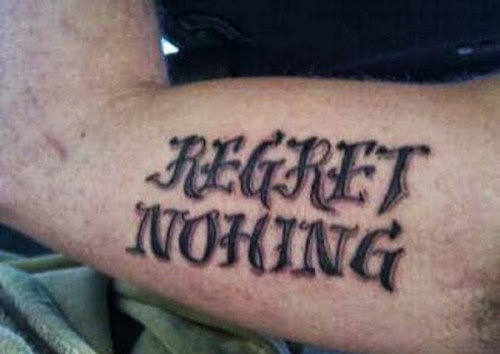
Spelling
Ensure all words are spelt correctly, to the best of your ability
Check carefully for spellings of author names, key terminology and key words in the novel
If you can’t spell it, don’t use it!

Slide 282
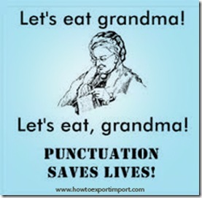
Punctuation and Grammar
Ensure you are structuring your sentences properly using full stops and commas-don’t let them ramble on!
Look back at advice for structuring quotations-ensure this is done properly
Again, if you don’t know how to use it, don’t use it! E.g. don’t use a semi-colon if you don’t know why it’s used.
PARAGRAPHING-follow the structure and you’ll do fine!

Slide 283
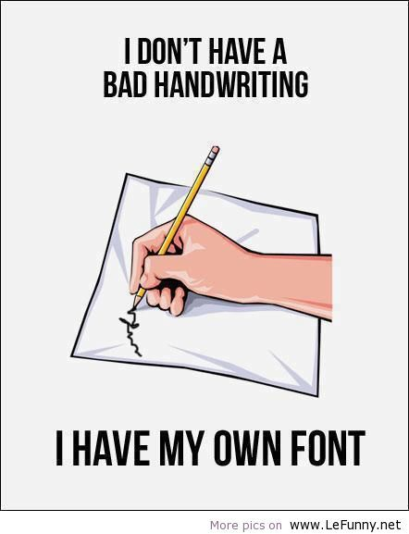
Presentation
Take time to ensure your handwriting is legible-not just to you, but to others!
Make sure spacing and size of lettering is appropriate
To emphasise changes in paragraphs, miss a line before beginning a new one

Slide 284
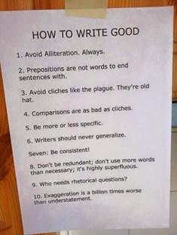
Clarity of Expression

Slide 285
Deadlines
Mindfulness CR Task-due today
Final folio pieces overdue
Nixon-both
Shea-persuasive
Sophie-both
Marta-both

Slide 286
Conflict Essay-General Feedback
Strengths
Those that used the Essay Writing 101 booklet used it well!
Intros were mostly great-some clearly missing the link to the specific question though
Analysis was mostly detailed, showing good knowledge of text and techniques used by Miller
Areas for improvement
Basic punctuation-capitals, use of commas, full stops, etc.-ARGH!
Linking to the question and theme in every paragraph-PCQEL! I need to see the words ‘conflict’ and ‘toxic masculinity’ so much that I end up hating them!
Topic sentences and context-use them! Also, watch how much/how little detail in context
Spoiler alert…Eddie dies! Big part of play missed in essays-you must refer to this in any AVFTB essay!

Slide 287
Today
Next Monday, we are going to attempt a timed unseen essay Q on AVFTB
Three Q options will be given
Today, you’re going to work in pairs to create a variety of essay plans to prepare for this
I will photocopy these so you have a wealth of resources to revise!

Slide 288
Planning Essay-Conflict
Key Moments & quotes
Interpret Q-which character/theme/setting/scene?
AVFTB Essay Plan
Message/related themes

Slide 289
Deadlines
Mindfulness CR Task-due yesterday!
Final folio pieces overdue
Shea-creative
Sophie-both
Marta-both

Slide 290
Codes!
INTRO-TASTE
Title (name of text)
Author (who wrote text)
Summary (what happens, where, when)
Task (link to Q)
Explain techniques (how does writer do this?)
MPs-PCQEL
Point-(topic sentence-what are you writing about in this paragraph?)
Context- (when in the play does this take place? What’s going on at that point?)
Quotation-(appropriate evidence)
Explanation-(what does this quotation tell us? Explain key techniques used, why they are important)
Link to Q-(why is this important to your overall point? How does it relate to the wider ideas/themes?)
CONCLUSION-SERVE
Summarise the points you have made
Evaluate writer’s message (link to themes)
Refer back to the question
Vary your expression (don’t repeat yourself)
Express an opinion (appreciation of text)

Slide 291
Deadlines
Oculus Rift CR-due today
Final folio pieces overdue
Shea-creative
Marta-persuasive

Slide 292
Folio Cover Sheets
Name of centre-St Thomas Aquinas Secondary School
Town-Glasgow
SCN-at bottom of folio pieces
Give title and word count of both pieces-word count is at end of each piece
SIGN AND DATE

Slide 293
A View From The Bridge-Internal Conflict Essay

Slide 294
Question
ONE character-not conflict between characters
Choose a play in which a character struggles with an internal conflict.
Briefly explain how the dramatist presents this internal struggle and discuss the consequences this has on the play as a whole.
A struggle within themselves, problem/issue they are conflicted over
What is the struggle and how is it shown?
What happens as a result of character’s issue?

Slide 295
Basic Plan
Quotes and Techniques
MP1
“he is sizing up Rodolpho, and there is a concealed suspicion”-stage directions
“Katie, he’s only bowin’ to his passport!”-dialogue
MP2
Kissing scene quote-pg 58key incident
MP3
Alfieri quote “too much love”-pg42 foreshadowing, choric role
Glowing phone box-pg60/61-symbolism
MP4
Eddie’s death-pg79 symbolism
Breaking down the Q
Which character?
What is their internal conflict?
How is it shown in play?
What happens as a result of it?
AVFTB Internal Conflict Essay
Miller’s message
Follows format of Greek tragedy-where fate controls characters’ destinies-Miller’s use of foreshadowing by choric figure Alfieri, use of fatal flaw and symbolic death of tragic hero show Eddie’s fate was inescapable due to his inability to admit to his fatal flaw.

Slide 296
Codes!
INTRO-TASTE
Title (name of text)
Author (who wrote text)
Summary (what happens, where, when)
Task (link to Q)
Explain techniques (how does writer do this?)
MPs-PCQEL
Point-(topic sentence-what are you writing about in this paragraph?)
Context- (when in the play does this take place? What’s going on at that point?)
Quotation-(appropriate evidence)
Explanation-(what does this quotation tell us? Explain key techniques used, why they are important)
Link to Q-(why is this important to your overall point? How does it relate to the wider ideas/themes?)
CONCLUSION-SERVE
Summarise the points you have made
Evaluate writer’s message (link to themes)
Refer back to the question
Vary your expression (don’t repeat yourself)
Express an opinion (appreciation of text)

Slide 297
A View From The Bridge-Theme Essay

Slide 298
Example Theme Q
Choose a play which explores an important issues or issues within society.
Briefly explain the nature of the issue(s) and discuss how the dramatist's presentation of the issue(s) contributed to your appreciation of the play as a whole.

Slide 299
Format of a Theme Essay
Main Paragraph 1-establishing theme (opening)
Main Paragraph 2-development of character-Eddie(opening; speaking to C about R)
Introduction
Main Paragraph 4-key scene (ending)
Main Paragraph 3-turning point (Alfieri’s office)
Conclusion

Slide 300
A View From The Bridge-Conflict Essay

Slide 301
Previous Conflict Qs
Choose a play in which a central character is in conflict with or rejects another character.
Briefly explain the circumstances of the conflict or rejection and go on to discuss the consequences of this conflict or rejection for the play as a whole.
Choose a play in which the conflict between two characters in as important feature.
Briefly explain the nature of this conflict and discuss how the dramatist's presentation of this feature enhances your understanding of the play as a whole.

Slide 302
Example Conflict Q
Choose a play in which the conflict between two characters in as important feature.
Briefly explain the nature of this conflict and discuss how the dramatist's presentation of this feature enhances your understanding of the play as a whole.

Slide 303
Format of a Theme Essay
Main Paragraph 1-establishing conflict-R&E
Main Paragraph 2-developing conflict (E talking about R)
Introduction
Main Paragraph 4-key scene (ending)
Main Paragraph 3-turning point (end of act 1)
Conclusion

