Slide 1
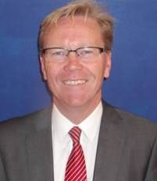
Child Protection Matters
Have a concern? Report it!
Miss Gaughan
Child Protection Coordinator
01415820180 ext 479
Mr McGuigan
Head of Establishment
01415820180 ext 431
If you have any concerns about a young person’s welfare or believe they may be at risk report the matter to Miss Gaughan, the CP Coordinator. In her absence alert Mr McGuigan, the Head of Establishment.
Follow the guidance of the CP Coordinator in supporting the young person and co-operate with subsequent actions by Social Work or the Police.
Consider the well being and safety of the young person.
Remain calm; listen and reassure the young person.
Don’t agree to keep it secret.
Do not interrogate but note what you observe, what you hear, what you are told. Be specific about your concerns.
Alert the CP Coordinator immediately.
Lourdes Secondary

