Slide 1

Lochend Community High School: Online Support for young people and parents/carers

Slide 2

e-Sgoil
e-Sgoil is a free, Scotland-wide online learning service that supports young people with their education.
It provides live online lessons and study sessions taught by qualified teachers
Young people join from home (or school) using a computer and their Glow login
It is designed to support school learning, not replace it
It can help with revision, homework, or subjects a school might not offer
There is also support for young people who are struggling to attend school, helping them learn in a more comfortable environment
https://www.e-sgoil.com/

Slide 3
e-Sgoil
Key Benefits for Families
✔ Free to access – no cost for families
✔ Qualified teachers – lessons are delivered by experienced educators
✔ Flexible learning – join sessions from home or school
✔ Wellbeing support – helps reduce stress and builds confidence
✔ Connected to school – works alongside your child’s education

Slide 4
e-Sgoil Easter Support
Our Easter Study Support programme for S4-6 learners is now open for registration. Running from 6-10 April, this year’s programme of free, live webinars covers almost 60 courses spanning National 4, National 5, Higher and Advanced Higher levels.
Please Note that young people must sign up for this programme through the e-Sgoil website where the programme timetable is also available

Slide 5
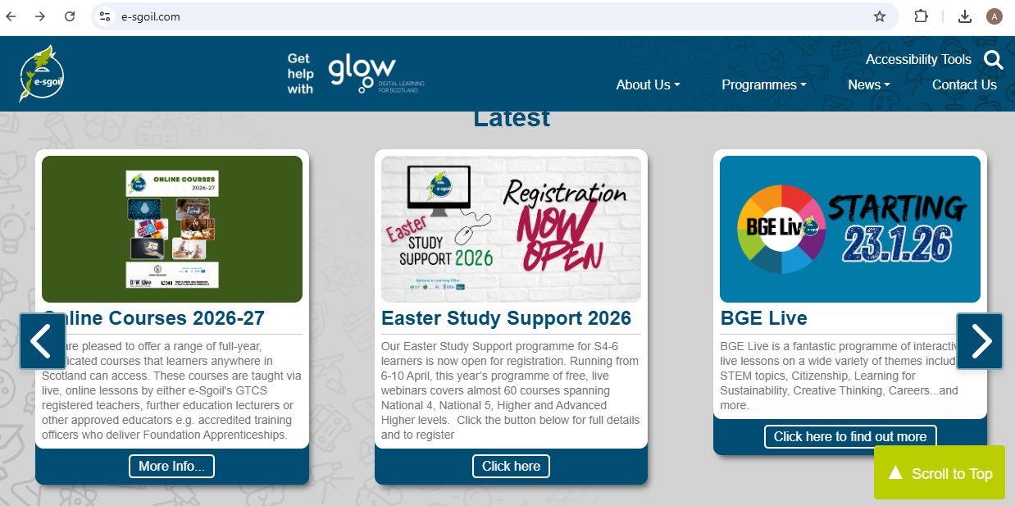

Slide 6

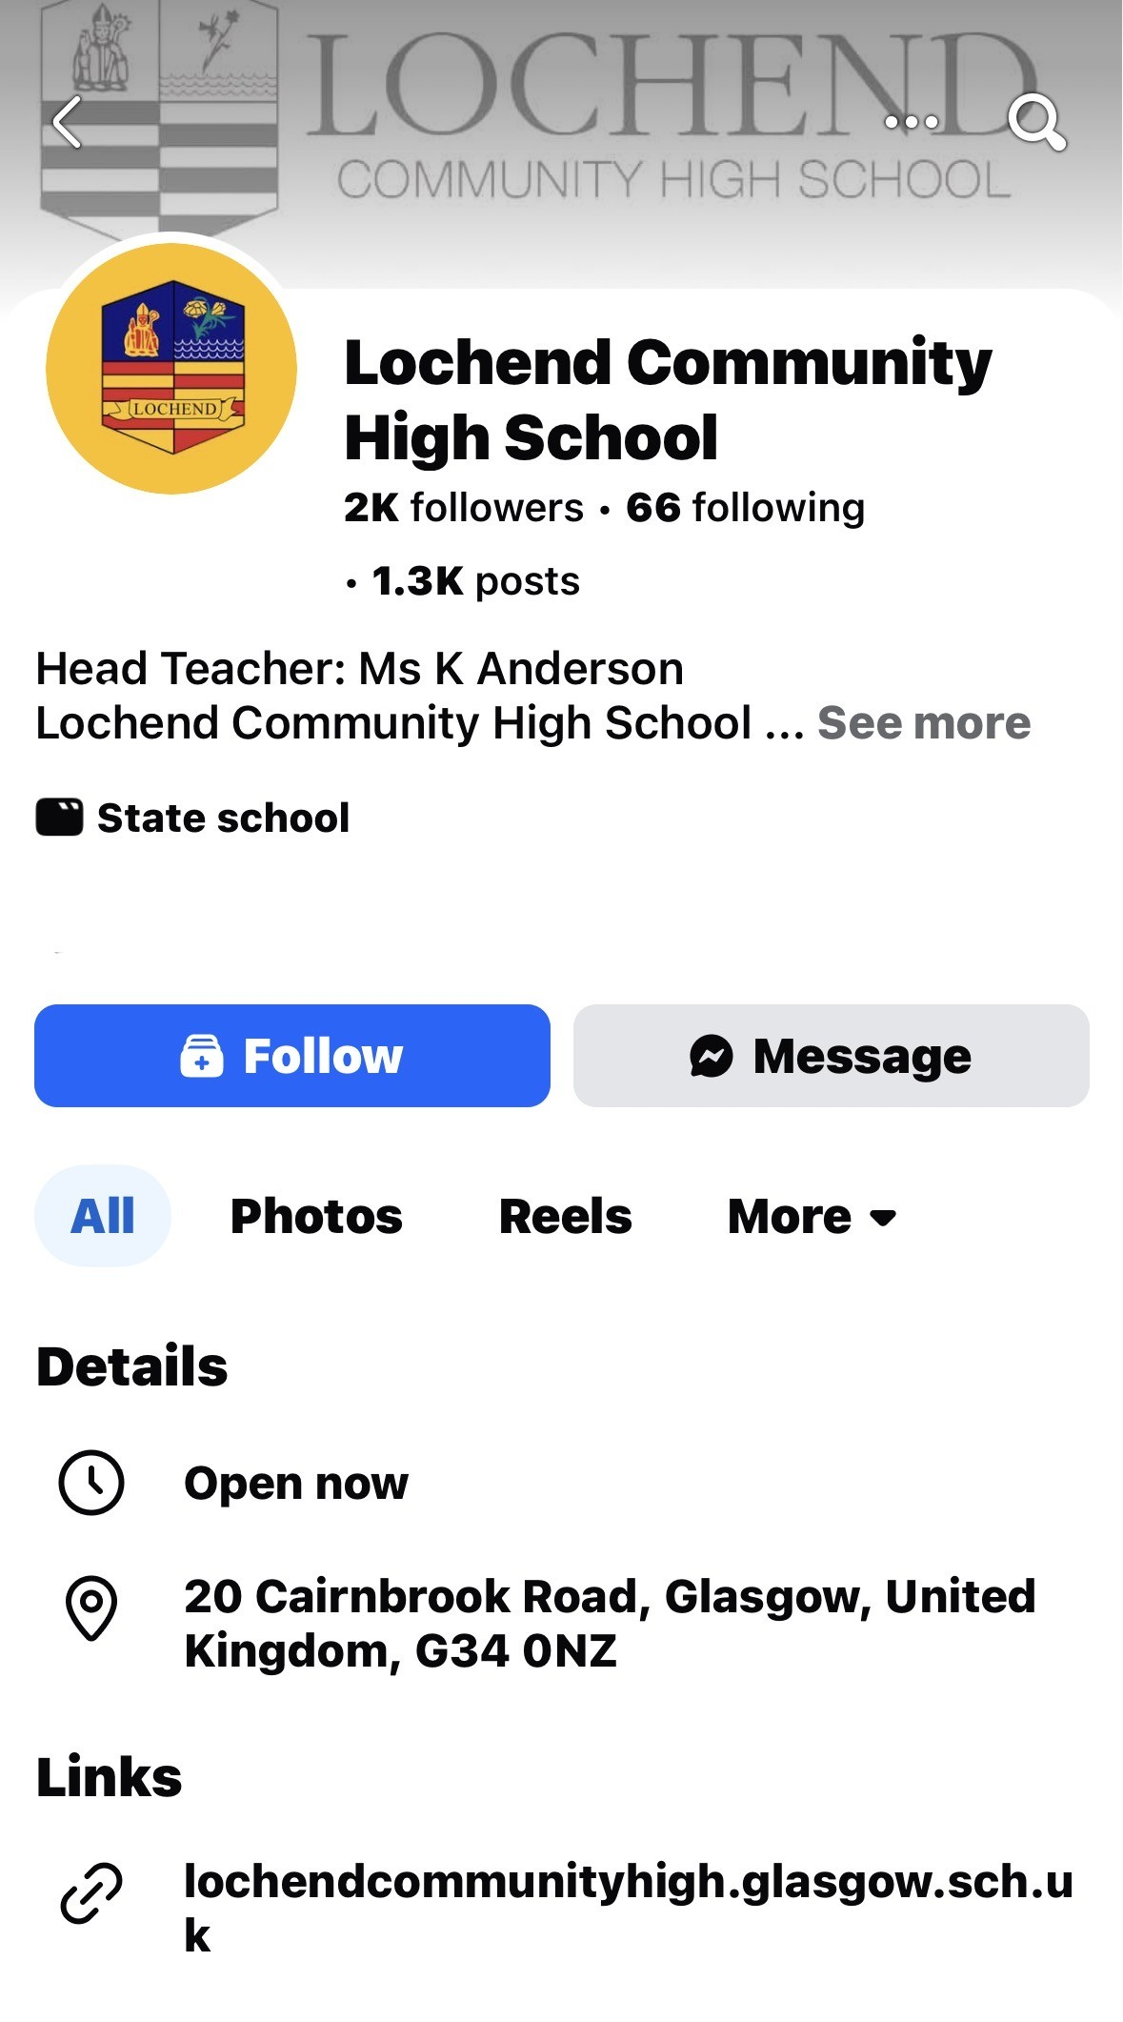
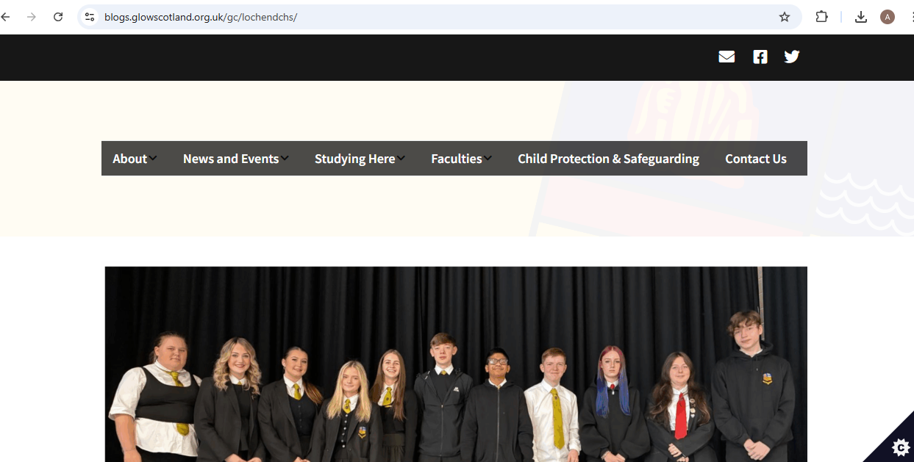
School Updates: As a school we are no longer use X (formerly twitter) to share updates instead updates will be shared on the school website or Facebook page
https://blogs.glowscotland.org.uk/gc/lochendchs/

Slide 7

Showbie
Class teacher will share and update work including homework onto the Showbie App
A parent account lets you stay informed about your child’s learning.
You need to request a parent code so that you can view pupils work and tasks.

Slide 8
Showbie
How can parents use it?
View your child’s work – see assignments, completed tasks, and teacher feedback
Keep track of deadlines – know what work is due and when
Understand progress – see how your child is getting on in different subjects
Stay organised – help your child plan and manage their workload

Slide 9
Showbie
Ways to support
Ask your child about the work you see on Showbie
Encourage them to complete and submit assignments on time
Help them respond to teacher feedback and improve their work
Use it as a starting point for conversations about school

Slide 10
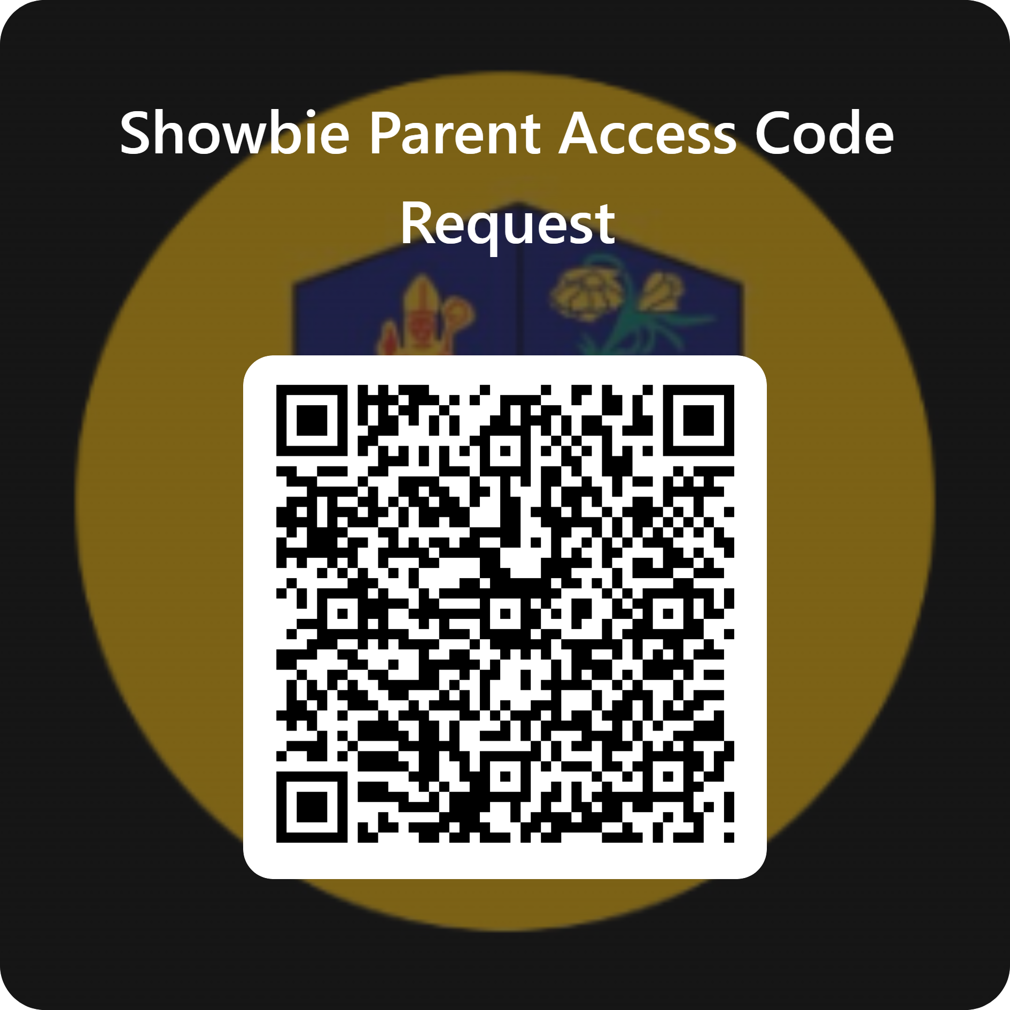
Showbie
Please complete the following form if you would like a parent code to create a parent showbie account.

