Slide 1

Revision Guides

Slide 2
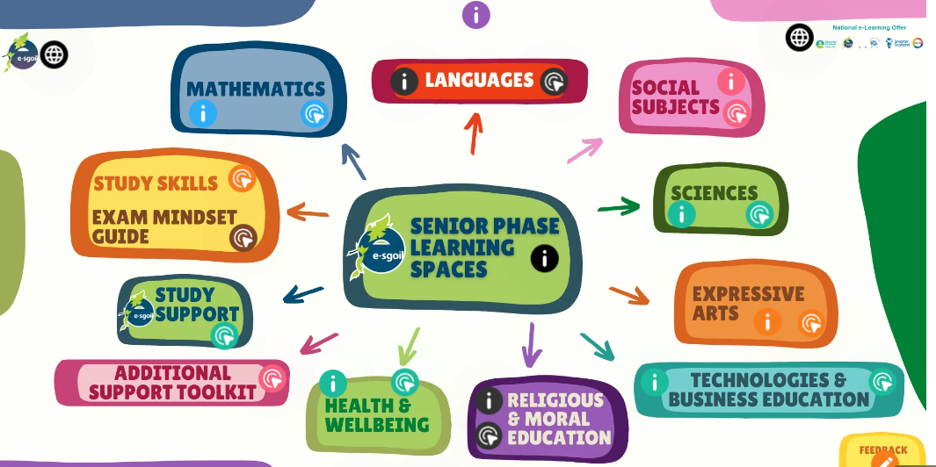
Thing Link
https://www.thinglink.com/card/1679198779850358786
This is a link which will take you to the page below, you can select which subject area you want to study. There are a variety of sources, links to other websites and helpful videos to watch.

Slide 3
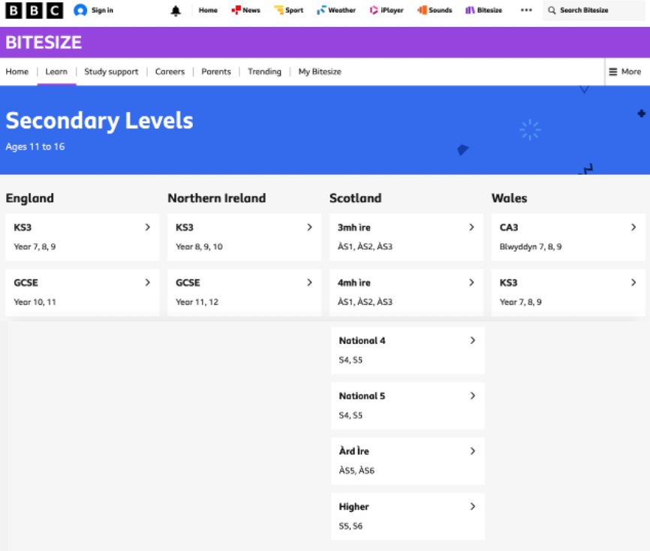
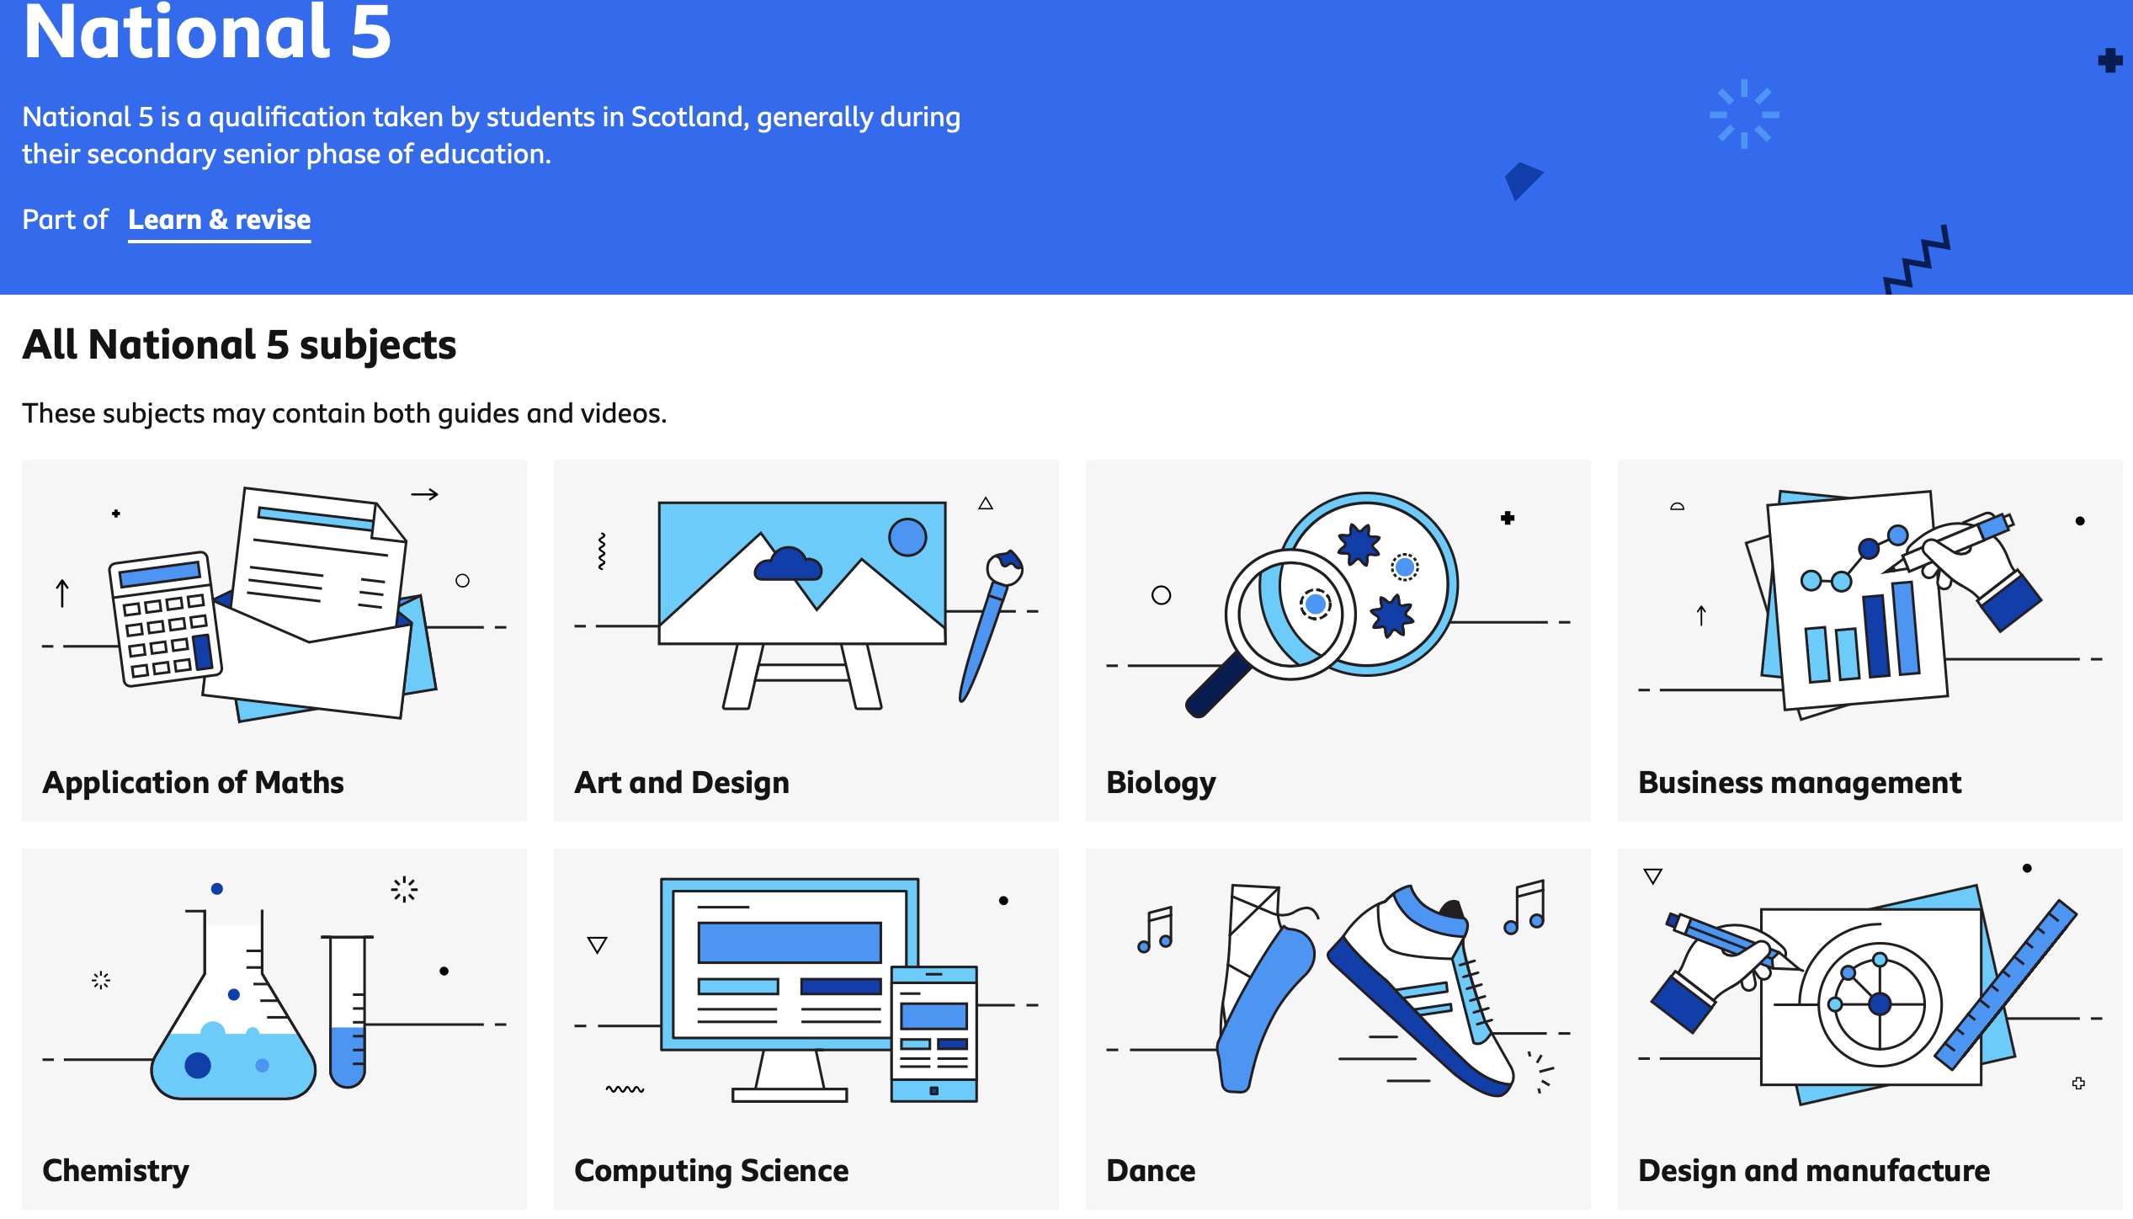
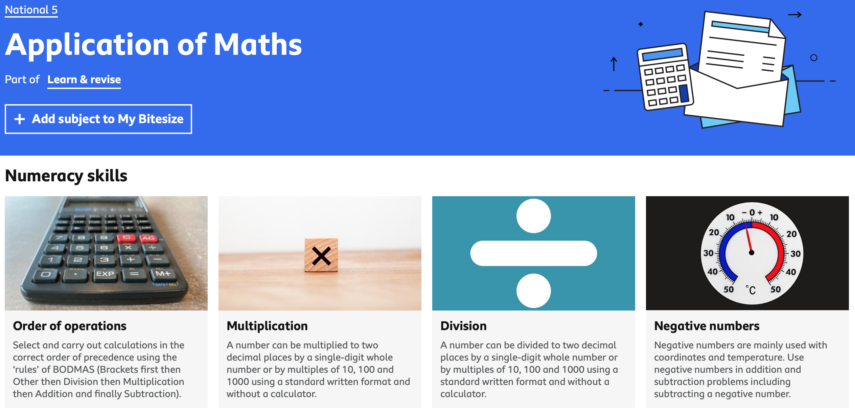
BBC BiteSIZE
https://www.bbc.co.uk/bitesize/secondary
Log into the Bitesize website and then select which level you are studying in the Scotland category.
Then select which subject you would like to study, then pick which topic to focus on.

Slide 4
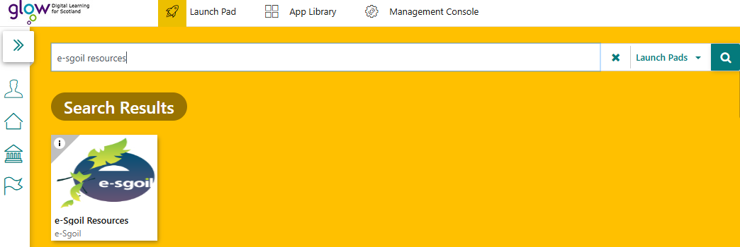
E-sgoil
You can add this as a tile in your GLOW launchpad. Just type in “e-sgoil resources” into the search bar.
There are a wide variety of resources to study in these subject areas:
Expressive Arts | Religious & Moral Education | Health & Well Being | Languages | Maths | Science | Social Studies | Technologies | Guidance | Other

Slide 5
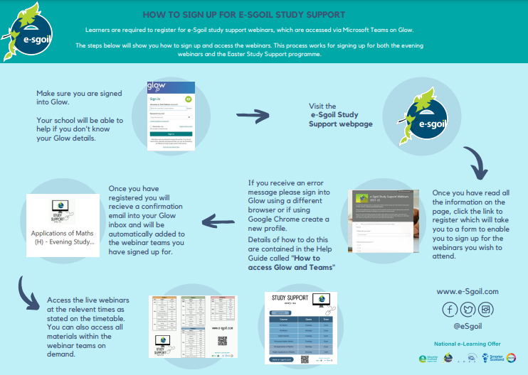
E-SGOIL – Study Support How to Sign up

Slide 6
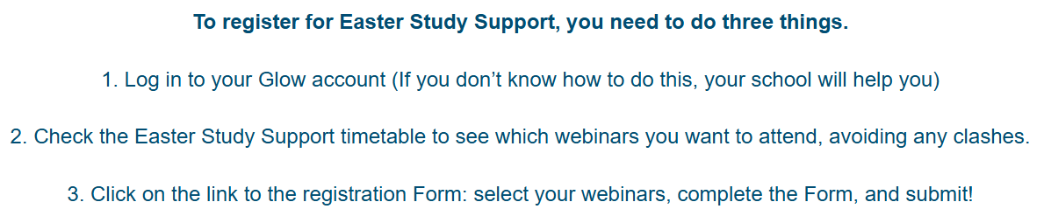
E-SGOIL – Easter School How to Sign up
Registration Form link:
https://forms.office.com/pages/responsepage.aspx?id=oyzTzM4Wj0KVQTctawUZKbQ-E7bqOW1Imztqf1fg0TZUMzFNNktTVEVXREJPUUFQMk8wNUpIUUgyVy4u&route=shorturl

Slide 7
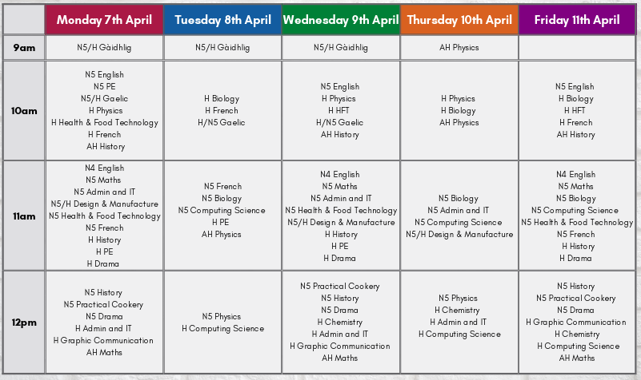
E-SGOIL - Easter Timetables

Slide 8
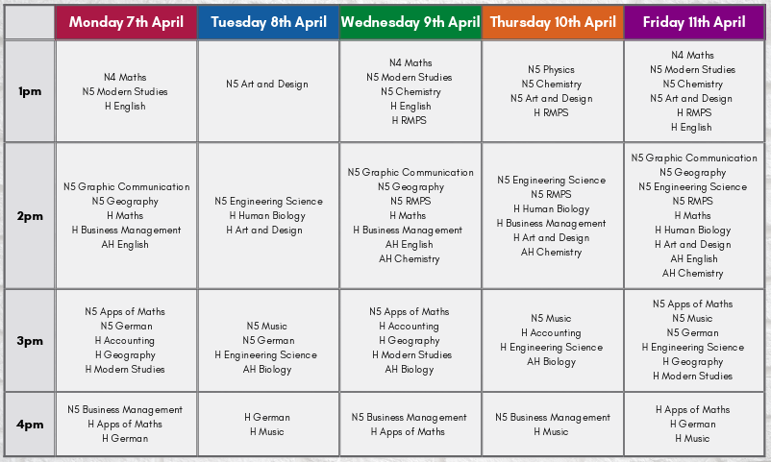
E-SGOIL - Easter Timetables

Slide 9

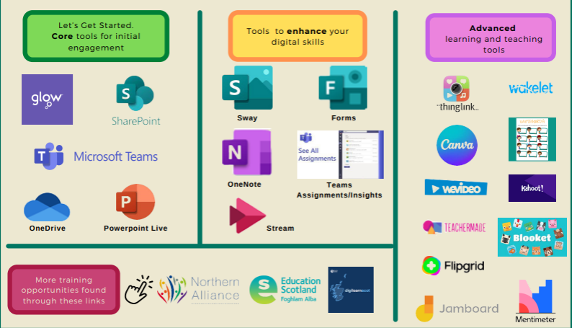
E-SGOIL – Staff Digital Skills
https://glowscotland.sharepoint.com/sites/6202721/eLearning%20Help%20Guides/Forms/AllItems.aspx?id=/sites/6202721/eLearning%20Help%20Guides/eSgoil%20Training%20Manuals%20and%20Handbooks/e-Sgoil%20Training%20manual%20FINAL%20V5%20-%20Nov%2022.pdf&viewid=f823d7dc-b52d-4b20-884c-af9208de5522&parent=/sites/6202721/eLearning%20Help%20Guides/eSgoil%20Training%20Manuals%20and%20Handbooks

Slide 10
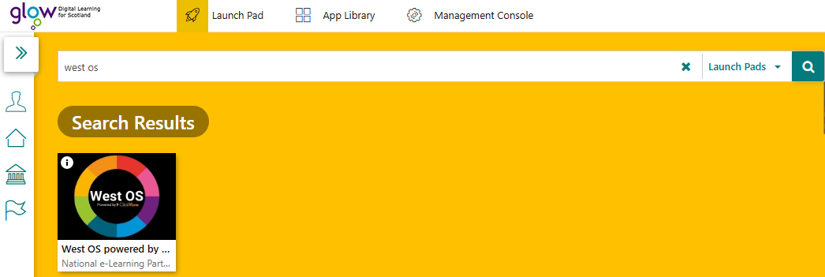
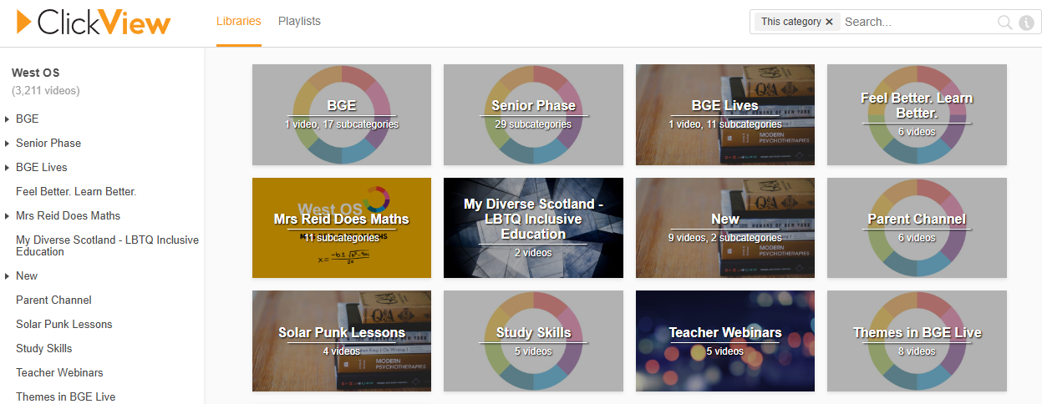
West os
You can add this as a tile in your GLOW launchpad. Just type in “WEST OS” into the search bar.
You just need to sign in with your GLOW email and you will be taken to this home screen:

Slide 11
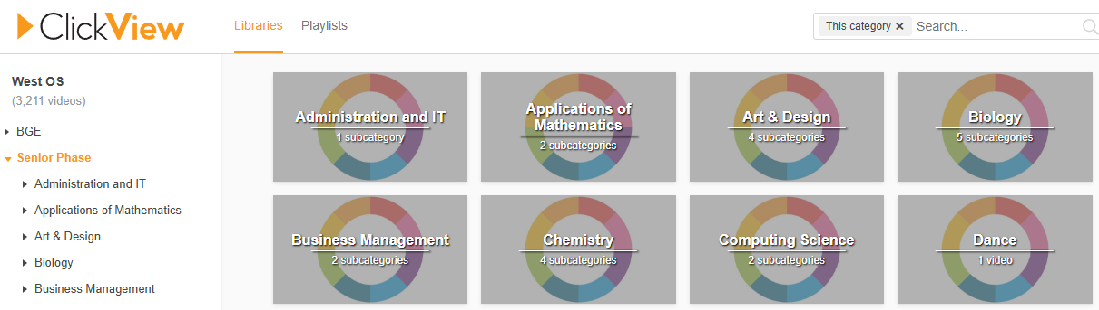
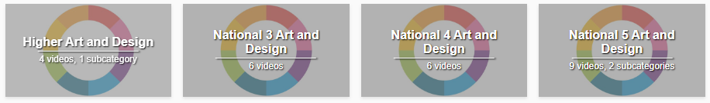
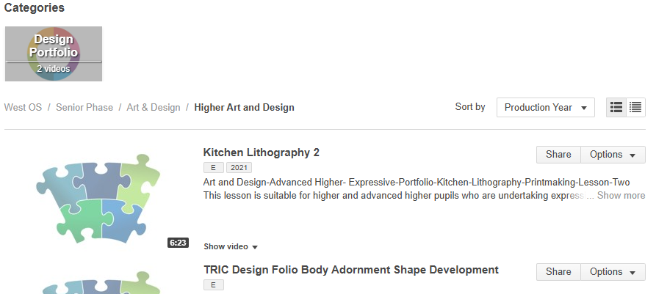
West os
Click into your stage of school. For example: Senior Phase
Click into the subject you want to study. For example: Art and Design
Click into the level you want to study. For example: Higher Art and Design
Look through the resources and topics you want to focus on.

Slide 12
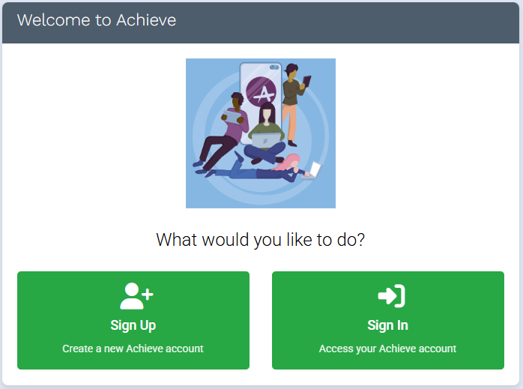
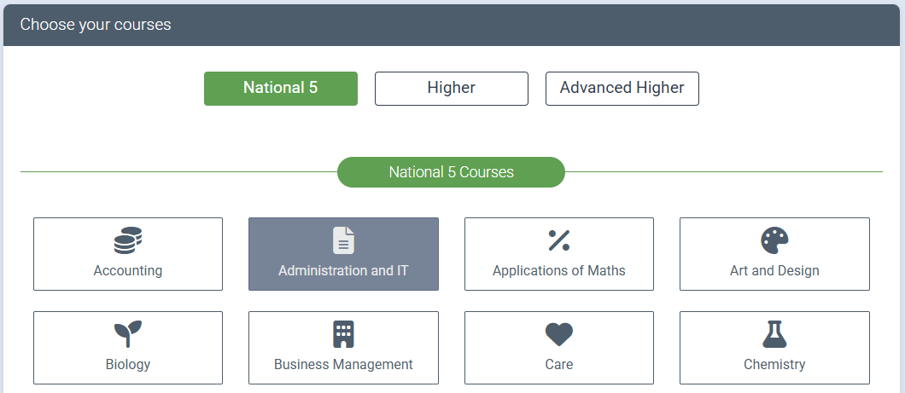
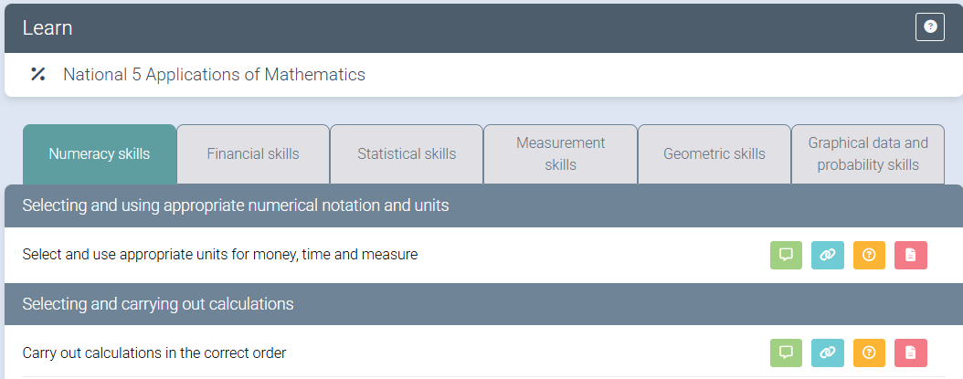
Achieve
Log in to the website using this link: https://achieve.hashtag-learning.co.uk/
Sign up and create a new account. Use your GLOW email address to sign up.
You can then choose the courses you would like to study.
You will be able to revise key areas, complete assessments and past paper questions.

Slide 13
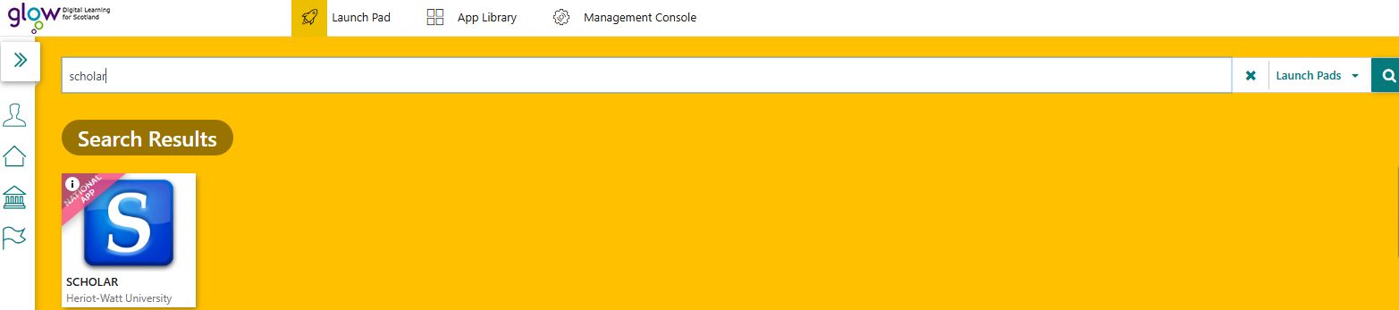
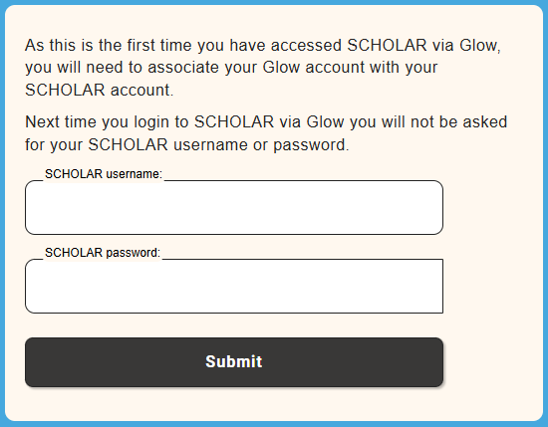
Scholar
You can add this as a tile in your GLOW launchpad. Just type in “Scholar” into the search bar.
You will then need to sign in with your GLOW email. You can use Scholar to learn key areas, assess your knowledge and develop your understanding using animations.

