Slide 1

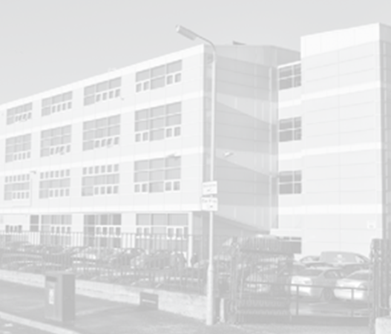

Pupil Wellbeing
Learning Intention
I will complete the wellbeing profile to the best of my ability to show a true reflection of how I am feeling.
Success Criteria
All questions will be answered
I will have reflected about how I am feeling and be able to speak to my pastoral care teacher about this
The Skill we are focusing on today is:
Notes:
My example slide

Slide 2
