Slide 1
Career Pathways at King’s Park Secondary School 2024-25

Slide 2
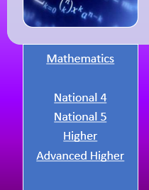
Introduction
This booklet is a guide to your option choices and pathways for learning in KPSS.
Each department has a page which explains your options in that department.
You can scroll through the document or click on a subject in the contents page, and you will be taken directly to that subject.
Any sections which are underlined are links which will take you to websites or documents to help you find out more information about that course or area of study. Some sections may have more than one link for different subjects, as shown here.

Slide 3
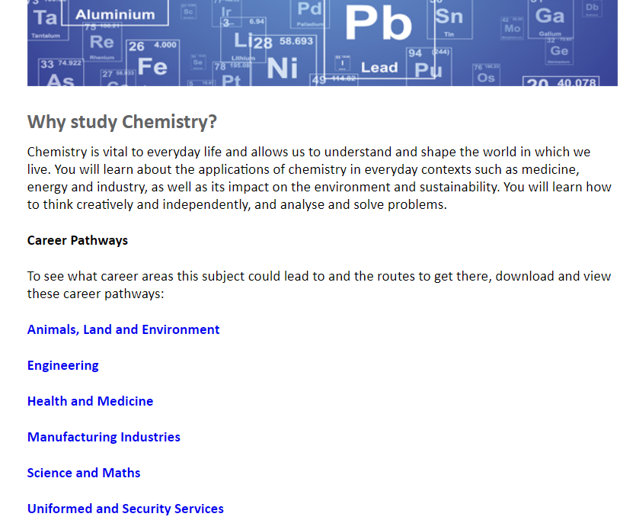
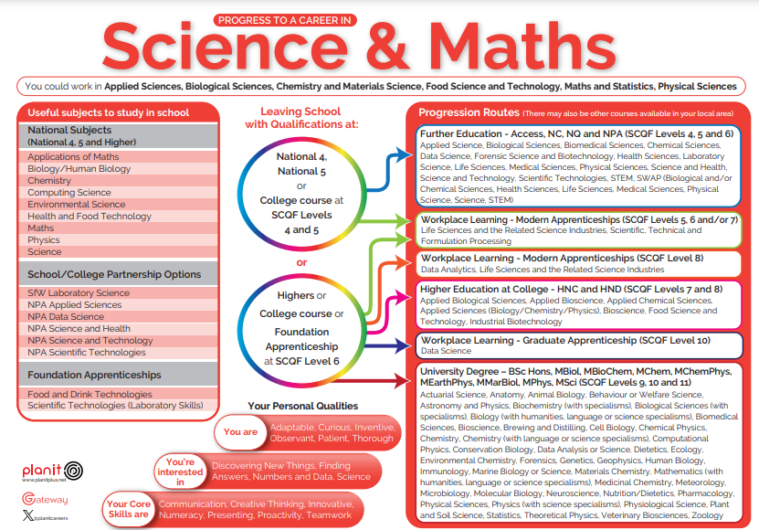
Career Pathways
If you can see a Career Pathways link, click on this to see where this subject can take you
The link will take you to the Planit Plus website where further information about Apprenticeships, College or University courses, or Careers can be found

Slide 4
Contents
Art, Design and Photography
Business and Computing
English
Health and Wellbeing: Health and Food
Health and Wellbeing: P.E.
Mathematics
Modern Languages
Performing Arts
Science
Social Subjects
Technical Education
Personal Development

Slide 5
Progression in Art Design & Photography
S1 &S2 BGE Art Design and Photography
S3 options
Art Design and Photography
Senior phase options
Art and Design
National 4
Level 5
National 5
Higher
Career Pathways
Photography
Level 5
Higher
Career Pathways

Slide 6
Progression in English
S1, S2 & S3 English
Senior phase options
English
National 4
National 5
Higher
Advanced Higher
Career Pathways
ESOL
National 5
Higher
Career Pathways
Media
National 5
Higher
Career Pathways
Literature & Communications
Level 5
Level 6

Slide 7
Progression in Business Education and Computing Science
S1 &S2 BGE Business and Computing
S3 options
Accounting
Administration & IT
Business Management
Computing Science
Senior phase options
Accounting
National 5
Higher
Level 6
Career Pathways
Administration & IT
National 4
National 5
Higher
Career Pathways
Business Management
National 4
National 5
Level 5
Higher
Level 6
Career Pathways
Computing Science
National 4
National 5
Higher
Advanced Higher
Career Pathways

Slide 8
Progression in Health and Wellbeing: Health & Food
S1, S2 & S3 BGE Health & Food
S4 Options
Early Learning and Childcare National 4/5
Health and Food Level 5
Practical Cookery National 3/4/5
S5/6 Options
Early Learning and Childcare
National 4
National 5
Career Pathways
Health and Food
National 5
Higher
Career Pathways
Practical Cookery
National 5
Hospitality Level 5
Career Pathways

Slide 9
Progression in Health and Wellbeing: P.E.
S1, S2 & S3 BGE Physical Education
S4 Options
Core (level 4 wellbeing award)
PE National 4
PE National 5
Dance Level 4
Dance National 5
Sports Leader Level 4
S5/6 Options
P.E.
National 5
Higher
Career Pathways
Dance
National 5
Higher
Career Pathways
Sports Leader
Level 5
Level 6
Refereeing
Level 7
Exercise & Fitness
Level 6

Slide 10
Progression in Mathematics
S1, S2 & S3 Mathematics
Senior phase options
Mathematics
National 4
National 5
Higher
Advanced Higher
Career Pathways
Applications of Maths
National 4
National 5
Higher
Career Pathways
Personal Finance
Level 4
Level 5
Level 6 Personal Finance
Statistics
Level 6 Statistics
Career Pathways

Slide 11
Progression in Modern Languages
S1 &S2 BGE Modern Languages
S3 options
French
German
Spanish
Modern Languages for Life and Work Level 3
Senior phase options
French
National 4
National 5
Higher
Career Pathways
German
National 4
National 5
Higher
Career Pathways
Spanish
National 4
National 5
Higher
Career Pathways
Modern Languages for Life and Work
Level 4
Level 5
Level 6

Slide 12
Progression in Performing Arts
S1 &S2 BGE Drama and Music
S3 options
Drama
Music
Music Tech
Senior phase options
Drama
National 4
National 5
Higher
Level 6 Musical Theatre
Level 6 Acting and Performing
Advanced Higher
Career Pathways
Music
National 4
National 5
Higher
Level 6 Music Performing
Advanced Higher
Career Pathways
Music Tech
National 4
National 5
Level 6 Sound Production
Career Pathways

Slide 13
Progression in Science
S1 &S2 BGE Science
S3 options
Physics
Biology
Chemistry
Senior phase options
Physics
National 4
National 5
Higher
Career Pathways
Biology
National 4
National 5
Higher
Adv. Higher
Career Pathways
Chemistry
National 4
National 5
Higher
Adv. Higher
Career Pathways
Health Sector
National 5
Career Pathways
Practical Electronics
National 4
National 5
Career Pathways

Slide 14
Progression in Social Subjects
S1 &S2 BGE Social Subjects
S3 options
Modern Studies
History
Geography
Senior phase options
Modern Studies
National 4
National 5
Higher
Higher Politics
Higher Sociology
Career Pathways
History
National 4
National 5
Higher
Career Pathways
Geography
National 4
National 5
Higher
Career Pathways
RMPS
National 5
Higher
Career Pathways
Additional Options
N4 People and Society
N5 Travel and Tourism
Level 5 Criminology
Level 5 Scottish Studies
Career Pathways

Slide 15
Progression in Design & Technology
S1 &S2 BGE Design and Technology
S3 options
Practical Woodworking
Graphic Communication
Design and Manufacture
Senior phase options
Practical Woodworking
National 4
National 5
Career Pathways
Graphic Communication
National 4
National 5
Higher
Career Pathways
Design and Manufacture
National 4
National 5
Higher
Career Pathways

Slide 16
Personal Development Options
Sports Leadership
Level 4
Level 5
Level 6
Duke of Edinburgh Award
Bronze
Silver
Gold
NPA in Musical Theatre
Level 6
Volunteering
Level 4
Level 5
Fuel Change
Level 6
Leadership in Languages
Level 5
Level 6
National Progression Award in Music Performance
Level 6

