Slide 1
Health and Wellbeing Information session for parents and carers

Slide 2
Our Objectives
Briefly describe what Health and Wellbeing is in a school context.
Show you how we check for progress in your child’s Health and Wellbeing levels.
Discuss what it is we do in school to support your child’s Health and Wellbeing.
Consider some of the things you may choose to do as parents/carers to further support your child’s wellbeing.

Slide 3
What is Health and Wellbeing?
Health and Wellbeing is about how we support your child in 6 key areas:
• Mental, emotional, social and physical wellbeing
• Planning for choices and changes
• Physical education, physical activity and sport
• Food and health
• Substance misuse
• Relationships, sexual health and parenthood

Slide 4
Monitoring Progress within HWB:
Curricular method:
This is the Health and Wellbeing experiences and outcomes from PSE, PE and HE combined.
Pupil A: Physical Education grade = level 3.1
Home Economics grade = level 3.2
Personal Social Education = level 3.1
Overall Grade Awarded = level 3.1
Wellbeing overview:
This is our wellbeing web made from the SHANARRI wellbeing indicators
Please see an example on our next slide

Slide 5
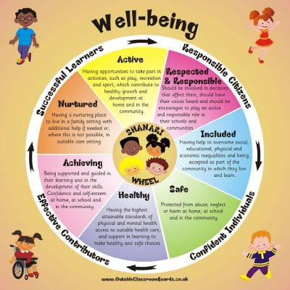
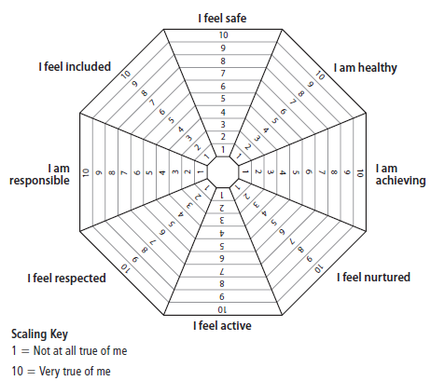
Wellbeing Indicators
“Each child is unique and there is no set level of wellbeing that children should achieve. Wellbeing is influenced by children’s individual experiences and changing needs as they grow” Scottish Government Website.

Slide 6
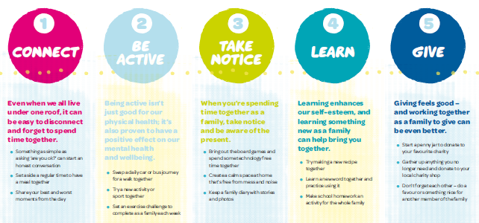
Mental, Emotional, Social and Physical Wellbeing
What we do:
How you could support us:
Pastoral support
Mental Health supports
PSE lessons
Targeted Groupwork
www.samh.org.uk

Slide 7
Planning for Choices and Change
What we do:
How you could support us:
Links with SDS
1 to 1 interviews
PSE lessons
College/UCAS application support
Option choice interviews
2nd highest in GCC for positive destinations, only behind the Gaelic School.
Discuss options with young person
Contact PT Pastoral care with any questions or concerns
www.myworldofwork.co.uk

Slide 8
Physical education, physical activity and sport
What we do
How you could support us
Additional periods of PE plus our masterclass programme
Fitness Testing
Fitness, athletics and cross country blocks of activity
Personalisation and choice of activities.
Investment in new equipment
Lunchtime and after school clubs
Check PE kit.
Encourage your young person to join extra curricular clubs
Encourage your young person to join clubs outwith school
Family fitness
Screen time

Slide 9
Food and health
What we do
How you could support us
In HE, PE, PSE and Science we teach:
Nutrition basics
How to cook healthy meals
Food Safety and labelling
Hydration
Calorific values and healthy calorie intake
Foods of the world and food culture
Food waste and recycling – learning for sustainability
Weigh To Go is a free NHS service available for all young people (12-18 year olds) who are overweight or obese, and wish to take positive steps in losing weight and leading a healthier lifestyle. www.nhsggc.org.uk/weightogo
Involve your young person in the cooking at home
Involve them in the shopping for food and the recycling you do at home
Monitor what your young person is eating at lunchtimes.
Try to cook healthier sit down meals at home.
Discuss things like calories and portion size with your young person.
Support available https://www.nhs.uk/live-well/eat-well/

Slide 10
Substance Misuse
What we do:
How you could support us:
PSE Lessons
Smoking
E-cigs/Vaping
Drugs
Solvent Misuse
Legal Highs
Alcohol
Consequences
Addiction support services

Slide 11
Relationships, Sexual Health and Parenthood
What we do:
How you could support us:
Links with school nurse
PSE Lessons: RSHP
Physical changes
Sexual health, contraception and reproduction
Positive relationships and friendships
Gender equality, discrimination and gender based violence
Parenthood and families
Consent
https://vimeo.com/showcase/6310425/video/361996285
Parent/Carer information page and all lessons for RSHP on www.rshp.scot

Slide 12
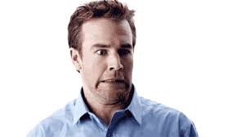
Relationships, Sexual Health and Parenthood
Question
What is the most common response from a PSE class when told they are being taught “Sex ed”?
A)
B)
C)
D)

