Slide 1
House Groups King’s Park Secondary School
Arran
Lewis
Mull
Skye

Slide 2
Why do we have House Groups?
Identity – House Groups give students and staff an additional identity within the school. Students and staff should be proud to be part of their House as well as the whole school community as it gives an added sense of belonging.
Collaboration (teamwork) - One of the main strengths of our House system is giving students of all ages the opportunity to work together, creating a truly cohesive environment and ensuring that age is not a barrier to friendship and collaboration.
Competition – Competition between Houses is so much fun! Everyone wants to be part of the most successful House Group – particularly if there is prizes for the winners! Competition drives all students to improve themselves and to work together with others to achieve success.
Leadership - The House system allows for the promotion of student’s responsibility. House Captains are appointed in our school and we have an Interhouse committee which allows young people to shape our House system.
Support – In our House system we have Pupil Support teachers who have a specific House group to provide support for. Support also comes from pupils being supportive of their peers in their own House as well as the wider school community

Slide 3
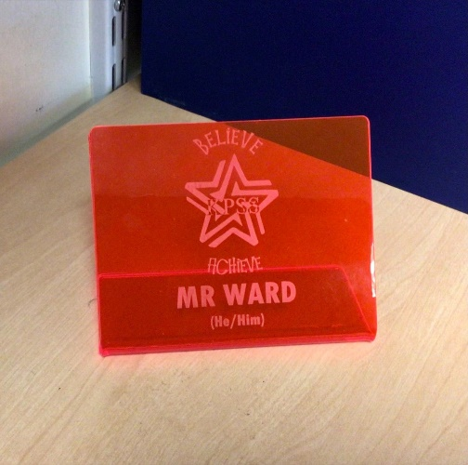
Identity
To help us with House identity we have two new features this session.
All Staff in the school have been randomly assigned to a House Group. You can see what House each teacher is in on the next slide. The teachers in your House are there to help you to win the overall House Championships!
Teachers will also soon have a name plate displayed on their desks which will show what House Group they belong to by colour.

Slide 4
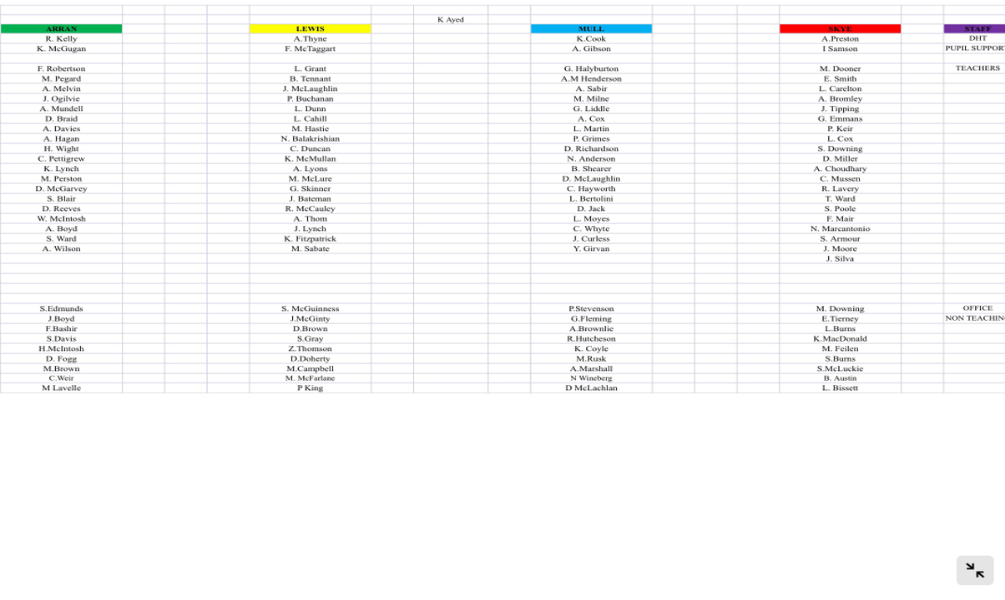

Slide 5
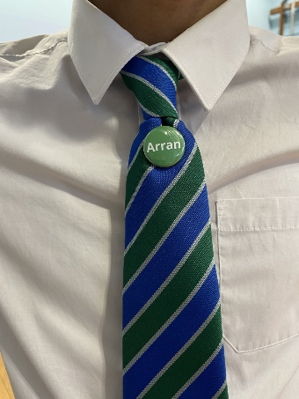
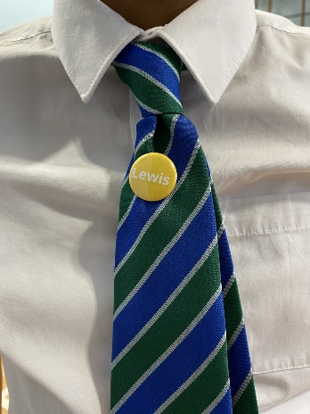
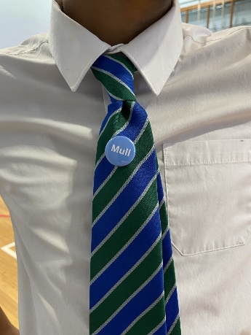
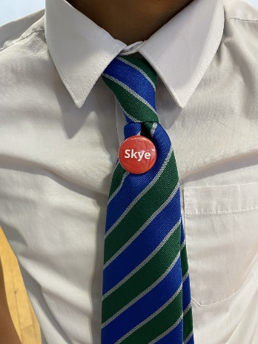
Identity
2. Pupil Badges
All pupils in the school will have a badge with their House name and colour on it. These should be displayed on your school tie.
Your Pupil Support teacher will give you your badge today before you leave the classroom.
Please do not lose your badge as you may be asked to purchase a replacement from the school office.

Slide 6
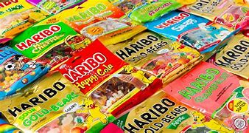
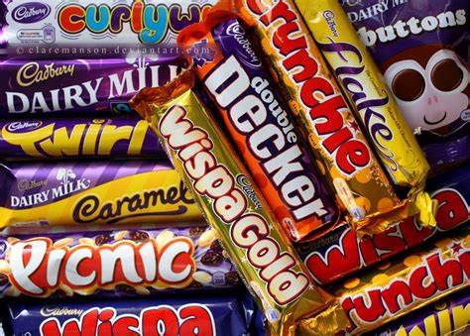
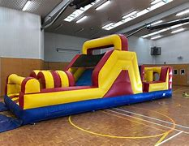
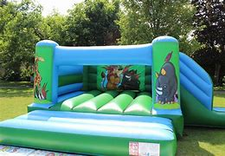
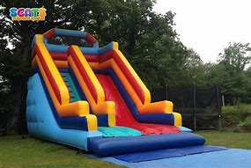
House Competition
+
PRIZES!
All pupils in the winning House this session will win time out of class with access to inflatable slides and bouncy castles in the PE department! This will take place on Wednesday 22nd June 2022 during the last week of summer term. With some treats thrown in too! Make sue you are part of the winning House!

Slide 7
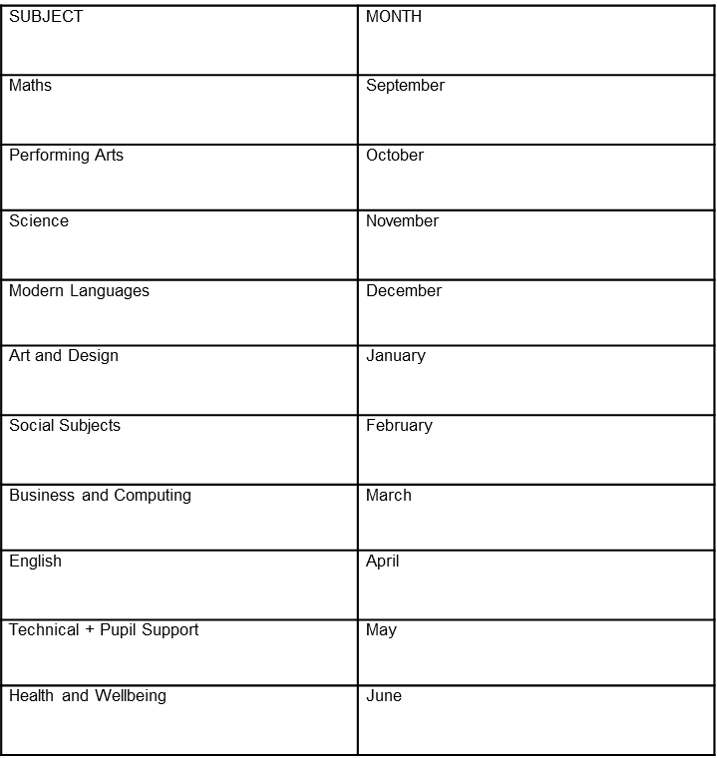
How does the competition work? How do you win?
Each month you will have a chance to win House Points. Every department in the school has a specific month where they can assign House points to you based on classwork, games and competitions.

Slide 8
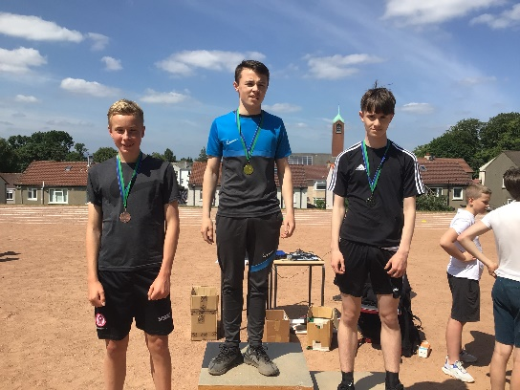
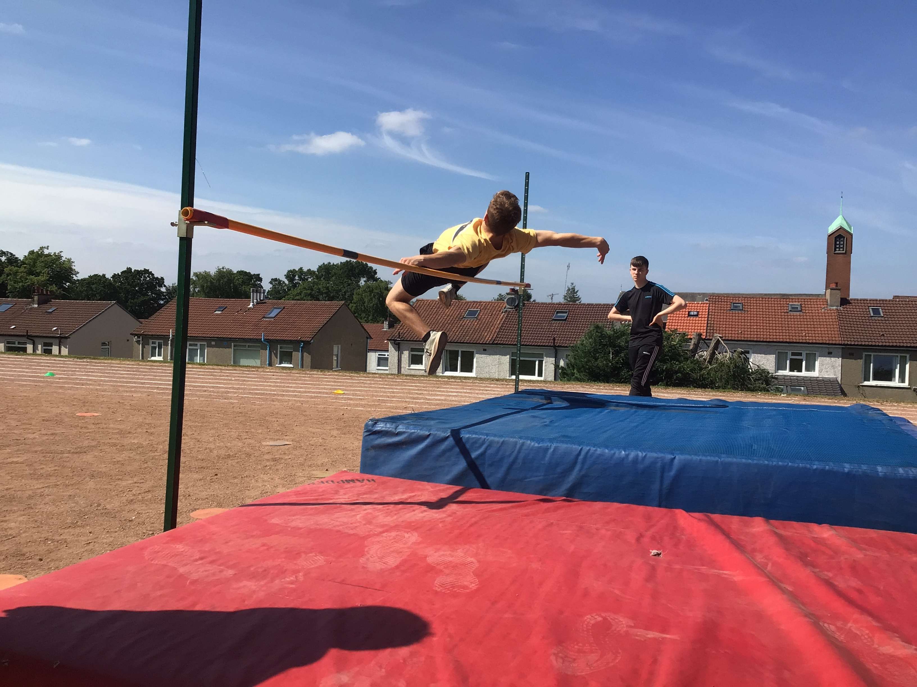
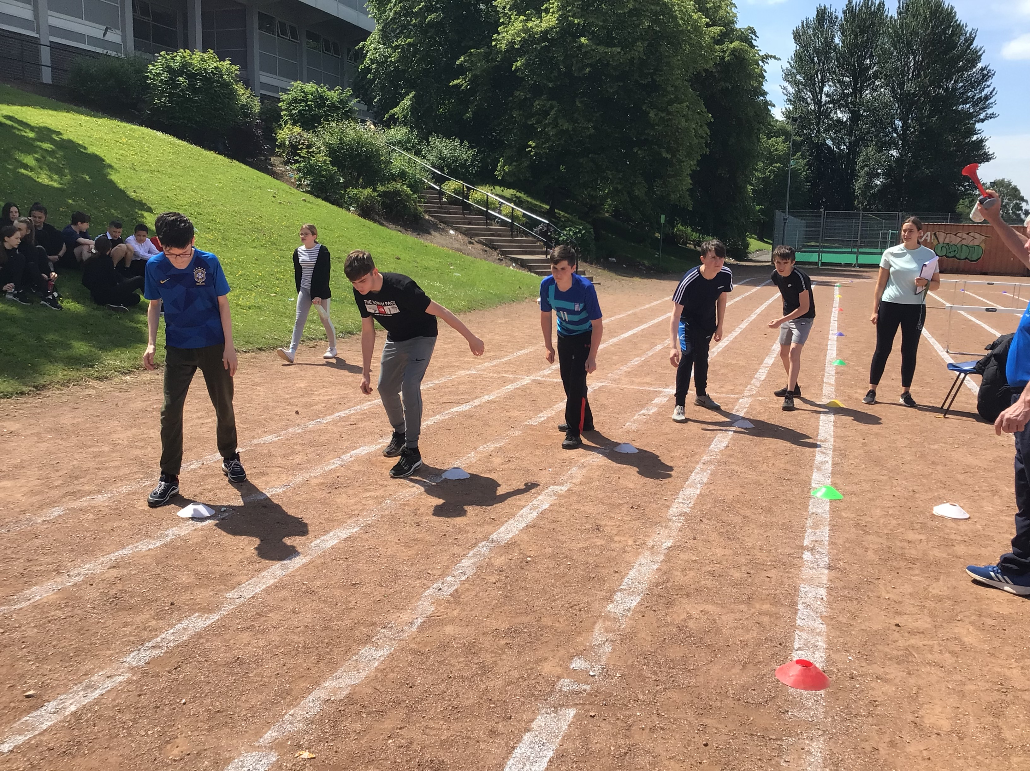
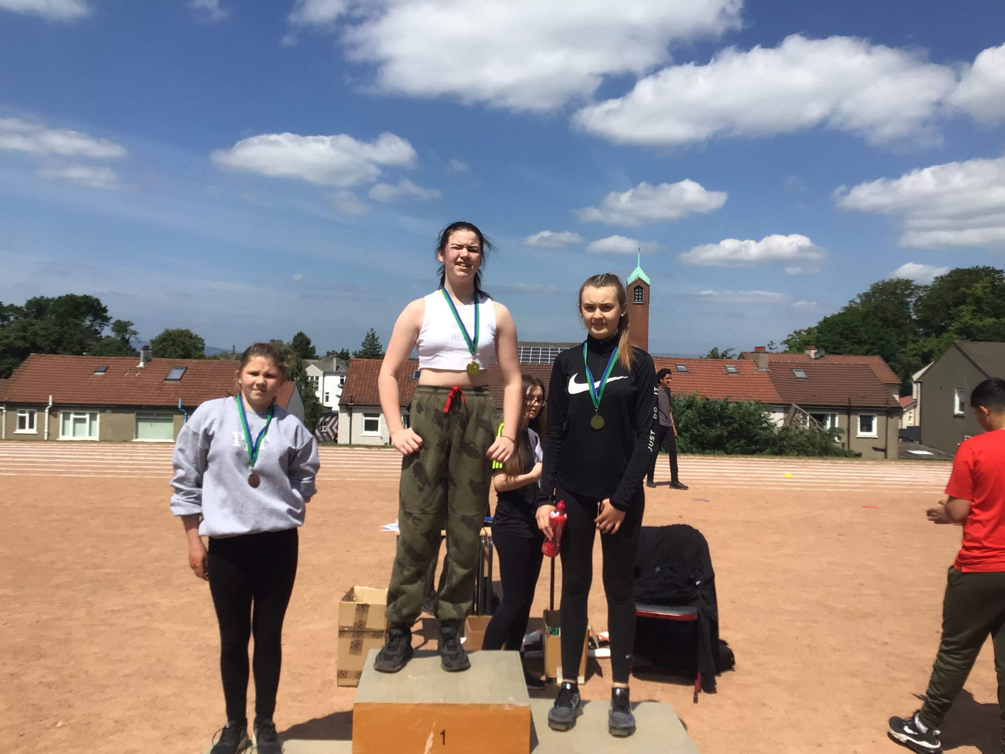
Each month your House will score either:
20 points – 1st Place
15 points – 2nd Place
10 points – 3rd place
5 points – 4th place
These House points and the overall running totals will be announced over the Tannoy by the House Committee at the end of each month to keep you informed of the scores.
When we get to June all of the House points won throughout the session will be added to the points you win on Sports Day. This will give us our overall House Champions. Champions will be announced at the end of Sports Day along with the presentation of the House trophy!
Be sure to represent your House as much as you can each month as well as at Sports Day! Every point counts – Good Luck!

Slide 9
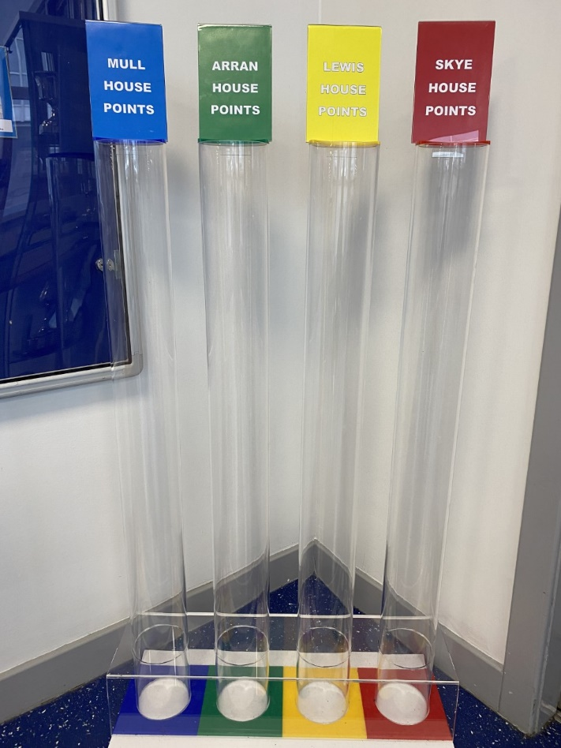
Finally
Outside the school office you will be able to keep track of what House is in the lead each month by the number of tokens in the House Jar.

