Slide 1
toxic stress, Triggers and timeout

Slide 2
Focus of wellbeing workshops
1) Our Environment: Emotional Triggers as Teachers
2) Our Values: Our actions based on our belief system
3) Our Skills: What resources do we require to support traumatised young people while avoiding burnout?

Slide 3
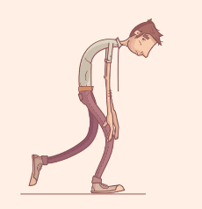
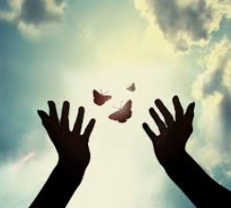
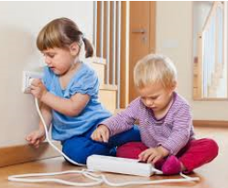
Our Environment What does toxic stress mean for staff and our emotional regulation?
Notes:
Just like young people and adults that have been exposed to ACEs growing up it is also possible for us a human beings to experience toxic stress from both our work and home environment.
If we are constantly trying to perform in a highly tense or overly productive environment that is unmanageable for us we will exist in a state of toxic stress and fear.
This mental, physical and emotional state forces our limbic system to constantly realise hormones that will put out bodies in survival mode and that in itself pollutes our minds therefore we cannot function.
If this becomes our new NORMAL, we will begin to BURN OUT!

Slide 4
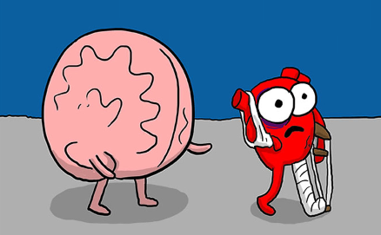
IT SHOULDN’T BE LIKE THIS…
BUT IT IS! So, what are you going to do about it?
Notes:
It shouldn’t be like this has been a reoccurring phrase in my head hearing about unfortunately circumstances and hearing of events in the school and community that have happened and it was even more clear and made even more sense after I watched the ACES video. Only, I didn’t feel as hopeless.
Which then made me feel quite fired up knowing that I know I could make a difference or maybe just an improvement for some young people.

Slide 5
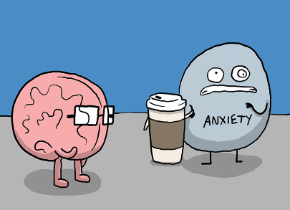
Eh…What do I do?
Maybe my need for COFFEE will just get me through…

Slide 6
My triggers
Watching pupils talk to each other negatively
(bullying/having a joke)
Sneaky bullying
Unsafe corridor conduct- especially on the stairs
When pupils answer back as if they are talking through teachers as if they are walls
Refusal to follow instruction when I know that they know better
Taking it personally
Pupils not taking the support they need
Pupils being unprepared for class.
Notes:
I is important to be aware of your triggers and be mindful and conscious about them to allow a rewiring of your reactions and responses.
Link this to values and responding in a way that you can model the type of behaviour or reaction that you would like. Motivate others!

Slide 7
Scenario decipher reactions and responses of teacher and pupil.
Pupil A enters the room and is blocked by the chair of Pupil B.
Pupil A swears and asks that person to move in a way that is inappropriate.
Teacher speaks to pupil about being patient and safe and how language is not acceptable, appropriate or kind.
Pupil A swears at teacher to articulate their sense of injustice.
Pupil A shoves pupil B at full force into the desk. Teacher shouts at pupil to get out of the class.
Pupils in the class are unsettled.
Teacher speaks to the class about entering the room and asks the rest of the class to give examples of how to speak to others.

Slide 8
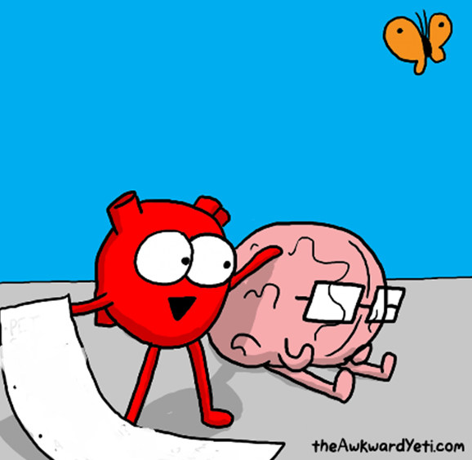
Our Values
Taking time to remember why we do what we do can emotionally recharge us and give us a focus of our next plan of action!
CENTRE OURSELVES WITH OUR VALUES
-our faith
-our passion for our subject
-valuing the relationships we have with staff and pupils
Love music
Pupils need to enjoy school
Want to have fun
Pupils need to make friends
Notes:
It is really hard to find motivation when we are tired and emotionally drained, but taking time to remember why we do what we do can emotionally recharge us and give us a focus of our next plan of action!
CENTRE OURSELVES WITH OUR VALUES
I know that I cannot teach my subject until every young person feels that they are on a level playing field with everyone else in the class.
Everyone knows the expectations
BUT WHAT GETS IN THE WAY??

Slide 9
Our Skills
Reflection is integral in any lesson to plan for improvement- we do this anyway!
Model the types of behaviours we want to see in young people.
E.g. – I’ ve been known to shout at a pupil, “How dare you shout across the room at another pupil!”
Embed Social Targets into the learning- Its not just what we learn it is how we learn.

Slide 10
I will communicate my feelings by… | Asking for help Asking for clarification Helpful talking Asking questions Being self-controlled (not using hands or feet or nasty language) Describing feelings when appropriate First considering my tone, volume, facial expression, body language and gesture | Put up your hand to get teachers attention Approach an adult if you have a concern or a worry that you don’t want to speak about in front of the class Think about your words and how you say them before you speak to a teacher or a pupil
I will be responsible for my actions by… | Trying to resolve conflicts positively and calmly Managing and looking after resources and materials Responding to consequence maturely and discuss disagreements calmly Moving quietly to groups | Count down from 10 -0 and wait until I am ready to talk to someone else in case I hurt someone’s feelings or cause harm Tidy up after my classwork by putting things away safely and in the correct place Listen to teacher when a consequence is being explained for my actions

Slide 11
“The only thing I have control over is my interactions with others… I need to adapt all the time …”
How can I teach YP these behaviours when I have to get through course content…
EXPLICIT: Musician Manners/Social Targets linked to Values.
REALISATION
My pupils are not learning at a rate or quality they could be.
REFLECT
REWIRE
RECHARGE
I need time to do the things I enjoy and spend time with the people I love.
I want to finish that painting off.
I am dying to see that new movie

Slide 12
HOW DO I REFILL AND RECHARGE?
I sometimes need to talk it out with someone that understands, but sometimes its important to talk to someone who doesn’t, so you can get a better or an external perspective
Play piano!
Breathing exercises
Sleep ☺
Paint my nails!
Cook a special meal and take time over it
I listen to music
I go to the gym
Watch an intense thriller film
Dairy Milk

Slide 13
Wellbeing Sessions
We will now break into our wellbeing sessions.
Session 1 will be at 1:10-1:55
Session 2 will be until 1:55- 2:35
We will then come together in the street area at the end of the day to complete our evaluations sheets.
ENJOY SOME TIME TOGETHER!

