Slide 1




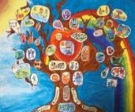


Ibrox Primary School & Nursery Class
P1 Induction Session (1)
19th May 2026
11-11.45am

Slide 2
Welcome from the
Leadership Team!
Mrs Fiona Young– Head Teacher
Gail Chalmers – Depute Head Teacher
Jennifer McGhee – Principal Teacher

Slide 3
Welcome from staff!
* Emma Hanks – P1 Teacher 25/26 *
Asma Rana – SfLW
Louise Fullerton – SfLW
Jennifer Heredia – SfLW
Kelsey Kennedy – Nurture teacher

Slide 4
Today…
11 – 11.45am
Children – time to play in the classroom
Parents/carers – presentation about Ibrox Primary School / option to visit the Dinner Hall / paperwork to be completed / questions

Slide 5
Let’s get to class!!

Slide 6

Welcome video…made by our Digital Leaders
Some thoughts from our current P1s…

Slide 7


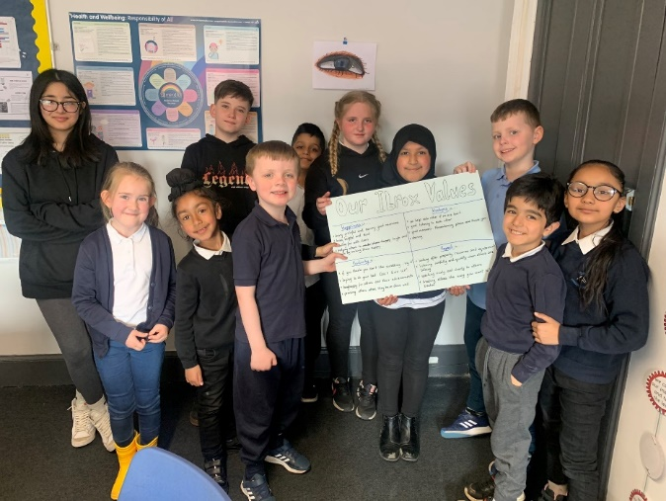
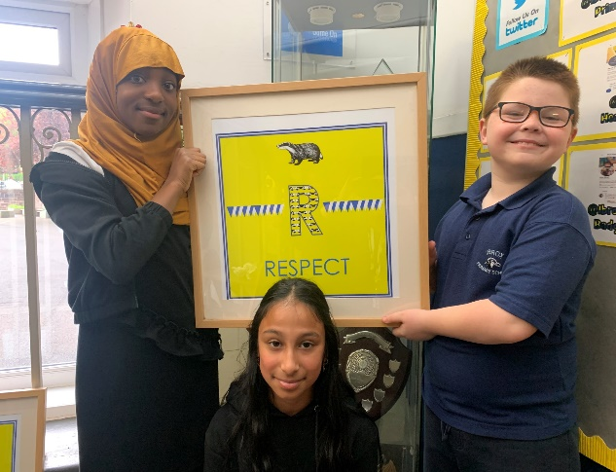
Meet 2 members of our JLT who are going to tell you about our Ibrox Values

Slide 8

Children return to school on Wednesday 12th August 2026.
P1 children will start at 9.30am & finish at 2.30pm.
The children will be in full time after this however please speak to staff if you are concerned about this.

Slide 9
School Day
School starts: 9am
Playtime: 10:30 - 10:45am
Lunchtime: 12:15 – 1:00pm
Home: 3:00pm

Slide 10

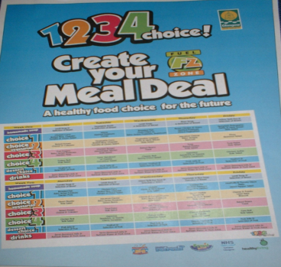
Lunchtime & playtimes
All children in Primary One are entitled to a free school meal.
Your child may stay for a school lunch, packed lunch or go home.
Please ensure that your child has a healthy snack for playtime and bottled water, please no fizzy drinks.
Website for information: www.fuelzoneprimary.co.uk
Menus also available on our app

Slide 11

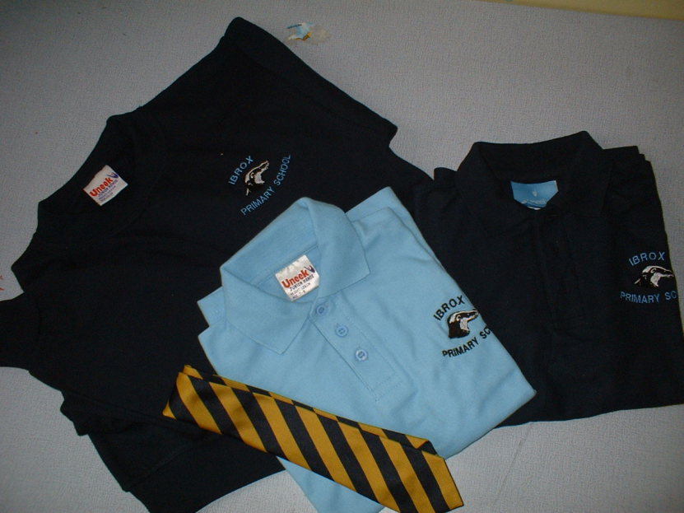
School Uniform
The uniform is:
White or pale blue shirt and tie or
White, pale or navy blue polo shirt
Navy sweatshirt with school logo
Grey or navy trousers
Grey or navy skirt
Navy joggers
Please ensure all items are labelled

Slide 12


Communication
Our school blog can be found- https://blogs.glowscotland.org.uk/gc/ibrox/
SEARCH – IBROX PRIMARY BLOG

Slide 13
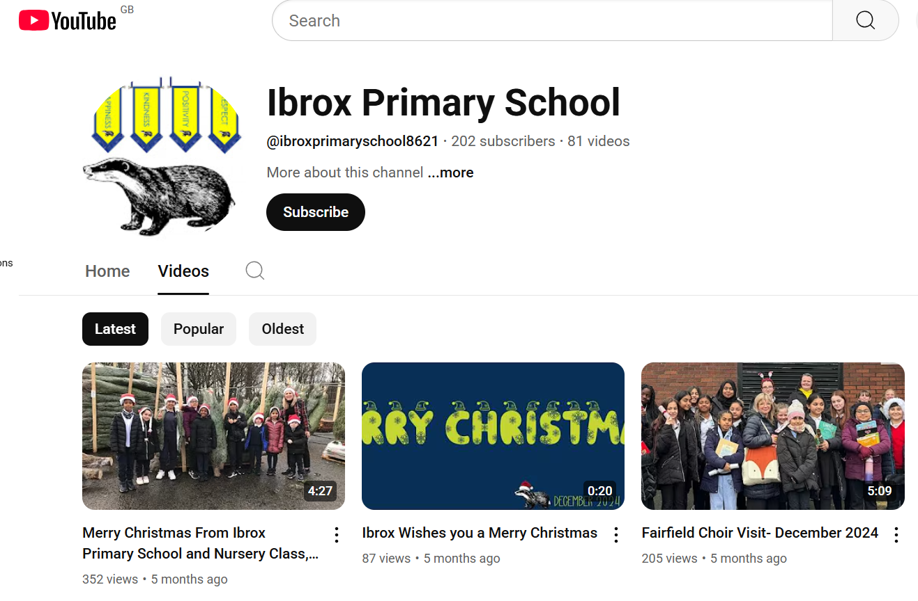
Communication
SEARCH – IBROX PRIMARY SCHOOL YouTube

Slide 14




Communication

Slide 15
Next visit -
Tuesday 2nd June
1.30pm
Children – Fun in the sheds followed by a Teddy Bear’s Picnic with their buddies in the playground. Don’t forget your teddy!
Parent/Carers- School tour from JLT, information tables, including information on uniform suppliers & time to look in Early Level classroom.

Slide 16
Questions?

Slide 17
Paperwork completion

