Slide 1

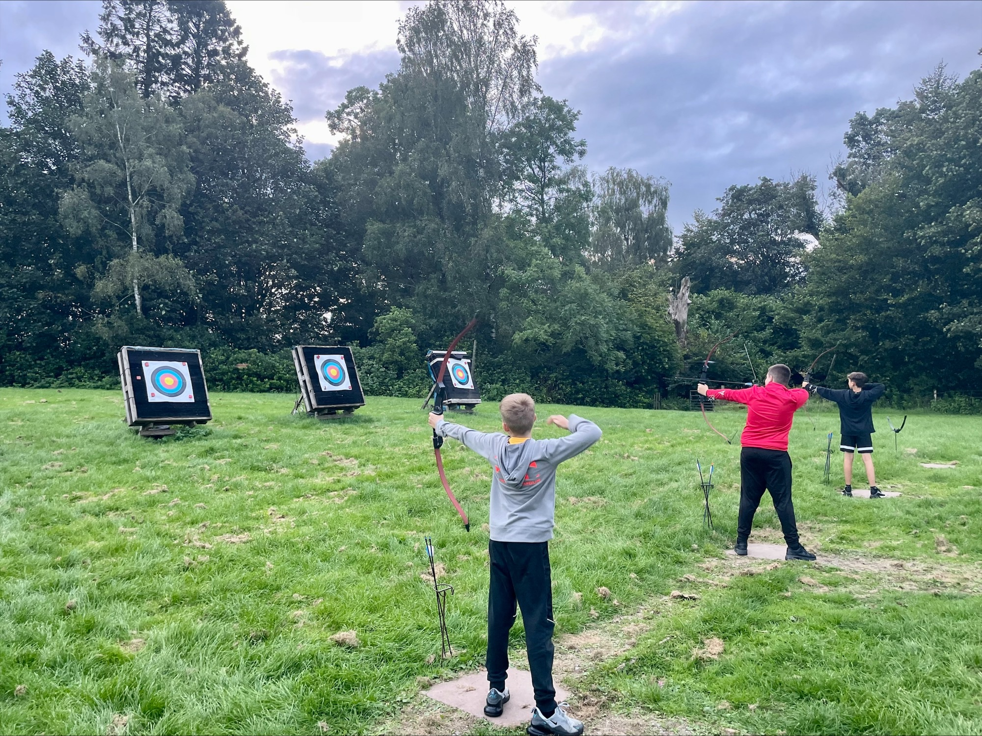
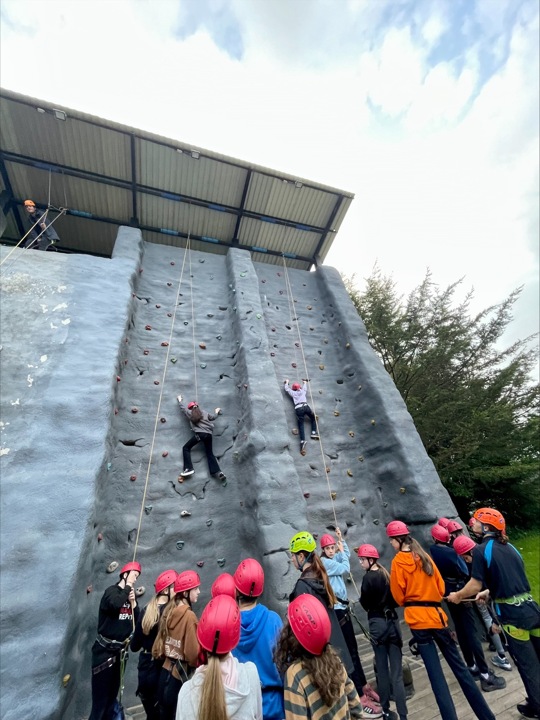
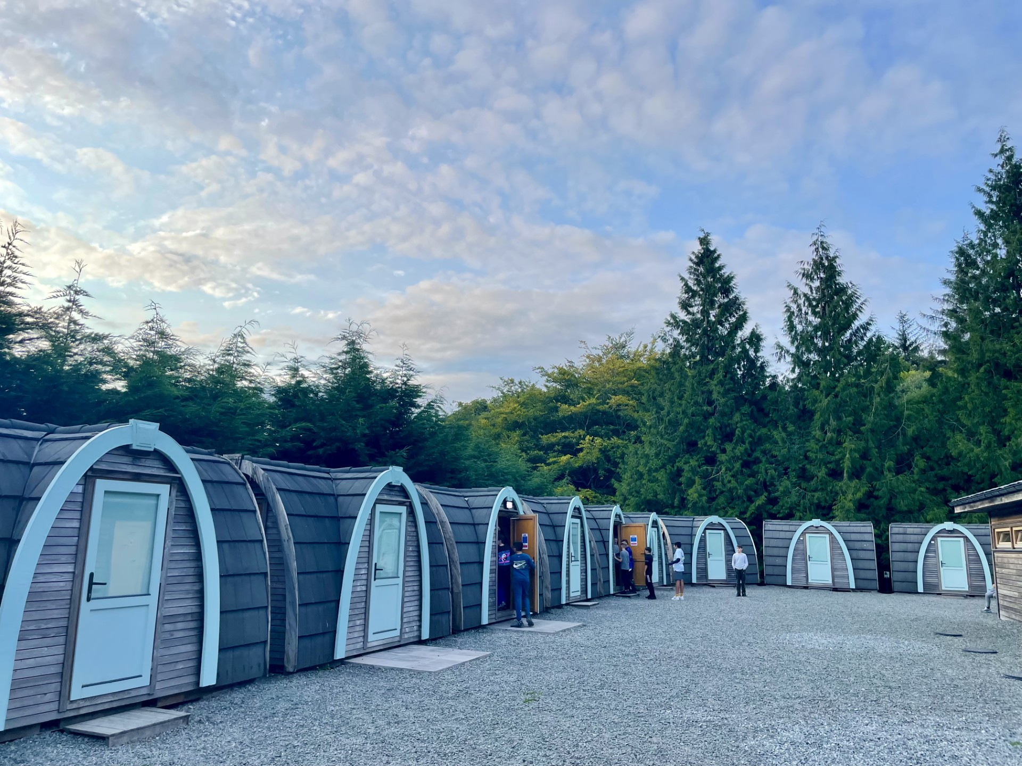
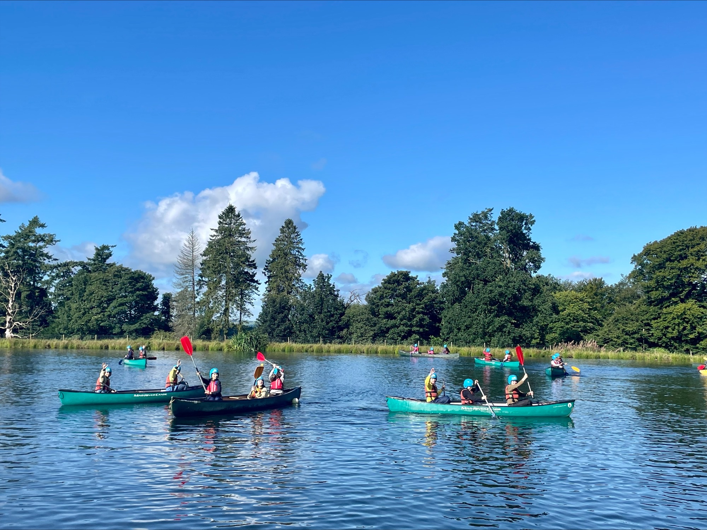
Welcome Parents/Carers
S1 Residential Trip
Information Session
Be the best version of yourself

Slide 2

Lockerbie Manor Activity Centre
Lockerbie Manor, Lockerbie DG11 2RG
Wednesday 30th Sept – Friday 2nd October
The main aims of the trip is for our new
S1 young people:
have fun! ☺
make lifelong memories
learn about and demonstrate our school values
build relationships with peers from house and practical group
develop team-work skills, confidence and resilience

Slide 3
Payment and Consent
Final payment is due by Friday 18th September via ParentPay.
As of today we have paid the full amount to Lockerbie Manor so cannot provide any refunds if a pupil wishes to pull out at this late stage.
Please complete consent form ASAP providing details about medication, allergies, dietary requirements etc. no later than 3:00pm this Friday 11th September.

Slide 4

Kit List - Luggage
Please restrict this to one case/rucksack/holdall plus one piece of hand luggage.
Metal framed rucksacks should be avoided as they are difficult to fit into the coach
Please make sure your child can carry their own bag

Slide 5
Kit List – What to pack
Freshly laundered sleeping bag, pillow and pillow case
A drink bottle (essential in summer)
Torch (a necessity for evenings)
Washbag and toiletries
  deodorant must be roll-on, no aerosols or glass bottles
Large plastic bag for dirty clothes
Towels x 2 (1 for showering and 1 for water activities)
Sunglasses, sun cream and hat depending on weather

Slide 6
Kit List – Clothing
Old clothes for activity sessions:
  least 3-4 sets for the 3 days (allocate 1 set for water activities (2 layers) and 1 set for muddy activities
  Long-sleeved shirts/jumpers, trousers / jogging bottoms (NO denim jeans), T-Shirts and closed-toe shoes are required for nearly all sessions so bring plenty. Lots of underwear & socks (ankle or above). Clothes, shoes and underwear for other times.
Shoes - at least 3 pairs; 1 for indoor, 1 sturdy pair and 1 pair for wet activities
Waterproof Jacket (Trousers are handy too)
Pyjamas and indoor shoes / slippers

Slide 7
Kit List - Useful Items
Books, playing cards and other quiet activities
Money for snacks (sweets & drinks) and souvenirs (e.g postcards).
Marshmallows for toasting ☺
Coins not notes – maximum £10.

Slide 8
Useful Notes
No wellies
Please name all clothing
Demin jeans are not allowed on any activities
No glass containers
No jewellery, including piercings (except for stud earrings)
No mobile phones
Manor Adventure can’t accept liability for the loss of any personal property brought to our centres – so please don’t bring any valuable items, expensive clothing and footwear, mobile phone, handheld games consoles etc. We’re unable to store them and they won’t be insured whilst on centre.
Manor Adventure cannot accept responsibility for any insect bites/infestations if brought in on clients’ sleeping bags/bedding

Slide 9
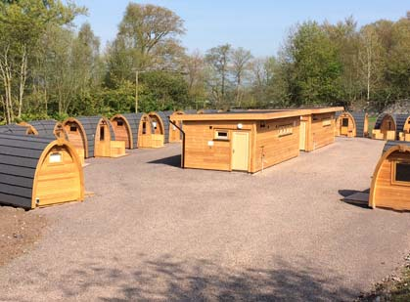
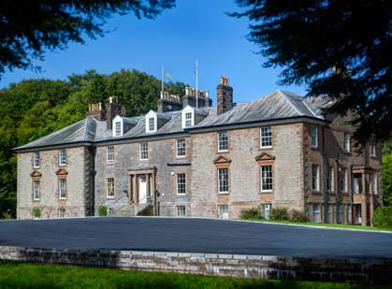
Rooms
Young people have completed a form to choose up to 3 pupils they would like to share a room with
Pods sleep 4 / dorms in the main house sleep 5 or 6.
We will ensure young people are kept together with at least one other person they chose.
They will find out their room allocation on arrival

Slide 10
Meals
Please ensure you note any allergies/ dietary requirements on Parent Pay to ensure the Centre can plan for alternatives.
Water @ 50p each
Drinks/chocolate/sweets @ £1 - £1.50 each
The centre only accepts coins – we advise young people bring a maximum of £10 with them and this is kept secure in a purse/ wallet inside their backpack at all times.

Slide 11
Activities
Canoe/Kayak
Climbing
Abseiling
Archery
Initiative Exercise
Blind Trail
Disco
Campfire

Slide 12
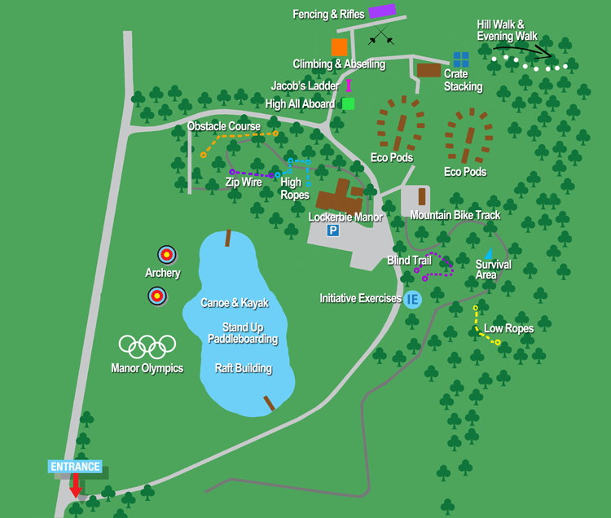

Slide 13
Staff
Mrs Wilson
Mrs Hayes
Jenny Wainright
Ms Fowlie
Ms Motion
Mrs Currie-Moodie
Mrs Ross
Mr Greer
Mr Carstairs
Mr Johnston
Mr Parsons
Mr Timpany
Mr Carroll

Slide 14
Expectations
Be the best version of yourself through modelling out school values
If staff have any concerns parent/carers will be asked to collect their young person.

Slide 15
Wednesday - Departure Plans
Arrive in school at 08:25 and report to Airlie Theatre to drop bags before heading to class at 08:40
No need to bring school bags as teachers will provide materials for morning classes
Attend period 1-4 as normal
Early lunch at 12:10
At 12:40 report to the Airlie Theatre to collect bags and start to board buses
Depart Hyndland no later than 13:00 with an approximate arrival time at Lockerbie of 14:30
Settle into rooms/pods then 1 activity before evening meal

Slide 16
Daily Timetable
School’s Discretion - Rise & Shine
See meal rota - Breakfast starts
09.15 – 10.30 - Outdoor Pursuit Session 1
10.30 – 10.55 - Break Time
10.55 – 12.20 - Outdoor Pursuit Session 2
12.20 – 13.45 - Lunch Time
13.45 – 15.10 - Outdoor Pursuit Session 3
15.10 – 15.35 - Break Time
15.35 – 17.00 - Outdoor Pursuit Session 4
17.15 – 19.00 - Evening Meal / Free time
19.05 – 20.30 - Outdoor Pursuit Session 5
Bedtime - At the discretion of the school

Slide 17
Friday – Return to Hyndland
Leave Lockerbie Manor between 13:00 and 13:30
Approximate arrival time of 14:45 – 15:00
Any delays will be communicated via email groupcall

Slide 18
Any questions?

