Slide 1
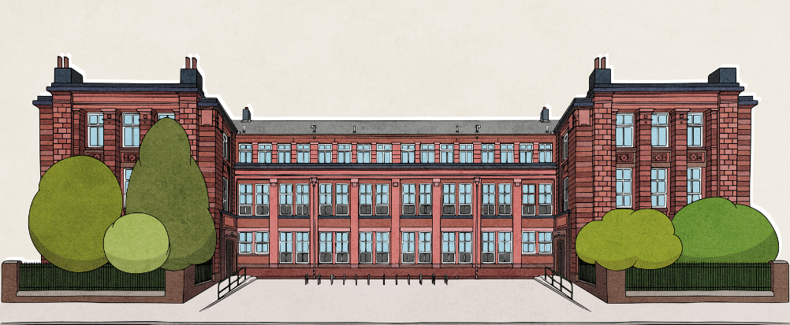


PRIMARY 7 INFORMATION EVENING
MAY 2026

Slide 2
Programme
Welcome, introduction Mrs Edgerton, Head Teacher
Supporting pupils with the transition to secondary school Ms Letford, DHT
The role of Pupil Support
Ms Black, Principal Teacher Pastoral Care
Principal Teacher Learning Support, Mrs McFarlane
The Hyndland Experience – S1 Pupils (Thaim, Joseph, Hana Mae, Emily, Zara)
Parent Council, Alex McTier
Fare Youth Worker, Jenny Wainwright

Slide 3

Our Vision & Values

Slide 4
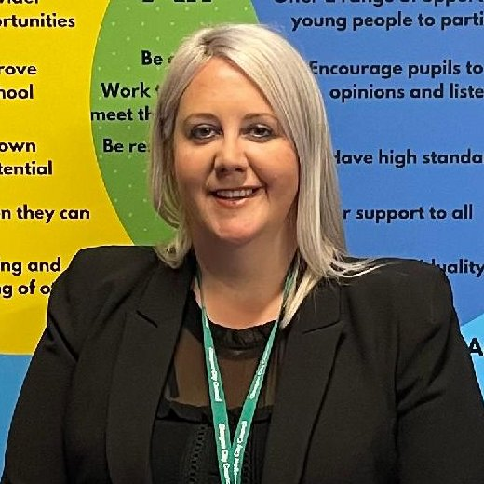
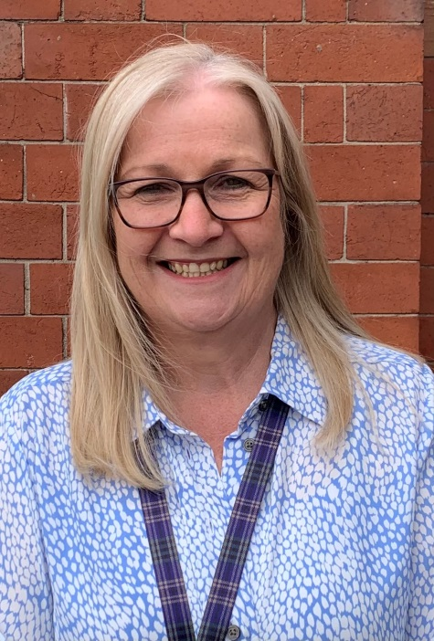
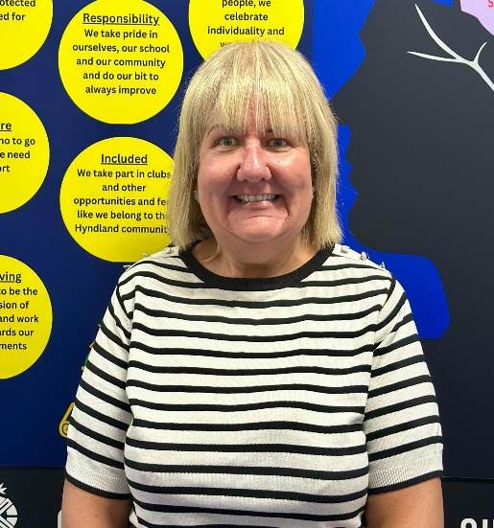
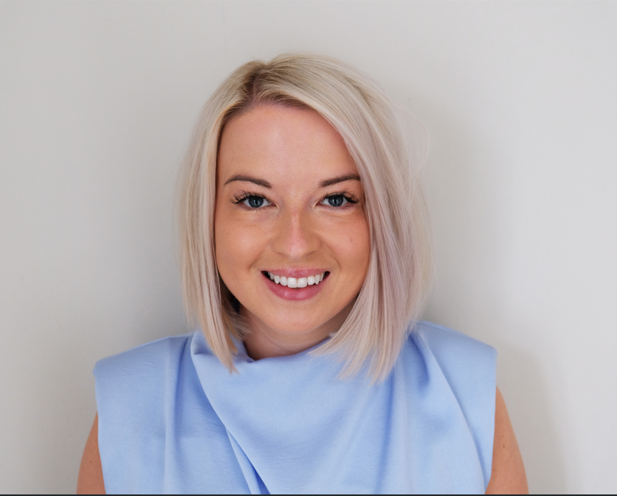
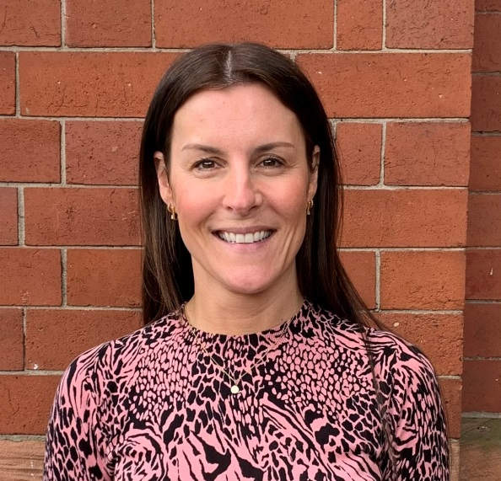
Our Senior Leadership Team
Mrs Edgerton
Head Teacher
Mrs Hayes
DHT Torridon House
Mrs Forrester DHT Katrine House
Ms Wilson DHT Lomond House
Ms Letford DHT Rannoch House

Slide 5
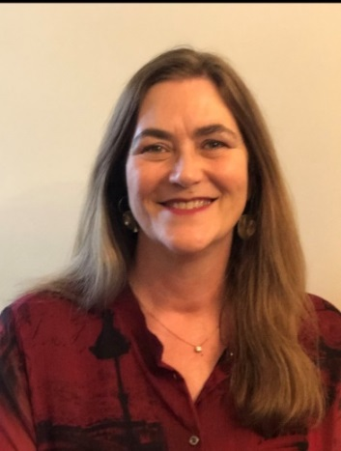
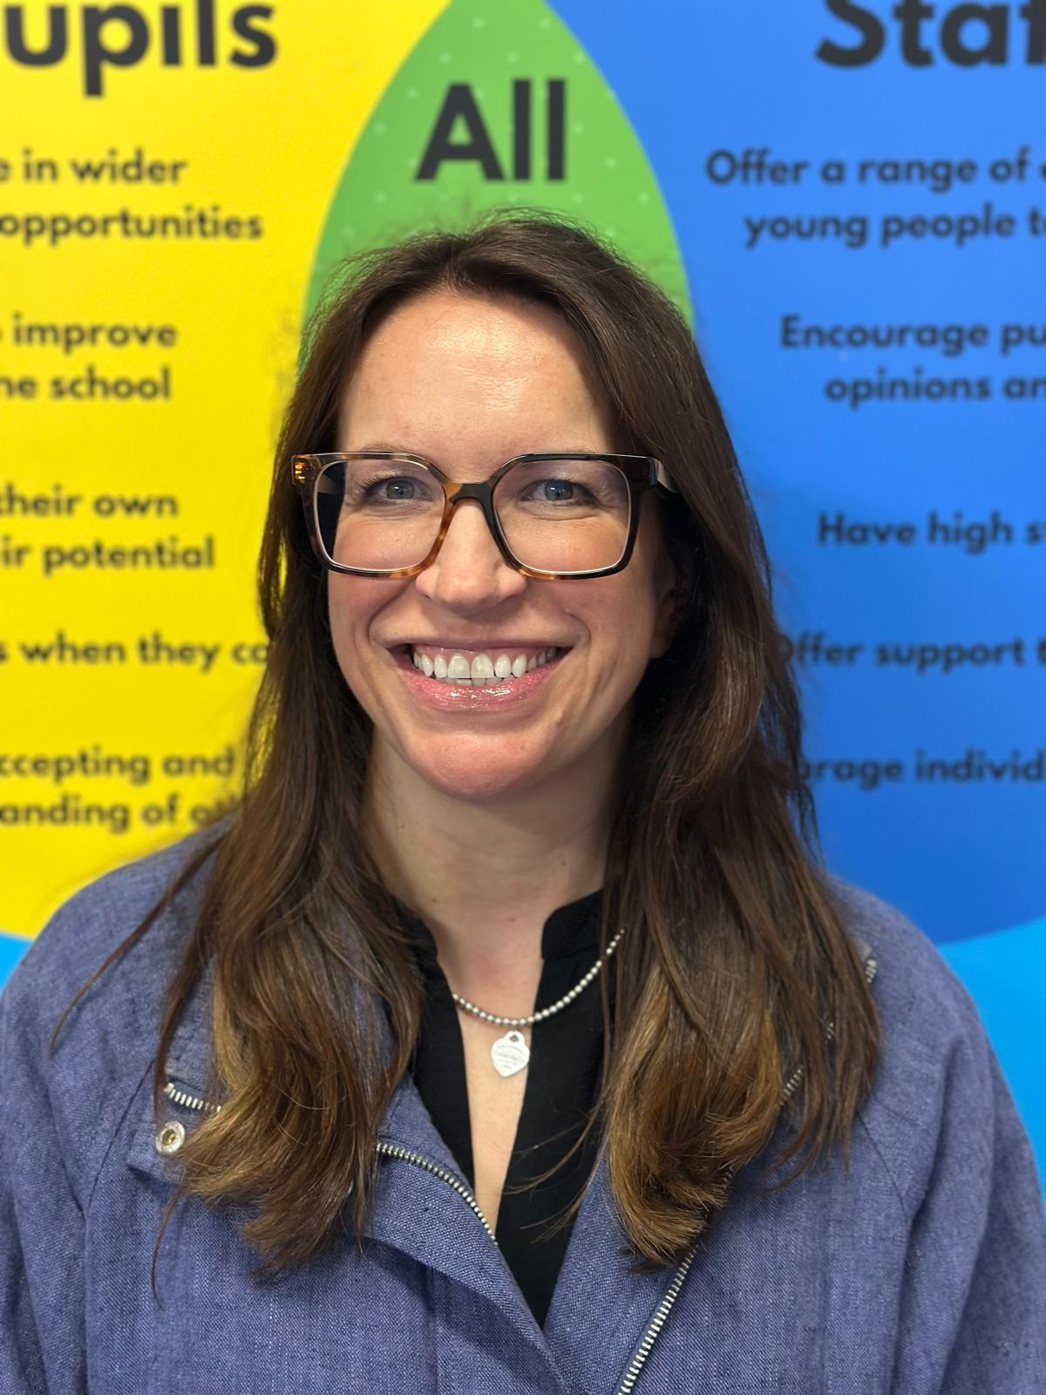
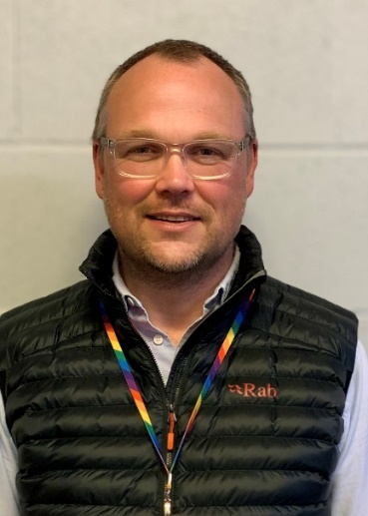

Our Pastoral Care Team
Mrs Mills Rannoch House
Ms Black Lomond House
Mr Carstairs Torridon House
TBC Katrine House

Slide 6
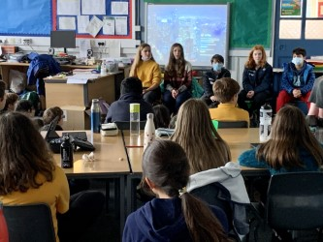
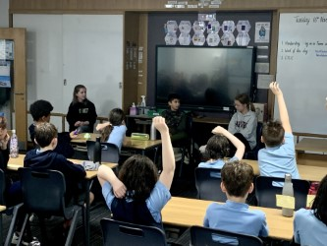
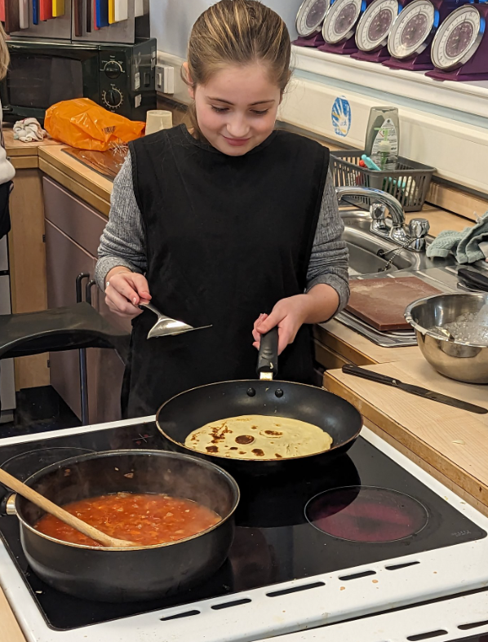
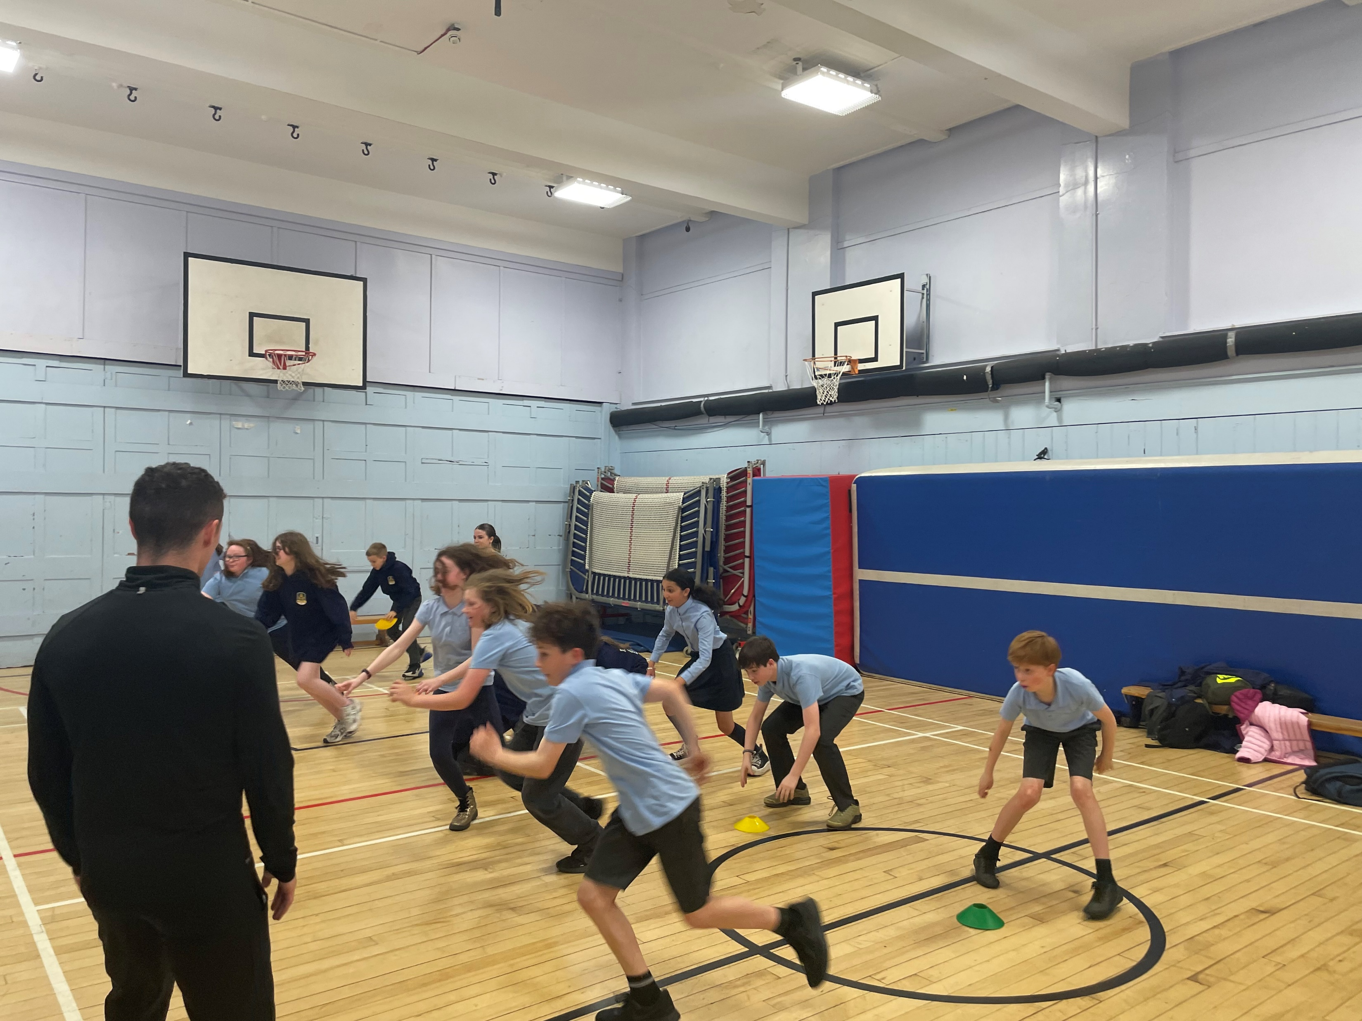
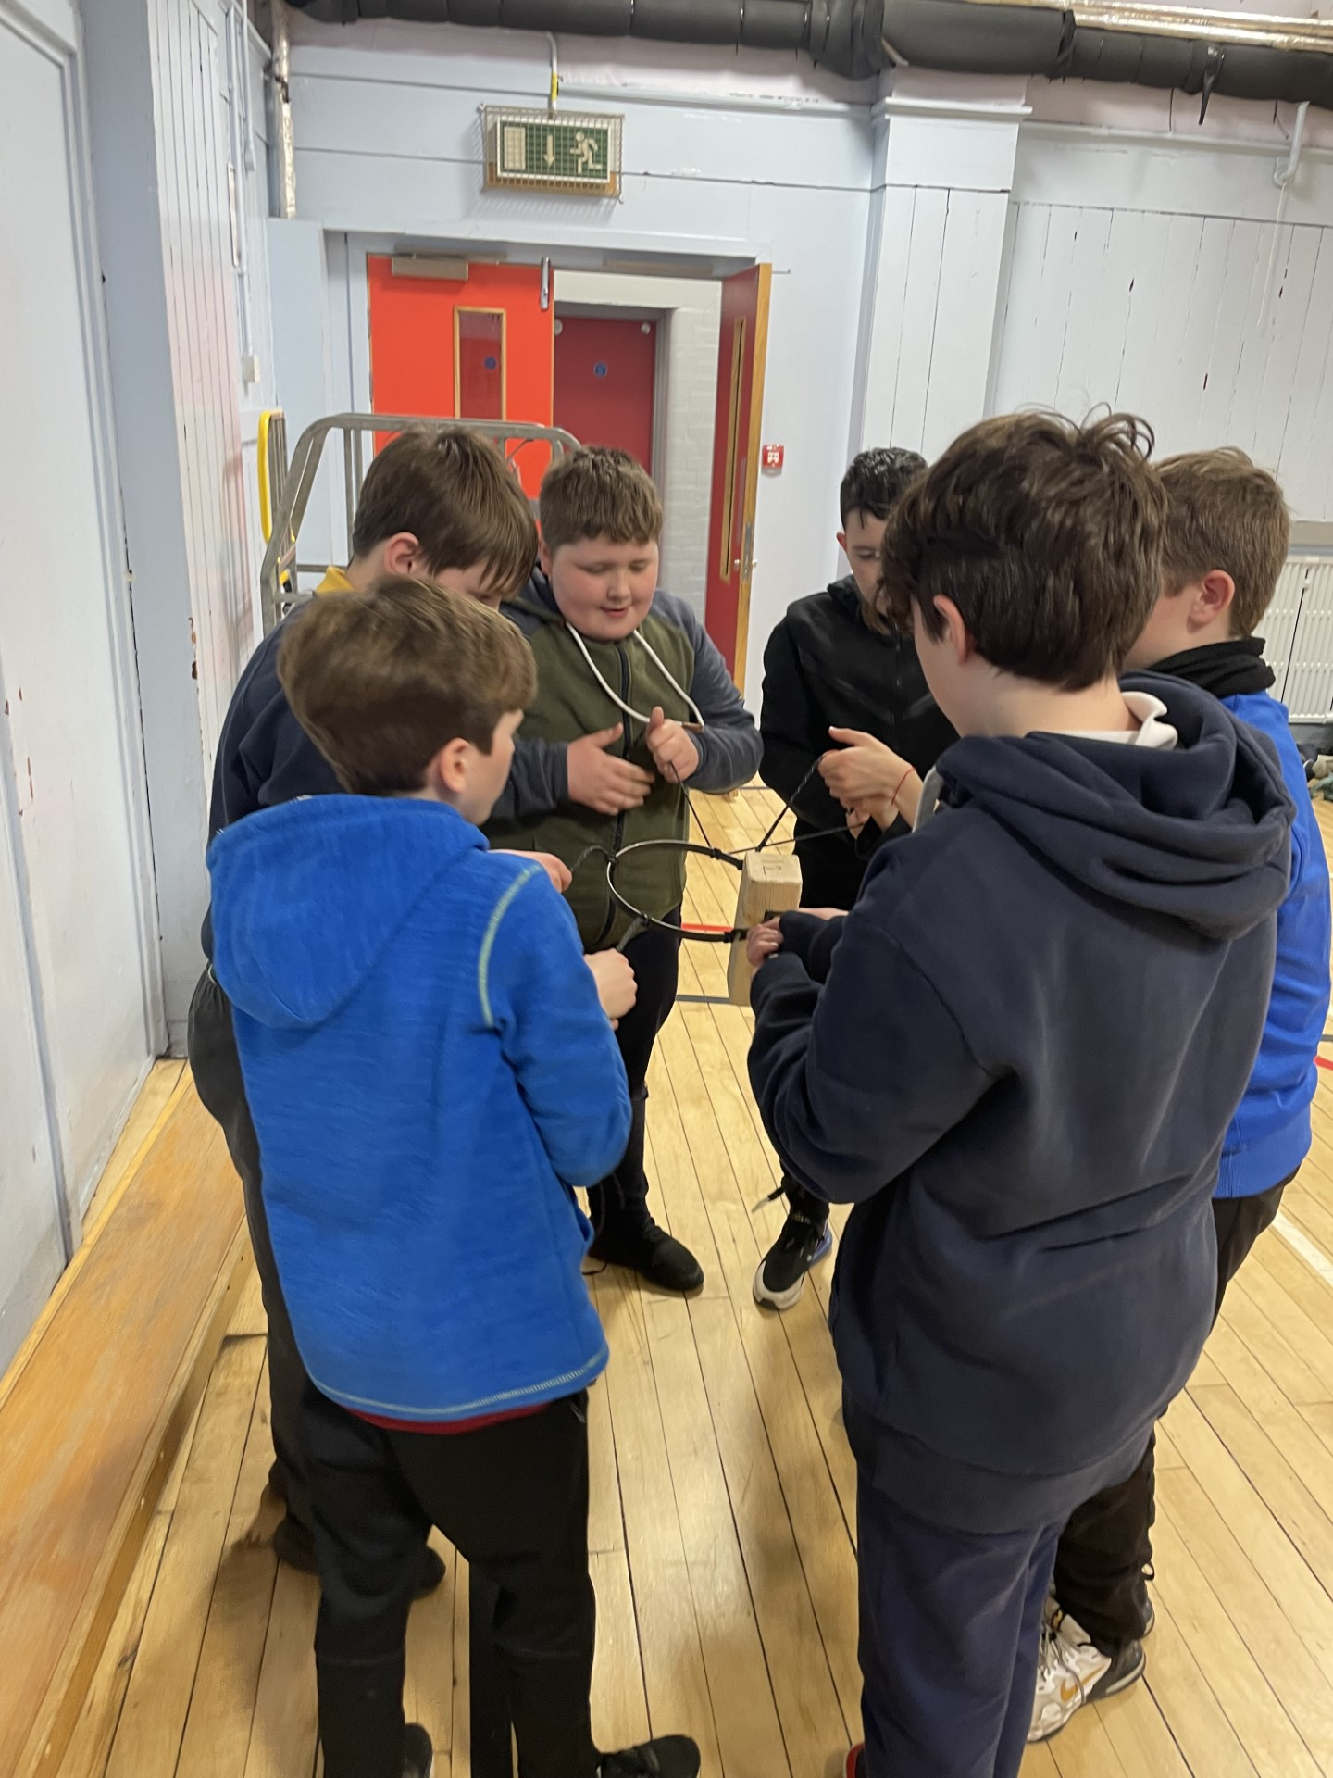
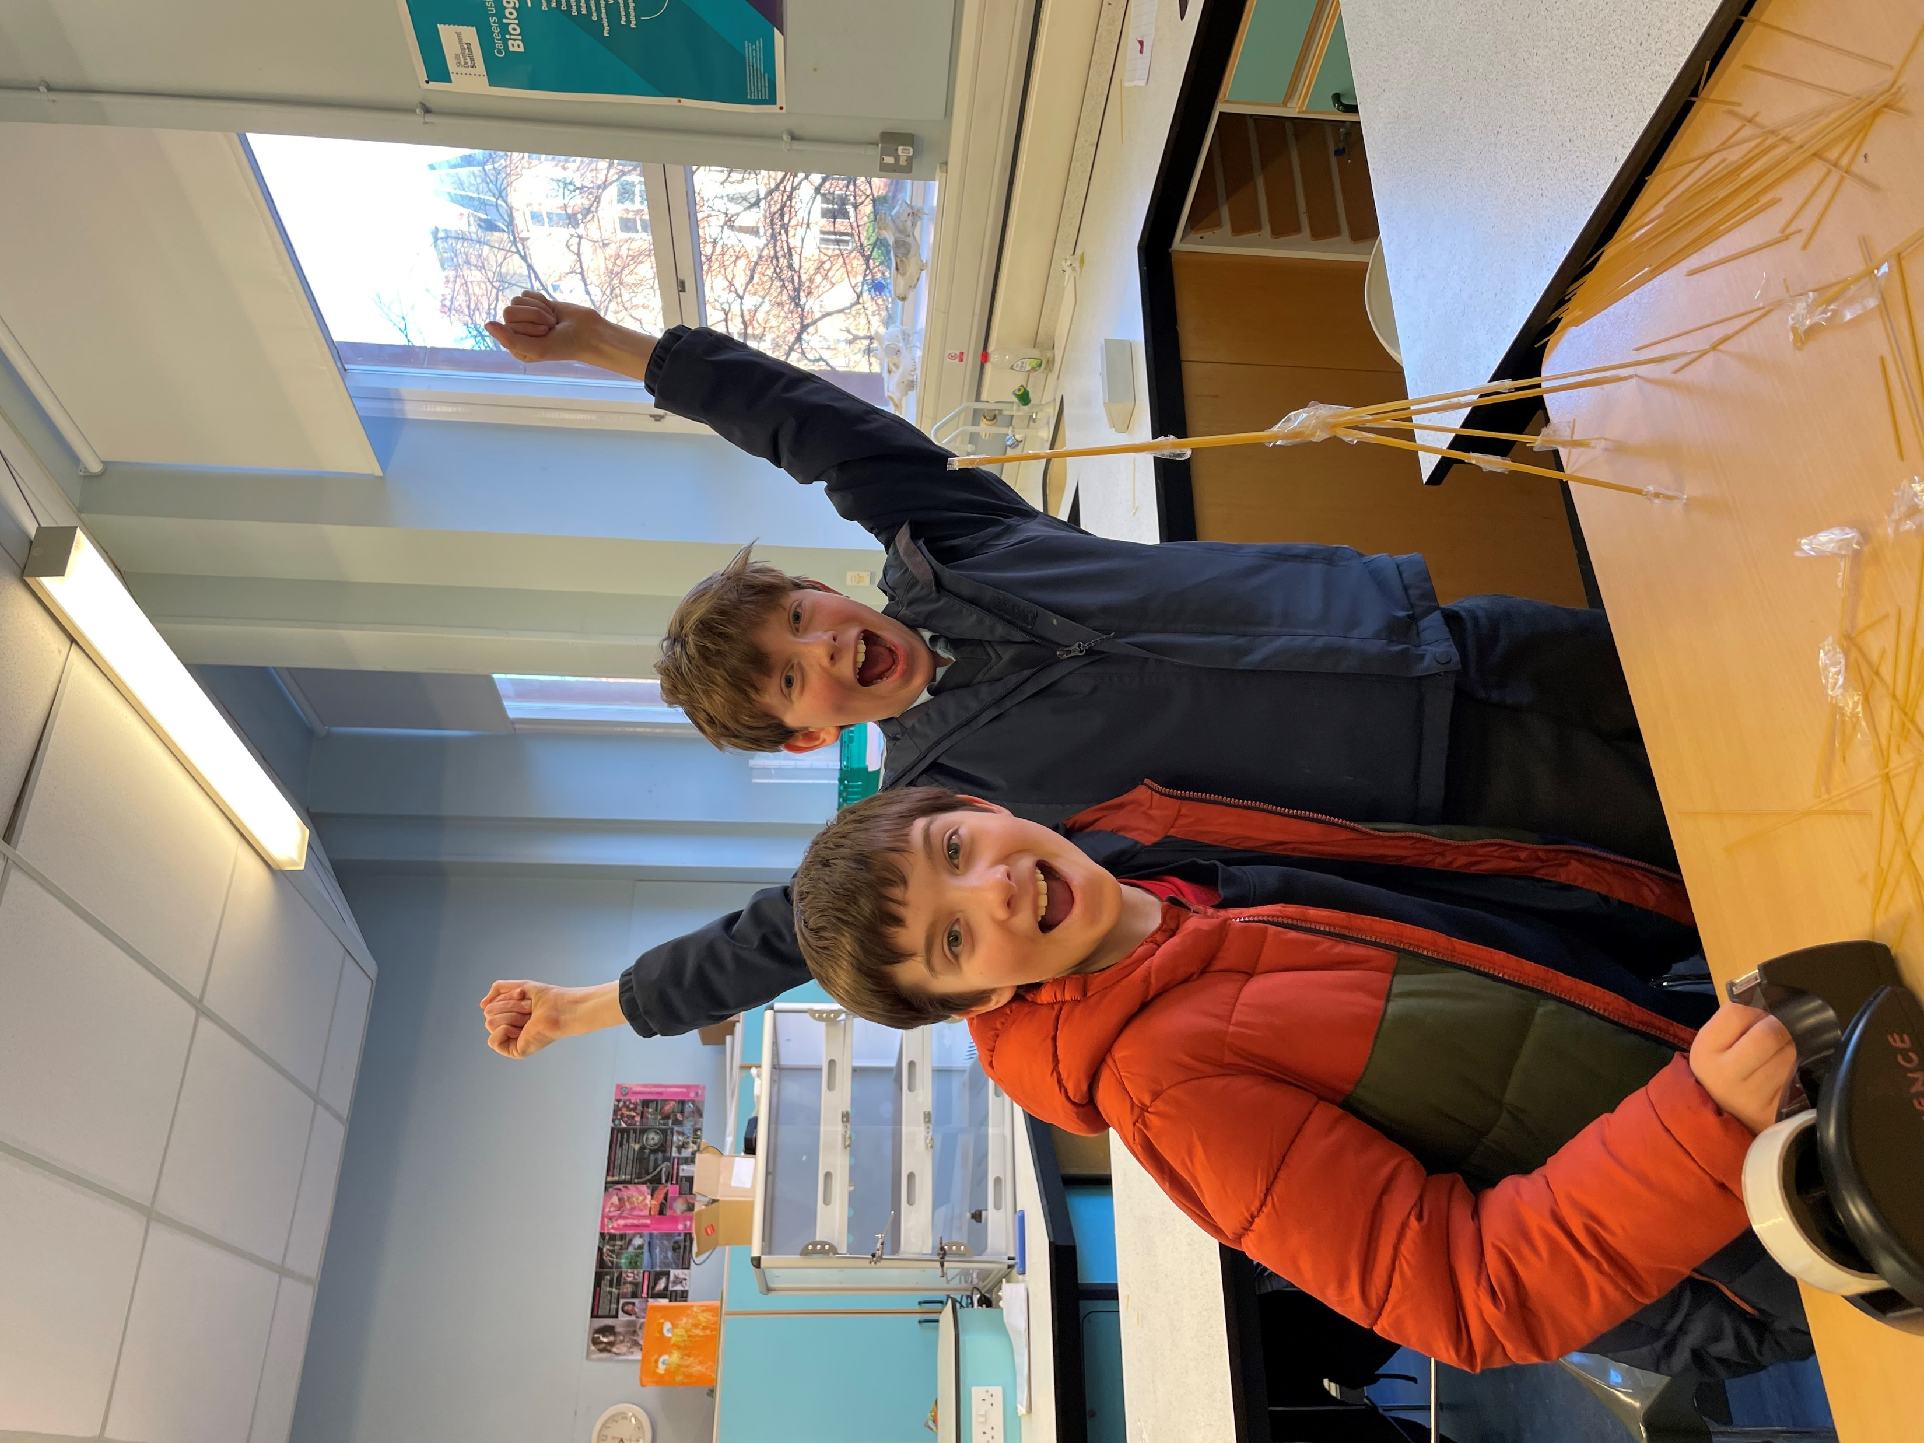
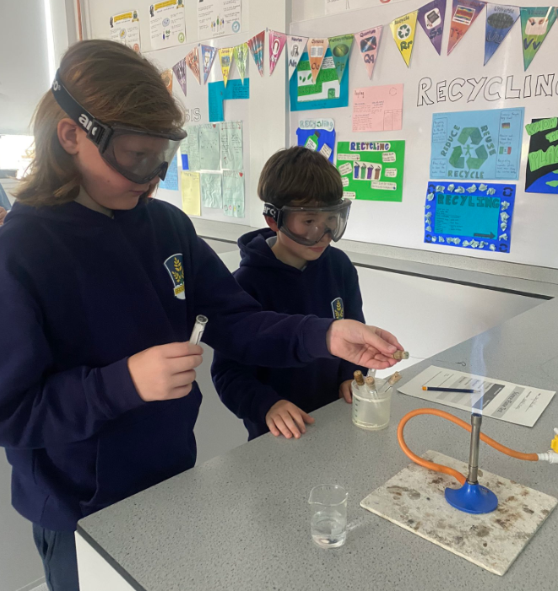
The Transition Journey so far…
S1 Question Panels with our four associated primaries
English teacher & language ambassadors
visits to primaries
Enhanced Transition Visits for p7 pupils
and parents/carers
After School Visits for All

Slide 7
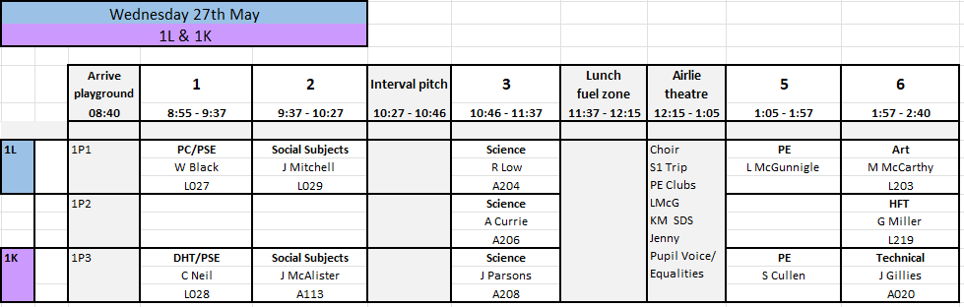
The Journey still to come……
S1 Induction Days – 27th , 28th and 29th May 2026

Slide 8
The Journey still to come……
After School Taster Lessons
- Microsoft form emailed 4th and 11th June 2026
Summer Activities Programme - Jenny July - August
Meet the Hyndland Family – by house group August
Residential Trip to Lockerbie Manor Wednesday 30th September to Friday 2nd October

Slide 9
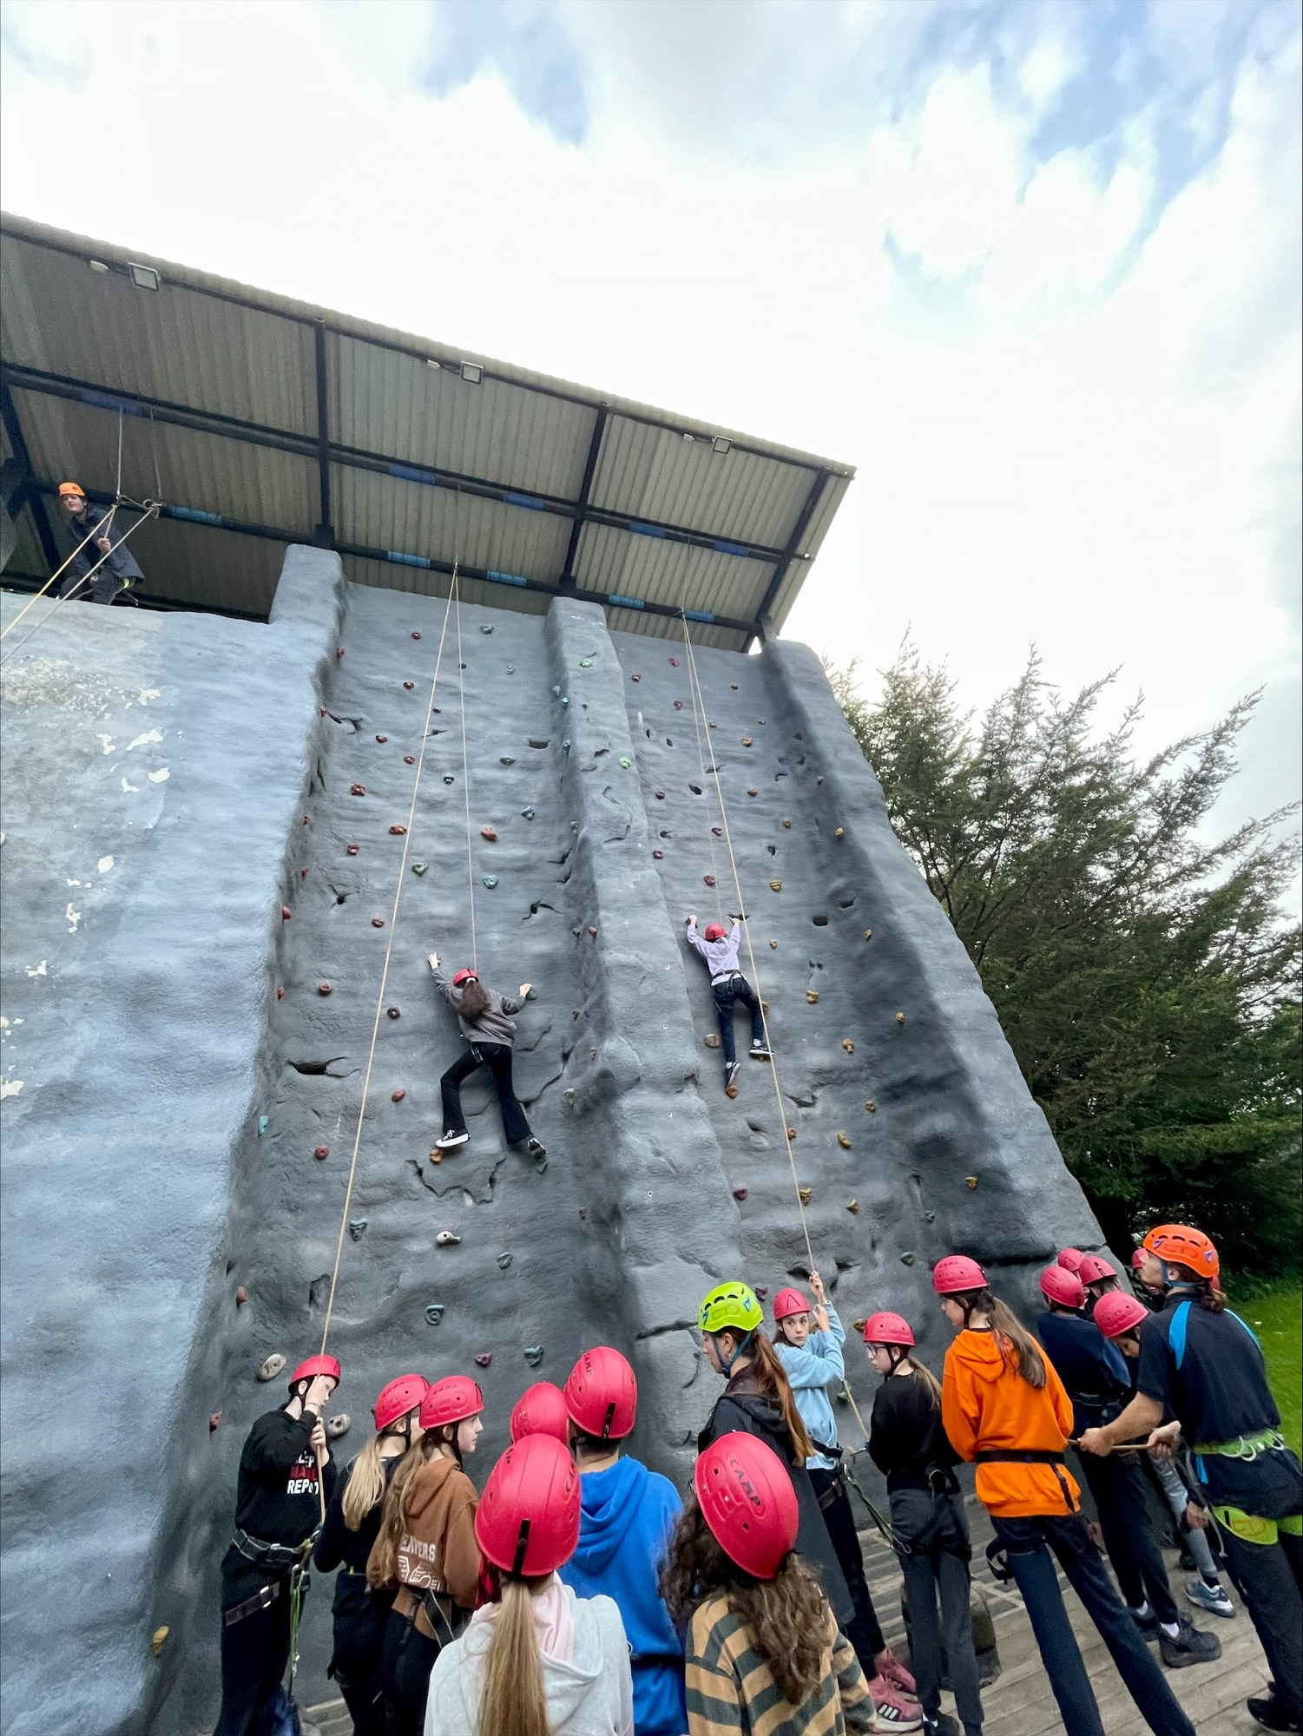
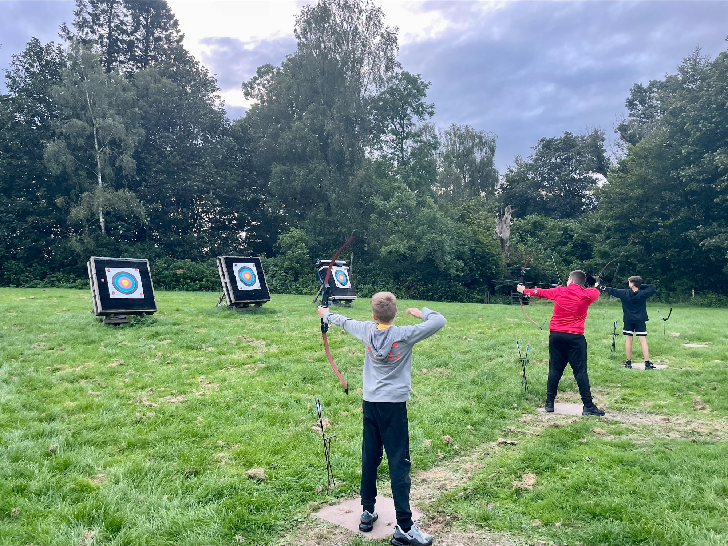
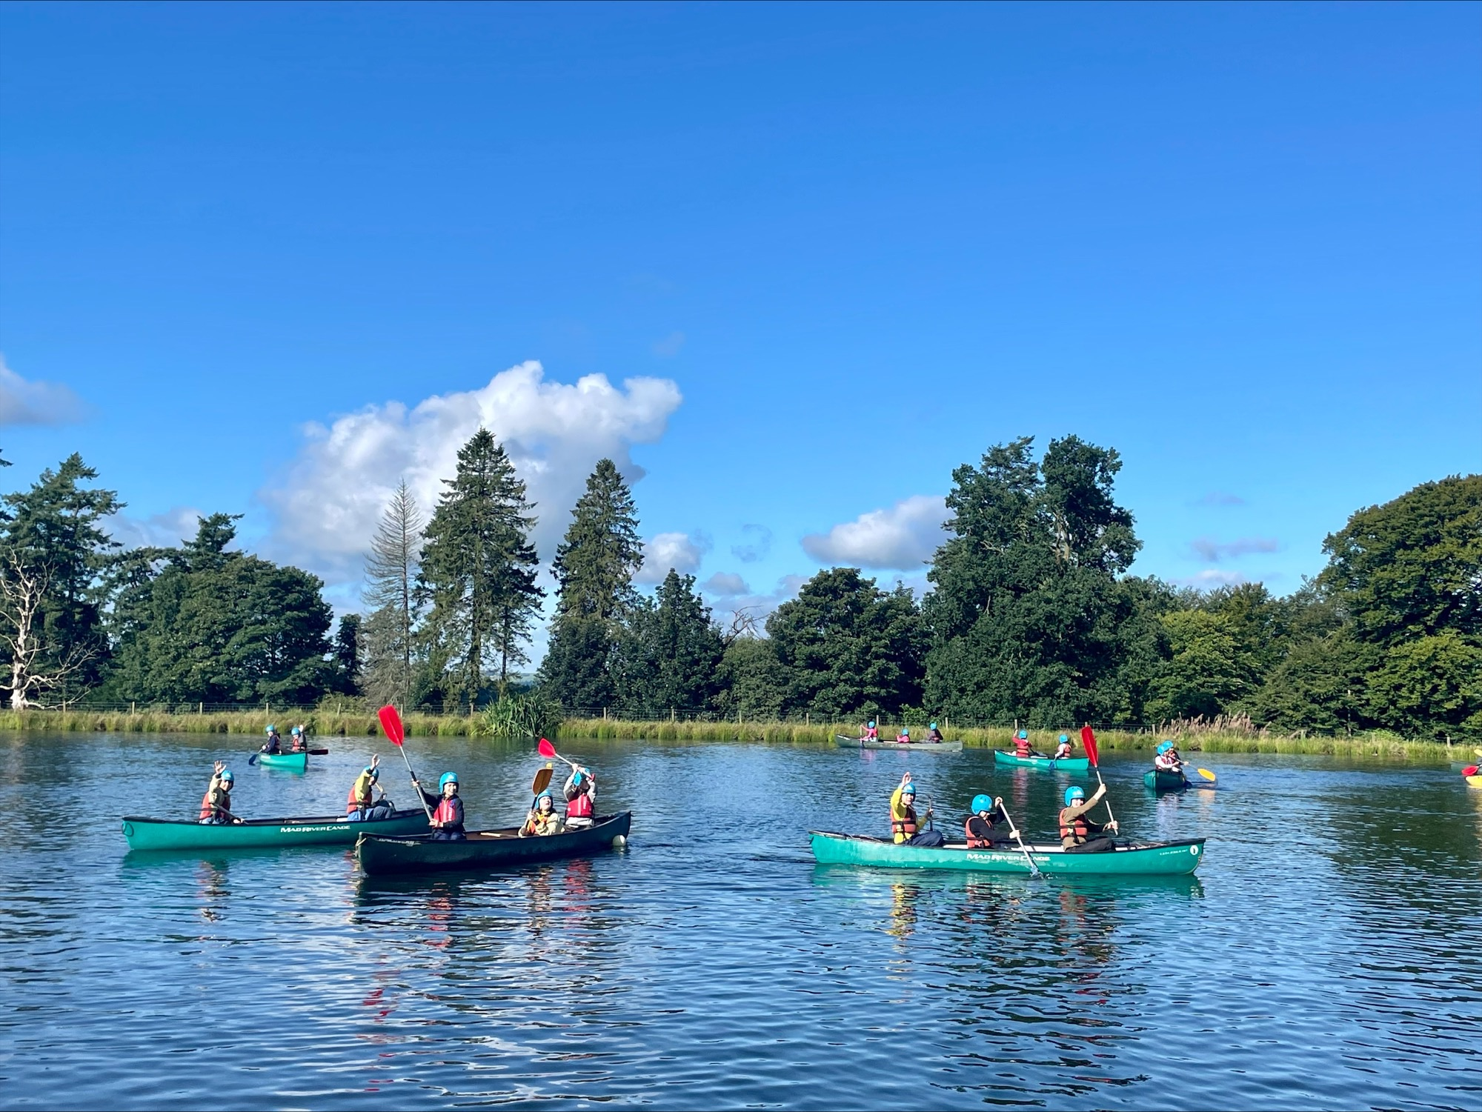
S1 Residential Trip
3 day/2 night trip to Lockerbie Manor
Obstacle courses, kayaking, climbing wall, raft building, archery
Building relationships, teamwork skills
Cost – £237
Finance should not be a barrier – school can support (microsoft form)
Deposit of £50 by Monday 1st June (cash to school office/ gym tonight)
Information Evening – Thursday 10th September 4pm

Slide 10
S1 Classes - Gathering of Information
Meetings between Ms Stewart (previously) and Miss McFarlane
Detailed information gathered on every P7 young person
Plan for supports to be in place for August
Share key information with staff

Slide 11
What information do we gather?
Working levels in all curricular areas
Progress within the level – are young people beginning to work at this level or are they making good progress within that level?
Additional support needs, strategies for support
Areas of strength, where to challenge
Pastoral information
Health information – allergies and other important information.

Slide 12
How we organise the classes
180 Pupils in S1 – best groupings for learning
If a S1 student has siblings at the school already we will try to maintain the house link as this works better for families.
At least one other boy/ girl from primary
20 pupils in practical class – for Art, Drama, Music etc
30 pupils in tutor class – Languages, Social Studies, PSE
Mixed ability classes
Some setting in Maths – not till October

Slide 13

Opportunities
Notes:
This S1 journey helps us understand the curriculum as a whole
The curriculum is structured around experiences that are planned as part of learning and teaching. This includes the curriculum areas and subjects, the school community and interdisciplinary projects. By recognising and planning learning around different contexts and experiences, the curriculum aims to make better connections across learning.
1. The experiences and outcomes are set out in lines of development which describe progress in learning. They are organised into the eight curriculum areas:
2. Interdisciplinary studies, based upon groupings of experiences and outcomes from within and across curriculum areas, can provide relevant, challenging and enjoyable learning experiences and stimulating contexts to meet the varied needs of children and young people.
Interdisciplinary studies can also take advantage of opportunities to work with partners who are able to offer and support enriched learning experiences and opportunities for young people’s wider involvement in society.
3. Personal achievement provides children and young people with a sense of satisfaction and helps to build motivation, resilience and confidence.
Challenge and enjoyment
Breadth
Progression
Depth
Personalisation and choice
Coherence
Relevance.

Slide 14
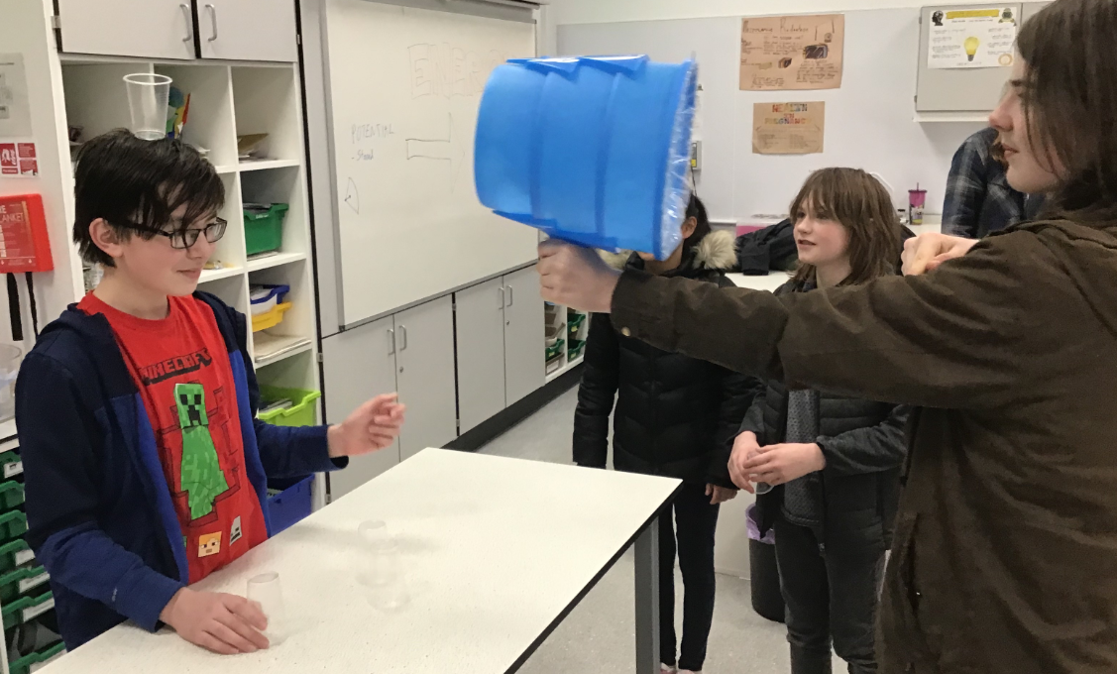
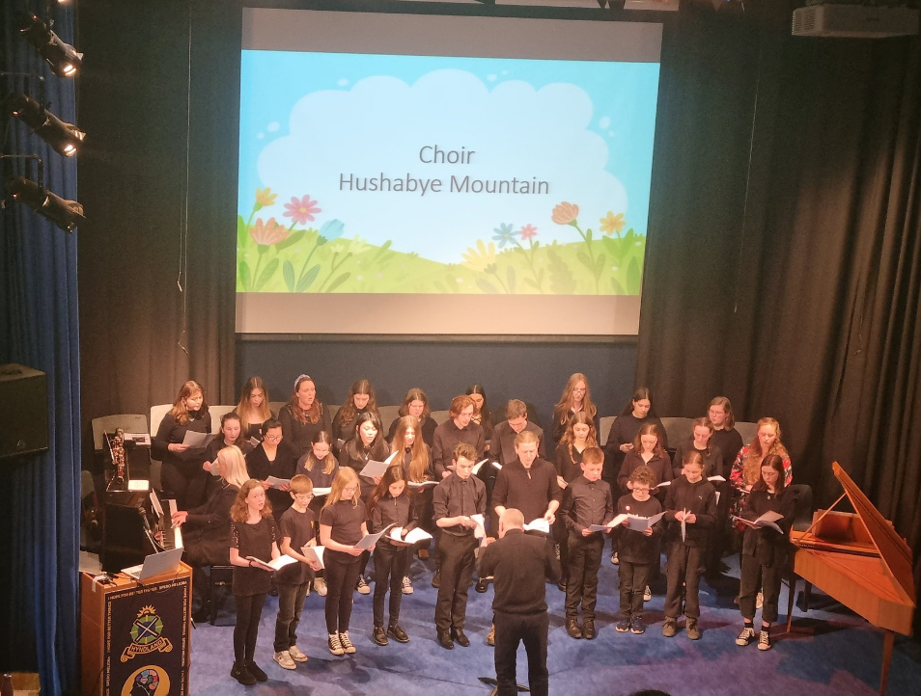
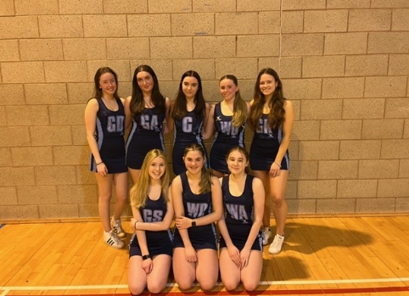
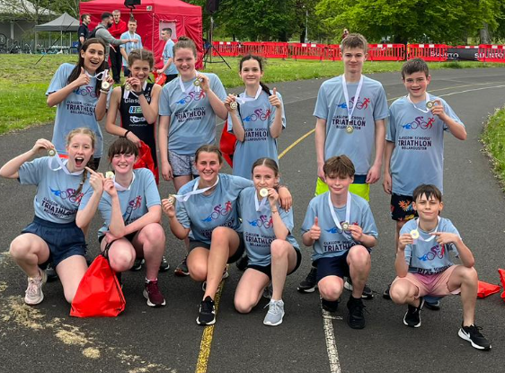
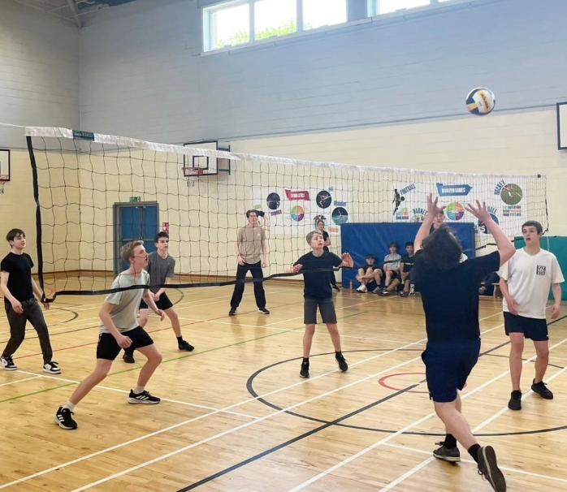
Wider Achievement
Science and STEM Clubs
Music – orchestra, wind band, choir
Sports – Badminton, Basketball, Football, Netball, Fitness, Rugby, Dance, Cheerleading
Film review club, Film making club and News club
Chess Club, Dungeons & Dragons, LGBT Club
Coding club, Enterprise club

Slide 15
The role of Pastoral Care in supporting young people at Hyndland Secondary
Ms Black

Slide 16
Our Pastoral Care Team
Mrs Mills Rannoch House
Ms Black Lomond House
Mr Carstairs Torridon House
TBC Katrine House

Slide 17
The role of a Pastoral Care Teacher
Main link between home and school.
Monitoring and supporting attendance and time-keeping.
Promoting positive health & wellbeing
Coordinating support for young people
Weekly PSHE input
Supporting key transitions, subject choices & careers

Slide 18
Settling in support
House Assemblies with House Team (DHT & PTPC)
Targeted Mentoring programme (senior pupils)
S1 Residential Trip to Lockerbie Manor
S1 Settling in Interviews with Pastoral Care – October 2026

Slide 19
Supporting young people at Hyndland
School & parental partnership
Anti Bullying Policy
Mental Health Peer Supporters and Buddies
Rights Respecting Schools Gold Award
LGBT Schools Gold Award
Notes:
Cath…

Slide 20
Supporting Young People at Hyndland
School Counsellor
Campus Police Officer
Youth Worker
Pupil Support Assistants
Extensive Group Work opportunities
Notes:
Cath…

Slide 21
The role of Pupil Support – Supporting learning at Hyndland Secondary
Mrs McFarlane

Slide 22
Our Pupil Support Team
Ms O Ennemoser (Mon-Fri)
Ms E Conway (Mon-Fri)
Mr V Carroll (Mon-Fri)
Mrs J Ross (Mon-Thur)
Mrs K Black (Wed-Fri)
Ms A Miller (EAL Teacher, Mon-Tue)
Notes:
Cath…

Slide 23
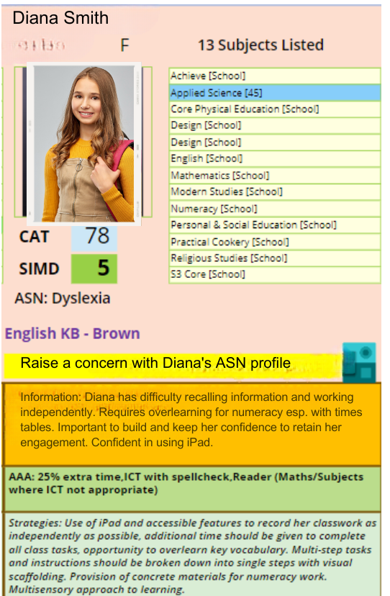






Supporting Pupils
ASN Database
Curricular & Assessment Support
Social & Emotional Support
Notes:
Cath…

Slide 24
Student Perspective
S1s
Hanna Mae, Emily, Zara, Thaim, Joseph

Slide 25

Parent Council
Meets six times during the year (dates for 2026-27 to be confirmed)
More a parent ‘forum’ than a (formal) ‘council’
Place where parents and carers can:
  Hear from Mrs Edgerton and other members of staff
  Hear from pupils
  Ask questions about the school
  Discuss and support school plans and initiatives
  Everyone is welcome
  “If you want to know about the school and what it offers for your children, I can’t recommend it enough” (Alex McTier, chair)

Slide 26
F.A.R.E. Youth Worker
Jenny Wainwright
Work directly with young people and families in a non-judgmental way empowering them to get the most out of the educational opportunities available.
Experience of planning and delivering needs led programmes by working alongside the school, local people, and other organisations
Offering a variety of different training opportunities including manual handling, health and safety in the workplace, first aid training, mental health first aid, Barista Skills and SQA qualifications.
Meet with young people individually or in groups to support them to improve attendance and/or attainment.
Attend meetings with the Senior Leadership Team and other agencies that can support students to improve their attendance and/or qualifications.
Work in partnership with parents, carers and young people in a school context to enable students, particularly the most disadvantaged, to have full access to educational opportunities and overcome barriers to learning and participation.
Sound knowledge of the issues faced by children, young people, adults, and families – lead groupwork for young people and events for family learning

Slide 27
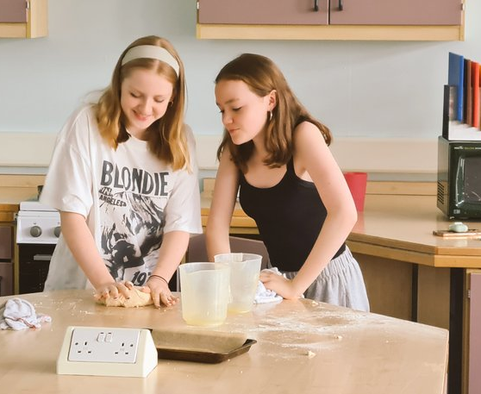
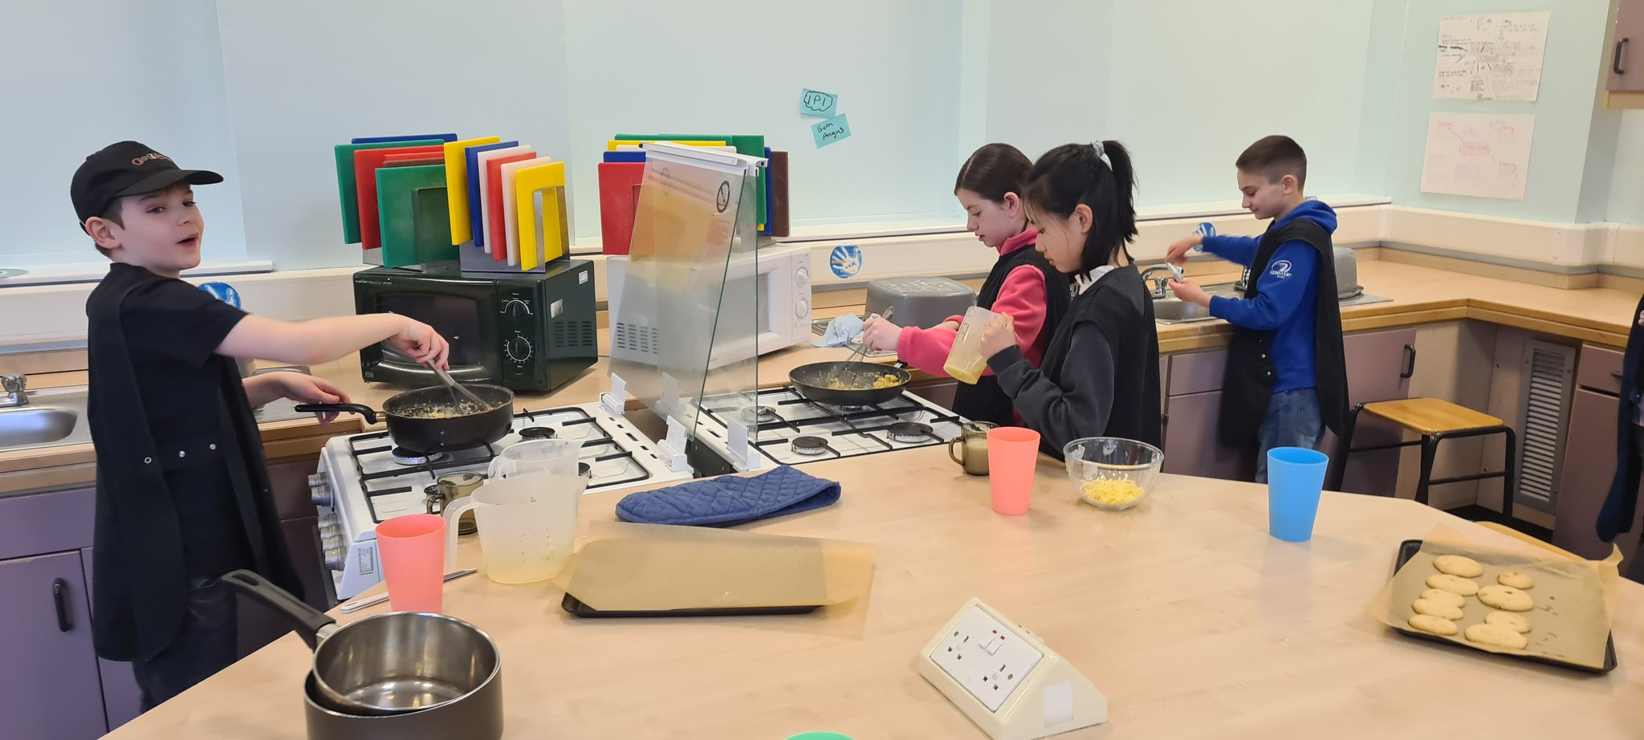
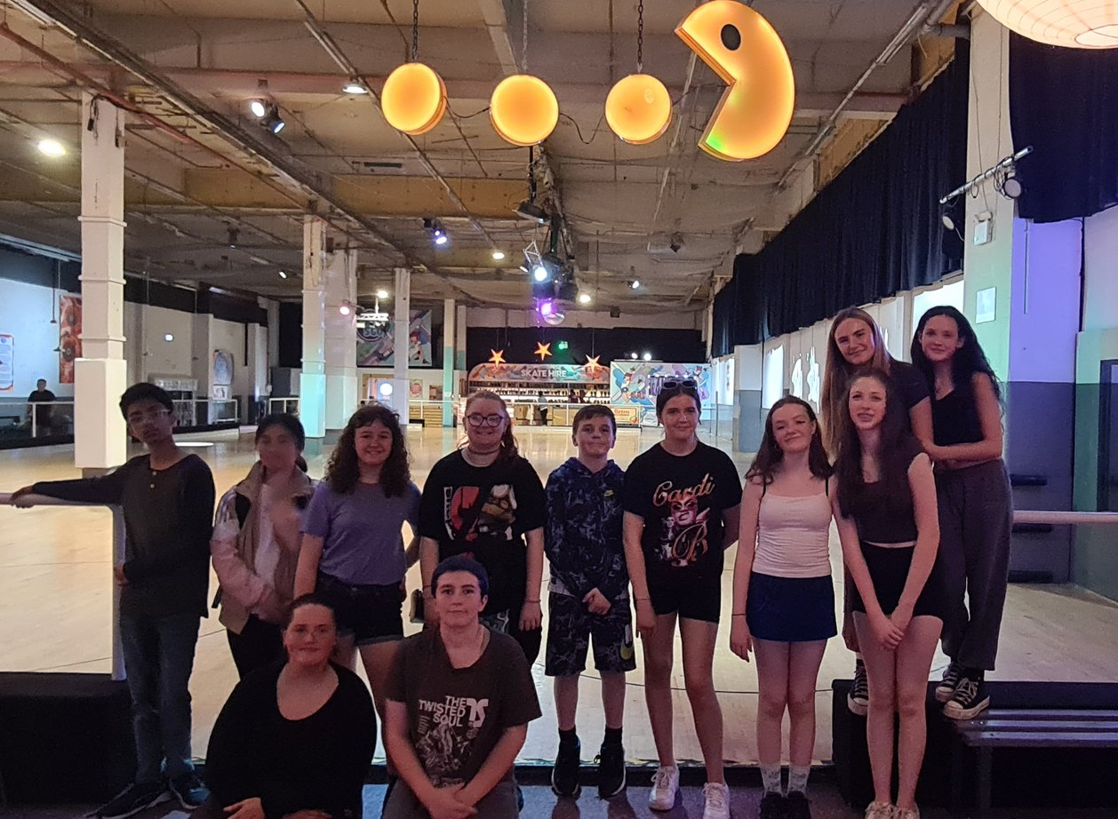
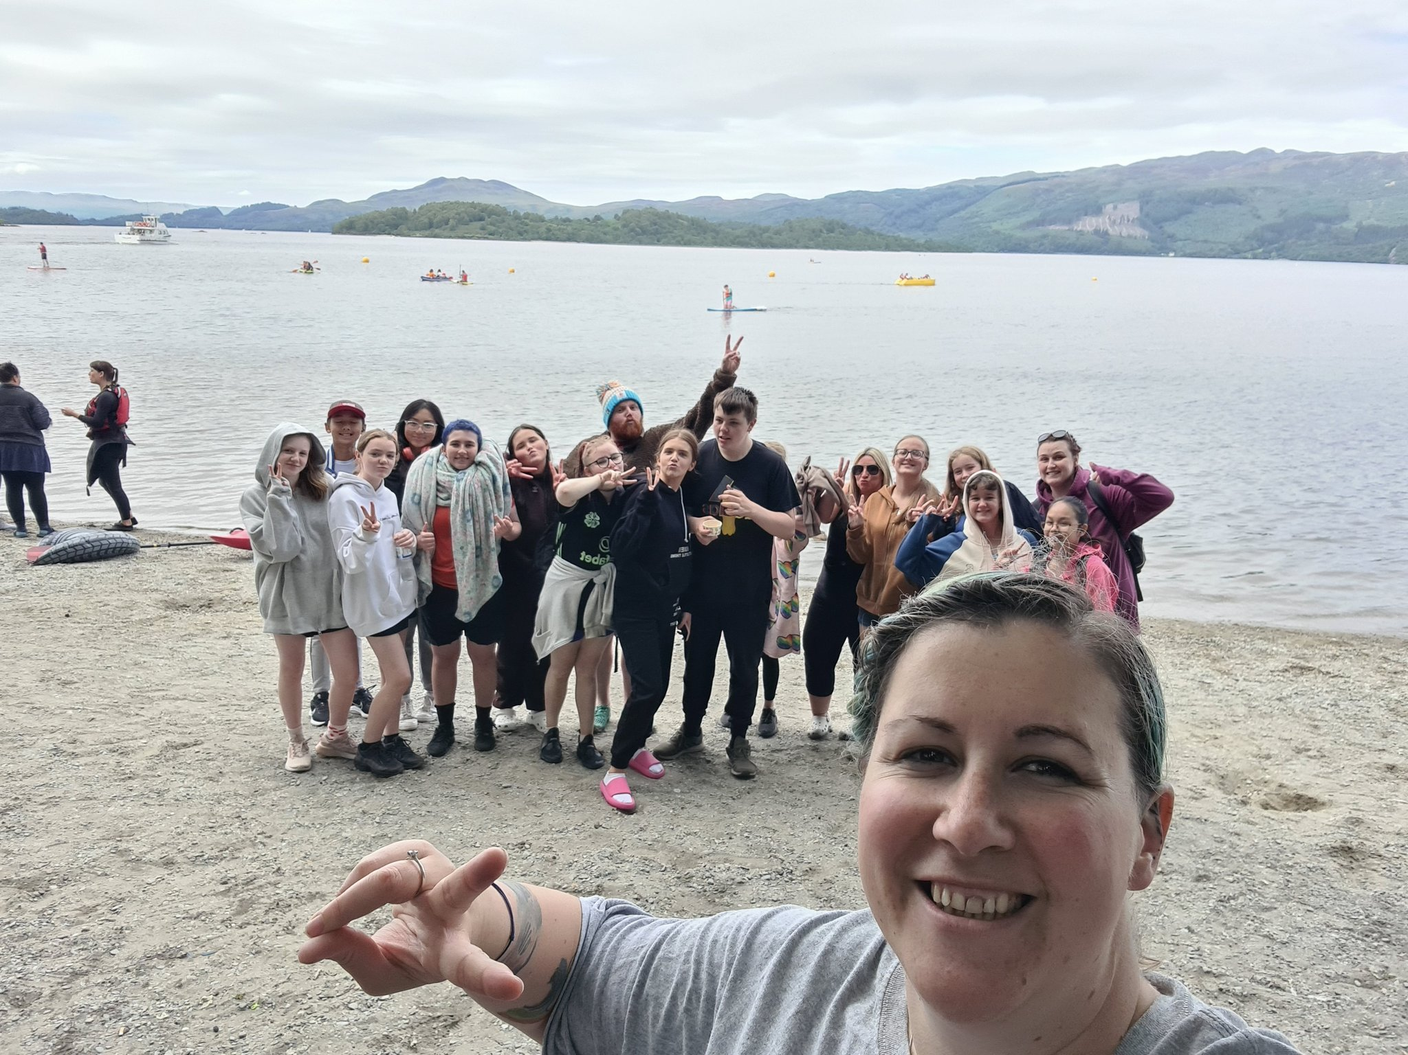
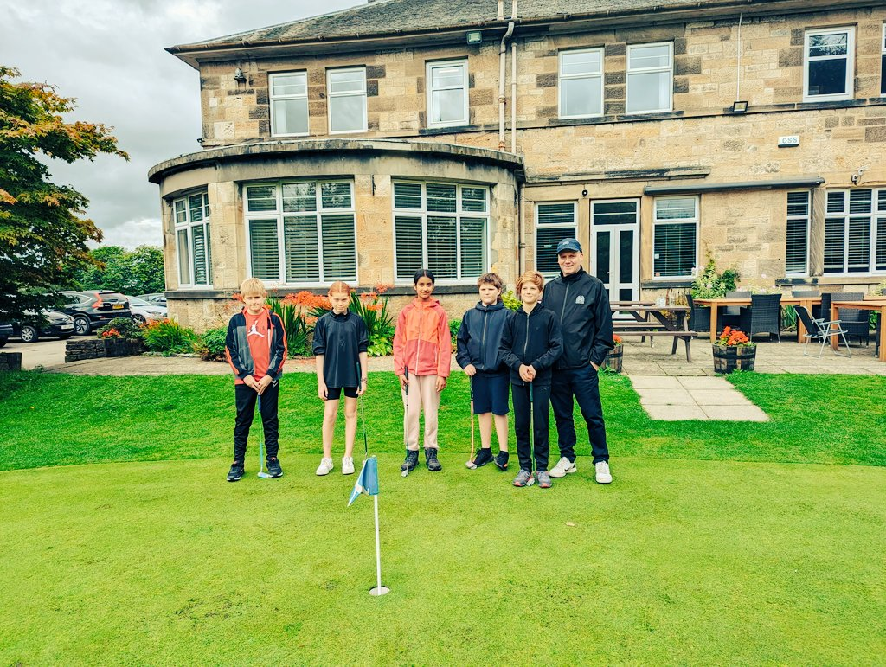
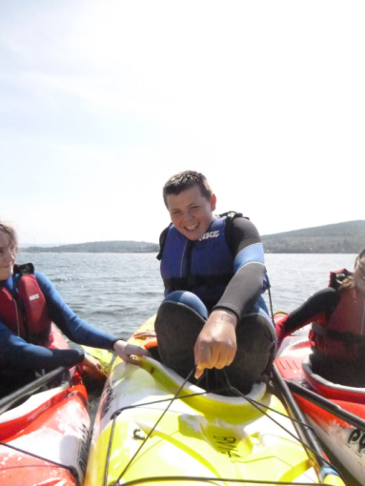
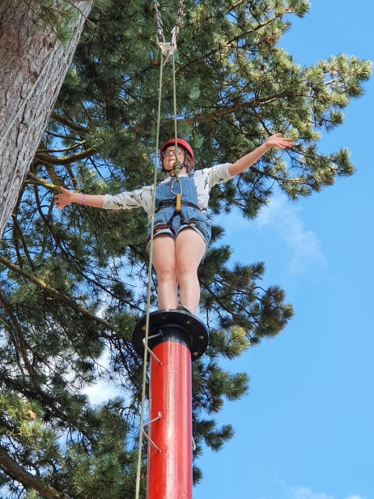
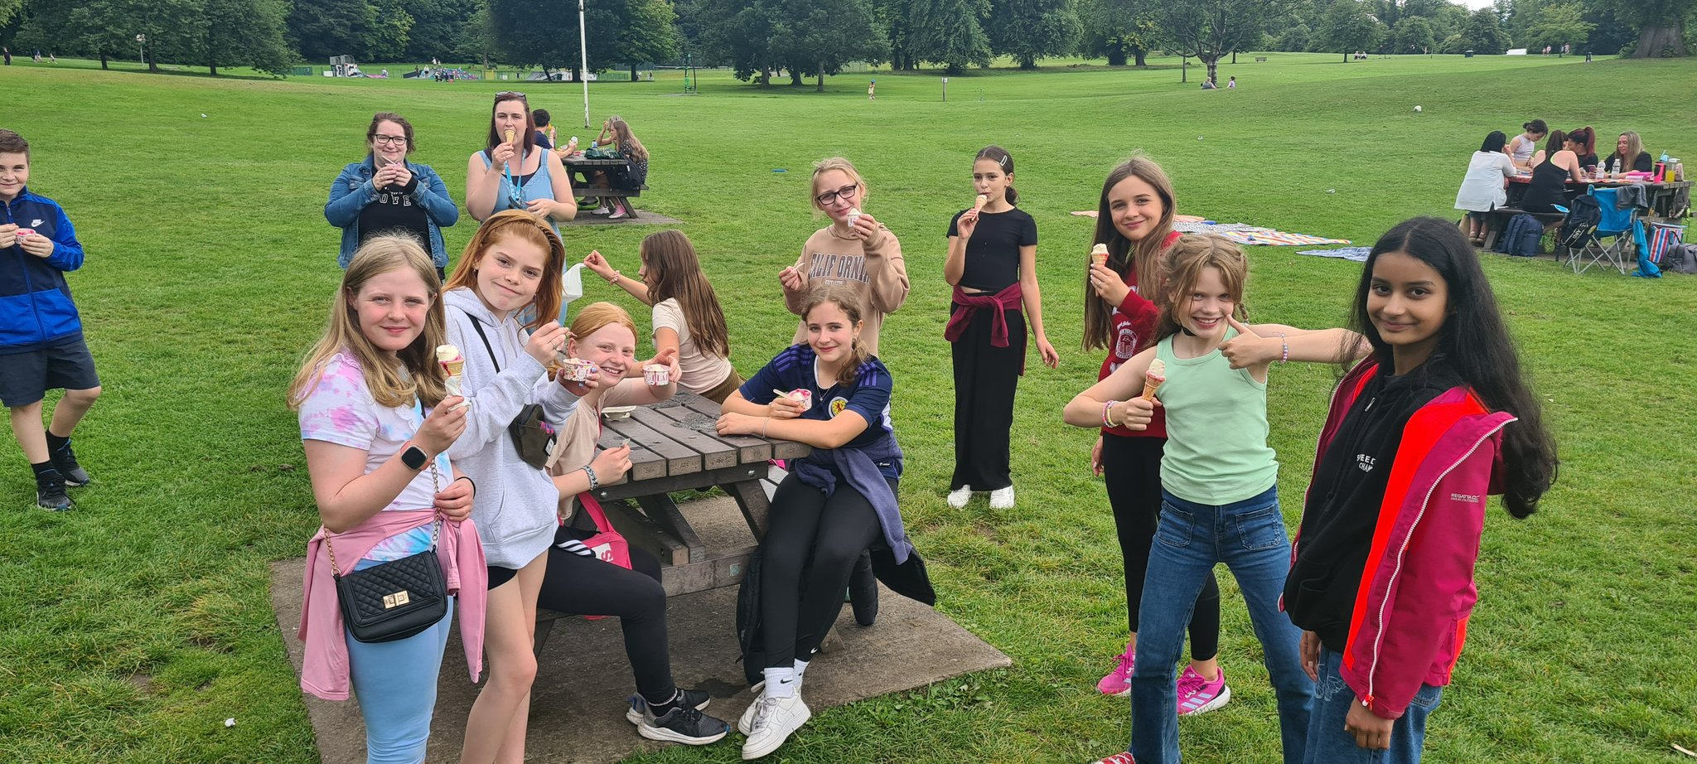
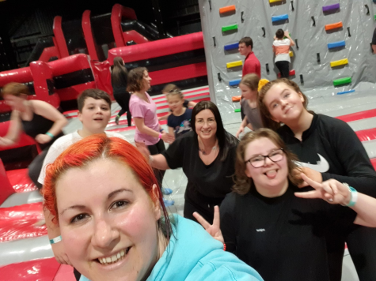
Holiday Programmes

Slide 28
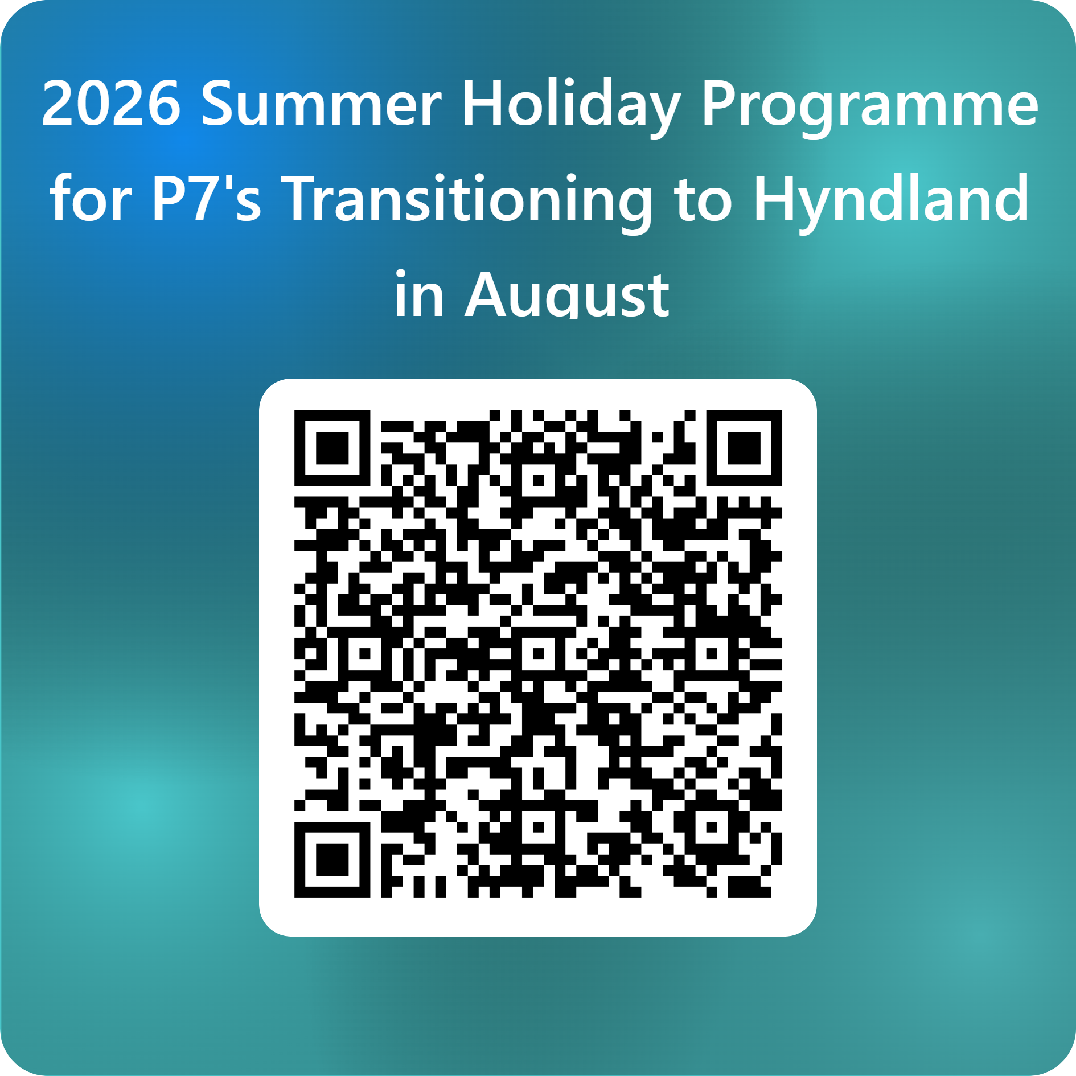

Slide 29
Communication with Parents
Regular communication via email
School website – all communications posted here
Parents Meetings
Reports – 2 tracking reports during the school year
Contact School – Pastoral Care
Parent Focus Groups
Active Parent Council

Slide 30
Thank you very much for coming along tonight.
We look forward to seeing you again in August at our Hyndland Family event

