Slide 1

Hyndland Secondary School S2 Course Choices – Information Evening

Slide 2
Format of the Evening
Young Peoples’ perspective
Course Choice Process – Ms Letford
Pastoral Care Support – Mr Carstairs
Careers Event: 6:45 – 7:45pm
Careers Support – Kay Mathieson

Slide 3
No need to take photos of slides!
We will post the presentation on the school website tomorrow and share on the S2 TEAM

Slide 4
Why attendance matters
The top performing 20% of S4 students had an average attendance of 97.49% whilst the bottom 20% had an average attendance of 73.98%.
Those in S4 who are currently on course to pass 8 National 5 awards in May have an average attendance of 96.87%.
Notes:
Over the last few years, we have carefully analysed attendance and attainment.
There is a clear and direct correlation between attendance and attainment.
We encourage attendance of at least 95%

Slide 5
(Anti-) Social Media
Multiple studies have found a strong link between heavy social media USE and an increased risk for depression, anxiety, loneliness, SELF HARM AND EVEN SUICIDAL THOUGHTS.
We deal with many relationship difficulties and for the most part, this starts with inappropriate posts on Social Media.
Notes:
The impact on wellbeing can then impact attendance and engagement in school which in turn will reduce young people’s chances of achieving the qualifications they are truly capable of in S4.
We are appealing to parents and carers to monitor your young person’s use of social media and appealing to young people yourselves to be more aware of the negative impact of too much time spent on phones / engaging irresponsibly on social media. Focus on your learning!

Slide 6
How Parents can help
Talk to young people about their phone use
Be aware of what they are viewing/posting
Reinforce ‘acceptable use’ message
Remind young people that what they post will remain online and may resurface years from now
You pay – its your phone – look at their posts!

Slide 7
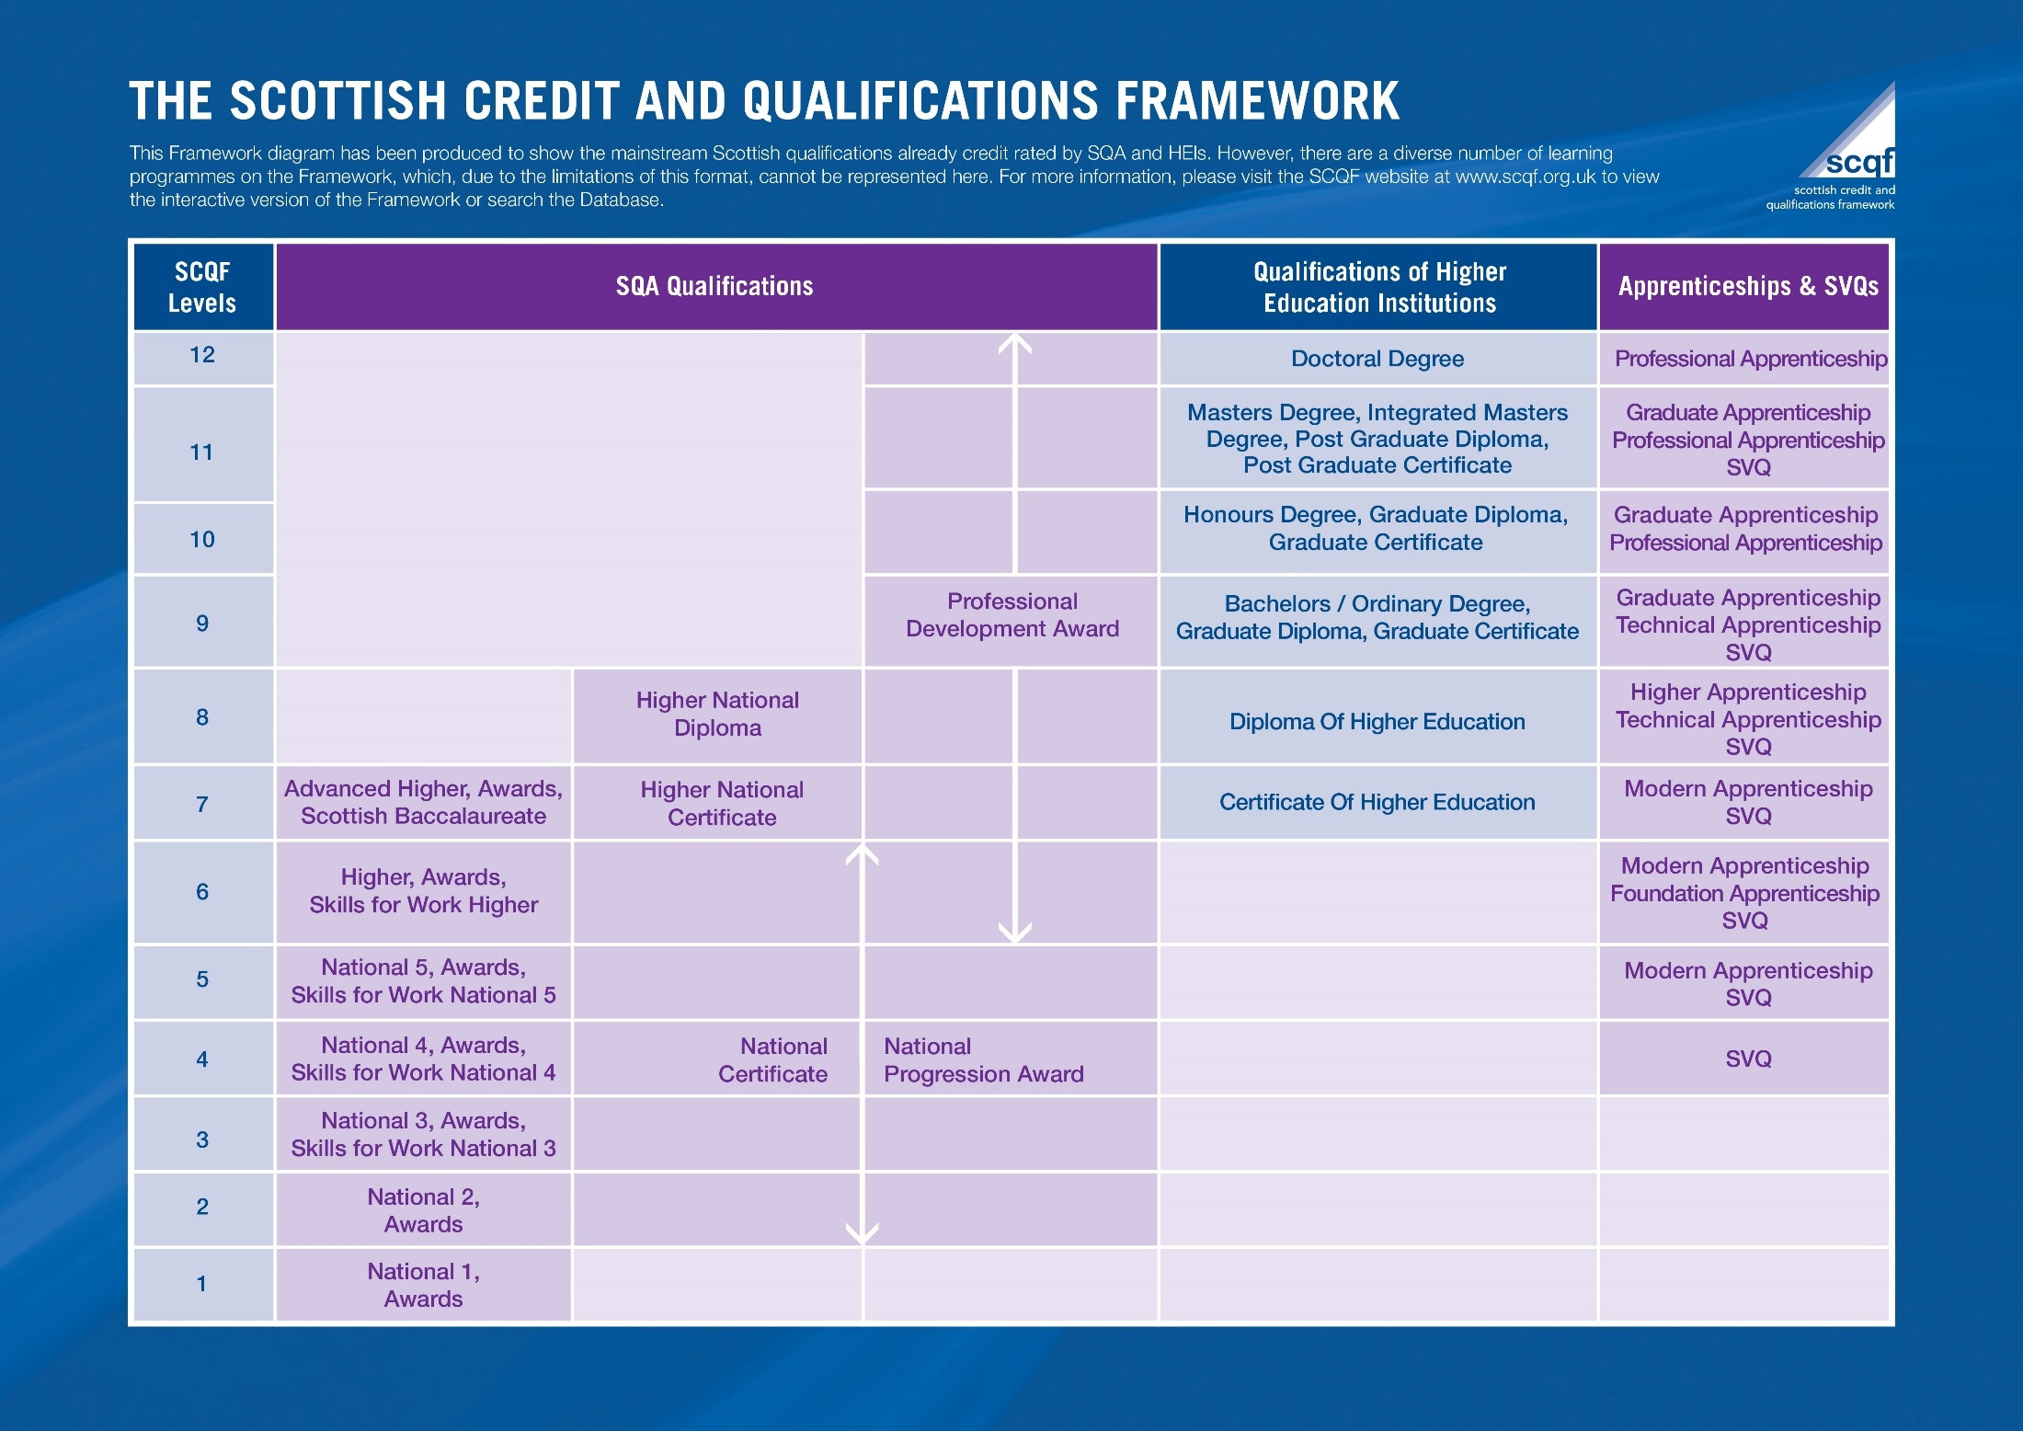
Notes:
When considering the course choice process a good place to start is always with the qualifications framework – the SCQF. You may already be familiar with this and you can have a closer look once this is posted on our website so I won’t go into too much detail. However, one thing I do like to highlight is the format. Learners can use the diagram to map out where they want to go, how they want get there and crucially how all these different qualifications compare.
Just by looking at level 7 you can see Advanced Highers, HNC, Certificate of Higher Education, Modern Apprenticeships and SVQ’s - this lets us draw broad comparisons across a range of different learner pathways.
A key aspect for us is to raise as much awareness of the SCQF as possible so it is important to share this with parents and to discuss with learners during their course choice process.

Slide 8


Slide 9
The SCQF Framework
SCQF points tell you how much time it takes, on average, to complete a qualification or learning program. They act as a measure of the "size" or volume of learning involved, rather than the difficulty of the qualification itself.
The Level of the qualification tells you the difficulty.
National 4 is at Level 4
National 5 is at Level 5
Higher is at Level 6
Advanced Higher is at Level 7
So a Level 6 NPA is the same level of difficulty as a Higher qualification

Slide 10
Key details about SCQF points:
4 Point = 1 period per week: One SCQF credit point represents a notional 10 hours of learning time, which includes teaching, private study, and assessments.
24 SCQF points will get 6 periods on the timetable
Distinction from Levels: While SCQF levels (1–12) tell you how difficult a qualification is, points tell you how long it takes to complete.
Recognition of All Learning: They are used to recognize formal school/university qualifications AND also vocational training, workplace learning, and community-based programs.
Young people can build a bespoke curriculum with a mixture of traditional exam-based qualifications and qualifications with continuous assessment

Slide 11

Developing the Young Workforce

Slide 12
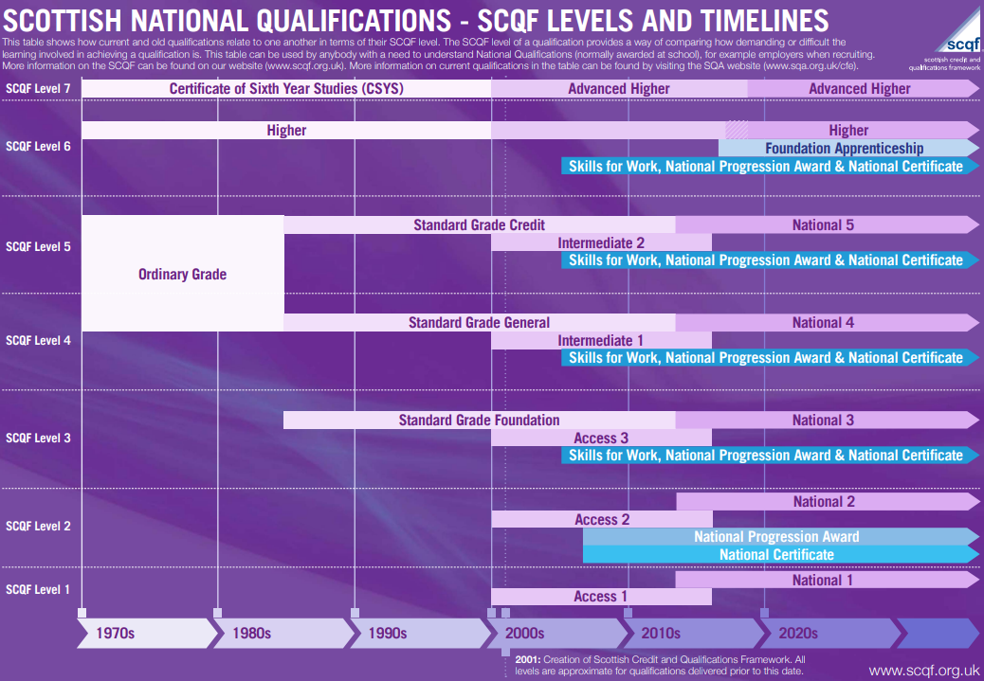
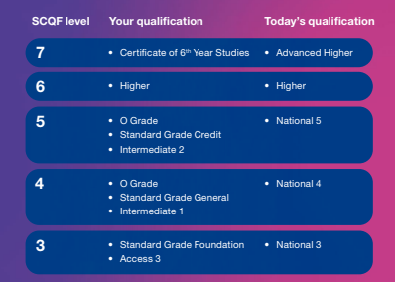
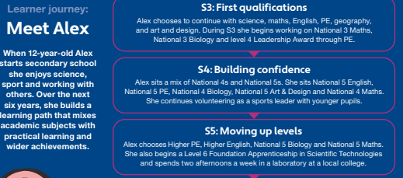
Parents & carers of learners - Scottish Credit and Qualifications Framework
Notes:
This is a link to the Parent/ Carers Information section of the SCQF website - you can also access this in your own time and is useful in providing a comparison between today’s qualifications and the qualification you and I would have sat many moons ago, it also illustrates some examples of learner journeys through qualifications pathways.

Slide 13
The S3 Curriculum
English
Maths or Applications of Maths
Modern Language OR 1 free choice
Expressive Art
+ 1 free choice
+ Wellbeing choice
Science
Social Study
Technology
Core PE & PSHE
Notes:
Every young person will be expected to study English and Maths at an appropriate level. In addition, young people have core subjects –PE, delivered by specialist PE staff and Personal Social and Health Education led by their Pastoral Care Teacher.
For the past 5 years we have had a Wellbeing period in the S3 curriculum and this has proven to be a success – activities such as chess, preparation for Bronze DofE Expedition, dance, cooking, yoga, fitness to name but a few have introduced young people to new skills and provided a platform for supporting positive mental health and wellbeing.

Slide 14

S2 Pathways
Subject Information
Notes:
Our New Pathways presentations have been shared on TEAMS and young people have been accessing these and discussing during PSHE lessons.. These sets out all the choices available in each curricular area, provides information about pathways, course content, assessment, skills developed and potential careers

Slide 15

Curricular Area - English & Literacy

Slide 16
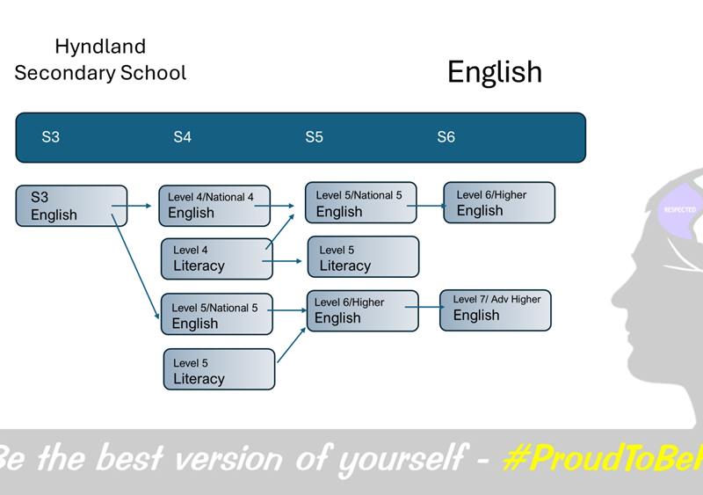
Notes:
We have presentation for every subject on offer. These sets out all the choices available in each curricular area, provides information about pathways, course content, assessment, skills developed and potential careers

Slide 17


Slide 18
English Sway – please click on the link below
English Sway
English s3 options (1).mp4

Slide 19
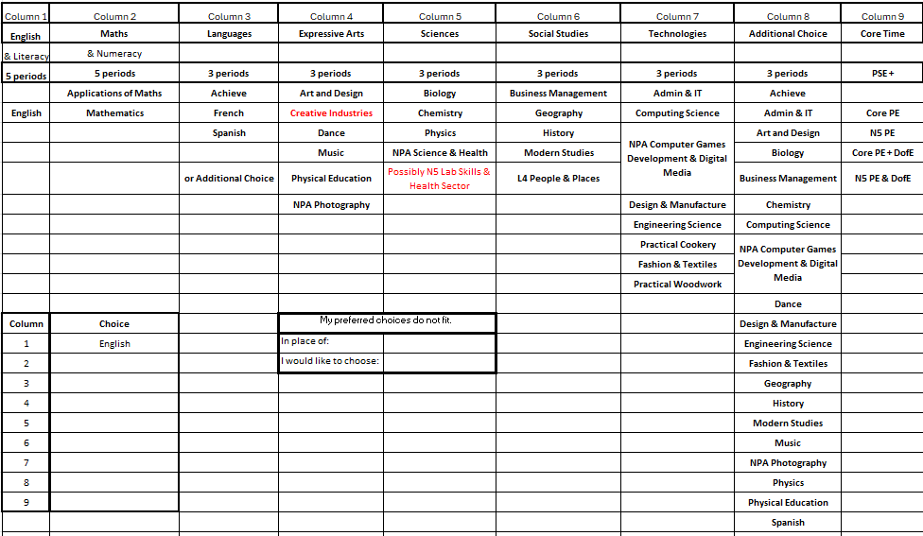
Notes:
Our option form covers all 7 curricular areas plus provides opportunity to double up in 2 or 3 of these.
Eg. Pupils can take an additional subject from a particular area in column 3 or 8, traditionally we have a very high uptake in PE so have an additional opportunity to take this in column 9 to free up a choice in column 4. This means the learner will be undertaking 9 subjects so this is only recommended if the learner can cope with this demand – tracking at L4 in all 9. Pastoral Care will advise pupils during their interviews next month.
Column 9 provides other wellbeing option combinations – with core PE plus Bronze DofE. Just to note N5 PE pupils will no longer attend core PE.

Slide 20
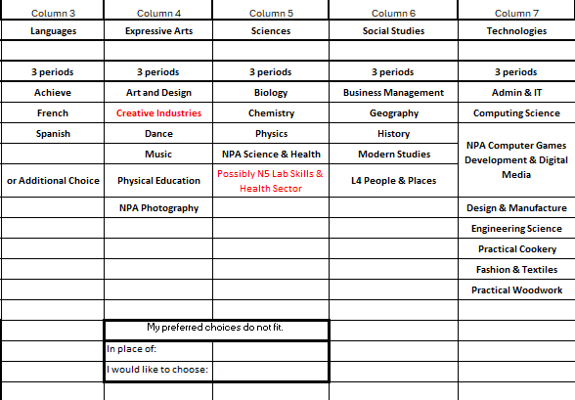
Notes:
To further increase the flexibility pupils can make a note of a preferred choice in place of a subject they do not want to take. Possibly a curricular area they have not experienced success in. We do however always encourage a full spread of curricular areas in order to keep as many pathways open to pupils as they move further up the school.

Slide 21
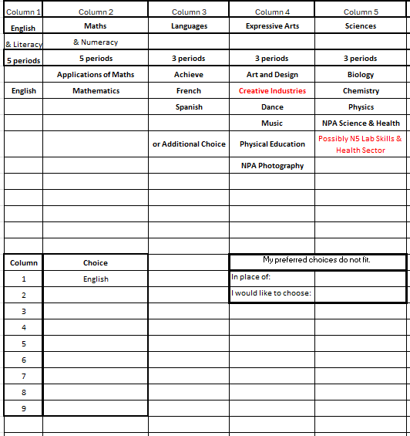
Notes:
Pupils will make their final choices on a Microsoft form on their ipad during their interview with Pastoral Care – this follows the distribution of tracking reports as well as the parents evening so by this stage on 20th March they should be fully confident in their course choices.

Slide 22
New/Unfamiliar Qualifications
N4 People and Society
Achieve – PTPC will recommend
NPA L4 Science & Health
NPA L5Computer Games & NPA Digital Media
NPA Photography & Creative Thinking
Option for everyone to do N5 PE
Wellbeing Choices – including DofE Bronze
L5 Health Sector/ Lab Skills
Notes:
N4 People & Society is an alternative to N5 Mods, Hist, Geog - this will suit young people who are working towards mainly N4 qualifications.
Achieve is a 2 year award accredited by the Princes Trust. If your PTPC feels this would be an appropriate course, they will provide information on an individual basis.
NPA Science & Health is a more accessible option for those working towards N4s – covers all 3 sciences – no exam.
Health Sector and Lab Skills – L5 NPA – no exam so provides a middle ground option in the Science dept.
NPA L5 CGD & Dig Media gives a 2for1 opportunity for young people who make good progress. Similarly with NPA Photography/Creative Thinking
PE – only advised for those tracking at 4th level in their 9 subjects.
Wellbeing choices include the opportunity for every young person to undertake DofE Bronze level.

Slide 23
What does this mean for qualifications?
This will allow most young people to attain eight qualifications at the level most appropriate to their ability by the end of S4.
In S4, young people who demonstrate a talent for Maths may be presented for Applications of Maths as an additional qualification
Young people expected to achieve 8 N5 qualifications may add N5 PE in the wellbeing column.
Pupils can balance coursework and exams by choosing a mixture of NPA NA National 5 qualifications.

Slide 24
Some DOs and DON’Ts
What you should do:
Remember that you are choosing a course that you will study through until the end of S4
Choose a BALANCED timetable. You should have a range of different types of subjects.
Listen to advice from your teachers, your parents, and Skills Development Scotland.

Slide 25

Pay Attention
Read your S2 Report carefully. Play to your strengths and choose subjects you have an aptitude for.
Consider
Consider also how much you ENJOY a subject. You should enjoy learning!
Remember
Remember to think about what you may wish to do in Fifth and Sixth Year

Slide 26
Some DOs and DON’Ts
What you shouldn’t do:
Don’t give up a subject without finding out if you need it for a specific career you hope to pursue.
Don’t choose a subject just because you like (or dislike) the teacher. You may have a different teacher next session..
Don’t narrow your curriculum e.g. Choose three Sciences or three Social Subjects. You can access the third subject in S6
Don’t base your decision on friends’ choices – you have different talents! Classes are mixed so you may not be together.

Slide 27
Young peoples’ perspective
S3 pupils Kitty Thomson Skinner & Aqsa Ahmad

Slide 28
Pupil Support - Pastoral Care
Mr Carstairs

Slide 29
The story so far…
Interim Reports last term: Target Setting Strengths/Areas for Development
PSHE Support
Pupils registered with ‘My World of Work’
Presentations from Subject Ambassadors - ongoing
Pathways presentations and subject SWAYs shared on the S2 Team
Channel 4 experience
Strathclyder experience (by nomination)
Careers Adviser appointments
Careers Event - tonight
Notes:
Pupils will get reports on 5th March – staff will have Learner conversations to give guidance on level of study, progress and next steps
PSE has been used to develop target setting
Pupils have created accounts on the My world of Work website – they can use this to build their profile recording achievements and success throughout their time at Hyndland
Channel 4 worked in the school for 2 days to provide information about careers in Media and TV production
Targetted support for young people in SIMD 1&2 to consider University via the Strathclyder programme.
All S2 pupils receive presentations from subject ambassadors – all subject information is available on the S2 team
Careers event

Slide 30
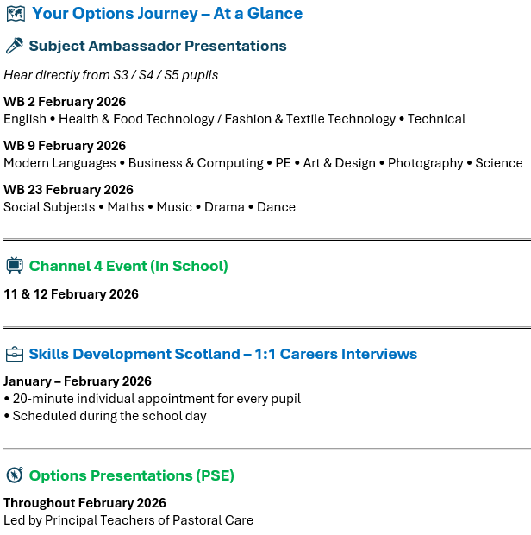
Notes:
These are the Key Dates taken from the letter emailed home…..
Young people will have had presentations in class from subject ambassadors in each subject area
Young people will undertake sample lessons from the S3 curriculum next week

Slide 31
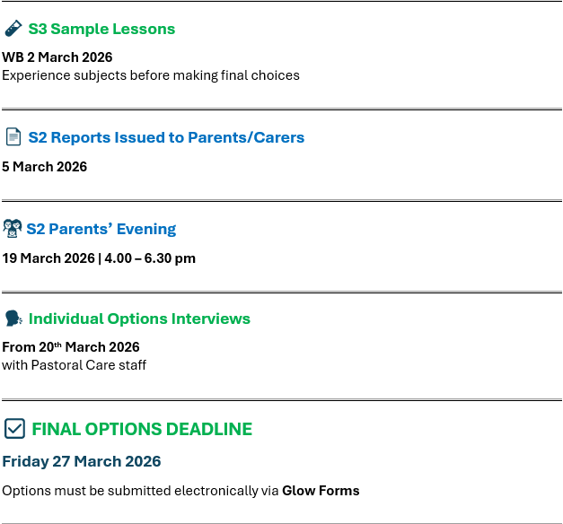
Next Steps…..
Notes:
These are the Key Dates taken from the letter emailed home…..
Young people will have had presentations in class from subject ambassadors in each subject area
Young people will undertake sample lessons from the S3 curriculum next week

Slide 32
Who Can I Ask for Advice?
Pastoral Care Staff and Personal Support Tutors
Careers Adviser
Subject Teachers
Senior Leadership Team
Mentors
Parents/Carers
Wider Family
Notes:
The success of anything comes through a successful partnership between the school and the home.
Take time to go through each of the subjects in the Pathways Powerpoints and Sways with your child. Talk to them about their understanding of the S3 Course. Remind them it is their choice not their friends as they may not be in the same classes as their friends.
Encourage them to reflect on the ambassador presentations for each subject.
If they are unsure encourage them to go back and talk with subject teachers for any further advice.
Take time to go through their final S2 report and again look at the advice given by class teachers.
If you require any further help or are unsure at any stage please contact your child's pastoral support teacher. We are here to support your and your child through the programme.

Slide 33
Useful Websites
Planitplus | https://www.planitplus.net/
My World of Work | https://www.myworldofwork.co.uk/
Apprenticeships | https://apprenticeships.scot/
Workit | https://www.workit.info/About/YoungPeople

Slide 34
Supporting well-being
School website – lots of signposts to materials including Sleep Scotland and Headspace.
https://www.parentclub.scot/
https://www.triplep.net/glo-en/home/
Be kind to yourself!

Slide 35


Slide 36
“To live is to choose.
But to choose well, you must know who you are, and what you stand for, where you want to go and why you want to go there.”
Kofi Annan
Nobel Peace Prize Winner 2001

Slide 37
Skills Development Scotland
Careers Advisor
Kay Mathieson

Slide 38
S2 Options Choices Careers Support S2 Parents/Carers Information Session Hyndland Secondary School

Slide 39
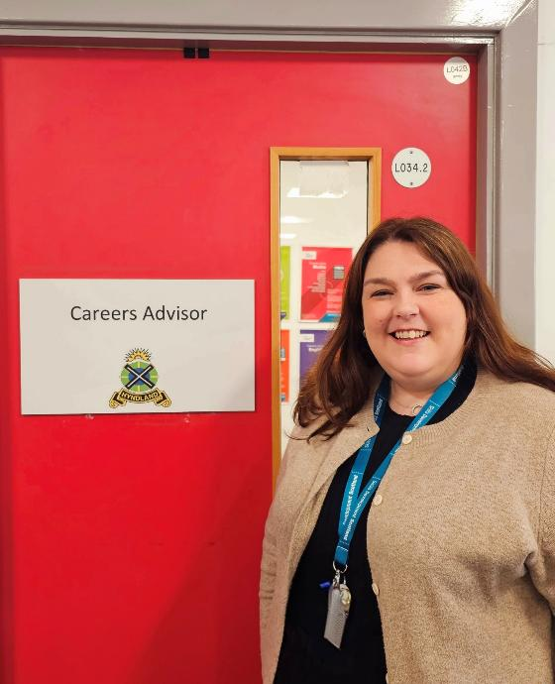

Careers support in school
Hi! I am Kay, the careers adviser at Hyndland Secondary School.
I support young people to build career management skills to help them feel confident when making career decisions in school and beyond.
I am based in school Monday – Friday in the careers room in the library.

Slide 40

Career Management Skills
Notes:
Career Management Skills are skills for life empowering us to strengthen our understanding of the four themes: Self, Strengths, Horizons and Networks. They help us to make informed decisions and realise our potential at any point. If you feel confident that you have a good understanding of these four themes and can demonstrate this then you will be well equipped to cope with developing your career.
The four areas are:
SELF is about
Understanding what you like
STRENGTHS is about
Understanding what you are good at
HORIZONS is about
Understanding what options might be available to you
NETWORKS is about
Understanding who can help you, and how.

Slide 41

Options Choices
In addition to support from Pastoral Care, and in preparation for making options choices, S2s will have taken part in*:
A group activity focused on effective decision making
A 1:1 discussion about options, careers support, and their career ideas.
Notes:
Explain support provided (explain a small number still to be seen over the end of this week/1st week in March and some absences for groupwork)
Looked at tools they can use at home to help as well
Explored key areas – 5 big questions – more on mywow but here’s what we focused on

Slide 42

Notes:
How do I like to learn?
Do you enjoy English and Modern Languages as you get to talk and listen? Do you prefer Art and Design or Science subjects as you get to be creative?
Think about how you like to learn.

Slide 43

Notes:
Where could these subjects take me?
Certain college and university courses, and some Modern Apprenticeships require you to have studied certain subjects at school to gain entry. Think about the types of jobs that might suit you.
Check out the industries and the pathways into careers in them at myworldofwork.co.uk

Slide 44

Notes:
What subjects do I enjoy?
if you are interested in a subject, learning about it and studying it can be quite fun! If you're doing something you love, you're more likely to do well.

Slide 45

Notes:
What subjects am I good at?
Consider the subjects you've done well in before. But remember, subject choice time is an opportunity to study subjects you've never done before.
Consider all of your options carefully.

Slide 46

Notes:
What do other people think?
This is not about doing what your pals are doing but about asking people what they think you are good at and could do well in.
Remember, the final choice is yours.

Slide 47

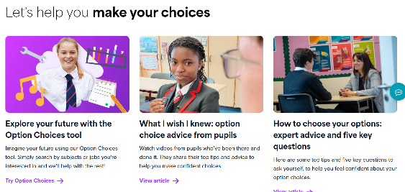
My World of Work – our online service
You can use My World of Work to research and discuss options choices and career ideas at home.

Slide 48
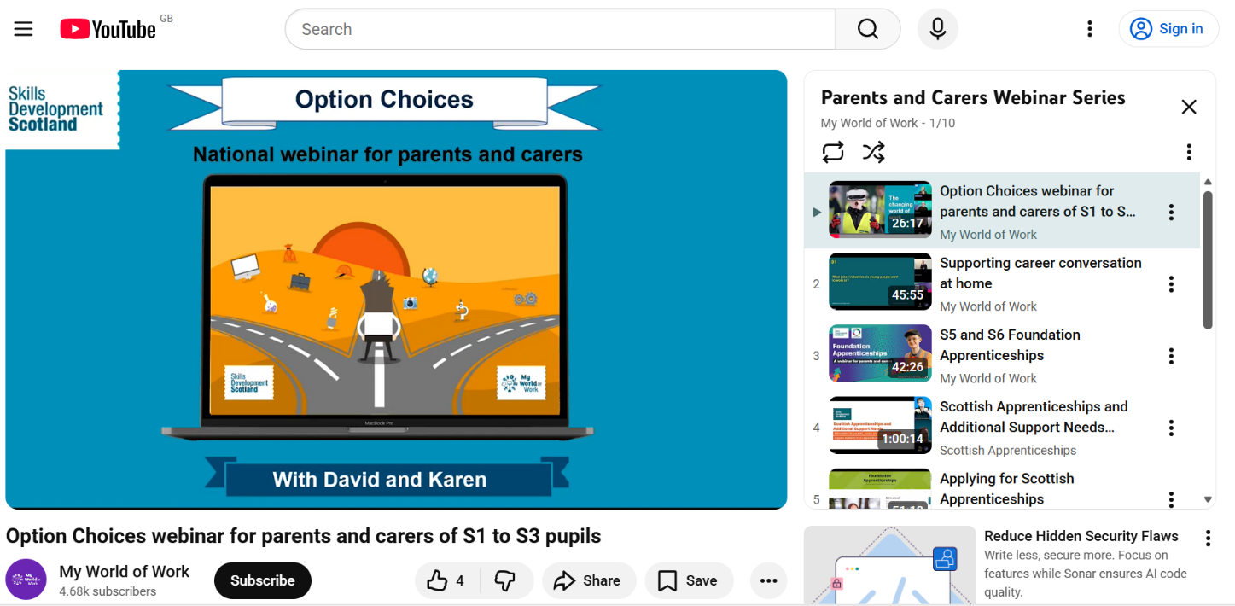
More information
You can watch the Parents and Carers Options Choices Webinar via the SDS Parents and Carers YouTube Webinar Series

Slide 49

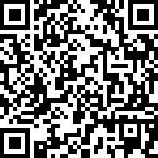
Parents and Carers Survey
Parents and carers are key influencers over young people’s career ambitions and choices. Skills Development Scotland would like to find out how you talk to your child about careers and your awareness and use of our services.

Slide 50


Get in touch!
Young people can drop by the careers room in the library Mon to Fri
OR
Email me at: kay.mathieson@sds.co.uk
Call/send me a text on 07824548118
Notes:
Discuss how pupils can make appointments with you
Where they can find you and on what days in school – drop in sessions, etc.
Contact details and information about continued in-school support

Slide 51
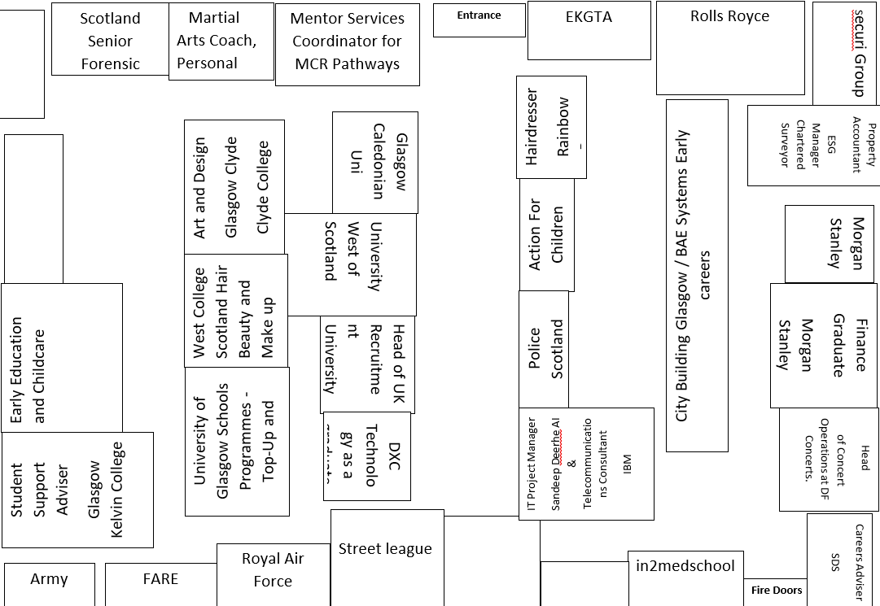
Careers Event

