Slide 1
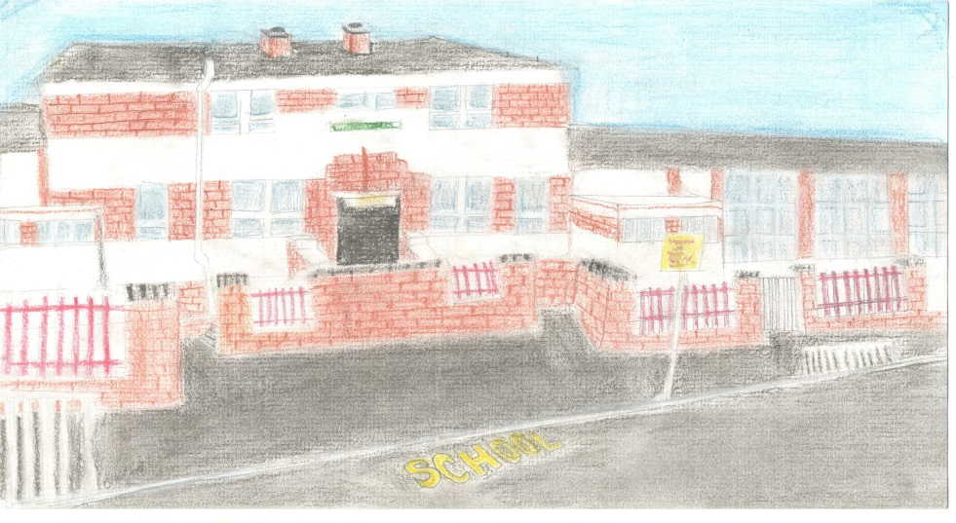
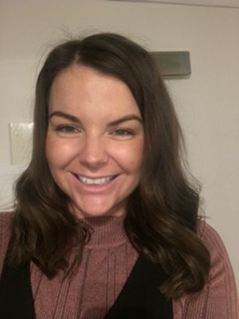
Welcome to Hillington Primary School
New Entrant Induction Day 2 – June 2022
Miss Davidson – Depute Head (P1-P5/4)

Slide 2
Staff at Hillington Primary
Senior Leadership Team
Head Teacher Ms J Gillies
Depute Head Miss L Davidson (P1-5/4)
Depute Head Mr D Ramsay (P5-7)
Primary 1 Teaching Staff
Primary 1a – Mrs Fergie
Primary 2/1 – Miss Dryden

Slide 3
Our Vision & Values
At Hillington Primary School we provide a welcoming and friendly environment, which celebrates the diversity of our community.
We are a nurturing school where everyone feels safe, happy and valued and all children are supported to reach their full potential. This is achieved through working together with children, their families and the community, based on a shared sense of direction.
Our Vision: To create a safe, happy environment in which everyone feels included, respected and motivated.
Our Values: There are four values, which we promote in Hillington Primary. We would like everyone to be:
Achieving Nurturing Healthy Kind

Slide 4
Our Parent Council
Every parent/guardian becomes a member of the Parent Forum whenever their child starts school, enabling parents to get involved in school life in whatever way they can. This could be helping on trips, at discos, assisting during the school day or as a representative on the Parent Council.
https://blogs.glowscotland.org.uk/gc/hillingtonprimary/parent-council/

Slide 5
Curriculum for Excellence Levels
Early level: Pre-School to P1
First level: P2,3 and 4
Second level : P5, 6 and 7
Third and fourth level : S1 to S3
Senior Phase

Slide 6
The Curriculum
Curriculum for Excellence : Early Level
Languages
Mathematics
Social Studies
Expressive arts
Technologies
Sciences
Health and Well Being
Religious and Moral Education.

Slide 7
Primary One Approaches
Literacy for All: Early literacy resources, reading/writing activity for parents
Glasgow Counts: Concrete Pictorial Abstract (CPA)
Playful Pedagogy: classroom organisation areas, outdoor learning
Learning Contexts: Storyline, Local Area

Slide 8
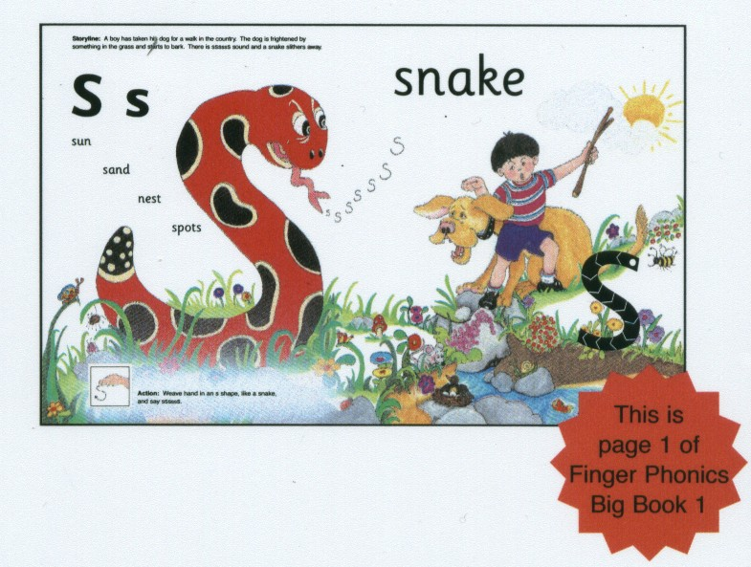
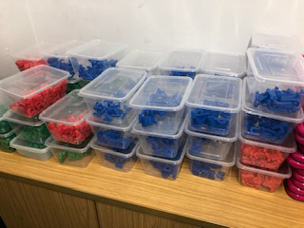
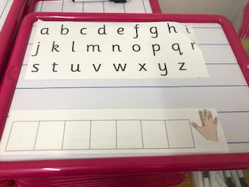
Phonics
Single Sounds/Phonemes
bin
pin
Joined Sounds/Phonemes
chop
shop
Please see phonics handout for more information.
Notes:
Learn the letter sounds daily
2 or 3 sounds per week and revise
Learn the letter formation
Blend : s-at, c-an, sh-op
Identify sounds in words

Slide 9
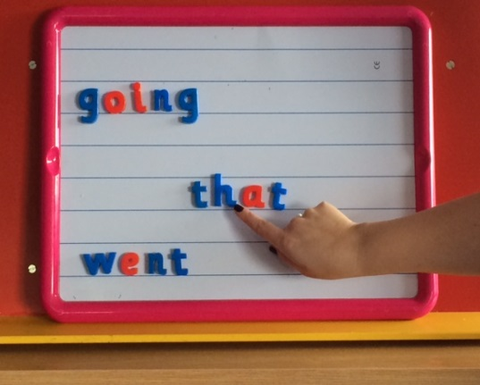
Spelling
Please see spelling handout for more information.
Notes:
Tricky words : the, that, want, said

Slide 10
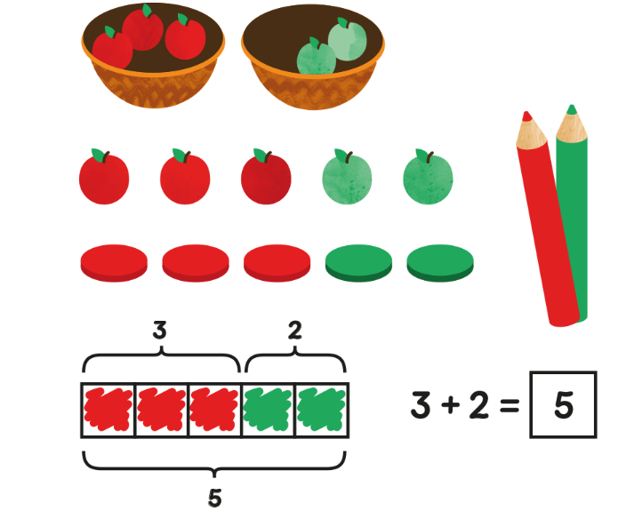
Maths/ Numeracy Concrete-Pictorial-Abstract
https://www.youtube.com/watch?v=0_wXcIPLzTk

Slide 11
Playful Pedagogy
Playful Pedagogy is a way of integrating children’s play experiences with curricular learning, giving pupils the flexibility to find their own solutions to both new and existing problems. It engages children in personally meaningful activities, learning about themselves and others, and encourages autonomy and their independent motivation-to-learn.

Slide 12
Celebrating Success

Slide 13
Anti-Bullying
https://blogs.glowscotland.org.uk/gc/hillingtonprimary/respect-our-anti-bullying-policy/

Slide 14
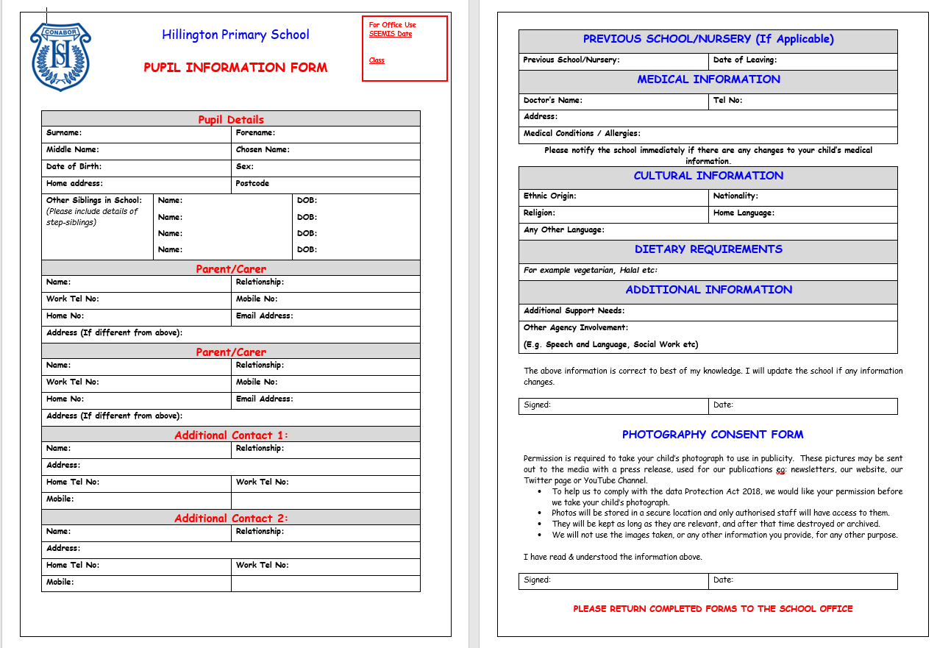
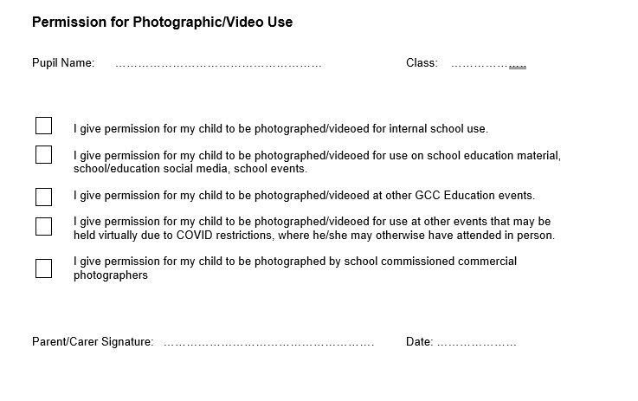
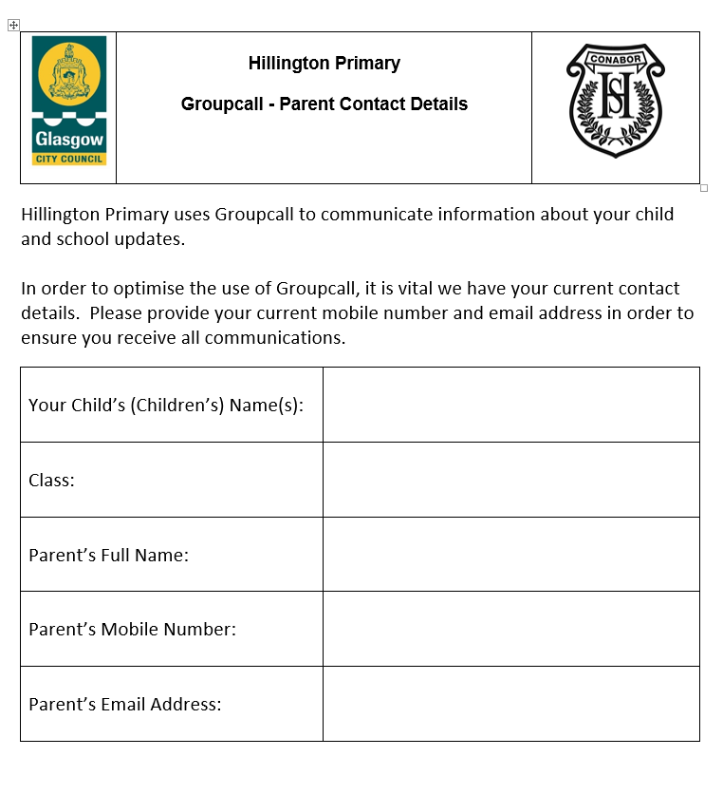
Forms to Complete

Slide 15
Keeping You Informed
You can keep up to date with things that are happening in school and in your child’s class through our school website.
https://blogs.glowscotland.org.uk/gc/hillingtonprimary/
You can also follow our school on Twitter
@HillingtonPS
Subscribe to our YouTube channel –
https://www.youtube.com/channel/UCNagTj8HXc7dGbXviGPh36Q
And download our Xpressions app through your app store -
https://www.youtube.com/watch?v=TuVQ4UyJO40

Slide 16
Please complete the following school forms and hand them to a member of staff before you leave -
Groupcall Guardian Form
Photographic Permissions
Pupil Information Sheet
Digital/ICT Home School Agreement
Online Uniform Order
Please take some time to read our Anti-Bullying Policy and the Phonics and Spelling Handouts.
If you have any further questions please do not hesitate to contact us at the school –
headteacher@hillington-pri.glasgow.ch.uk

Slide 17
Start Date Reminder
First Day at School – Wednesday 17th August 2022
Children will enter the school into the infant playground through the back gate at the right hand side. On the first day only, parents may come in to the school playground with their children and take photographs. The teachers will take the children out the back gate at the end of the school day.
First Day Timings (First Day Only)
School Start Time – 9.30am
School Finish Time – 2.30pm

