Slide 1
Higher Physical Education Specimen Paper
Question by Question Self Regulation Examples

Slide 2
What do you see when you see the question…

Slide 3
Aspects to consider when approaching questions…
The factor (s) named within the question - The features you then know most about for that factor
The topic area most closely linked to the question – Naming these next to the topic area comes in handy too
The number of marks for the question - E.g., 4 marks for describe means you are required to provide 4 points of description

Slide 4
Annotate the question… Eventually you will train yourself to do this in your head!
Use arrows
Use highlighters
Make connections with your answer

Slide 5
4

Slide 6
4

Slide 9
2

Slide 10
4

Slide 11
6

Slide 16
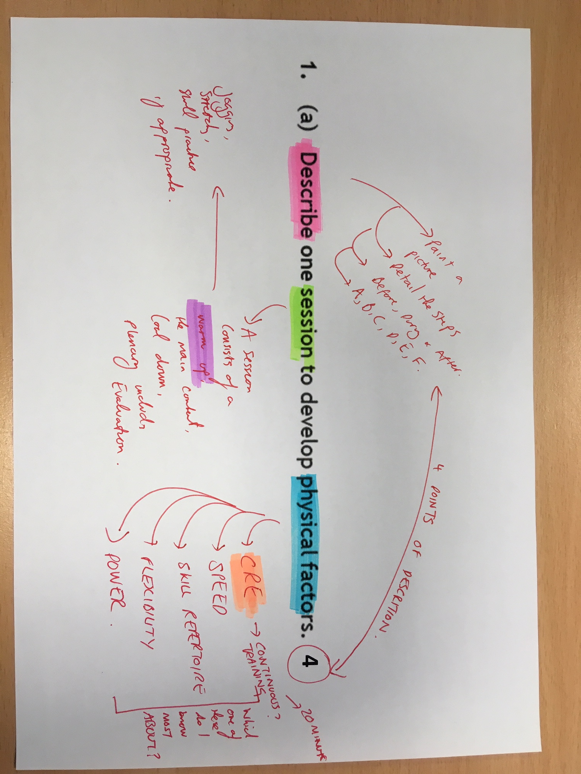

Slide 17
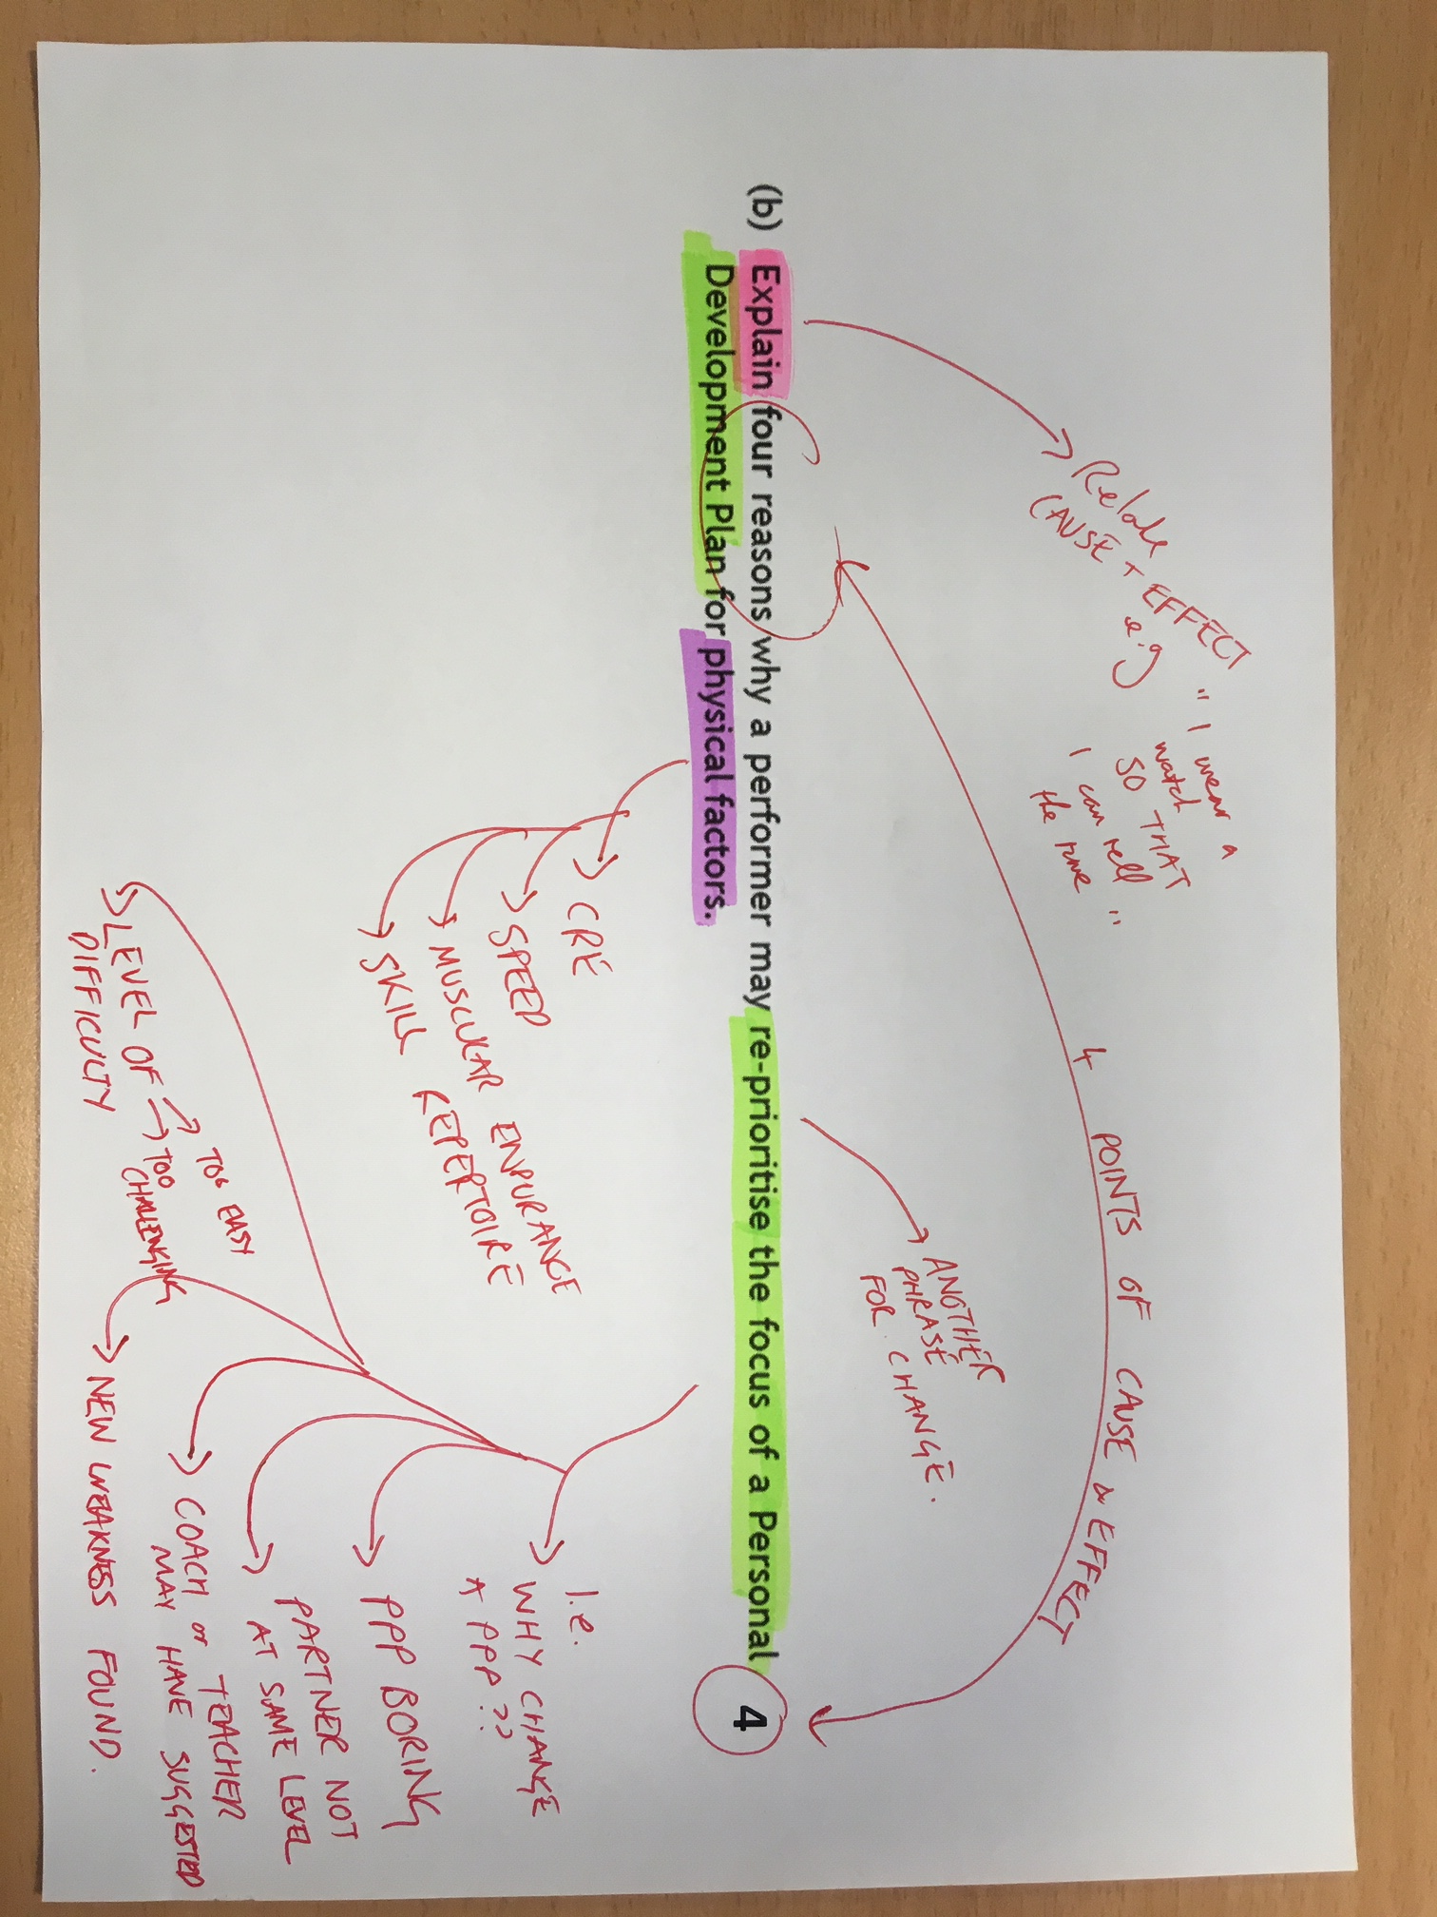

Slide 18
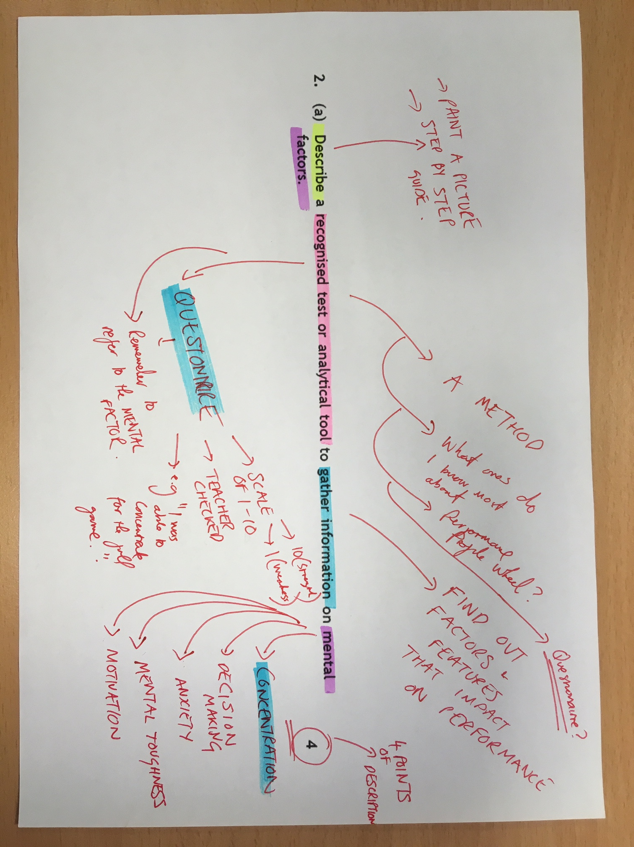

Slide 19
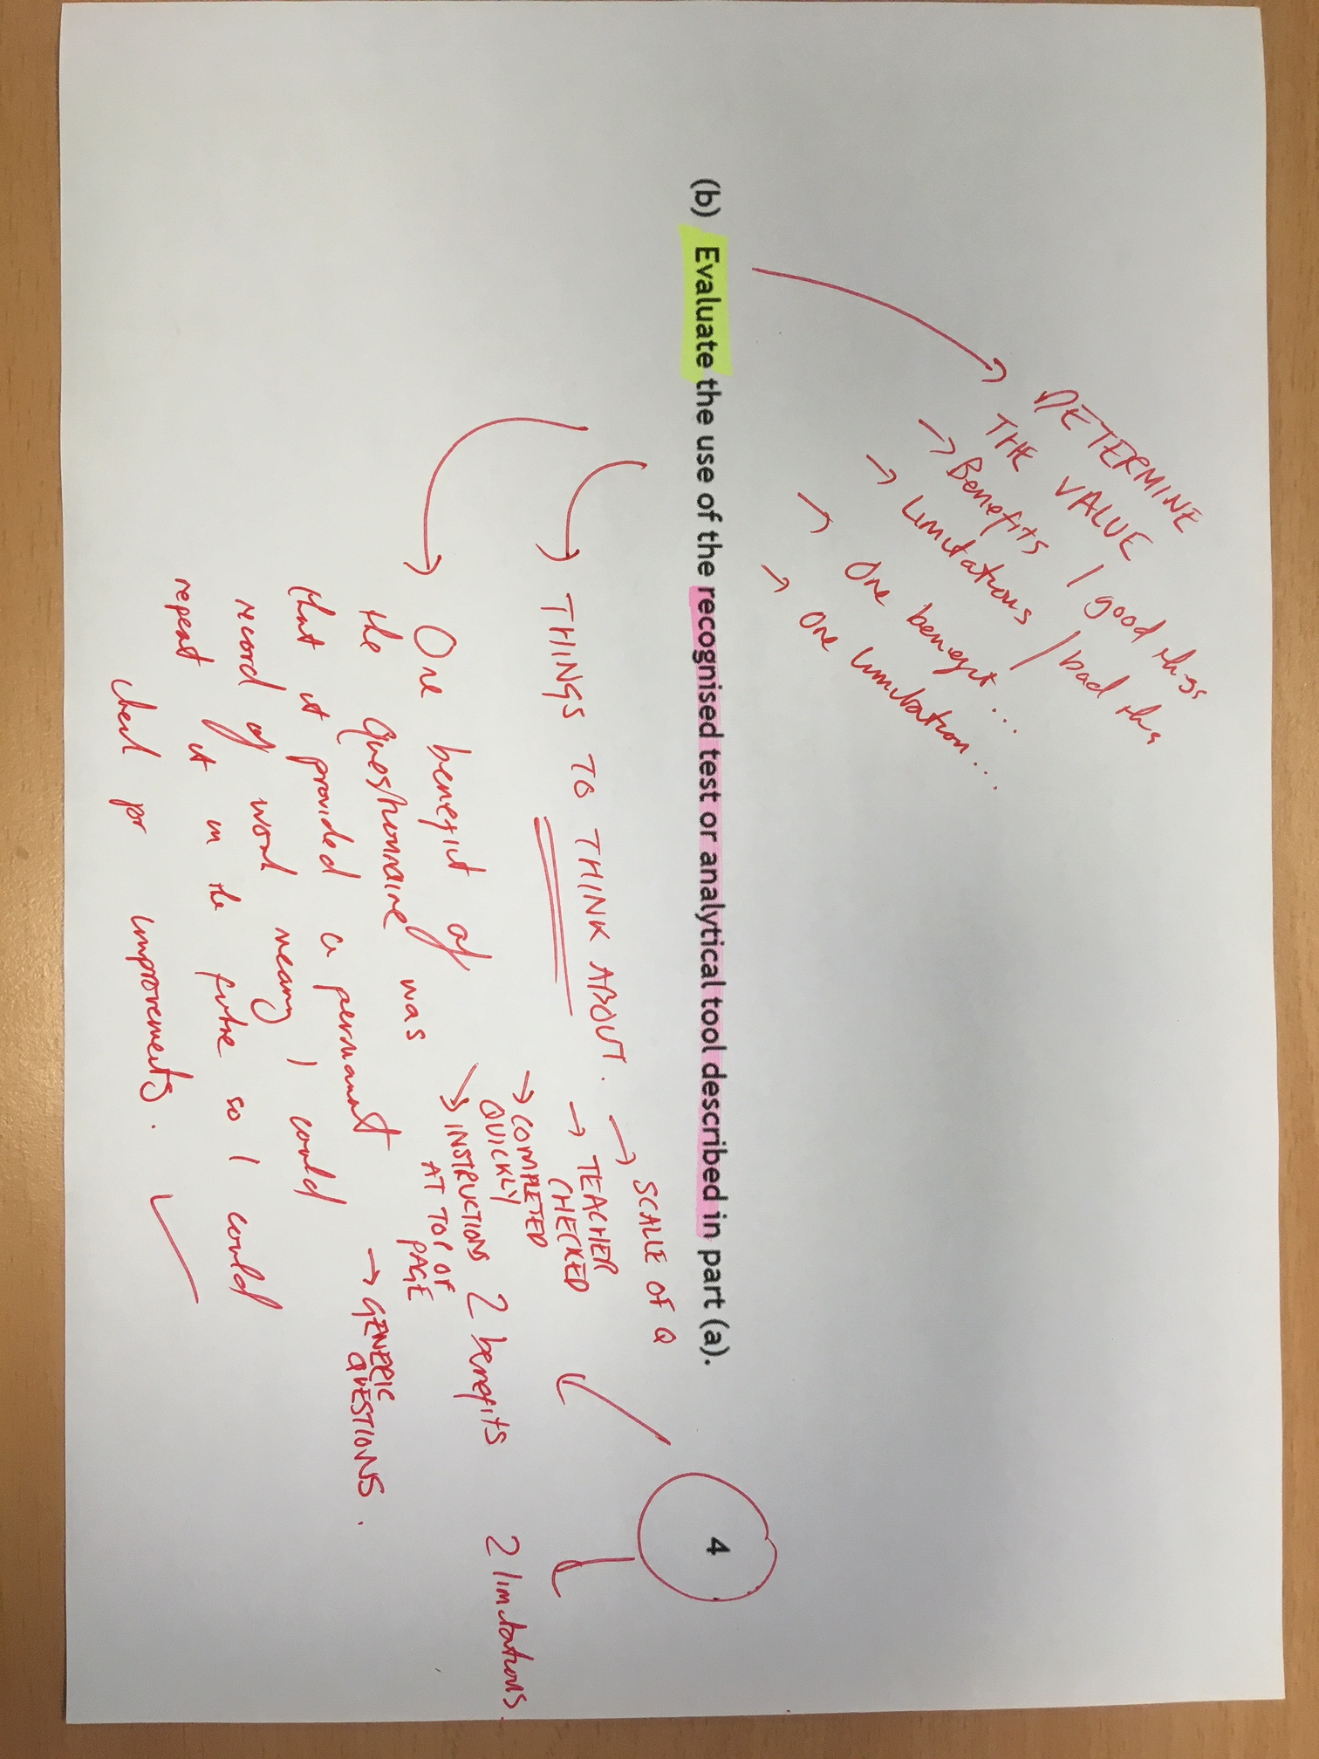

Slide 20
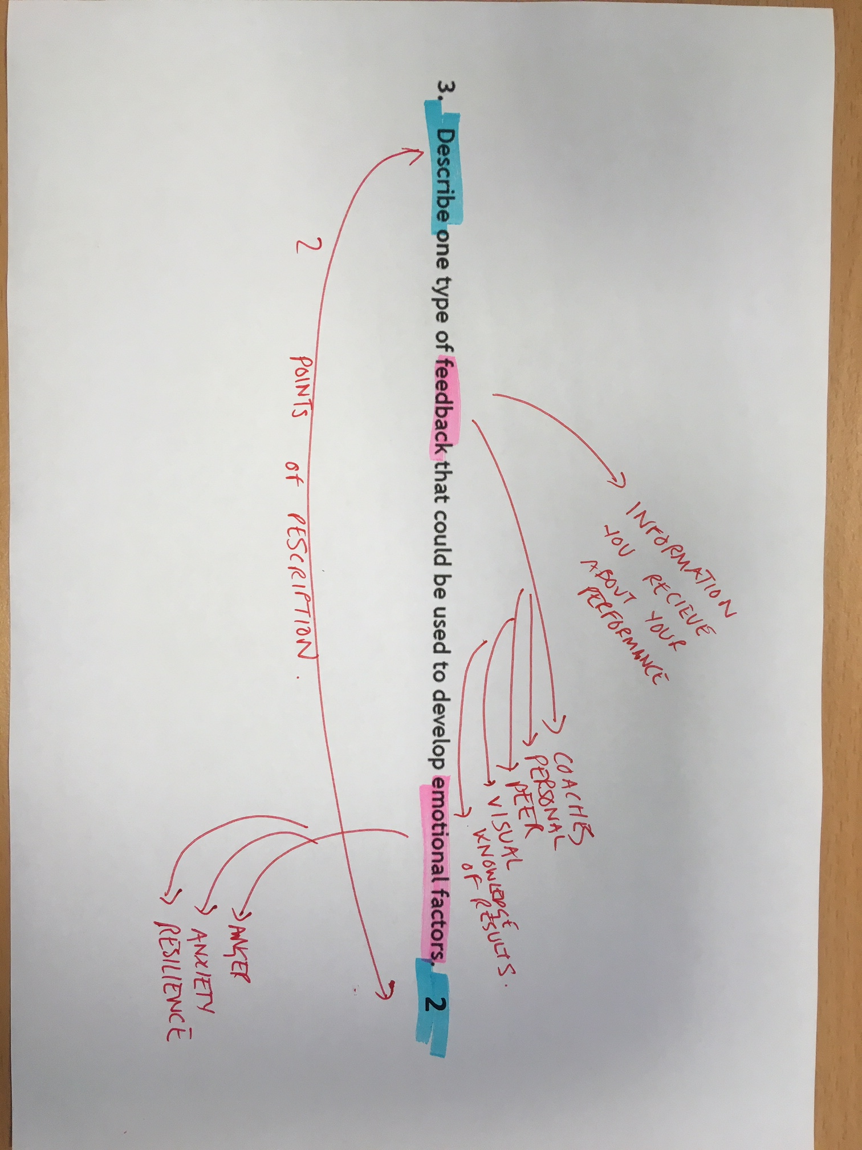

Slide 21
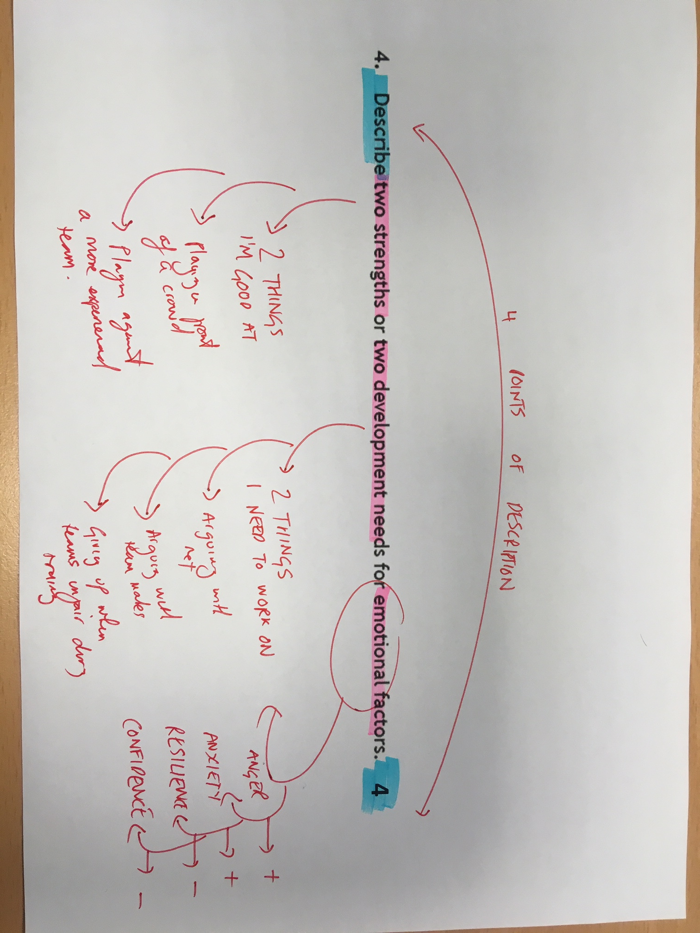

Slide 22
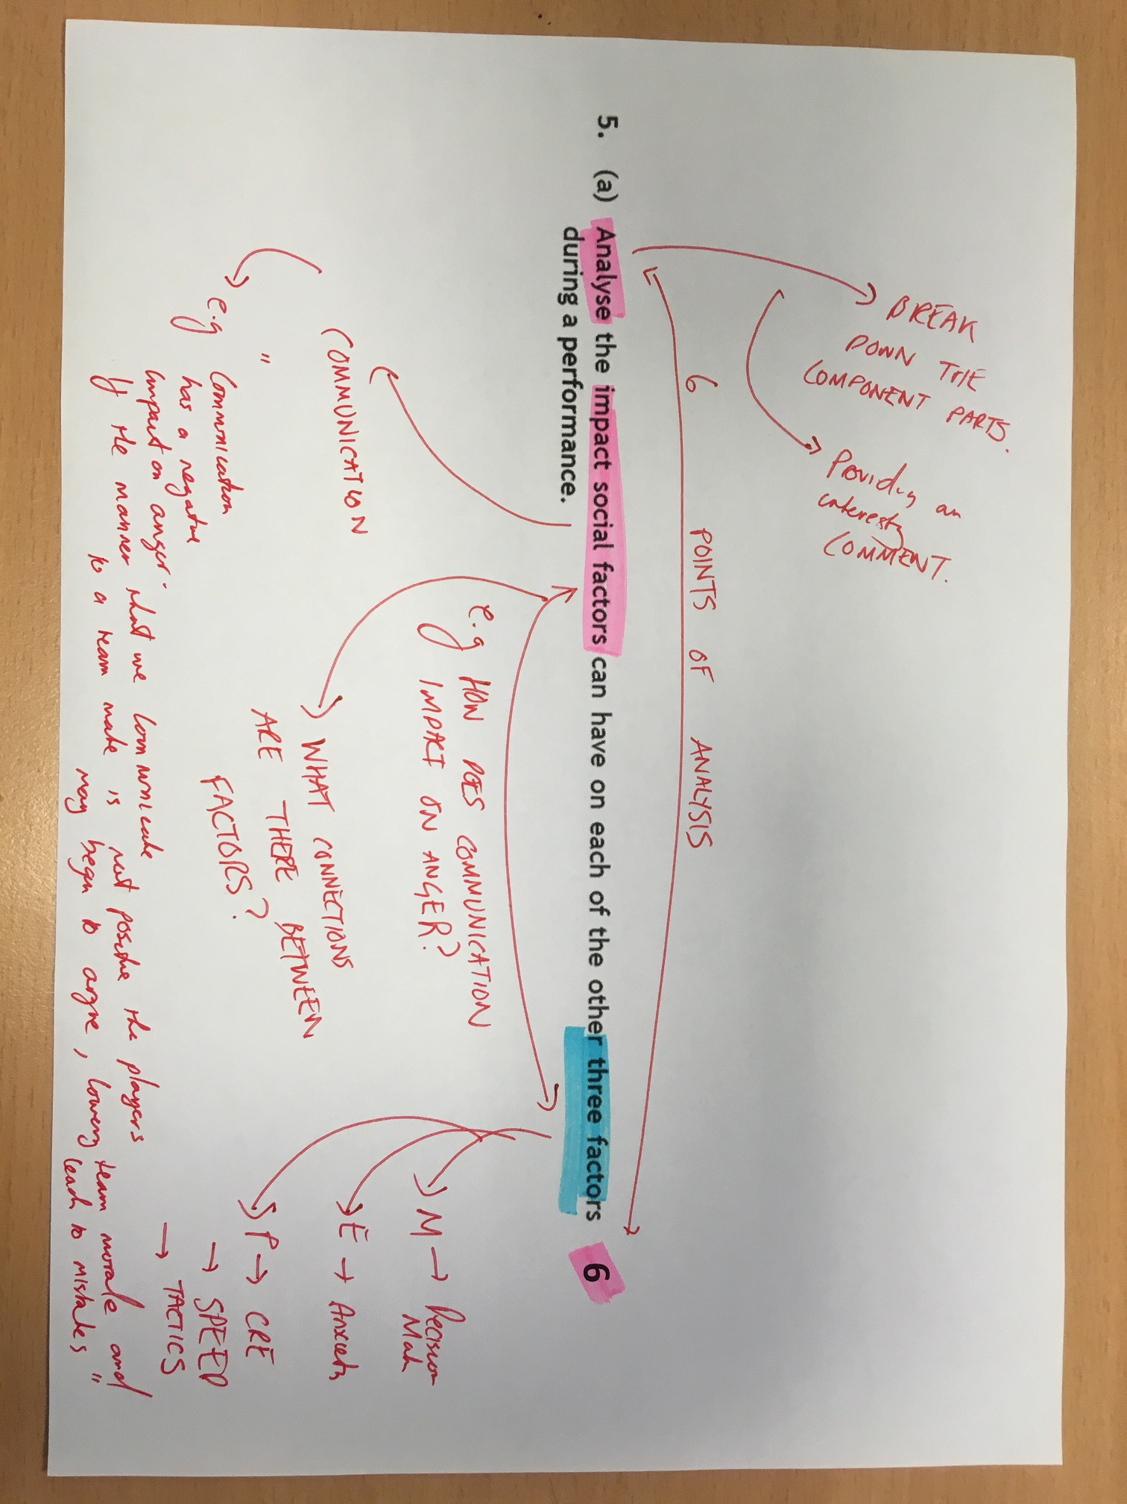

Slide 23
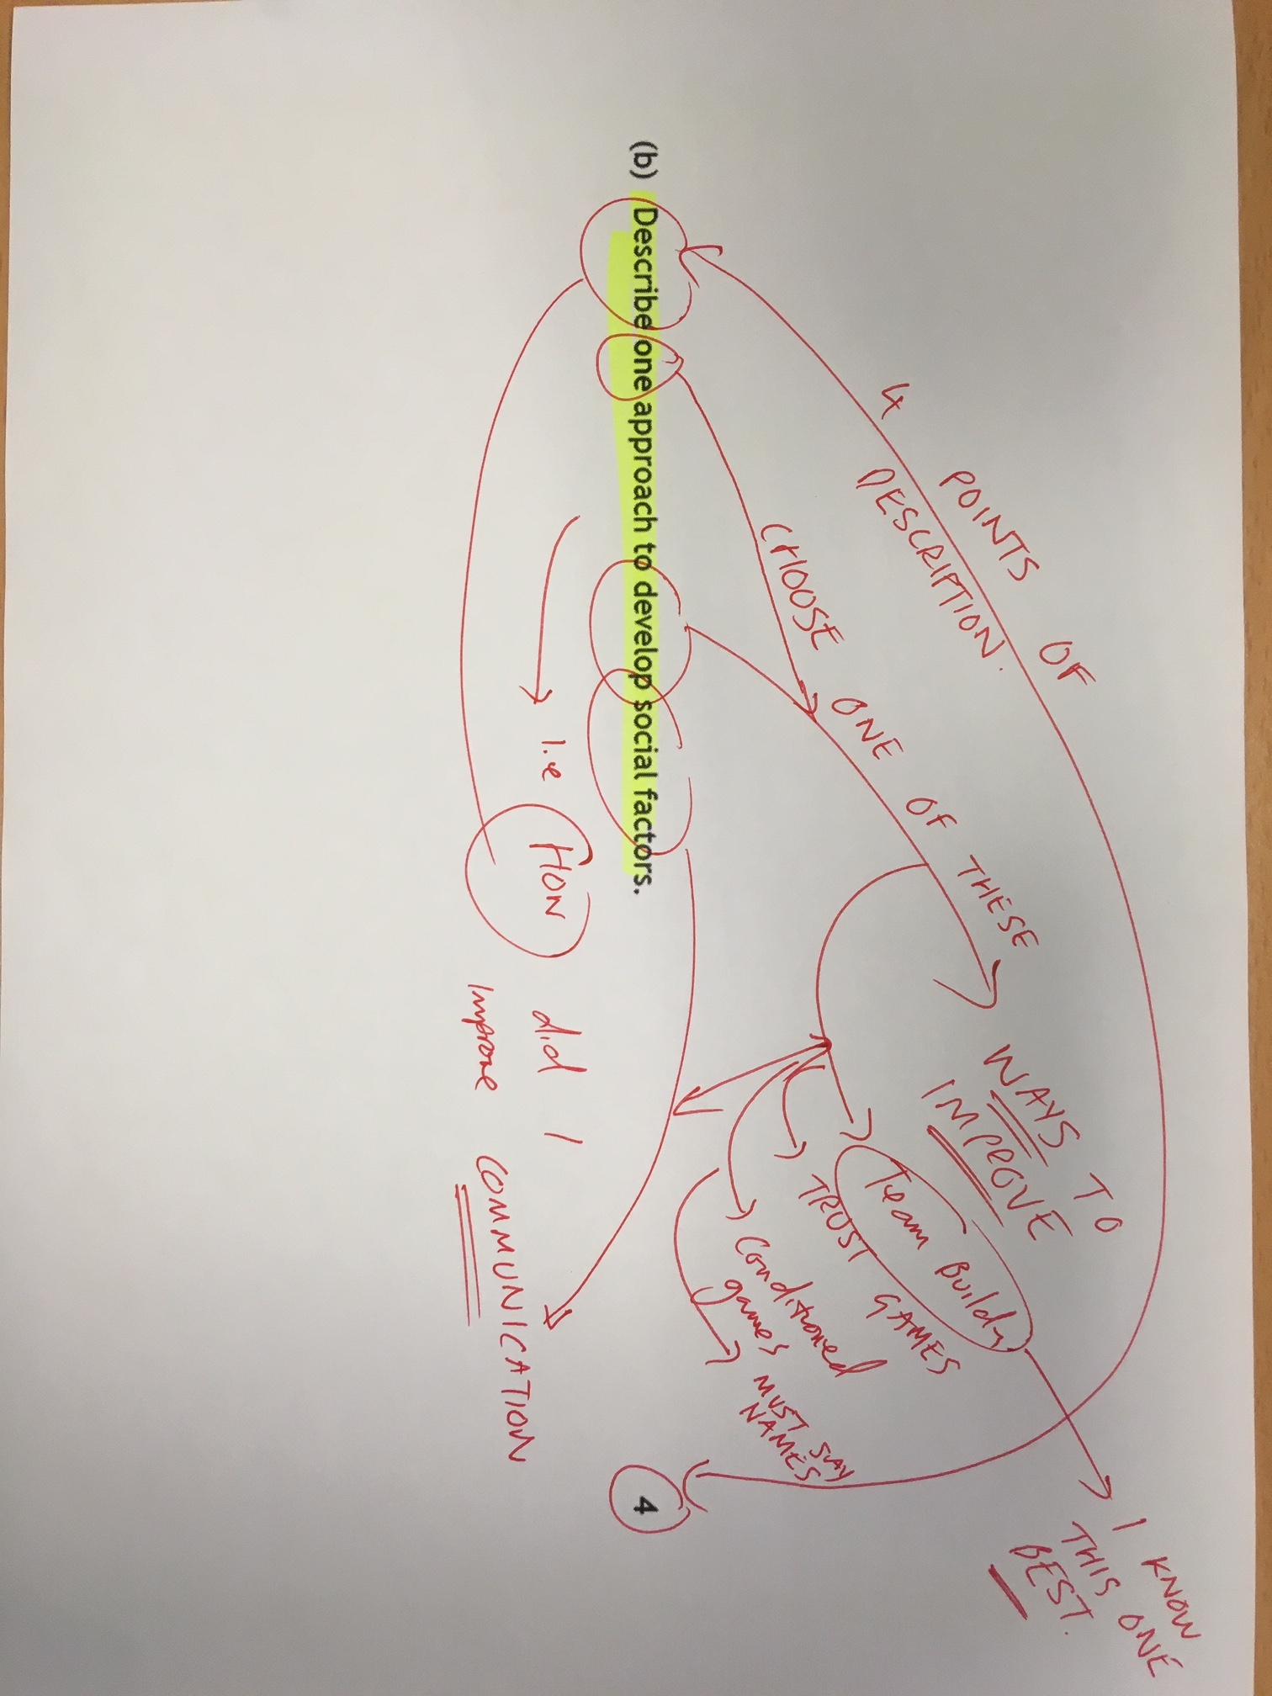

Slide 24
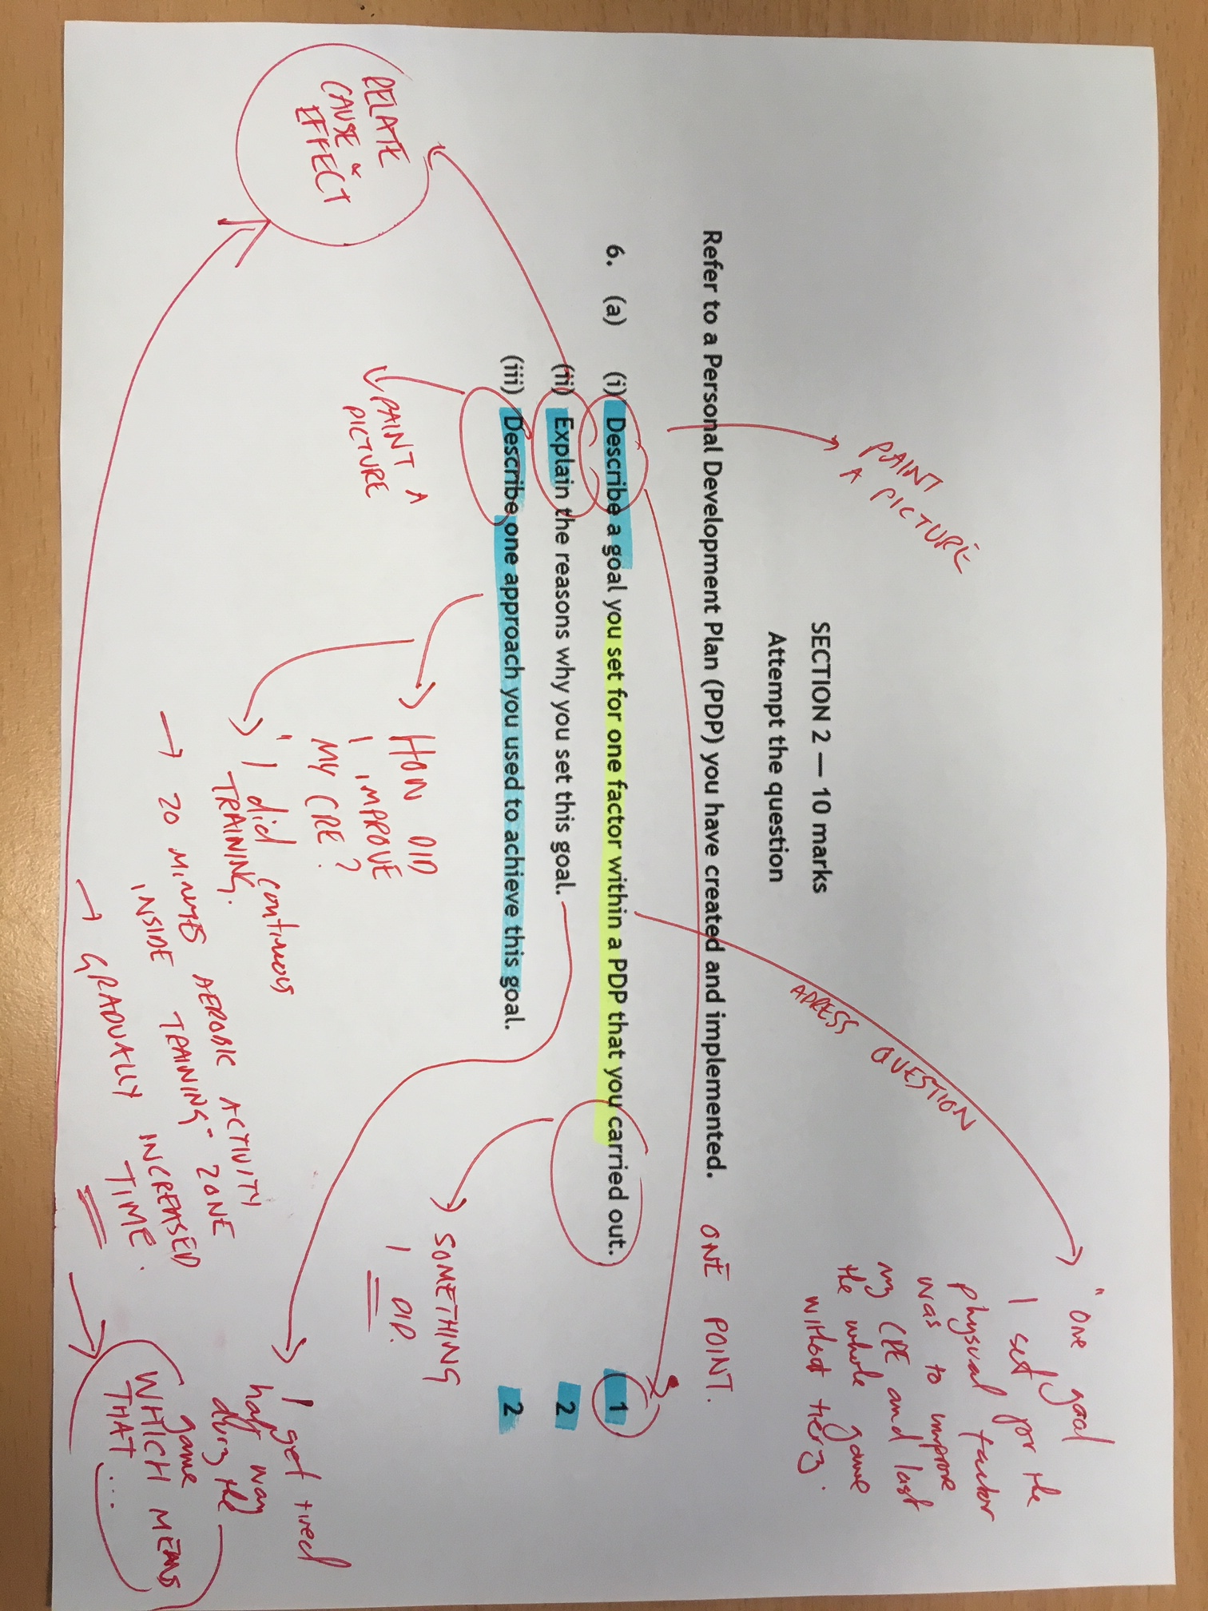

Slide 25
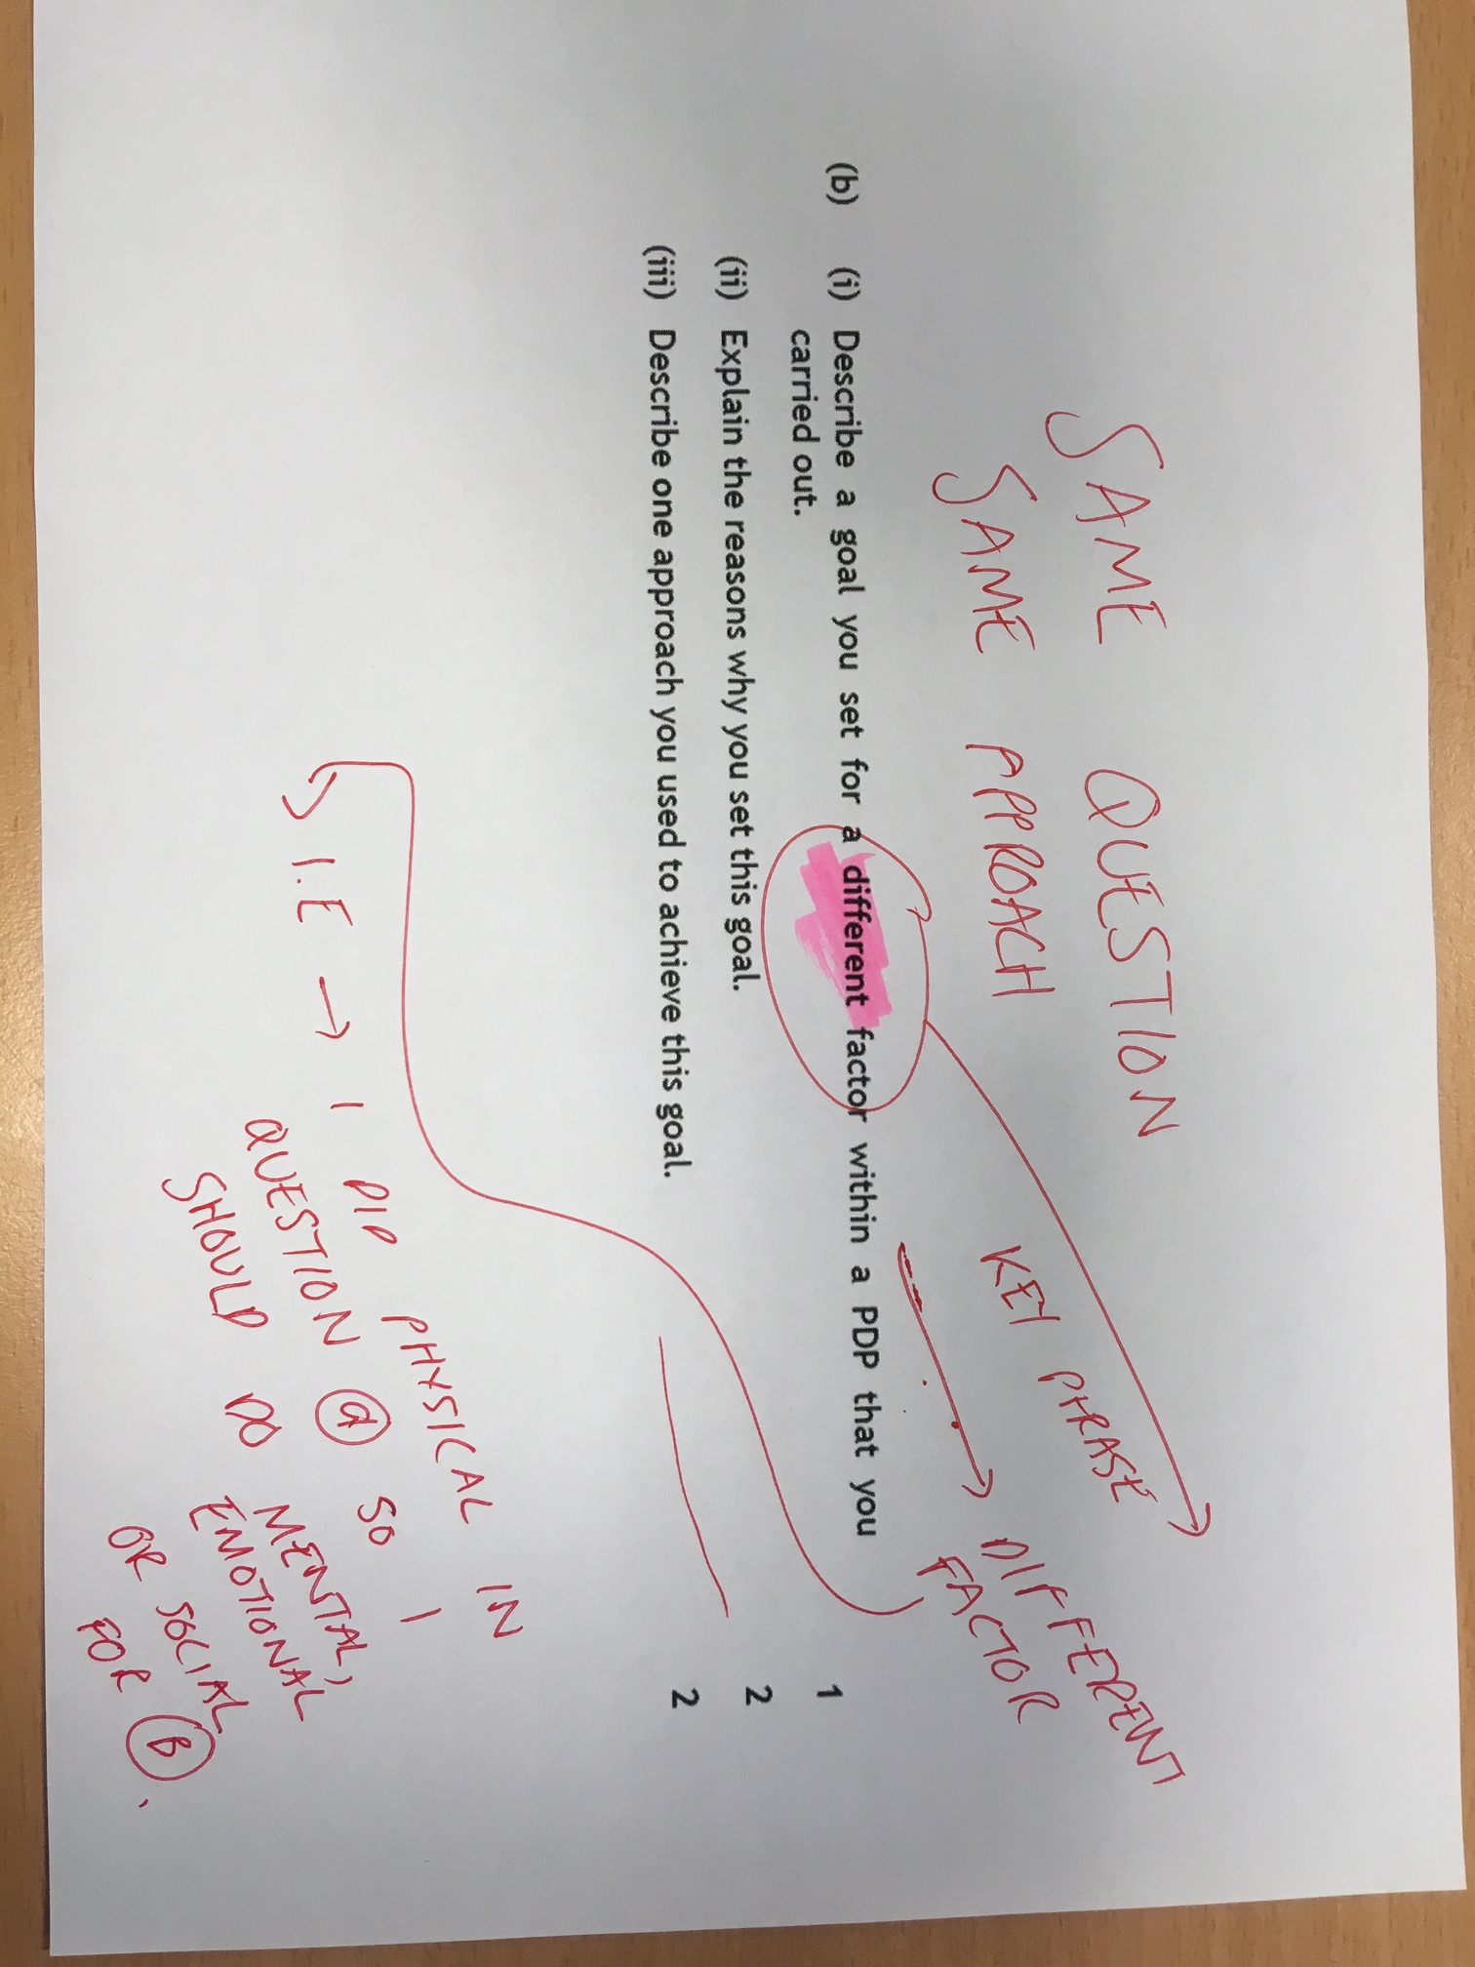

Slide 26
